Slide 1
Navigating the Institutional Review Board for Librarianship Research
Carolyn Schubert, MLIS
Health Sciences & Nursing Librarian
James Madison University

Slide 2
What brings you here today?
Need to do research for your position
Want to do research for your position
Curious about the topic
Killin’ time
Other

Slide 3
Learning Objectives
Understand the common required components of an IRB application and types of IRB review procedures
Consider the opportunities and challenges for using different research methodologies in LIS research
Learn about common tools and techniques to help with completing IRB applications

Slide 4

IRB?!
https://en.wikipedia.org/wiki/Panic#/media/File:Actress-fear-and-panic.jpg

Slide 5

https://pixabay.com/static/uploads/photo/2013/05/29/08/46/stamp-114438_960_720.jpg
Notes:
https://pixabay.com/static/uploads/photo/2013/05/29/08/46/stamp-114438_960_720.jpg

Slide 6
Types of IRB reviews
Exempt
Expedited
Full board
Not a research activity
Not vulnerable populations
Low risk
Vulnerable populations
High risk

Slide 7
What is a research activity?
A systematic investigation designed to develop or contribute to generalizable knowledge
Information is about living people
Information can identify individuals
Information is not public
http://www.hhs.gov/ohrp/regulations-and-policy/decision-trees/#c1
Notes:
http://www.hhs.gov/ohrp/regulations-and-policy/decision-trees/#c1

Slide 8
IRB Reviews Question
A librarian at a university develops a module about evidence based practice and wants to determine changes in student knowledge. The librarian will use a pre and post test to measure changes. What type of IRB review would this study most likely go through?
  Exempt
  Expedited
  Full Board
  Don’t know

Slide 9
Answer
NOT EXEMPT
Is it research? Yes
  Systematic approach
  Living people
  Not public information

Slide 10
Answer
NOT EXEMPT
NOT FULL BOARD
Is it research? Yes
  Systematic approach
  Living people
  Not public information
NOT vulnerable population (children, cognitively impaired, prisoners, etc)
NOT high risk (harmful) intervention

Slide 11
Answer
NOT EXEMPT
NOT FULL BOARD
Is it research? Yes
  Systematic approach
  Living people
  Not public information
NOT vulnerable population (children, cognitively impaired, prisoners, etc)
NOT high risk (harmful) intervention
MOST LIKELY: EXPEDITED*

Slide 12
Common exemption categories
Normal educational practices*
Public observation
Surveys/interviews of elected officials
Use of existing data
Taste and food quality evaluation
*Institutional policies may vary
Notes:
Normal educational practices = instructional strategies, techniques, curricula, classroom management methods
FERPA concerns/questions

Slide 13
Purpose
Your IRB Proposal
Audience
Genre

Slide 14

Audience
5+ members
Diverse representation (science vs non-science, gender representation)
Not affiliated to institution
Notes:
*see if you can get corrected image in time
*VCU as example of up to date administrivia http://www.news.vcu.edu/article/VCU_officials_work_around_the_clock_to_reinstate_research

Slide 15
Common elements of an IRB protocol
Purpose of the research
Participant recruitment methods and criteria
Research procedures (instruments, data collection methods)
Risks and benefits
Protection of subjects
Informed consent materials

Slide 16
2001 Johns Hopkins
Hexamethonium Asthma Study
  Researcher searched materials in PubMed and current textbooks
  Hopkins IRB “relied on the information submitted by the investigator who was known to them as an experienced researcher”
  MISSED 1950s literature on toxicity of hexamethonium
http://jme.bmj.com/content/28/1/3.full
Notes:
Death of 24-year-old, healthy volunteer Ellen Roche
http://jme.bmj.com/content/28/1/3.full

Slide 17
Literature review
Identifies purpose
Reviews known risks and benefits
Explains decisions for your methods
Source for instruments

Slide 18
So many methods…
Surveys
Interviews
Focus groups
Observation
Cohort study
Ethnography
Mixed methods
Explore more at
http://www.ala.org/research/larks/researchmethods

Slide 19
Question should determine method
Quantitative questions
  “to test a hypothesis or when the range of behaviors or outcomes is already known”
  Survey, structured observation with checklist
Qualitative questions
  “To investigate, explore, or describe”
  Interviews, focus groups, ethnography
http://www.inthelibrarywiththeleadpipe.org/2015/ditchthesurvey-expanding-methodological-diversity-in-lis-research/

Slide 20
Also consider your analysis
Type of Data
Qualitative
Quantitative
Interpretation of meaning in text or images Examples: Grounded theory Cultural models Ethnographic mapping | B) Interpretation of patterns in numeric data Examples: Epidemic curves Social network graphs
C) Statistical and mathematical analysis of text Examples: Content analysis Pile sorts Free listing Cluster analysis Chi square | D) Statistical and mathematical analysis of numbers Examples: Correlation measures Comparison of means
Qualitative
Adapted from Guest, G., MacQueen, K.M., & Namey, E.E. (2012). Applied thematic analysis. Thousand Oaks, CA: Sage Publications.
Type of Analysis
Quantitative

Slide 21
Words of wisdom
Surveys suffer from satisficing
  http://crln.acrl.org/content/77/5/249.full
Paper surveys > online surveys
  doi: 10.1080/02602930701293231
Dillman’s (2014) Tailored Design Method helps with survey design and response rates
  https://sesrc.wsu.edu/about/total-design-method/

Slide 22
Words of wisdom
12 interviews = saturated themes
  doi: 10.1177/1525822X05279903
For multisite, cross-cultural studies, 20-40 interviews
  doi: 10.1177/1525822X16640447
80% of themes in 2-3 focus groups, 90% in 3-6 focus groups
  doi: 10.1177/1525822X16639015

Slide 23
Participant recruitment
Criteria
  Inclusion (who & why)
  Exclusion
Timing
  Contingent on project
  Check institution calendars
Incentives
  Direct ($$$, extra credit, food)
  Indirect (donation)
Methods
  Flyers
  Email
  Listserv
  Doodle poll
  Mail merge
  Snowball sampling
  Mechanical Turk
  Social media

Slide 24
Words of wisdom
People found through online recruitment systems (Mturk) more committed, but less diverse pool
  doi: 10.1177/1525822X15603149
Certain groups, like physicians, need higher incentive rates than average US person ($50 vs $1-5)
  doi:10.1177/0163278711406113

Slide 25
Consent forms
Purpose of the research
Participation time
Procedures
Risks
Benefits
Confidentiality
Rights
Contact for questions
Options to volunteer or withdraw

Slide 26
Question - Readability
Clear
Unclear
Chronic diseases—those that go on for a long time and often don’t go away completely—are among the most common and costly health problems, and we often know how to prevent them
Chronic diseases and conditions—such as heart disease, stroke, cancer, diabetes, obesity, and arthritis—are among the most common, costly, and preventable of all health problems
Everyday Words for Public Health Communication. Center for Disease Control and Prevention website. http://www.cdc.gov/other/pdf/everydaywordsforpublichealthcommunication_final_11-5-15.pdf.

Slide 27
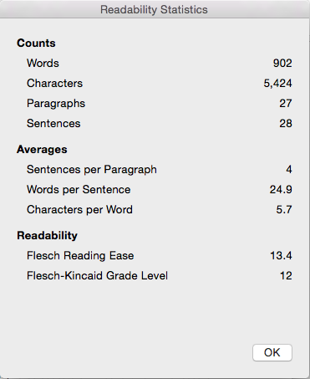
How to Assess Readability
Microsoft Word > Options > Spelling & Grammar > Readability Statistics
  Flesch-Kincaid Grade Level

Slide 28
Question - Usability of library terms
Kupersmith (2012) found that ”the average user success rate for finding journal articles or article databases is 52% (in 20 tests at 14 libraries reporting this information).” Which phrase best helps users achieve their goal of finding journal articles?
  Database
  E-Journals
  Find Articles
  Periodicals
http://escholarship.org/uc/item/3qq499w7#page-1

Slide 29
Ways to improve consent
Multimedia
  People learn better from graphics and text together
Discussion
Test/Comprehension Quiz
Consult with some regional experts at the University of Maryland, Baltimore HSHSL!
doi: 10.1186/1472-6939-14-28
doi: 10.3163/1536-5050.102.1.003
http://hilt.harvard.edu/files/hilt/files/mayerslides.pdf.

Slide 30
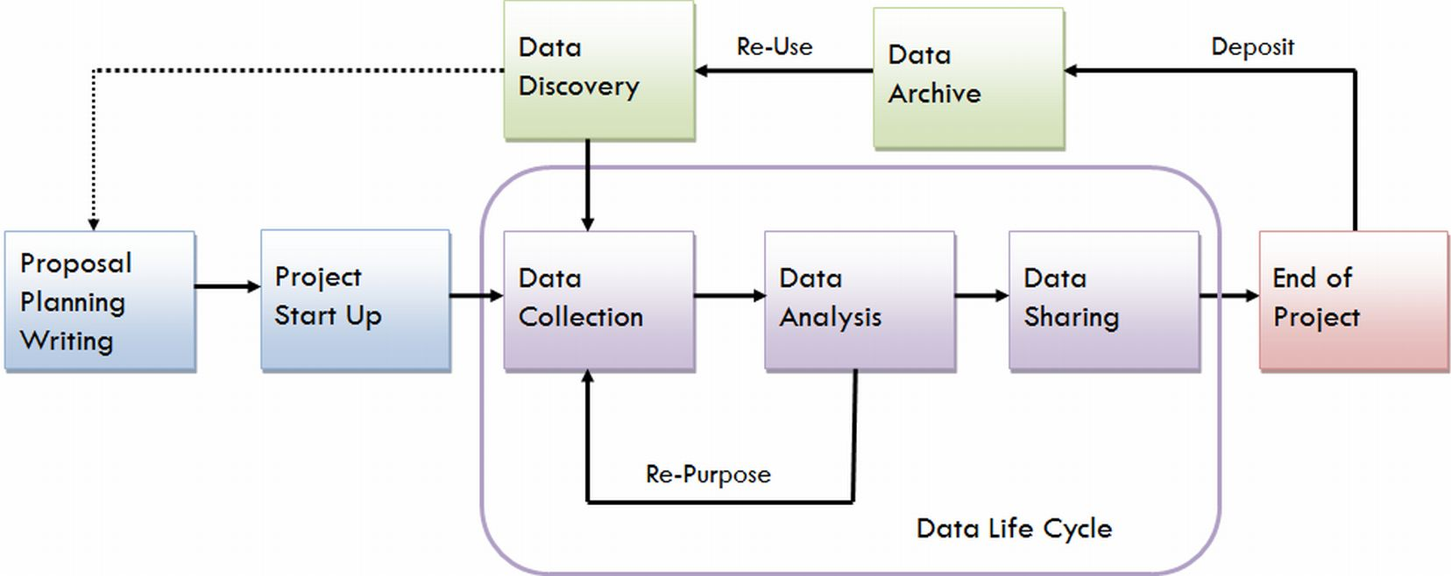
Data life cycle
http://data.library.virginia.edu/data-management/lifecycle/

Slide 31
Data management details
Data format(s)
  Print, electronic
  Text, audio, video
Collection vs analysis vs storage
Access permissions
Data sharing
Retention and destruction plan

Slide 32
Data management
Anonymous
De-identified
Not identifiable to an individual at any point
Identifiers collected at one point but later removed for analysis or publication

Slide 33
Re-identification risk is real
2006 AOL search results
De-identified search strings from a 3-month period
AOL user No. 4417749 = Thelma Arnold
http://www.nytimes.com/2006/08/09/technology/09aol.html?_r=0

Slide 34
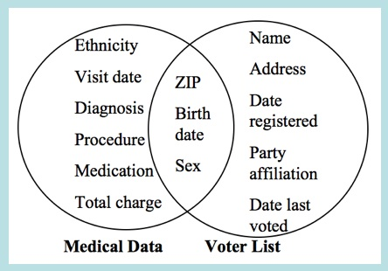
Re-identification risk is real
2006 AOL search results
Sweeney 1997 data mashup
De-identified search strings from a 3-month period
AOL user No. 4417749 = Thelma Arnold
http://www.nytimes.com/2006/08/09/technology/09aol.html?_r=0
http://latanyasweeney.org/work/identifiability.html

Slide 35
Words of wisdom
Backups
Encryption
Check what you collect
  Qualtrics = Location data, IP address

Slide 36
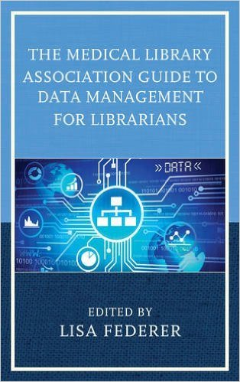
Data management resources
New England Collaborative Data Management Curriculum http://library.umassmed.edu/necdmc/index
DMPTool https://dmptool.org/dm_guidance#security

Slide 37

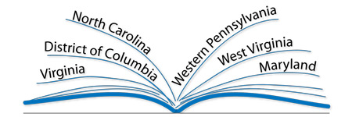
Thanks!
Mid-Atlantic Chapter of the Medical Library Association – Research & Assessment Committee

Slide 38
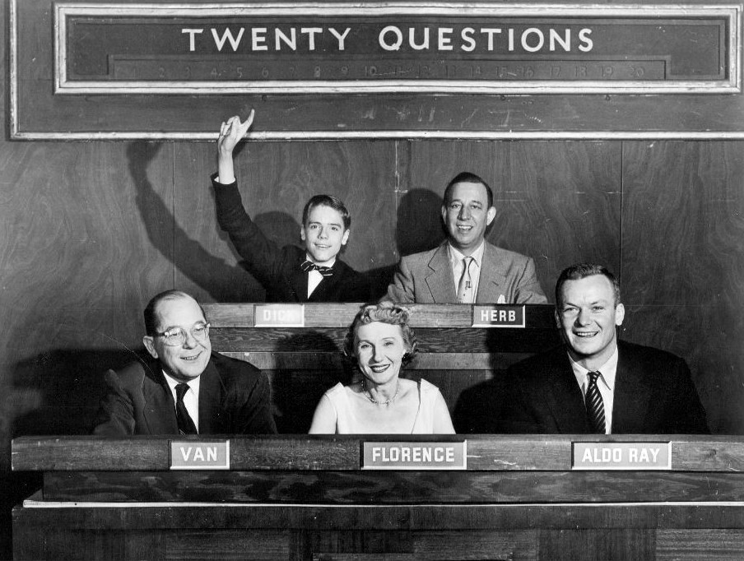
Questions?
You can contact me at schubecf {a} jmu.edu
https://upload.wikimedia.org/wikipedia/commons/6/65/20_questions_1954.JPG

