Slide 1
Management of Adrenal Insufficiency and Steroid Replacement for the Inpatient Setting
Carl Chojnacki, MBA, MSN, APNP, ANP-BC
Aurora Medical Group Endocrinology
Marian University – Adjunct Instructor

Slide 2
Objectives
At the end of this presentation you will be able to:
Explain the common causes of adrenal insufficiency, particularly in the hospitalized patient, with a focus on pharmacologic issues
Identify patients who have adrenal insufficiency
Order and interpret common tests related to adrenal function, including how to identify and avoid common pitfalls (pharmacologic and non-pharmacologic)
Explain how certain pharmacologic therapies may confound diagnosis of adrenal insufficiency
Choose appropriate treatment for the patient with adrenal insufficiency and be able to explain the pharmacologic benefits of various treatment regimens

Slide 3
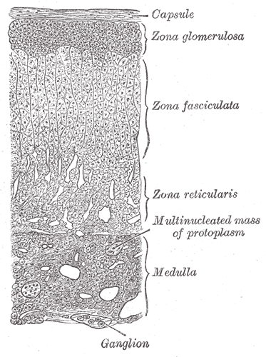
Adrenal physiology
Cortex and functional zones
Zona glomerulosa
  Aldosterone
    Angiotensin II
Zona fasciculata
  Cortisol
    ACTH
Zona reticularis
  Androgens
By Henry Vandyke Carter - Henry Gray (1918) Anatomy of the Human Body (See "Book" section below)Bartleby.com:
Gray's Anatomy, Plate 1185, Public Domain, https://commons.wikimedia.org/w/index.php?curid=357811

Slide 4
Adrenal physiology
Steroidogenesis
Cholesterol transport
CYP450 enzymatic pathways for cortisol
17α-hydroxylase
21 hydroxylase
11β-hydroxylase
Glucocorticoids, such as cortisol, are secreted at about 10-20 mg per day.

Slide 5
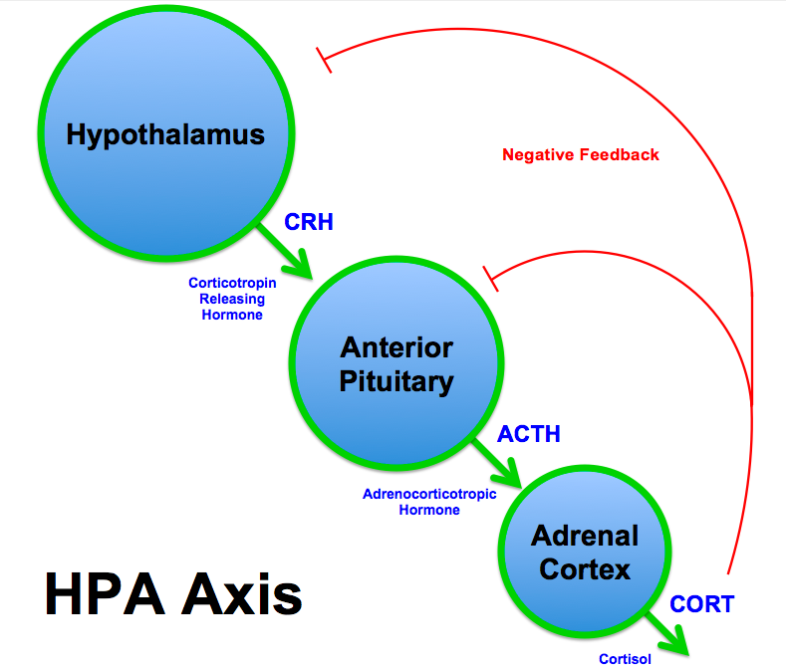
Hypothalamic-pituitary-adrenal axis
Negative feedback
Inhibition of POMC (pro-opiomelanocortin), the precursor of ACTH
Inhibition of CRH and AVP mRNA synthesis
BrianMSweis (https://commons.wikimedia.org/wiki/File:HPA_Axis_Diagram_(Brian_M_Sweis_2012).png), „HPA Axis Diagram (Brian M Sweis 2012)“, https://creativecommons.org/licenses/by-sa/3.0/legalcode

Slide 6
Hypothalamic-pituitary-adrenal axis
If ACTH is low, then adrenal glands are not being stimulated
Corticotropin-releasing hormone (CRH) → adrenocorticotropic hormone (ACTH) → cortisol
This is diurnal and has natural peak in AM and smaller peak in mid afternoon
Cortisol dose is approximately 30 mg daily
  Glucocorticoid hormones
    Direct effects on carbohydrate metabolism
    Anti-inflammatory, growth-suppressing effects
    Influence awareness and sleep habits
    Most potent naturally occurring glucocorticoid is cortisol
      Cortisol = Blood pressure control

Slide 7
Cortisol – You can’t live without it
Glucocorticoid steroid - cortisol
  Gluconeogenesis = increased blood glucose
  Immune suppression via down-regulation of IL receptors
  Glycogenolysis
  Decreases translocation of GLUT4
  INCREASES SENSITIVITY OF VASCULATURE TO EPI AND NOREPI
    No cortisol = vasodilation = no BP

Slide 8
Common causes of adrenal insufficiency
Primary (Addison’s Disease) | Secondary (ACTH-deficiency)
4 to 11 per 100,000 | 30 mg prednisone daily x ~ 3 weeks
Autoimmune | Hypopituitarism (any cause)
Infections (TB and HIV) | Sheehan’s syndrome
Metastasis (rare) | Granulomatous disease
Congenital adrenal hypoplasia (rare)
Bilateral adrenalectomy

Slide 9
Common causes of adrenal insufficiency
Exogenous steroid → suppression of CRH (hypothalamus) and ACTH (pituitary) → suppression of natural cortisol production → adrenal atrophy
Likely patient:
  Pain patients (steroid injections and opioids)
  COPD and asthma patients (bursts of prednisone)
    Prednisone 10-30 mg per day for > 3 weeks
    Can occur with doses as low as 5 mg daily
  Chronically ill
  Rheumatoid or other diseases (immunosuppression)

Slide 10
Identifying patients with adrenal insufficiency
Conduct a good history and physical, including chart review
Identifying past steroid dosing in all parts of the medical record
Low blood pressure
  Due to sensitizing effect of cortisol on vasculature
Orthostatic hypotension
  Due to lack of vascular responsiveness
Weakness
  Due to muscle wasting
Low blood sugar
  Due to GLUT4 translocation issues and metabolic effects

Slide 11
Case study #1 - identifying patients
Conduct a good history and physical, including chart review:
53 year old female well-known to the service due to multiple admissions for hyperglycemia. She had 4 ED visits between 1/2017 and 2/2017 with low blood sugars. Was injecting Lantus 50 units daily and Novolog 10 units AC with adjustment.
Fall 1/2017 with tibia and fibula fracture
States fatigue, dizziness and trouble breathing (history of asthma and COPD)
Blood sugar 36 mg/dL on admission
Transient response to dextrose
Place on D10 infusion at 100 mL/hour with blood sugars in the 80s
Insulin had been stopped for a few days

Slide 12
Case study #1 - identifying patients
Conduct a good history and physical, including chart review:
Multiple syncope episodes in 2013
  Orthostatic signs and SOB
From late 2014 until 11/2016, received over 60 encounters involving steroids were identified
  Prednisone burst, methylprednisolone IV, and steroid joint injections
Last dose of Medrol Depot injection 11/2016 for knee pain and prednisone burst for asthma later that month

Slide 13
Case study #1 - identifying patients
Conduct a good history and physical, including chart review:
Discontinued dextrose to cause hypoglycemia
Once BG < 55 mg/dL, STAT labs BEFORE treatment for hypoglycemia:
  Serum glucose
  Total cortisol
  Proinsulin
  Insulin
  C-peptide
 | 2/27/17 15:19
Glucose (serum) | 33 (L)
Total cortisol | 1.6 (L)

Slide 14
Case study #1 - identifying patients
Conduct a good history and physical, including chart review:
Started on hydrocortisone stress dosing of 50 mg IV TID
Tapered quickly to physiologic doses of 20 mg in the AM and 10 mg in the afternoon
Complete resolution of symptoms in one day and restarted on lower doses of insulin
Advised to double steroid dosing for 3 days if ill and follow-up
Plan is for very gradual taper
  HPA suppression lasts for an average of 9-10 months
  Can be as long as 2 years

Slide 15
Testing for adrenal insufficiency
Testing includes central and primary functioning
Albumin
Thyroid function
Serum cortisol
  Free serum cortisol – very long return time
ACTH
Cosyntropin stimulation test
  Baseline ACTH and cortisol
  Administer synthetic ACTH (cosyntropin)
  Wait to see if the adrenal glands respond with cortisol production at 30 and 60 minutes (check cortisol level
  If cortisol is > 18 mcg/dL, patient is likely fine

Slide 16
Testing for adrenal insufficiency
Testing includes central and primary functioning
Serum cortisol
  Done in AM
  Done while OFF OF STEROIDS
  Should be > 5 mcg/dL
ACTH
  Usually done with AM cortisol
  Done while OFF OF STEROIDS
Cosyntropin stimulation test
  Baseline ACTH and cortisol
    Must be done BEFORE cosyntropin administration
  Administer synthetic ACTH (cosyntropin)
  Cortisol levels must be checked at 30 AND 60 MINUTES
  If cortisol is > 18 mcg/dL, patient is likely fine

Slide 17
Case study #2
45 year old female with a one month history of fatigue, dizziness, weakness, teeth spacing and increased ring size. Presents with HA, diplopia and fatigue.
2 cm suprasellar mass with apoplexy compressing the optic chiasm (surgery on 12/19)
Normal thyroid function and albumin before surgery
Discharged on hydrocortisone 15 mg in AM and 5 mg in afternoon
 | 12/20 1910 | 12/21 0750
Total cortisol (3.4-22.5 mcg/dL) | 2.5 | 1.7
ACTH (0-46 pg/mL) | <5.0 | <5.0

Slide 18
Case study #2
Returned with fatigue. TSH was 0.056 (0.350-5.000 normal range) and free T4 was 0.4 (0.8-1.5 normal range)
Told to hold hydrocortisone the afternoon before and morning of her repeat lab test.
 | 1/19 0807
Total cortisol (3.4-22.5 mcg/dL) | 44.6
ACTH (0-46 pg/mL) | <5.0
Why is her cortisol so high now, even with a low ACTH?

Slide 19
Case study #2 – Always check to see if a steroid was given
At the follow-up visit, patient stated she forgot to hold her steroid. Repeat labs were drawn a week later and confirmed she had secondary adrenal insufficiency due to the surgery.
Told to hold hydrocortisone the afternoon before and morning of her repeat lab test.
 | 1/27 0800
Total cortisol (3.4-22.5 mcg/dL) | 1.0
ACTH (0-46 pg/mL) | <5.0

Slide 20
Case study #3
45 year old female presents with a meningoencephalocele. She has an EEA for resection due to location and complexity. During surgery on 1/16, she was given 12 mg IV dexamethasone by the anesthesiologist. She has no history of steroid use, opioid use, or illicit drug use. She has no past history of head trauma.
BP low normal after surgery
Potassium in AM was 5.3
Why was AM cortisol low if she received dexamethasone?
 | 1/17 0354 | 1/18 0415 | 1/18 1428 | 1/20 0330
Total cortisol (3.4-22.5 mcg/dL) | 0.6 | 0.6 |  | 2.4
ACTH (0-46 pg/mL) |  |  | <5.0

Slide 21
Case study #3 – Always check to see if a steroid was given
Patient felt weak, dizzy and had nausea after surgery. She was started on hydrocortisone 10 mg BID and discharged on 20 mg daily with a 2 week taper.
AM cortisol and ACTH was rechecked in 10 days
  WHY DID THIS HAPPEN?
 | 1/30 0831
Total cortisol (3.4-22.5 mcg/dL) | 10.4
ACTH (0-46 pg/mL) | 11.5

Slide 22
Testing for adrenal insufficiency - caveats
Dexamethasone
  Dexamethasone IS NOT detected by cortisol assay.
    All other corticosteroids are reflected on the assay
  Dexamethasone lowers ACTH through negative feedback
  It is a replacement steroid, but will not show-up on cortisol test
  If patient took dexamethasone, it will replace endogenous cortisol and suppress ACTH

Slide 23
Glucocorticoids
Dexamethasone
Half-life: 36-72 hours
High anti-inflammatory potency, useful in reducing swelling in the brain
  May reduce prostaglandin production
Useful as anti-emetic, especially in chemotherapy induced emesis
  Commonly given in surgery to reduce post-operative nausea and vomiting

Slide 24
Case study #4 – normal and abnormal cosyntropin stimulation test
58 year old female with a history of multiple, complex illnesses. Made hospice care on 6/8/16. Had multiple fragility fracture and severe osteoporosis.
Had TWO cosyntropin tests
One in 2013, while relatively healthy
One in June 2016 a few days before hospice initiated
 | 11/2013 | 6/2016
Baseline ACTH | 12 | 8.7
Baseline cortisol | 11.7 | 8.4
Cortisol at 35 minutes | 19.3
Cortisol at 140 minutes |  | 14.4 (low)

Slide 25
Case study #4 – normal and abnormal cosyntropin stimulation test
Normal stimulation is a cortisol over 18 and should be checked at 30 and 60 minutes post administration of cosyntropin
Is the test in 2013 normal or abnormal?
Is the 2016 normal or abnormal?
Why?
 | 11/2013 | 6/2016
Baseline ACTH | 12 | 8.7
Baseline cortisol | 11.7 | 8.4
Cortisol at 35 minutes | 19.3
Cortisol at 140 minutes |  | 14.4 (low)

Slide 26
Case study #4 – normal and abnormal cosyntropin stimulation test
The 2013 test IS normal. Any reading over 18 is a proper stimulation
The 2016 test MIGHT be abnormal. The level was check too late after the baseline administration to know for sure
  Symptomatic patients could be started on replacement steroids and have test redone later, with steroid held as directed.
 | 11/2013 | 6/2016
Baseline ACTH | 12 | 8.7
Baseline cortisol | 11.7 | 8.4
Cortisol at 35 minutes | 19.3
Cortisol at 140 minutes |  | 14.4 (low)

Slide 27
Case study #5 – cortisol timing
65 year old female with orthostatic symptoms, weakness and fatigue.
 | 4/14 1111 | 4/15 0920 | 6/5 0750
ACTH |  | 7.5
Total cortisol | 2.4 (L) | 3.4
Cortisol at 60 minutes |  | 15.7 (L) | 5.6

Slide 28
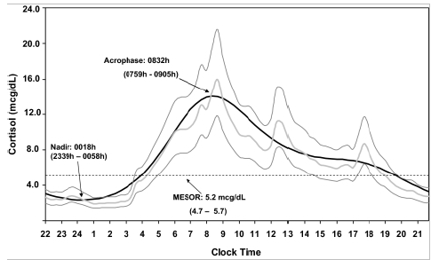
Case study #5 – cortisol timing
Cortisol MUST be checked in the AM for adrenal insufficiency in most cases.
Exception: emergency. If cortisol is very low, then it is likely insufficiency
Exception: cosyntropin stimulation test should go to > 18 mcg/dL AT ANY TIME OF DAY
  Debono, M., Ghobadi, C., Rostami-Hodjegan, A., Huatan, H., Campbell, M. J., Newell-Price, J., … Ross, R. J. (2009). Modified-Release Hydrocortisone to Provide Circadian Cortisol Profiles. The Journal of Clinical Endocrinology and Metabolism, 94(5), 1548–1554. http://doi.org/10.1210/jc.2008-2380

Slide 29
Steroid dose conversion
Steroid dose conversions

Slide 30
Treatment - glucocorticoids
Hydrocortisone 15-20 mg PO in AM and 5-10 mg PO at 1500
Mechanism – closest medication to natural cortisol
Side effects – tremor, loss of bone density, hyperglycemia, Cushing’s, HTN, CHF, GI, mood issues, hypokalemia, acne, infection, impaired wound healing
Pharmacokinetics – half-life is 8-12 hours
Tips
  Take with food, if possible
  BID dosing can mimic diurnal cycles
  With Addison’s and true AI, will need hydrocortisone injection kit, as patient can die during crisis
  Double dose for at least 3 days if ill, may need to double again if s/sx of AI

Slide 31
Treatment - glucocorticoids
Prednisone 4 mg daily
Mechanism – glucocorticoid
Does not mimic natural rise and fall in levels
Easier to remember once daily dosing
Pharmacokinetics – half-life 18-36 hours

Slide 32
Stress dosing - inpatient
Severe illness: Hydrocortisone 100 mg IV TID
After illness stabilizes or 3 days, cut dose by half daily until maintenance dose
Moderate illness: Hydrocortisone 50 mg IV BID
Taper rapidly during recovery
Minor procedures: regular dosing
Do not hold doses
Moderately stressful procedures: Hydrocortisone 100 mg IV x 1 before procedure
Monitor
Major surgery: Hydrocortisone 100 mg IV x 1 before procedure and severe illness dosing for at least 24 hours post-procedure

Slide 33
Tapering steroids – inpatient versus outpatient
Inpatient | Outpatient
Moderate versus severe dosing | Physiologic dosing
Physiologic dosing (1-3 day) | Vitals signs
Check BP, orthostatic signs | Slow taper
Symptoms | Reassess symptoms
Cosyntropin test | Cosyntropin test
Most tapering can be done over a few weeks, but some patients with real HPA suppression may need 9 to 10 months or longer.
Some patients will need no daily dose, but need stress dosing during illness.

Slide 34
Summary
Your likely patient and their signs and symptoms
Ill patient with a history of repeated or long-term steroid use
Brain injury or brain surgery patient
Patient will have low BP, maybe a low BG. Look for dizziness, orthostatic hypotension and weakness
Appropriate testing
CMP, TSH, AM cortisol and maybe an ACTH
If cortisol is normal and you suspect AI, try a cosyntropin stimulation test (done properly)

Slide 35
Summary
Results
AM cortisol under 5 mcg/dL and/or ACTH low for cortisol result
Cosyntropin stimulation test with cortisol under 18 mcg/dL at 30 and 60 minutes
Make sure they are off steroids. Consider low albumin (binding) and opioid use
Treatment
Hydrocortisone 15-20 mg in the morning and 5-10 mg in the early afternoon
Prednisone 4 mg daily if compliance a concern
Double dose if ill
Hydrocortisone 100 mg IV TID inpatient if severely ill
Remember to taper slowly outpatient and repeat testing

Slide 36
References
  Broersen, L. H., Pereira, A. M., Jørgensen, J. O., & Dekkers, O. M. (2015). Adrenal Insufficiency in Corticosteroids Use: Systematic Review and Meta-Analysis. The Journal of Clinical Endocrinology & Metabolism, 100(6), 2171-2180. doi:10.1210/jc.2015-1218
  Debono, M., Ghobadi, C., Rostami-Hodjegan, A., Huatan, H., Campbell, M. J., Newell-Price, J., … Ross, R. J. (2009). Modified-Release Hydrocortisone to Provide Circadian Cortisol Profiles. The Journal of Clinical Endocrinology and Metabolism, 94(5), 1548–1554. http://doi.org/10.1210/jc.2008-2380
  Gardner, D. G., Shoback, D. M., & Greenspan, F. S. (2011). Greenspan’s basic & clinical endocrinology. New York: McGraw-Hill Medical.
  Goodman & Gilman’s the pharmacological basis of therapeutics. (2011). New York: McGraw-Hill Medical.
  Kazlauskaite, R., Evans, A. T., Villabona, C. V., Abdu, T. A., Ambrosi, B., Atkinson, A. B., . . . Tordjman, K. (2008). Corticotropin Tests for Hypothalamic-Pituitary- Adrenal Insufficiency: A Metaanalysis. The Journal of Clinical Endocrinology &amp; Metabolism,93(11), 4245-4253. doi:10.1210/jc.2008-0710
  Kronenberg, H. M., Melmed, S., Polonsky, K. S., & Larsen, P. R. (2008). Williams Textbook of Endocrinology (11th ed.). Philadelphia, PA: Saunders Elsevier.
  Nieman, L. K., MD. (2016, September 30). Causes of secondary and tertiary adrenal insufficiency in adults. Retrieved March 09, 2017, from https://www.uptodate.com/contents/causes-of- secondary-and- tertiary-adrenal- insufficiency-in- adults

