Slide 1

International Business and Information Literacy: Faculty/Librarian Collaboration to Prepare Students for the International Business Workforce
AIB/MBAA- Chicago
March 23, 2017
Michael E. Ricco, Grand Valley State University
Cara Cadena, Grand Valley State University

Slide 2
Agenda
Introductions
Our collaboration goals
The literature
The intervention model
Findings
Discussions: applying the model to your courses
Questions

Slide 3

Introductions
Michael Ricco, DBA
Cara Cadena, MLIS

Slide 4

Collaboration Goals
To better prepare students for the international workforce.
Enhance students’ international business research/literacy skills.
Expand students’ resource knowledge/perspectives to foster a global mindset.

Slide 5

The Literature
Skills sought by employers
Global Mindset
Successful collaborations
Multiple Learning Modalities

Slide 6
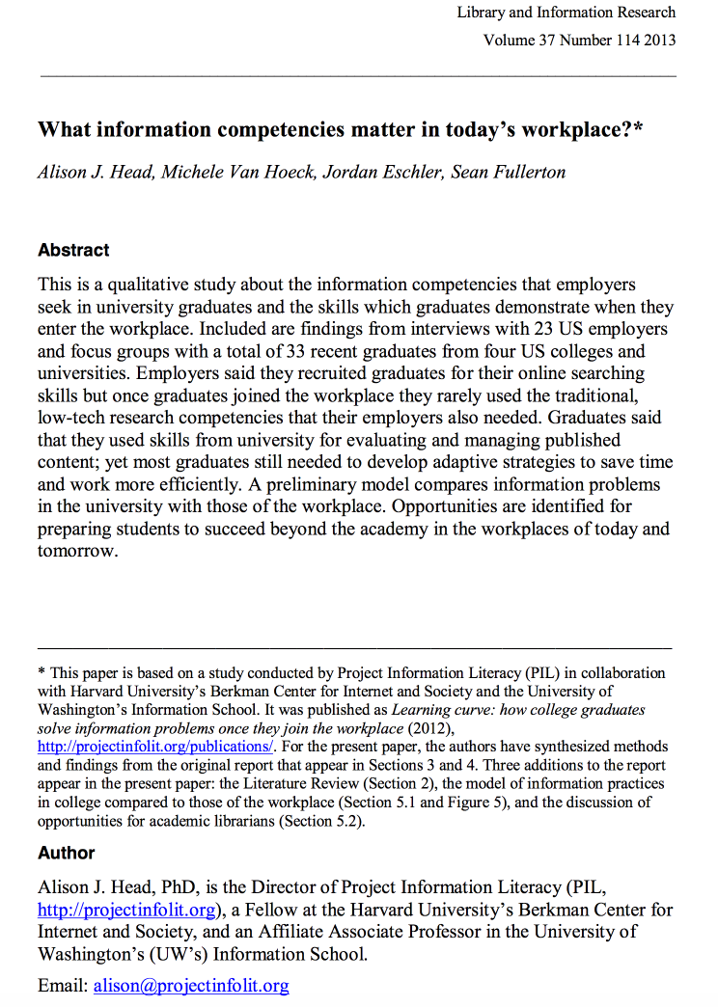
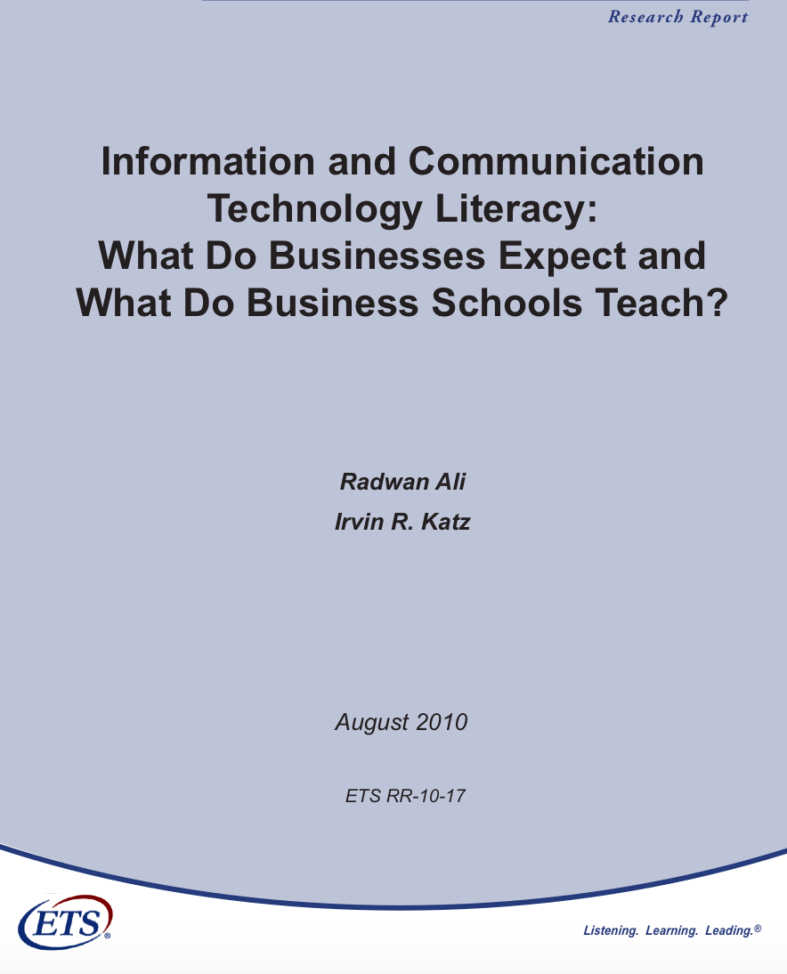

Slide 7
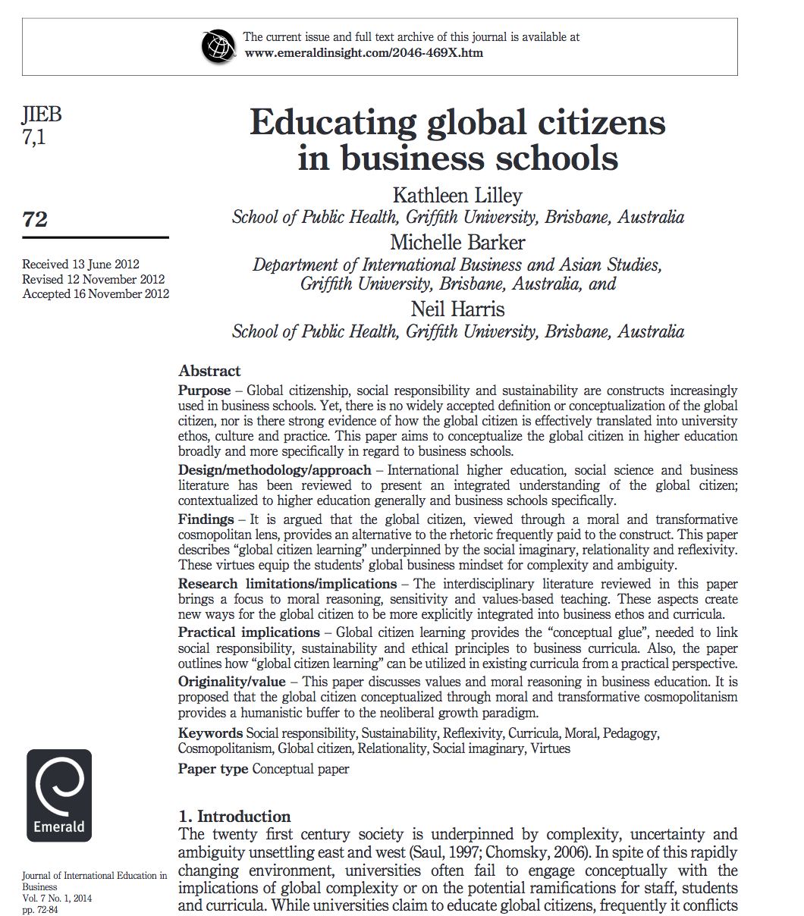
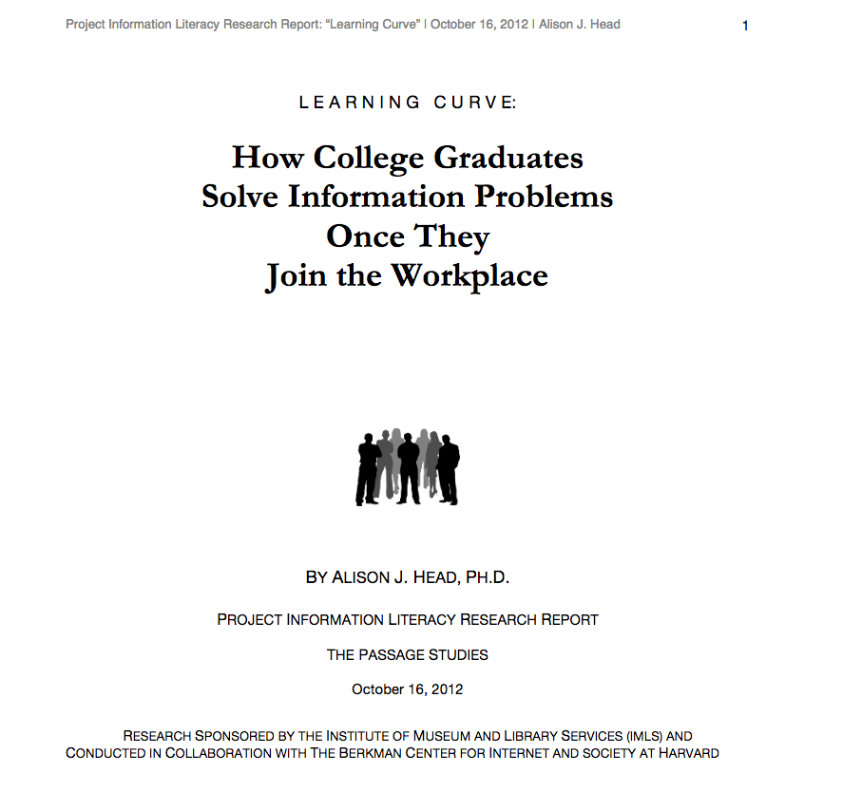

Slide 8
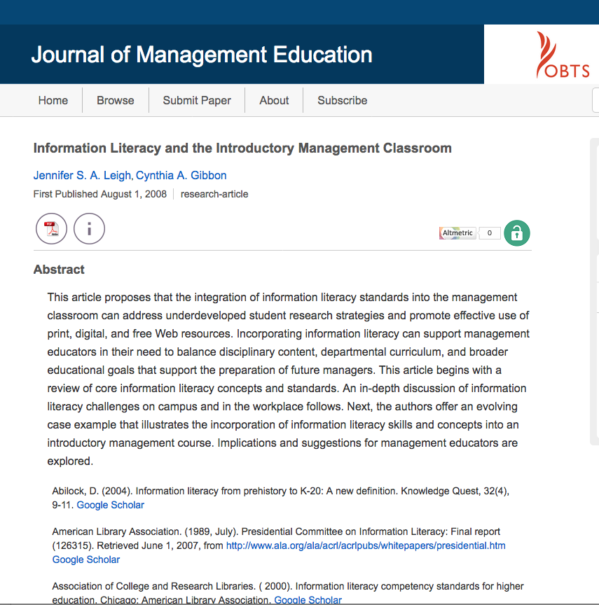
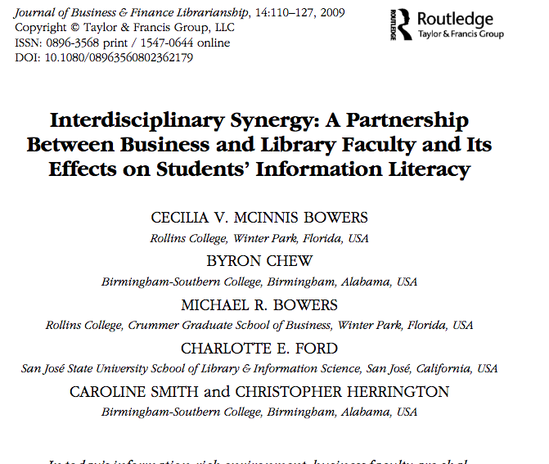

Slide 9
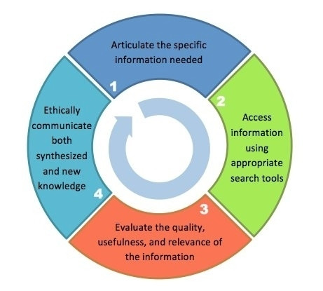
Information Literacy at GVSU
Revised, 2013: Sarah Beaubien, Emily Frigo, Mary O’Kelly, Kathryn Waggoner – Grand Valley State University Libraries

Slide 10

The IL Framework and Threshold Concepts
Authority is contextual and constructed
Information creation as a process
Information has value
Research as inquiry
Scholarship as a conversation
Searching as strategic exploration
Notes:
Framework introduced in 2015. Librarians have been using the standards since 2000. Made a lot of people uncomfortable. How to assess? How to implement?

Slide 11
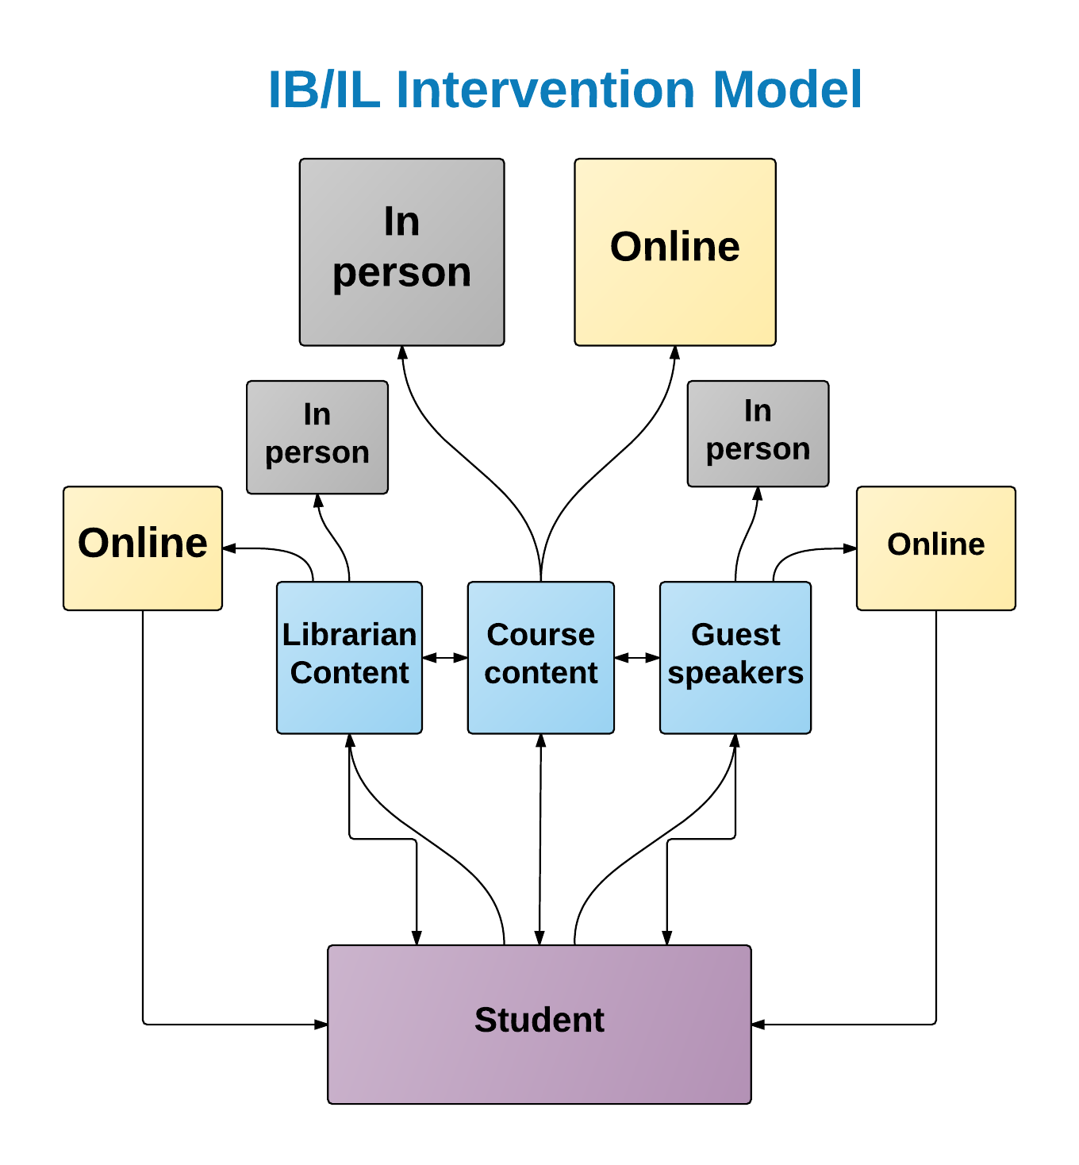

Slide 12
The “IB-IL Intervention Model”

Slide 13
Methodology
Control group sections & test sections
Pre- and post-course surveys
Video Reflective Journals
Assignment Analysis
Librarian as an active participant

Slide 14
Findings—Pre and post survey

Slide 15
Findings: IB Research & IL Challenges
“Knowing if the numbers a company is putting up are good or bad.”
“Determining which of the databases to use.”
“First finding credible data, and then being able to turn the data into information.”
“I don’t know how and where to find a lot of information.”
“I am not familiar with the services and resources at my disposal.”
Notes:
”As a college student, what have been your primary challenges in doing international business research?”
“As a college student, what your primary challenges in using the GVSU libraries for research purposes?”

Slide 16
“Rate the degree to which the information literacy interventions were useful to supplement your learning.”
4/5 students rated our intervention model
“somewhat useful” or ”very useful”

Slide 17
Findings--Citation Analysis

Slide 18
Key Takeaways
Enhanced focus on providing more IB source information pays off in added learning/application.
Training on information literacy and ongoing support, increases quality of supporting research in assignments.
Integration of resources across learning modalities provides relatively consistent advancement.
Student preparedness for the workforce is likely enhanced.

Slide 19
Applying the Intervention Model to your Courses
What are your challenges and opportunities?
Technology
Putting the tools into practice
Other ideas/practices?

Slide 20
Thank you!
Dr. Michael E. Ricco riccom@gvsu.edu
Cara Cadena cadenac@gvsu.edu

