Slide 1


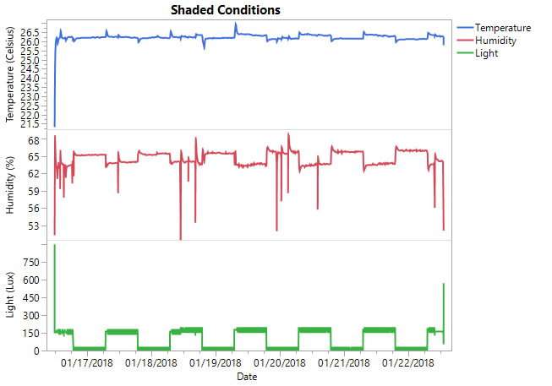
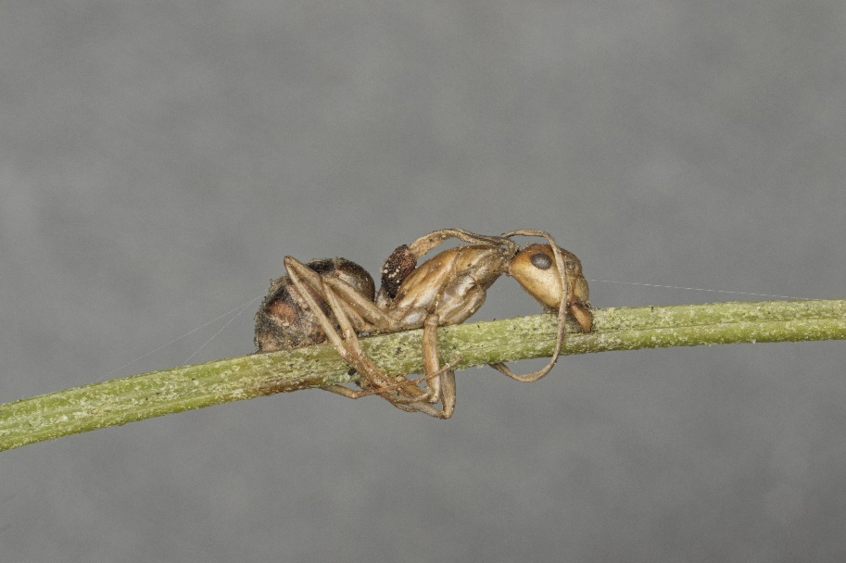
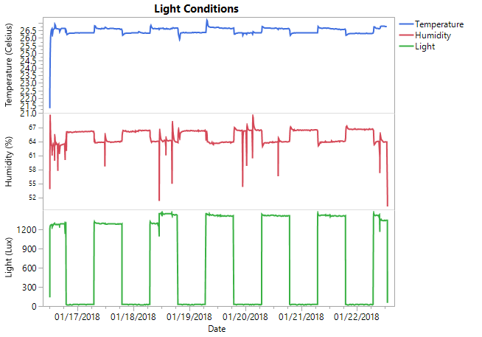
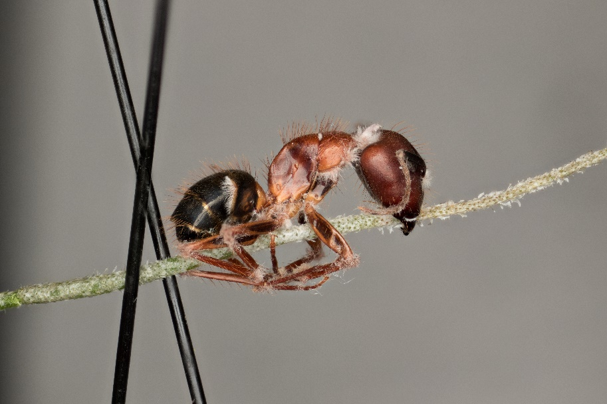
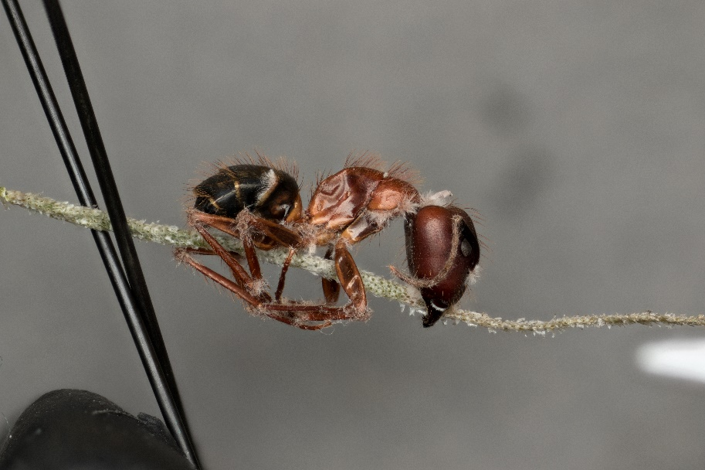
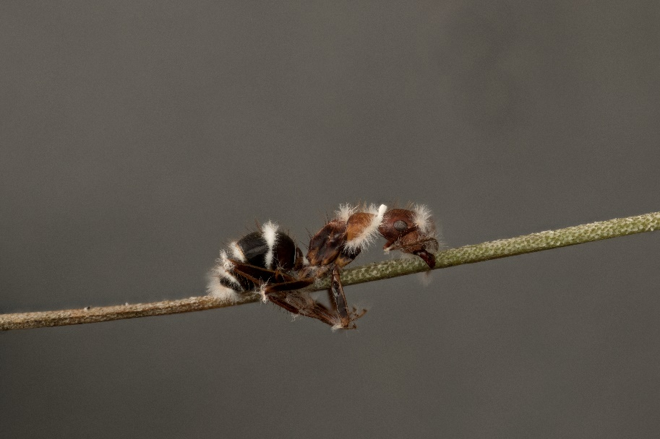
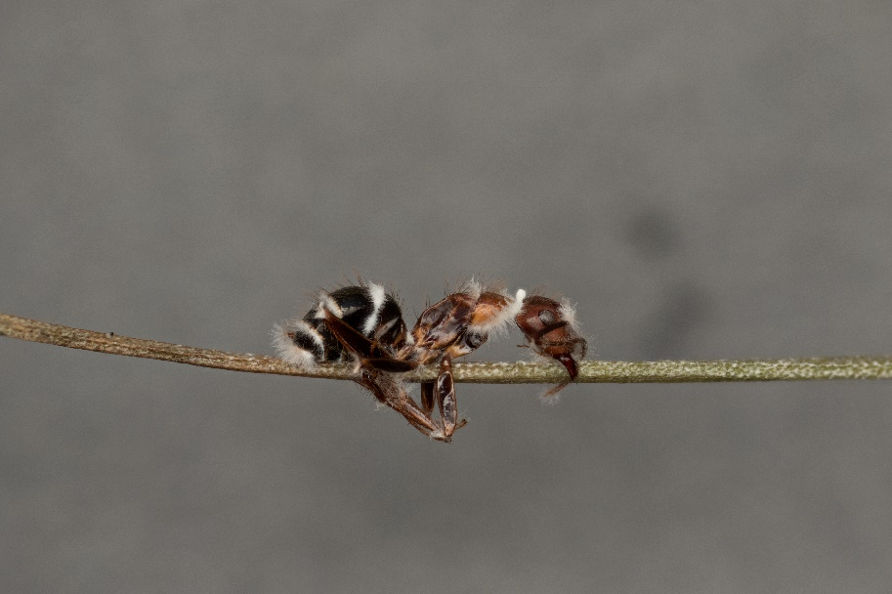
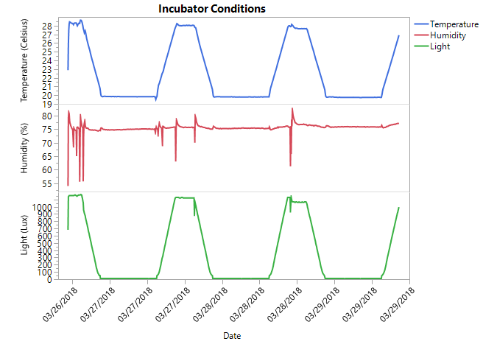
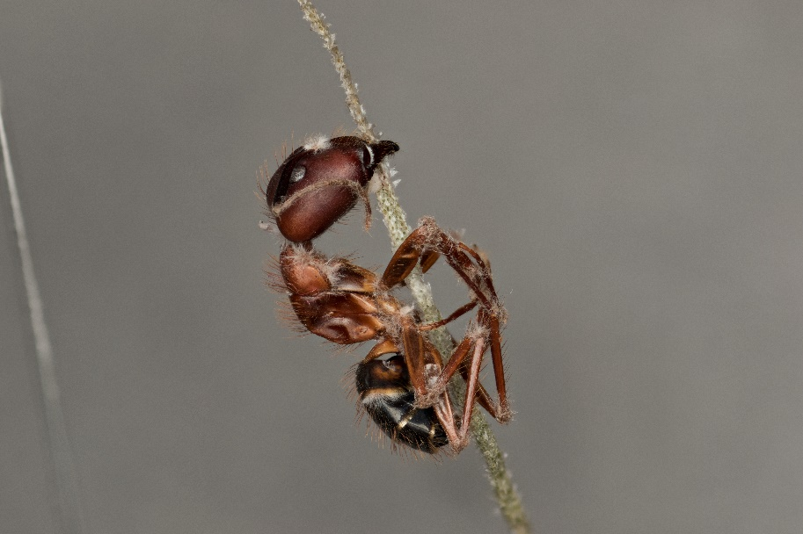
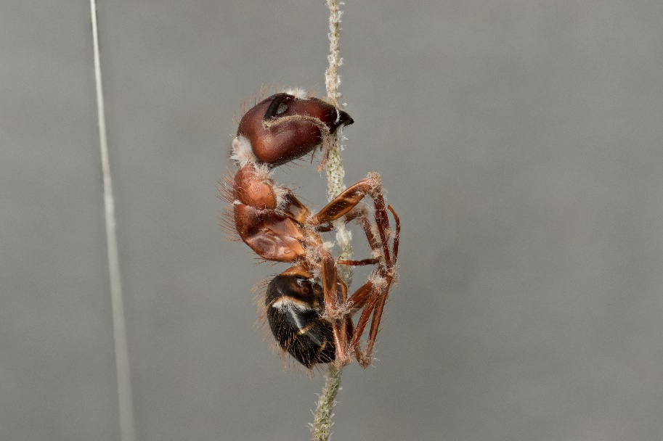
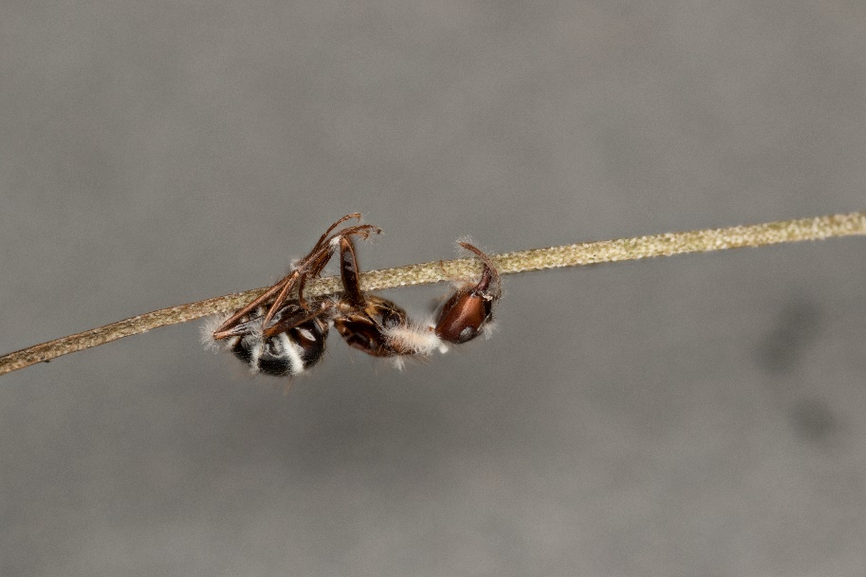
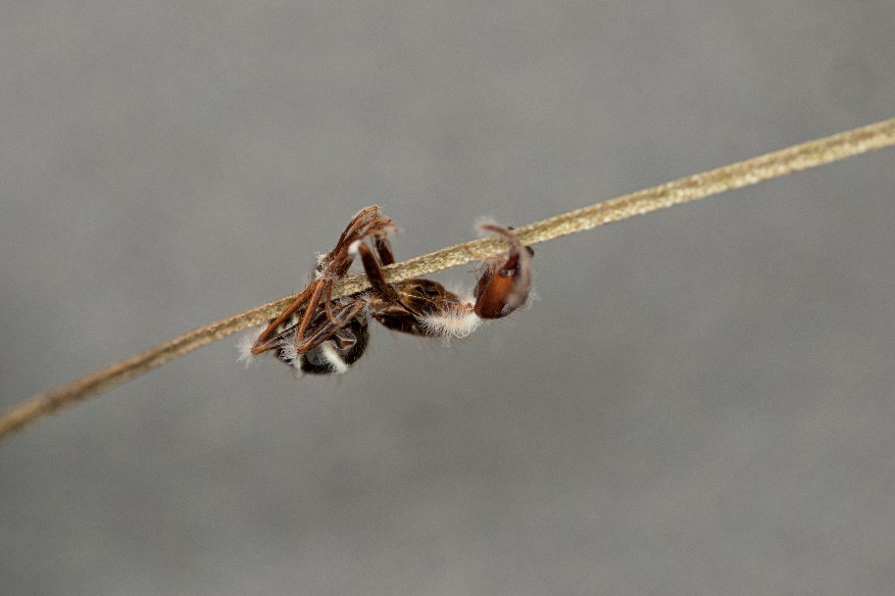
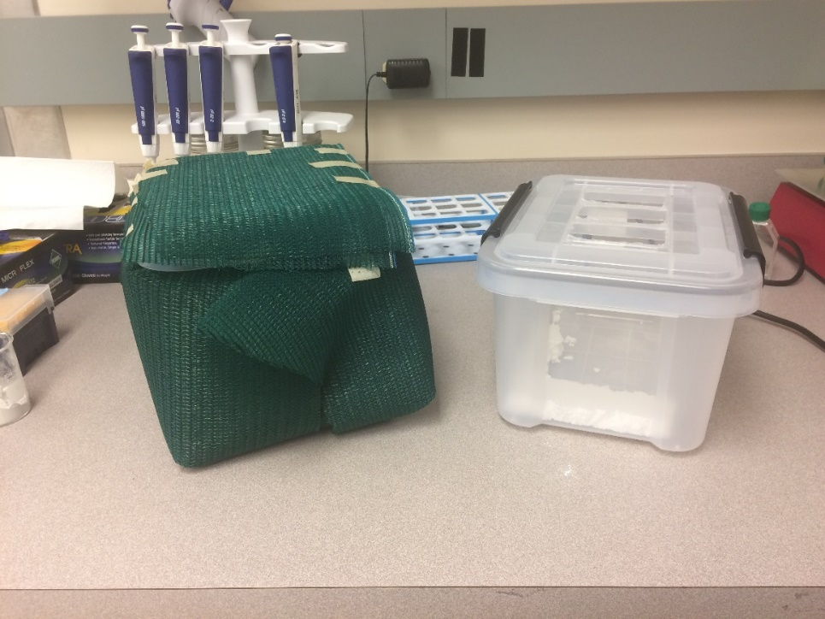
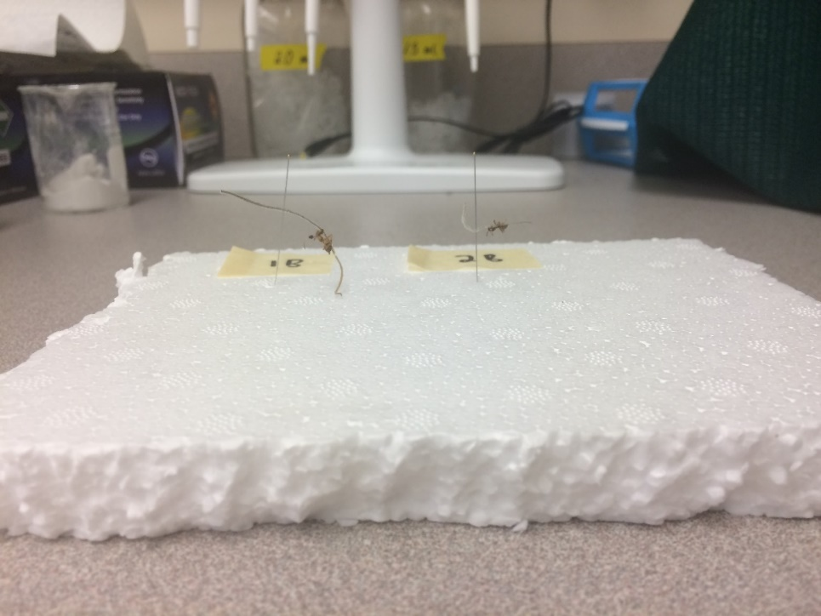
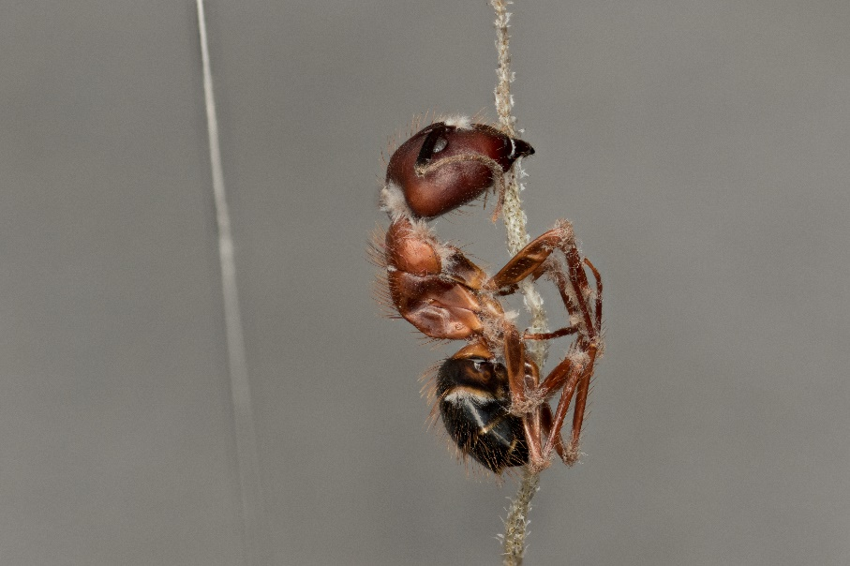
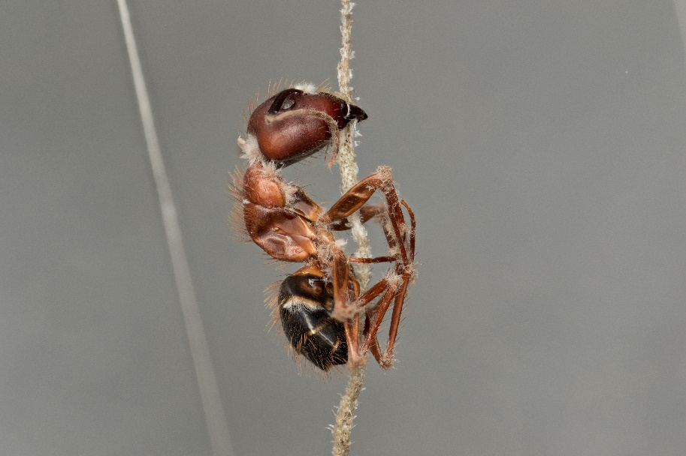
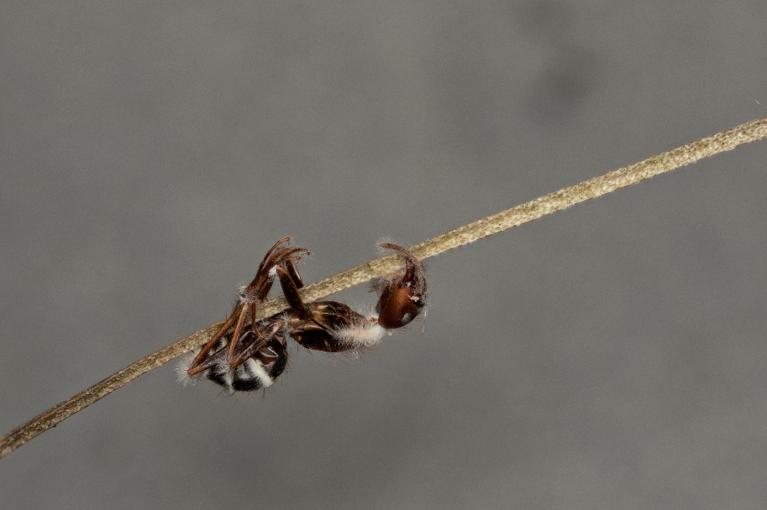
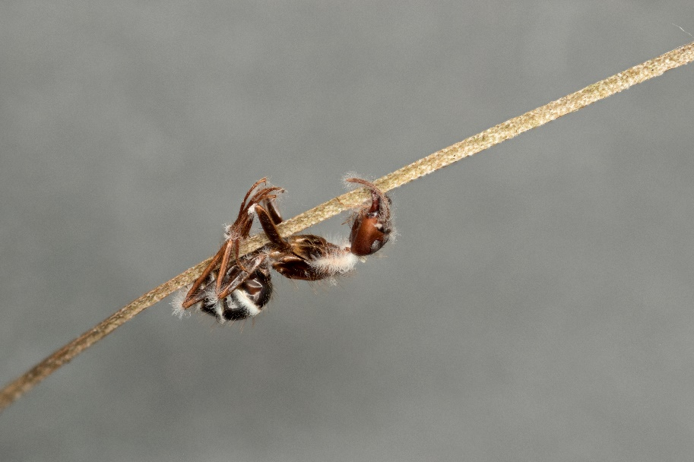
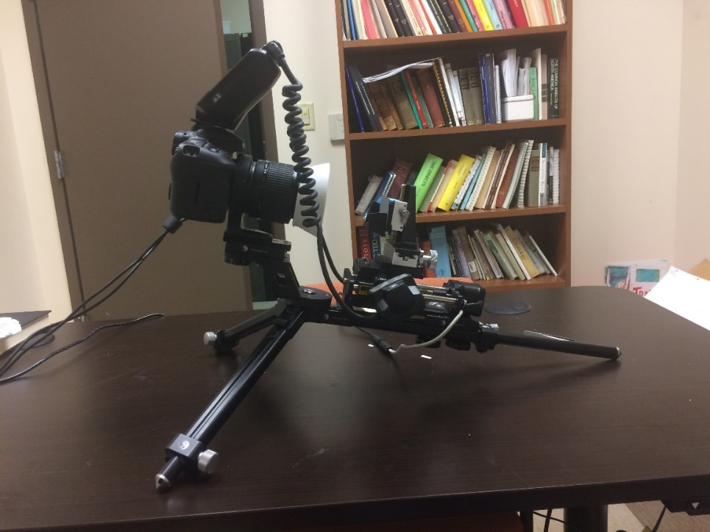
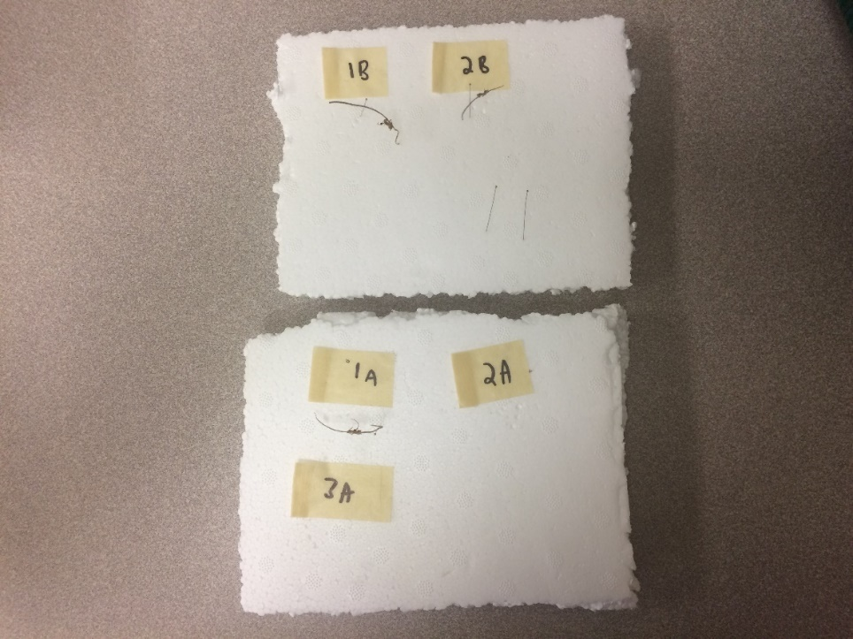
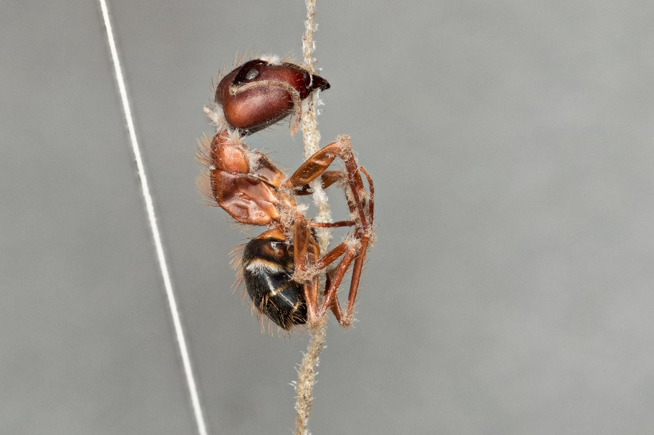
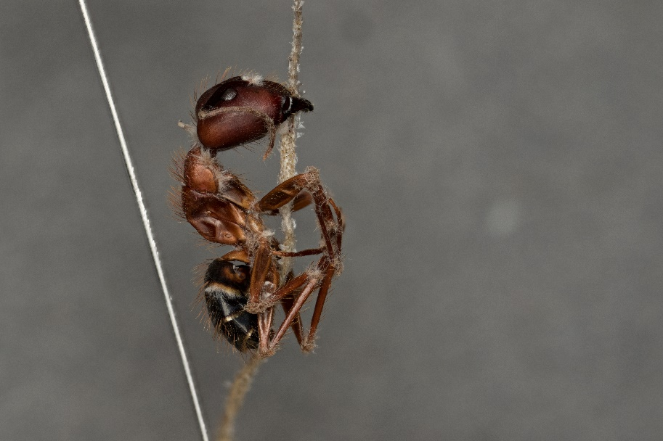
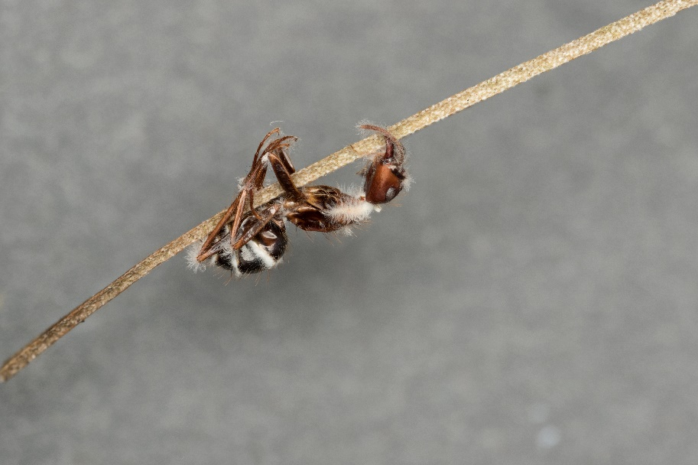
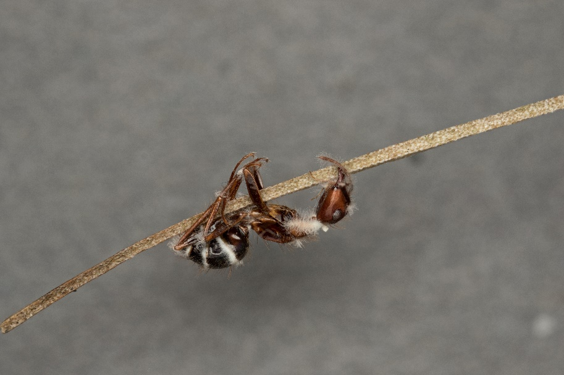
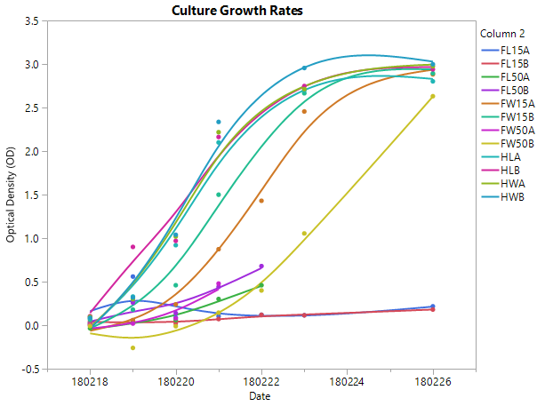
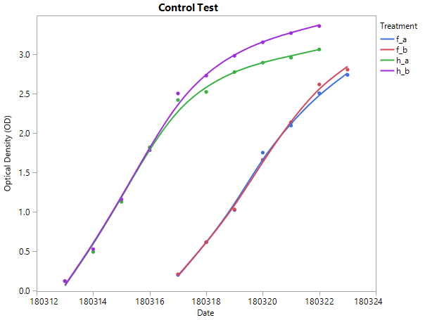
Growing the Zombie Ant Fungus in the Lab:
Optimizing Conditions for Stalk Formation in Host and Culturing in Media
Brianna Santamaria, Ian Will, Charissa de Bekker
Department of Biology, University of Central Florida
Background
Results
Conclusion
Ophiocordyceps unilateralis is a parasitic fungus that infects and manipulates Carpenter ant behavior.
An infected ant will usually climb up onto a piece of vegetation, bite down, and die.
Once dead, a fungal stalk will grow from the host and release spores from a fruiting body.
The spores will fall to the ground where it then infects another ant so that the same process will repeat.
The goal of our lab is to find the molecular mechanisms used by the fungus to manipulate the ants behavior.
To study how the fungus does this, it is important to observe the ants from the moment it is infected to when it is ready to release its spores.
Ants can be successfully infected and manipulated under laboratory settings. However, a stalk with a successful fruiting body have not yet been grown in under the same conditions.
My first objective is to find the right laboratory conditions to successfully grow a fungal stalk with a fruiting body from an infected ant.
To infect the ants, live fungal specimens need to be kept in the lab for use.
Our current protocol does not provide the most effective way to harvest and culture O. unilateralis.
My second objective is to find the best conditions to culture the fungus using different harvesting techniques.
Objective 1
Objective 1
There was no change in either the shaded group or the unshaded group for the first test.
Future experiments will have to be conducted to find the right conditions to grow the fungal stalk.
For the culture growth rates, the harvest cultures reached their final stage faster than the frozen ones.
The frozen cultures experienced a dip before they reached a stable OD.
These results suggest that a different treatment should be used for frozen samples to obtain the same growth rates as the harvest samples.
Objective 2
Infected ant grown in natural conditions
Future Experiments
Objective 1
Methods
The next experiment to test the growing conditions for the fungus would be to expose them to the conditions above.
My next step for culturing involves using different media to store the cells as well as different chemicals to freeze them.
Instead of Graces medium, I will culture the fungi in phosphate-buffed saline (PBS) to see how the cells grow in that.
For freezing the cells, I plan on using a mixture of DMSO and glycerol to see if that will help prevent ice crystals from forming while not harming the cells.
Another possible chemical I plan on using is ethylene glycol which has shown to be successful in protecting some fungi.
Objective 1
1 week 2 weeks
1 week 2 weeks
3 weeks 4 weeks
3 weeks 4 weeks
Boxes used to store ants (Shaded left, unshaded right)
Ants hanging upside down
5 weeks 6 weeks
Objective 2
5 weeks 6 weeks
Camera used to take ant pictures
Overhead view of ants
The abiotic conditions I am testing are humidity, temperature, and light.
Five ants in various stages of the infection were collected and stored in a shaded or unshaded box. They were kept in an incubator for 8 weeks at a constant 26°C, 65% humidity, and a 12/12 light cycle.
7 weeks 8 weeks
7 weeks 8 weeks
Objective 2
Objective 2
References
Harvest Frozen
Water LiAc Water LiAc
HW HL Glycerol Glycerol
15% 50% 15% 50%
FW15 FW50 FL15 FL50
Lithium Acetate (LiAc) – Penetrates cell walls
Glycerol – Prevents ice crystals from forming when freezing cells
Hubalek, Zdenek. 2003. Protectants used in the cryopreservation of microorganisms. Cyrobiology [Internet] [cited 2018 Mar. 28]; 46: 205-29.
Boomsma, J. Jacobus, Himaman, Winanda, Hughes P. David, Hywel-Jones, L. Nigel. 2009. Graveyards on the Move: The Spatio-Temporal Distribution of Dead Ophiocordyceps-Infected Ants. PLOS. [Internet][cited 2018 Mar. 28]
Hashimoto, Wataru, Kawai, Shigeyuki, Murata, Kousaku. 2010. Transformation of Saccharomyces cerevisiae and other fungi. Bioengineered Bugs [Internet] [cited 2018 Mar. 28]; 1:6. 395-403.
Flow chart of the different variables used for cultures
Acknowledgements
Cells were washed with water or LiAc. They were then separated into 12 aliquots.
Four of the aliquots were put straight into medium to grow.
The other 8 were treated with either 15% or 50% glycerol and frozen for a few days before being put in Graces + 2.5% FBS medium.
Their optical density's (OD) at 660nm were taken to measure cell growth.
Thanks to the Research and Mentoring Program (RAMP) for helping to fund my research
Special thanks to my mentor Charissa de Bekker for giving me the chance to conduct research in her lab

