Slide 1

Goal-Free Evaluation
A potential model for the evaluation of
social work programs
Brandon W. Youker, Ph.D. & Lyza Ingraham, B.S.
Grand Valley State University
Notes:
Lady Justice is Blind

Slide 2
NASW Code of Ethics
5.02: Evaluation and Research (a – p)
5.02(a): Social workers should monitor and evaluate policies, the implementation of programs, and practice interventions.

Slide 3

Goal-Free Evaluation
GFE is the process of determining something’s merit intentionally without reference to its stated goals and objectives.

Slide 4
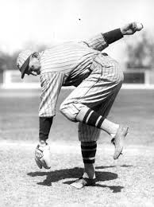
GFE History
“As you can learn from any baseball pitcher who has set out in the first inning to pitch a shutout, the game’s final score is the thing that counts, not good intentions.”
      Popham

Slide 5

The Streetlight Effect

Slide 6
The idea behind GFE is…
“Finding out what the program is actually doing without being cued as to what it is trying to do. If the program is achieving its stated goals and objectives, then these achievements should show up; if not, it is argued, they are irrelevant.”
-Scriven
Notes:
There are so many possible program effects, outcomes, and impacts. Having a half dozen or so identified for you is as Scriven says “scarcely a drop in the bucket”.

Slide 7
GFE can be…
Full or Partial
Quantitative or Qualitative

Slide 8
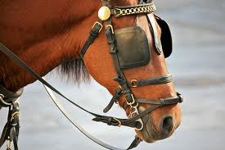
The Screener
Conducts initial meetings
Edits materials, documents, &
communiqués
Serves as a liaison to the project staff

Slide 9


GFE, it works in practice but does it work in theory?
Notes:
13 evaluators who claim to have conducted GFE

Slide 10
GFE’s Four Underlying Principles
1. Identify relevant effects to examine without referencing goals and objectives.
2. Identify what occurred without the prompting of goals and objectives.
3. Determine if what occurred can logically be attributed to the program/intervention.
4. Determine the degree to which the effect(s) are positive, negative, or neutral.

Slide 11
Goal-Free Evaluation
Dos
Don’ts

Slide 12
GFE Dos
Identify & use a screener
Refer all communiqués to screener
Screen all written material screened
Advise all staff of goal-free nature of GFE
Stop staff if they talk about goals or objectives
Identify areas to search for effects
Select measurement tools/instruments
Measure/observe performance
Assess the impact on consumer needs
Profile the positive, negative, & neutral effects
Notes:
Does it look better to use one slide rather than break “GFE Dos” into two slides?

Slide 13
GFE Don’ts
Ø
Communicate with program staff regarding goals or objectives
Attempt to find stated goals & objectives

Slide 14
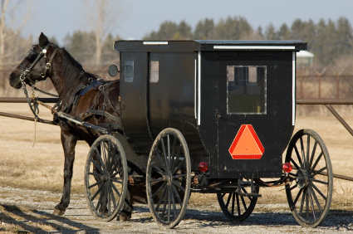
“If I had asked the people what they wanted, they would have said faster horses.”
- Henry Ford

Slide 15


Slide 16


Slide 17
Thank you.
“One of the great mistakes is to judge policies and programs by their intentions rather than their results.”
- Milton Friedman
Questions?

