Slide 1
Coordinating and Marketing Digital Collections
A presentation to the
Society of Florida Archivists
by Barbara Lewis, MLS
May 5, 2010

Slide 2
Coordinating and Marketing
Digital Collections
What is a digital collection?
Staffing / Organization
Project management
Grant opportunities
Reaching your audience
Collection portals/guides and more

Slide 3
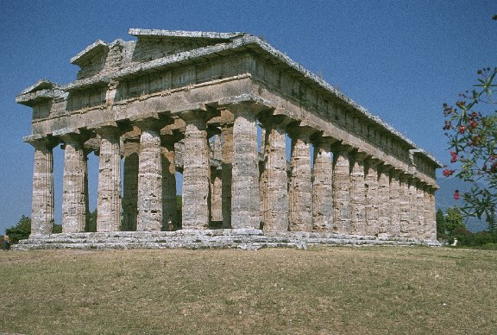

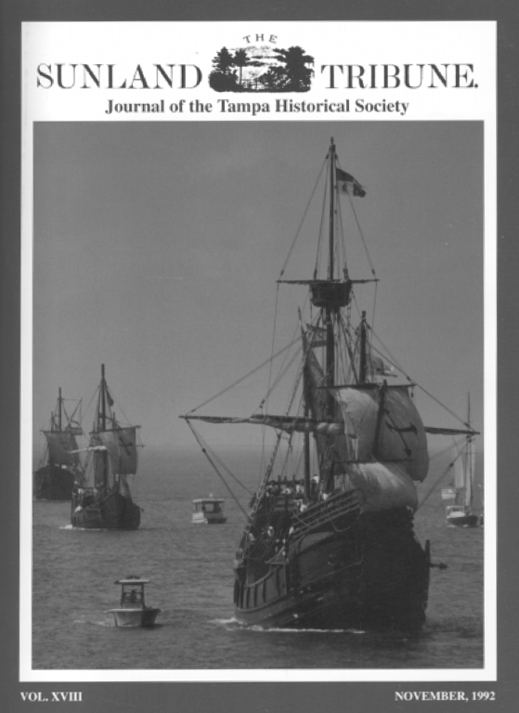
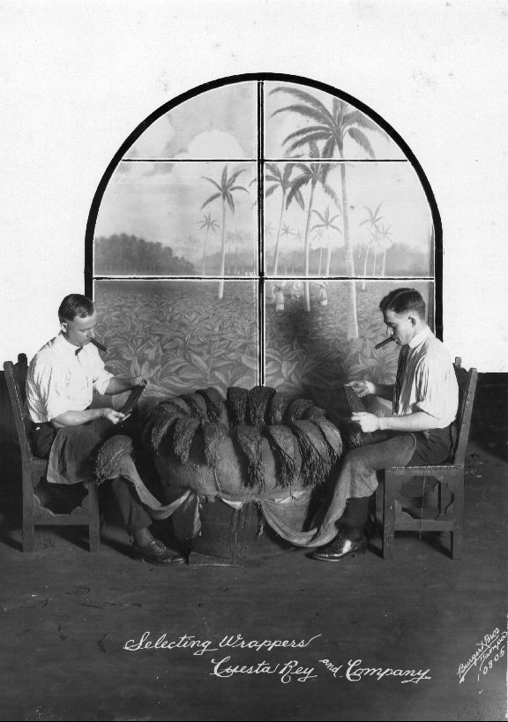
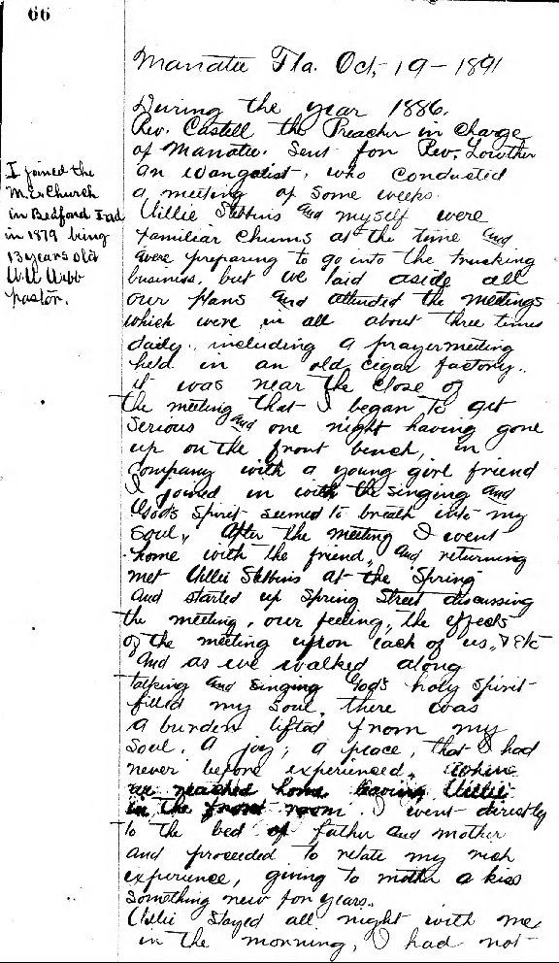
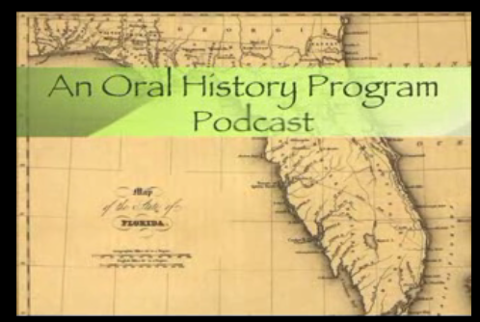
What is a digital collection?

Slide 4
Why create digital collections?
Access from anywhere
Access at anytime
Access by multiple clients
Structured access
Searchability
Preservation and conservation
Library space
Resource sharing

Slide 5
Staffing / Organization
In-house vs. out-sourced
  One project vs. digitization initiative
  Types of materials
  Timeline / deadlines
  Equipment cost / obsolescence
  Staff costs
  Learning curve
  Quality control

Slide 6
Staffing / Organization
Digitization Services Suppliers
  Lyrasis Mass Digitization Cooperative
  Backstage Library Works (acquired OCLC Preservation Services)
  iArchives

Slide 7
Staffing / Organization
Centralized or decentralized
  Selection
  Digitization, image processing, OCR
  Metadata
  Discovery/display tools
  Database and system administration
  Project management

Slide 8
Staffing / Organization
Staff
  Permanent employees
  Student assistants
  Interns
  Volunteers
Skills
  Project management
  Scanning & photography
  Image editing
  OCR
  Cataloging
  Programming/database development
  Web design

Slide 9
Staffing / Organization
Documentation
    Workflows
    Procedures
    File naming schemas
    Equipment calibration
    Quality standards
    Metadata schema
    Storage and archiving plan
  Samples at http://guides.lib.usf.edu/dcs-procedures

Slide 10
Project management
Project management
  Scope of work
  Adjustments to standards and procedures
  Timeline, milestones, and deadlines
  Funding and reporting
  Work breakdown and task assignments
  Communication
  Negotiation
basecamphq.com

Slide 11
Grant opportunities
National Archives
  National Historical Publications and Records Commission (NHPRC)
    http://www.archives.gov/nhprc/announcement/
NEH
  Digital Humanities
    http://www.neh.gov/whoweare/divisions/DigitalHumanities/DHSUGprojects.html
  Preservation & Access
    http://www.neh.gov/whoweare/divisions/PreservationAccess/index.html
IMLS
  Digital Collections & Tools
    http://www.imls.gov/applicants/project.shtm#tools
  LSTA
    http://dlis.dos.state.fl.us/bld/grants/Lsta/LSTA.html

Slide 12
IMLS Grant Projects
Cornell University Library
  $281,449; 2-year project
  Digitized text and illustrations taken from early Western travel narrations and first-person accounts of life in Southeast Asia before 1927.
  http://dlxs.library.cornell.edu/s/sea/
State Historical Society of Wisconsin
  $202,596; 21-month project
  Created a digital library containing full texts of ~150 exploration narratives and distributed instructional guides to 40,000 teachers in the National History Day program.
  http://www.americanjourneys.org/
Wayne State University
  $110,072; 14-month project
  Digitized images from the Detroit News photo collection dating from the late 19th Century through 1980.
  http://dlxs.lib.wayne.edu/cgi/i/image/image-idx?c=vmc

Slide 13
LSTA Grant Projects
  Windows into Florida’s Coastal Environment
  Mote Marine Laboratory
  Library Technology Connectivity and Services
  $87,146
  This project digitizes, catalogs, and uploads documents from the Bass Biological Lab collection and the Mote Technical Reports onto Mote Marine’s Web-based Institutional Repository.

Slide 14
LSTA Grant Projects
Picturing the Past: Photographs and Postcards of Central Florida
  University of Central Florida Libraries
  Library Technology Connectivity and Services
  $52,002
  This grant will make possible the addition of up to 30,000 images of photographs and visual ephemera that enhance the visual story of Central Florida by giving institutions the opportunity to have materials described and digitized by project staff and providing a digital home to those archives unable to establish their own digital infrastructure

Slide 15
Reaching your audience
Discovery & access tools
  ContentDM, Fedora, DSpace, etc.
  Google, Bing, Yahoo, etc.
  Internet Archive
  Florida on Florida, PALMM, etc.
OPAC & OCLC: item vs. collection records

Slide 16
Collection Portals/Guides

Slide 17
Collection Portals/Guides
Adding value
  Essays
  Bibliographies
  Glossaries
  Other collections
  Programming
Examples
  Farid Karam, M.D. Lebanon Antiquities Collection http://guides.lib.usf.edu/karam
  Documenting the American South http://docsouth.unc.edu/
  Tufts: Walter B. Wriston Archives http://dca.lib.tufts.edu/features/wriston/index.html

Slide 18
Online Exhibits
USF: Victorian Era Children’s Literature http://guides.lib.usf.edu/victorian-exhibit
West Virginia University: David Copperfield http://www.libraries.wvu.edu/exhibits/dickens/copperfield/index.htm
Ringwood Public Library: The Upper Ringwood Collection http://www.upperringwood.org/
Claremont College: Original Voices from the Past http://libraries.claremont.edu/sc/exhibits/litmag/default.html
Chicago History Museum: Lincoln at 200 http://lincolnat200.org/
National Archives: Designs for Democracy http://www.archives.gov/exhibits/designs_for_democracy/index.html

Slide 19
Web 2.0
Blogs
  Duke Digital Collections Blog http://library.duke.edu/blogs/digital-collections/
  Birmingham Public Library http://bpldigital.blogspot.com/
  IMLS Digital Collections and Content http://imlsdcc.wordpress.com/
  University of Washington http://uw-digitalcollections.blogspot.com/
  Ohio History http://ohiohistory.wordpress.com/

Slide 20
Web 2.0
Flickr
  University of Washington Digital Collections http://www.flickr.com/photos/uw_digital_images/
  Auburn University Digital Library http://www.flickr.com/photos/auburnuniversitydigitallibrary/
  Duke University Digital Collections http://www.flickr.com/photos/dukedigitalcollections/
  Miami University Digital Collections http://www.flickr.com/photos/muohio_digital_collections/
  University of Florida http://www.flickr.com/photos/ufdc/
  East Carolina University http://www.flickr.com/people/ecu_digital_collections/

Slide 21
Web 2.0
Social tagging
  Oregon State University case study
Facebook
  University of Wisconsin Digital Collections http://www.facebook.com/UWDigiCollec?v=app_9953271133
Twitter
  Duke University http://twitter.com/DukeDigitalColl
  University of Wisconsin http://twitter.com/UWdigiCollec

Slide 22
Resources
Moving Theory into Practice: Digital Imaging Tutorial http://www.library.cornell.edu/preservation/tutorial/contents.html
Talking and Tagging: Using CONTENTdm and Flickr in the Oregon State University Archives http://lib.byu.edu/sites/interactivearchivist/case-studies/flickr-at-osu/
Digital Best Practices http://digitalwa.statelib.wa.gov/newsite/best.htm
BCR’s CDP Digital Imaging Best Practices Version 2.0 http://www.bcr.org/dps/cdp/best/digital-imaging-bp.pdf

