Slide 1
Harnessing Your Projects: Using Project Management Techniques and Basecamp in Libraries
Presented by: Barbara Lewis
Coordinator for Digital Collections
University of South Florida
April 1, 2011

Slide 2
Agenda
Introductions
A project is…
Project management is…
Project management tools
Using Basecamp™
Questions

Slide 3
A project is…
A series of related tasks to be completed
That has an explicit beginning and end
And a defined scope of work
Which often requires multiple participants, skill sets, and resources to achieve
Specific deliverables for a customer

Slide 4
A project is…
Worthy of being well managed

Slide 5
Project management is…
A set of skills, techniques, and tools
Used by a project manager to
  Plan
  Track
  Report
The successful completion of a project.

Slide 6
Project management is…
Planning
  Define the project and its scope
  Assemble a project team
  Identify the specific tasks required
    Work breakdown, schedule, and milestones
    Task relationships and dependencies
    Resources needed
  Ascertain potential risks

Slide 7
Project management is…
Tracking
  Identifying completed tasks
    Time used
    Money spent
  Recognizing and resolving bottlenecks
  Detecting and adapting to changes
  Ensuring quality

Slide 8
Project management is…
Reporting
Communication!!!

Slide 9
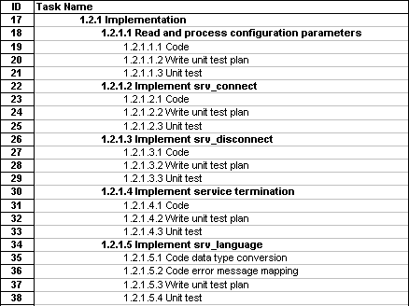
Project management tools
Work breakdown structure
  Project task and subtask list

Slide 10
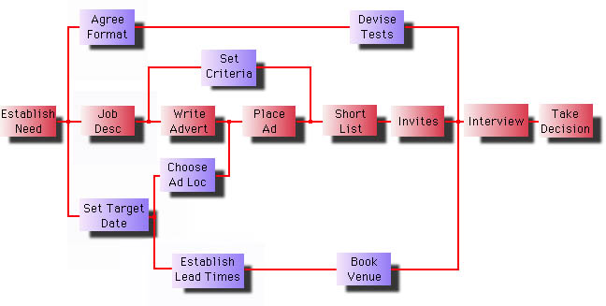
Project management tools
PERT charts (Program Evaluation Review Technique) and critical path analysis
  Project tasks and dependencies

Slide 11
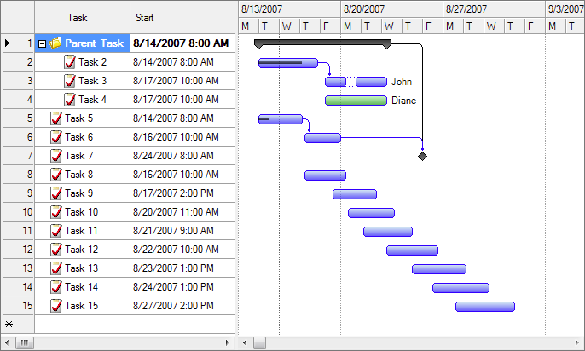
Project management tools
Gantt charts
  Project tasks and schedule

Slide 12
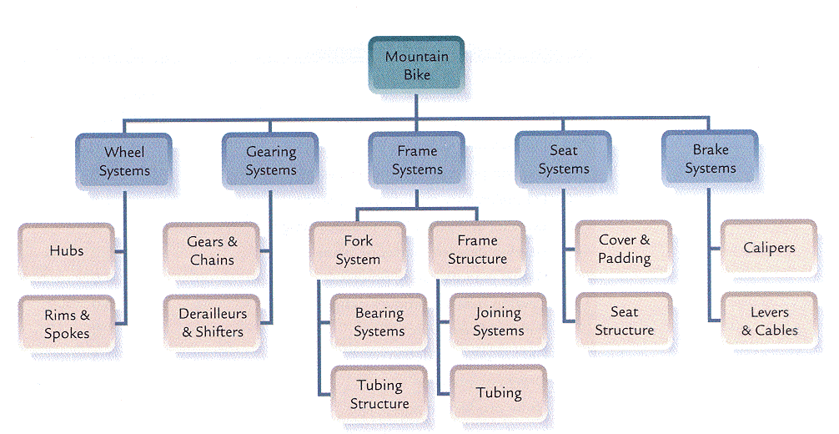
Project management tools
Product Breakdown Structure
  List of the components of a deliverable

Slide 13
Project management tools
Microsoft Project
OpenProj (open source)
Trac (wiki-based)
Easyprojects.net, AceProject, @task, etc.
Basecamp

Slide 14
Using Basecamp™
Basecamp projects at USF
  Digitization Projects
  New Acquisitions Manual
  Staff Core Competencies
  E-Journal Processing
  New Library Website
  Textbook Affordability Project
  Etc.

Slide 15
Using Basecamp™
Dashboard / Overview
People / Permissions
Task / To Do lists
Messaging
Writeboards
File storage
Time Tracking

Slide 16
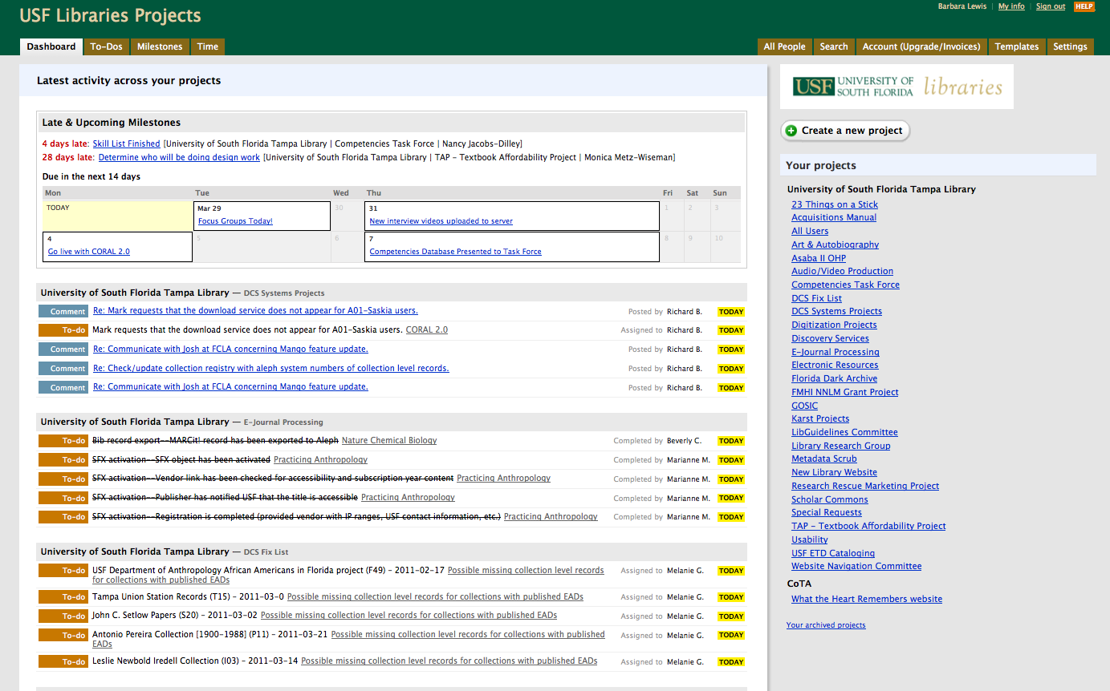

Slide 17
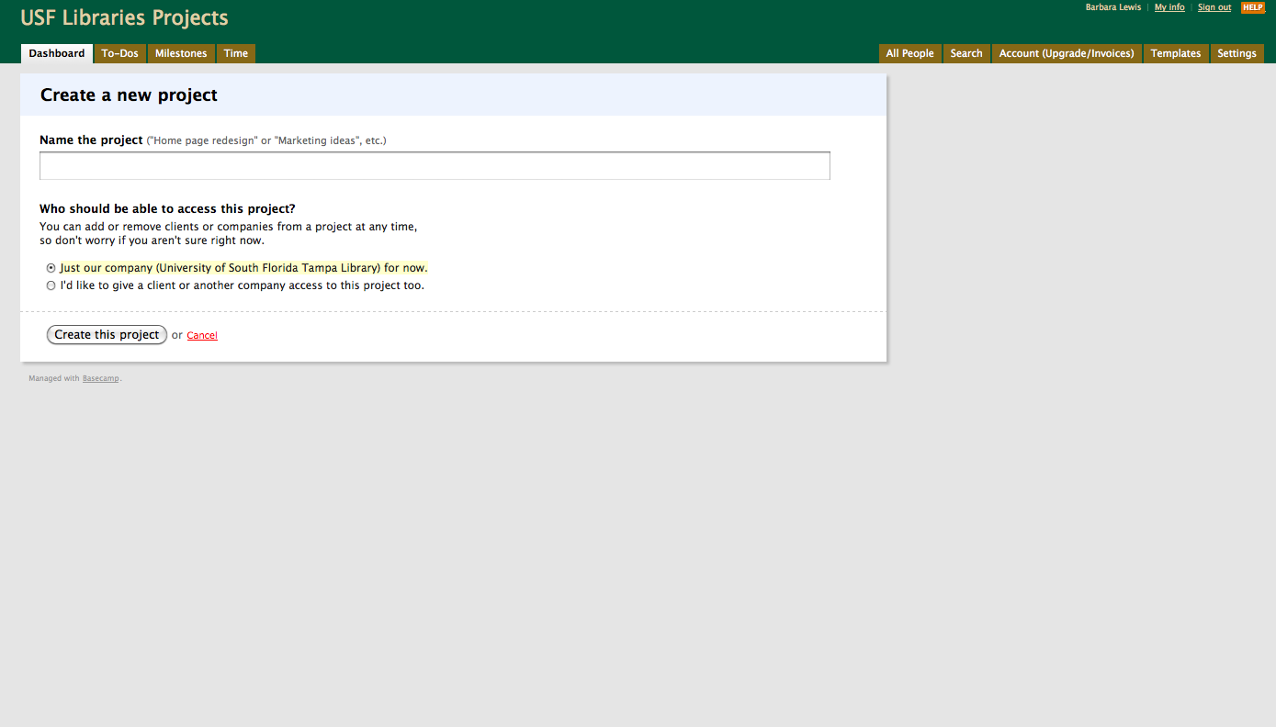

Slide 18
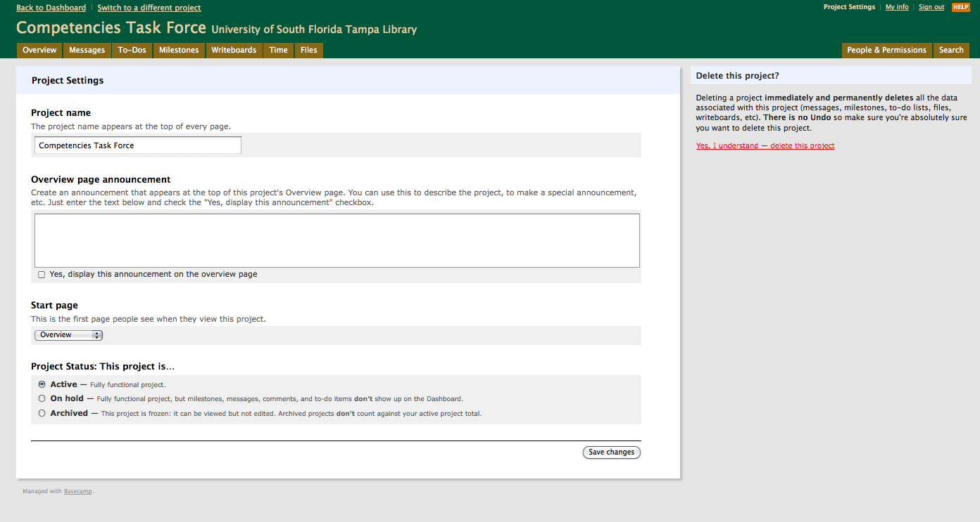

Slide 19
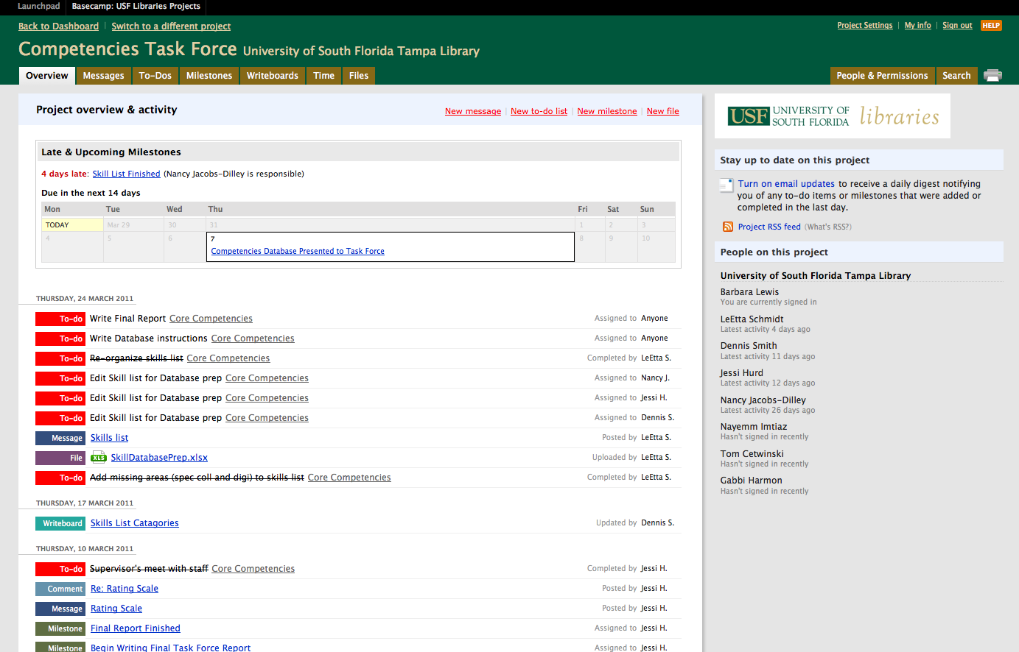

Slide 20
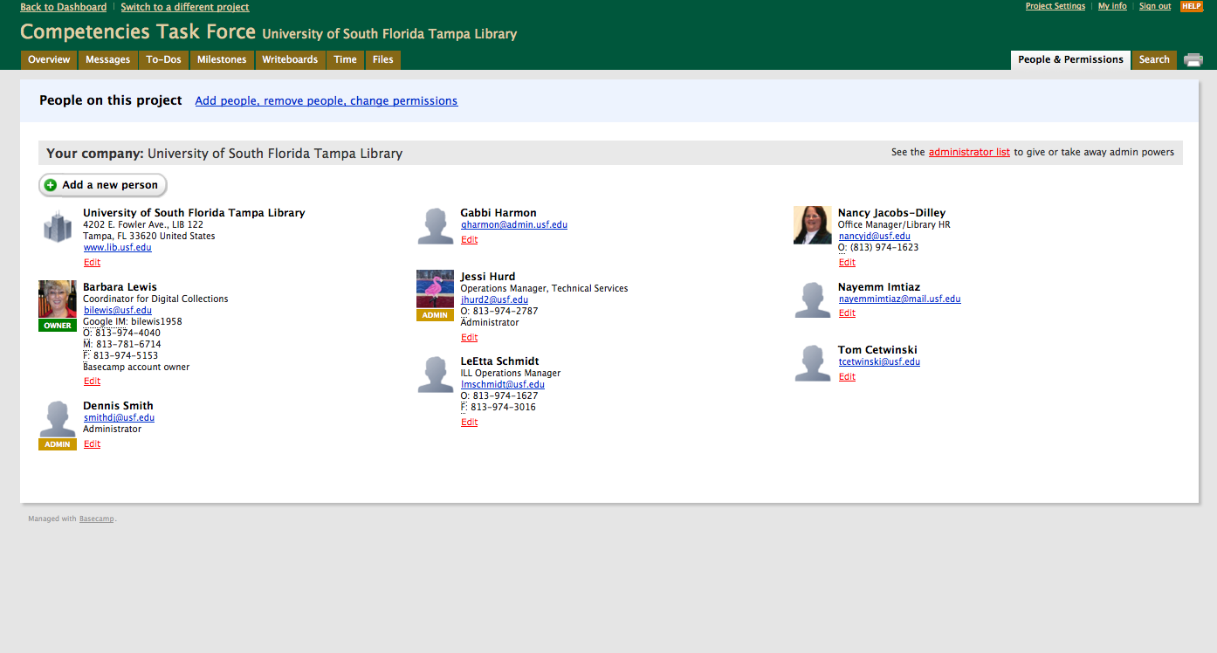

Slide 21
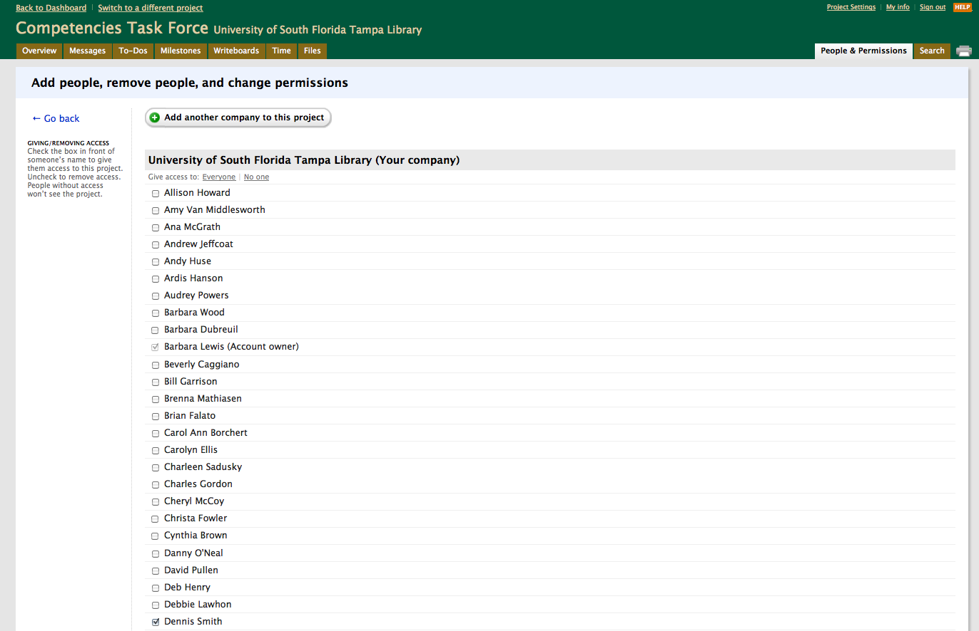

Slide 22
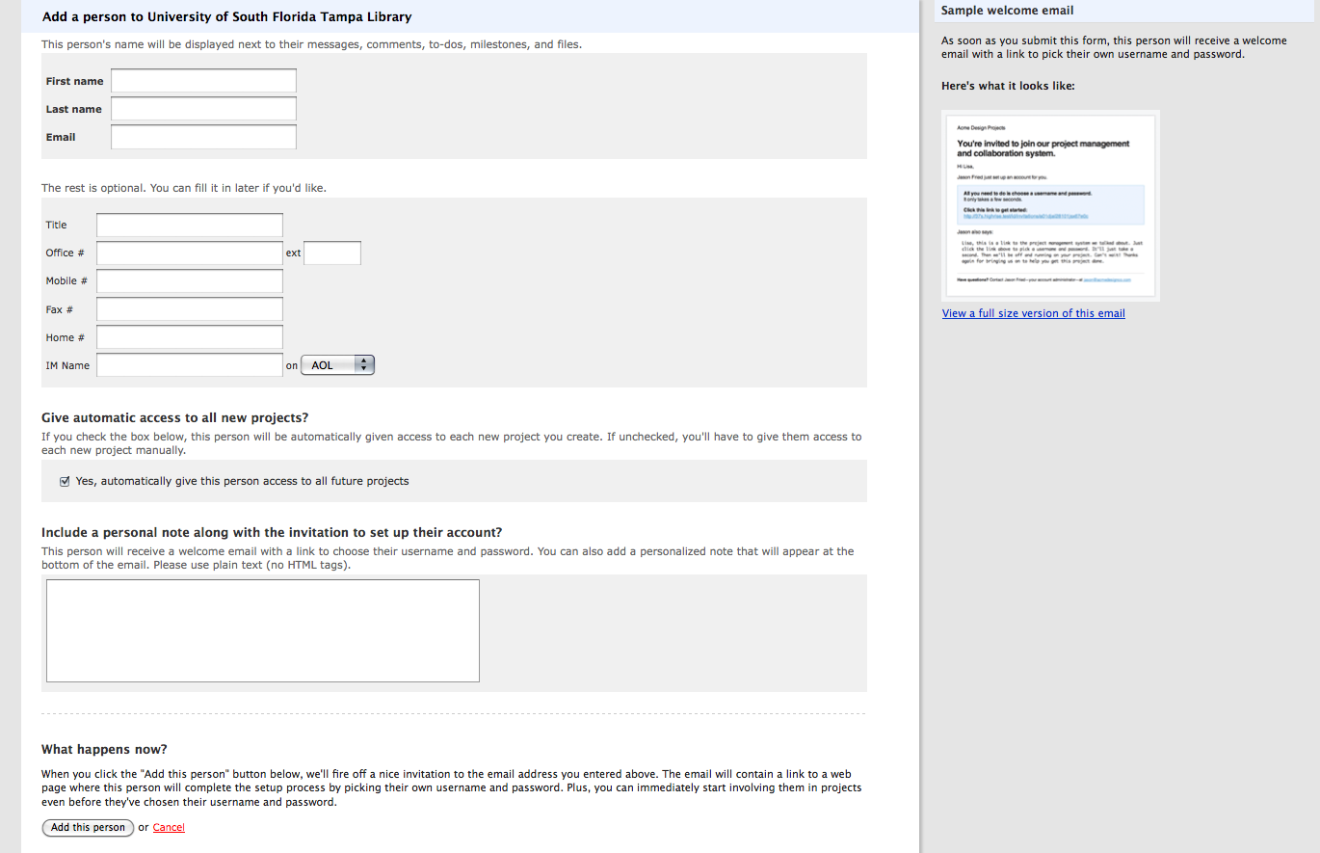

Slide 23
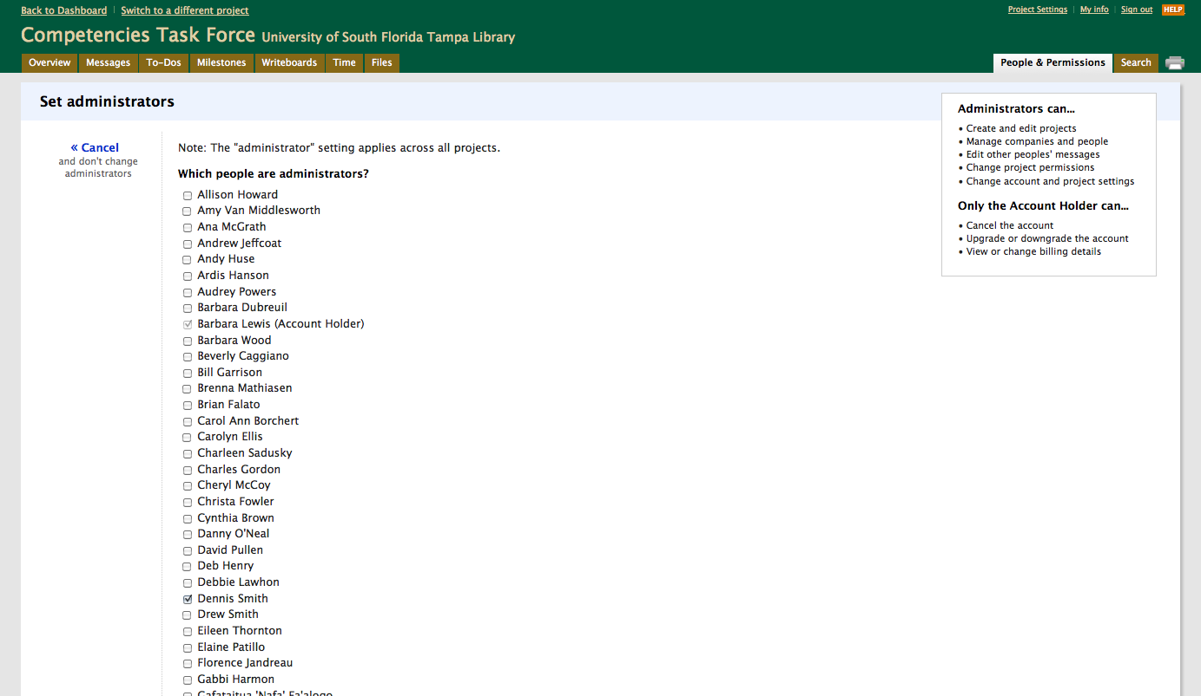

Slide 24
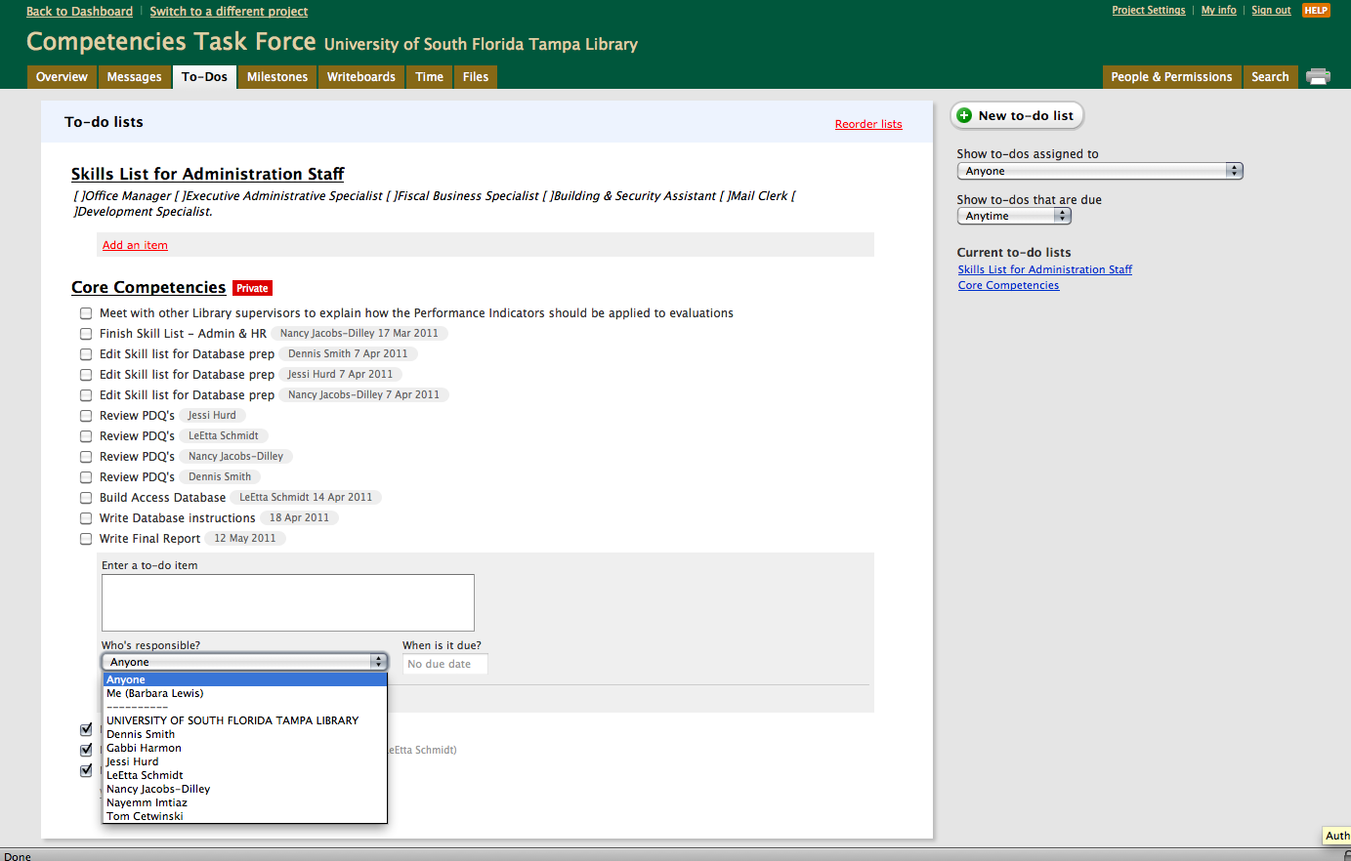

Slide 25
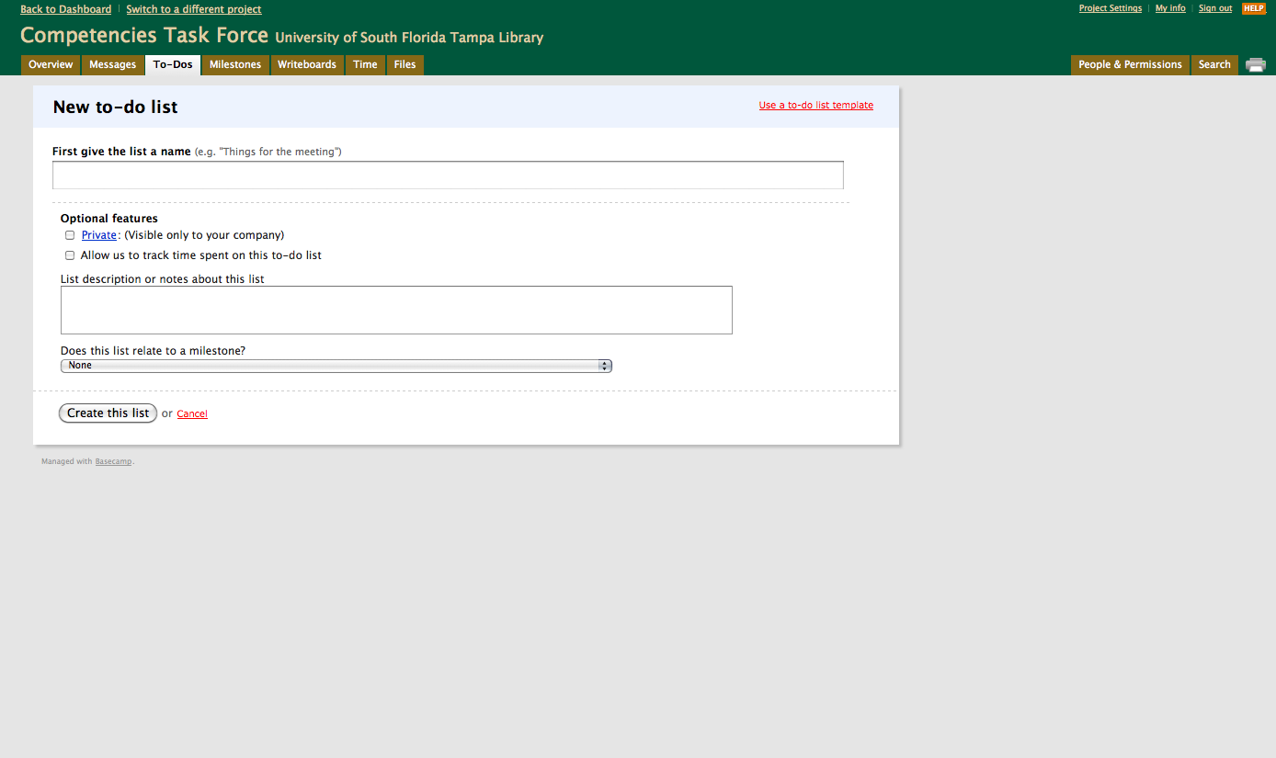

Slide 26
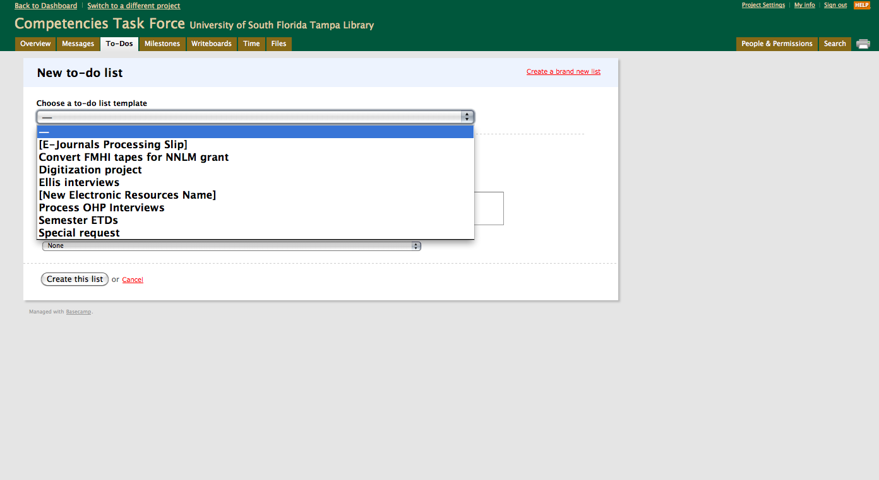

Slide 27
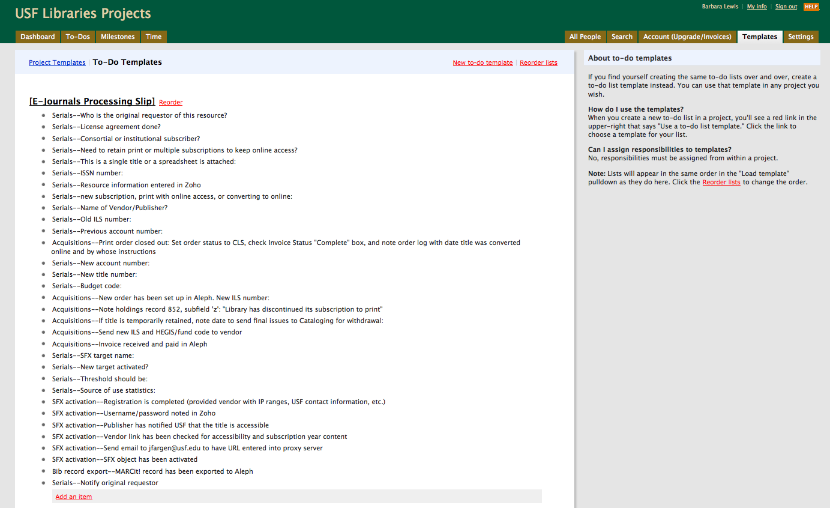

Slide 28
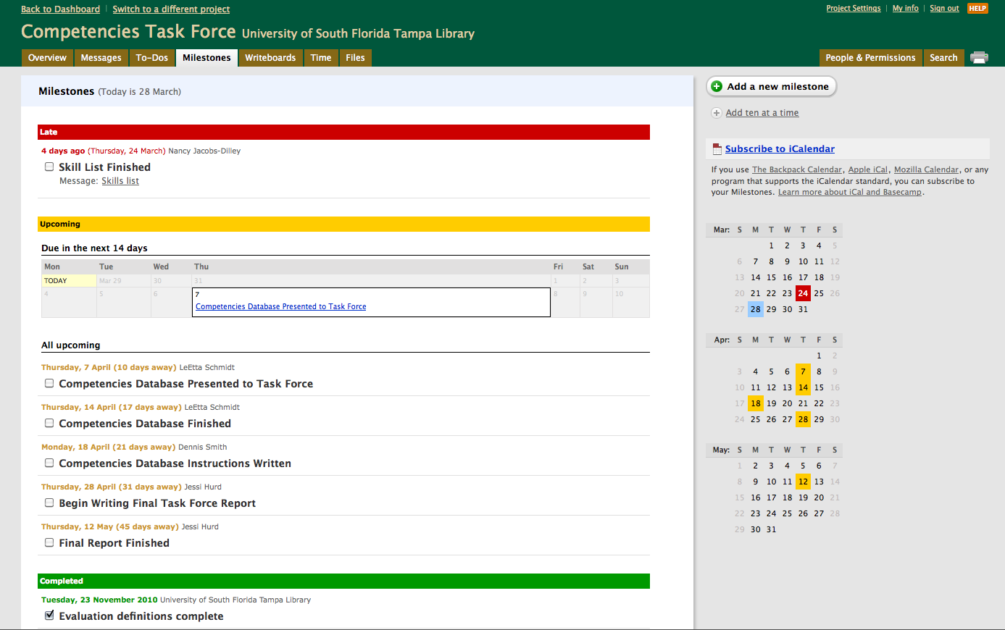

Slide 29
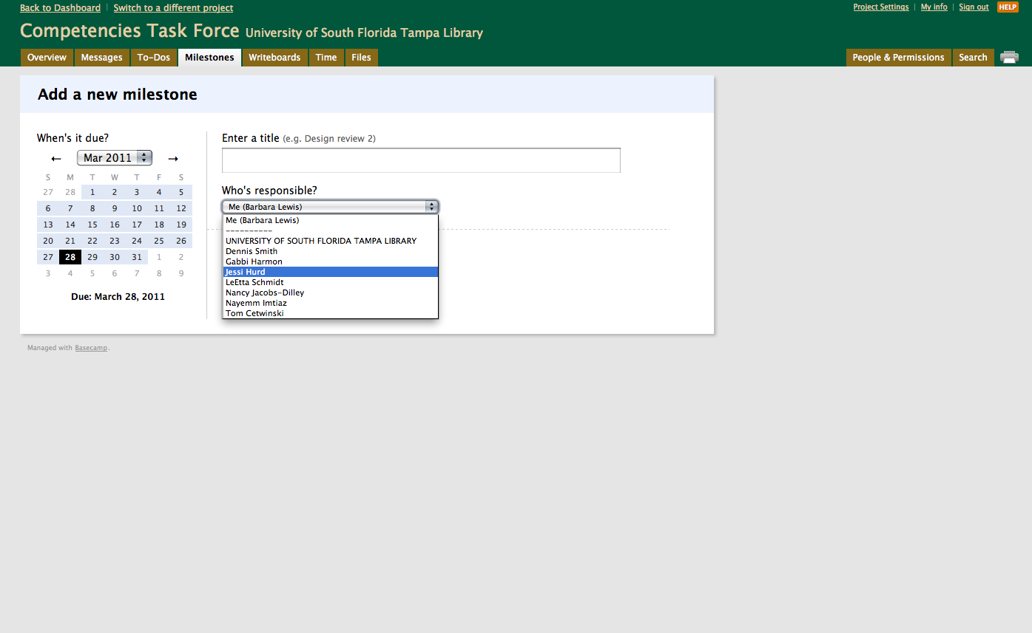

Slide 30
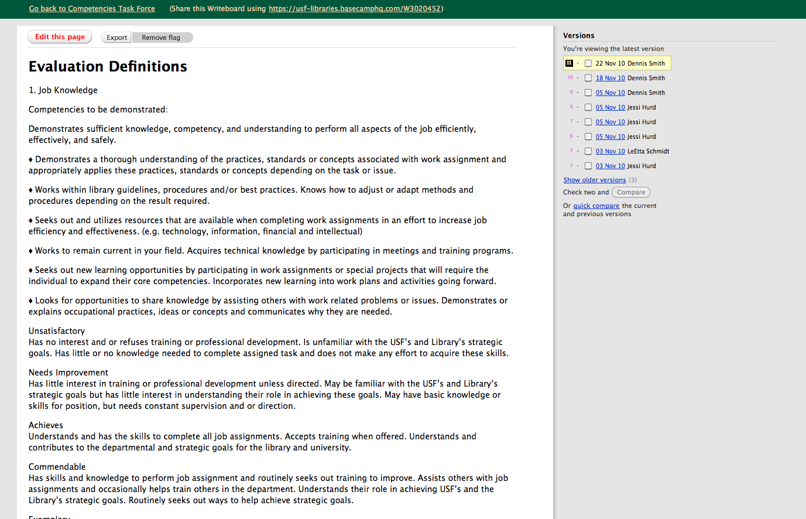

Slide 31
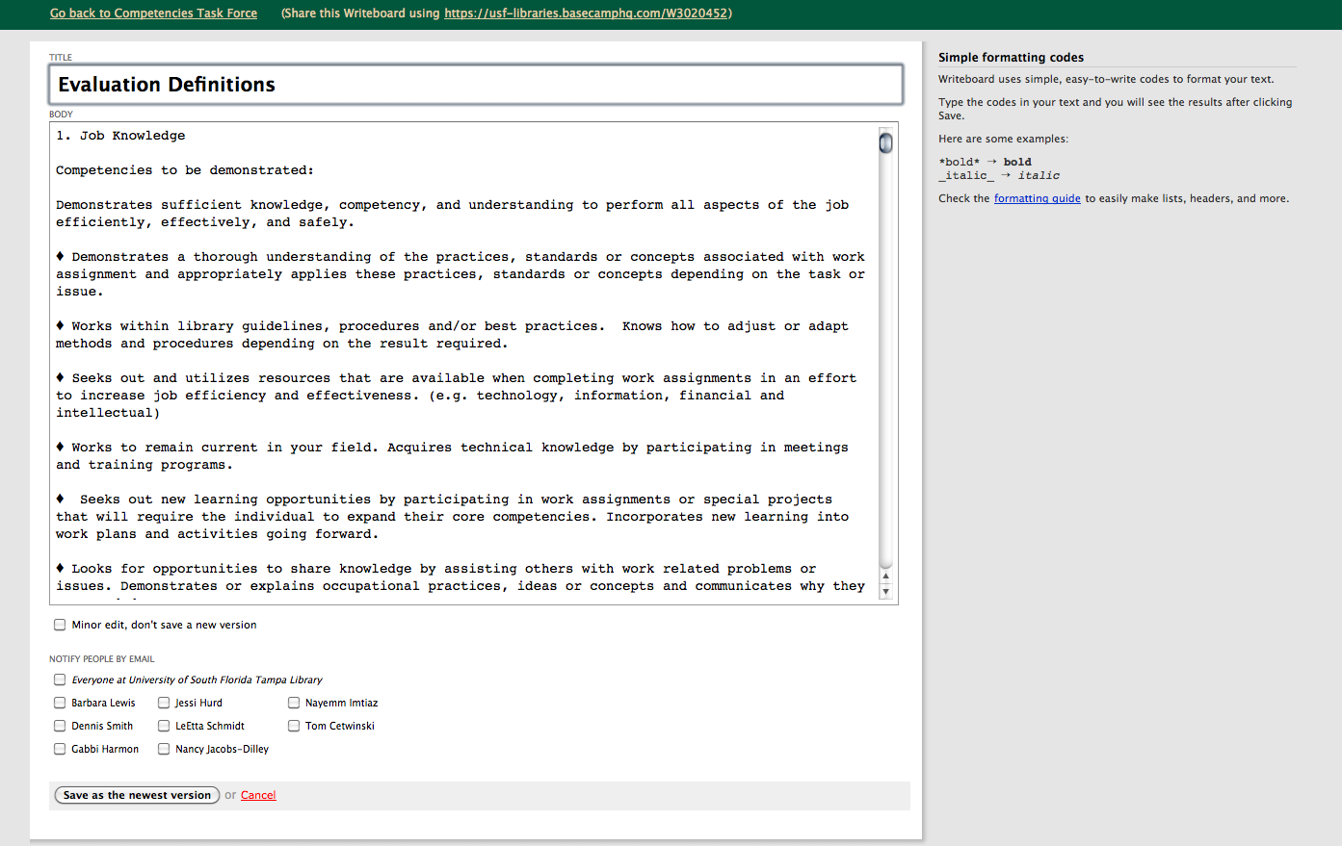

Slide 32
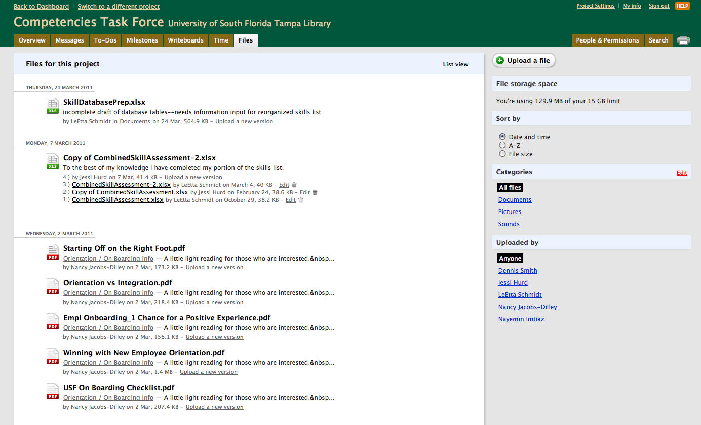

Slide 33
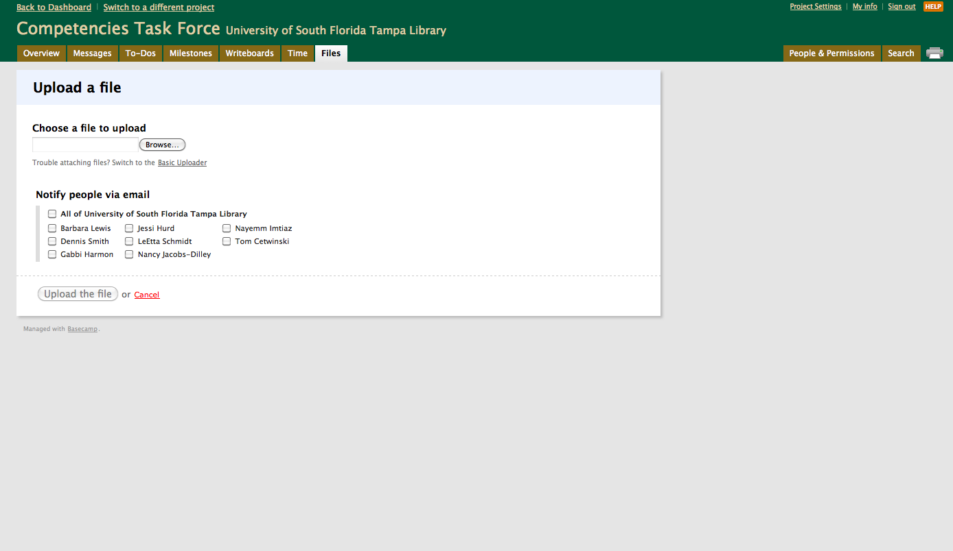

Slide 34
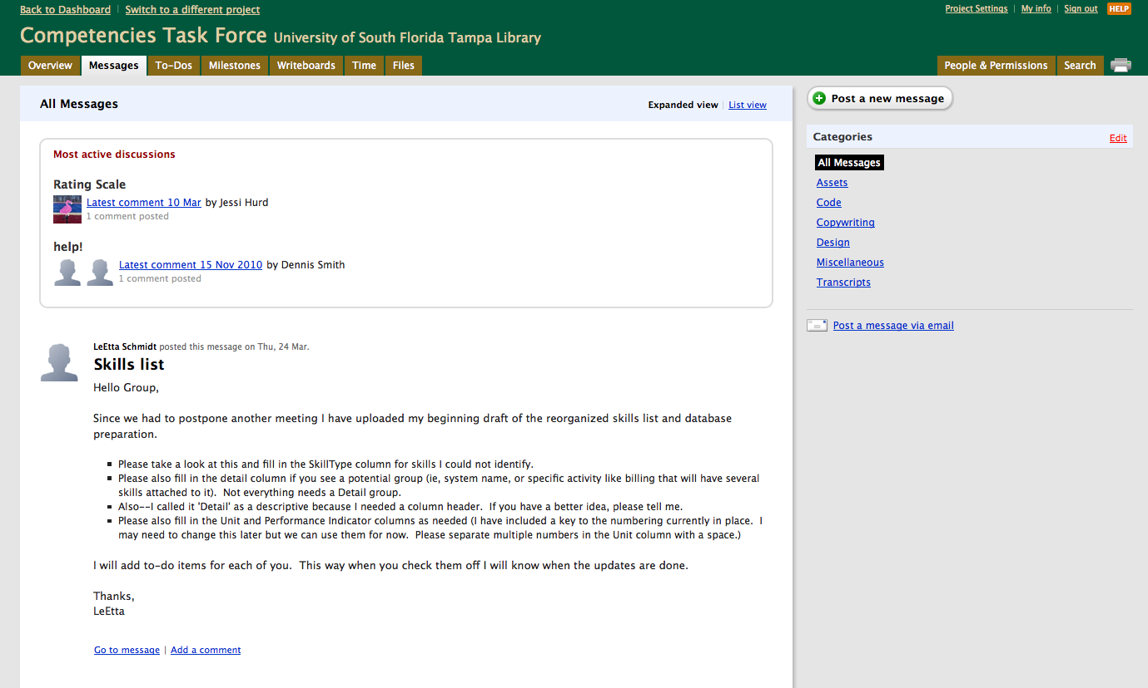

Slide 35
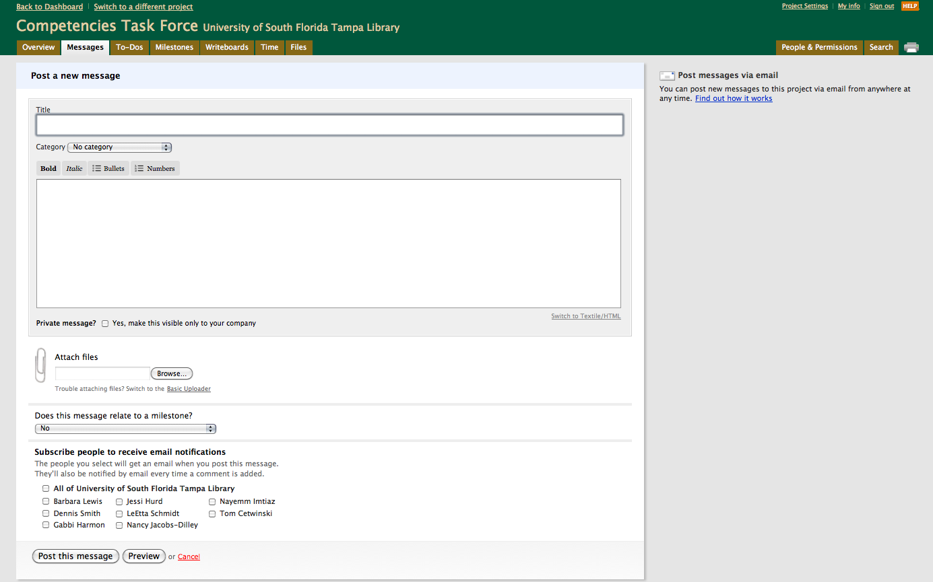

Slide 36
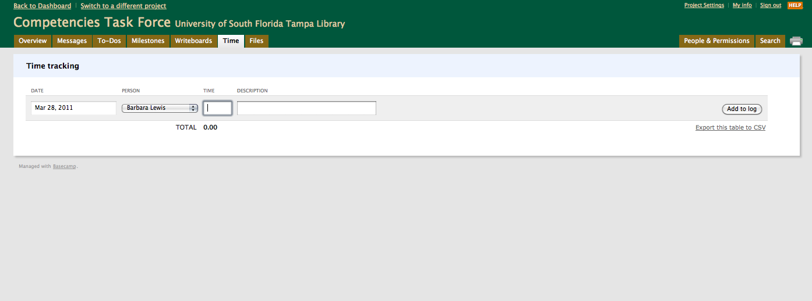

Slide 37
Using Basecamp™
Limitations
  No calendar or export for tasks
  Tasks can only be assigned to one person
  No view only users
  Search doesn’t search Writeboards
  Can’t globally change users assigned to tasks
  Can’t convert To Do list to a template

Slide 38
Suggested Resources
Project Smart
  http://www.projectsmart.co.uk/
Comparison of project management software
  http://en.wikipedia.org/wiki/Comparison_of_project_management_software
Cornell Project Management Methodology
  https://confluence.cornell.edu/display/CITPMO/Cornell+Project+Management+Methodology+%28CPMM%29

Slide 39
???

