Slide 1
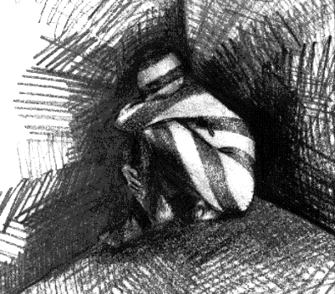
Designing Thematic Instruction with Authentic Resources:
Alienation and Assimilation
Davara Potel, Solon High School, Solon High School
Brian Kennelly, California Polytechnic State University

Slide 2
Overview
Recommended context (Alienation and Assimilation) of one of six course themes (Personal and Public Identities)
Activities
Assessment

Slide 3

Brainstorming Activity 1
How do you define alienation?
What one word comes to mind when you hear or think of “Alienation and Assimilation”?
Notes:
Use multiple points, if necessary.

Slide 4
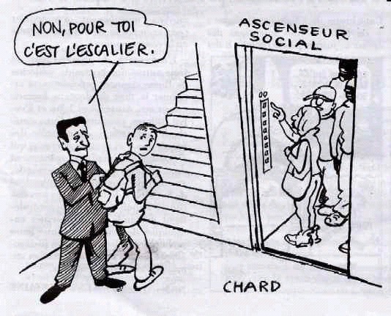
Brainstorming Activity 2
What essential questions can be asked for the context of Alienation and Assimilation?
Examples: What does alienation look like in a given society? What groups are the least assimilated? What ties exist between language and culture and assimilation? Is total cultural assimilation ever possible?
Notes:
Use multiple points, if necessary.

Slide 5
What do students need to know?
Students define key terms and indicate groups affected by alienation and/or assimilation
Students indicate groups impacted by alienation and/or assimilation
Teachers fill in with any other terms or concepts deemed necessary
Notes:
Use multiple points, if necessary.

Slide 6
Useful vocabulary
Notes:
Use multiple points, if necessary.

Slide 7
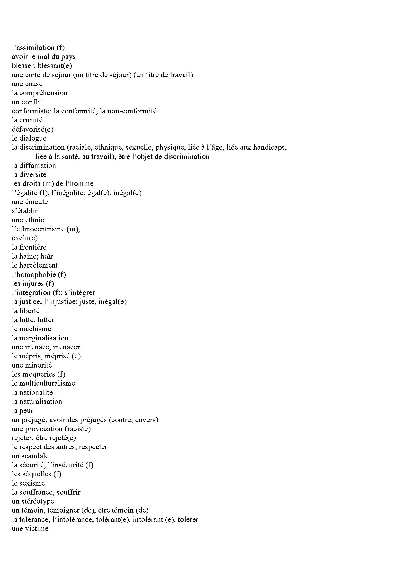

Slide 8
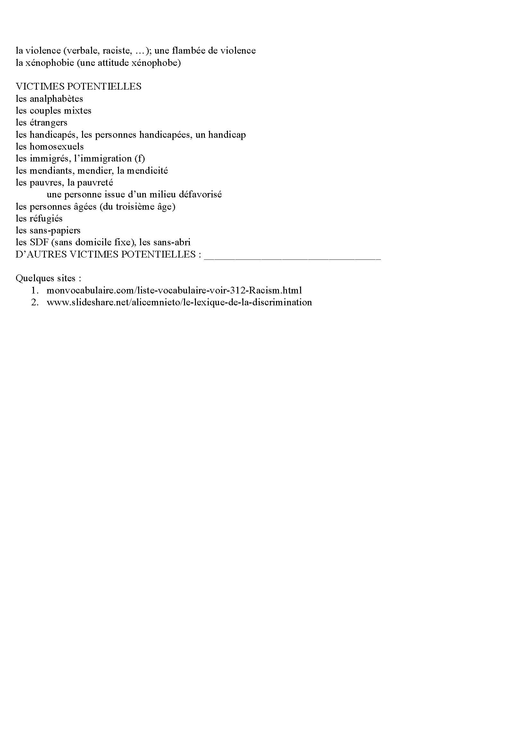

Slide 9
Student Activity
Students find authentic materials – podcasts, articles, charts, etc. – from Francophone world that reflect Alienation and Assimilation (not just immigration or Europe)
Notes:
Use multiple points, if necessary.

Slide 10
Cultural journal
Students keep cultural journal as they work through recommended context
Notes:
Use multiple points, if necessary.

Slide 11
Sample Exam: 13 Stimuli
Same theme and recommended context (Alienation and Assimilation)
AP exam item and question types
Authentic documents (except for conversations)
Francophone world
Three modes of communication

Slide 12
13 Stimuli
Promotional Material (5 questions)
Literary Text (7 questions)
Article and Chart (11 questions)
Letter (7 questions)
Audio Report and Article (10 questions)
Conversation and Chart (7 questions)
Interview (5 questions)
Instructions (5 questions)
Presentation (8 questions)
Email
Persuasive Essay
Conversation
Cultural Comparison
Notes:
Use brief bullets and discuss details verbally.

Slide 13
Promotional Material
Le Refuge (see Sample Exam)
Les Nymphéas (see Sample Exam) http://nympheas-tahiti.com/services.htm
La Nuit des Sans-Abri (see Other Sources) http://liguedesdroitsqc.org/2011/09/la-22e-nuit-des-sans-abri/
Notes:
Use brief bullets and discuss details verbally.

Slide 14
Le Refuge
Lots of potential stimuli for activities on website
http://www.le-refuge.org/
Notes:
Use brief bullets and discuss details verbally.

Slide 15

Le Refuge
Check ARG

Slide 16
Student Activities
Students find similar organizations for same topic in other Francophone parts of world then report findings back to class
Students find other examples of promotional material reflecting alienation

Slide 17
http://mcetv.fr/mon-mag/2604-detresse-des-jeunes-homosexuels-le-refuge-lance-sa-nouvelle-campagne-daffichage

Slide 18


Slide 19
Student Activity
Students find posters or images on same topic from other Francophone parts of world then report their findings
Students find posters or images reflecting alienation then report findings
Students write news article in which they identify types of alienation, victims, locations, contexts, etc.

Slide 20
Le Refuge
Reportage d'Envoyé Spécial de France 2
http://www.youtube.com/watch?v=a3pFKulntFw
Ils ont été jetés à la rue par leurs parents.
Aujourd’hui ces jeunes en ont assez de se taire, de se cacher… Les journalistes d'Envoyé Spécial sont allés à leur rencontre au Refuge de Montpellier.

Slide 21
Pre-Viewing Activity
If you could interview the person in the poster, what questions would you ask him?

Slide 22

Envoyé Spécial

Slide 23
Post-Viewing Student Activities
Students develop comprehension questions that can be asked about report
Students develop their own posters that can be used by similar organizations then compare, contrast, critique, and discuss them

Slide 24
Literary Text
“Il n’y a pas d’exil”, Assia Djebar (see Sample Exam)

Slide 25
Pre-Reading Student Activities
Presentations on “La guerre d’Algérie”
http://www.larousse.fr/encyclopedie/divers/guerre_dAlg%C3%A9rie/104808
From General: When? Why? Where?
To Specific: Explain map in context of war; explain posters in context of war; summarize information in INA video clip/s

Slide 26
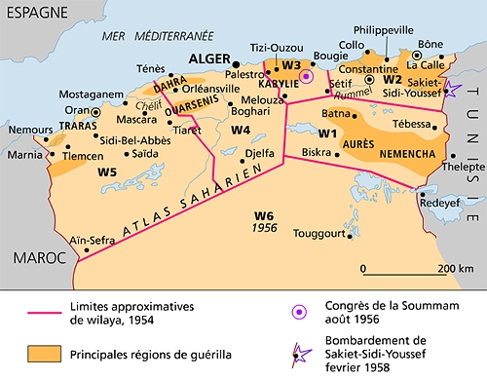

Slide 27


Slide 28


Slide 29
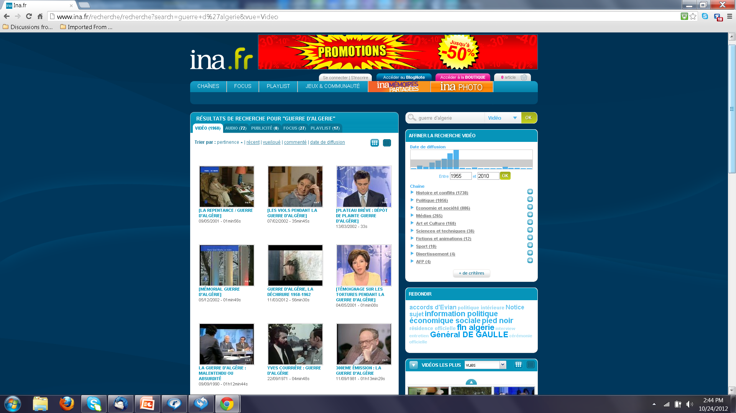

Slide 30
“Il n’y a pas d’exil”
Have French perceptions vis-à-vis war changed over time?
http://www.lemonde.fr/societe/article/2010/05/21/france-algerie-la-simple-reconnaissance-des-faits-commis-est-tres-importante_1361286_3224.html

Slide 31
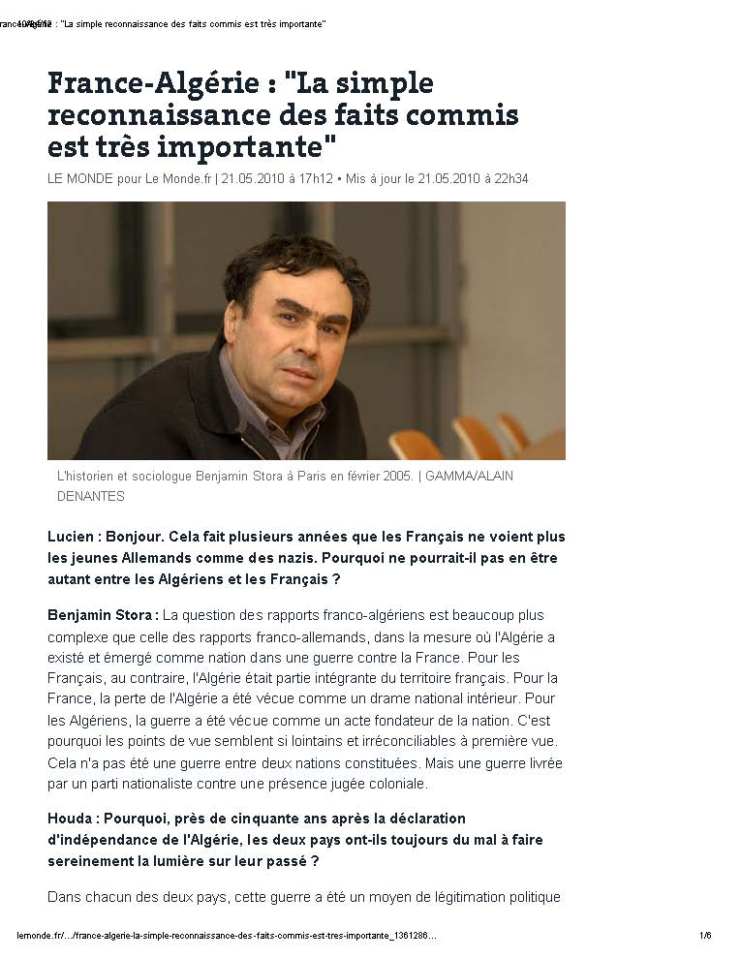

Slide 32
Il n’y a pas d’exil
Read and answer questions about the text
http://www.ablongman.com/samplechapter/0132413922.pdf

Slide 33
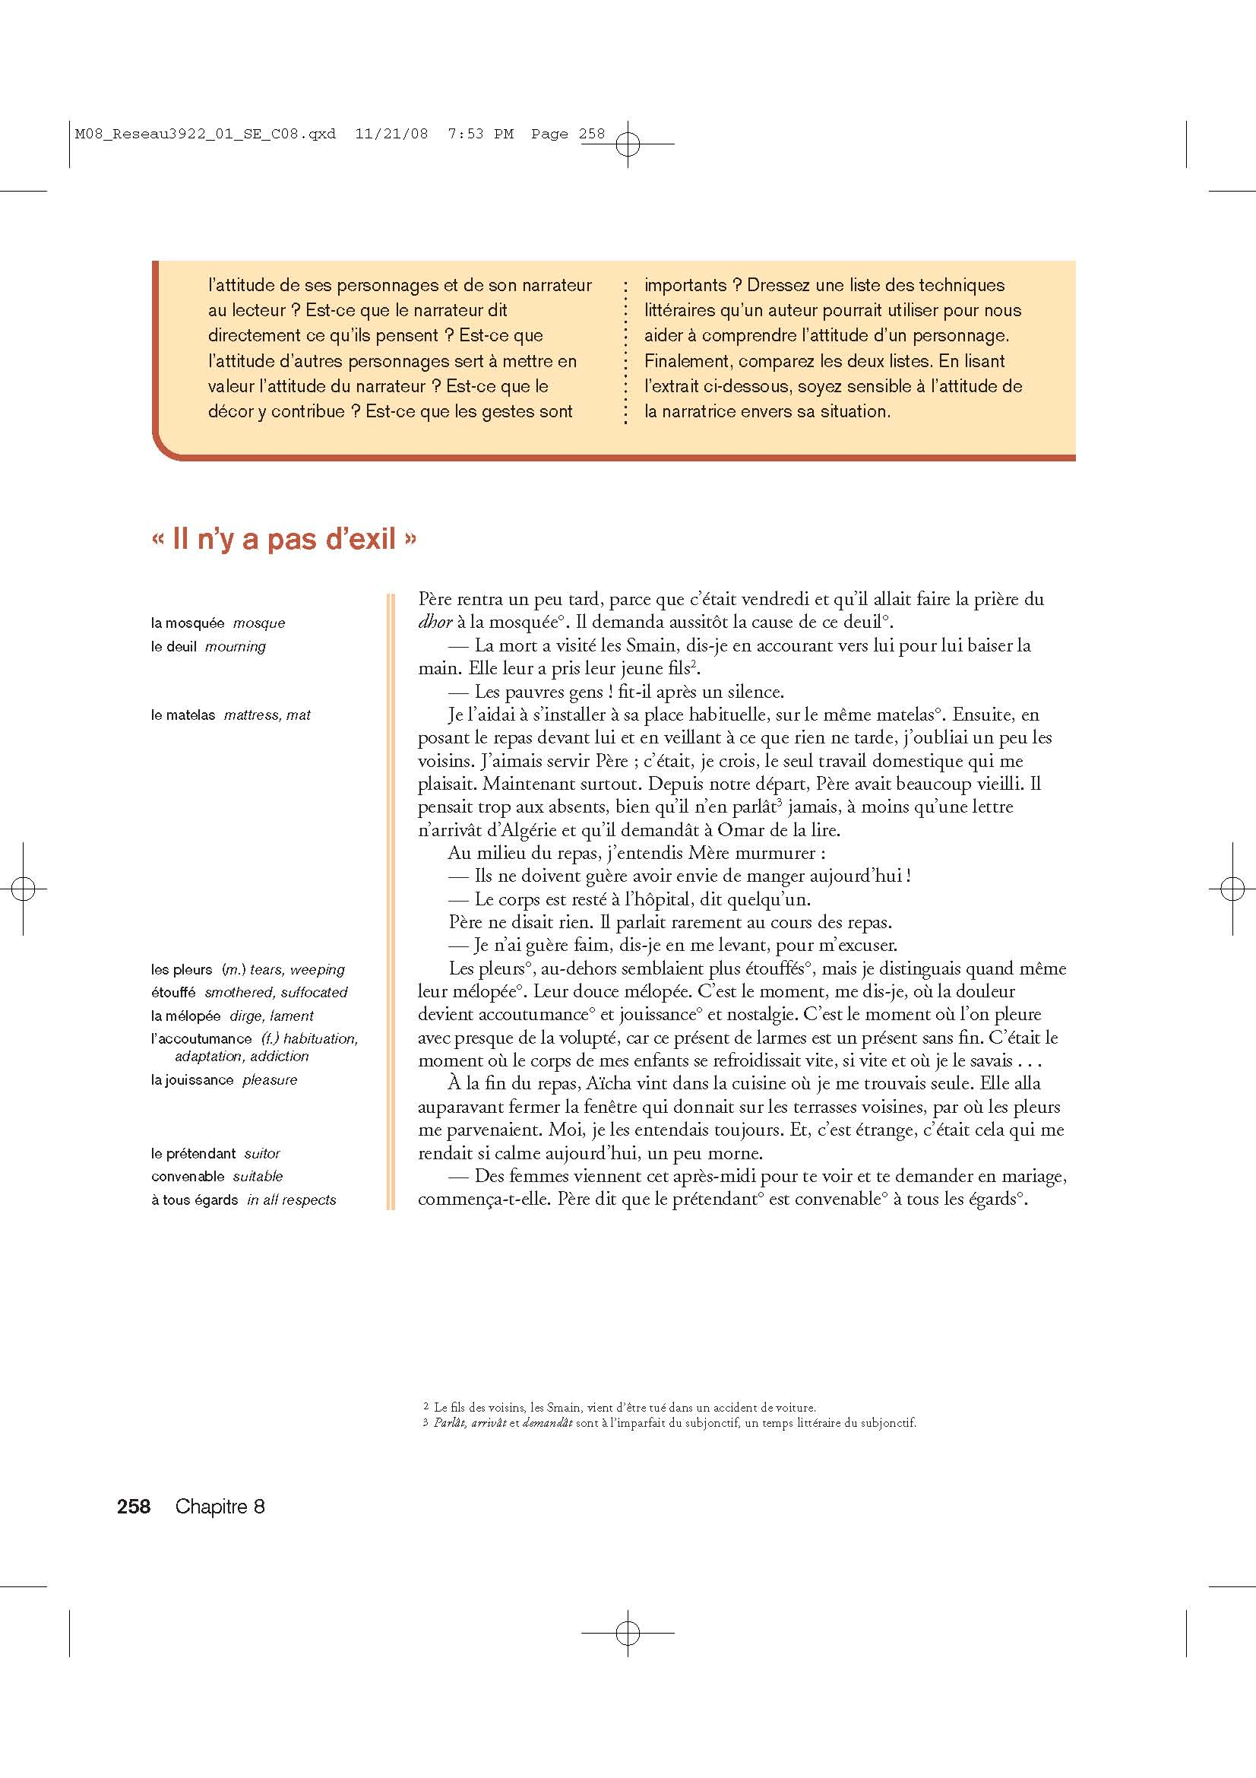

Slide 34
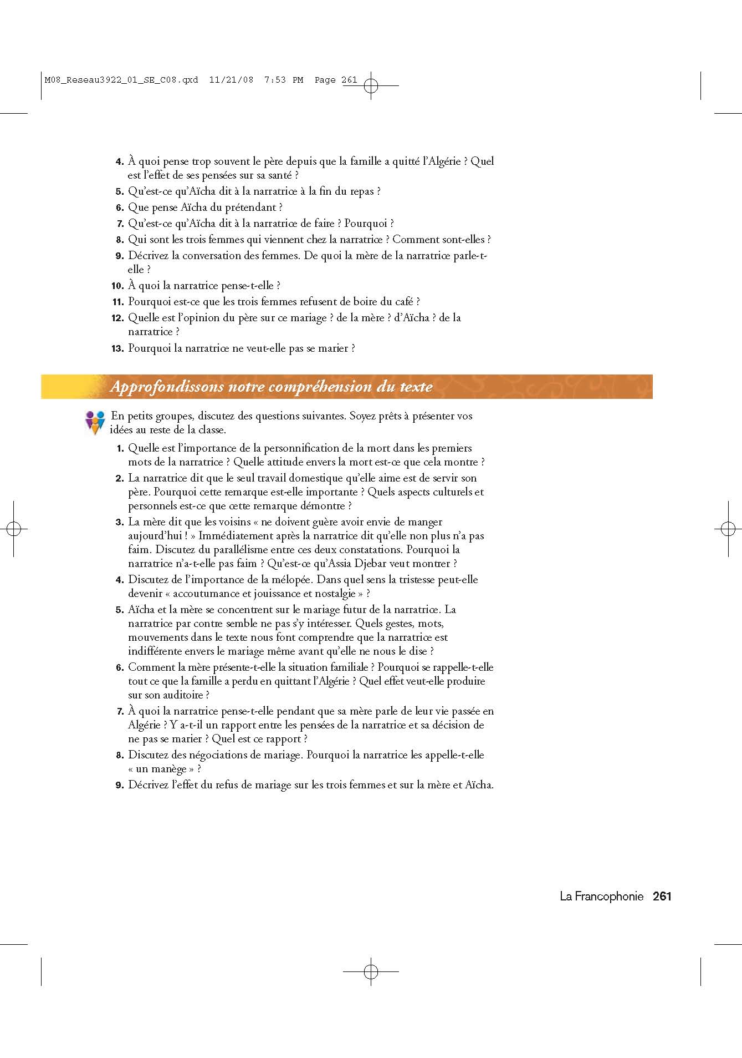

Slide 35
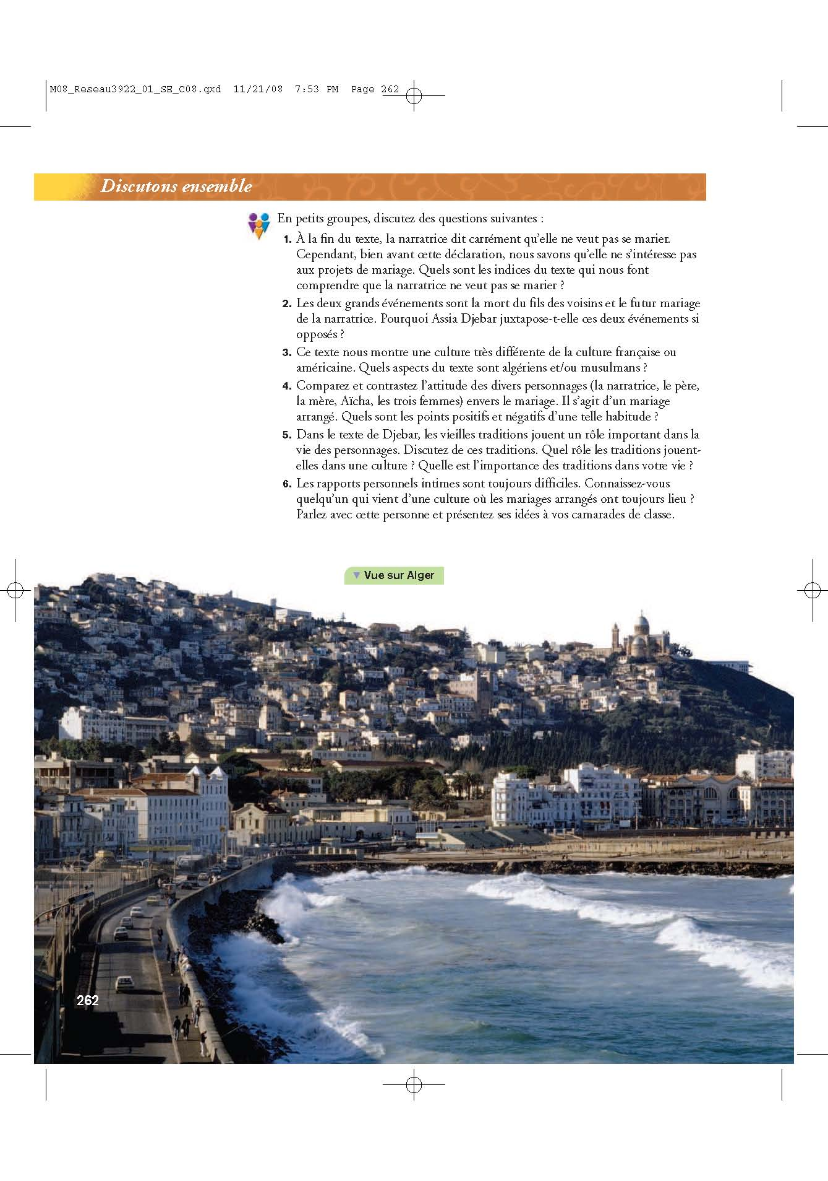

Slide 36
Extension Student Activity
Djebar as “immortelle” (Académie Française)
“Discours de réception” (22 juin 2006)
http://www.canalacademie.com/ida845-Reception-d-Assia-Djebar-a-l-Academie-francaise-par-Pierre-Jean-Remy.html

Slide 37
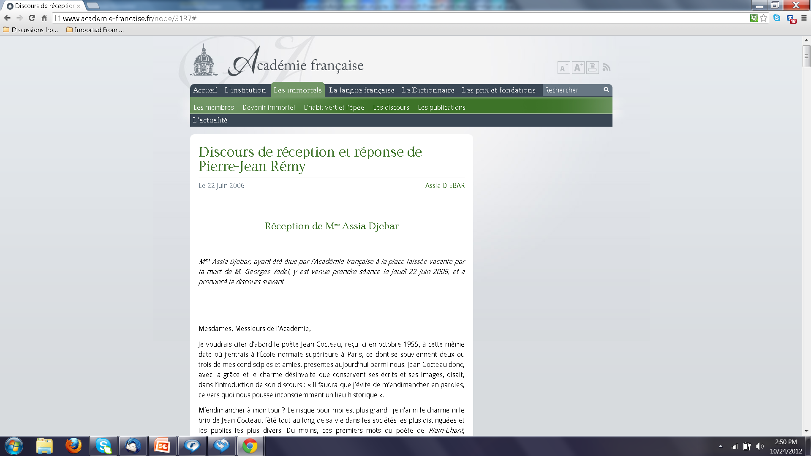

Slide 38
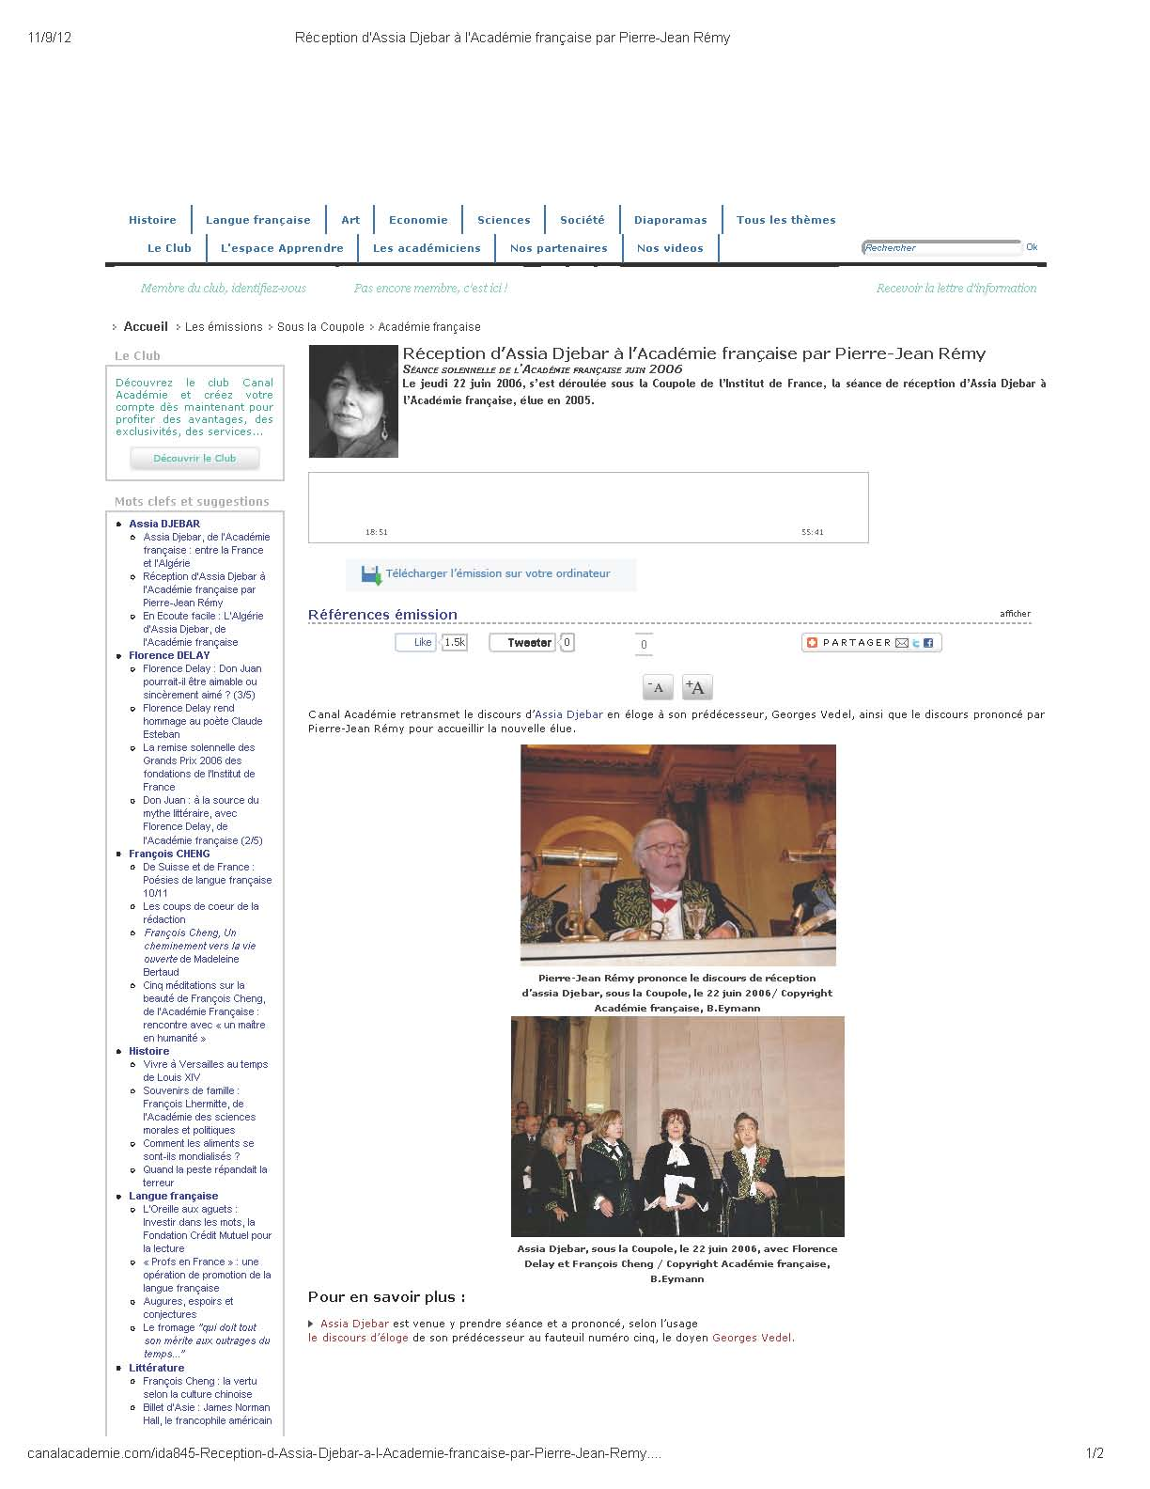

Slide 39
Ourika & Vénus noire
http://www.bmlisieux.com/archives/ourika01.htm
Students read, compare, and discuss Extracts 1 and 2
Students watch interview about film, Vénus noire, then read article/s

Slide 40
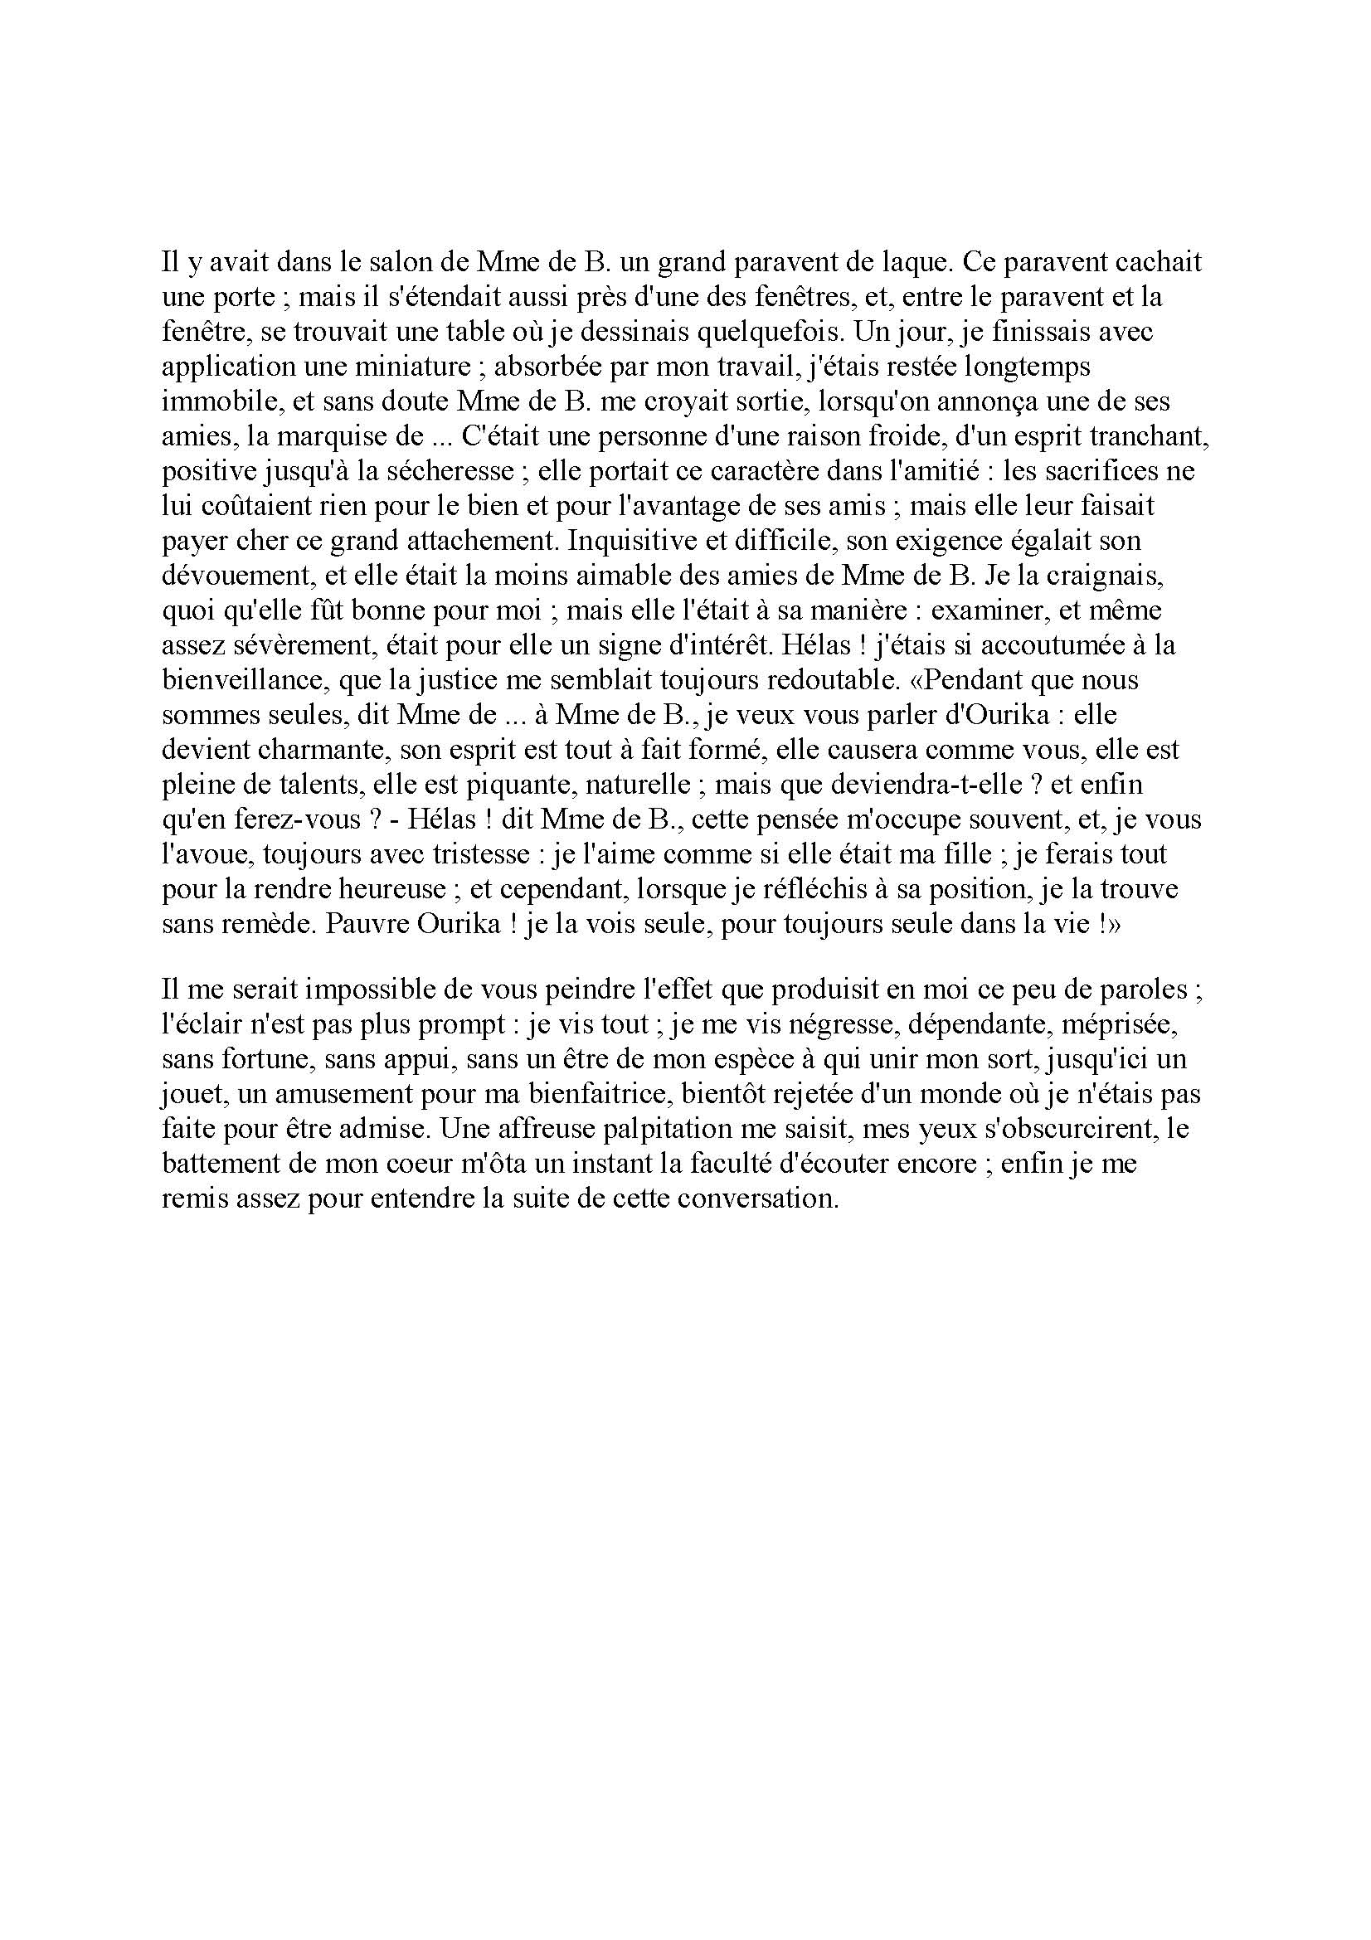

Slide 41
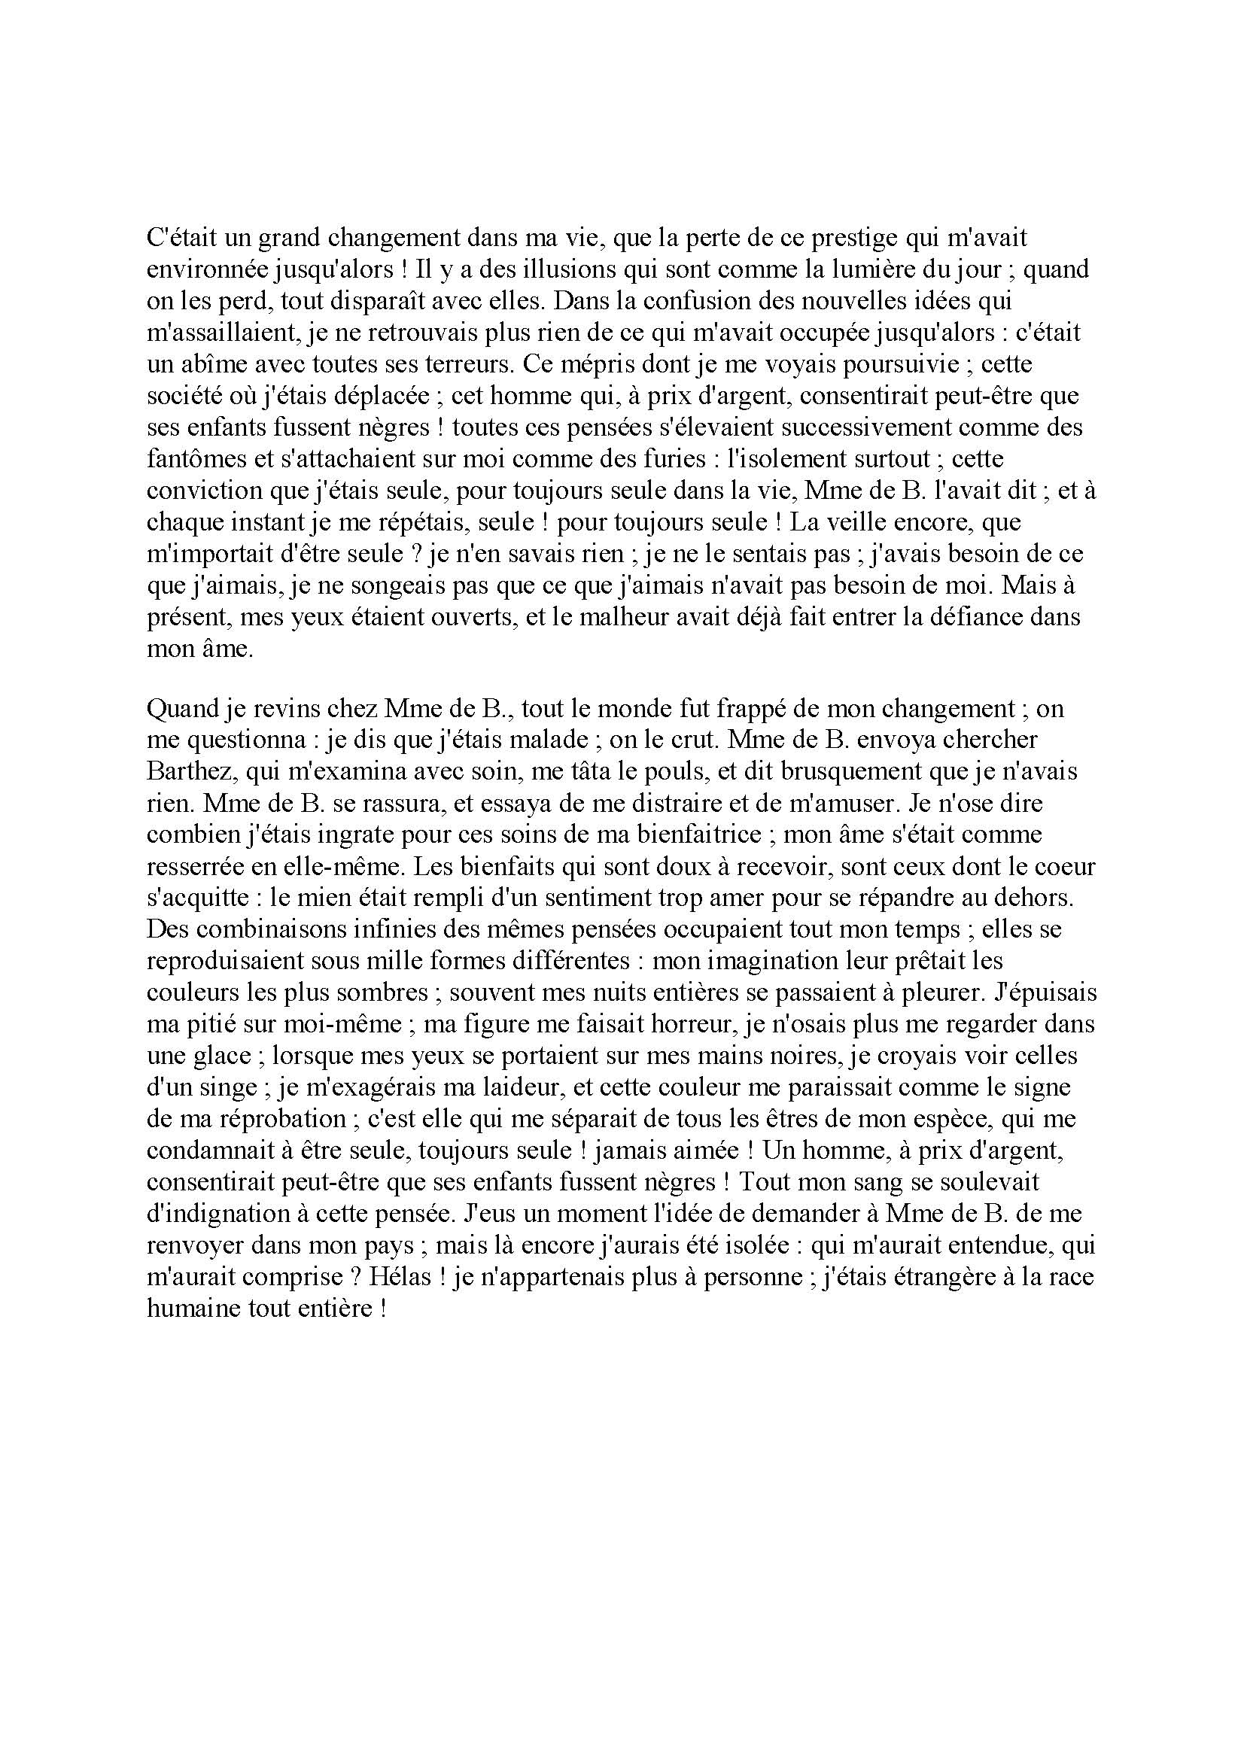

Slide 42
Student Activities
Watch interview
Read and discuss article/s

Slide 43
Interview
"Yahima Torres: Je suis la Vénus noire victime du racisme" http://www.youtube.com/watch?v=ocy4UjYOfnM
8 minutes, 8 seconds

Slide 44
Article/s
La véritable histoire de la "Vénus Noire"
http://www.lexpress.fr/actualite/societe/histoire/la-veritable-histoire-de-la-venus-noire_930758.html
Vénus Noire: la Vénus dérangeante et bouleversante de Kechich http://www.lemonde.fr/cinema/article/2010/10/26/venus-noire-la-venus-derangeante-et-bouleversante-de-kechiche_1431368_3476.html

Slide 45
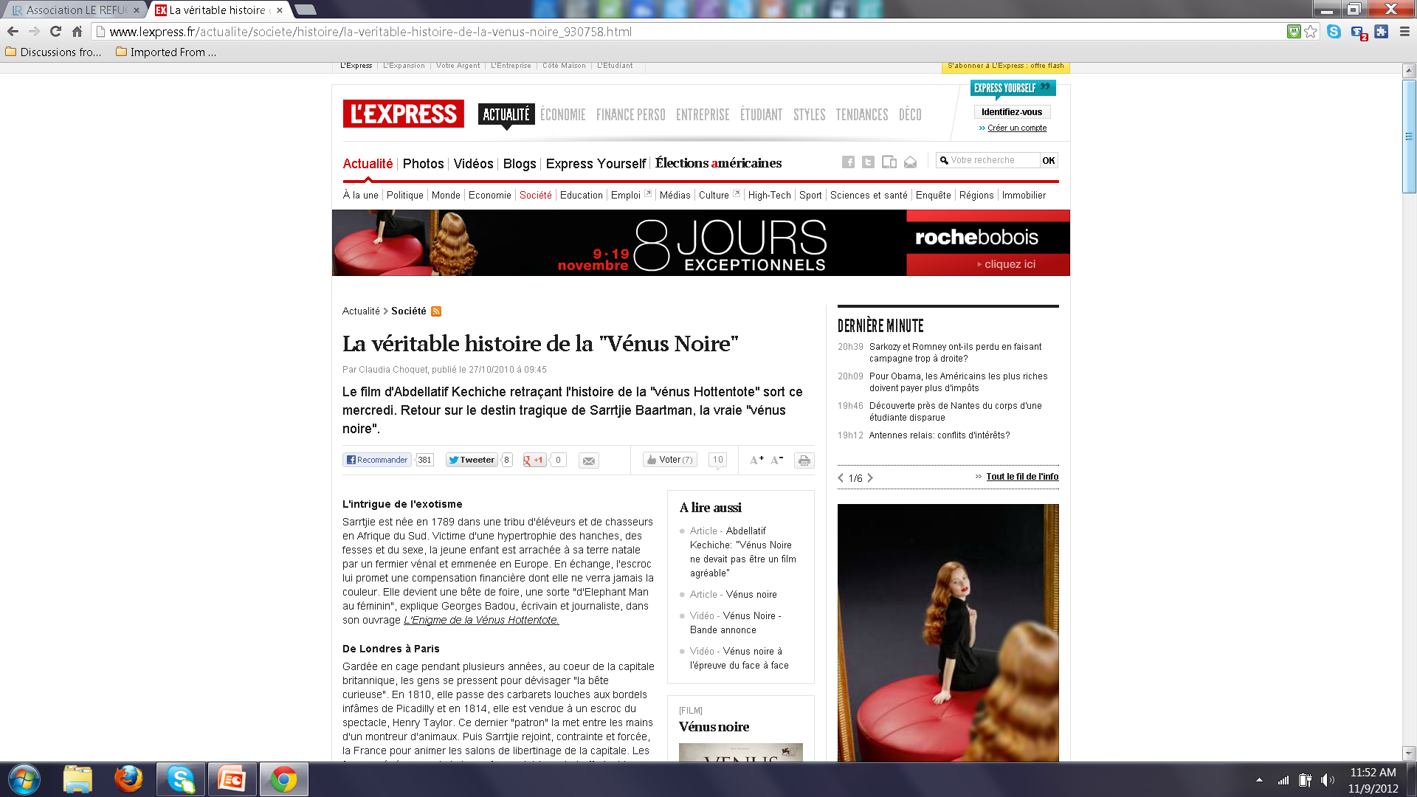

Slide 46
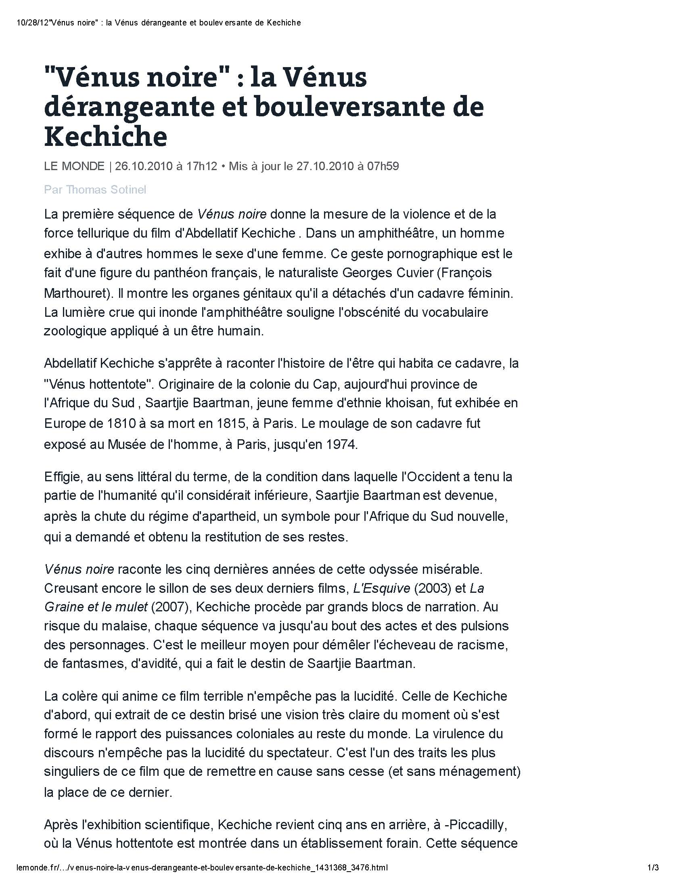

Slide 47
Article and Chart
http://www.linfo.re/-Societe-/Des-maraudes-sociales-pour-secourir-les-SDF?ps=589905
http://www.insee.fr/fr/ffc/docs_ffc/IP893.pdf

Slide 48
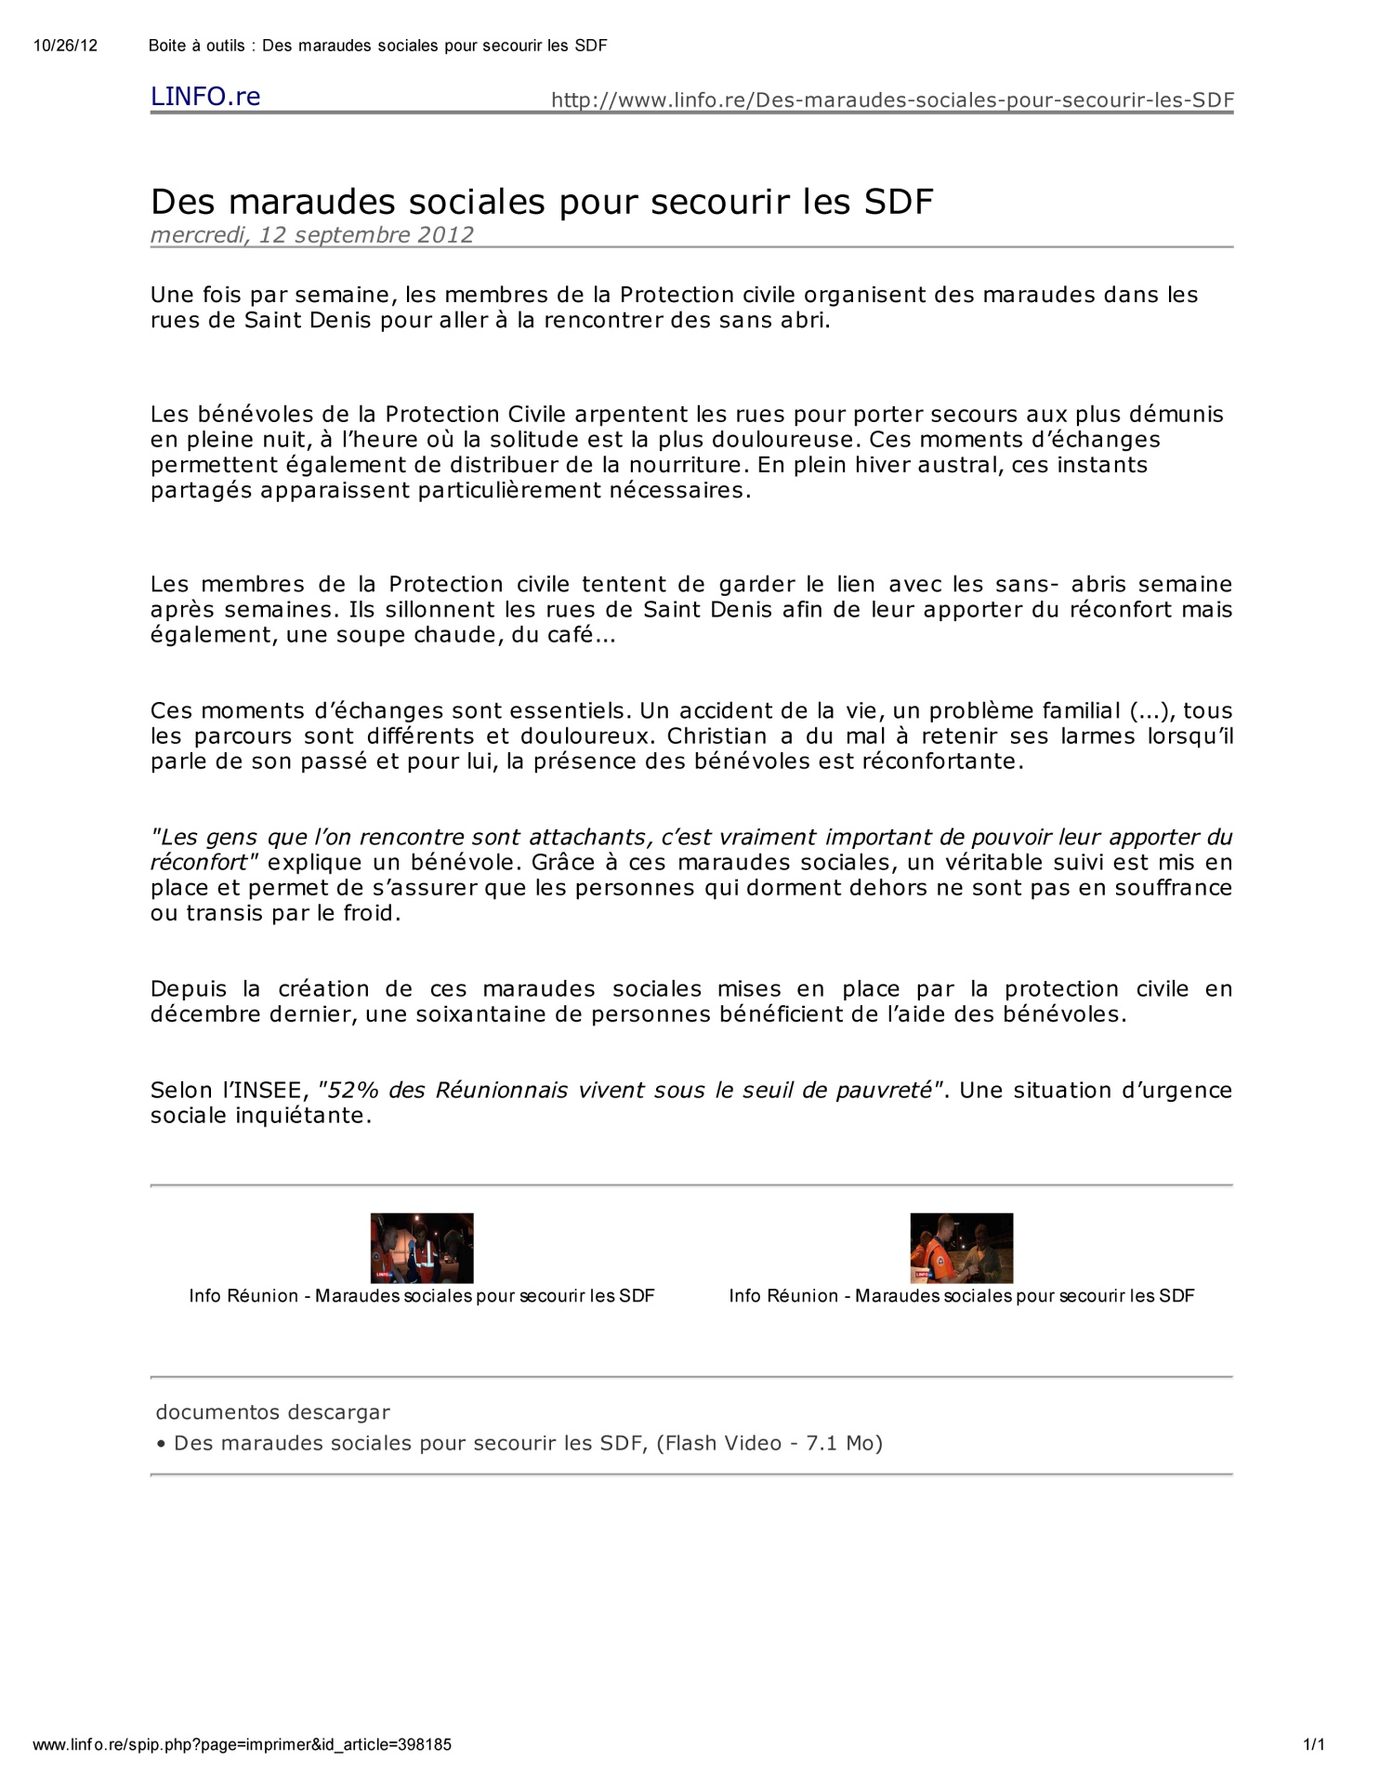

Slide 49
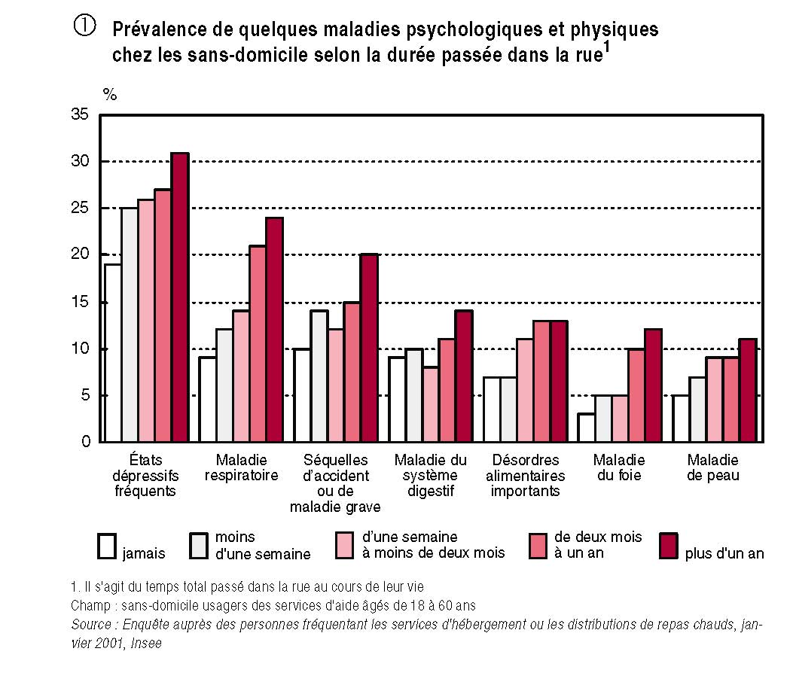

Slide 50
Student Activities
Individual or small-group selection of Francophone location
Students conduct research on homelessness in that Francophone area
Students report findings and take notes
Small groups draw conclusions based on reports
In which Francophone country is homelessness the biggest problem? Why? What can be done to solve it? How?
Is homelessness somehow tied to culture?

Slide 51
Letter
www.mix-cite.org/.../Lettre_adressee_aux_maisons_d'editions.doc

Slide 52
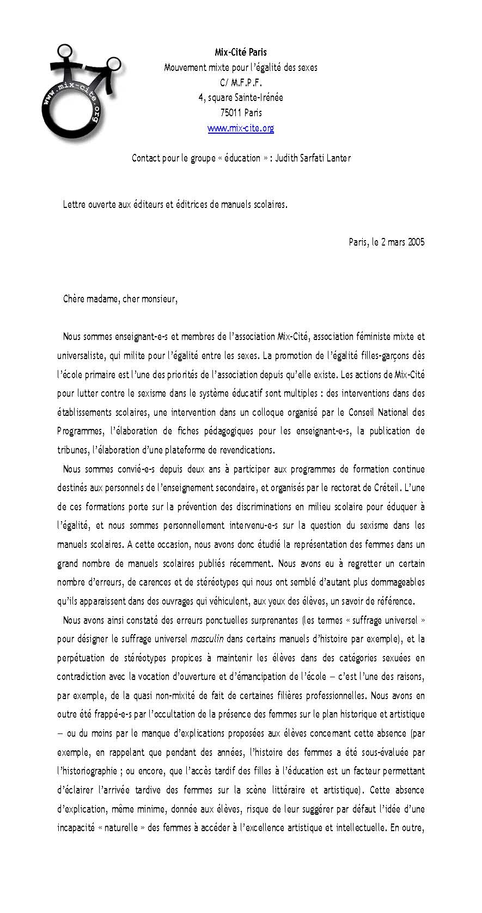

Slide 53
Student Activities
Identify purpose of letter
Identify supporting examples
Make comparisons with their community

Slide 54
Audio Report and Article
La beauté est-elle vraiment un "plus" pour trouver du travail
http://www.franceinfo.fr/economie/c-est-mon-boulot/la-beaute-est-elle-vraiment-un-plus-pour-trouver-du-travail-588957-2012-04-17
La tyrannie de l’apparence
http://www.psychologies.com/Beaute/Image-de-soi/Complexes/Articles-et-Dossiers/Se-reconcilier-avec-son-corps/La-tyrannie-de-l-apparence/4La-tete-de-l-emploi

Slide 55
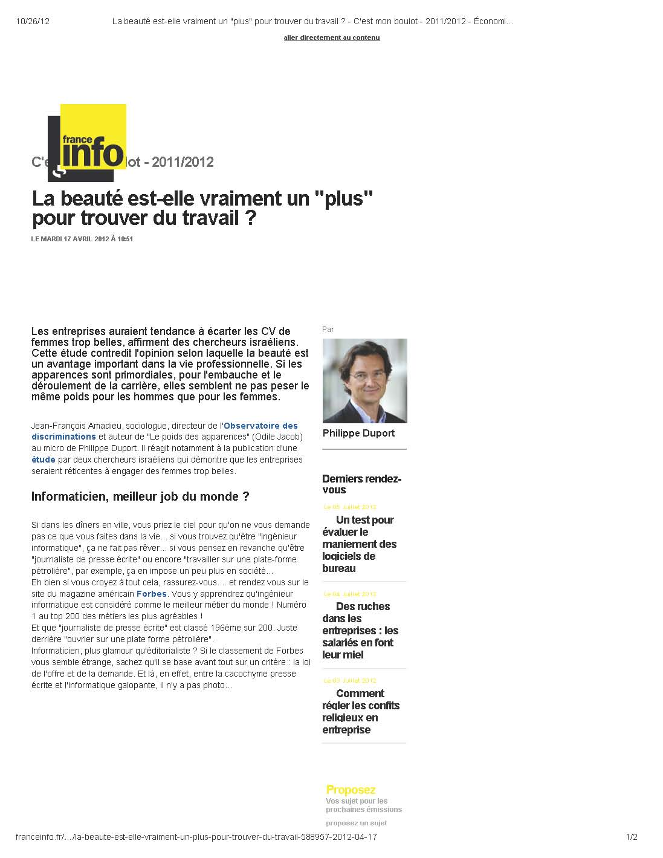

Slide 56
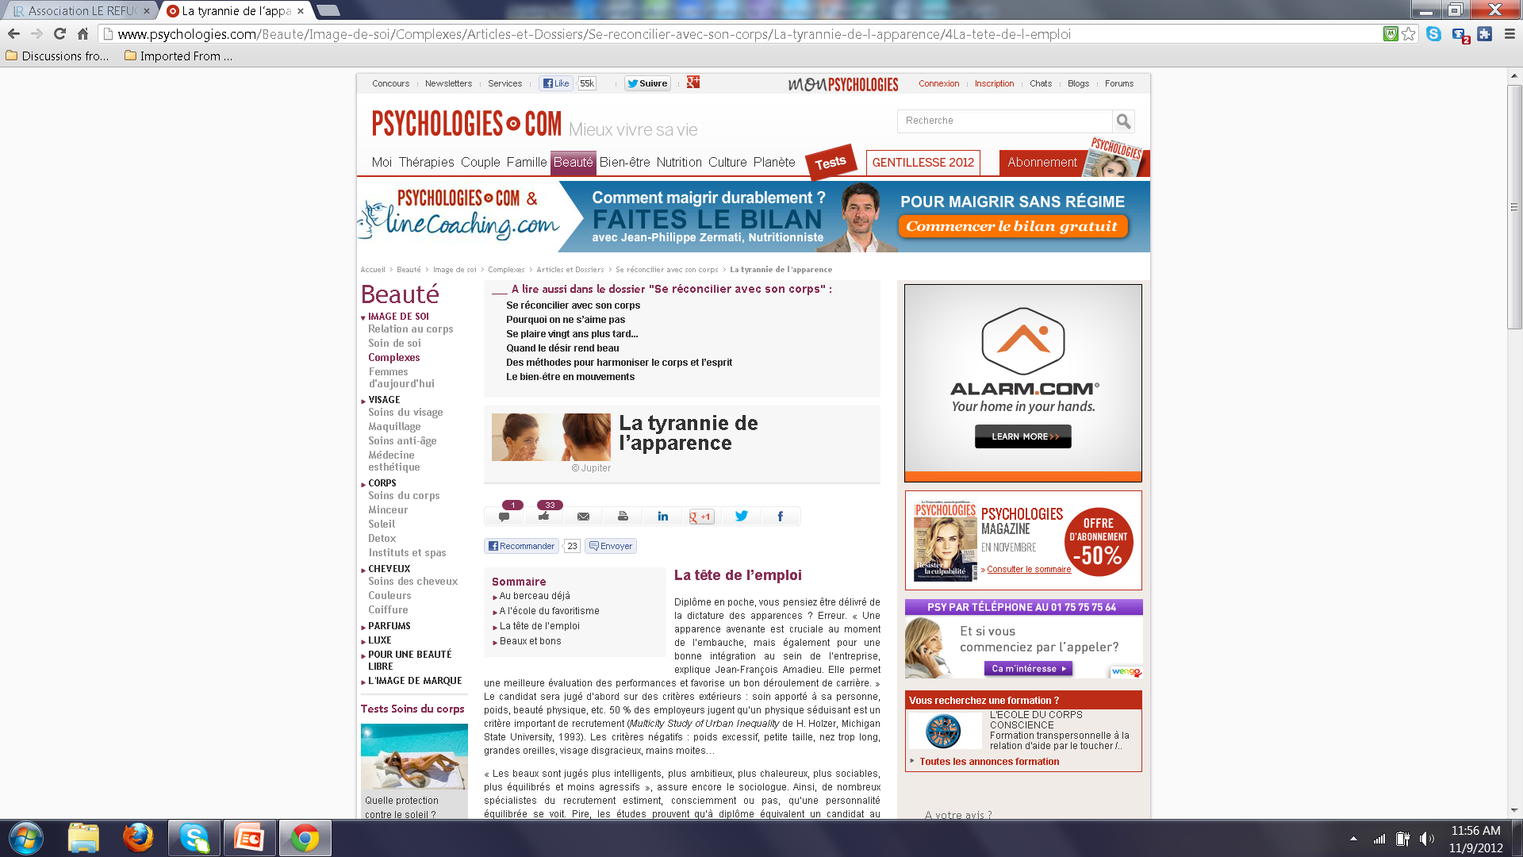

Slide 57
Student Activity
What is the relationship between Audio Report and Article?

Slide 58

Conversation and Chart
Charts available at INSEE, for example

Slide 59
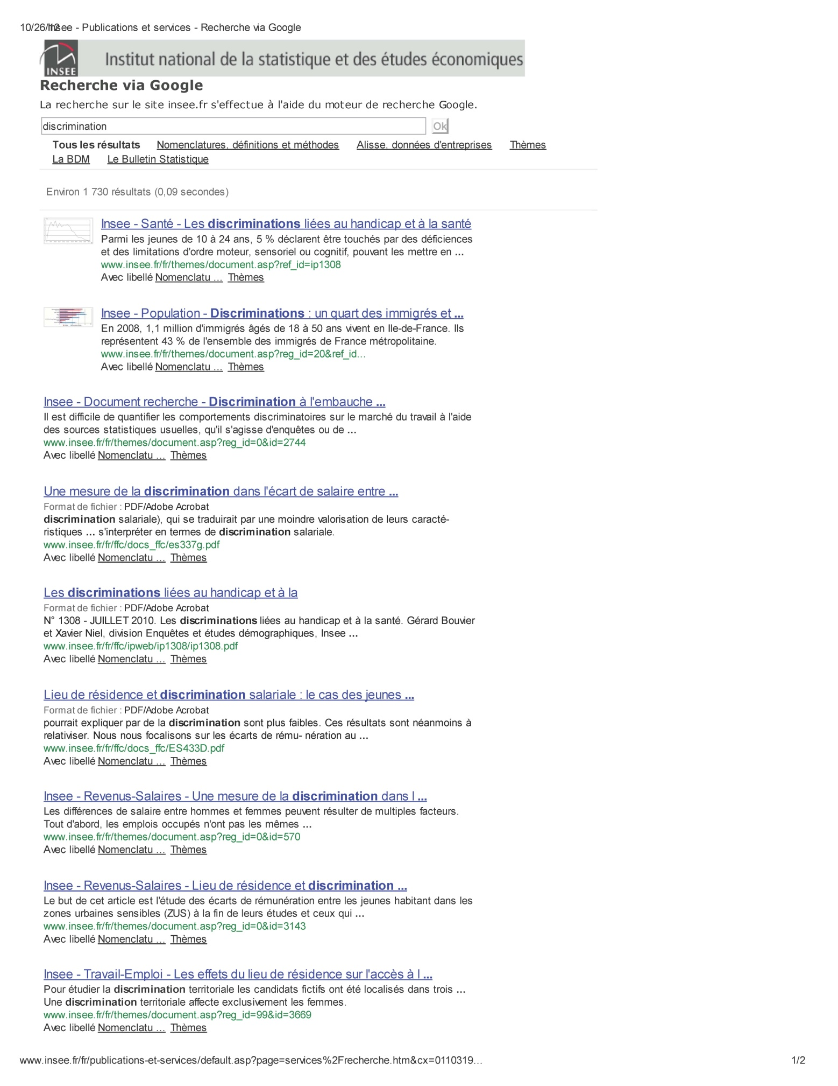

Slide 60
Student Activities
Students present information in charts to class
Students find two charts supporting the same information, then present them to class
Students find two charts with contradictory information, then present that information to class
Students find charts presenting similar/different information from two or more Francophone countries, then present the information in writing

Slide 61
Interview
Qu'est-ce que l'observatoire des discriminations ? Que mesure-t-on? Quels outils utilisent-ils? Comment évolue la lutte contre les discriminations?
http://www.youtube.com/watch?v=o2vuQLHzfbE
Entretien avec Laura Mourey, directrice de l'association Droit pour la justice.
http://www.youtube.com/watch?v=eLbOqpgtQck

Slide 62
Student Activities
Students discuss similarities and differences between the two interviews in small groups
Cultural Comparison activity concerning how communities tolerate, react/respond to discrimination

Slide 63
Instructions
Comment se faire des amis en moins de 2 minutes ? ( 5 clés )
http://www.youtube.com/watch?v=g0MlMBy6nEE

Slide 64
Student Activities
Students summarize five points after listening to instructions twice
Students then present the five points to a partner
Discussion: Which of these techniques works best in an American context?
Are any of these techniques culture-specific?

Slide 65
Presentation
http://www.tv5.org/cms/chaine-francophone/enseigner-apprendre-francais/FLE/10-ans-du-TCF/galerie/p-21211-TCF-pour-le-Quebec-le-francais-une-langue-pour-s-integrer.htm

Slide 66
Student Activity
Find similar examples of how to become a citizen (naturalisation) in other Francophone countries

Slide 67
Email
http://ufr-lag-lea.univ-provence.fr/Local/dema/dir/user-266/Horaires/Emploi%20du%20temps%20Licence%201%20semestre1/MessagepourEtudiantsL1-2.pdf

Slide 68
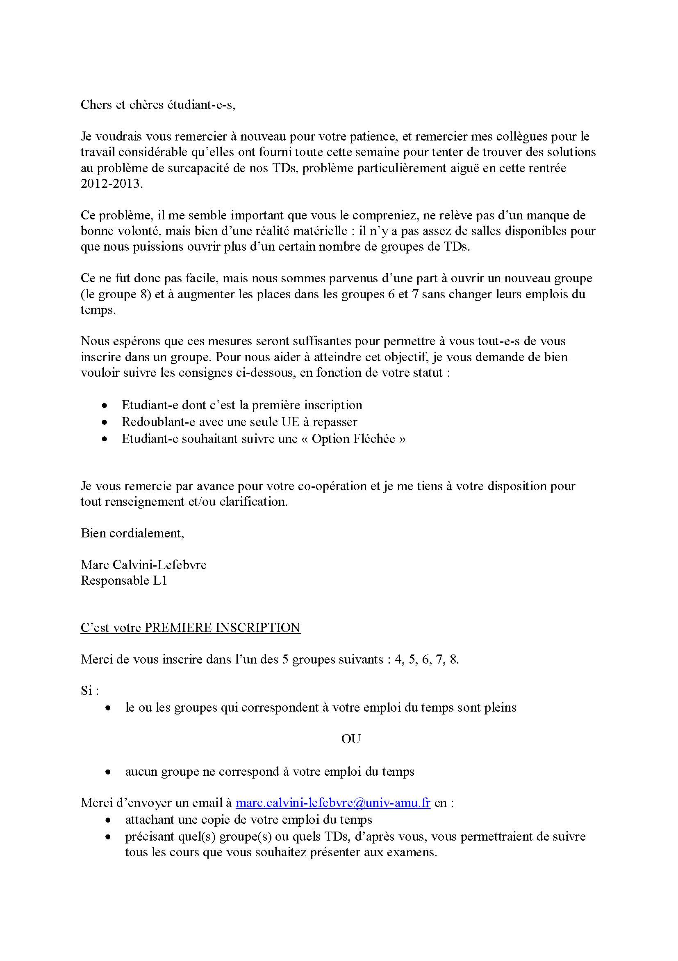

Slide 69
Student Activities
Define pertinent vocabulary and abbreviations
Answer the following questions: Who is writing? To whom? What is purpose of correspondence? What information is provided? What questions are asked?
Students write a response to email in small groups
Students find similar emails online, present them to class, then share for additional writing activity practice
Students find other emails online and modify them appropriately to fit the item type from AP French Language and Culture exam

Slide 70
Persuasive Essay
Longer-term/Senior project assignment
Students find three sources (podcast, article, chart) and develop question
Students orally present findings and what they have learned about topic
Teachers then add to bank of practice items to be used in or outside class
Opportunity to reflect diversity of Francophone world and also to fill in gaps (still working on Cultural Journal)

Slide 71
Conversation
Students practice spontaneous conversation (functions, etc.)
Example: offrir son aide
Tu veux que je te donne un coup de main ?
Tu as besoin d’un coup de main ?
Tu veux que je t’aide (que je t’accompagne…)
Laisse-moi t’aider.
Je peux t’aider ?

Slide 72
Cultural Comparison
Students develop items based on what they have studied in the unit and materials contained in their Cultural Journal
Teachers use some for practice, one for unit assessment, and one for midterm or final

Slide 73
Recommended Resources
Available at AP French Language and Culture Teacher Community (ARG)
And various others (including entire sample exam on Alienation & Assimilation)

Slide 74
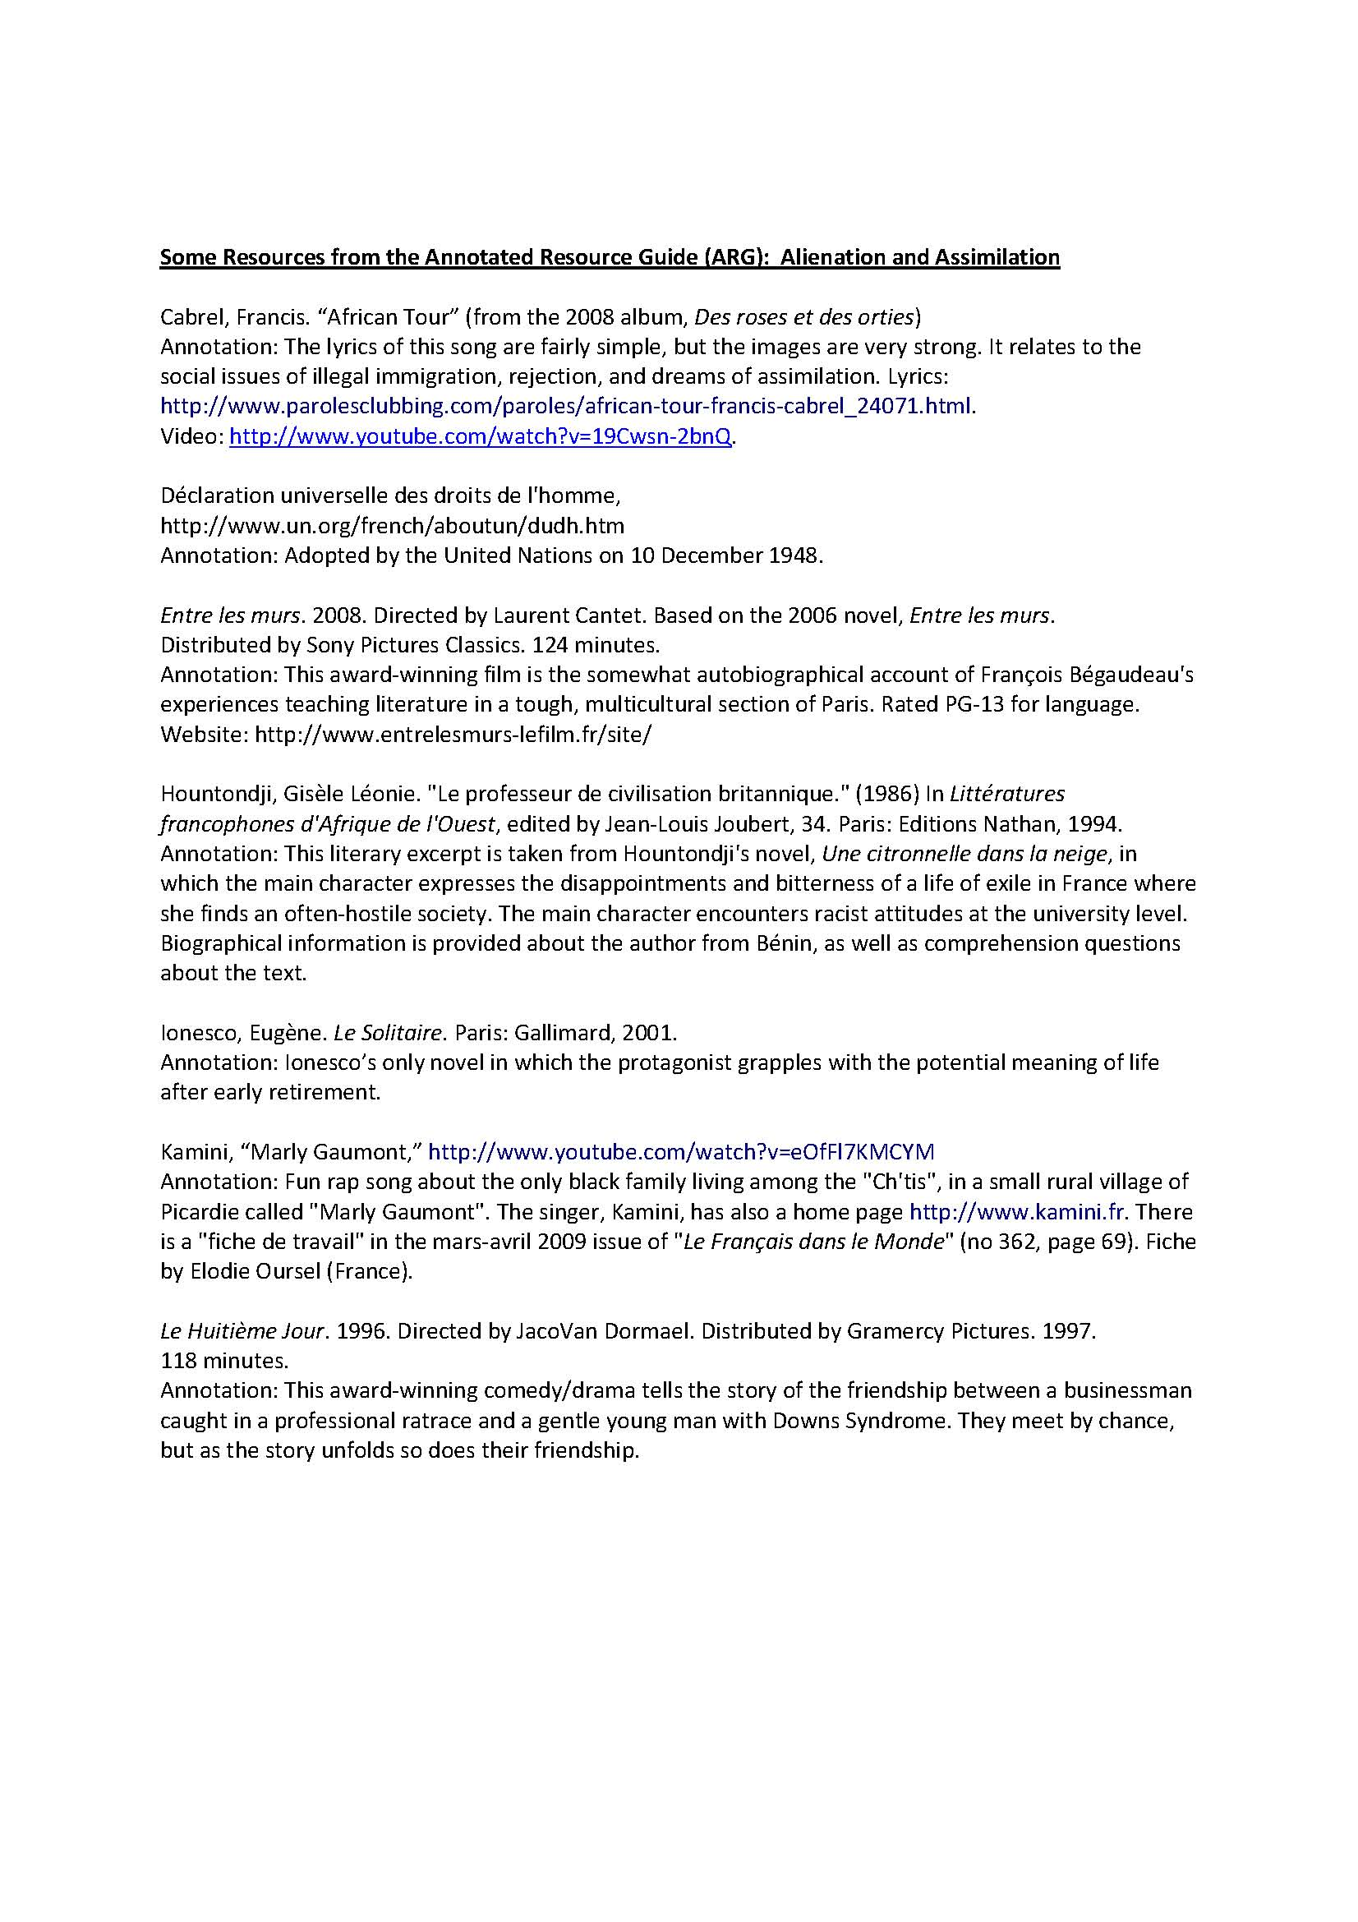

Slide 75
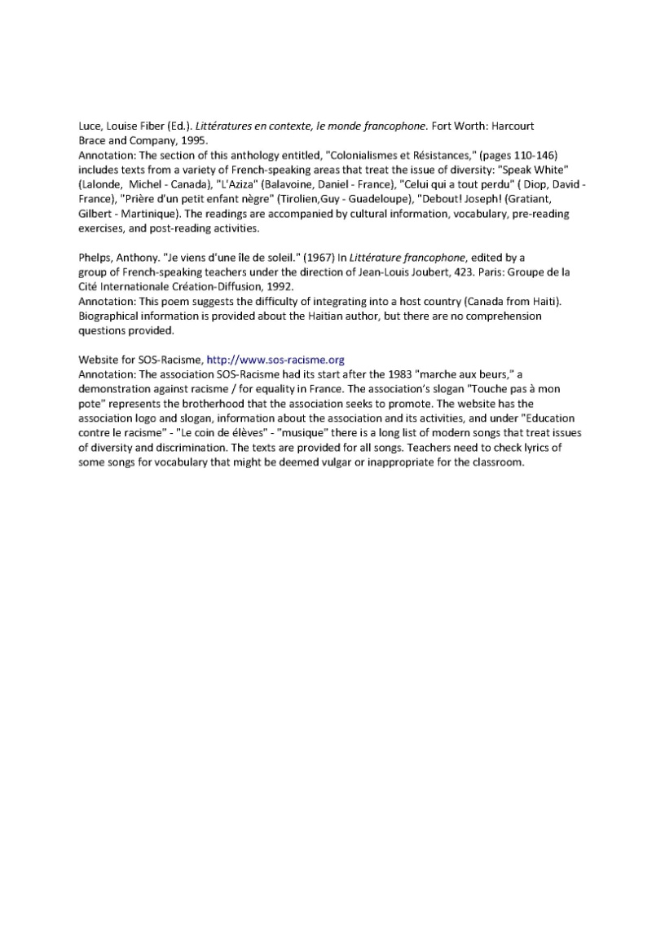

Slide 76
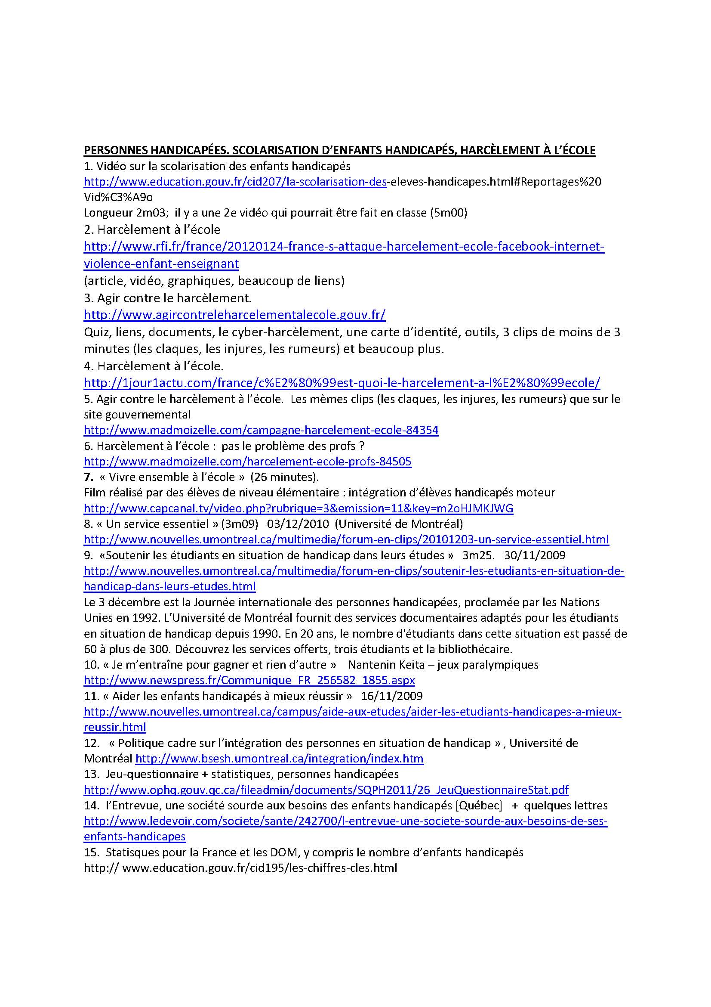

Slide 77
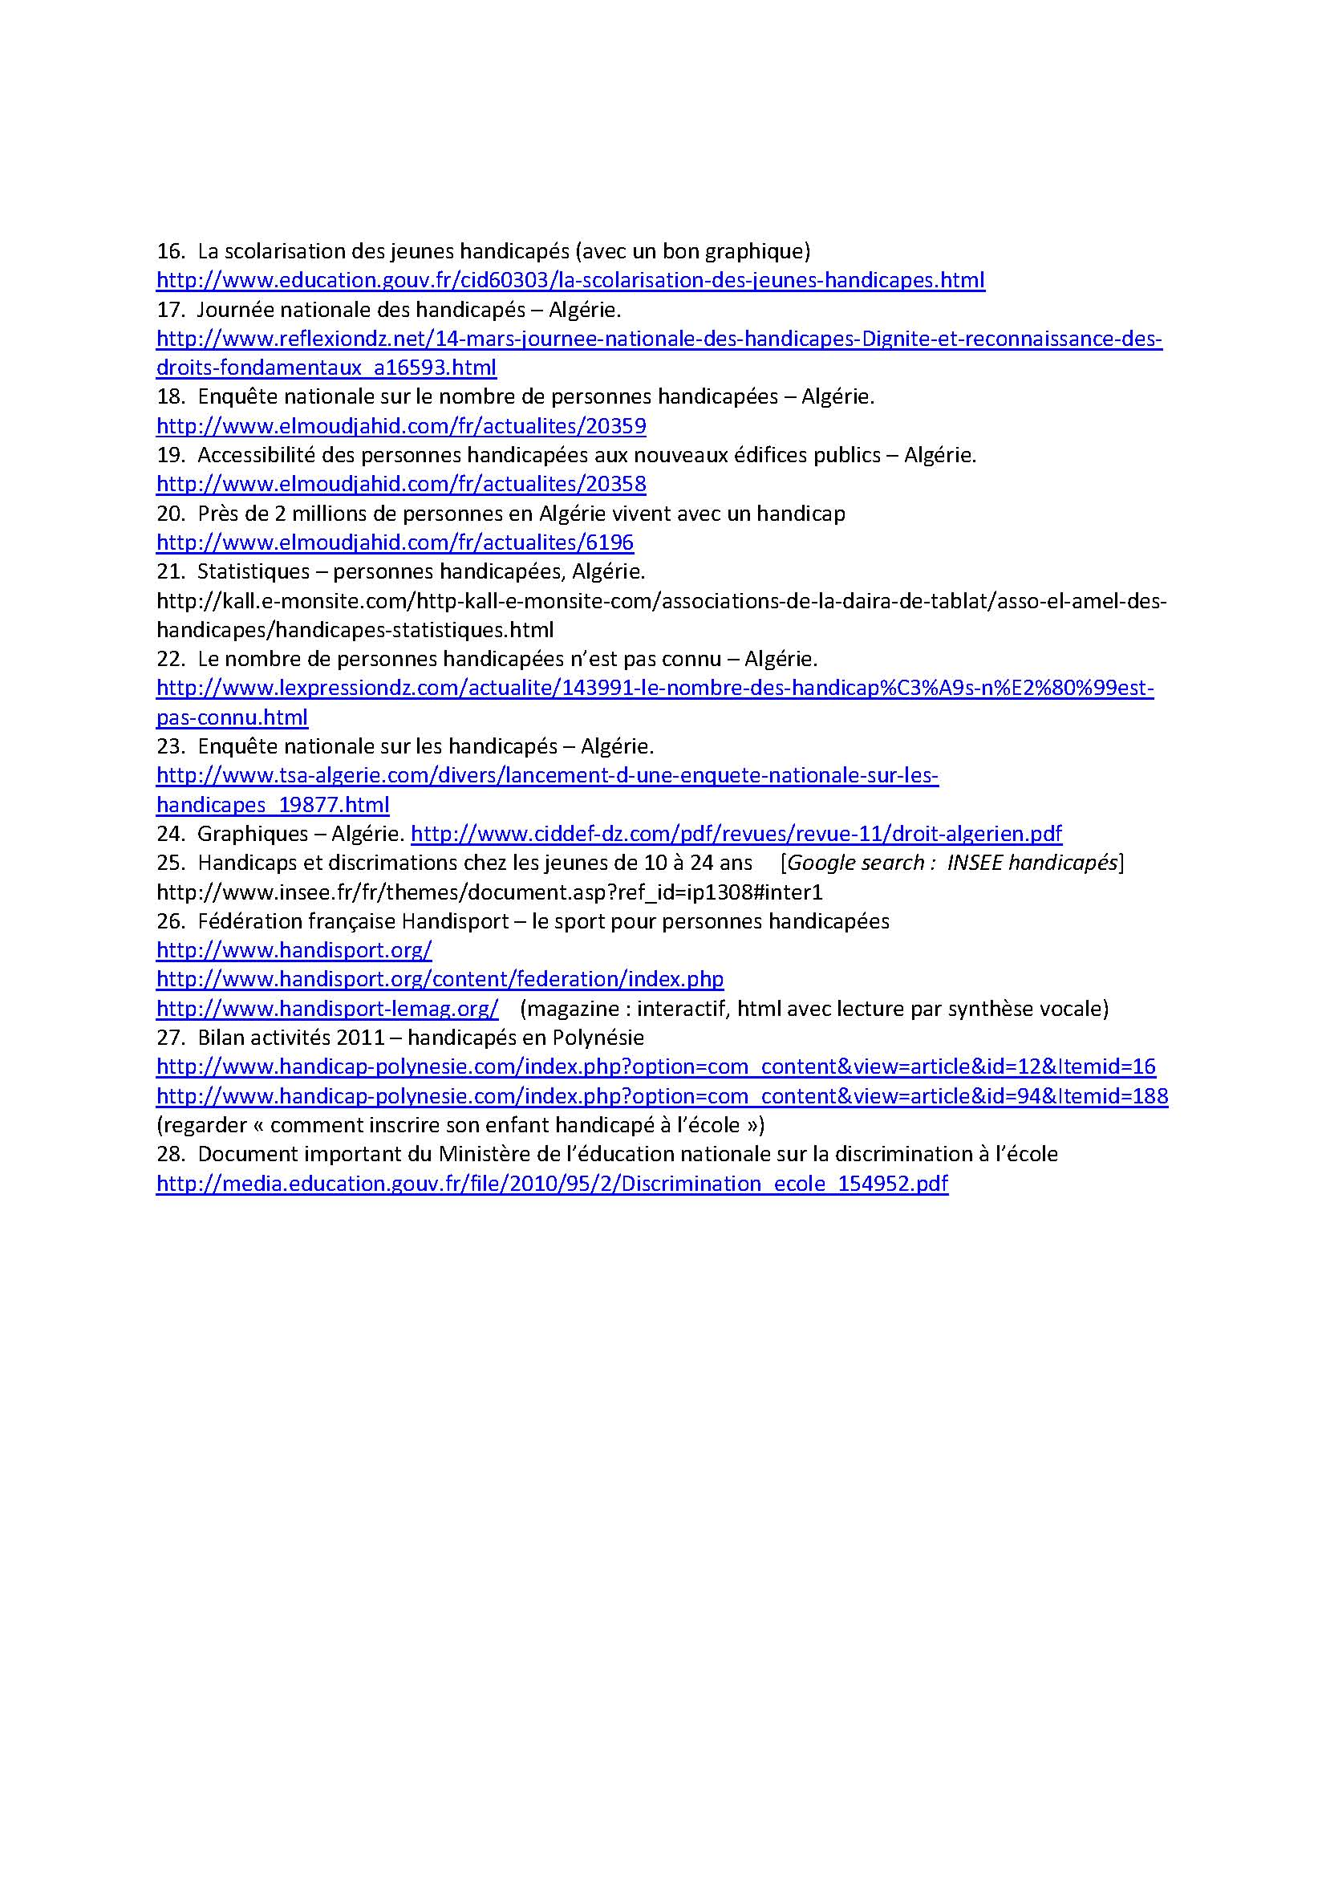

Slide 78
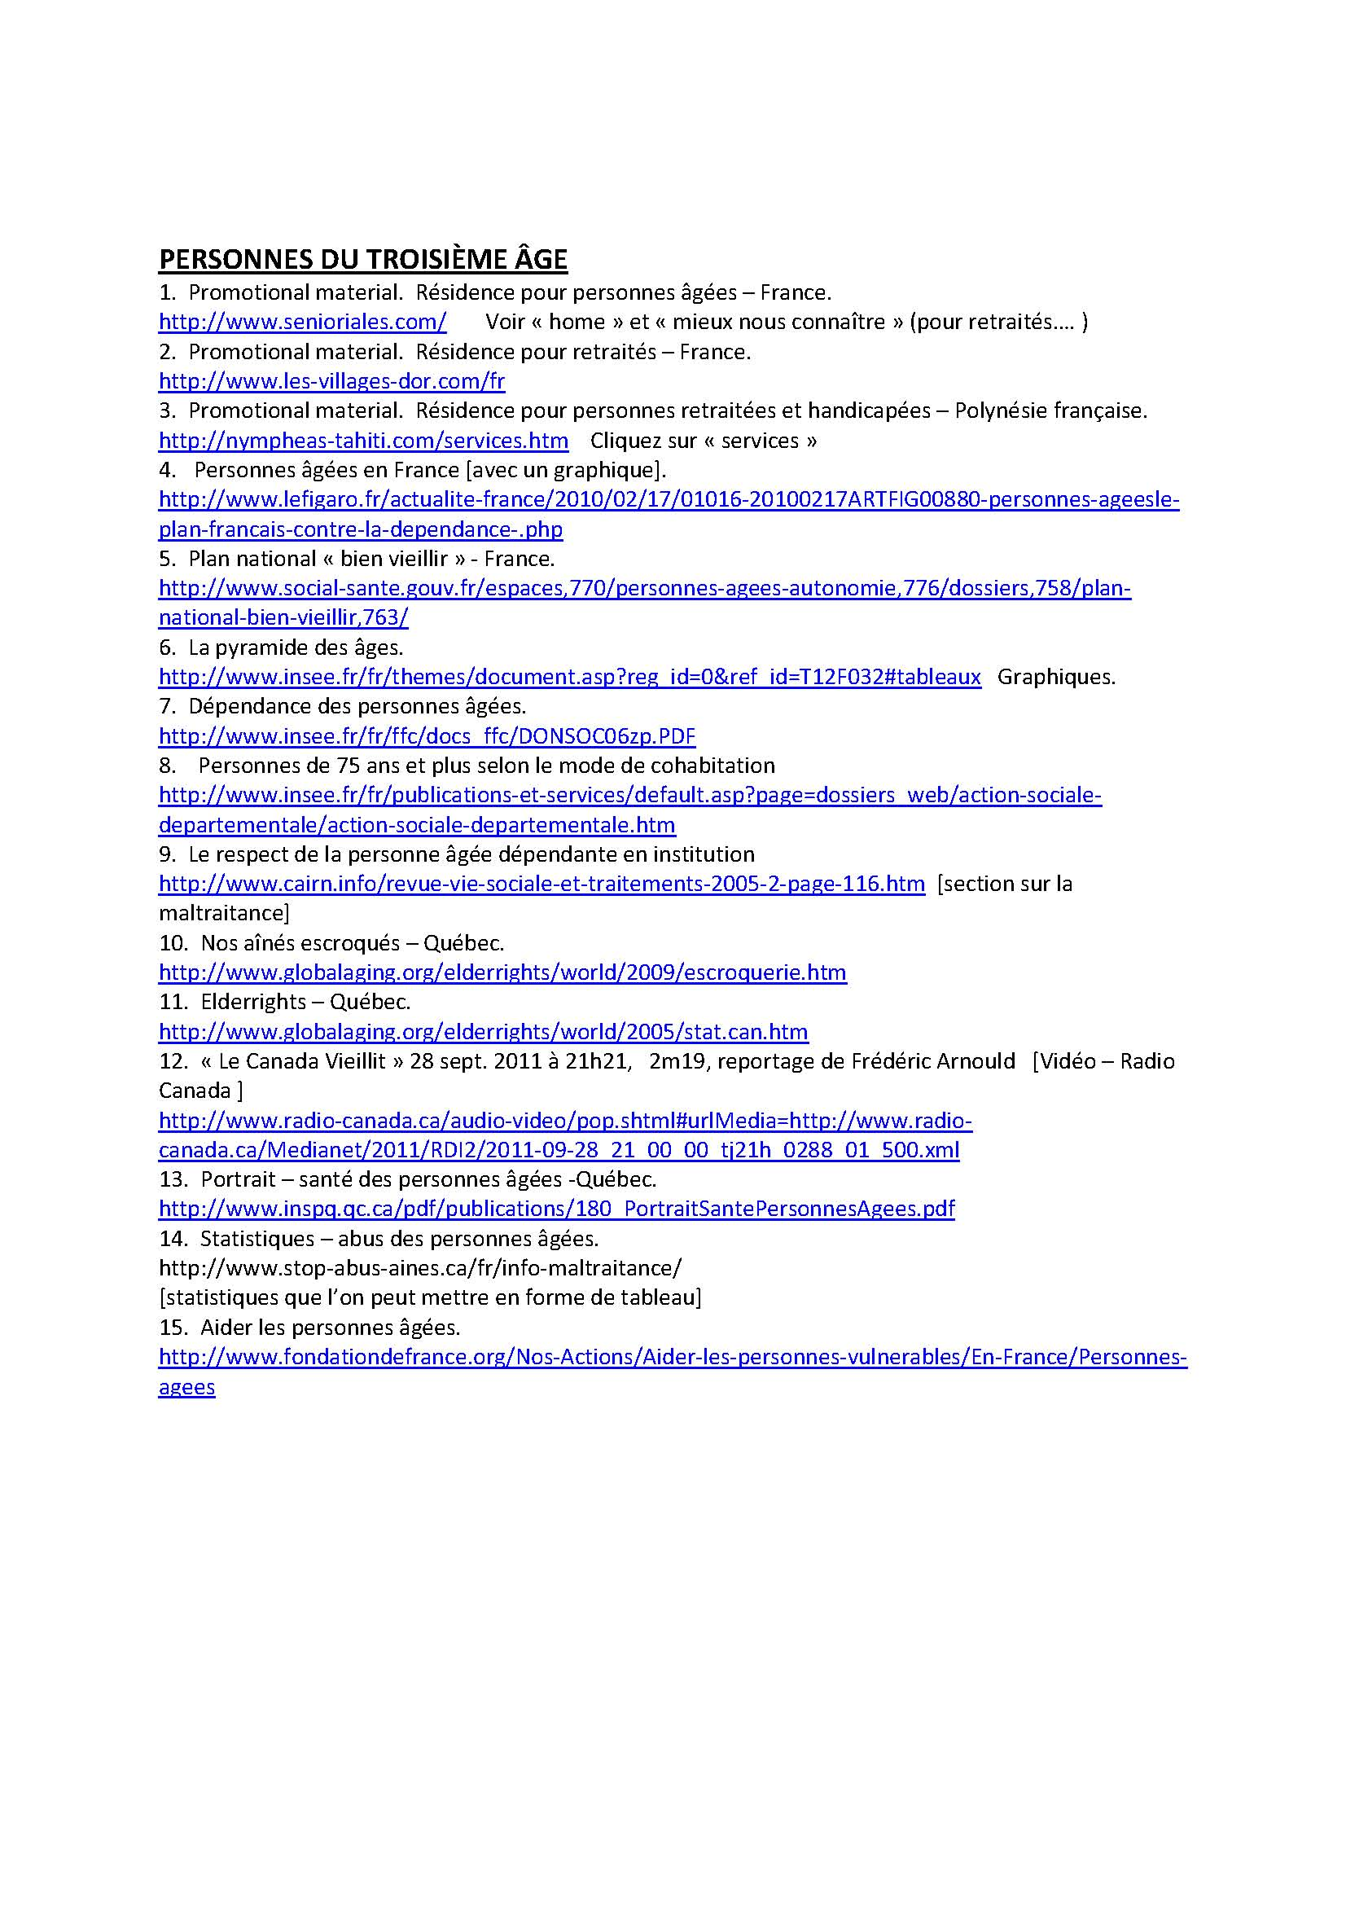

Slide 79
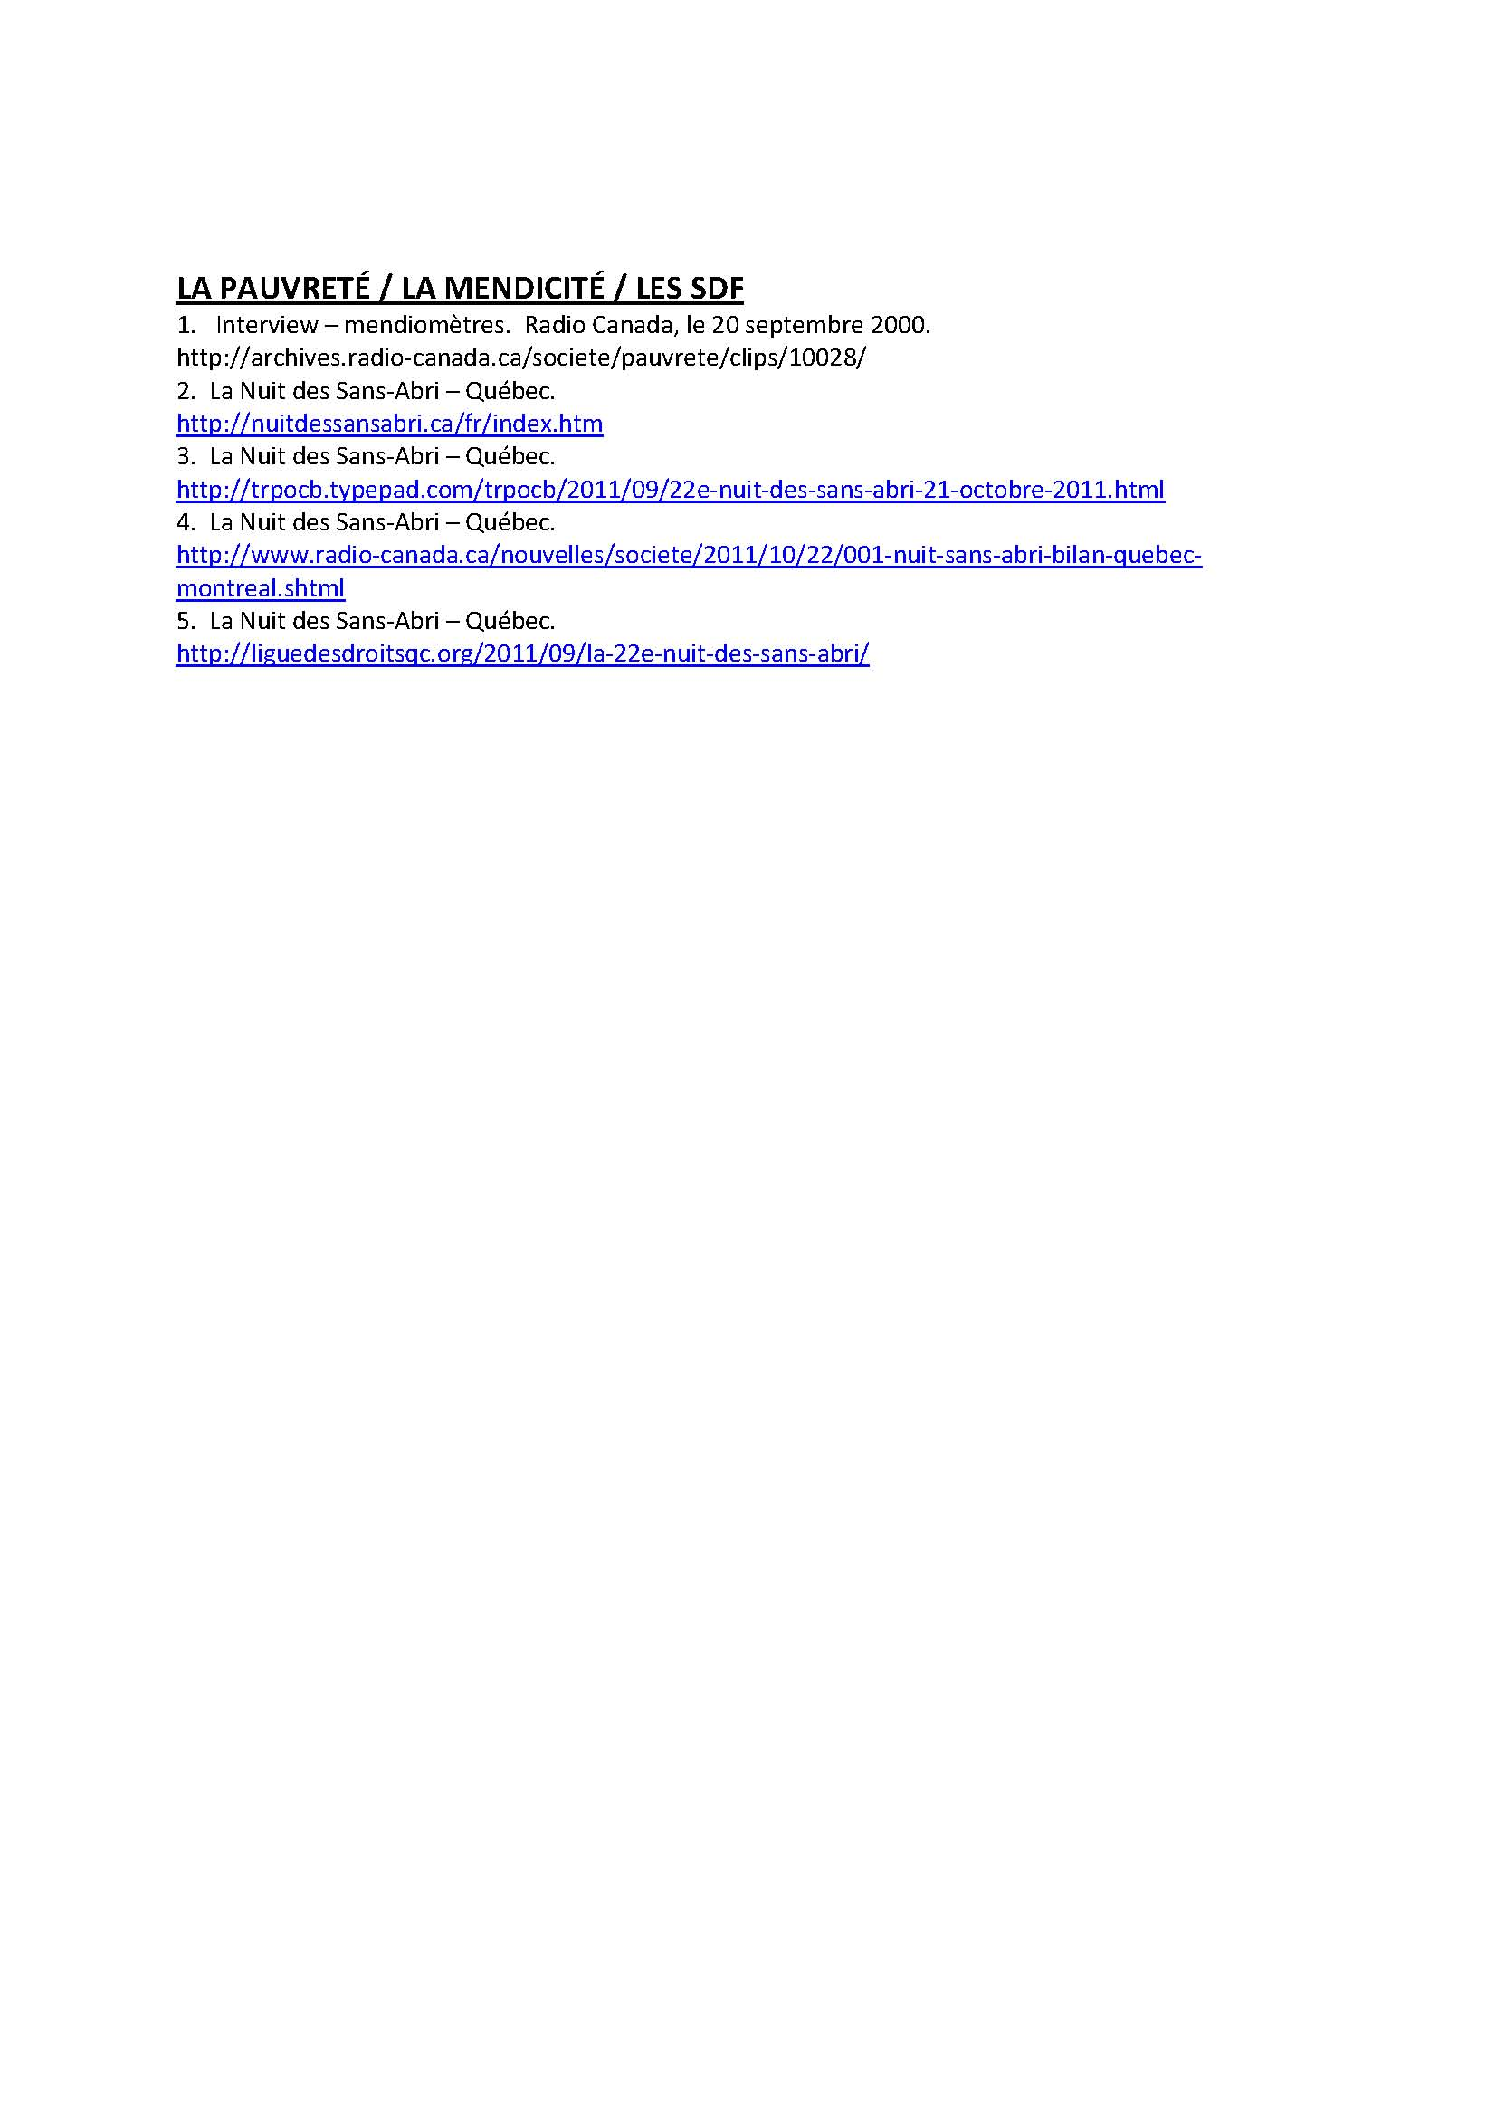

Slide 80
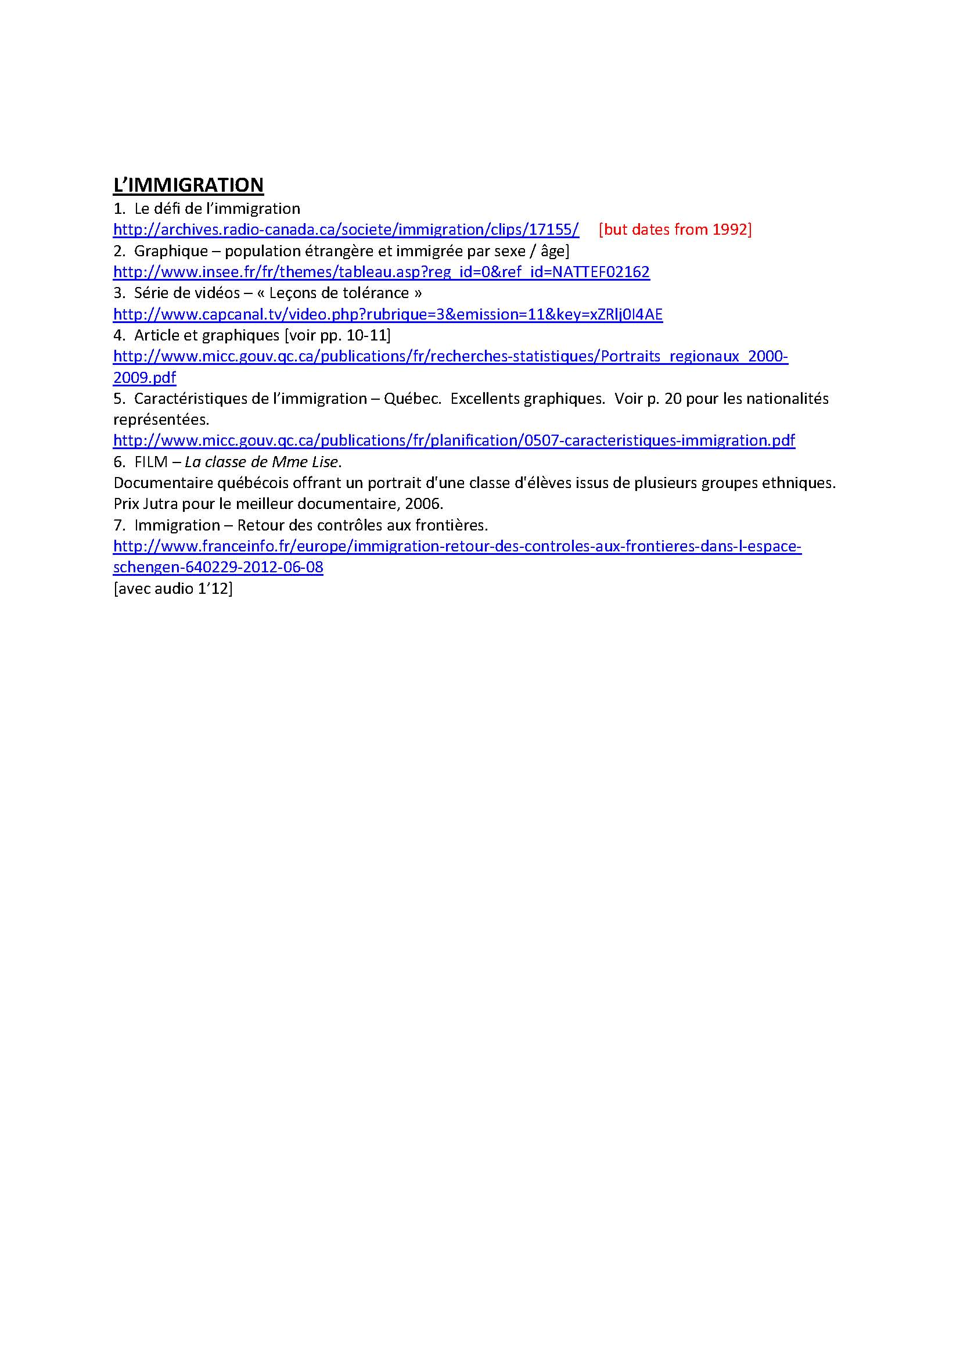

Slide 81


Slide 82


Slide 83
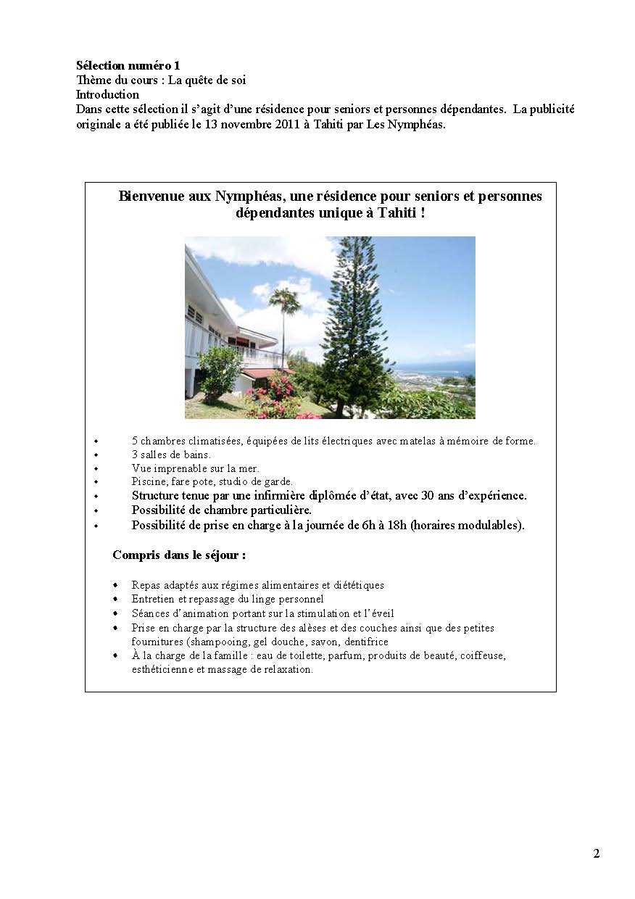

Slide 84
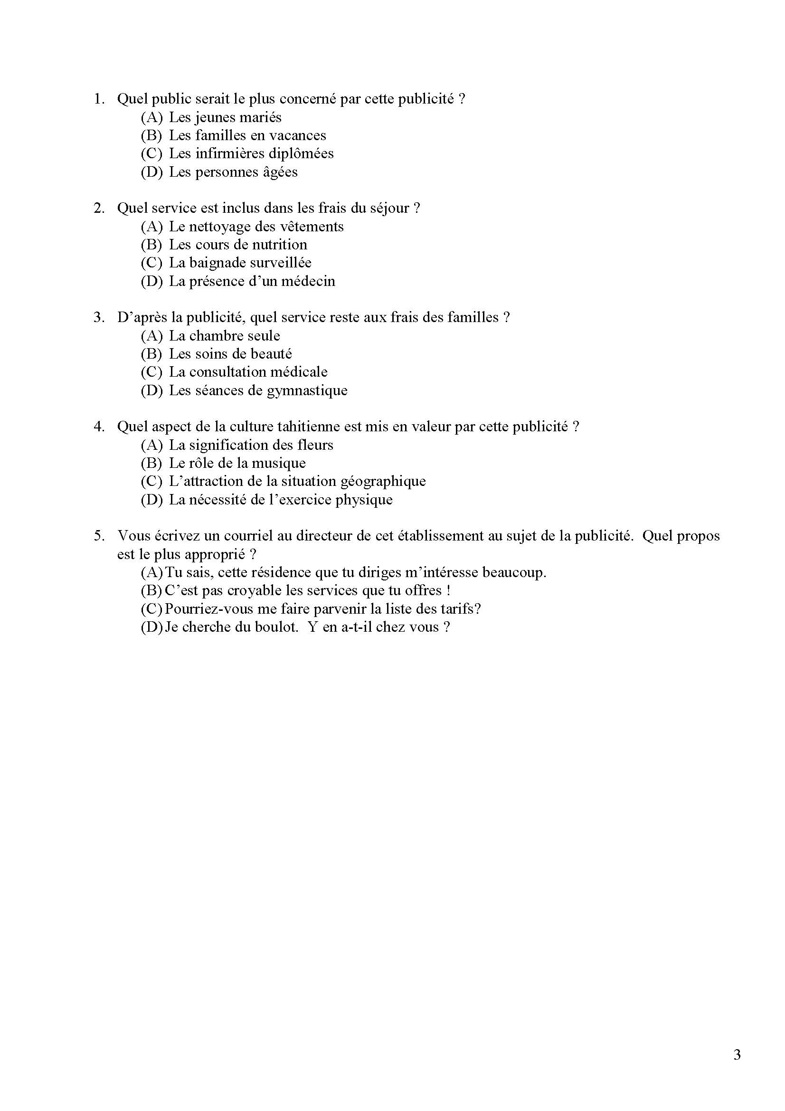

Slide 85
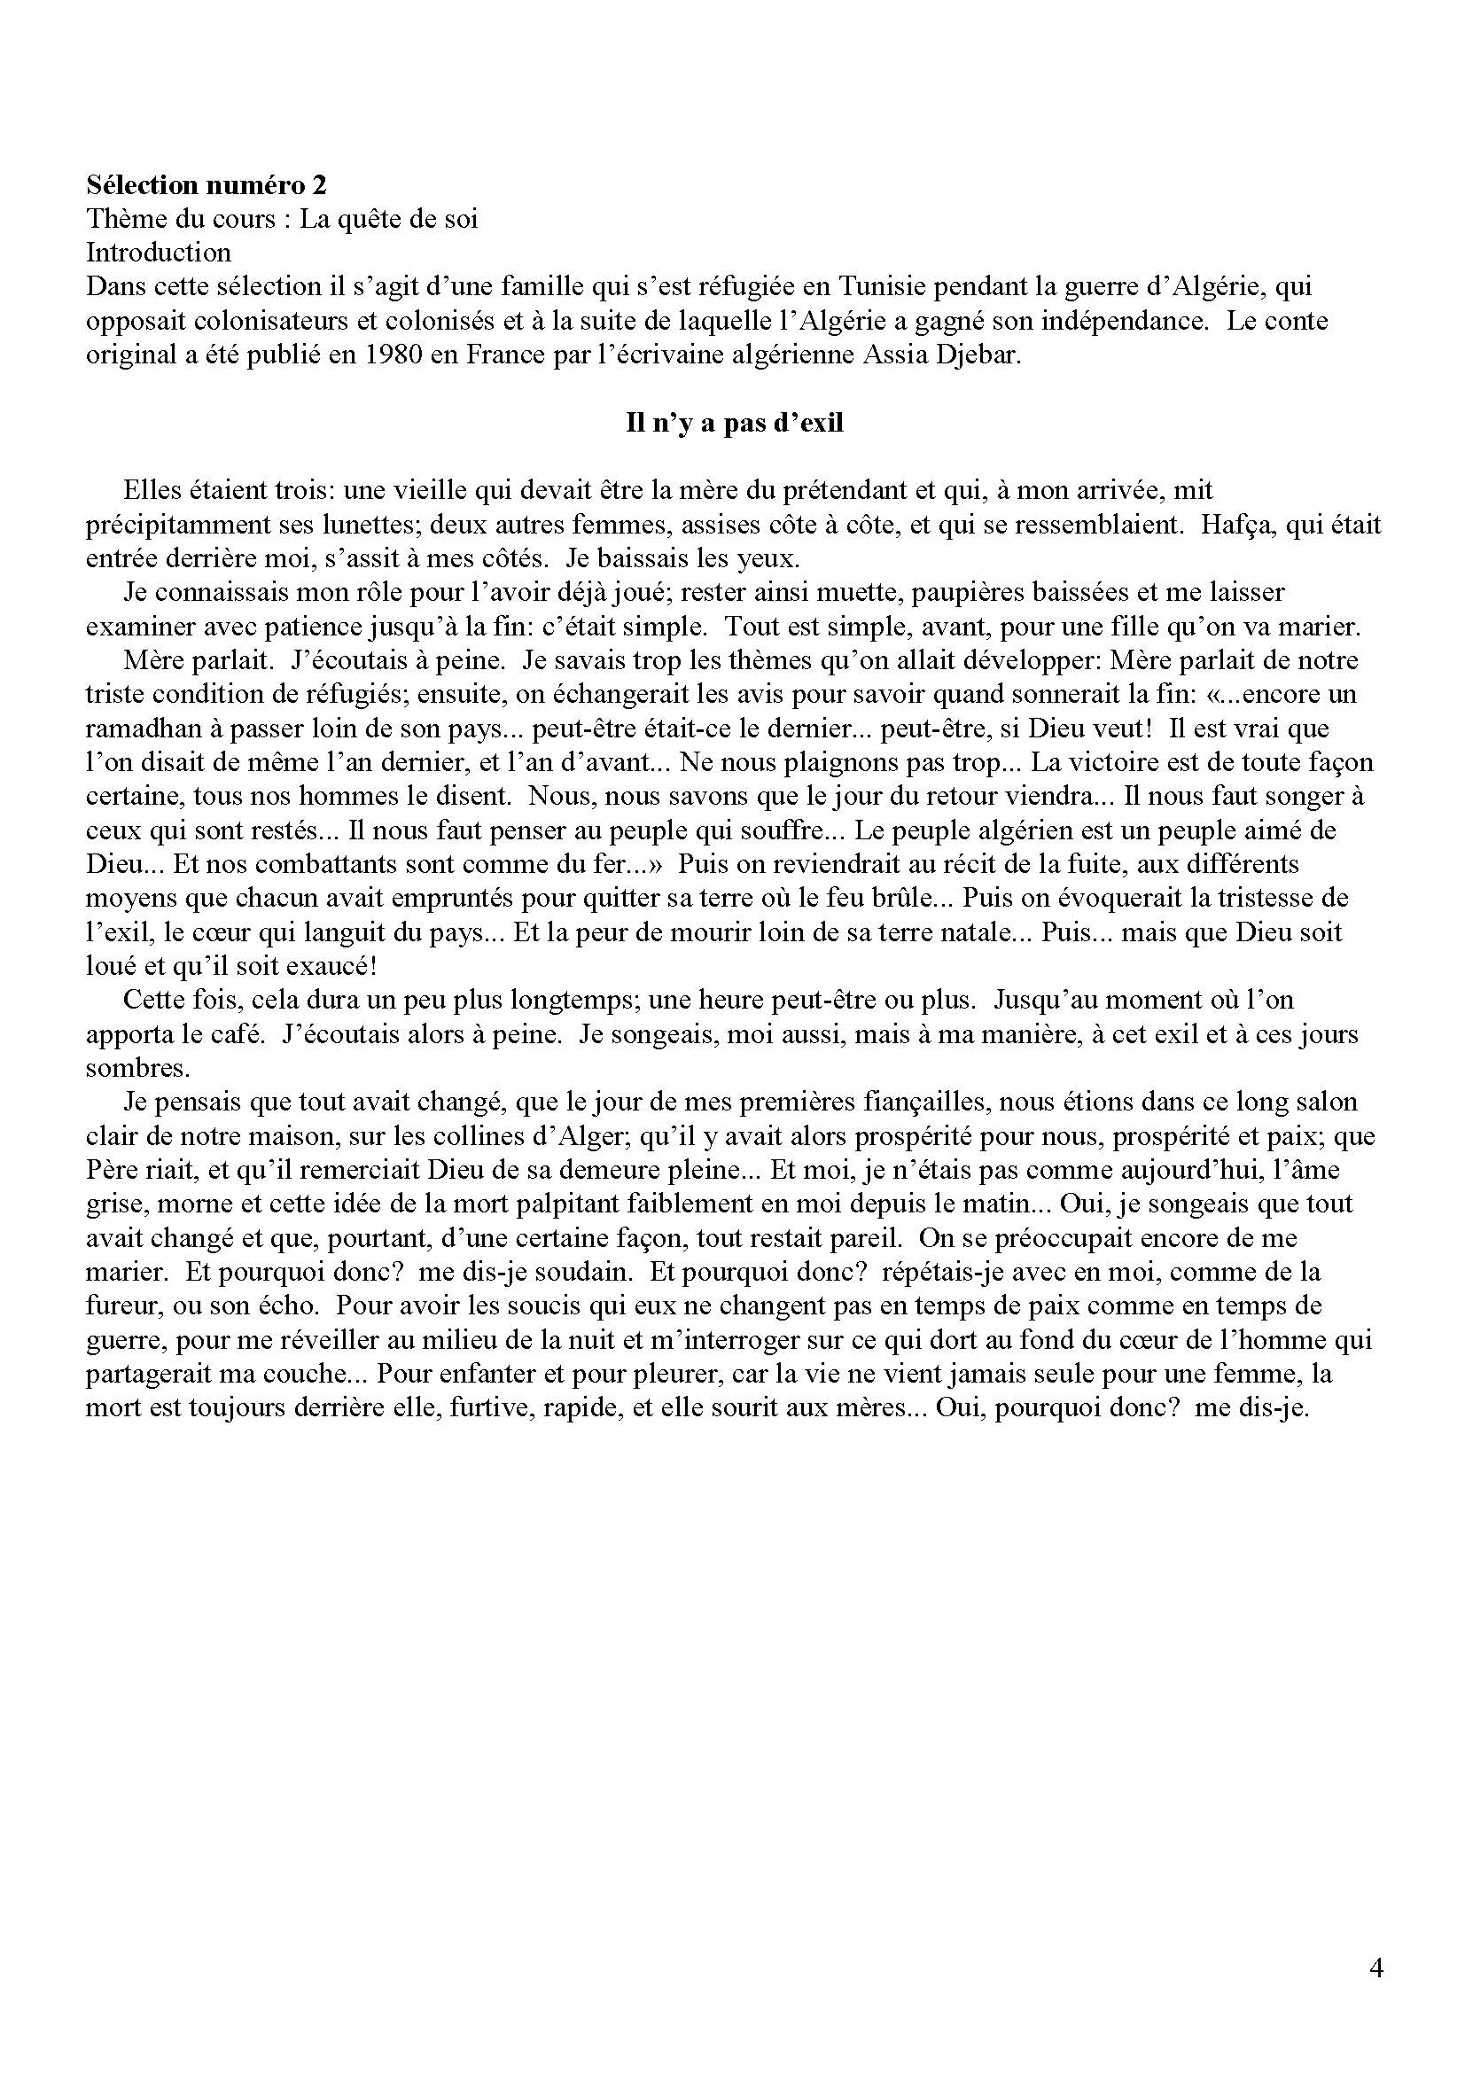

Slide 86
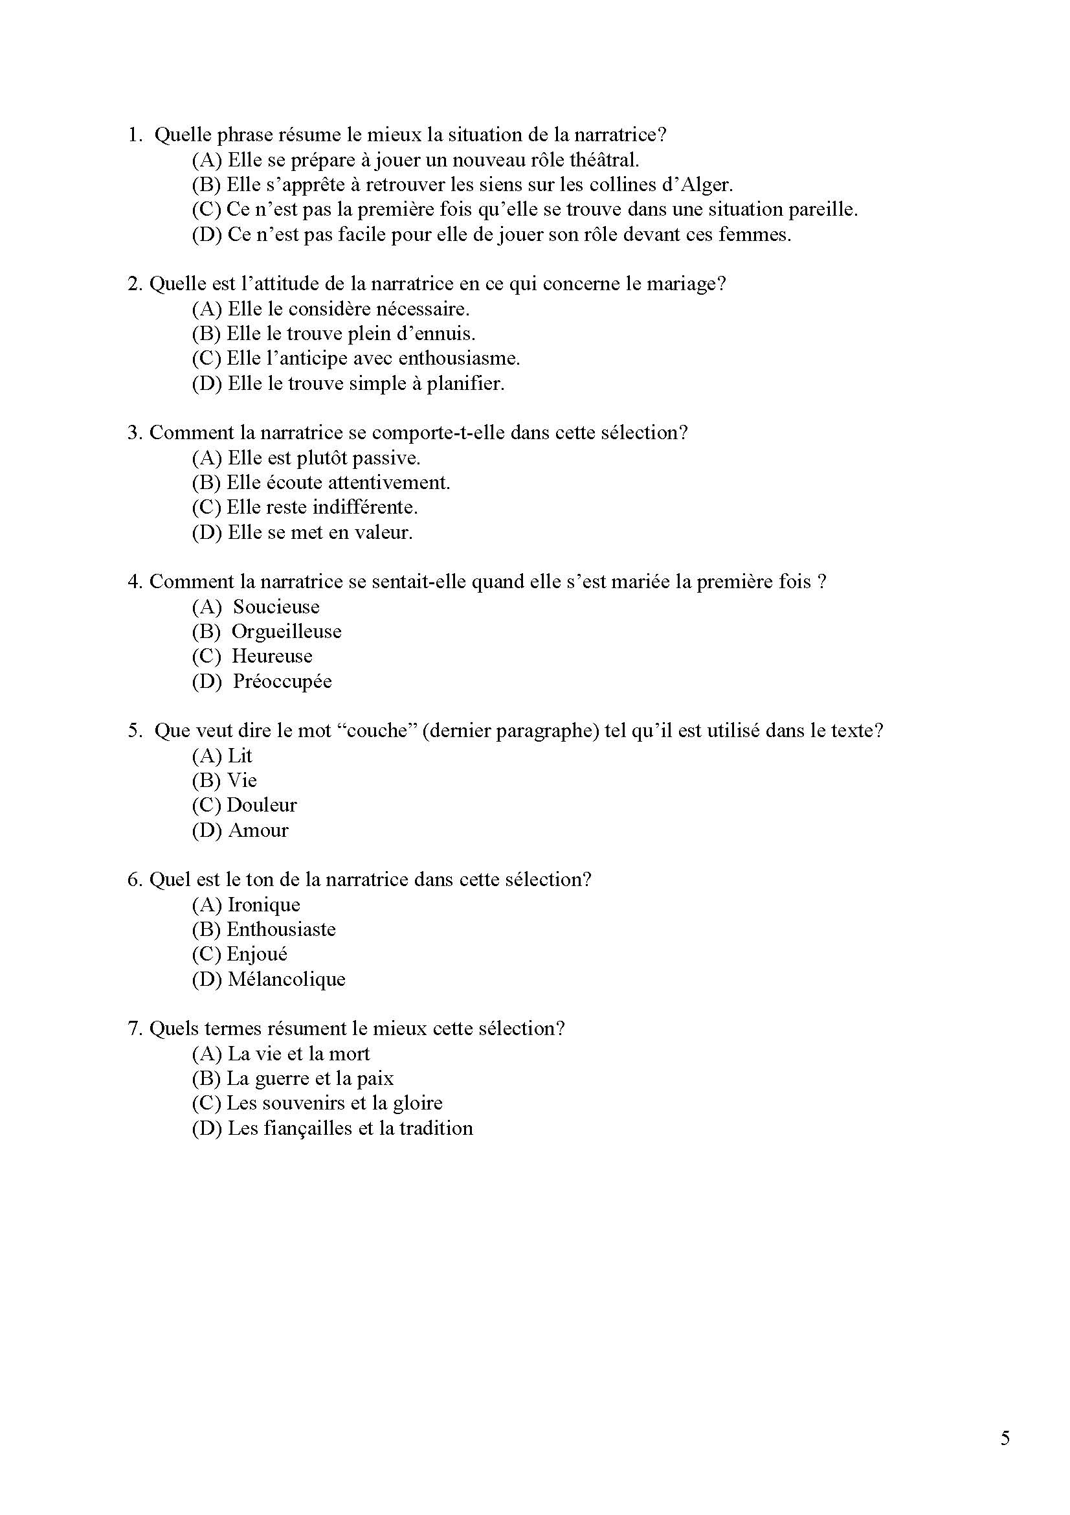

Slide 87
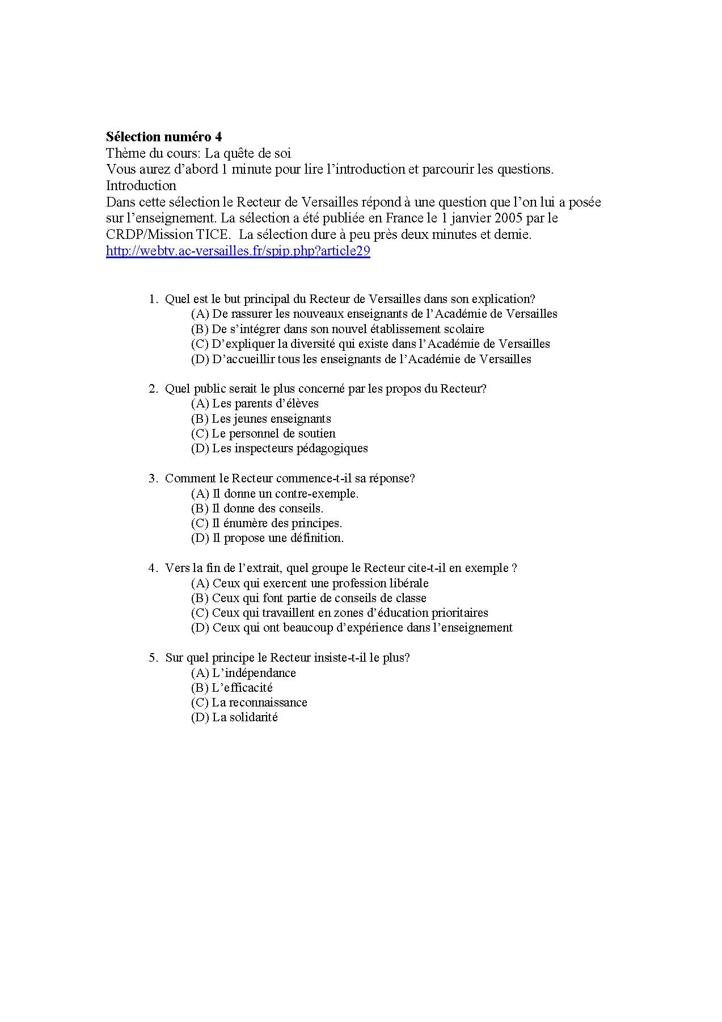

Slide 88
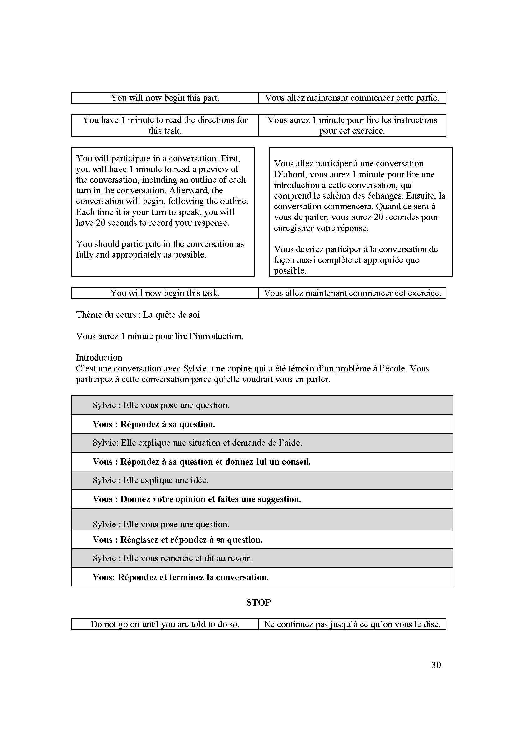

Slide 89
Contact Information
Davara Potel,
mmedpotel@gmail.com
Brian Kennelly, bkennell@calpoly.edu
PPT available at: http://works.bepress.com/bkennell/
Sample Exam available at:
http://cla.calpoly.edu/~bkennell/AlienationAndAssimilationSampleExam.pdf
(password: ACTFL2012)

