Slide 1
Improving Student Performance on the Persuasive Essay
20 July 2013
AP Annual Conference

Slide 2
Overview
Learning Objectives for Written Presentational Communication
Overview of Persuasive Essay & Prompt from 2013 AP Exam
2013 Scoring Guidelines
Student Samples from 2013 AP Exam
Sharing of Instructional Strategies for Persuasive Essay

Slide 3
Learning Objectives
Written Presentational Communication

Slide 4
Presentational Communication
The Presentational Mode is characterized by the creation of messages in a manner that facilitates interpretation by members of the target culture where no direct opportunity for the active negotiation of meaning exists.

Slide 5
Written Presentational Communication
Primary Learning Objective
The student plans and produces written presentational communications.

Slide 6
Written Presentational Communication
Additional Learning Objectives
The student produces a variety of creative writings.
The student retells or summarizes information in narrative form, demonstrating a consideration of audience.
The student produces persuasive essays.
The student produces expository writing, including researched reports.
The student uses reference tools, acknowledges sources, and cites them appropriately.
The student self-edits written work for content, organization, and grammar.
The student demonstrates an understanding of the features of target culture communities.
The student demonstrates knowledge and understanding of content across disciplines.

Slide 7
Persuasive Essay
Overview & Prompt from 2013 AP Exam

Slide 8
Persuasive Essay
Overview: For this task, the student…
writes persuasive essay for a French-language writing contest on topic.
presents viewpoints on topic in three sources.
states and supports own viewpoint on topic.
has 6 minutes to read Sources 1 & 2.
listens to Source 3 (audio played twice).
has 40 minutes to prepare & write essay.
has access to Sources 1 & 2 and notes taken on Source 3 during these 40 minutes.

Slide 9
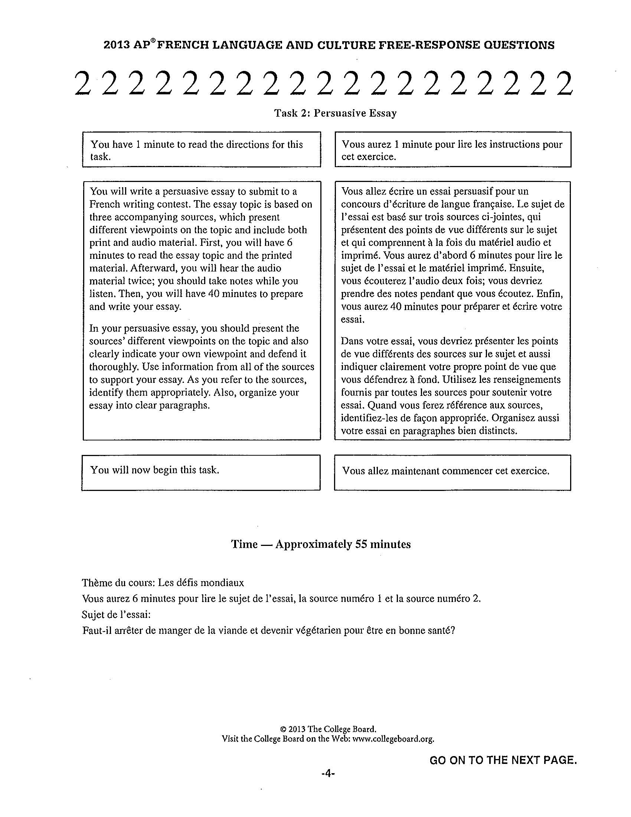

Slide 10
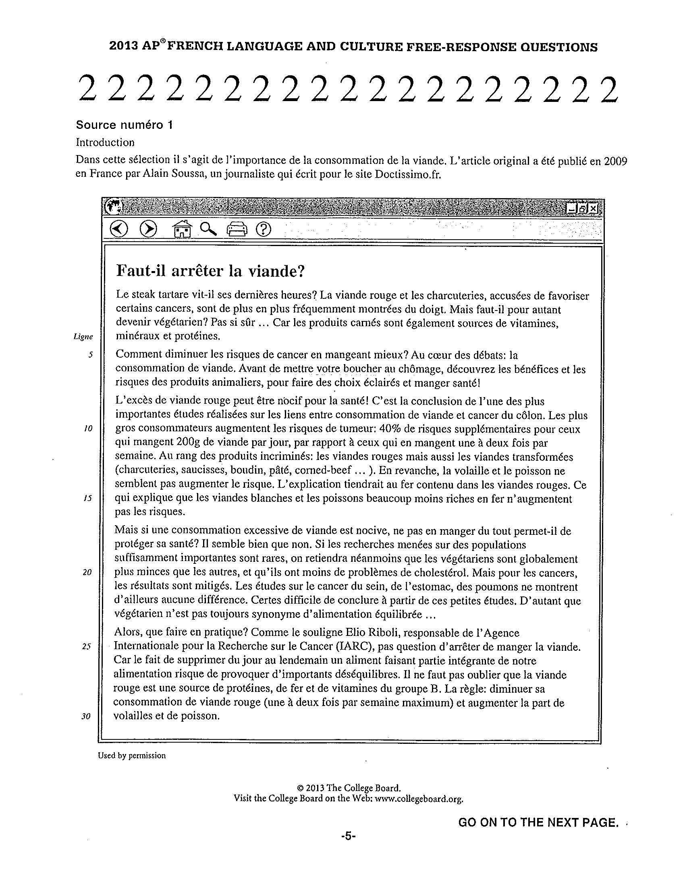

Slide 11
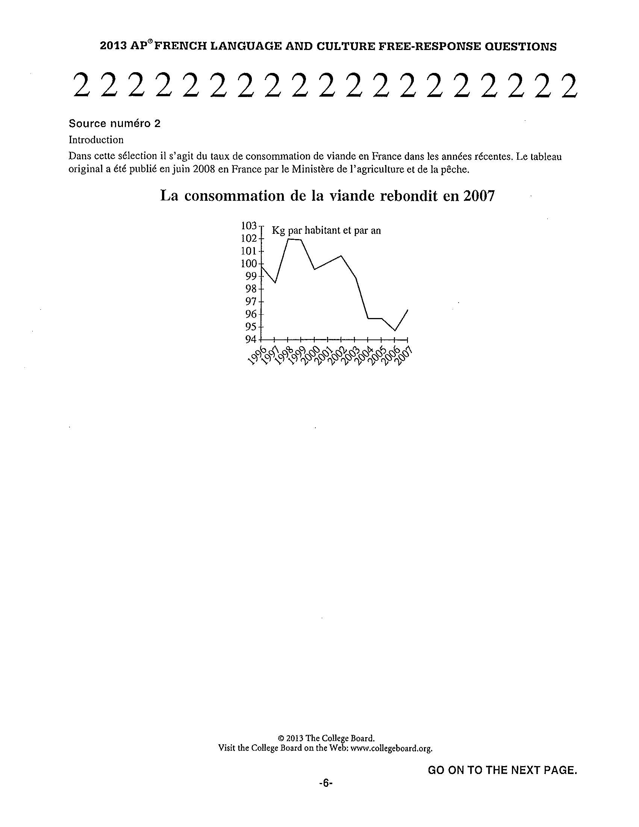

Slide 12
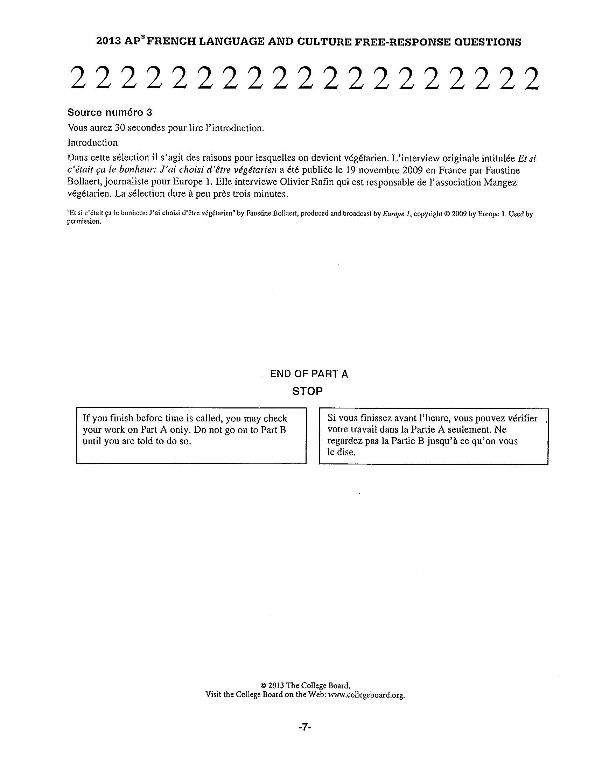

Slide 13

Audio

Slide 14
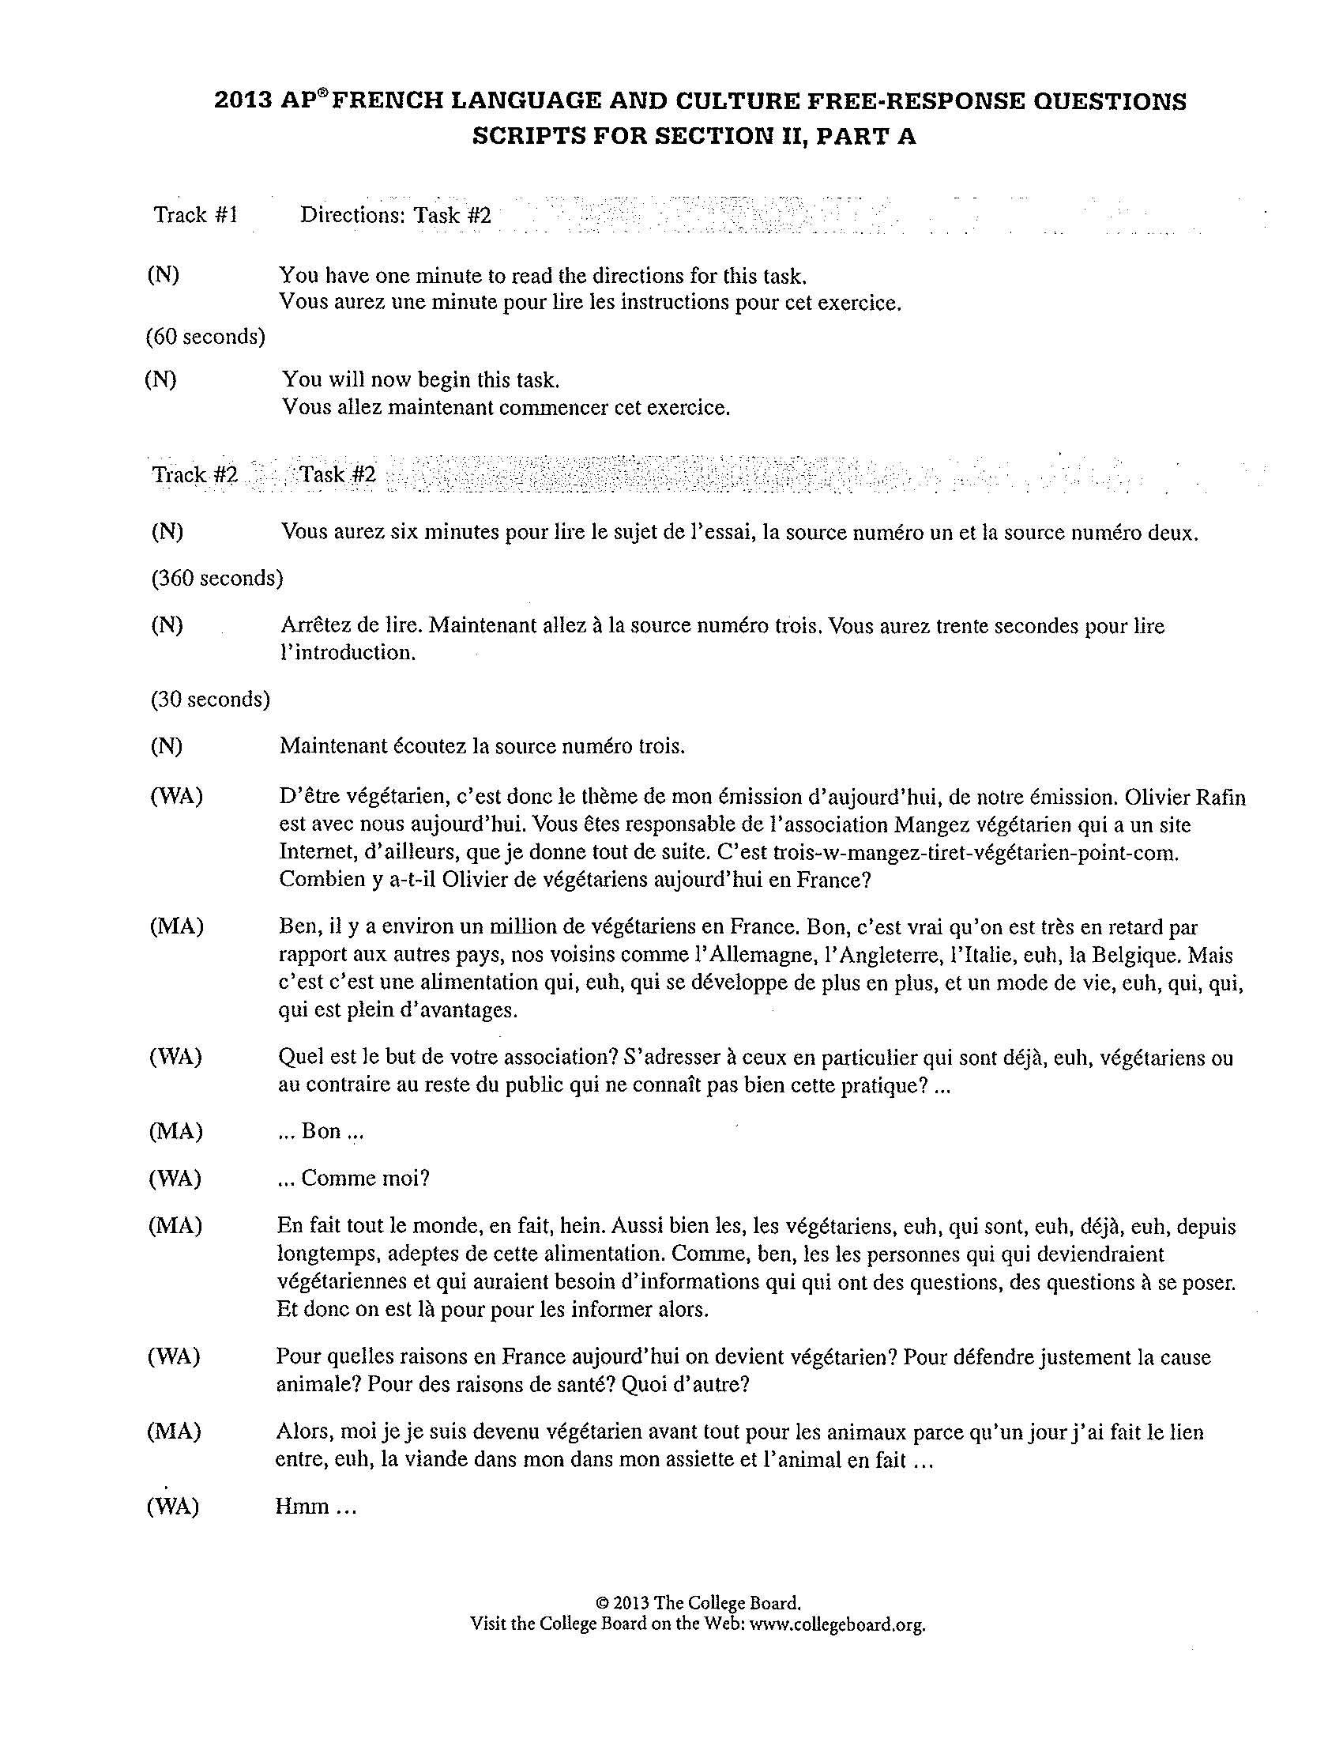

Slide 15
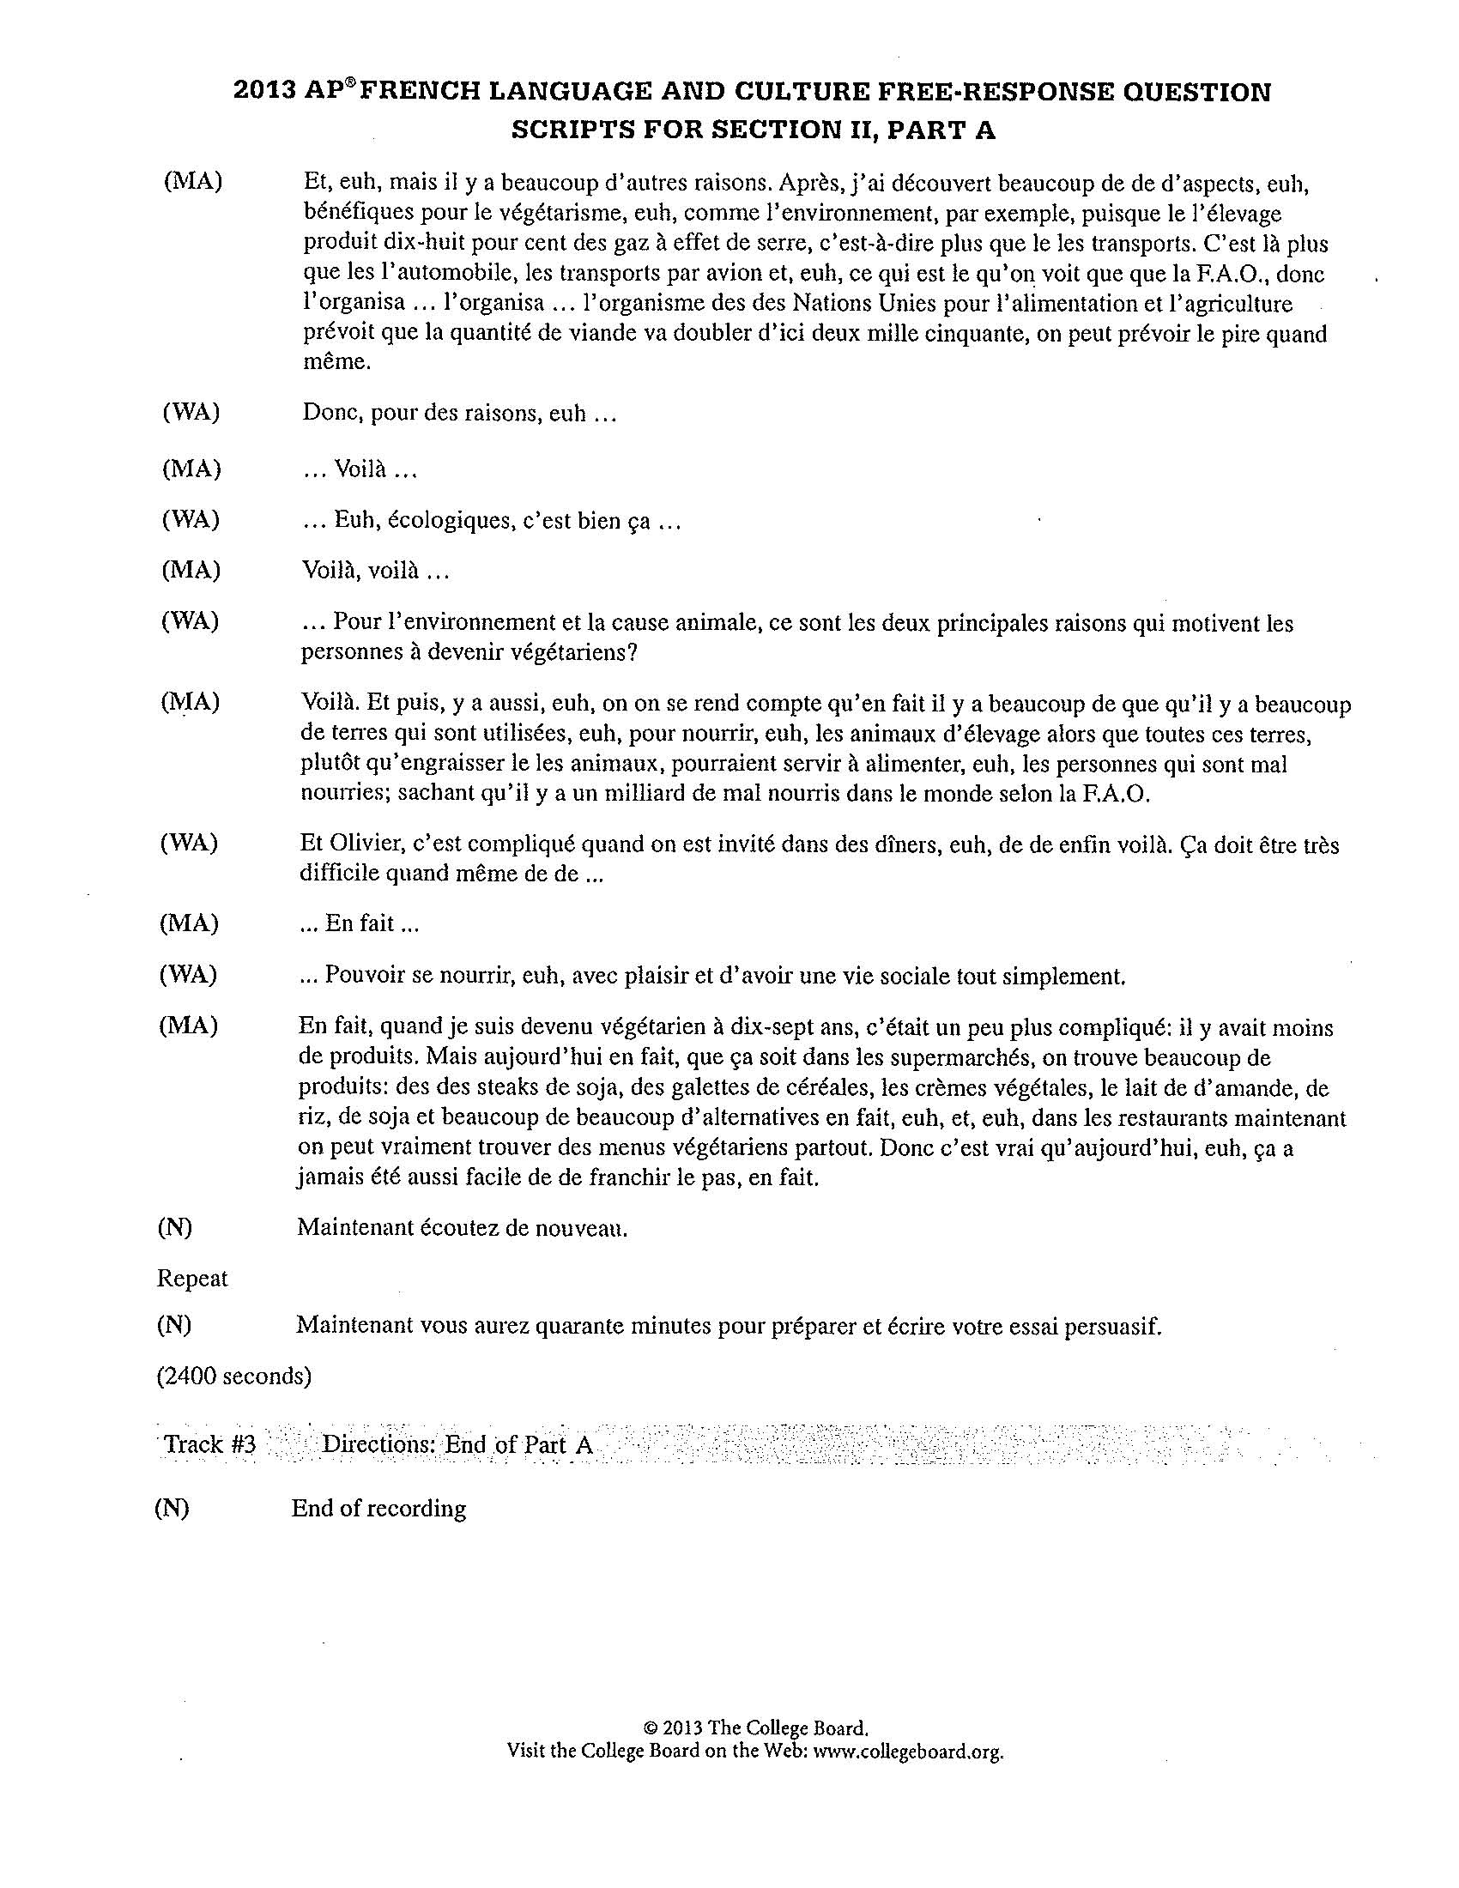

Slide 16
Persuasive Essay
2013 Scoring Guidelines

Slide 17
Students organize responses into clear paragraphs with effective transitions.
Students cite at least one specific and relevant example from each of the three sources and are able to provide some elaboration.
Students offer more than a general summary statement of each source but integrate specific examples into discussion of essay topic.
Students not required to dedicate equal time or space in essays to each of the three sources and to their own viewpoints.
Students will present examples from all three sources and also state and briefly support their opinions on subject with specific and relevant comments or examples.

Slide 18
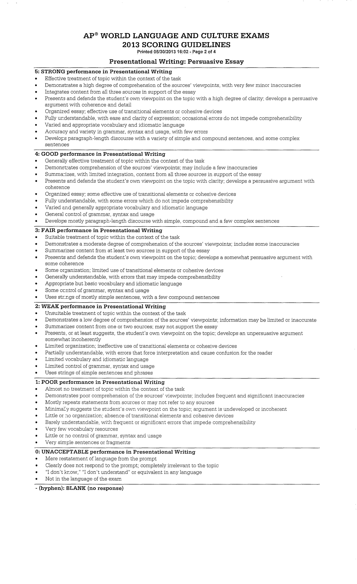

Slide 19
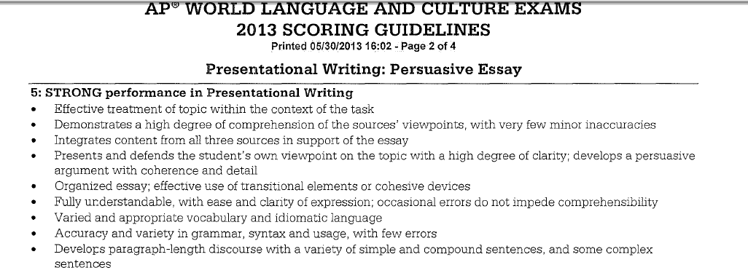

Slide 20
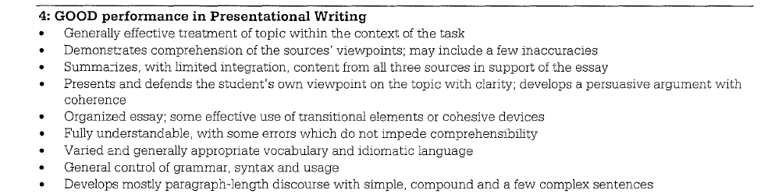

Slide 21
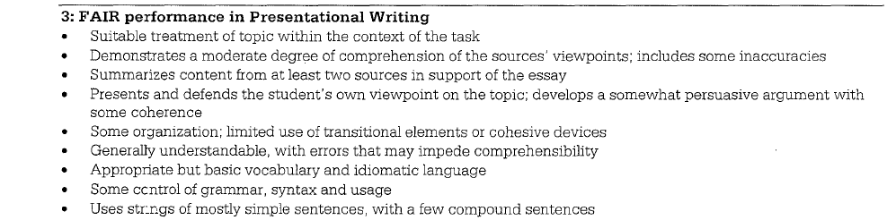

Slide 22
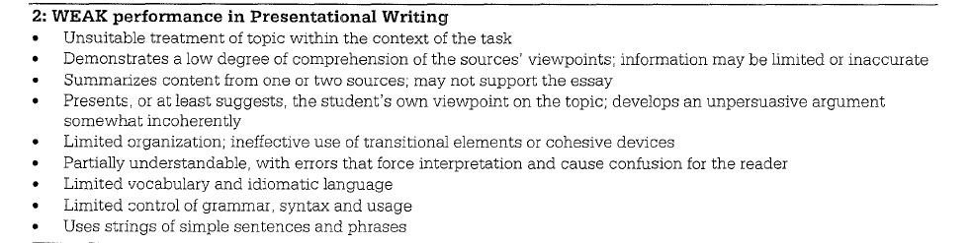

Slide 23
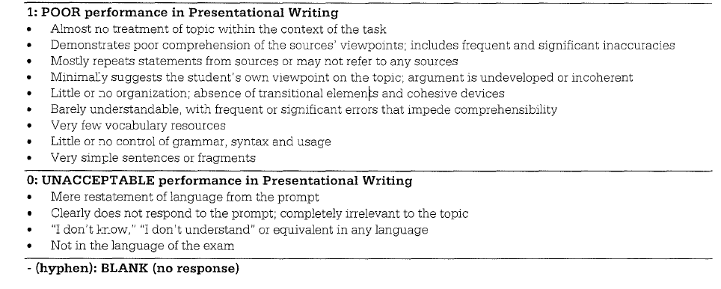

Slide 24
Student Samples
2013 AP Exam

Slide 25
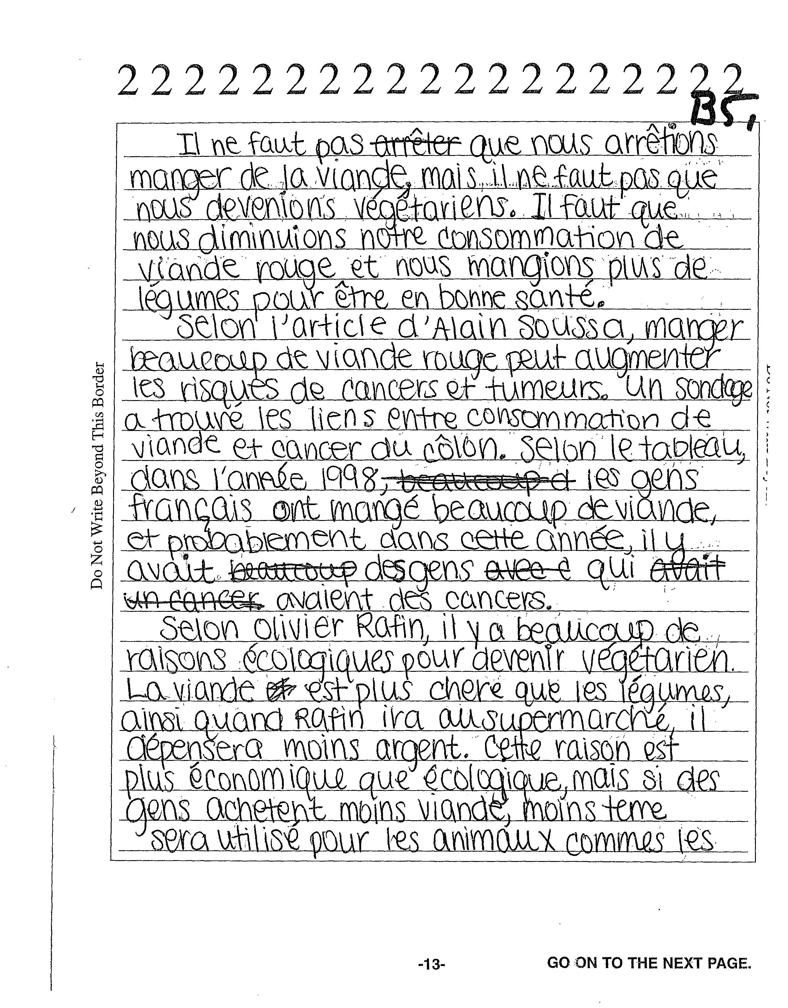

Slide 26
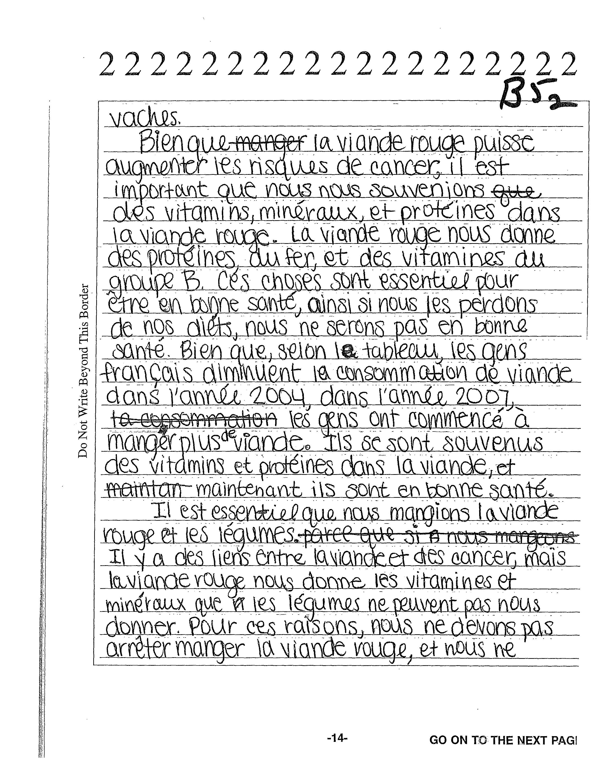

Slide 27
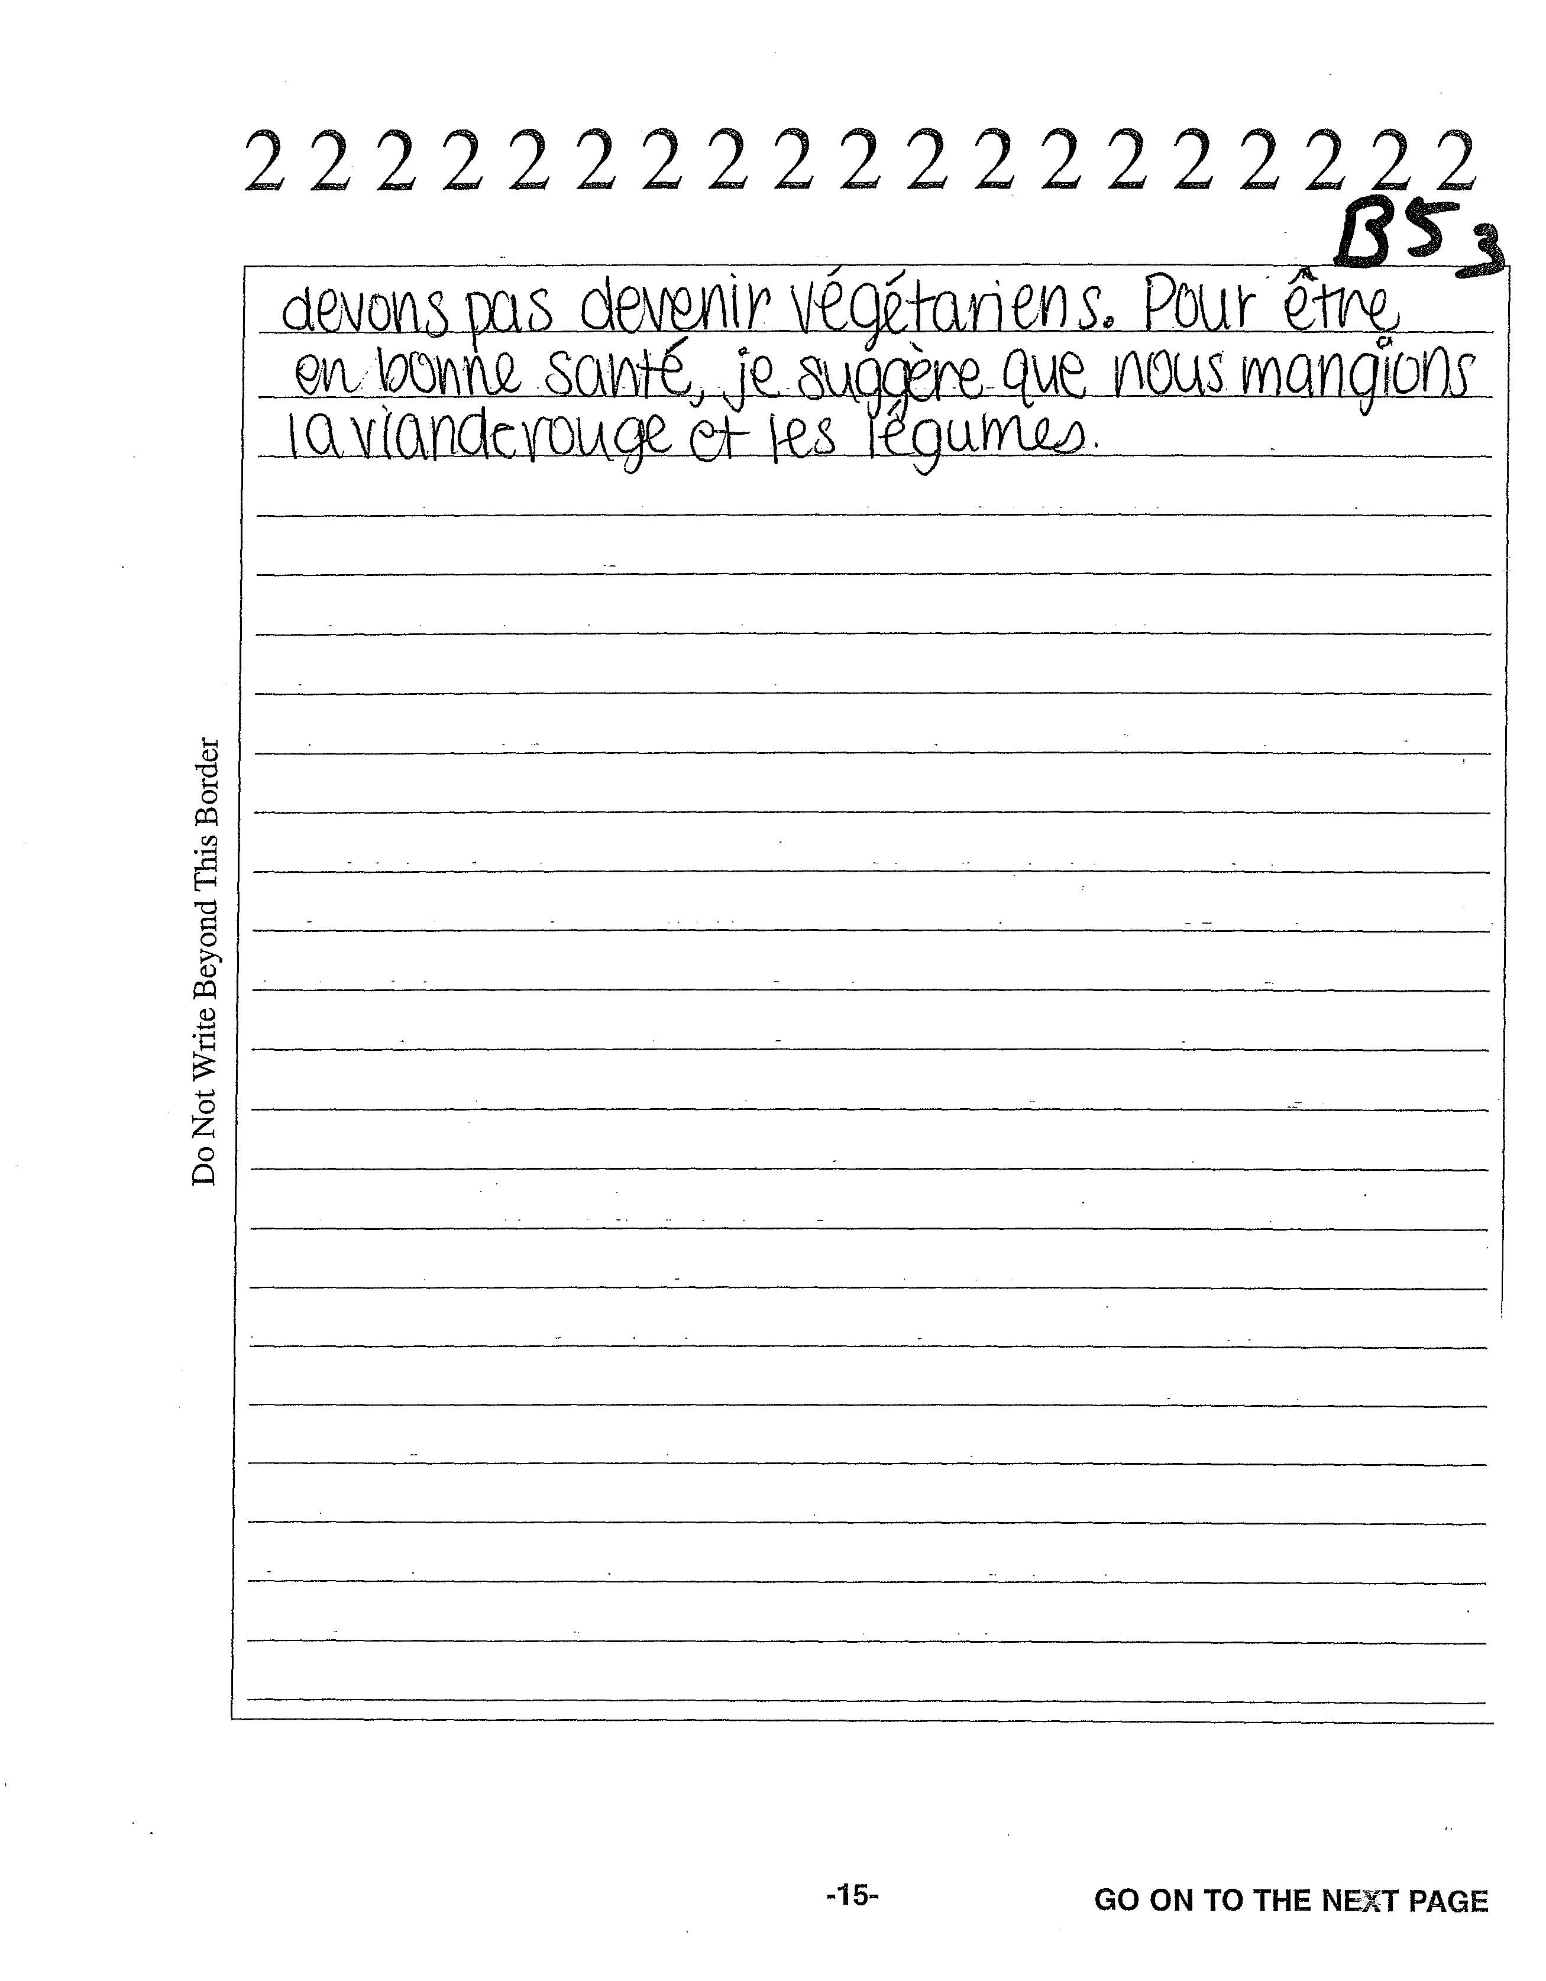

Slide 28
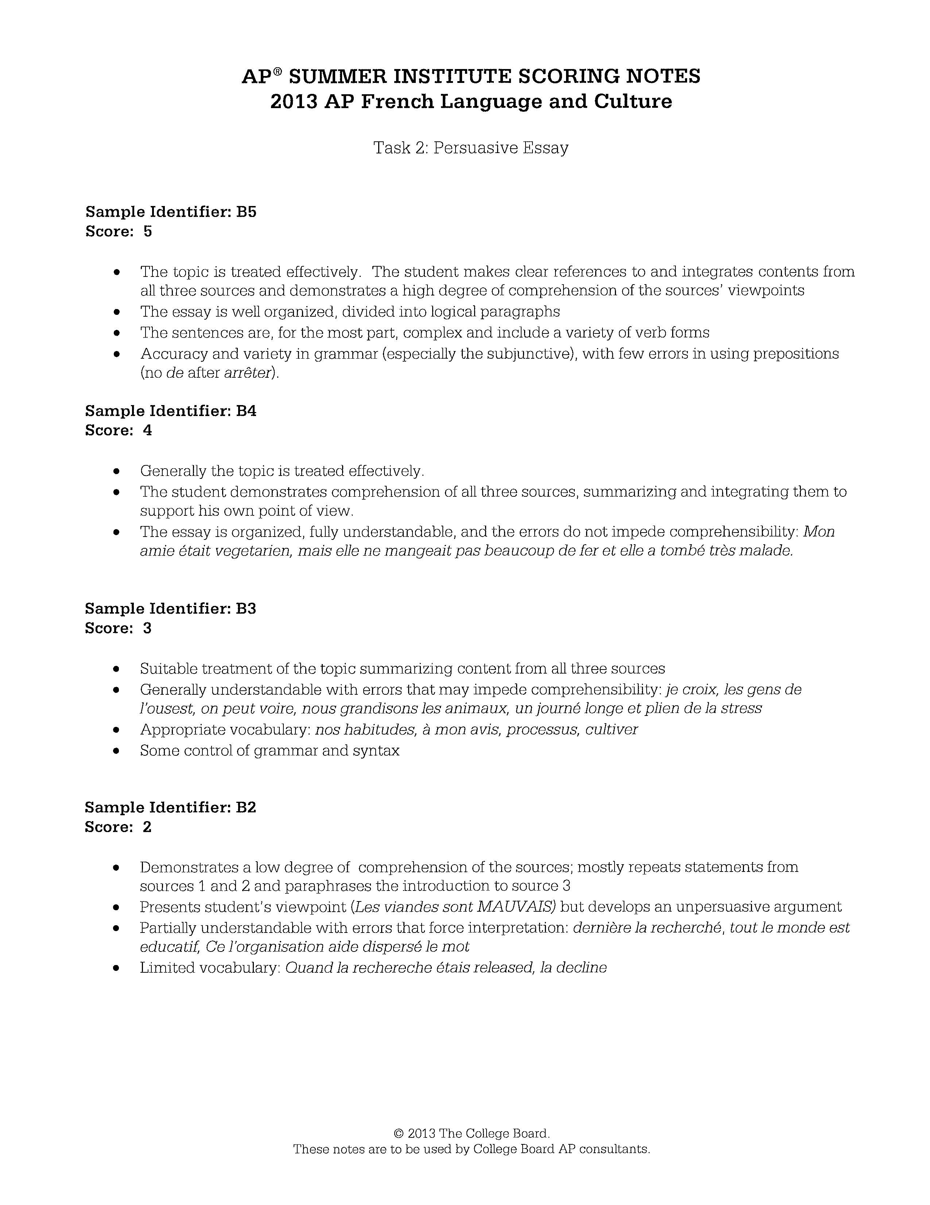

Slide 29
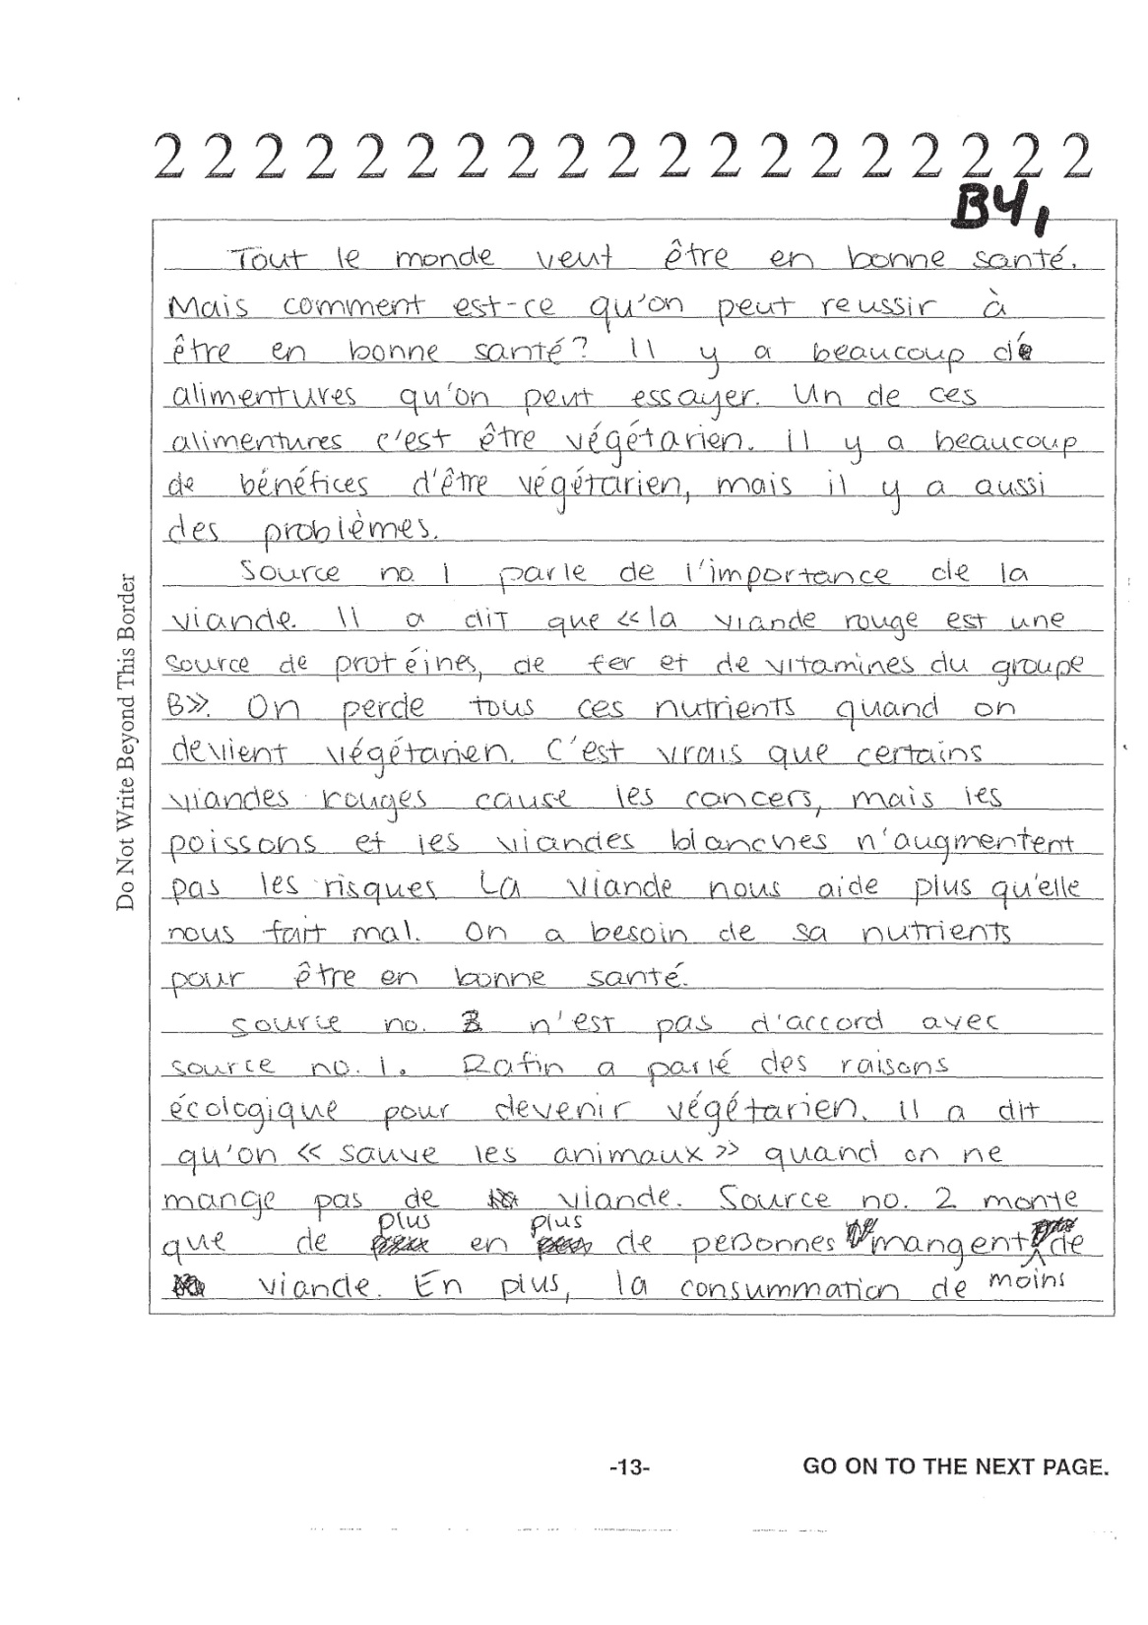

Slide 30
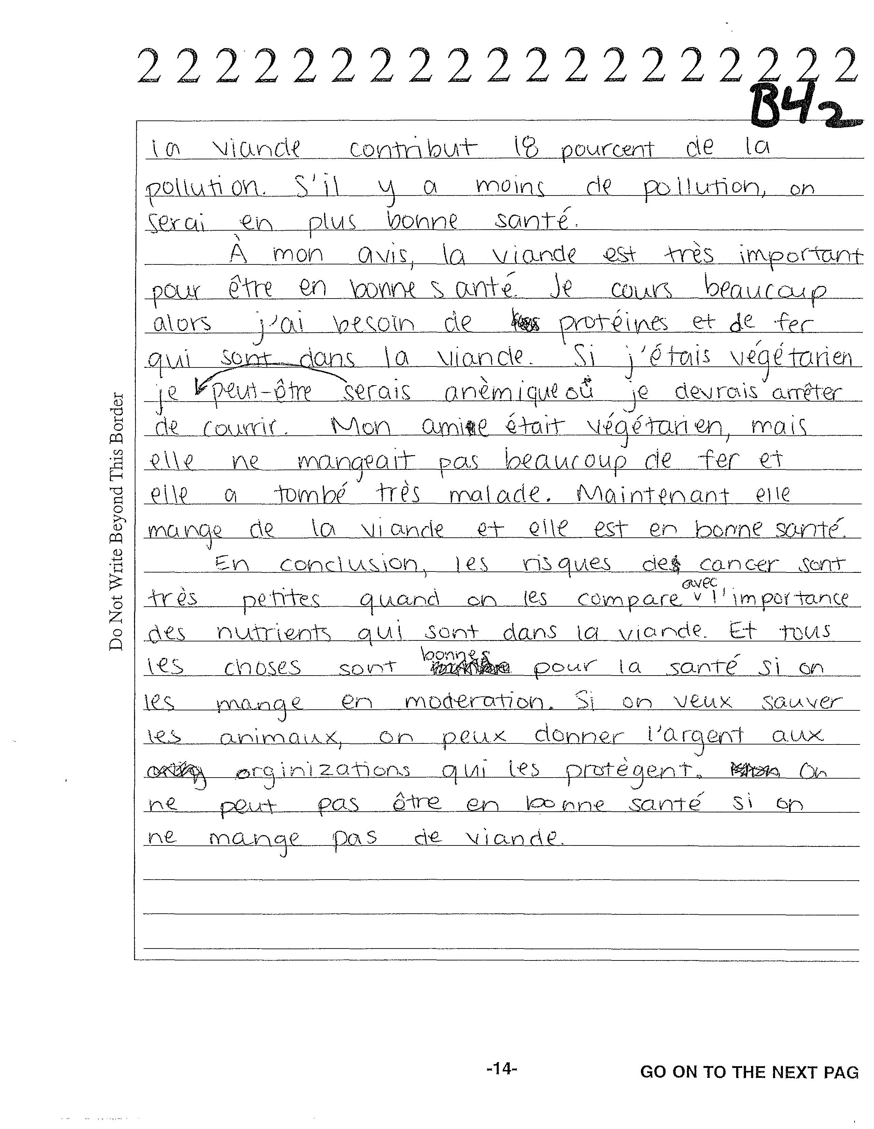

Slide 32
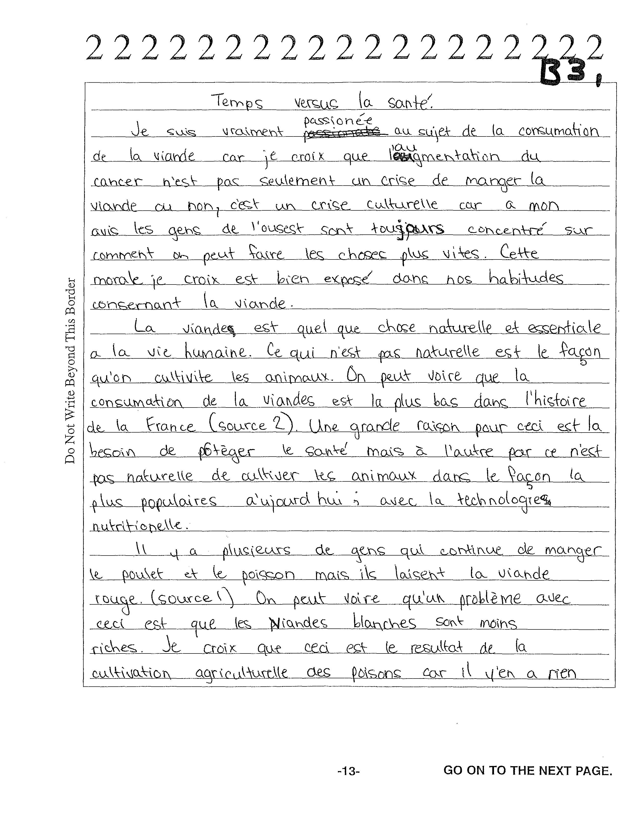

Slide 33
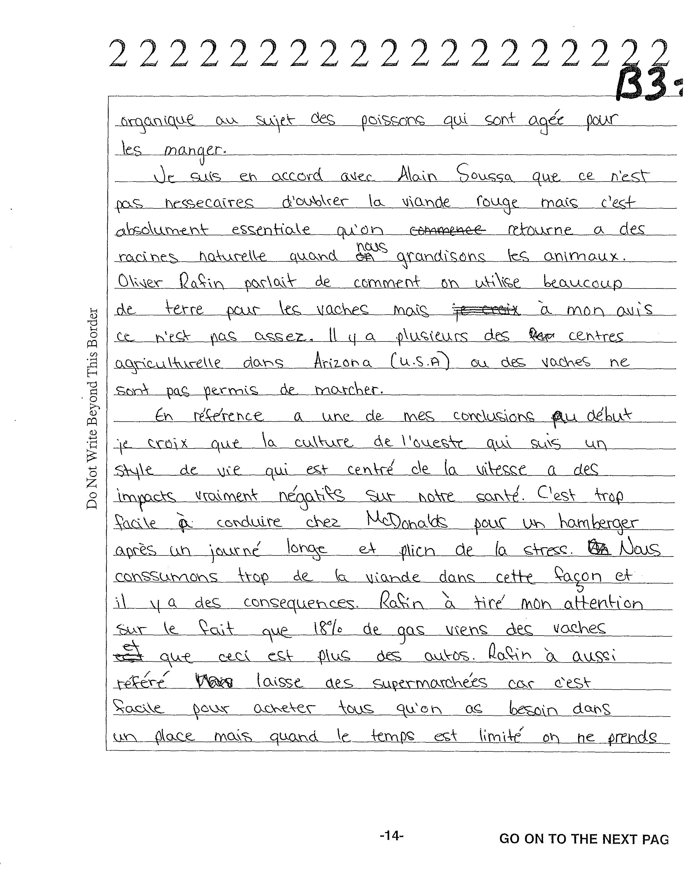

Slide 34
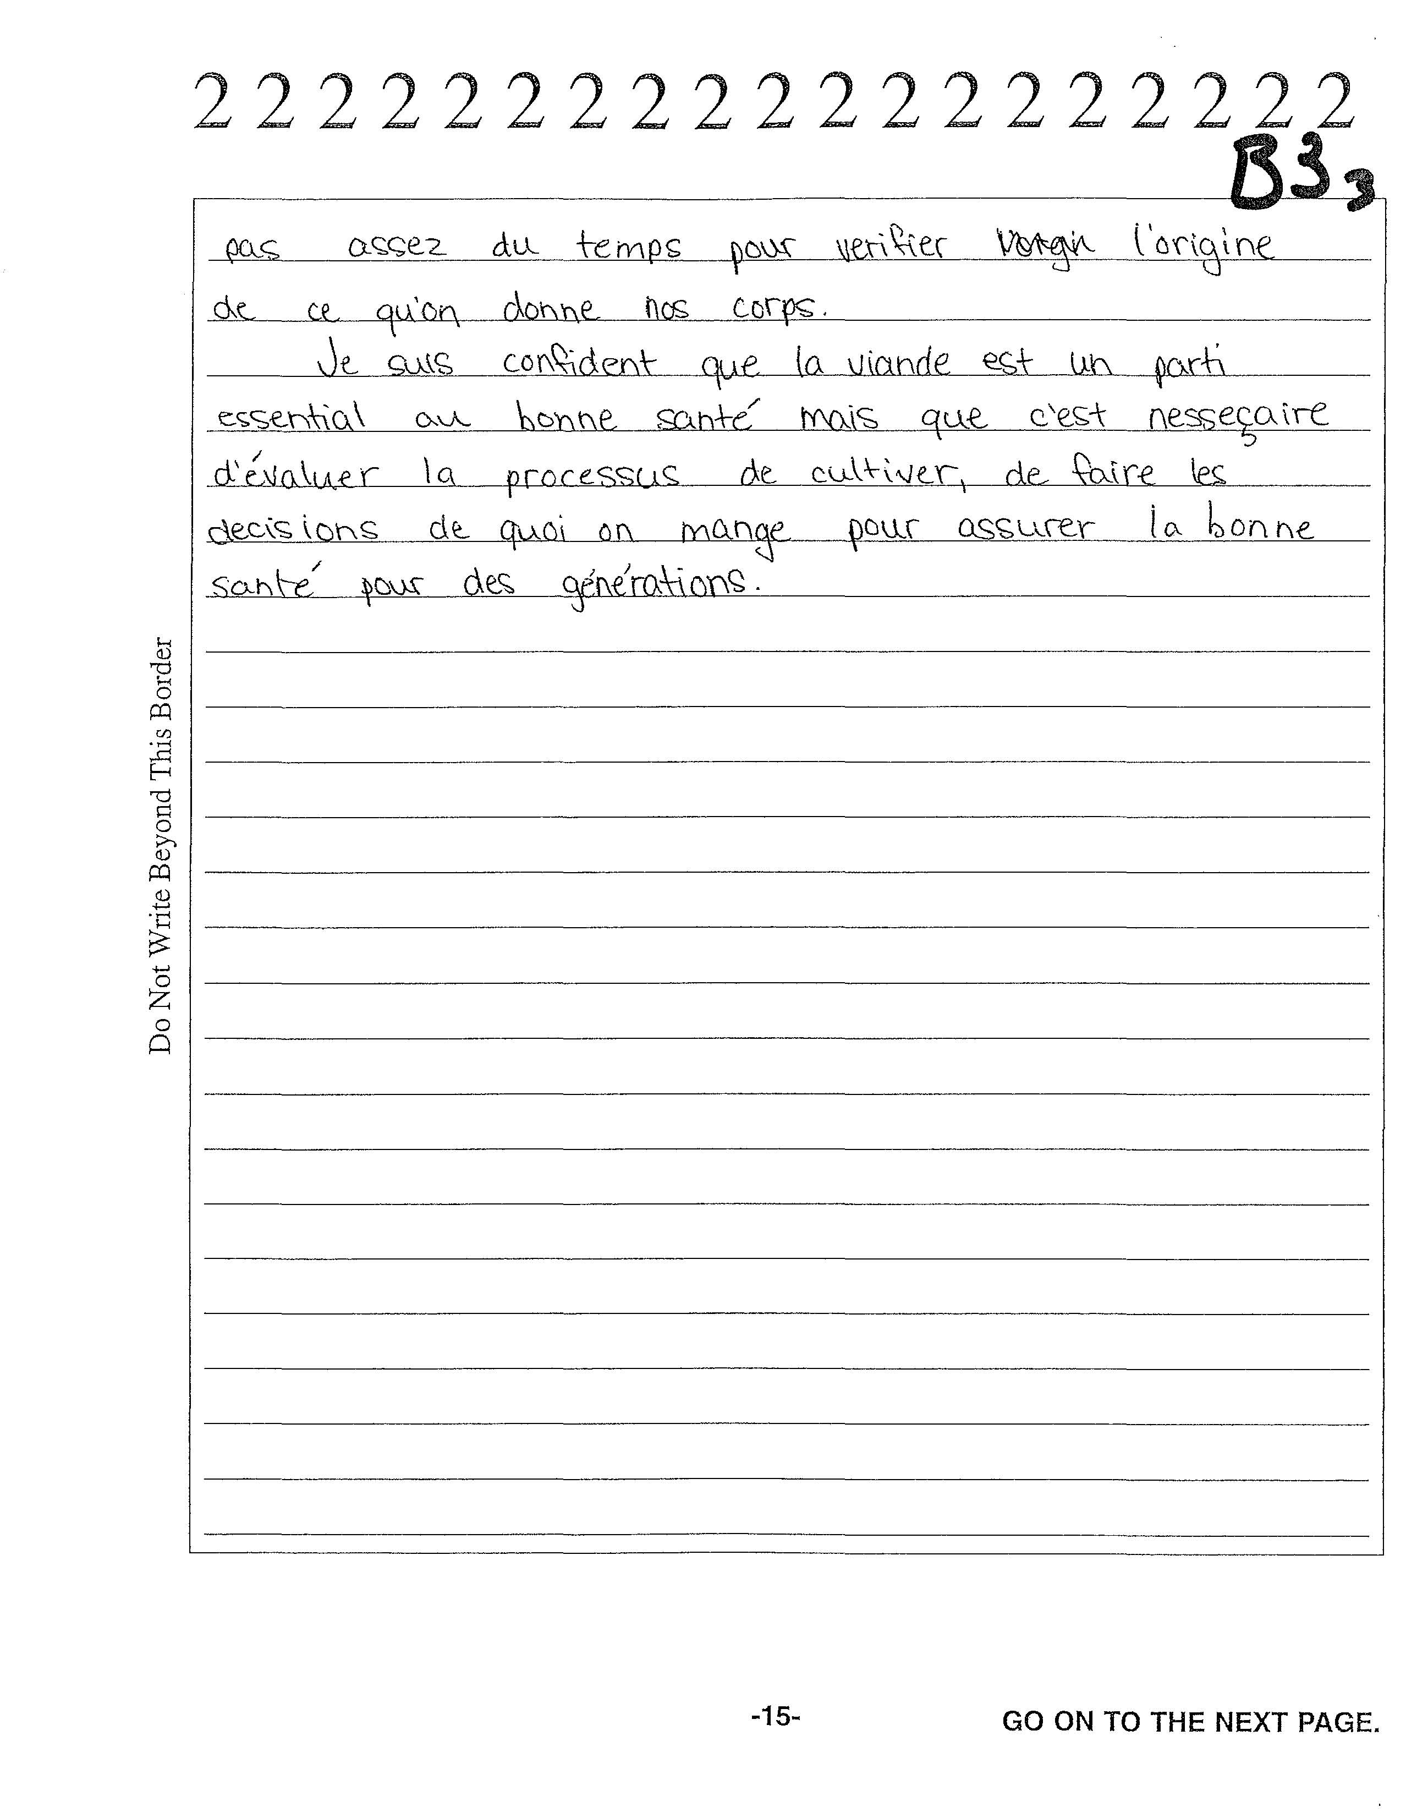

Slide 36
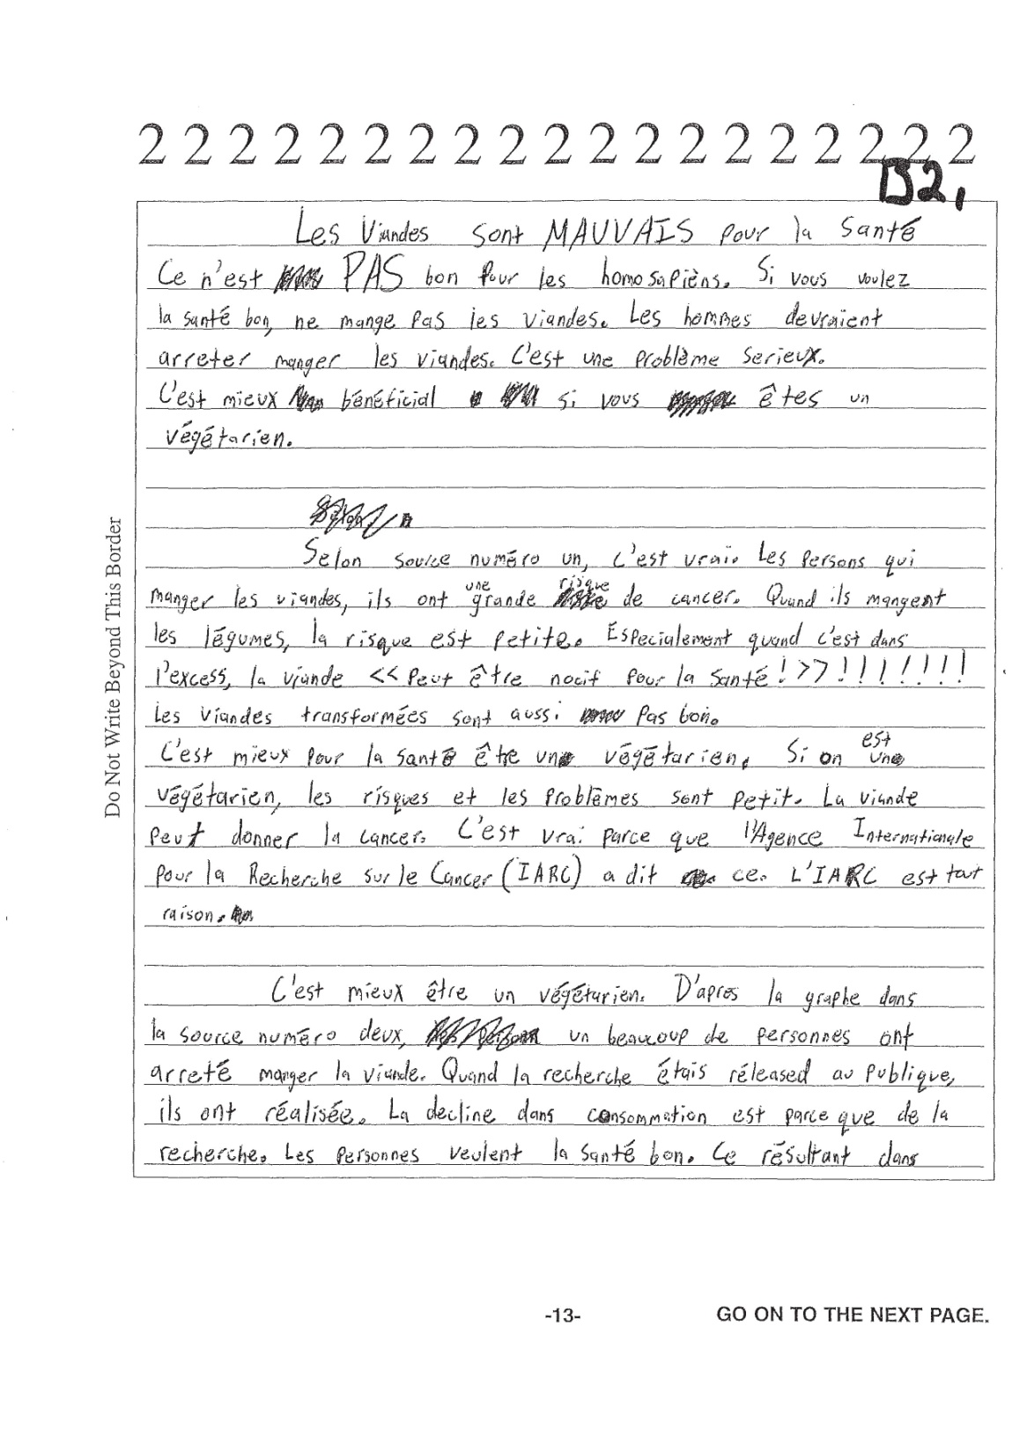

Slide 37
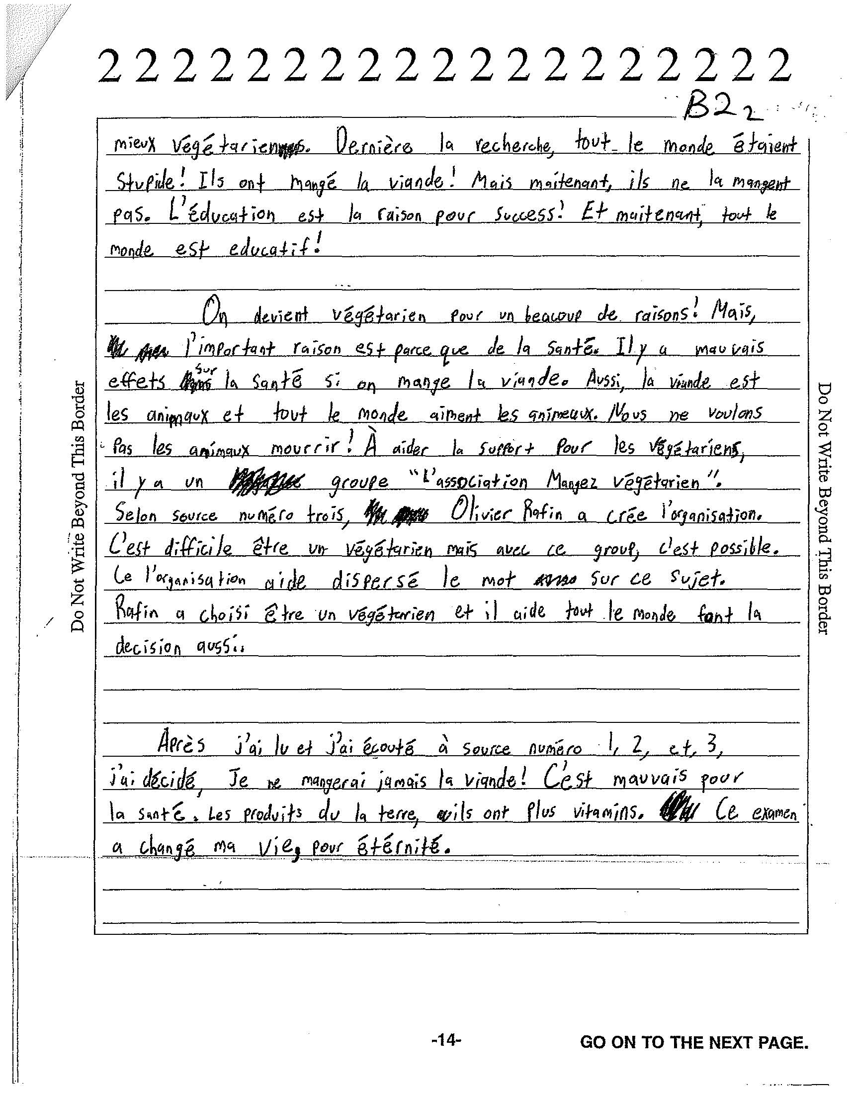

Slide 39
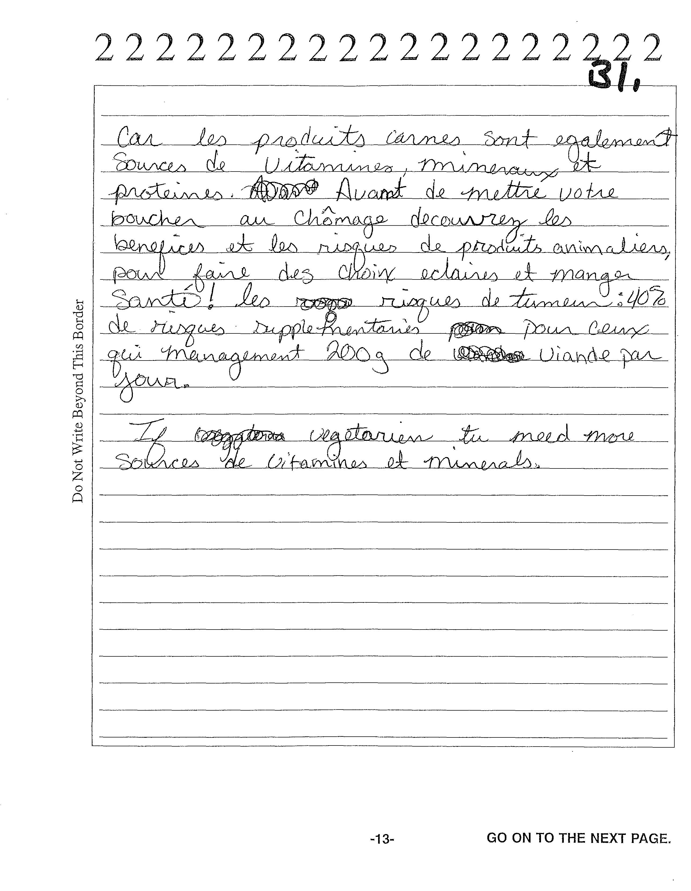

Slide 40


Slide 41
Student Responses from AP Central

Slide 42
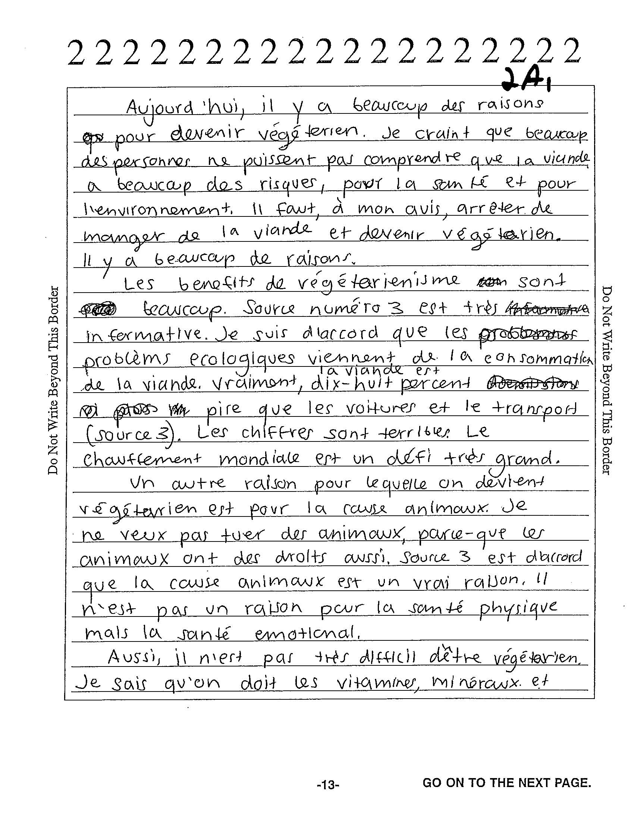

Slide 43
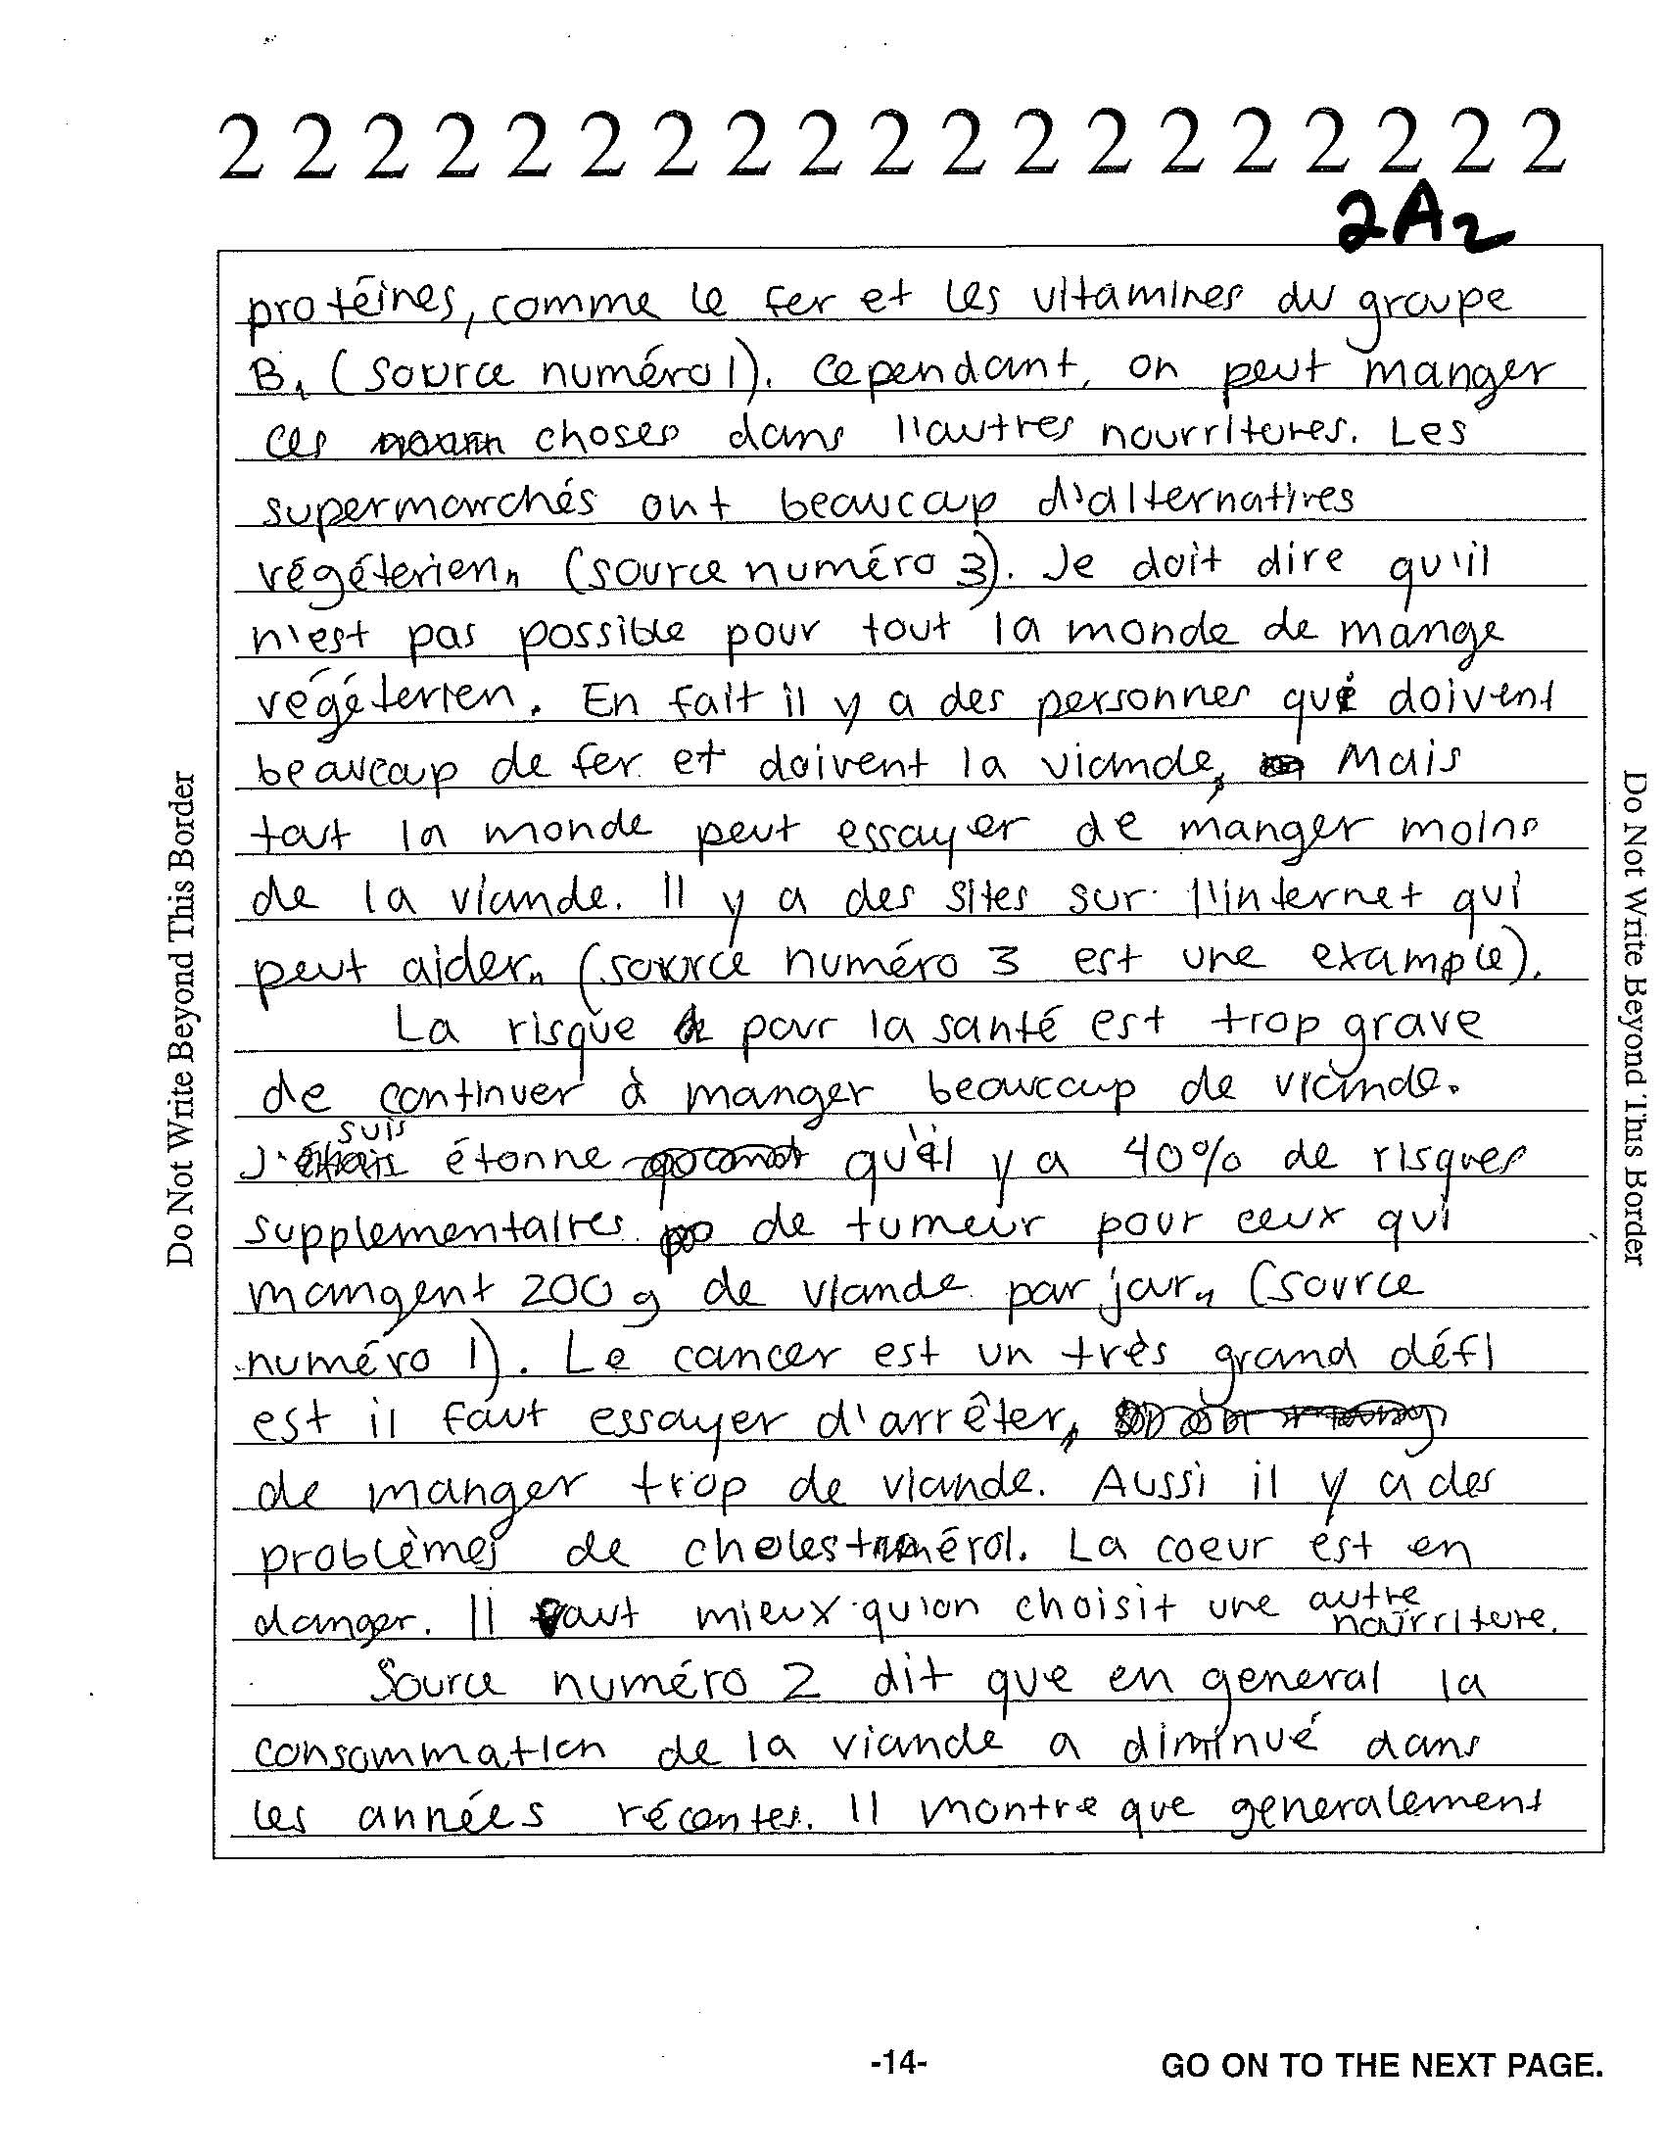

Slide 44
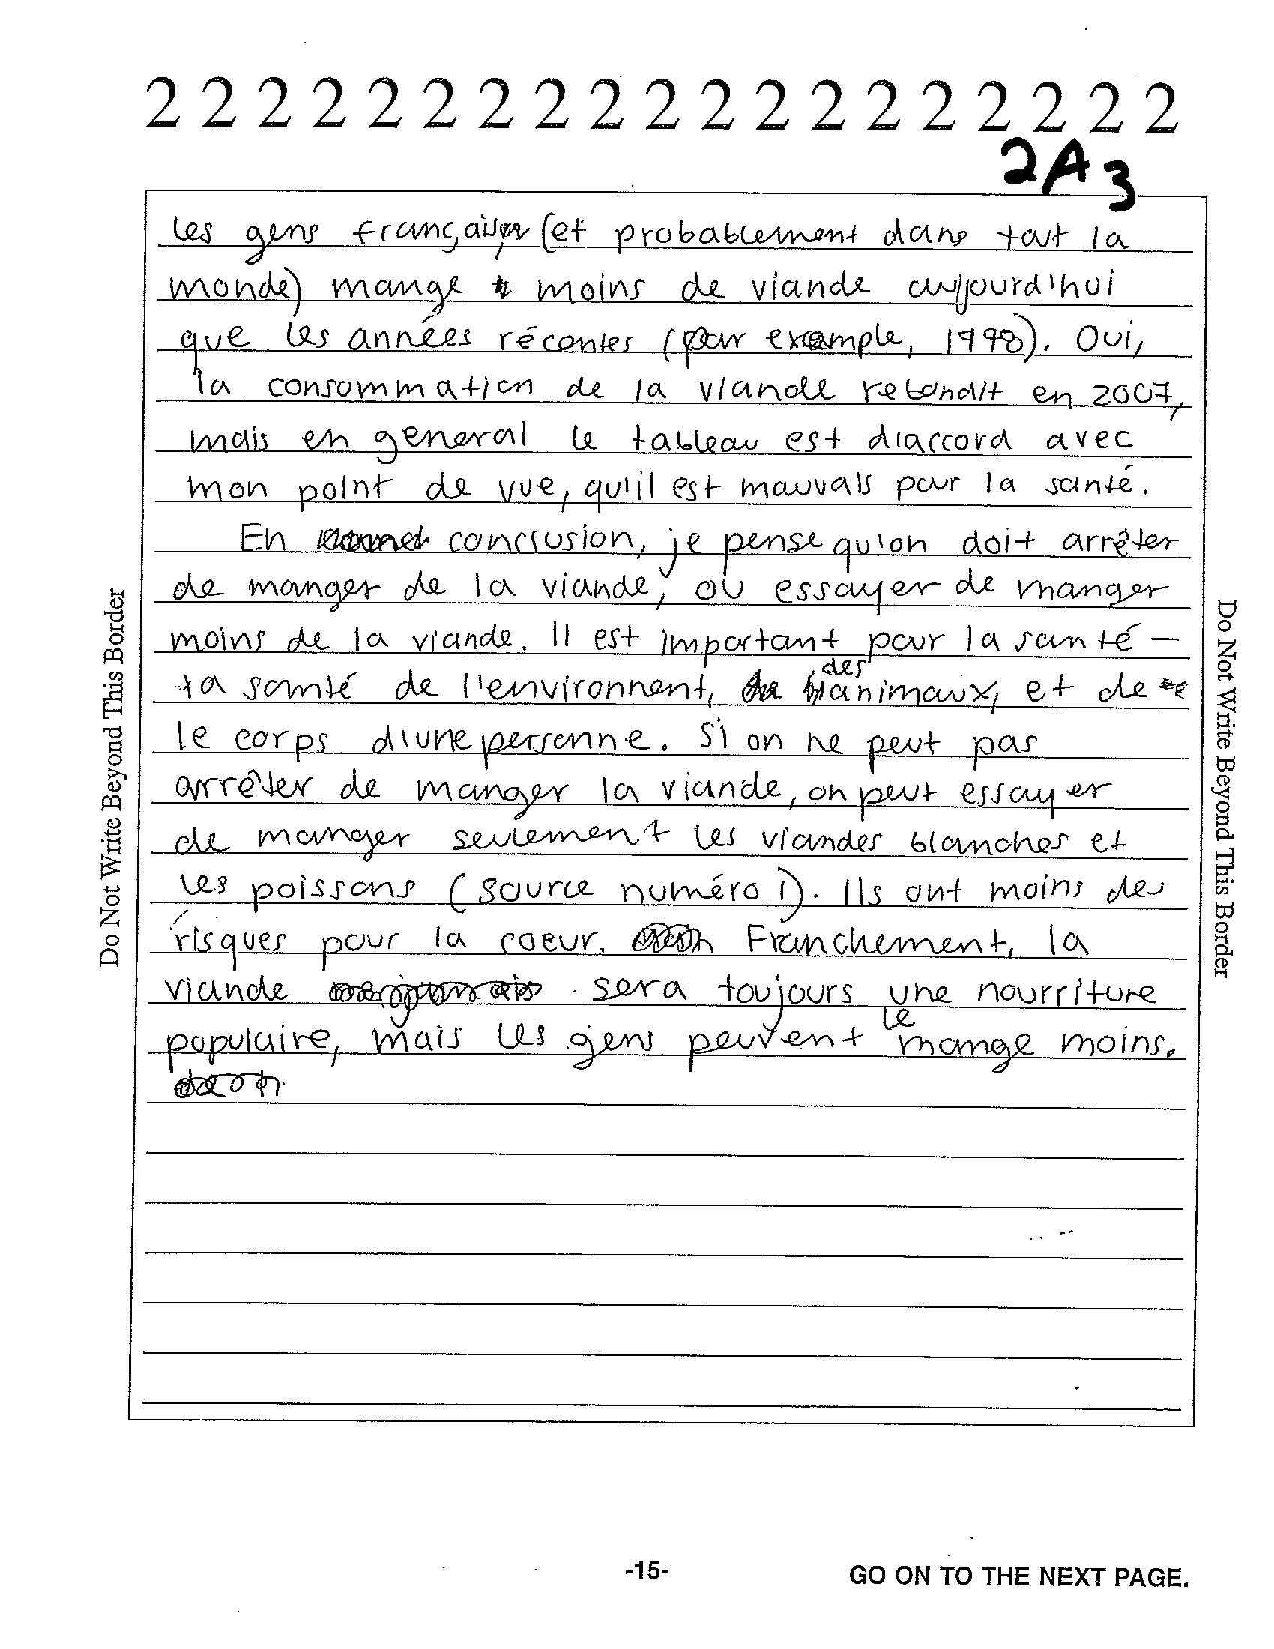

Slide 45
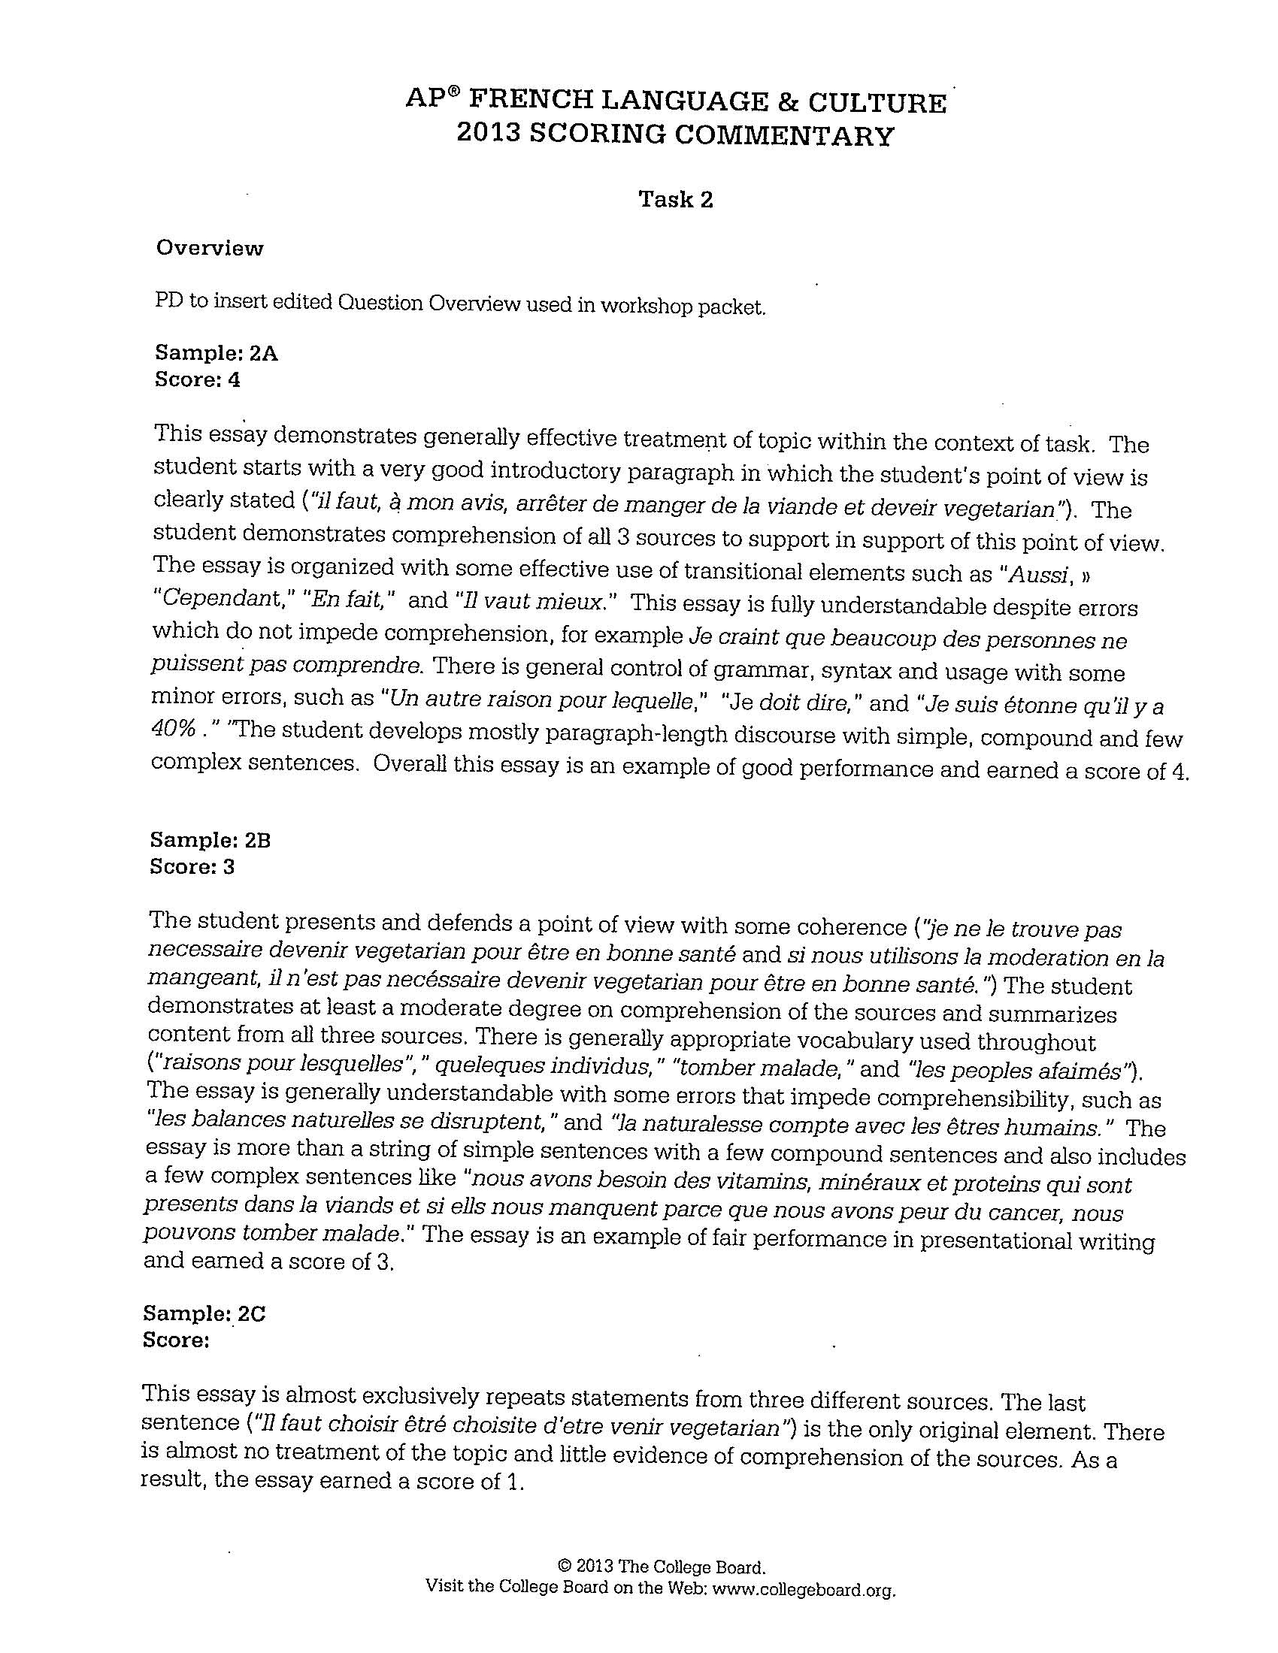

Slide 46
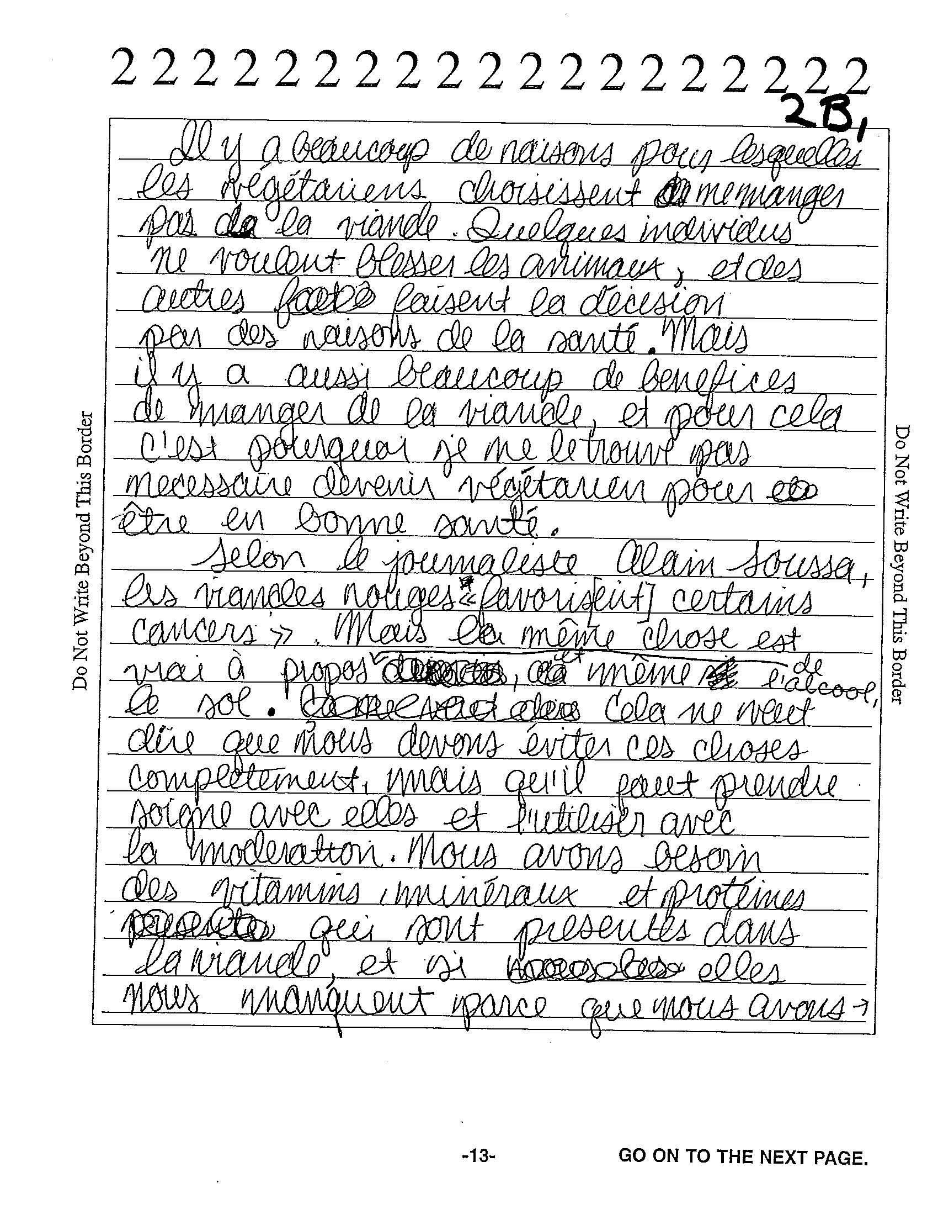

Slide 47
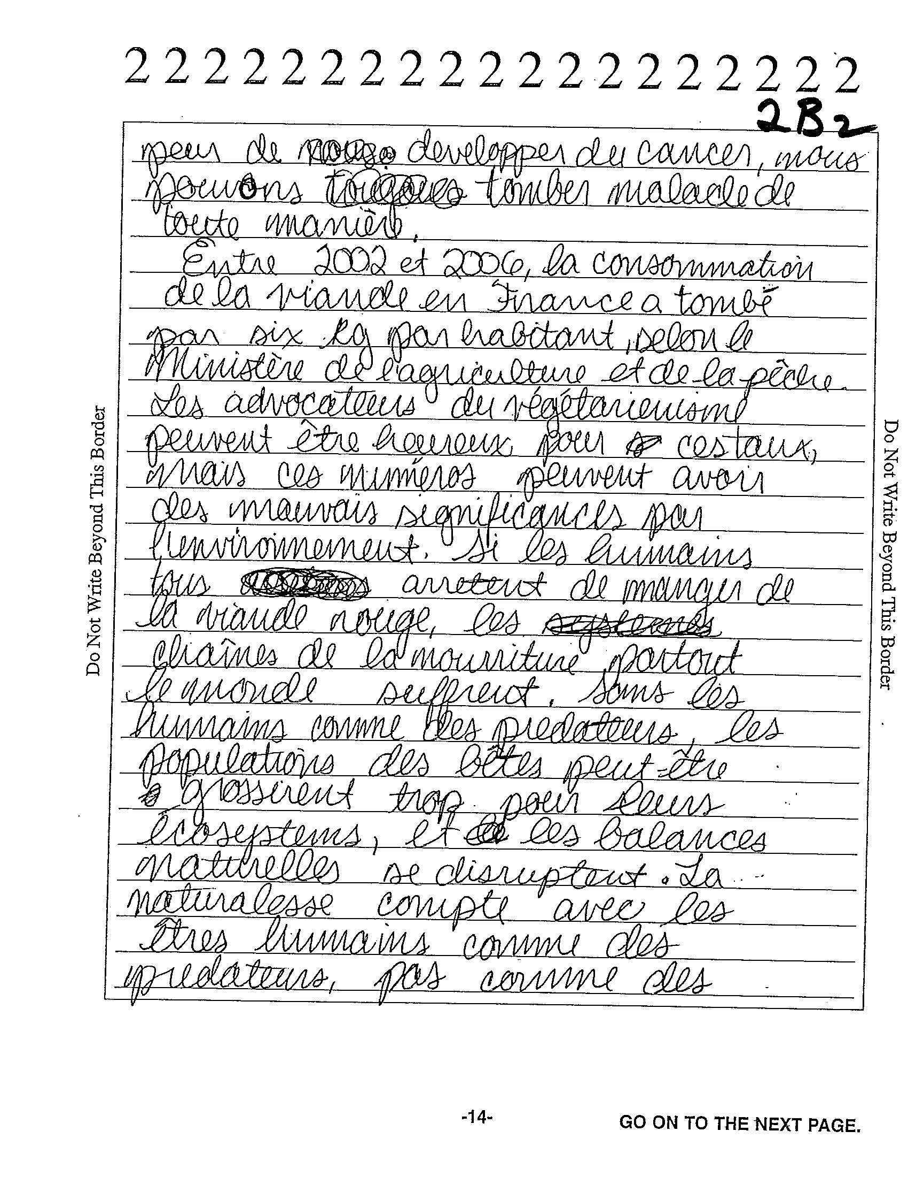

Slide 48
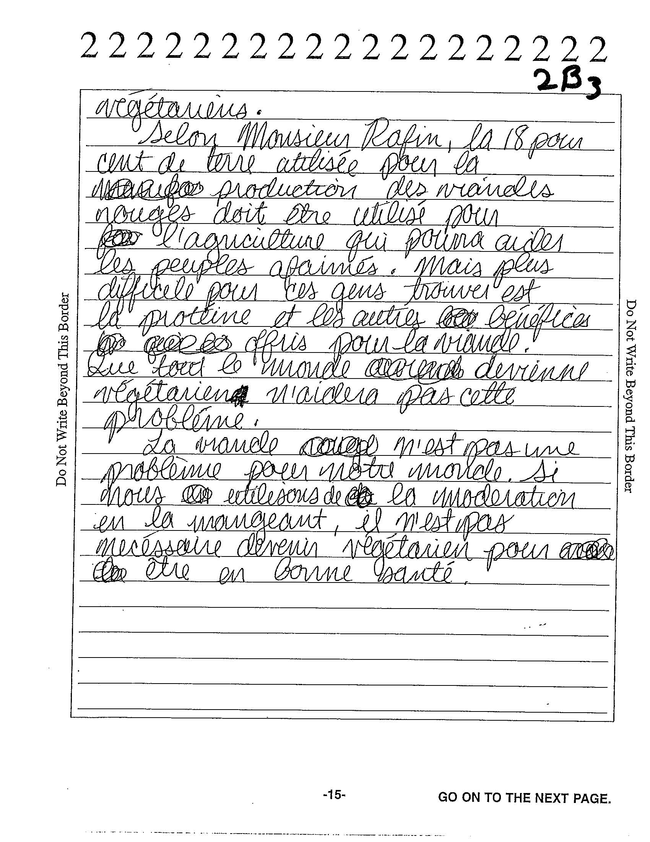

Slide 50
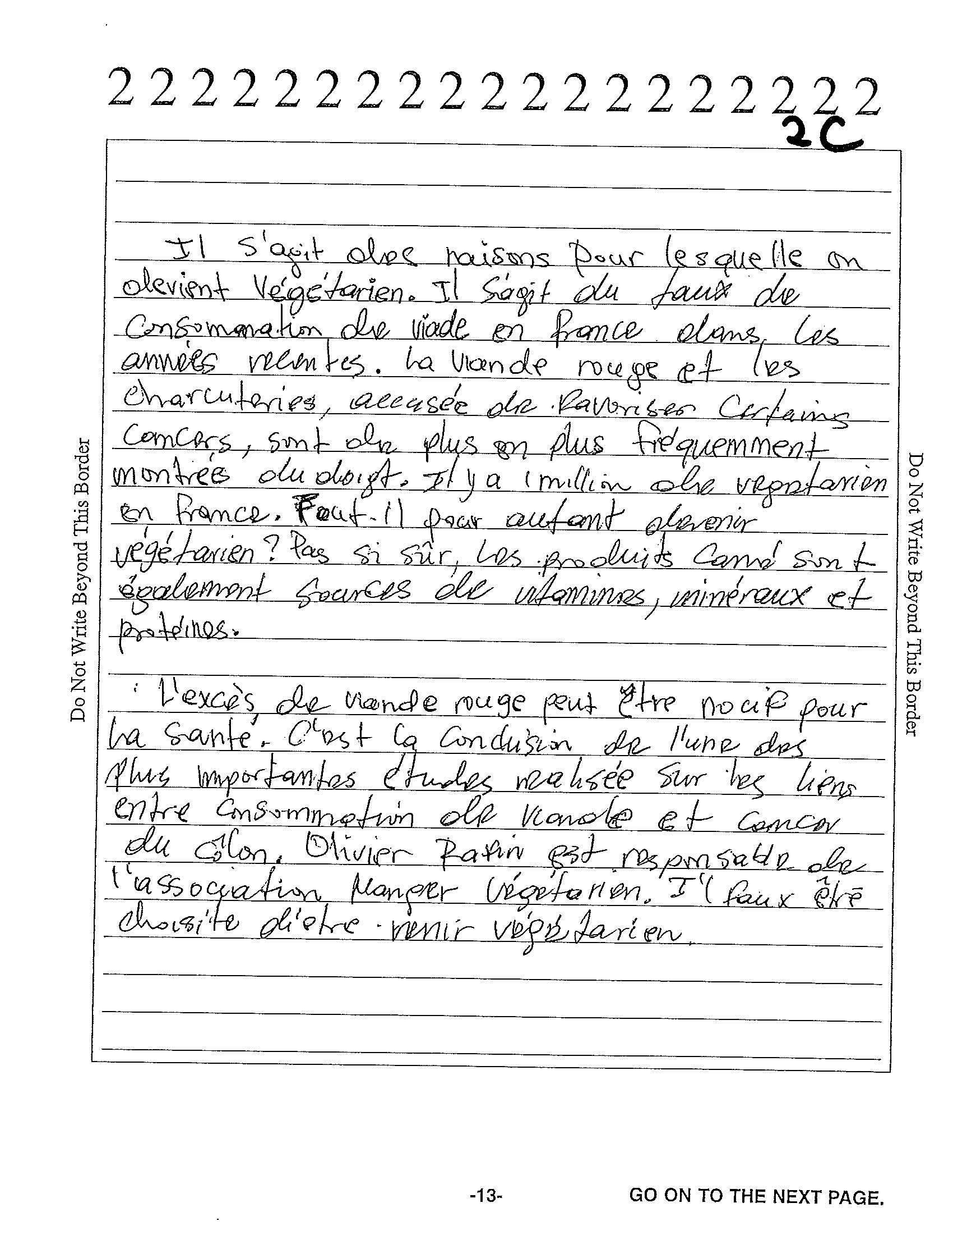

Slide 52
Instructional Strategies
Persuasive Essay

Slide 53
Common Errors/Omissions
Failure to integrate all three sources (cited or paraphrased).
Failure to present own point of view.
Language problems (incorrect use of subjunctive, passive voice, lack of transitions, vocabulary).
Disproportional use of language from prompt in answers.
Disorganized essays.

Slide 54
Teachers should address the following points:
Remind students to manage their time well (for first 6 minutes, scan article and chart; underline examples to use in essay; take notes when the audio is played in order to use example/s).
Insist that students read the prompt carefully and complete the task (cite the three sources and use them in an integrated way).
Push students to organize their persuasive essays carefully and to employ a variety of transitions.
Bring cultural practices, products, and perspectives into the classroom (supplement textbooks with variety of authentic materials).
Teach and practice the subjunctive, the passive voice, and vocabulary in context.
Insist on the difference between summarizing and integrating.
Remind students that it is not appropriate to refer to journalists or interviewees by their first name in this context.

Slide 55

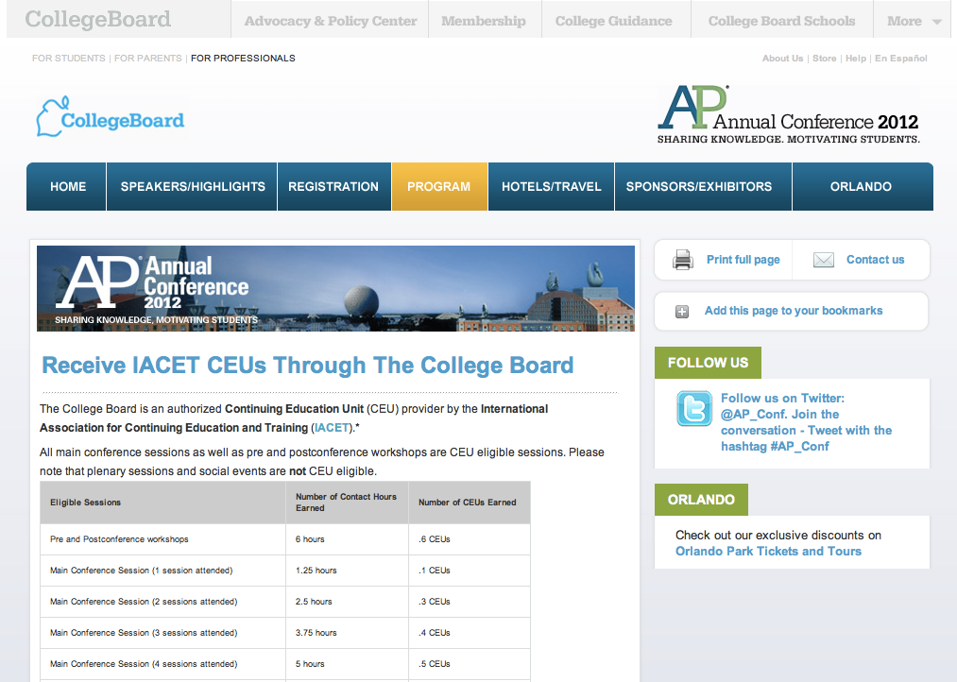
Share Your Feedback On This Session
And Earn Continuing Education Units (CEUs)
Visit the conference website at apac.collegeboard.org
  Click on
  “Earn Main Conference CEUs”
  From there you will be taken to
  the CEU Online Platform
Questions?
  While onsite, visit the
  information desk at the Sands Expo – Upper Lobby
  After the event write to: support@pesgce.com

Slide 56
Brian Kennelly
calpoly.edu/~bkennell

