Slide 1
Improving Student Performance on the Cultural Comparison
20 July 2013
AP Annual Conference

Slide 2
Overview
Learning Objectives for Spoken Presentational Communication
Overview of Cultural Comparison & Prompt from 2013 AP Exam
2013 Scoring Guidelines
Student Samples from 2013 AP Exam
Sharing of Instructional Strategies for Cultural Comparison

Slide 3
Learning Objectives
Spoken Presentational Communication

Slide 4
Presentational Communication
The Presentational Mode is characterized by the creation of messages in a manner that facilitates interpretation by members of the target culture where no direct opportunity for the active negotiation of meaning exists.

Slide 5
Spoken Presentational Communication
Primary Learning Objective
The student plans, produces, and presents spoken presentational communications.

Slide 6
Spoken Presentational Communication
Additional Learning Objectives
The student produces a variety of creative oral presentations.
The student retells or summarizes information in narrative form, demonstrating a consideration of audience.
The student creates and gives persuasive speeches.
The student expounds on familiar topics and those requiring research.
The student uses reference tools, acknowledges sources, and cites them appropriately.
The student self-monitors and adjusts language production.
The student demonstrates an understanding of the features of target culture communities.
The student demonstrates knowledge and understanding of content across disciplines.

Slide 7
Cultural Comparison
Overview & Prompt from 2013 AP Exam

Slide 8
Cultural Comparison
Overview: For this task, the student…
makes an oral presentation to French class on topic.
demonstrates understanding of cultural features of some area of French-speaking world.
may cite examples from materials read, viewed, or listened to in class as well as from personal experiences and observations.
has 4 minutes to read topic and prepare presentation.
has 2 minutes to record presentation.

Slide 9
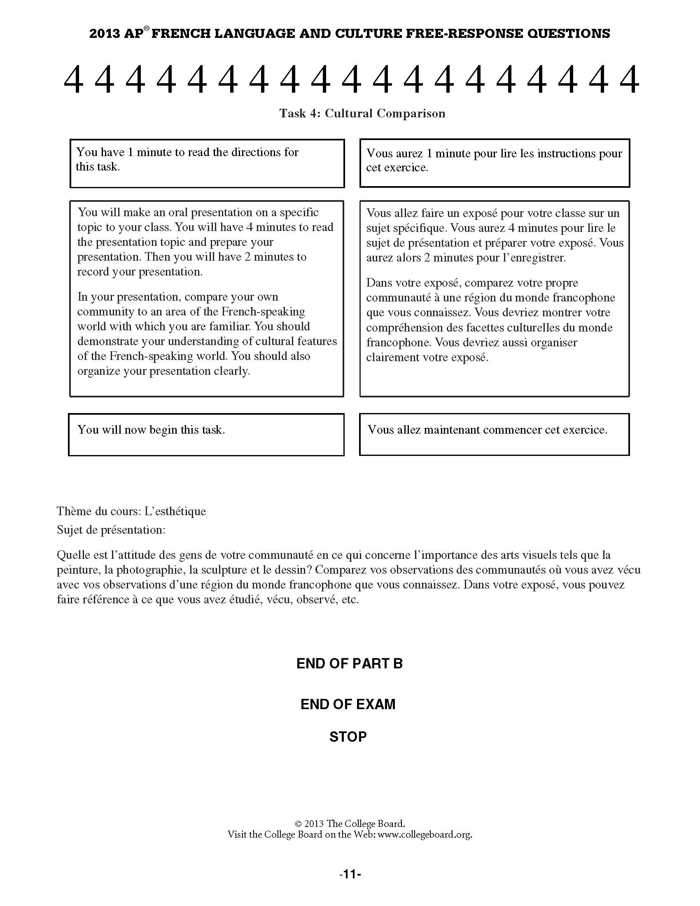

Slide 10
Cultural Comparison
2013 Scoring Guidelines

Slide 11
Presentation is organized and effectively addresses topic by including examples that represent both sides of cultural comparison (i.e. student’s family, school or community and an area of the French-speaking world).
Examples need not be numerous—if well described, one example for each side of the comparison is sufficient—and student does not have to dedicate equal time to each side of the comparison.
Examples cited are specific (i.e. not merely cultural stereotypes or generic statements), relevant to the topic, and student is able to provide some elaboration.

Slide 12
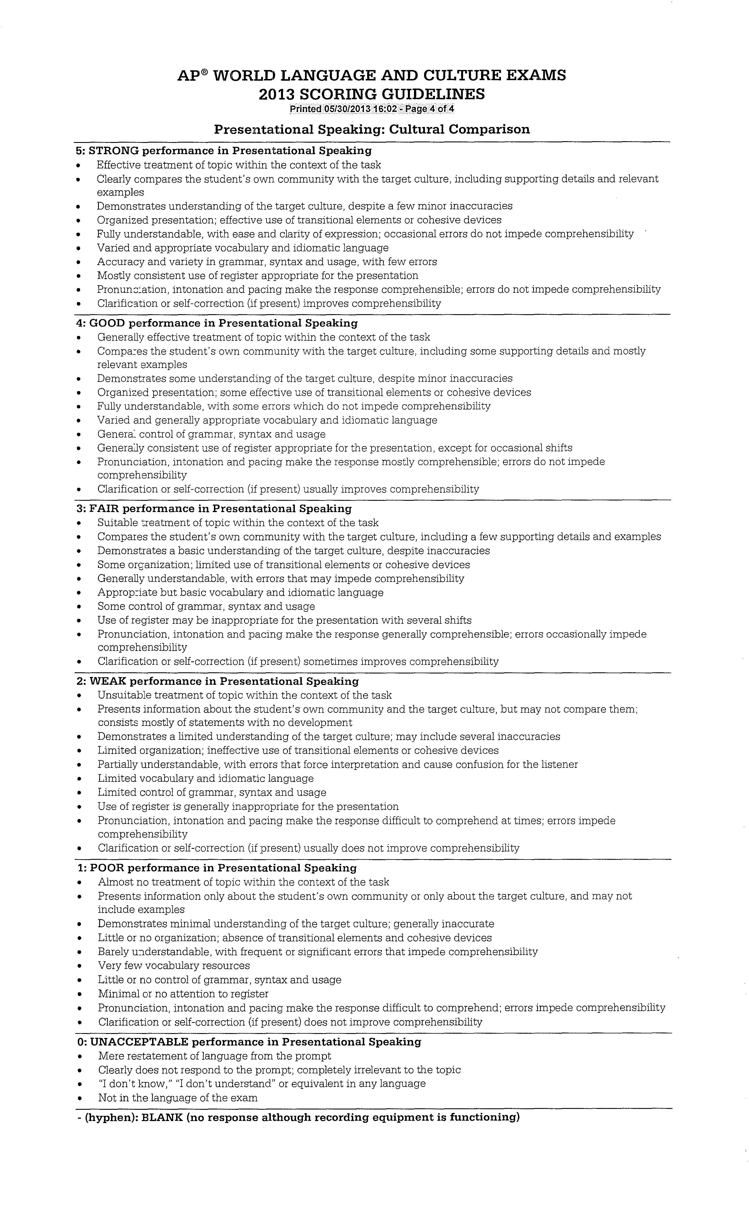

Slide 13
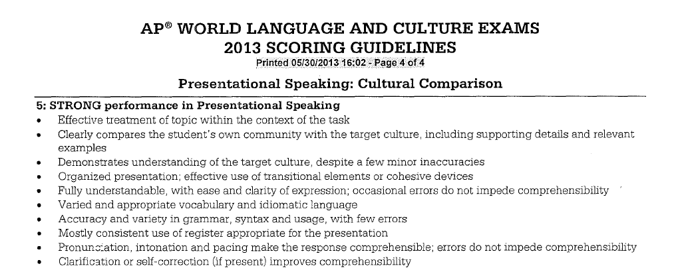

Slide 14
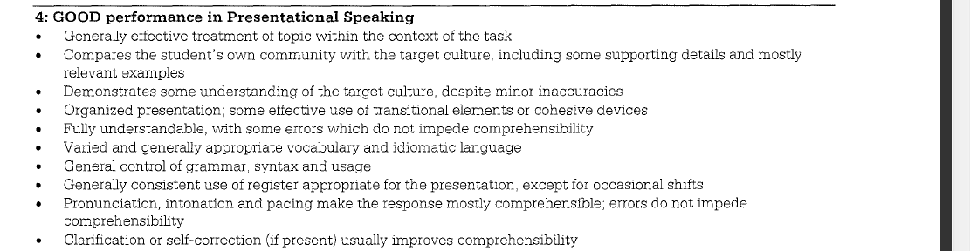

Slide 15
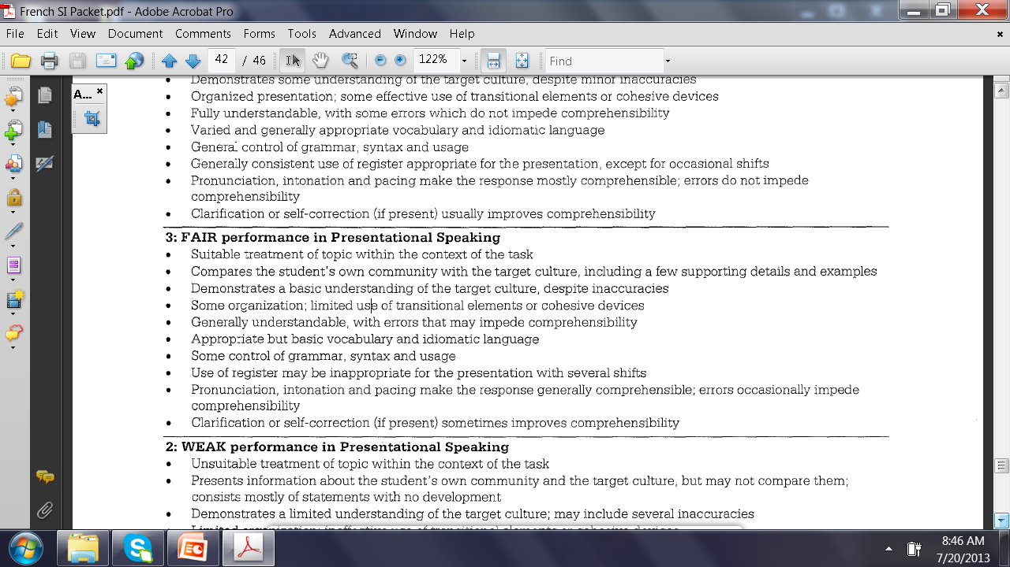

Slide 16
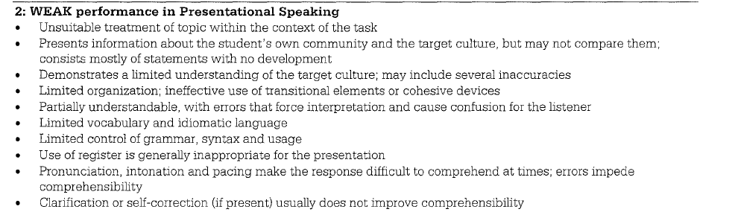

Slide 17
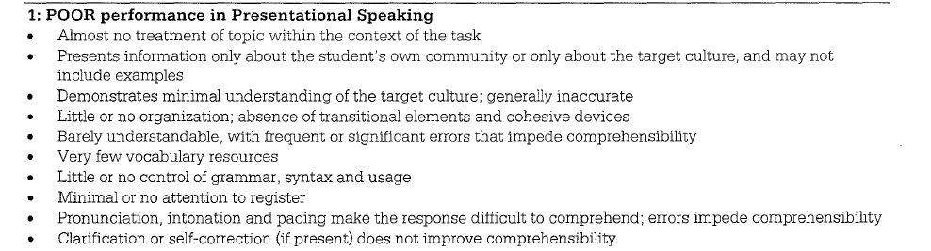

Slide 18
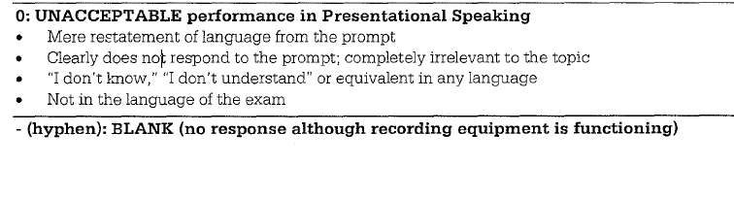

Slide 19
Student Samples
2013 AP Exam

Slide 20
Audio CDs of first five student samples are distributed at College Board-endorsed one-day workshops and AP Summer Institutes.
Audio of second three student samples will be available on AP Central in Fall 2013.

Slide 21

Student Sample 4A

Slide 22
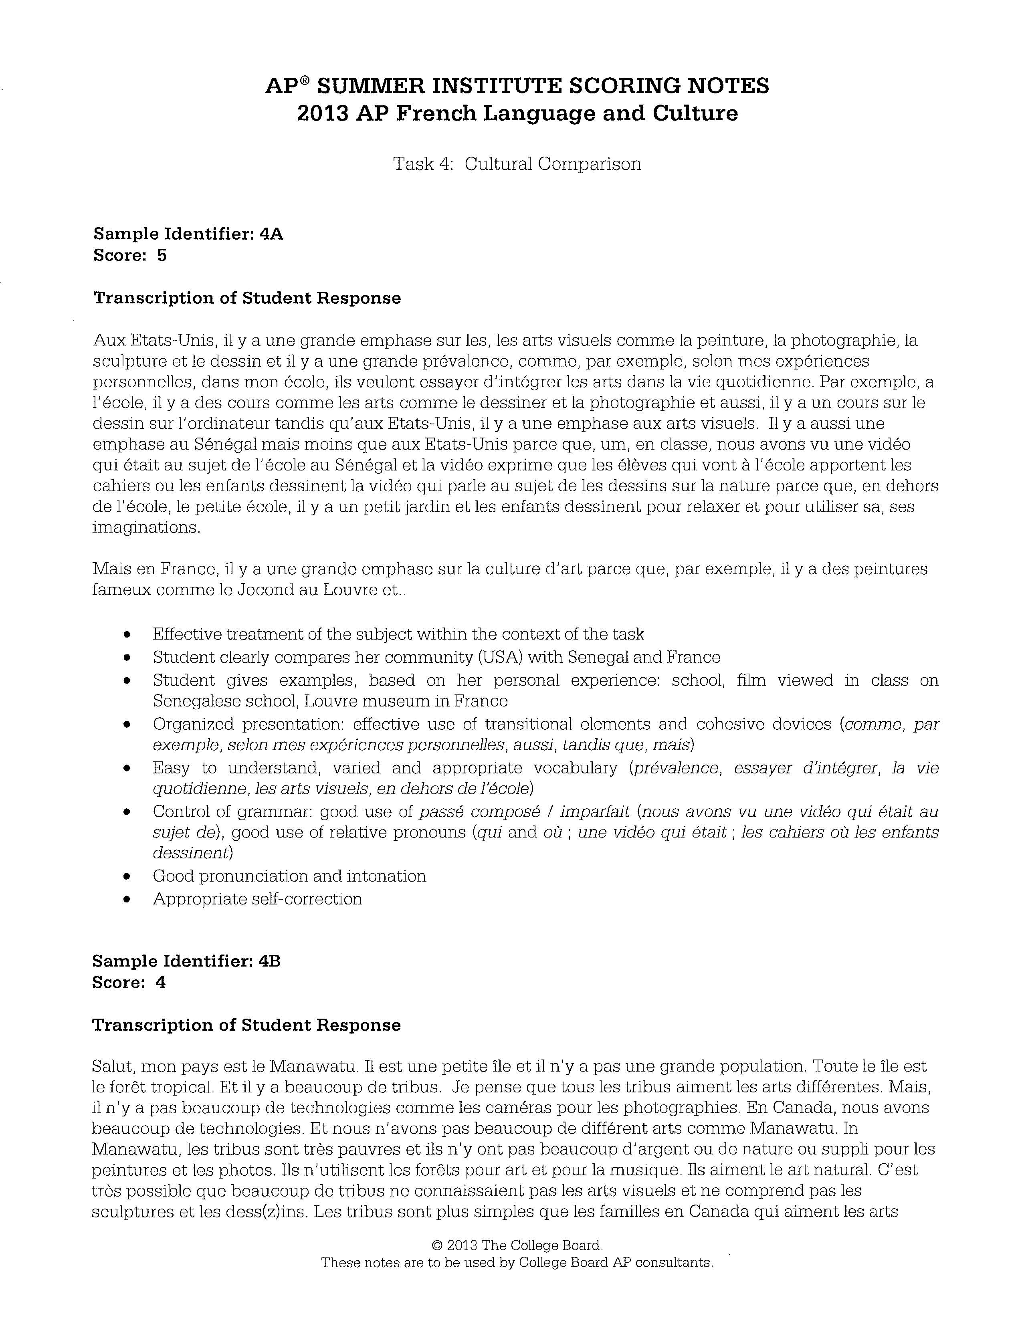

Slide 23
Student Sample 4B

Slide 25
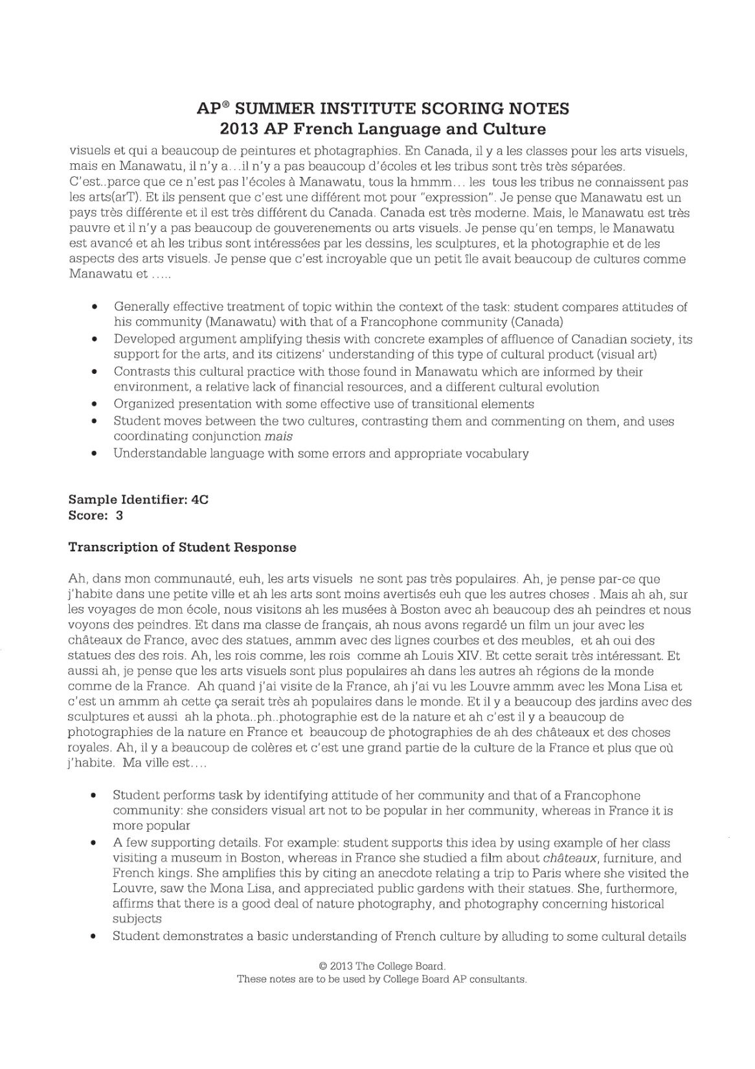

Slide 26
Student Sample 4C

Slide 28
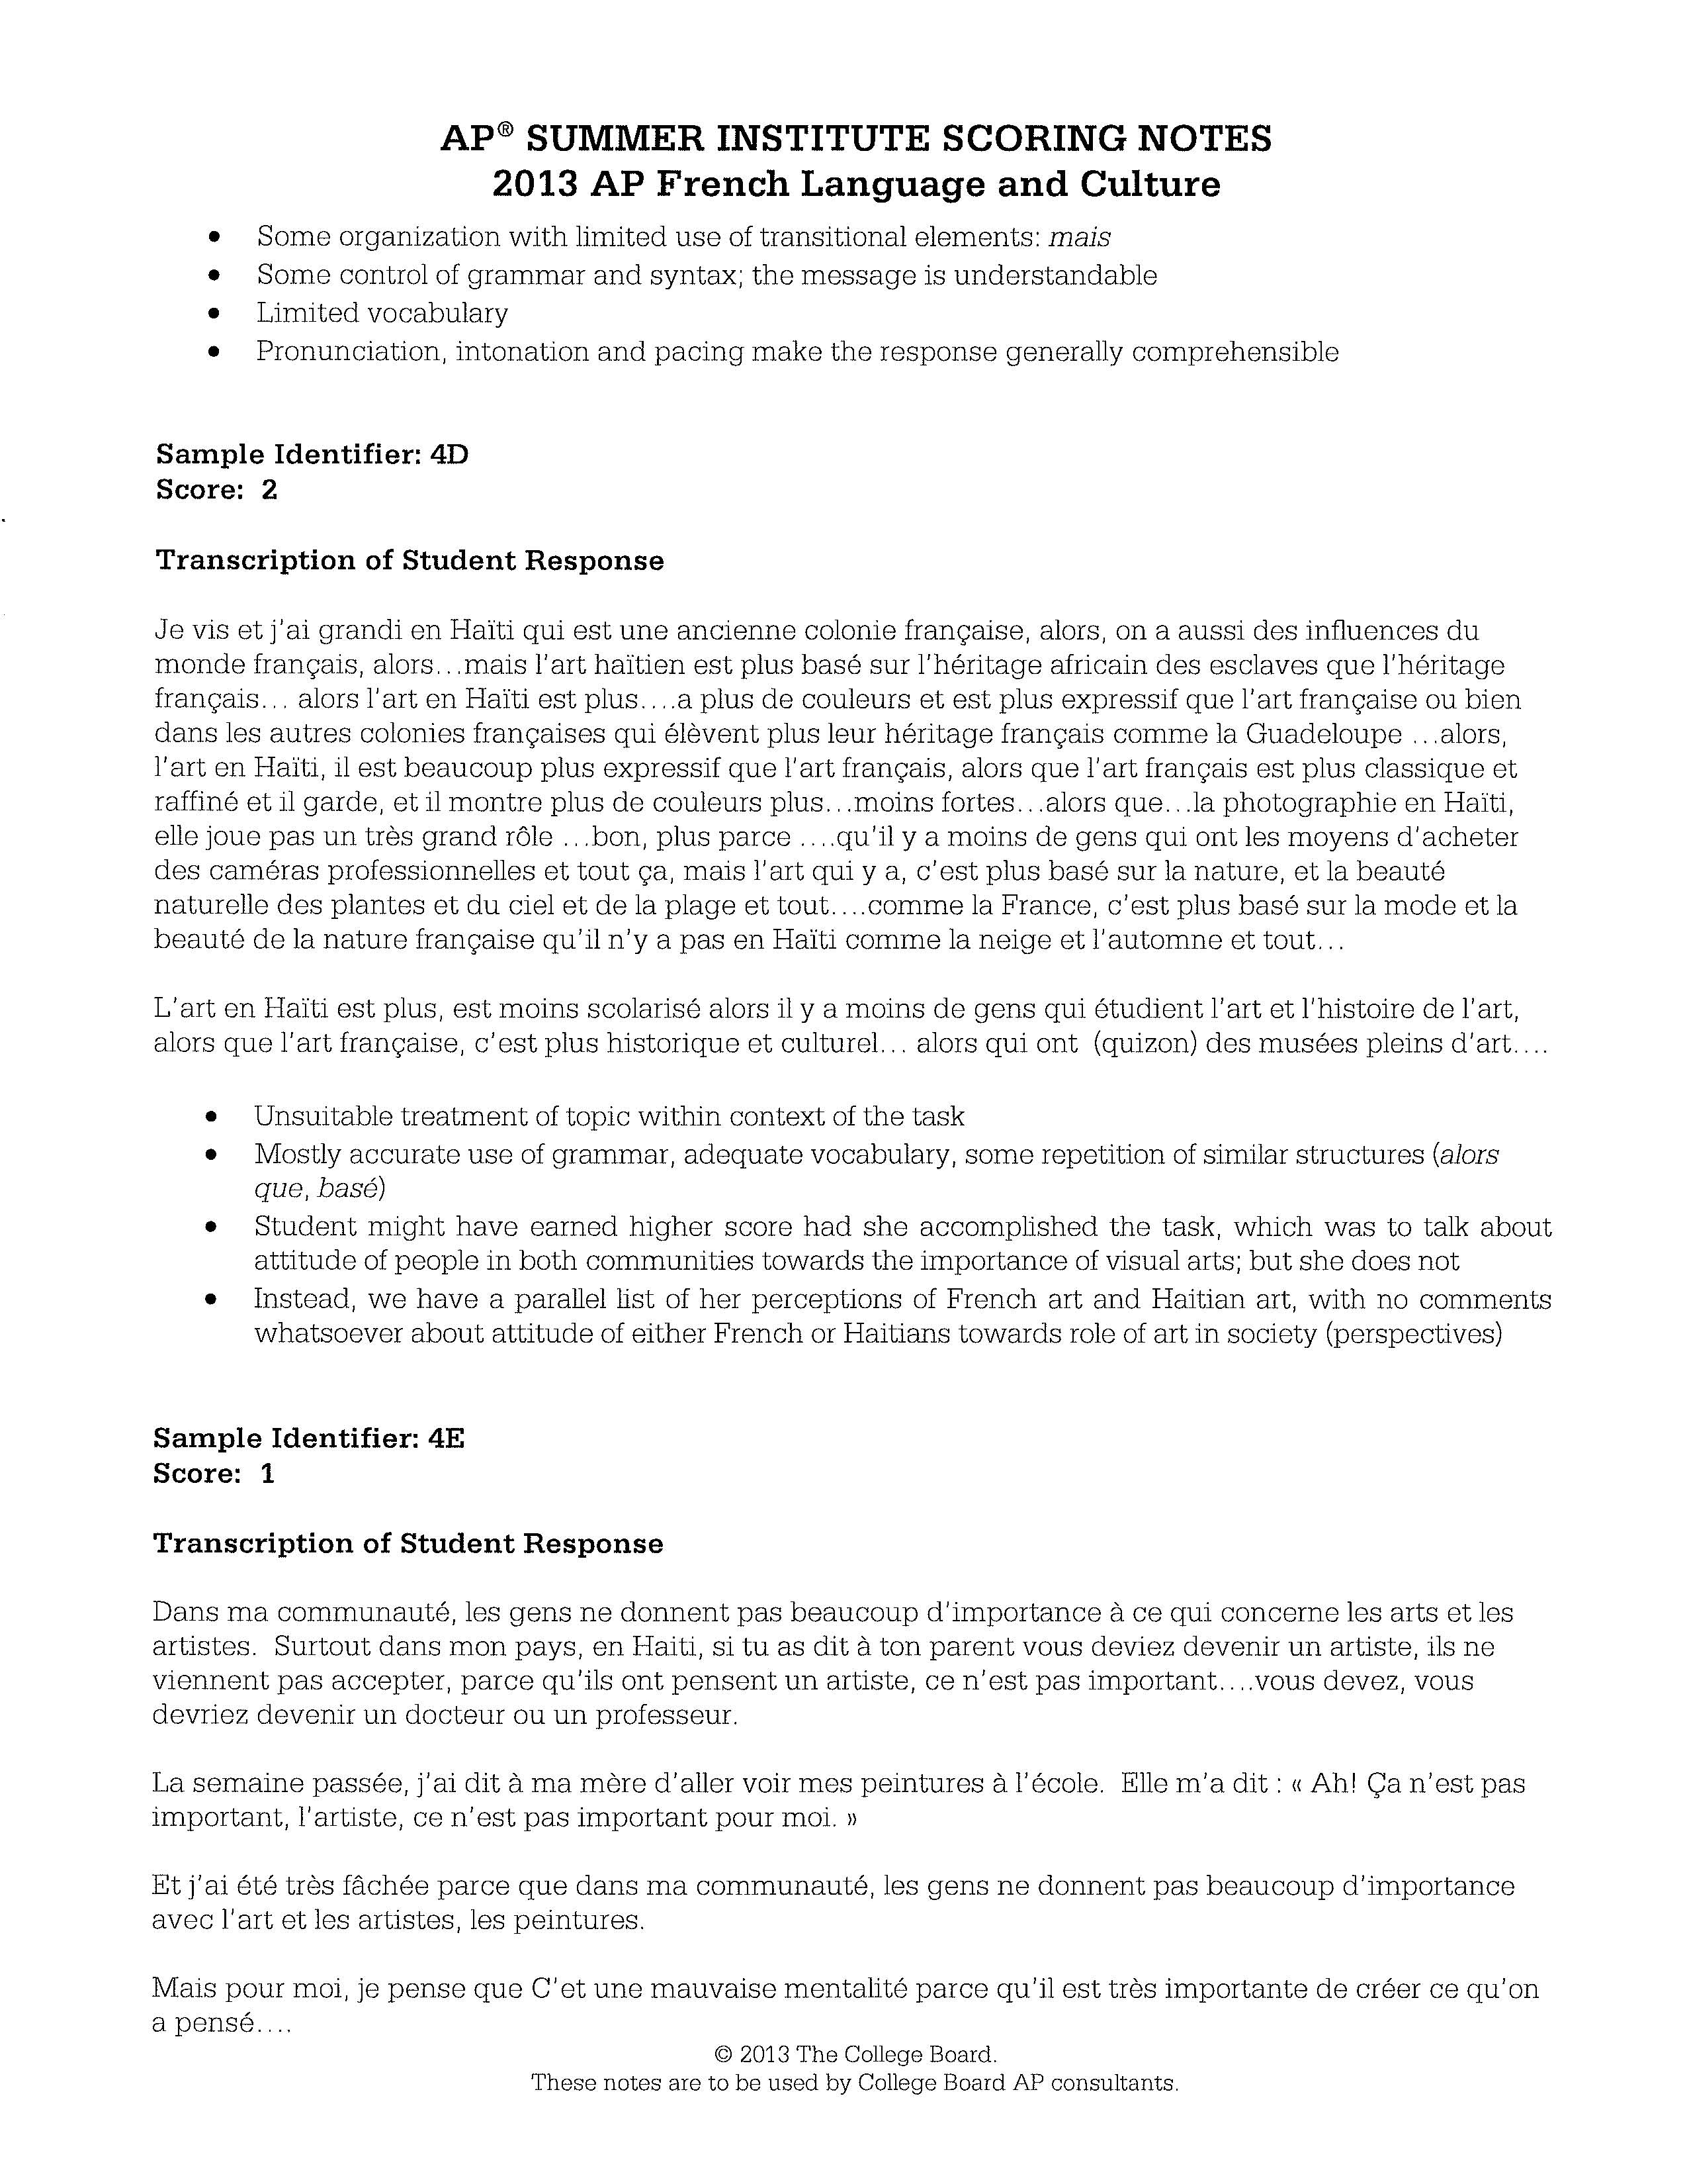

Slide 29
Student Sample 4D

Slide 31
Student Sample 4E

Slide 33


Slide 34
Student Samples from AP Central

Slide 35
Sample 4A

Slide 36
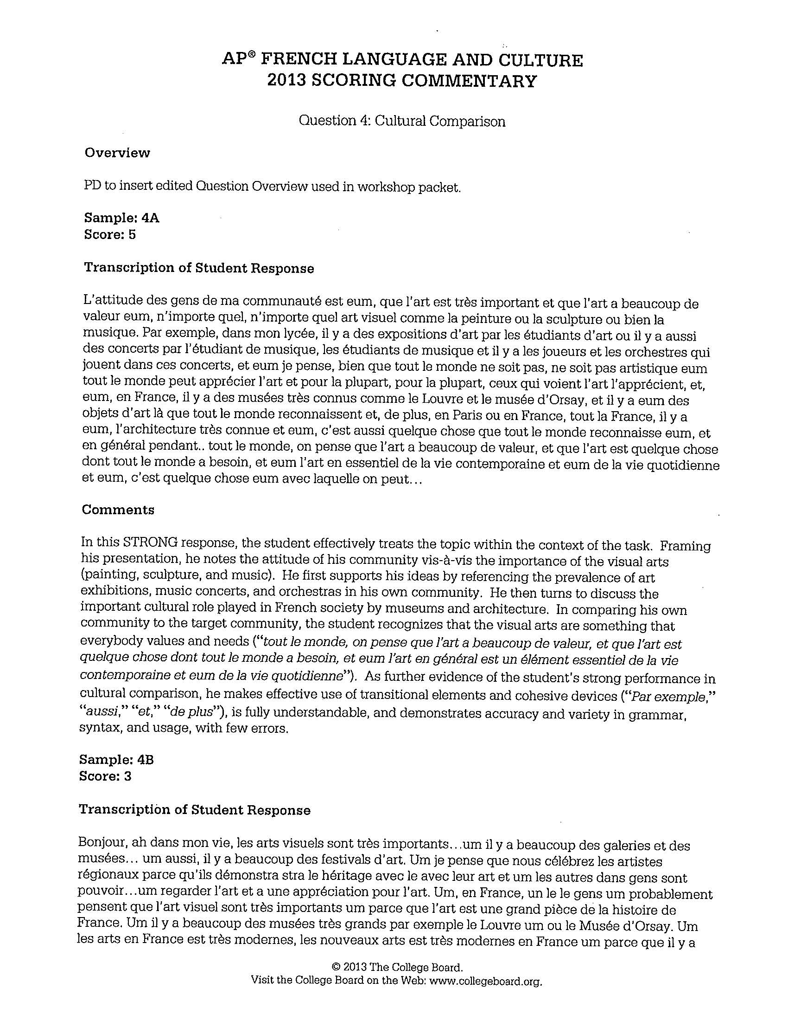

Slide 37
Sample 4B

Slide 39
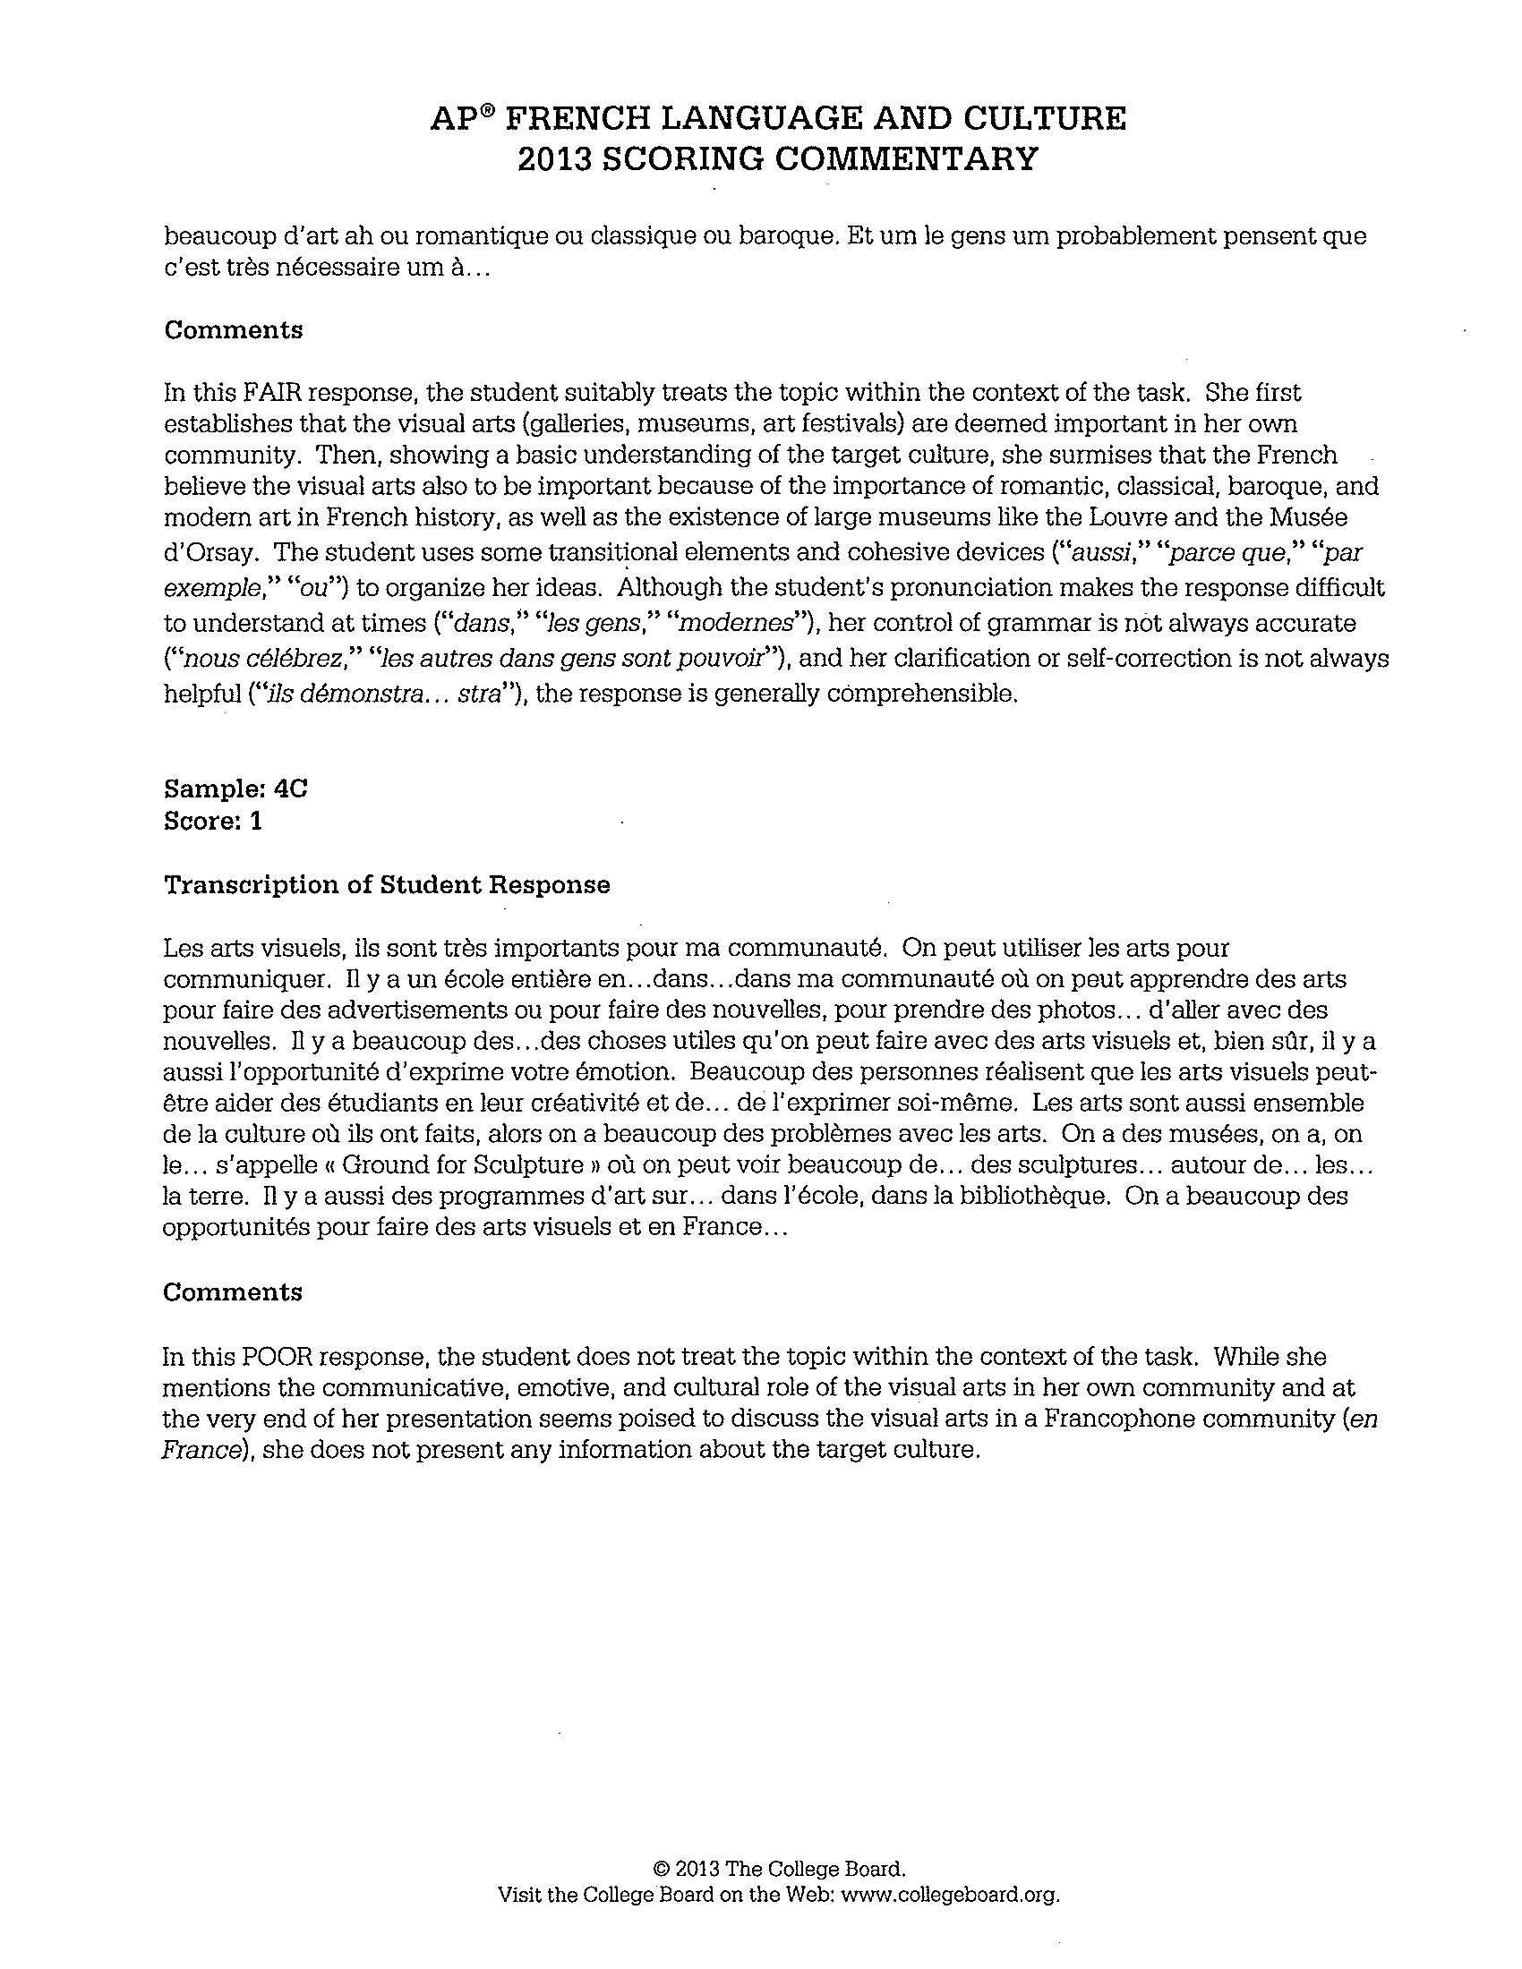

Slide 40
Sample 4C

Slide 42
Sharing of Instructional Strategies
Cultural Comparison

Slide 43
Common Errors/Omissions
Students did not explicitly compare attitudes concerning importance of…
Students instead presented their own opinions.
Students compared communities but ignored the topic.

Slide 44
Advice
Teach students to make logical and appropriate comparisons and carefully organize their presentations (is it appropriate, for example, to compare a neighborhood with a whole continent?).
Insist that students read the subject carefully and complete the task.
Discourage students from wasting time restating the prompt.
Bring cultural practices, products, and perspectives into the classroom (supplement textbooks with variety of authentic materials).
Provide opportunities for students, who are often used to speaking about themselves, to speak about people and perspectives in the Francophone world.
Students should avoid cultural clichés and generalizations.
Encourage students to employ a variety of transitions .

Slide 45

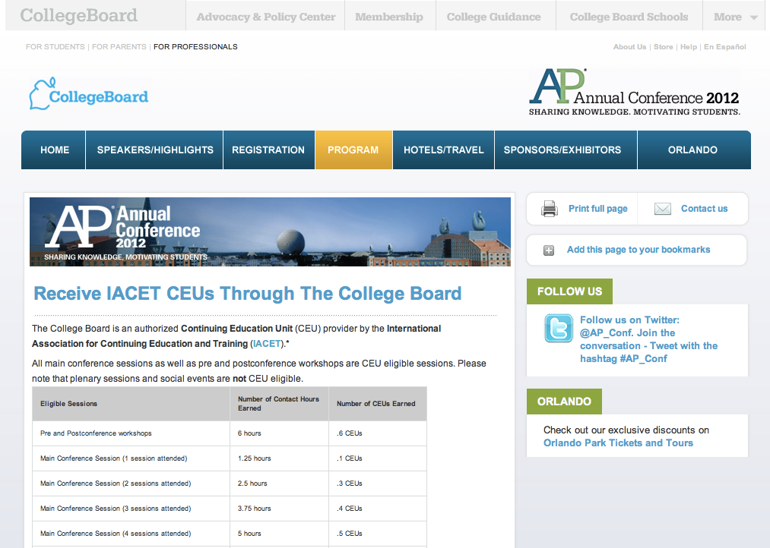
Share Your Feedback On This Session
And Earn Continuing Education Units (CEUs)
Visit the conference website at apac.collegeboard.org
  Click on
  “Earn Main Conference CEUs”
  From there you will be taken to
  the CEU Online Platform
Questions?
  While onsite, visit the
  information desk at the Sands Expo – Upper Lobby
  After the event write to: support@pesgce.com

Slide 46
Brian Kennelly
calpoly.edu/~bkennell

