Slide 1
Results from the 2019 AP French Language and Culture Exam
Brian Kennelly
Cal Poly, San Luis Obispo
Friday, 19 July 2019

Slide 2
Agenda
Exam Overview
Reading Process
Scoring
Score Distributions
Student Performance by Question/Task
How to Become an AP Reader
2

Slide 3
AP French Language and Culture Exam Overview
3

Slide 4
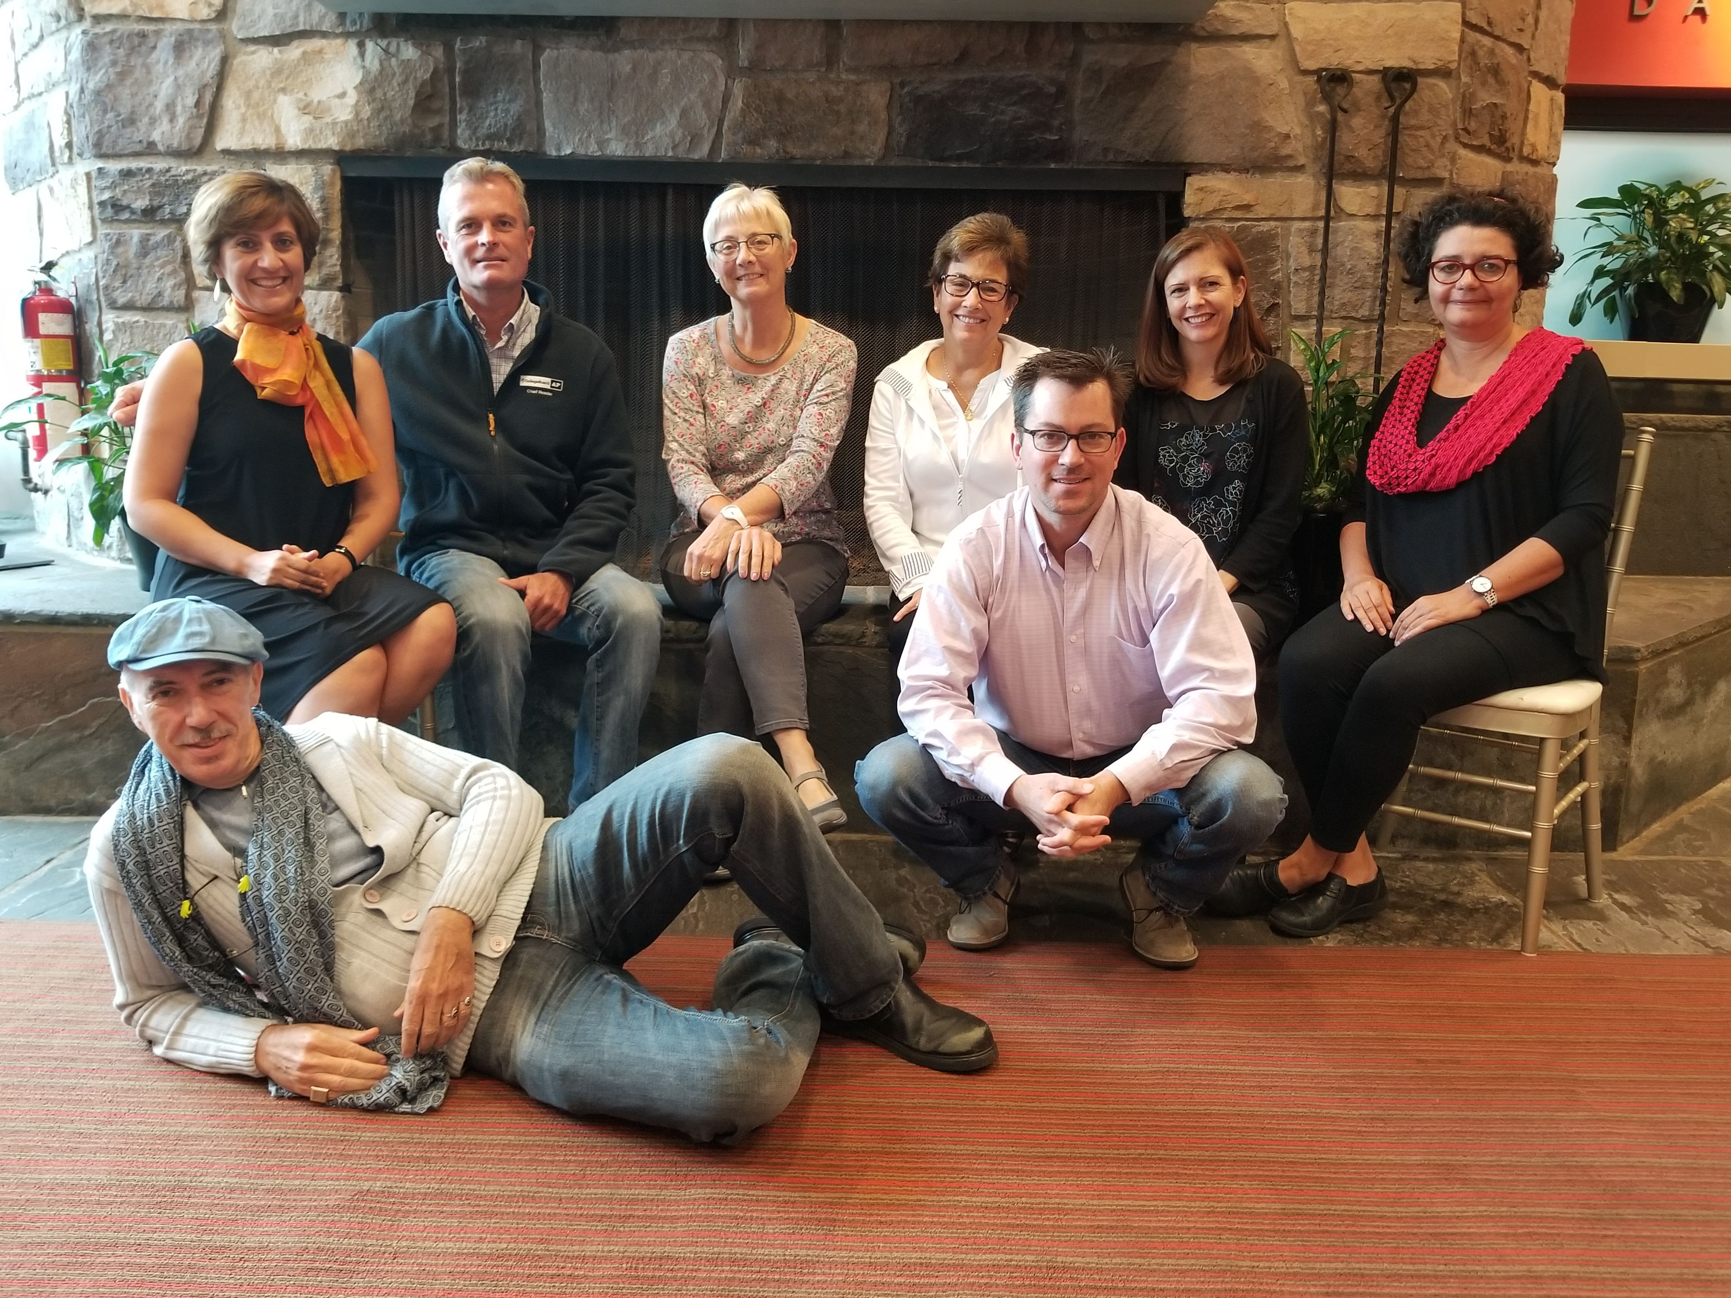
AP French Language and Culture and Exam Development Committee
Co-Chairs
  Deb Reisinger Duke University, Durham, NC
  Jane Kairet Cincinnati Country Day School, Cincinnati, OH
College Board Advisor
  Scott Field Glenbrook South HS, Glenview, IL
Members
  Carla Calargé Florida Atlantic University, Boca Raton, FL
  Guy Spielmann Georgetown University, Washington, DC
  Sandrine Collomb Interlake HS, Bellevue, WA
  Abbe Guillet Charles W. Baker HS, Baldwinsville, NY
Chief Reader
  Brian Kennelly Cal Poly, San Luis Obispo, CA
ETS Test Developer
  Monica Michaud ETS, Princeton, NJ
  Jeff Roberts ETS, Princeton, NJ
4
Notes:
Experienced college faculty and AP [Course] teachers
Develop/update the curriculum, rubrics, and professional development activities for the course

Slide 5
Structure of AP French Language and Culture Exam
Section Number | Number and Type of Questions | Weight | Time Allotted
1 | 65 Multiple-Choice Questions (4 possible responses A, B, C, D) 9 sets of items Section 1A: 30 questions; 40 minutes Section 1B: 35 questions; 55 minutes | 50% | 95 minutes
2 | FRQ 1: E-Mail Reply | 12.5% | 15 minutes | Total: ~88 minutes
 | FRQ 2: Persuasive Essay | 12.5% | ~55 minutes
 | FRQ 3: Conversation | 12.5% | 5 exchanges of 20 seconds each
 | FRQ 4: Cultural Comparison | 12.5% | 6 minutes (4 to prepare and 2 to speak)
Exam follows specific criteria regarding number of items in certain categories.
5

Slide 6
Question Development and Exam Assembly
Multiple forms developed every year
1
2
3
Initial Draft of Questions
Question Review and Revision
Pre-Testing and Statistical Analysis – Clarity, difficulty, etc.
AP community teachers and faculty; Test Development Committee
Test Development Committee; Content experts
Psychometricians
4
5
Higher-Ed Exam Review
“Fresh Eyes” Review
Chief Reader; Higher-Ed Co-Chair of Test Development Committee
Additional Higher Ed experts
6

Slide 7
AP French Language and Culture:
The Reading
7

Slide 8
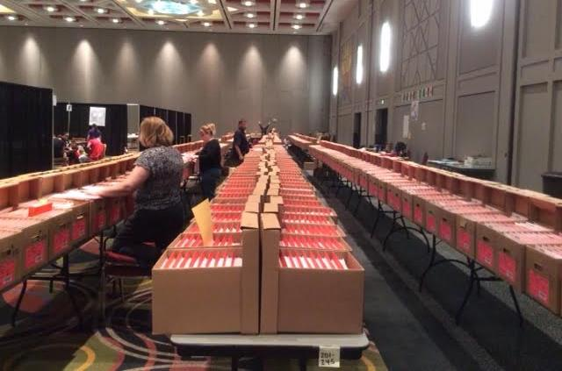
What the AP French Readers See
8

Slide 9

About the AP French Language and Culture Reading
Cincinnati, Ohio
On-site
Spoken responses scored remotely (operational exam)
9

Slide 10
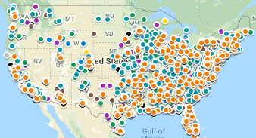
AP Online Scoring from Home
Online scoring in 2019
In 2019, close to 4,000 AP readers scored 5 million responses from home
Our latest survey shows that ¾ of readers scoring from home would not have been able to have traveled to a Reading site to score
Readers report they gained access to training and development they otherwise wouldn’t have had
  “I value the professional development from the experience”
  “I appreciated being able on the West Coast to set my own reading hours that made sense while still teaching”
How it works
Ten AP subjects offer score-from-home opportunities
Leadership remains on site during the reading
Readers are asked if they prefer to score onsite or from home and can choose full- or part-time flexible schedules
Offers scoring opportunities to educators who cannot attend an on-site reading
Subjects that have scoring onsite currently will continue to do so…the face-to-face Reading is important and remains integral to AP
In 2019, AP readers scored from home in all 50 states, as well as Puerto Rico!
10

Slide 11
AP French Language and Culture Reading Facts and Figures
Readers & Leaders
176 total: 142 readers + 34 leaders
Trained to use rubric reliably & consistently
Exams
21,388: number of exams submitted for scoring
Total of 85,552 student responses scored (# of exams X number of FRQs)
11

Slide 12
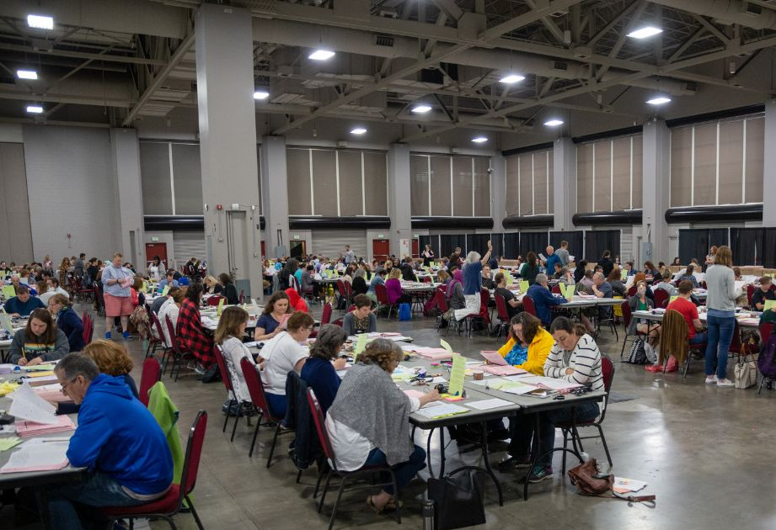
AP French Language and Culture Volume
12

Slide 13
Scoring the AP French Language and Culture Exam
13

Slide 14
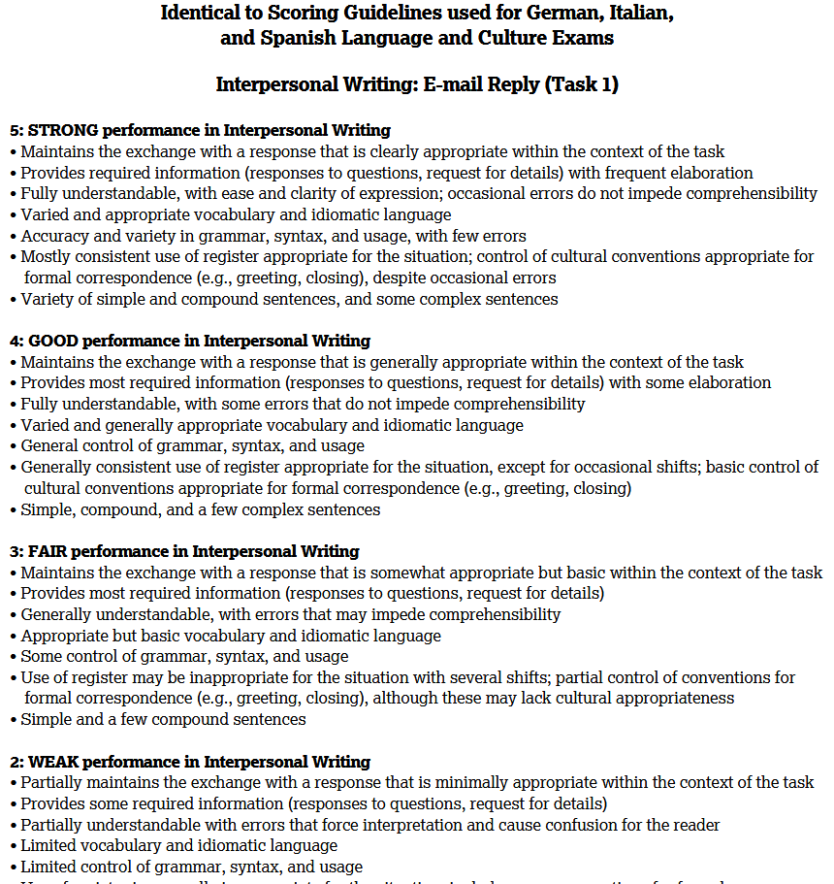
Scoring Guidelines
14

Slide 15
How Student Responses are Scored
Student responses are scored holistically using the scoring guidelines
Readers are looking for the preponderance of evidence when reading or listening to student work
Any written or spoken sample, read by any reader, at any point in the reading, should result in the same score
15

Slide 16
Ensuring Accuracy, Fairness, and Consistency
Scoring Guidelines Establish the Scoring Criteria
Developed by the Development Committee alongside the exam question
Strong draft finalized in advance of pre-reading by Chief Reader, College Board course lead, and ETS test development staff
Locked-down by end of pre-reading, incorporating examples from actual student work
Include “Scoring Notes” to ensure consistency in application of Scoring Guidelines
Reading Leadership
Table Leaders
All readers
CR
CB/ETS
Leads
Test Dev
Committee
Consistent Application of the Scoring Guidelines Implemented in Reader Training and Monitoring
Question Leaders select training samples (actual student work) representing different ways of earning each score point
Leader training → Reader training
Paired reading and retraining as needed
Table Leader back-reading
Potential drift of individual readers from the established criteria tracked statistically
16

Slide 17
2019 Score Distributions
AP French Language and Culture

Slide 18
Standard Group
Only scores of Standard Group are used to determine the score distributions (5, 4, 3, 2, 1)
Comprised approximately 77.9% of test takers
Answered “No” to the following questions:
Do you hear or speak the target language regularly at home?
Have you lived for more than a month in a country where the target language is spoken?

Slide 19
AP French Language and Culture Exam Score Distribution
AP Score | Standard Group % at | Standard Group % below | Total Group % at | Total Group % below
5 | 10.1 | 89.9 | 15.5 | 84.5
4 | 24 | 65.9 | 25.1 | 59.4
3 | 39.7 | 26.2 | 36.1 | 23.3
2 | 21.1 | 5.1 | 18.5 | 4.8
1 | 5.1 | N/A | 4.8 | N/A
73.8% of standard group scored 3 or higher
76.7% of total group scored 3 or higher
19

Slide 20
AP French Language and Culture Exam Score Distributions (2017-2019)
Observations:
Compared to the last two years,
2019 students earned:
more 3’s
about same # of 5’s
fewer 2’s and 1’s
20

Slide 21
AP French Language and Culture Exam Score Distributions (2017-2019)
Observations:
Compared to the last two years,
2019 students earned:
more 3’s
about same # of 4’s and 1’s
fewer 5’s
21

Slide 22
AP French Language and Culture:
Mean Student Scores in 2019
STANDARD GROUP | Mean Score
Multiple Choice (MCQ) | 33.12 / 65
Print Resources (MCQ) | 15.90 / 30
Print and Audio Resources (MCQ) | 7.21 / 17
Audio Resources (MCQ) | 10.01 / 18
22

Slide 23
AP French Language and Culture:
Student Performance by Question / Task
23

Slide 24
Summary of student performance on 2019 FRQs
 | Mean Score (out of 5)
FRQ 1 (E-Mail Reply) | 3.46
FRQ 2 (Persuasive Essay) | 2.97
FRQ 3 (Conversation) | 2.98
FRQ 4 (Cultural Comparison) | 1.62
24

Slide 25
E-Mail Reply
This task assessed writing in the interpersonal communicative mode by having students write a reply to an e-mail message. Students were allotted fifteen minutes to read the message and write the reply. The response received a single, holistic score based on how well the student accomplished the assigned task. Students needed to be able, first, to comprehend the e-mail, and then to write a reply in a formal register. In the reply, students had to address the two questions in the message, as well as ask for more details about something mentioned in it.

Slide 26
E-Mail Reply
The course theme for the 2019 e-mail reply was Families and Communities. The task required the student to respond to the director of a summer camp, who wanted to get the student’s opinion on how to improve the summer-camp experience for future participants. The director thanks the student for participating in the program the past summer and reminds the student of what the summer camp offers. The director then asks why the student enjoyed the summer-camp experience the past summer and in which new activity the student might like to participate the following summer, and why.

Slide 27
E-Mail Reply
Neglecting to read instructions, the introduction to the e-mail, or the e-mail prompt thoroughly, which resulted in some students saying that they had never participated in the program before or not identifying a new activity in which to participate
Not knowing the location of Lausanne, which—although not required—led to confusion, such as thinking that it was in France and then telling why they like Paris or Marseilles
Thinking that Passeport Vacances was a travel agency and not a summer camp
Thinking that they were going to a summer camp as a counselor and not as a participant
Not understanding what was meant by “La 36e Édition” in the context of the e-mail
Replying with questions or requests that did not pertain to something mentioned in the e-mail prompt
Composing e-mails consisting solely or principally of language taken directly from the prompt, and often revealing a misunderstanding thereof
Using exclamation marks, inappropriate for a formal written exchange
Using the informal “tu” form and vocabulary not appropriate for the task, such as “trucs,” “vachement,” and “À plus”
Common Errors or Omissions

Slide 28
E-Mail Reply
A very long and formal closing is not necessary, neither is a long introductory paragraph
Avoid recycling the language from the stimulus
Maintain a formal register
No need to incorporate a certain number of “advanced structures”
Integrate transitional words
Use complete sentences and avoid lists
Use clear and logical paragraphs
Embrace the role
Start practicing the task at the earliest level possible
Complete all the elements of the task
Expose students to e-mails of various types and lengths
Manage the time well
Expose students to as many Francophone communities as possible
Advice

Slide 29
Persuasive Essay
This task assessed writing in the presentational communicative mode by having the student write a persuasive essay on a given topic while referencing three sources of information about the topic. Students were first allotted 6 minutes to read the essay topic and the two printed sources. Then they listened to the one audio source twice. Afterward they had 40 minutes to write the essay. The response received a single, holistic score based on how well it accomplished the assigned task. Students needed to be able first to comprehend the three sources and then to present their different viewpoints. They also had to present their own viewpoint and defend it thoroughly, using information from all of the sources to support the essay. As they referred to the sources, they had to identify and integrate them appropriately. Furthermore, the essay had to be organized into clear paragraphs.

Slide 30
Persuasive Essay
The course theme for the 2019 persuasive essay was Science and Technology. Students had to write a persuasive essay on whether one must resist artificial intelligence. The first source was an article entitled “Do robots threaten your job?” The author suggests that many jobs are threatened not only by robots but by a whole host of technological advances, such as software, mobile technology, and IBM Watson. However, with automation and the digital economy also come new jobs that did not exist before, such as those of data scientist and bioinformatician. The second source was an infographic showing the extent to which robotic technology is used in various sectors in Quebec. The third source was a report entitled “Science: Must One Be Wary of Artificial Intelligence?” After a brief explanation by two journalists of how robots are increasingly being used in homes, transportation, agriculture, and business, one of the journalists interviews a specialist in artificial intelligence. The expert notes that the extent to which robots will replace humans in various tasks is open to debate but an important ethical question.

Slide 31
Persuasive Essay
Not recognizing the need to persuade while answering the question
Not understanding the vocabulary in the sources, which led to confusion: “aliments,” which some students confused with the English word “ailments”; and “tsunami,” which students did not understand in context, for example
Attributing everything said in the audio source to Jean-Claude Heudin himself and not to the scientists to whom he alludes
Neglecting to distinguish between artificial intelligence and technology in general
Neglecting to cite and integrate the three sources appropriately
Neglecting to organize the essay to support the point of view being presented
Common Errors or Omissions

Slide 32
Persuasive Essay
Proofread and avoid misquoting the sources
Write legibly
Integrate information from all three sources; avoid merely summarizing it
Practice taking notes when listening to audio prompts
Task completion is important, as well as accuracy and variety in grammar, syntax, and usage
Ensure familiarity with each of the course’s themes
Practice developing point/s of view in writing
Manage time appropriately
Organization matters
Do not merely restate the opinions in the source materials; student needs to articulate his/her opinion on the topic
Advice

Slide 33
Conversation
This task assessed speaking in the interpersonal communicative mode by having the student respond as part of a simulated oral conversation. Students were first allotted 1 minute to read a preview of the conversation, including an outline of each turn in the conversation. Then the conversation proceeded, including 20 seconds for students to speak at each of the five turns in the conversation. The series of five responses received a single, holistic score based on how well it accomplished the assigned task. The responses had to address each turn in the conversation appropriately, according to the outline as well as the simulated interlocutor’s utterances.

Slide 34
Conversation
The course theme for the 2019 conversation task was Global Challenges. In the task the student had a simulated telephone conversation with Thomas, a classmate, who wanted to organize an event at school for Environment Day. The student needed to respond to the following five audio prompts:
1) Thomas greets the student and notes that they have not spoken recently. He asks how the student is and what is new in the student’s life.
2) Thomas explains the reason for his telephone call: to see if the student is interested in helping with the organization of a school event the next month for Environment Day.
3) Thomas notes that there are many ways to help but that they only have one month to plan the event. He asks whether the student has any ideas for how to raise student awareness of ecological questions.
4) Thomas notes that there are many ways to publicize such an event. He asks the student what they should do to get other classmates interested in it.
5) Thomas suggests that the student meet with interested classmates the next Friday to discuss the event more and asks if he can count on the student to join them.

Slide 35
Conversation
Not answering the first question “Quoi de neuf?”
Difficulty answering the third and fourth questions due to misunderstanding the verbs “sensibiliser” and “attirer”
Not answering both parts of two-part questions
Not following the outline of the conversation
Using the noun “avertissement” instead of “publicité” (or an appropriate synonym)
Having difficulty ending the conversation
Being inconsistent in the use of the informal register (using both “tu” and “vous,” for example)
Common Errors or Omissions

Slide 36
Conversation
Fill the 20 seconds in each turn of the conversation
Clearly follow the outline of the conversation
Use transitions effectively
Do not use rote answers; respond using phrases appropriate to the specific context of the conversation
Practice ending conversations appropriately
Practice writing interpersonal questions (flipped classroom), then incorporate them in simulated conversations with partners—starting in the first year of instruction
Do not get flustered if part of the conversation is misunderstood; students are scored holistically
Advice

Slide 37
Cultural Comparison
This task assessed speaking in the presentational communicative mode by having the student make a comparative oral presentation on a cultural topic. Students were allotted 4 minutes to read the topic and prepare the presentation and then 2 minutes to deliver the presentation. The response received a single, holistic score based on how well it accomplished the assigned task. The presentation had to compare the student’s own community to an area of the French-speaking world, demonstrating understanding of cultural features of the French-speaking world. Furthermore, the presentation had to be organized clearly.

Slide 38
Cultural Comparison
The course theme for the 2019 cultural comparison task was Personal and Public Identities. Students had to respond to the following question: What is the importance of how one dresses for the people of your community? Students had to compare their observations of their own community to those of a Francophone community or region. Students could make reference to what they had studied, observed, and/or experienced as support for their claims.

Slide 39
Cultural Comparison
Misunderstanding the prompt: instead of discussing how one “dresses” (“s’habiller”), many students discussed how one “lives” (“habiter”)
Misunderstanding the prompt: the noun “manière” was interpreted by many students as meaning “good/bad manners” or “etiquette”—instead of “a way of”
Providing unbalanced responses (unequal treatment given to the communities discussed)
Providing lists of cultural differences, rather than comparing cultures based on the specific topic contained in the prompt
Not comparing their community with a Francophone community or with another Francophone community (if already living in a Francophone community)
Not clearly identifying their own community (just saying “ici” or “chez moi,” for example), or not identifying the target community
Including geographical inaccuracies (stating that Africa is a country, for instance)
Not presenting information beyond stereotypes and superficial information about the Francophone communities discussed (people dress in rags in Haiti; or people are too poor in African countries to bother about how they are dressed; and most French people dress with clothing from the fashion house and luxury retail company Louis Vuitton, for example)
Organizing the presentation in a confusing or haphazard way
Common Errors or Omissions

Slide 40
Cultural Comparison
Teachers should collaborate with colleagues teaching economics, geography, and history as well as speech and forensics, for example, to help students address gaps in content knowledge and hone their rhetorical skills.
Students should be explicit (not implicit) in their presentations: they should clearly state what two communities are being compared (and which one is their own community).
Teachers should present a wide range of Francophone cultures in as much depth as possible, using current authentic (audio and print) materials to ensure that students have a clear understanding of those cultures that transcends stereotypes and clichés.
Teachers should encourage students to make good use of the last four minutes they are allotted for planning and organizing their presentations. Using topics from past World Languages and Cultures’ exams (available on AP Central), teachers should have students practice the task with the technology to be used during the exam.
Teachers should provide students effective strategies for comparing cultures: methods for introducing transitional phrases and structures needed for comparison; and the vocabulary to present one’s opinion. When introducing these strategies, teachers should emphasize how these tools can help students go beyond listing and elevate the quality of their responses.
Teachers should emphasize that an effective cultural comparison requires students to discuss both their own community and a Francophone community and explicitly to articulate both the similarities and differences between them.
Advice
continued on next slide

Slide 41
Cultural Comparison
Teachers could encourage students to learn different ways to express the idea of “importance” (if it is in the prompt, as it was in 2019): they could use synonyms and also convey the idea in the examples they provide in their cultural comparison.
Teachers should underline the importance of reading all parts of the question and provide their students strategies on how to answer each part (“importance,” “how” or “the way of,” for example)
Teachers should continue updating the materials they use in the classroom by employing recent and authentic resources (fashion trends, for example, can change over time).
Teachers should enable their students to speak about any of the six course themes (and as many of their recommended contexts as possible), as they apply to their own communities and Francophone communities.
Teachers should remind their students of the difference between the theme of the prompt (“Personal and Public Identities” in 2019) and the prompt itself, to avoid confusion.
Teachers should encourage their students to avoid overly general statements that could be applied to any prompt without adding specific prompt-specific examples and details.
Advice
continued from previous slide

Slide 42
AP French Language and Culture:
How to Become an AP Reader
42

Slide 43
Why consider becoming an AP reader?
Some reasons to consider becoming an AP reader
AP readers enjoy the experience―98% of educators responding to our AP reader survey in 2018 say they had a positive experience. AP teachers and college faculty enjoy coming together to exchange ideas and experiences.
Experiencing the AP Reading leads to positive changes in the classroom―97% of high school AP teachers and 72% of college faculty who have attended more than one Reading and responded to our 2018 survey indicated that they have actually made changes to the way they teach based upon their participation at the Reading.
AP readers learn to apply rubrics with fidelity―All AP readers are mentored by teams of experienced Reading leaders to effectively and consistently apply scores to responses using a rubric. This includes the usage of benchmark samples and scoring guidelines selected and agreed upon by the Reading leaders for a particular subject.
AP readers gain exposure to representative pool of student responses―AP readers gain valuable insight into the quality and depth of student responses from the entire pool of AP Exam takers, instead of only being exposed to student work from a single class or single school.
AP readers are compensated for their effort―All AP readers are compensated for the work they do, including time spent training. AP readers traveling to a Reading site have their travel expenses covered, including lodging. Meals, snacks, and drinks are also provided to readers scoring at a Reading site.
AP readers can earn Continuing Education Units (CEUs) and Professional Development Hours (PDHs)―These may be applied to professional development requirements required by states, districts, and schools.
AP readers often refer to the AP Reading as one of the best professional experiences they have ever had
43

Slide 44
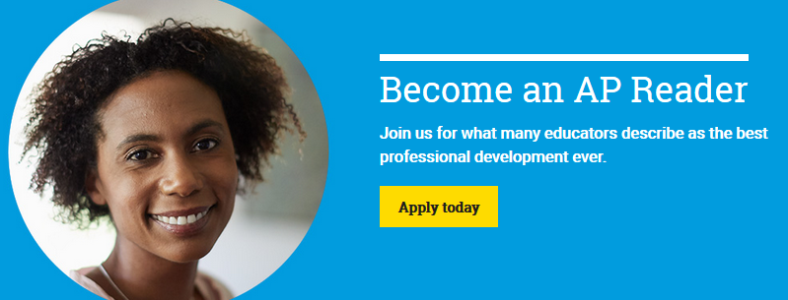
Become an AP Reader
Who can score AP exams?
Current AP teachers with at least two years of experience teaching their subject (except for CSP, Seminar, Research)
Active college faculty members who have taught one semester of a comparable AP course in the past three years
When to apply to be an AP reader
There is no official cutoff to submit an application. Applying earlier in the school year is recommended, however
If your application is accepted, you are hired into the reader pool and eligible to be invited to future AP Readings (no need to reapply each year)
Consider applying as soon as possible, because it can take several weeks to get through the application and onboarding process
Invitations to the 2020 Reading will start being extended in January 2020
We do our best to expose as many educators as possible to the Reading, but some subjects have deep reader pools so it may take time to receive an invitation
To learn more and apply visit:
collegeboard.org/apreading
44

Slide 45
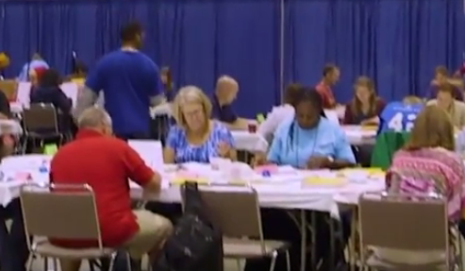
How to become an AP Reader
College & University Faculty
  aphighered.collegeboard.org
  Click on “Get Involved”
  Choose “Become an AP Reader”
Experienced High School Teachers
  apcentral.collegeboard.org
  Click on “Professional Development”
  “Become an AP Reader”
45

Slide 46
Thank
You.
Brian Kennelly
bkennell@calpoly.edu
https://works.bepress.com/bkennell

