Slide 1
2019 Professional Development Night: AP French Language and Culture
17 June 2019
How the AP French Language and Culture Exam is Developed
Scott Field (Glenbrook South High School)
Brian Kennelly (California Polytechnic State University)

Slide 2
Introduction
Composition Of The Exam (Review)
Parties Involved In Exam Development
Development At A Glance
Hands-On Activities
Questions

Slide 3
Two parts
Multiple-choice section
Free-Response section

Slide 4

Multiple-Choice Section
Stimulus type and skills assessed by set
  Promotional Material
  Literary Text
  Article and Chart
  Letter
  Audio Report and Article
  Conversation and Chart
  Interview
  Instructions
  Presentation

Slide 5
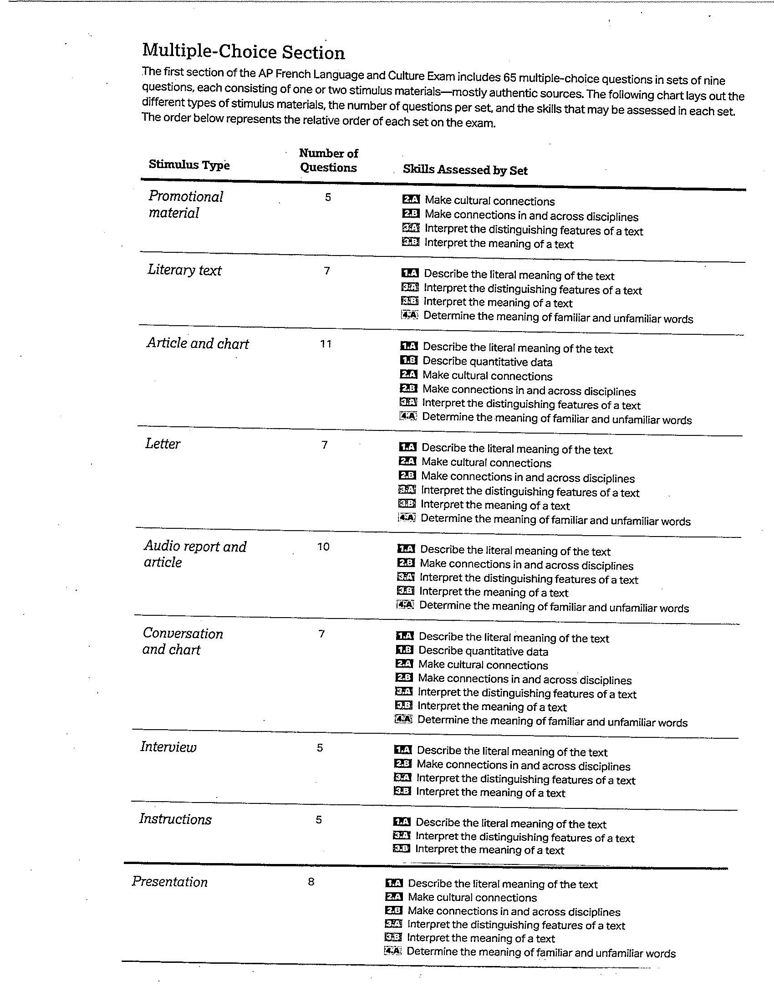

Slide 6
Free-Response Section
E-mail
Persuasive Essay (to be called Argumentative Essay)
Conversation
Cultural Comparison

Slide 7
Developing The Exam
ETS
College Board
Outside Consultants and Writers
Development Committee

Slide 8
Committee Co-Chairs
Deborah Resinger, Duke University – Durham, North Carolina
Jane Kairet, Cincinnati Country Day School – Cincinnati, Ohio
Committee Members
Carla Calarge, Florida Atlantic University – Boca Raton, Florida
Guy Spielmann, Georgetown University – Washington, D.C.
Sandrine Collomb, Interlake High School – Bellevue, Washington
Abbe Guillet, Charles W. Baker High School – Baldwinsville, New York
College Board Advisor
Scott Field, Glenbrook South High School – Glenview, Illinois
Chief Reader
Brian Kennelly, California Polytechnic State University – San Luis Obispo, California

Slide 9
Meetings And Procedures
Virtual
Face-to-Face

Slide 10
Piloting
Do the questions perform as intended?

Slide 11
Braiding
Reuse
Statistical Analysis

Slide 12
Source
Review
Set Review
FR Review
Pilot

Slide 13
Hands-On Activity – Literary Text
Personal and Public Identities
Write questions according to skills outlined in the Course and Exam Description

Slide 14
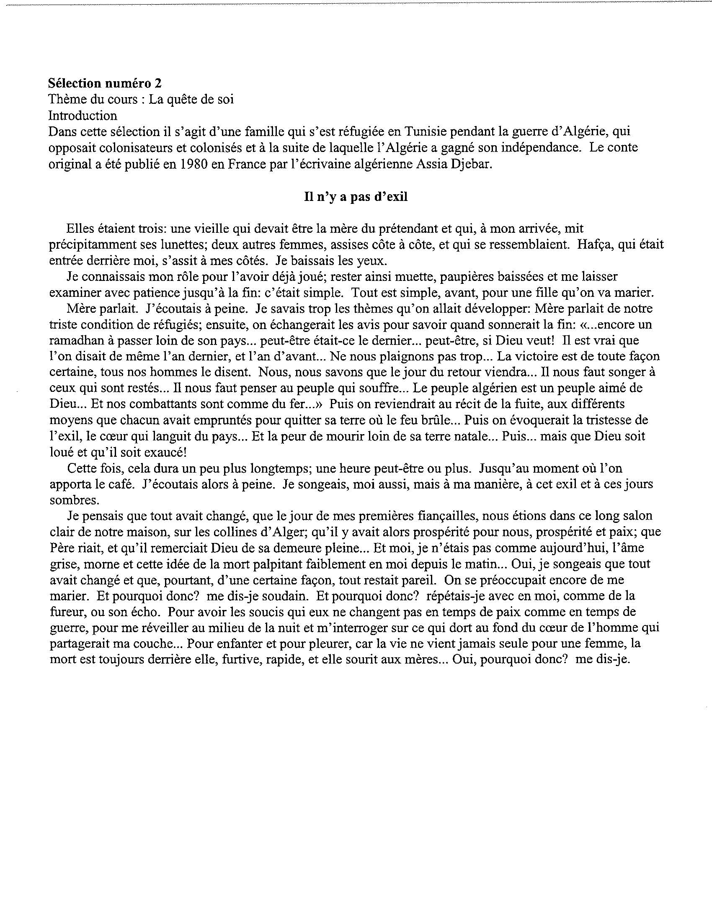

Slide 15
Hands-On – Cultural Comparison
Create a Cultural Comparison question based on the theme Families and Communities
  How [topic] affects the lives of people in your community…
  What the role of [topic] is in your community…
  What types of events or activities are considered [topic]…
  What the attitude of people in your community is regarding [topic]…

Slide 16
Questions

Slide 17
Merci sfield@glenbrook225.org bkennell@calpoly.edu

