Slide 1
Results from the 2018 AP French Language and Culture Exam
Brian Kennelly
Cal Poly, San Luis Obispo
20 July 2018

Slide 2
Overview
Exam Information
Score Distributions
Comments on Free-Response Section with Advice for Teachers

Slide 3
Exam Information

Slide 4
Multiple Choice
65 questions
50% of total score
Interpretive Communication (Print Texts)
Interpretive Communication (Print and Audio Texts
Interpretive Communication (Audio Texts)

Slide 5
Free Response
4 tasks
50% of total score
Interpersonal Writing (E-Mail Reply)
Presentational Writing (Persuasive Essay)
Interpersonal Speaking (Conversation)
Presentational Speaking (Cultural Comparison)

Slide 6
Score Distributions

Slide 7
Standard Group
Only scores of Standard Group are used to determine the score distributions (5, 4, 3, 2, 1)
Comprised approximately 78.2% of test takers
Answered “No” to the following questions:
Do you hear or speak the target language regularly at home?
Have you lived for more than a month in a country where the target language is spoken?

Slide 8
Score Distributions
Operational Exam
Standard Group
Approximately 78.2% of test takers
16,354 test takers
AP Score
5 10.8%
4 25.2%
3 38.2%
2 20.8%
1 5.0%

Slide 9
Score Distributions
Operational Exam
Standard Group
3-year data
AP Score 2016 2017 2018
5 11.5% 10.9% 10.8%
4 25.8% 23.8% 25.2%
3 36.0% 37.1% 38.2%
2 21.2% 22.6% 20.8%
1 5.3% 5.6% 5.0%

Slide 10
Score Distributions
Operational Exam
Total Group
100% of test takers
20,907 test takers
AP Score
5 15.9%
4 25.7%
3 35.3%
2 18.6%
1 4.5%

Slide 11
Score Distributions
Operational Exam
Total Group
3-year data
AP Score 2016 2017 2018
5 17.3% 16.8% 15.9%
4 26.5% 25.0% 25.7%
3 32.6% 33.5% 35.3%
2 18.7% 19.7% 18.6%
1 4.9% 5.0% 4.5%

Slide 12
Comments & Advice

Slide 13
E-Mail Reply
This task assessed writing in the interpersonal communicative mode by having students write a reply to an e-mail message. Students were allotted fifteen minutes to read the message and write the reply. The response received a single, holistic score based on how well the student accomplished the assigned task. Students needed to be able, first, to comprehend the e-mail, and then to write a reply in a formal register. In the reply, students had to address the two questions in the message, as well as ask for more details about something mentioned in it.

Slide 14
E-Mail Reply
The course theme for the 2018 e-mail reply was Personal and Public Identities. The task required the student to respond to the director of a non-governmental organization in Mauritius, who had been contacted regarding the possibility of an interview for the students’ high-school newspaper and who had some follow-up questions. The director expresses her appreciation for the student’s interest in her NGO, reminds the student of the organization’s mission, and briefly outlines its outreach activities. The director agrees to an interview but asks for clarification. She asks how—practically speaking—the interview will be conducted, given the distance and time-zone difference between Mauritius and where the student is located. She also asks why the students’ classmates might be interested in learning more about her NGO.

Slide 15
E-Mail Reply
Neglecting to read the instructions in the introduction to the e-mail or the e-mail prompt thoroughly, which resulted in some students believing that they themselves were to be interviewed
Not knowing the location of Mauritius, which posed problems for some students trying to answer the first question
Not understanding vocabulary in the first question (entretien, décalage horaire, plan pratique, and volontiers)
Replying with questions or requests that did not pertain to something mentioned in the e-mail prompt
Composing e-mails consisting solely or principally of language lifted from the prompt, and often revealing a misunderstanding thereof
Using exclamation marks, inappropriate for a formal written exchange
Common Errors or Omissions

Slide 16
E-Mail Reply
Long and very formal closing not necessary (“Bien à vous” or “Bien cordialement,” for example, is fine)
Don’t merely recycle language from stimulus
Formal written interpersonal exchange (e-mail), not formal written presentation (essay)
No requisite quantity of advanced structures (grammar should serve purpose of message)
Integrate transitions
Paragraphs, legibility, and task completion matter
Role-play is key (don’t negate the premise of the task)
Exposure to as many Francophone communities as possible so that responses do not include inaccurate information
Advice

Slide 17
Persuasive Essay
This task assessed writing in the presentational mode by having students write a persuasive essay on a given topic while referencing three sources of information about the topic. Students were first allotted six minutes to read the essay topic and the two printed sources. They then listened to the one audio source. Thereafter, they had forty minutes to write the essay. The response received a single, holistic score based on how well the student accomplished the assigned task. Students needed to be able, first, to comprehend the three sources and then to present their own viewpoint, defending it thoroughly, using information from all the sources as support. As they referred to the sources, students needed to identify them appropriately. Furthermore, the essay had to be organized into clear paragraphs.

Slide 18
Persuasive Essay
The course theme for the 2018 persuasive essay was Beauty and Aesthetics. Students had to write a persuasive essay on whether one must acquire a good knowledge of general culture to succeed in the contemporary world. The first source was an article titled, “Sciences Po eliminates the general culture test.” The author discusses how this elite school has eliminated the general culture test to increase the diversity of its students and to concentrate less on knowledge that many young people may not yet have and to concentrate more on the personality of students in admissions’ decisions. The second source was an infographic showing what young people think about the importance of general culture, the level of general culture they believe themselves to have, and factors they believe important for the development of general cultural knowledge. The third source was an interview with a literature professor who had organized a public reading of a French classical text which, she argues, underscores the continued relevance of aesthetics in society.

Slide 19
Persuasive Essay
Not recognizing the need to persuade while answering the question
Neglecting to cite and integrate the three sources appropriately
Demonstrating limited cultural competency in responses (unaware of the existence of grandes écoles in French education; and misunderstanding of culture générale and baccalauréat, for example)
Not realizing that La princesse de Clèves is a literary work (in audio source) and misunderstanding vocabulary: supprimer, discrimination positive (in article); and guichetière (in audio source)
Neglecting to organize the essay to support the point of view being presented
Common Errors or Omissions

Slide 20
Persuasive Essay
Double-check errors and don’t misquote sources
Write legibly
Integrate information from all three sources (don’t just summarize)
In addition to task completion, accuracy and variety in grammar, syntax, and usage is important
Be familiar with vocabulary from each of course’s themes
The process of writing matters (prewriting, drafting, revising, and editing)
Content and structure of response matters more than length thereof
Don’t merely restate stereotypes or opinions in source materials; articulate own opinion while integrating source materials (for support or to be refuted)
Advice

Slide 21
Conversation
This task assessed speaking in the interpersonal communicative mode by having the student respond as part of a simulated oral conversation. Students were first allotted one minute to read a preview of the conversation, including an outline of each turn in the conversation. Then the conversation ensued, including twenty seconds for students to speak at each of the five turns in the conversation. The series of five responses received a single, holistic score based on how well students accomplished the assigned task. In the responses, students had to address each turn in the conversation appropriately, according to the outline as well as the simulated interlocutor’s utterance.

Slide 22
Conversation
The course theme for the 2018 conversation task was Global Challenges. In the task, the student had a conversation with Sébastien, a classmate, who was part of a student committee to promote good lifestyle habits among his high-school classmates. The student needed to respond to the following five audio prompts:
1. Sébastien greets the student and explains that he has a composition due the following day but that he has not yet begun working on it. He asks the student whether the student also has lots to do. The student needed to respond by providing details.
2. Sébastien reacts then asks what the student does to manage stress, explaining that for him yoga helps. The student needed to respond by providing details.
3. Sébastien reacts then explains to the student that a committee of which he is part wants to promote good lifestyle habits among his high-school classmates. Its members are preparing a presentation for classmates in which he will provide them advice. He asks the student what the student might propose. The student needed to respond and explain the response.
4. Sébastien reacts and invites the student to work with the committee of which he is part. As its members intend to meet the following week and Sébastien would like the student to join them, he asks whether the student has a preferred meeting day. The student needed to respond and explain the response.
5. Sébastien reacts and asks the student how the student might be reached. The student needed to respond and end the conversation.

Slide 23
Conversation
Difficulty answering the third question, not providing advice pertaining to good lifestyle habits but instead offering suggestions on how to plan and organize the presentation
Misunderstanding the verb “promouvoir” and the noun “conseils” (in third turn)
Not following the outline of the conversation
Difficulty ending the conversation
Being inconsistent in the use of the informal register (using both “tu” and “vous,” for example)
Common Errors or Omissions

Slide 24
Conversation
Participate as fully as possible in conversation (elaborate for twenty seconds in each turn)
Use transitions effectively
Avoid rote answers (“bonne idée,” “je suis excité/e,” for instance)
Practice writing interpersonal questions (flipped classroom), then incorporate them in simulated conversations with partners
Don’t get flustered if a question is misunderstood or answered poorly; recover quickly so as to anticipate, understand, and respond well to next prompt/s
Read instructions and outline carefully; listen to prompts carefully; respond following outline
Advice

Slide 25
Cultural Comparison
This task assessed speaking in the presentational communicative mode by having the student make a comparative oral presentation on a cultural topic. Students were allotted four minutes to read the topic and prepare the presentation and then two minutes to deliver the presentation. The response received a single, holistic score based on how well the student accomplished the assigned task. In the presentation, students had to compare their own community to an area of the French-speaking world, demonstrating understanding of cultural features of the French-speaking world. Furthermore, the presentation had to be organized clearly.

Slide 26
Cultural Comparison
The course theme for the 2018 cultural comparison task was Contemporary Life. Students had to respond to the following question: What is the place of advertising in your community? Students had to compare their observations of their own community to those of a Francophone community or region. Students could refer to what they had studied, observed, and/or experienced as support for their claims.

Slide 27
Cultural Comparison
Misunderstanding the prompt (discussion of publications, of the public, of public places, or of advertising of public places, for example)
Unbalanced responses (unequal treatment given to the communities discussed)
Lists of cultural differences, rather than comparing cultures based on the specific topic contained in the prompt
Not comparing their community with a Francophone community or with another Francophone community (if already living in a Francophone community)
Not clearly identifying their own community (just saying “ici” or “chez moi”), or not identifying the target community
Geographical inaccuracies (stating that Africa is a country, for example)
Not presenting information beyond stereotypes and superficial information about the Francophone communities discussed (there is no outside advertising in France; or there are neither products to buy nor advertise in African countries, for example)
Inadequately organizing the presentation
Common Errors or Omissions

Slide 28
Cultural Comparison
Collaborate with colleagues teaching economics, geography, history, and forensics, for example, to help students address gaps in content and hone rhetorical skills
Be explicit (not implicit) in presentations: clearly state what two communities are being compared (and which one is that of student)
Present various Francophone cultures in as much depth as possible, using current authentic materials (to avoid stereotypes and clichés)
Make good use of four minutes for planning and organizing presentation
Use topics from past World Languages and Cultures’ exams for practice (available on AP Central)
Effective strategies for comparing cultures: methods for introducing transitional phrases and structures needed to compare and contrast; means for providing vocabulary to present one’s opinion
Avoid lists
Discuss own community and Francophone community: explicitly articulate both similarities and differences between them
Advice

Slide 29
Become an AP Reader/Rater
College Faculty
AP Readers from colleges and universities must be active faculty members and have taught at least one semester of a comparable AP course — as described in the AP Course Description — within the past three years.
High School Teachers
Must currently teach the AP course in a classroom and have at least two years of experience doing so. Two exceptions apply: Teachers of a new AP course who demonstrate appropriate expertise or online AP course teachers who also have experience teaching the course in a classroom for at least two years.

Slide 30
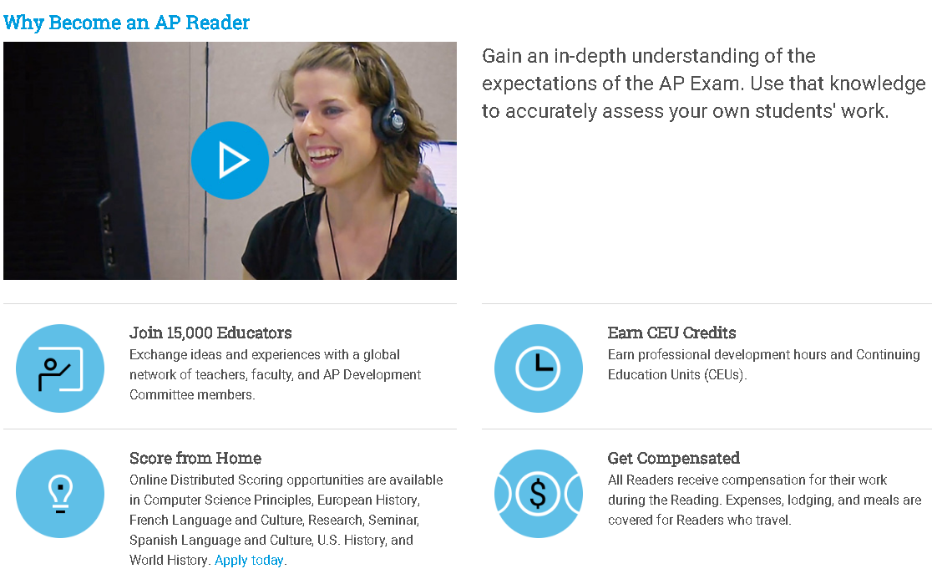

Slide 31
Thank
You.
Brian Kennelly
bkennell@calpoly.edu
https://works.bepress.com/bkennell/

