Slide 1
Standards-Aligned Instruction and Assessment of Presentational Speaking in AP
Brian Kennelly
Cal Poly (San Luis Obispo)

Slide 2
From Conference Proposal Form
This session will provide participants the opportunity to explore the connections between the ACTFL Performance Descriptors and the AP World Languages and Cultures’ Presentational Speaking Scoring Guidelines; to see and collectively to develop appropriate activities that can be adapted and incorporated at all levels of instruction in French, German, Italian, and Spanish—from pre-AP to AP, and to understand better how standards are reflected on past AP exam questions and assessed. Participants will have hands-on opportunities to share, critique, and enhance classroom activities, as well as to score student samples.

Slide 3
From Conference Program Description
What are the connections between the ACTFL Performance Descriptors and the AP World Language and Cultures’ Free-Response Scoring Guidelines for Presentational Speaking?
How do they complement each other?
How might teachers address them through activities that can be adapted and incorporated at all levels of instruction, leading to and including the AP level?

Slide 4
Overview
Unpacking the Presentational Speaking (Cultural Comparison) Task on the AP exam
Sharing, Critiquing, and Enhancing Classroom Activities

Slide 5
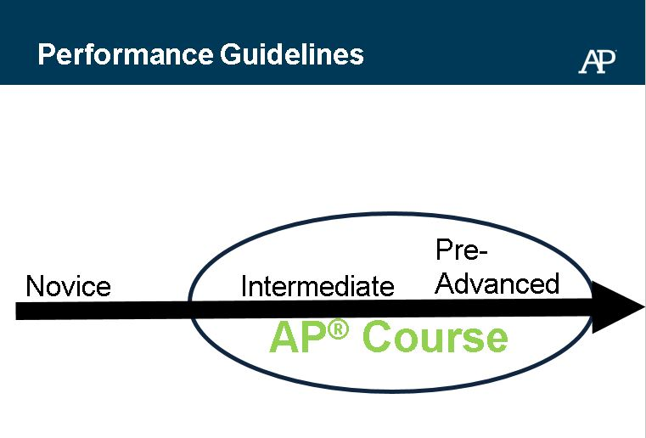

Slide 6
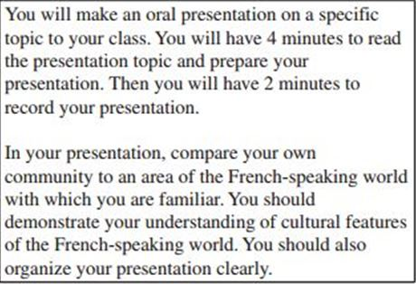

Slide 7
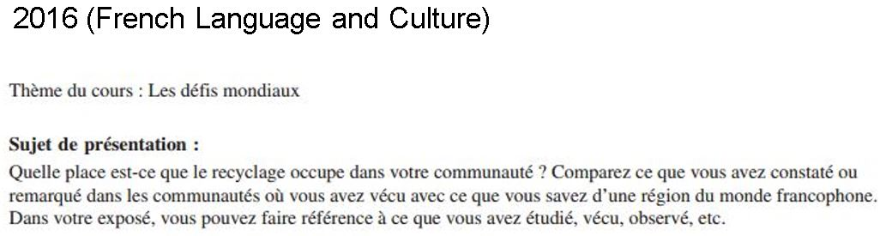

Slide 8
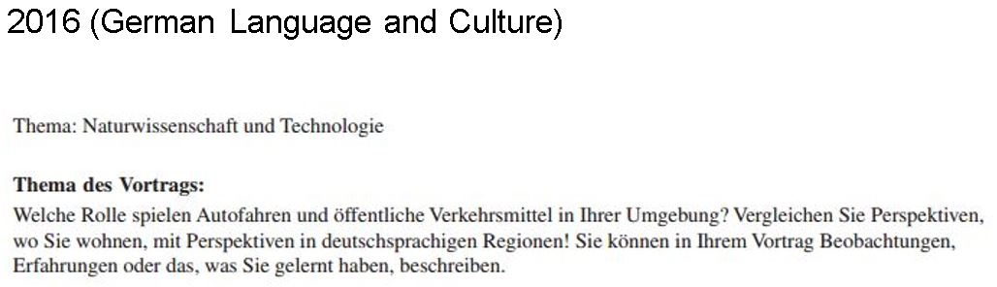

Slide 9
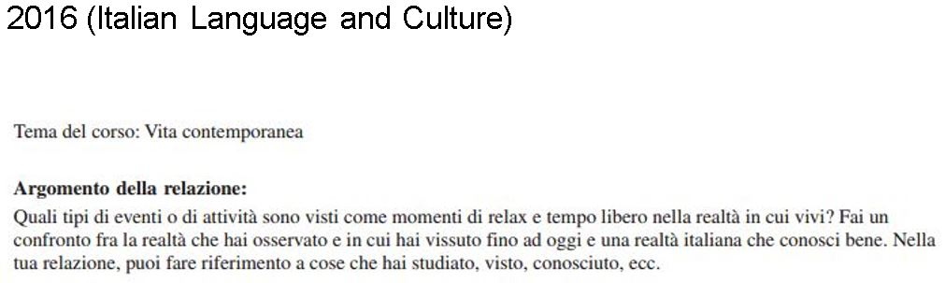

Slide 10
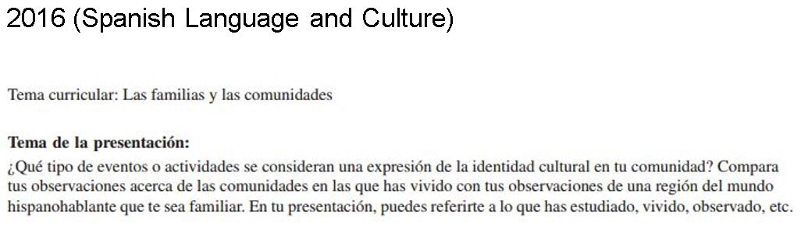

Slide 11
Scoring Guidelines
Clarification Notes
  The term “community” can refer to something as large as a continent or as small as a family unit.
  The phrase “target culture” can refer to any community large or small associated with the target language.

Slide 12
5: STRONG performance in Presentational Speaking
  Effective treatment of topic within the context of the task
  Clearly compares the student’s own community with the target culture, including supporting details and relevant examples.
  Demonstrates understanding of the target culture, despite a few minor inaccuracies
  [continued on next slide]

Slide 13
5: STRONG performance in Presentational Speaking
  Organized presentation; effective use of transitional elements or cohesive devices
  Fully understandable, with ease and clarity of expression; occasional errors do not impede comprehensibility
  Varied and appropriate vocabulary and idiomatic language
  Accuracy and variety in grammar, syntax and usage, with few errors
  [continued on next slide]

Slide 14
5: STRONG performance in Presentational Speaking
  Mostly consistent use of register appropriate for the presentation
  Pronunciation, intonation and pacing make the response comprehensible; errors do not impede comprehensibility
  Clarification or self-correction (if present) improves comprehensibility

Slide 15
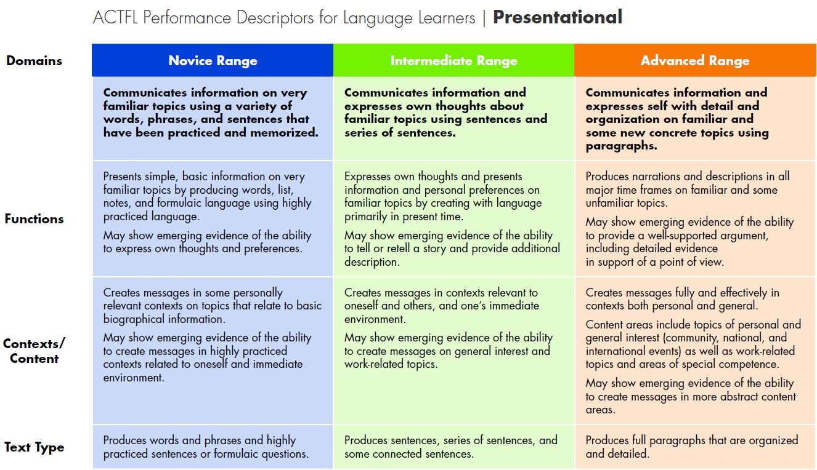

Slide 16
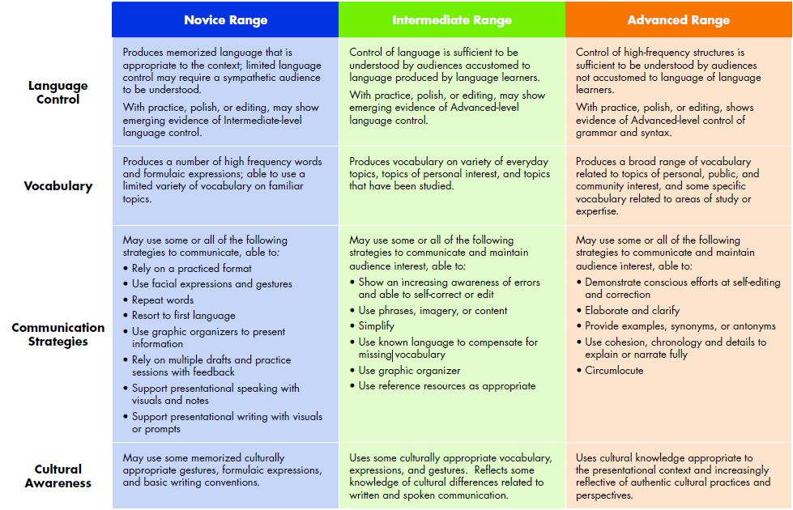

Slide 17
Student Samples
French (Benchmarks)
German (available on AP Central)
Italian (available on AP Central)
Spanish (available on AP Central)
Three more French samples (available on AP Central)

Slide 18
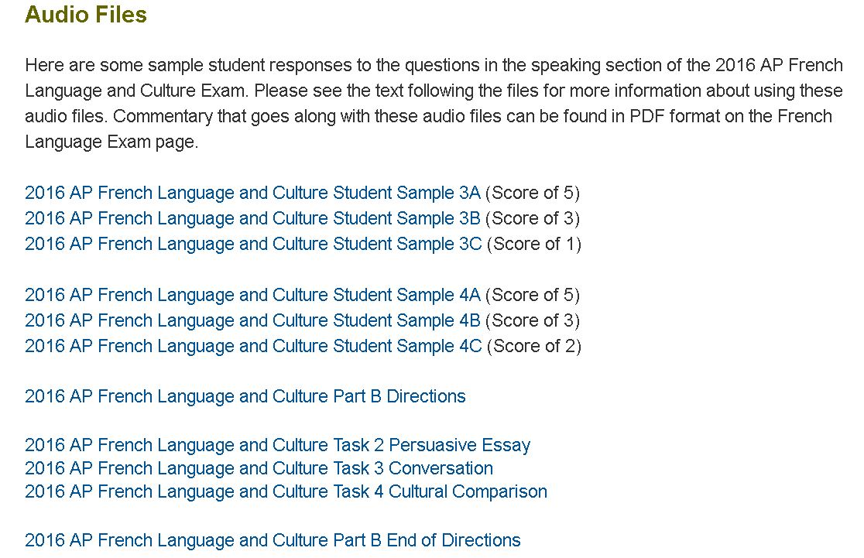

Slide 20

French

Slide 21
French

Slide 22
French

Slide 23
French

Slide 24
French

Slide 26
German

Slide 27
German

Slide 28
German

Slide 30
Italian

Slide 31
Italian

Slide 32
Italian

Slide 34
Spanish

Slide 35
Spanish

Slide 36
Spanish

Slide 37
Small-group discussion
What are the connections between the ACTFL Performance Descriptors and the the AP World Languages and Cultures’ Free-Response Scoring Guidelines for Presentational Speaking?

Slide 38
Debriefing
What are the connections between the ACTFL Performance Descriptors and the the AP World Languages and Cultures’ Free-Response Scoring Guidelines for Presentational Speaking?

Slide 39
Hands-on
Share, critique, and enhance an in-class activity that can be adapted and incorporated at all levels of instruction

Slide 40
Debriefing
What activity can be adapted and incorporated at all levels of instruction?

Slide 41
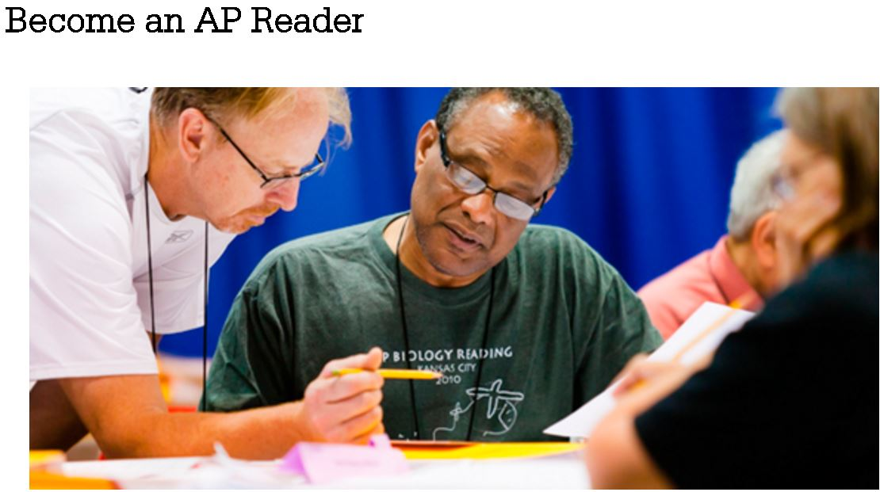
http://apcentral.collegeboard.com/apc/public/professional_development/232447.html?excmpid=MTG2-ED-10-hnet

Slide 42
bkennell@calpoly.edu
http://calpoly.edu/~bkennell

