Slide 1
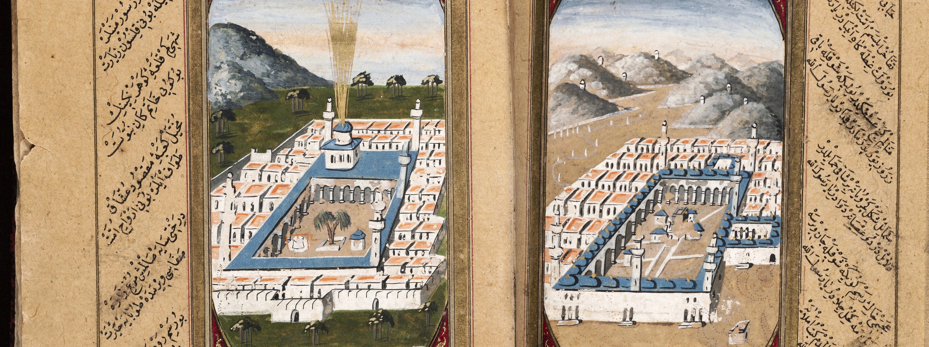
Picturing a landscape for the faithful
Topographical views in the دلائل الخيرات,
a 15th-century Muslim prayer book
Notes:
INTRO SLIDE: TITLE
The first thing I thought of when Cindy invited me to participate was this image from a Beinecke item that I frequently use when giving presentations.

Slide 2
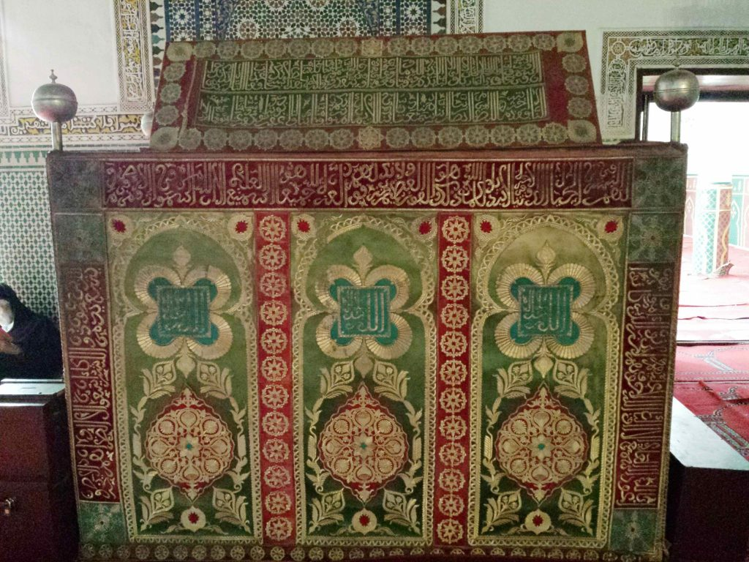
al-Jazuli’s zawiyah (tomb) in Marrakesh
Notes:
SLIDE: JAZULI’S ZAWIYAH
Al-Jazuli (d. 1465):
One of the “seven saints” of Marrakesh
A Sufi leader who was assassinated for claiming to be the mahdi (the Muslim leader who will come before the Day of Judgement to rid the world of evil)

Slide 3
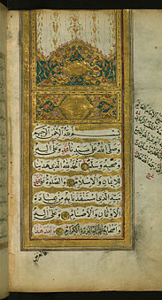

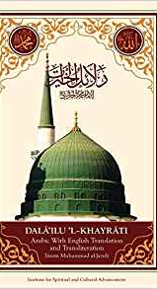
Notes:
SLIDE: MODERN EDS OF THE DALAIL
Author of the Dalail al-khayrat, for some of the faithful the second-most important text after the Quran
The text is meant to be recited orally as a part of daily or weekly devotion

Slide 4
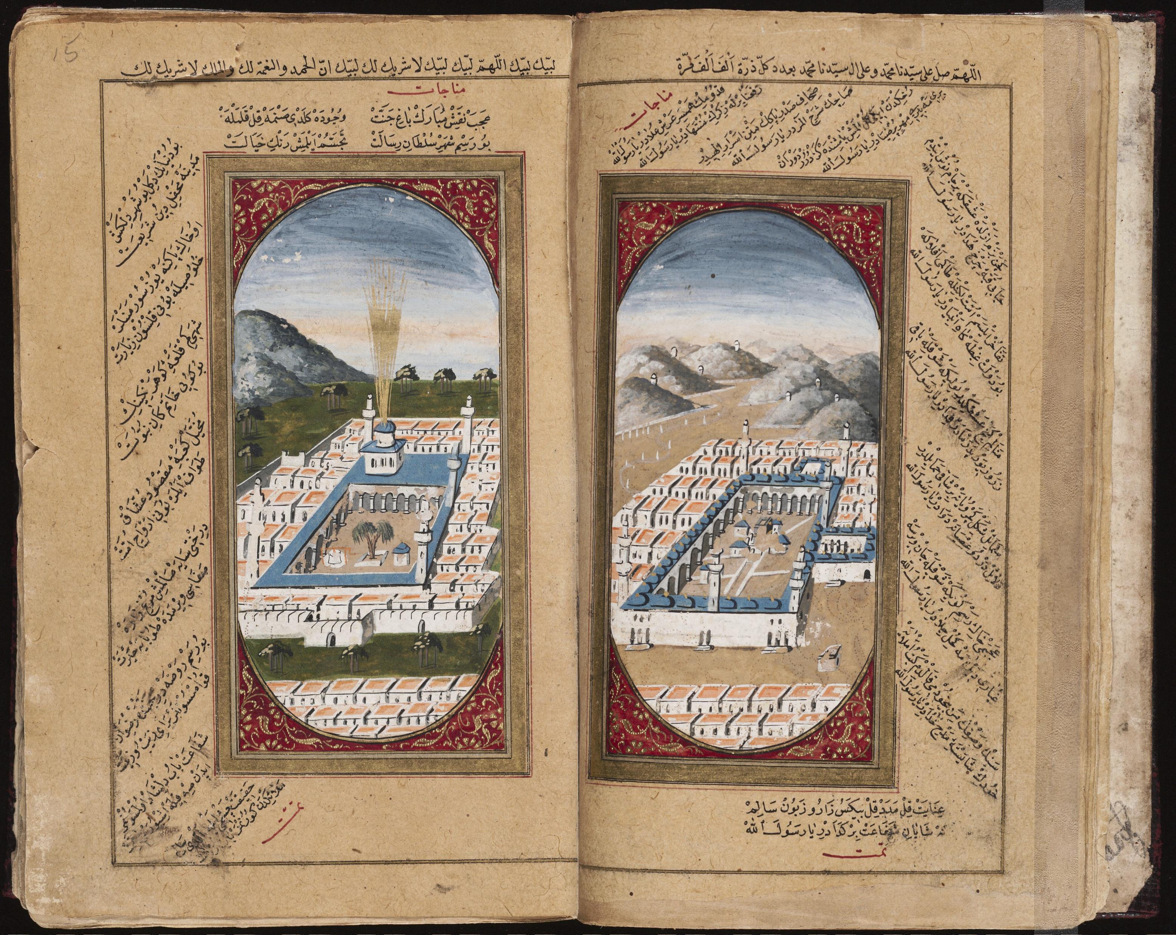
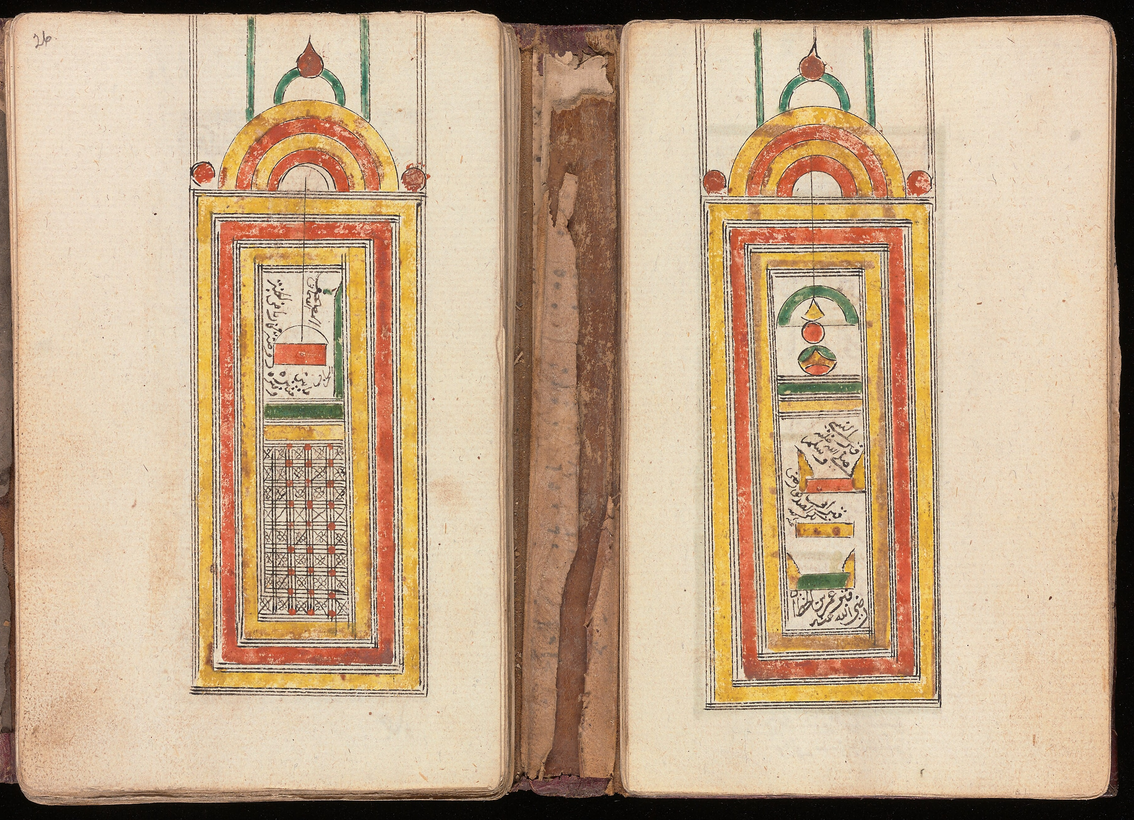
Views of Medina, East vs West
Notes:
SLIDE: VIEWS OF MEDINA, E. VS. W.
East: view of Medina & Mecca, Turkish
Arabic MSS suppl. 616, 1793 or 1794
Purch. Worldwide Antiquarian 2006
West: Medina: the minbar & the rawdah, W. African origin
Arabic MSS 317, before 1865
Purch. Wellcome-Kraus 1949

Slide 5
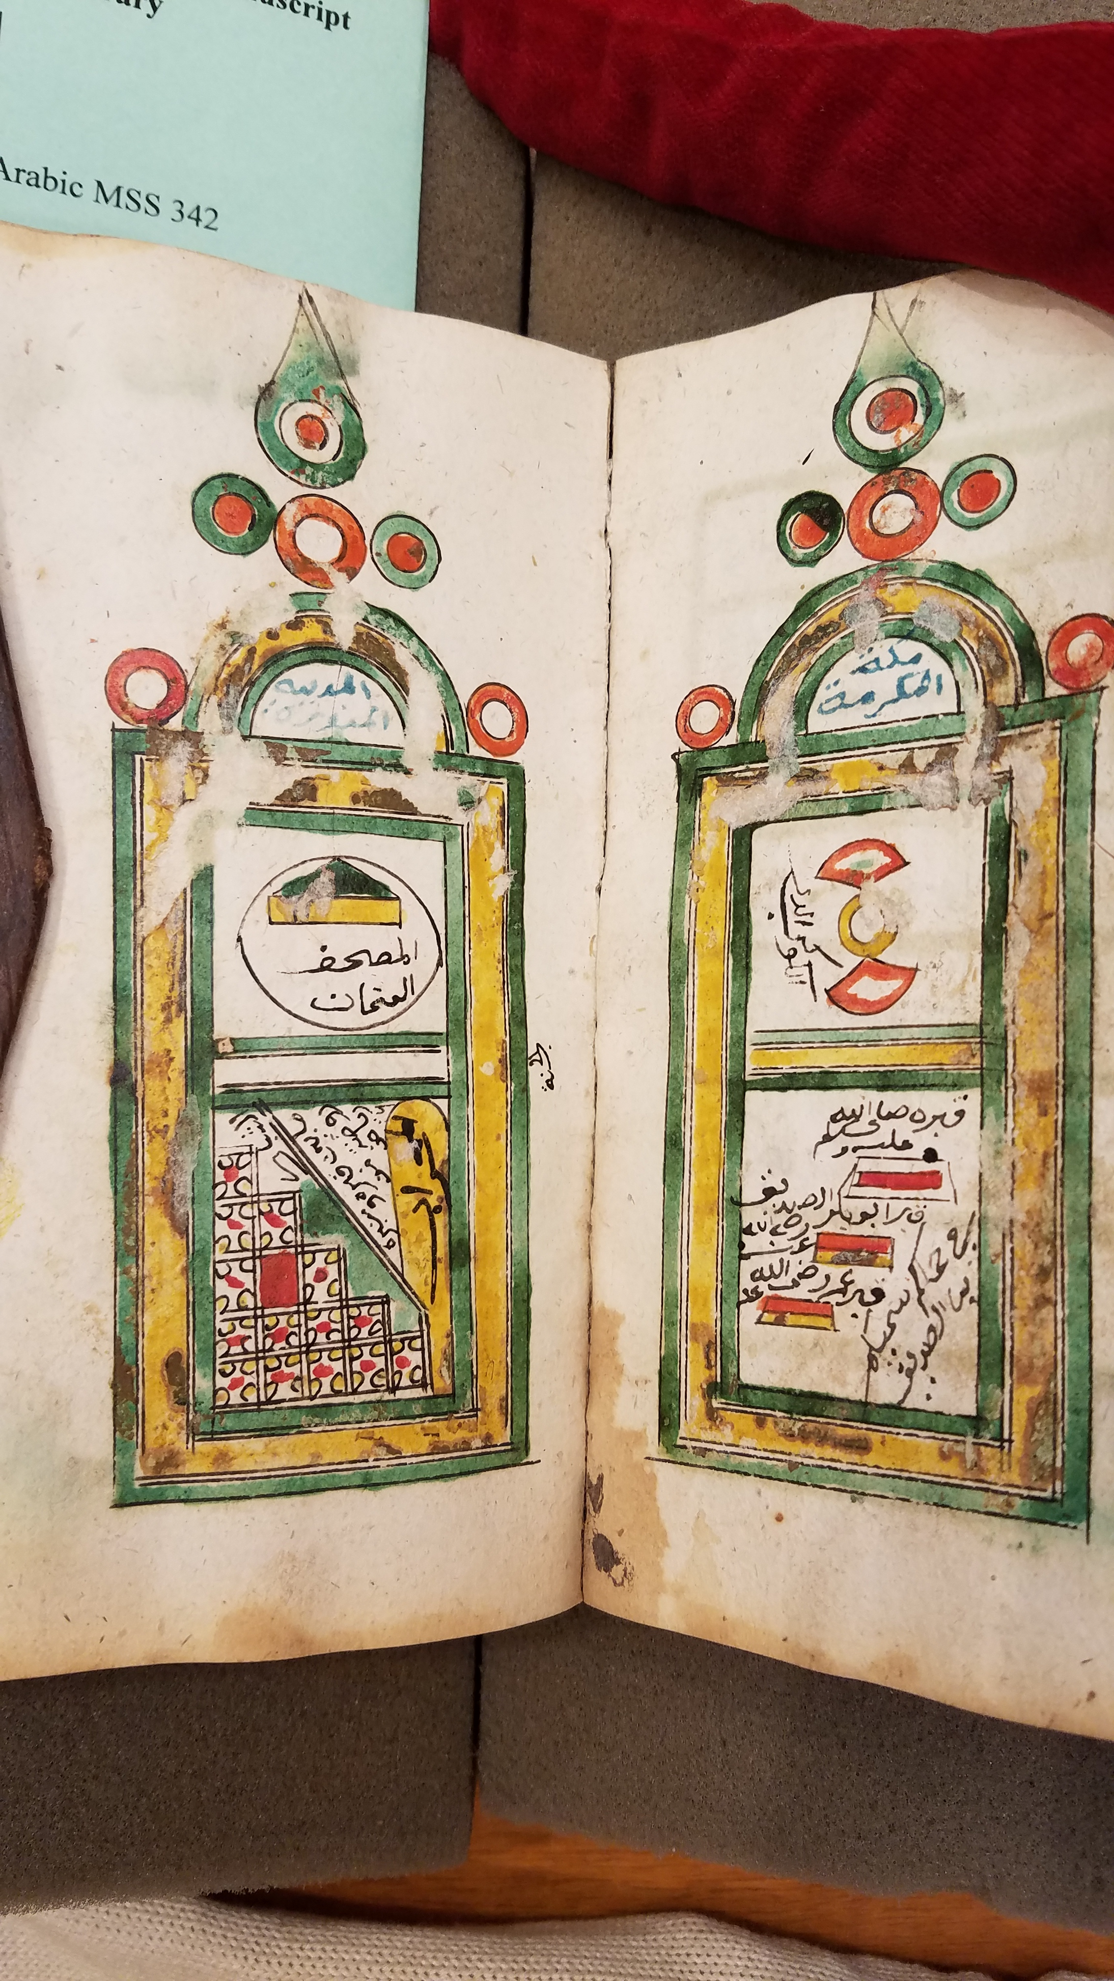
Notes:
Arabic MSS 342 (19th c.)
hdl.handle.net/10079/bibid/3769516

Slide 6
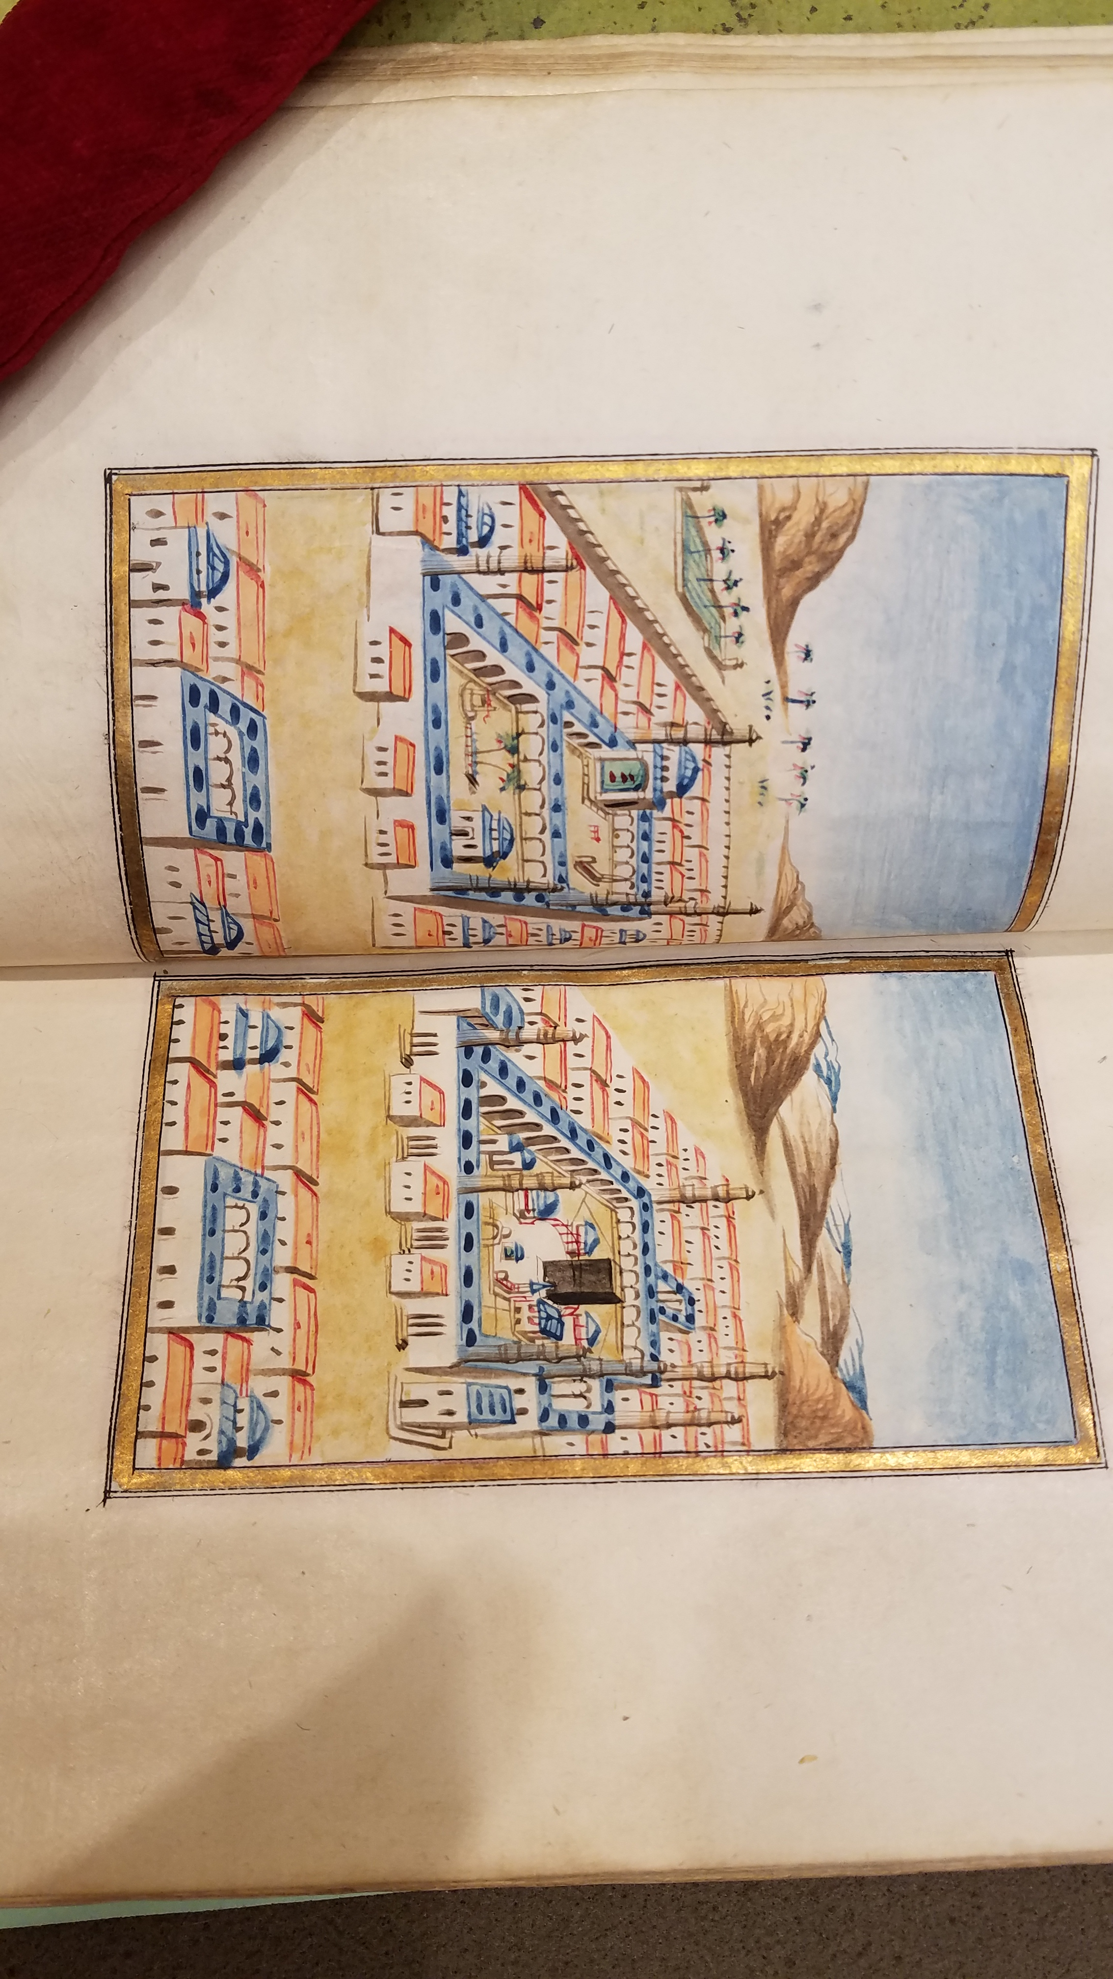
Arabic MSS suppl. 493 (1797 or 1798)
Notes:
SLIDE: ARABIC MSS SUPPL 493 (1797 OR 98)
Gift, 1979
hdl.handle.net/10079/bibid/3684386

Slide 7
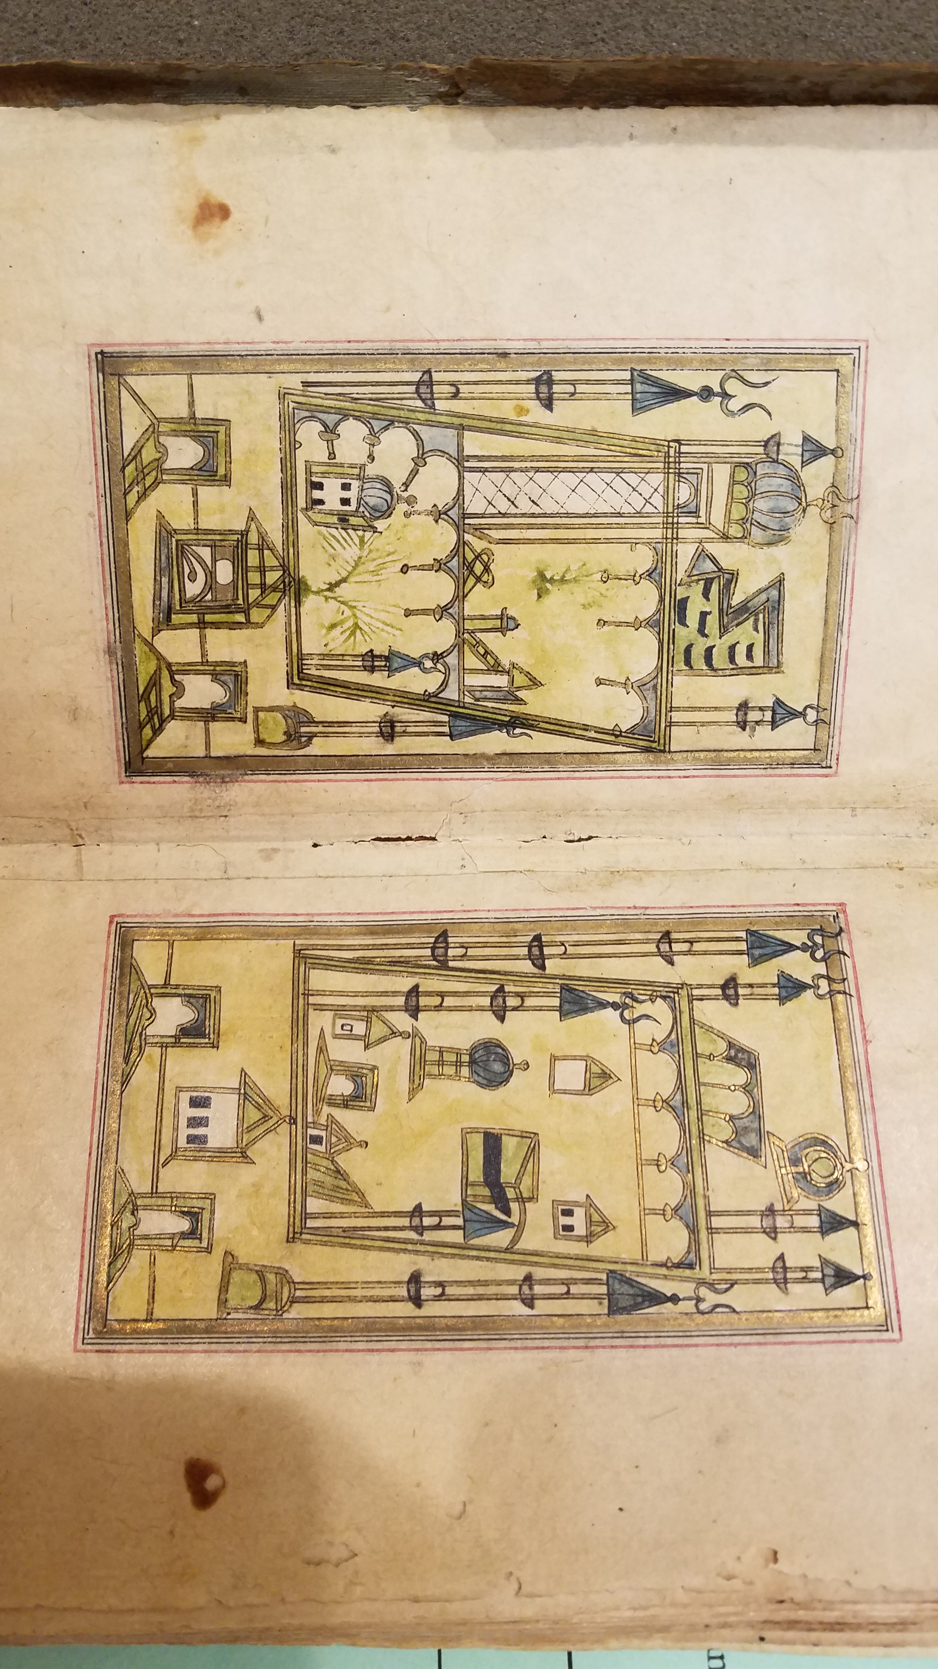
Arabic MSS 315 (1826)
Notes:
Arabic MSS 315 (1826)
hdl.handle.net/10079/bibid/3767053
Purch. Wellcome-Kraus, 1949

Slide 8
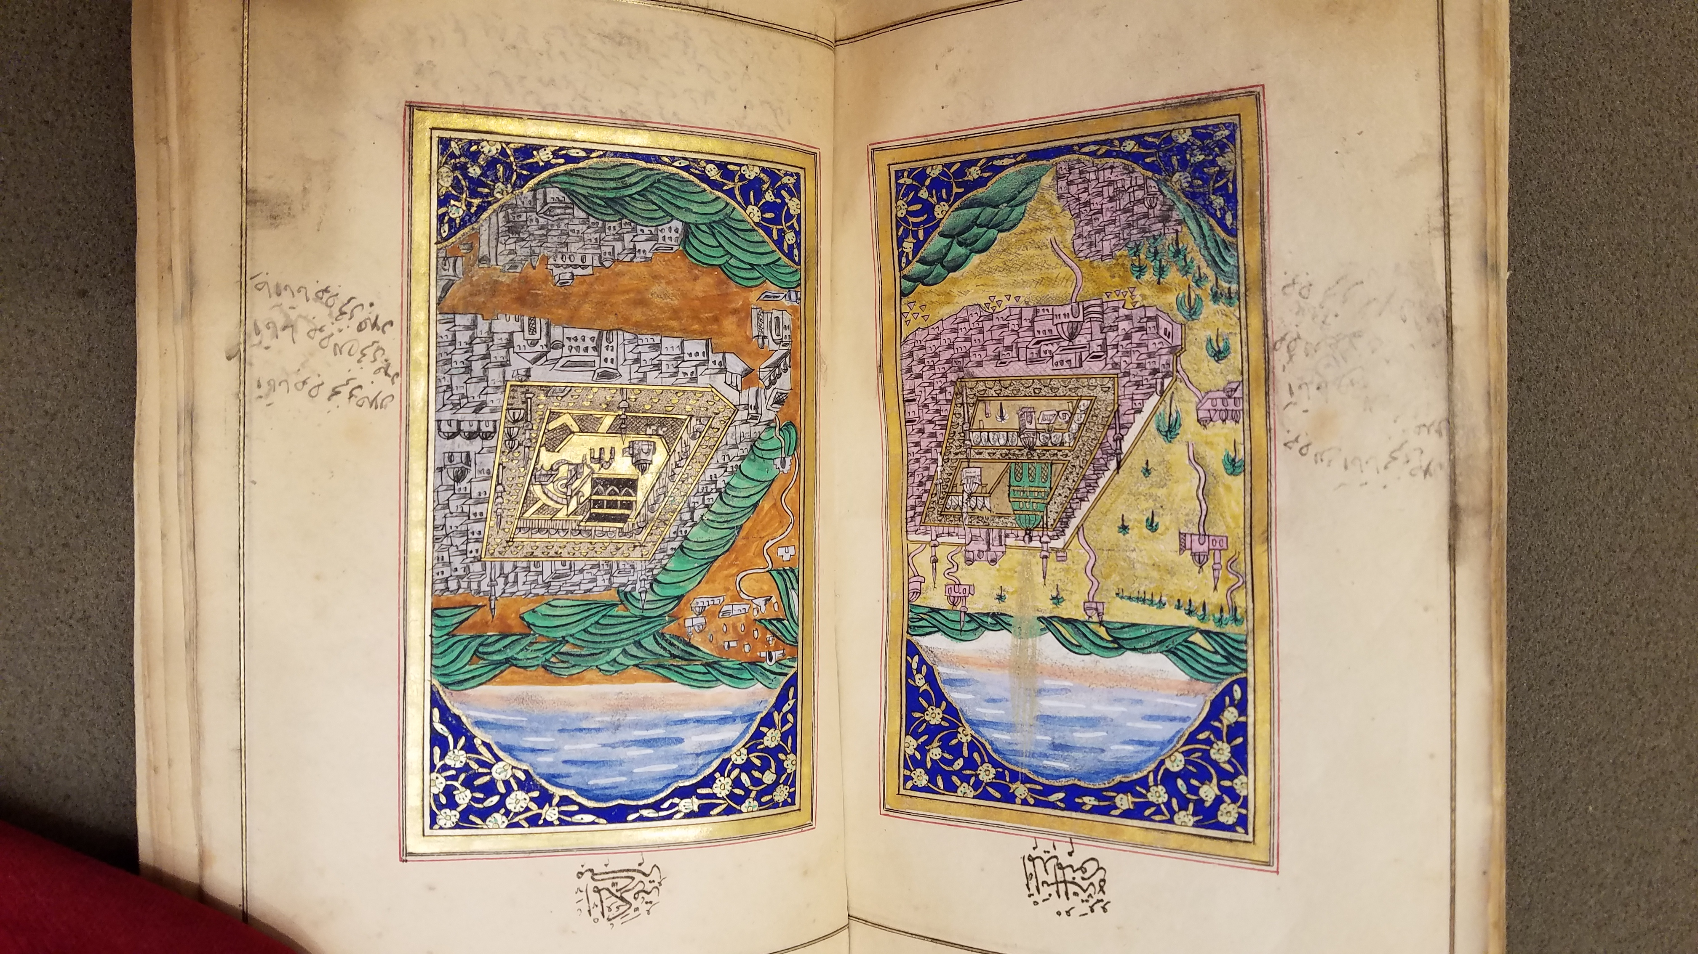
Arabic MSS 437 (1845)
Notes:
Arabic MSS 437 (1845)
Purch. London 1954
Note stream of light issuing from Medina
hdl.handle.net/10079/bibid/3776126

Slide 9
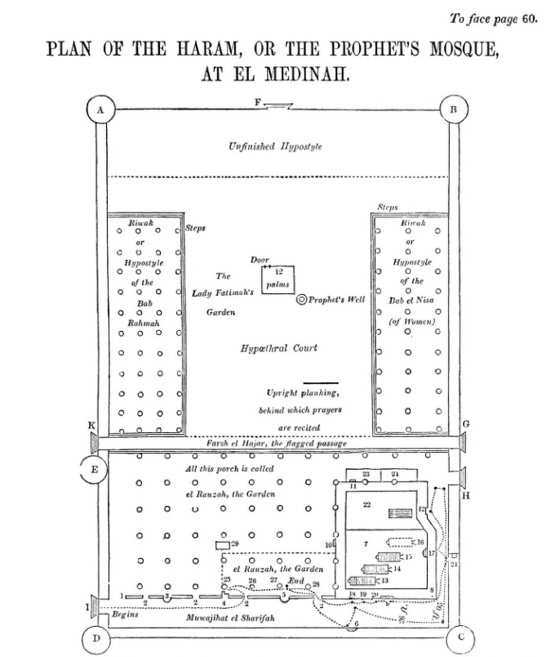
Burton’s plan of the Masjid al-Nabawi (Medina), before 1855

Slide 10
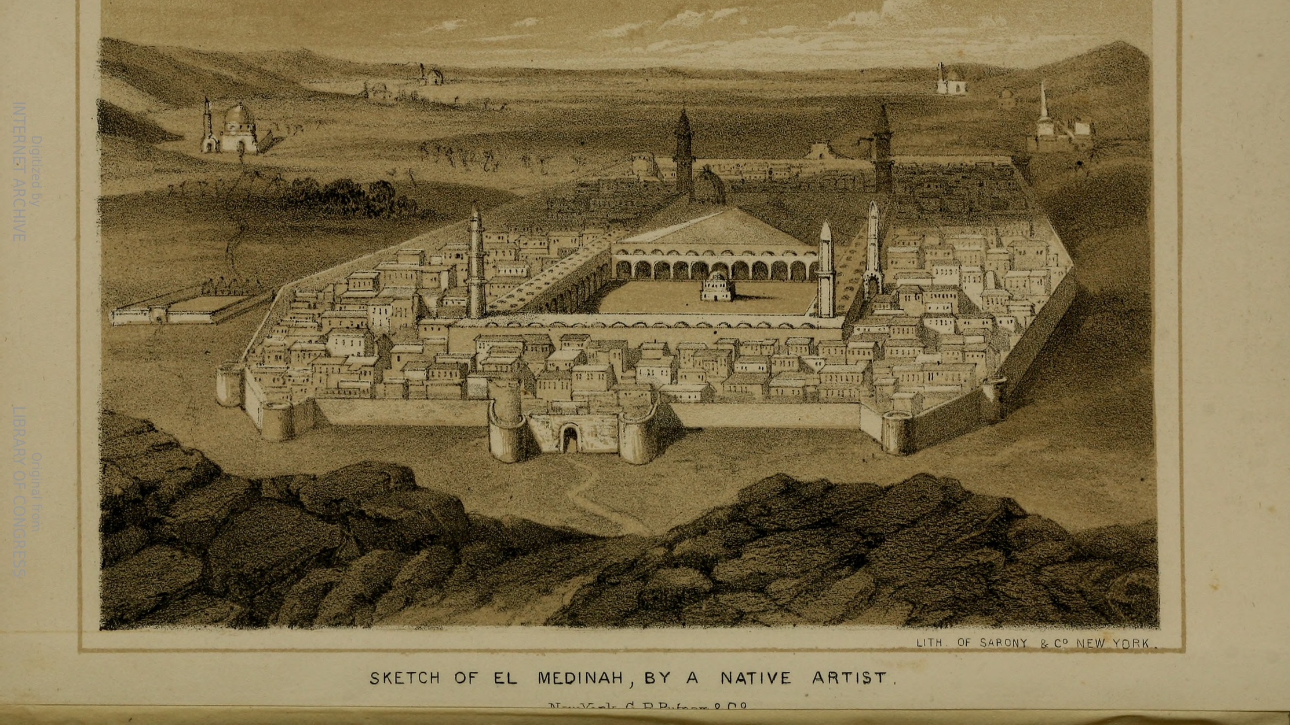
Sketch of Medina from Burton’s Personal Narrative of a Pilgrimage to El-Medinah and Meccah (pub. 1855)
Source: HathiTrust

Slide 11
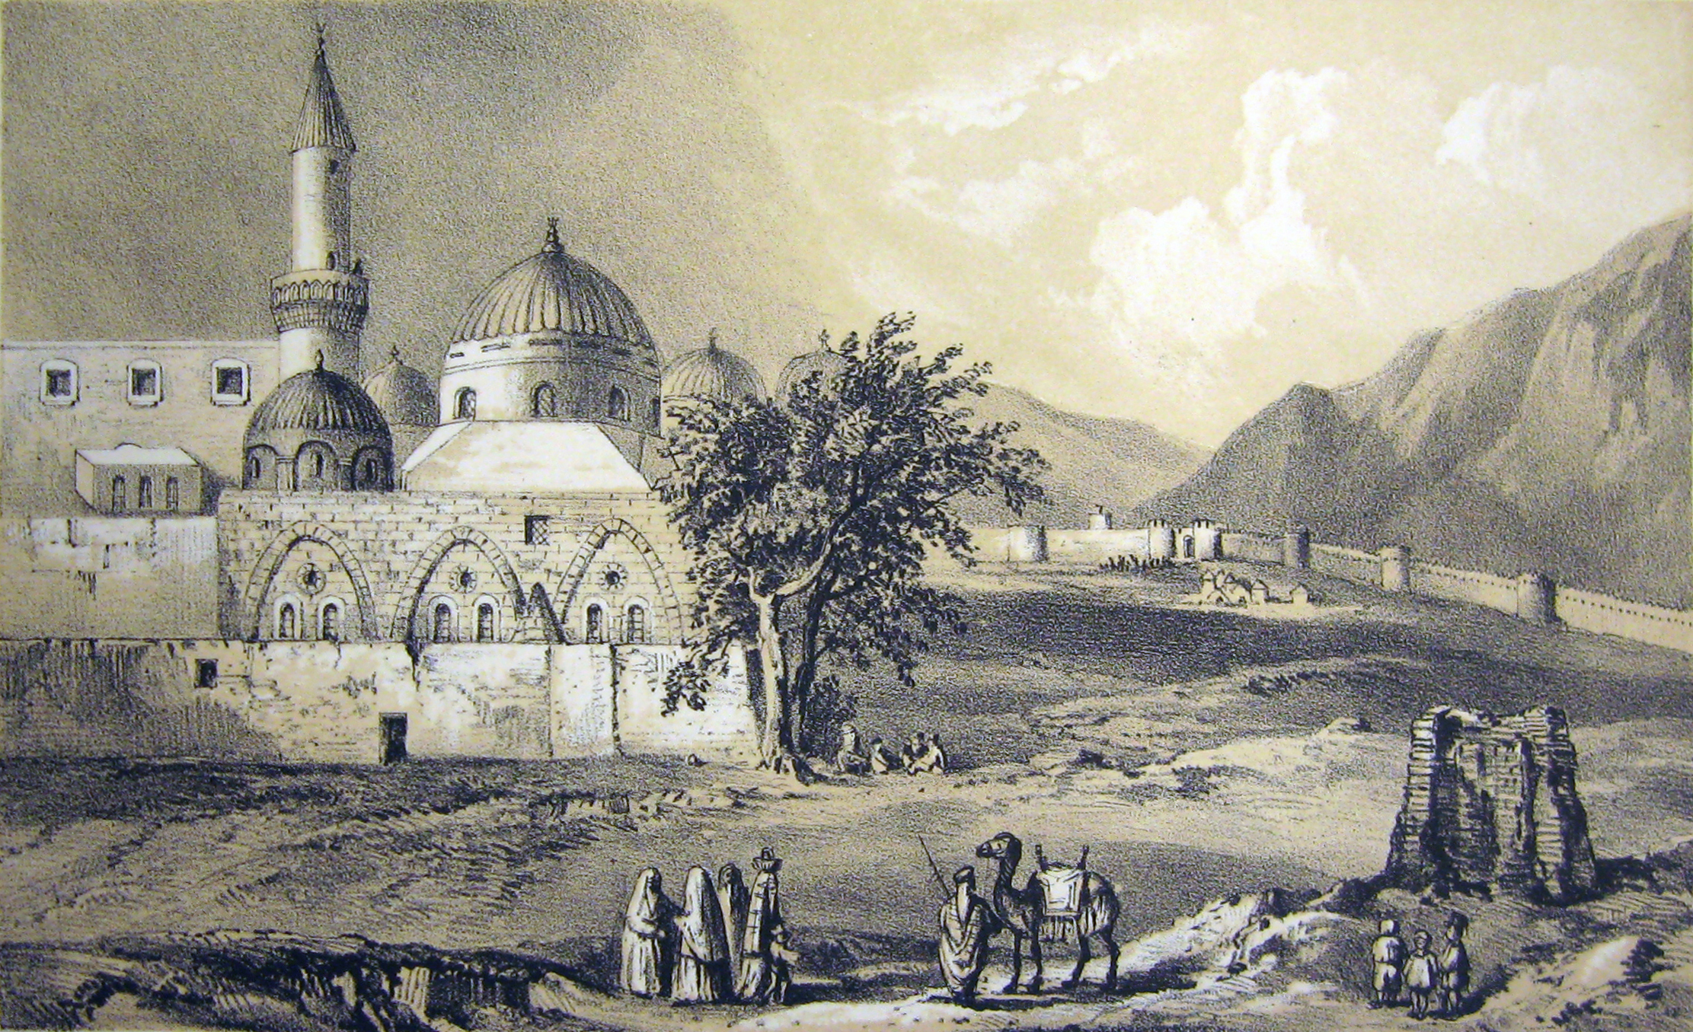
The Prophet’s place of prayer outside of the Masjid al-Nabawi of Medina, from Burton’s Personal Narrative… (1855)

Slide 12
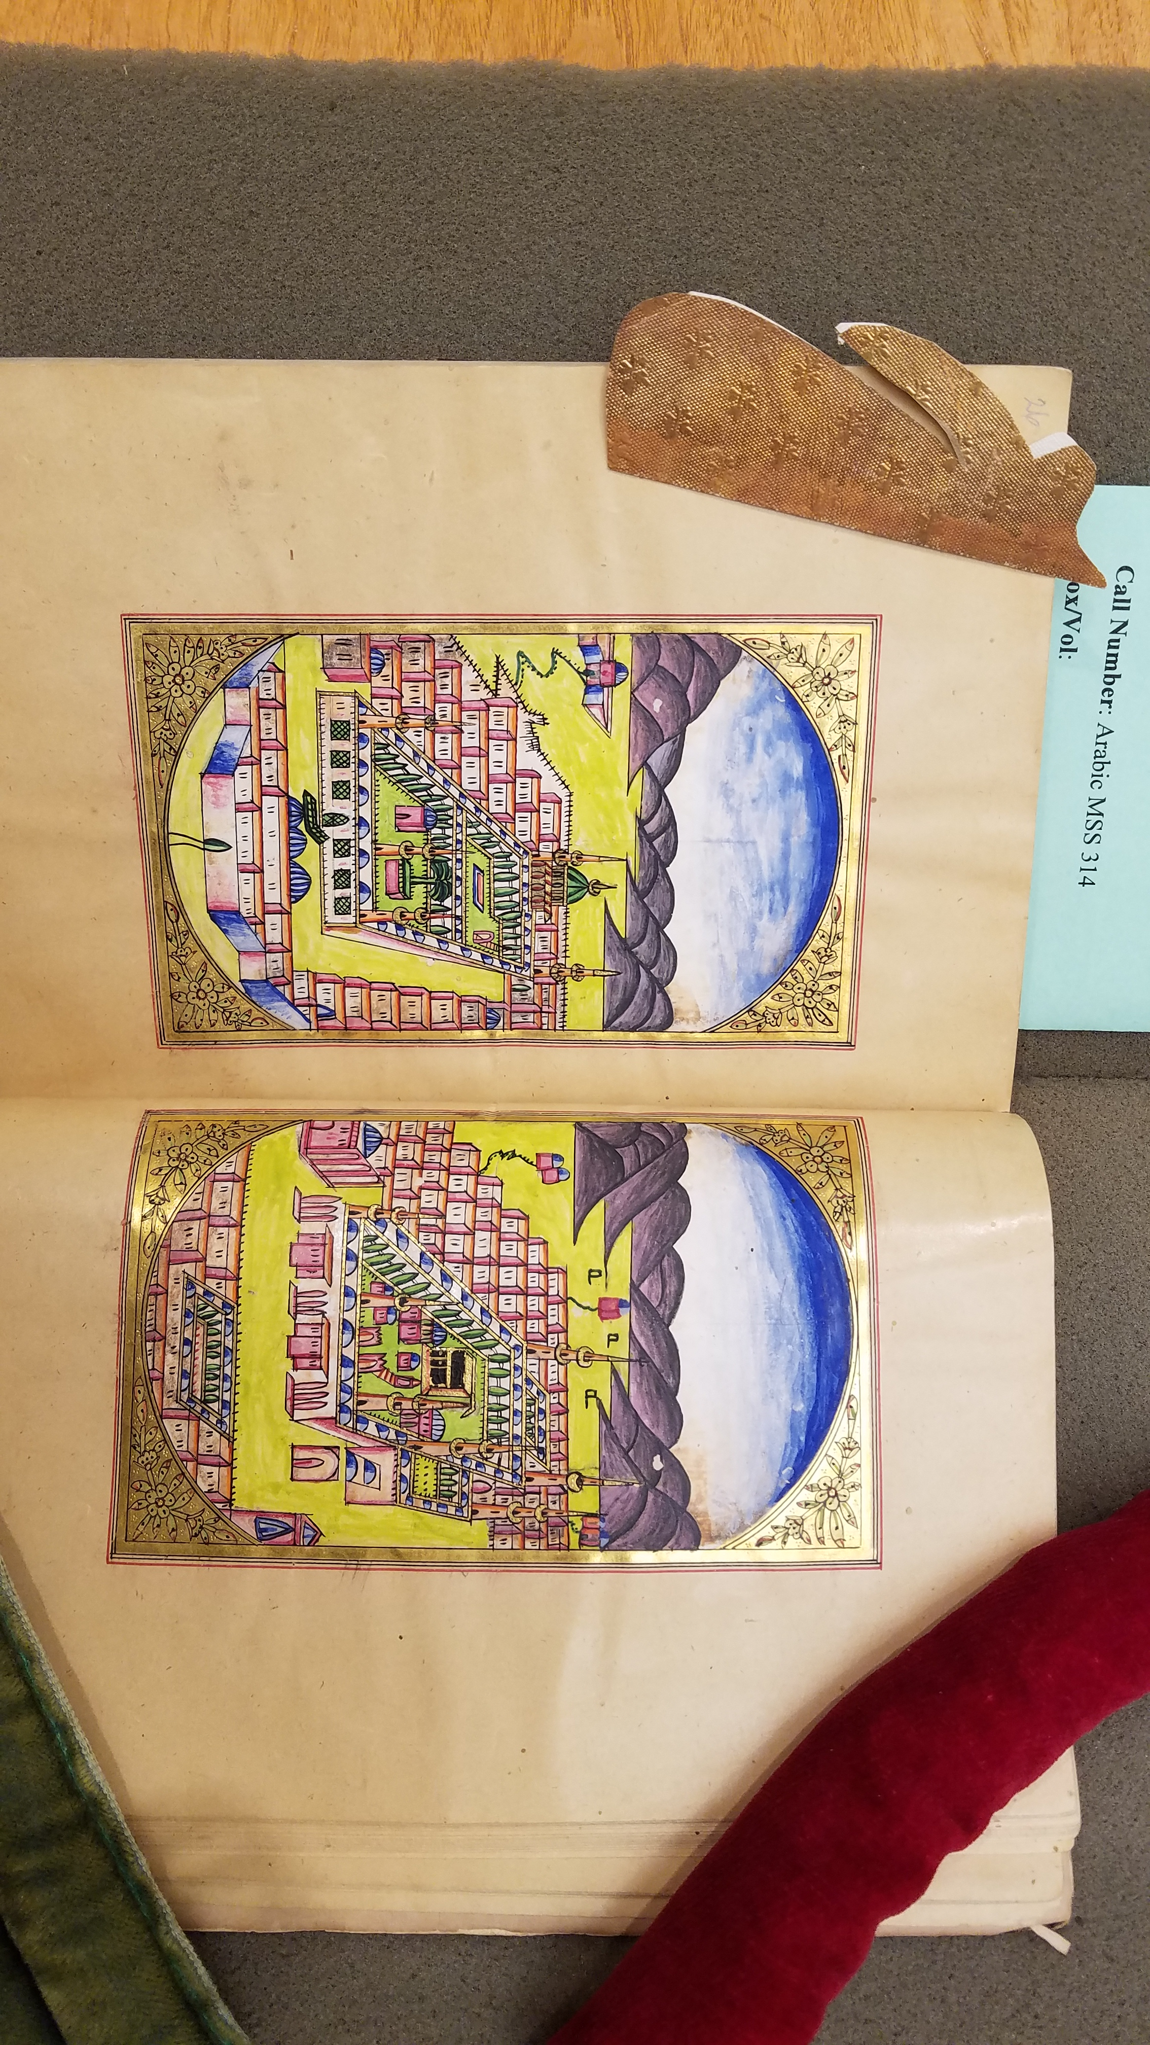
Arabic MSS 314 (1862 or 1863)
Notes:
Arabic MSS 314 (1862 or 1863)
hdl.handle.net/10079/bibid/3766976
Purch. Wellcome-Kraus 1949

Slide 13
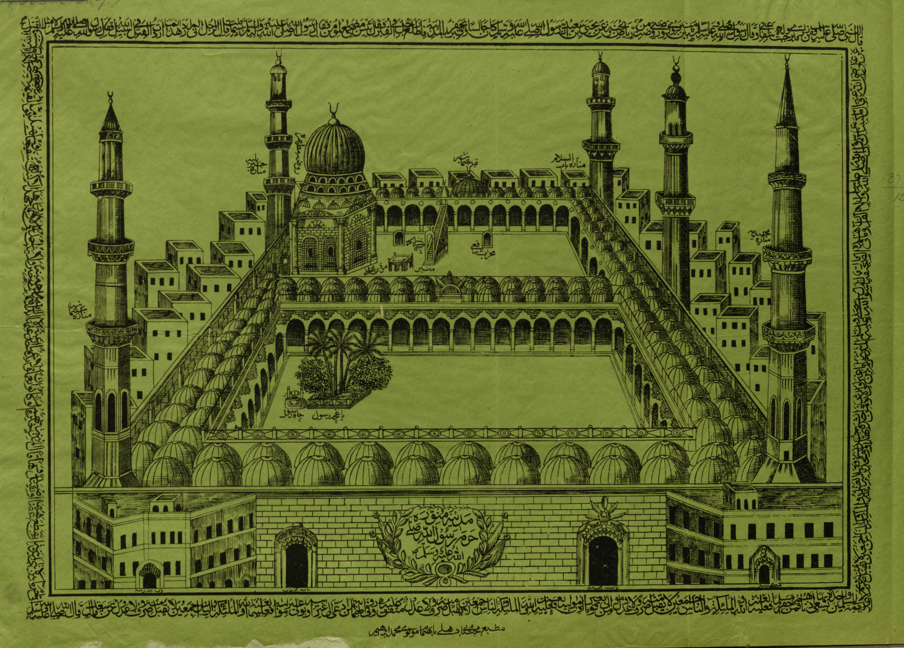
Madīnah Munawwarah Ḥaram Rasūl Allāh
مدينة منورة حرم رسول الله
(printed
Delhi, 1877)
BL Shelfmark O.P.219(9)
Source: EAPB (Gale)
Notes:
SLIDE: DELHI LITHOGRAPH OF MEDINA, 1877

Slide 14
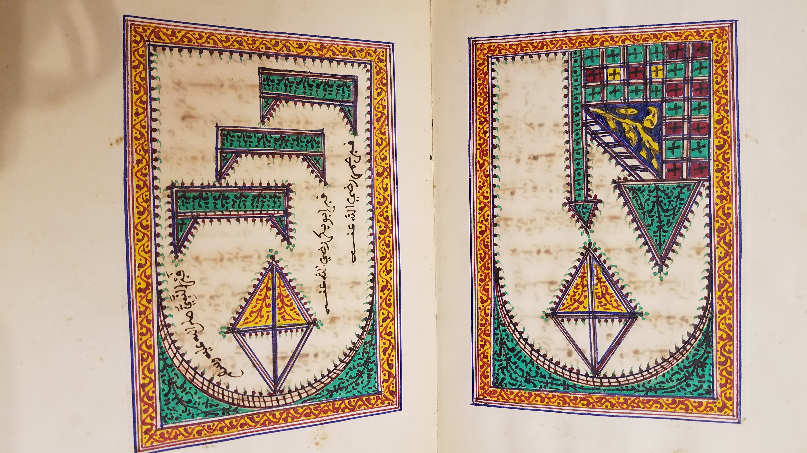
Arabic MSS 313 (1878)
Notes:
Arabic MSS 313 (1878)
hdl.handle.net/10079/bibid/3766932
Purch. Wellcome-Kraus 1949

Slide 15
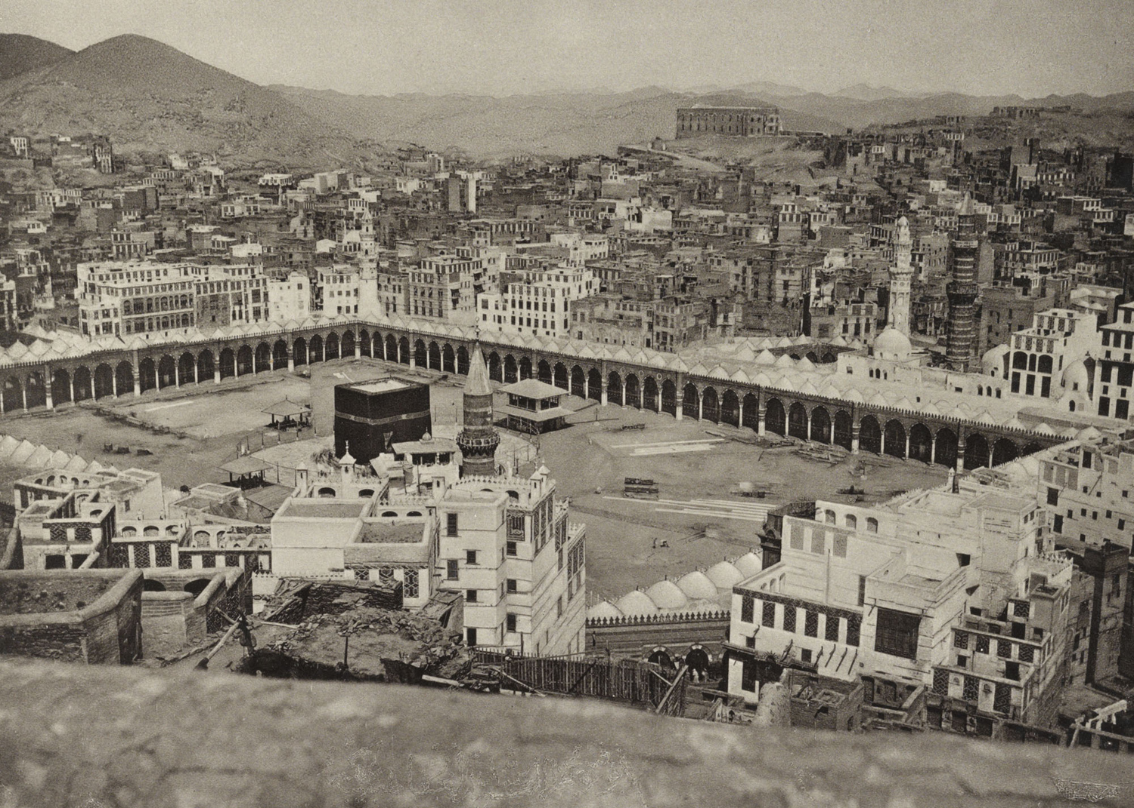
The Kabah of Mecca,
ca. 1887
(photo by
al-Sayyid Abd al-Ghaffar)
Source: Library of Congress

Slide 16
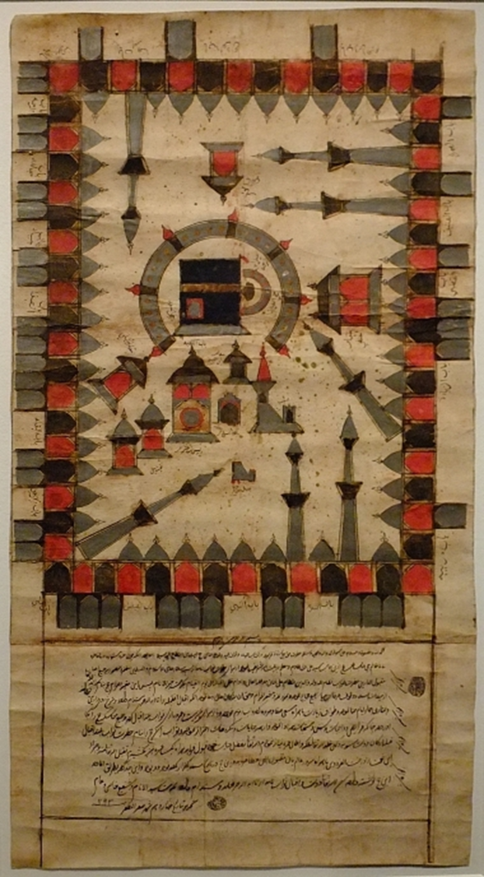
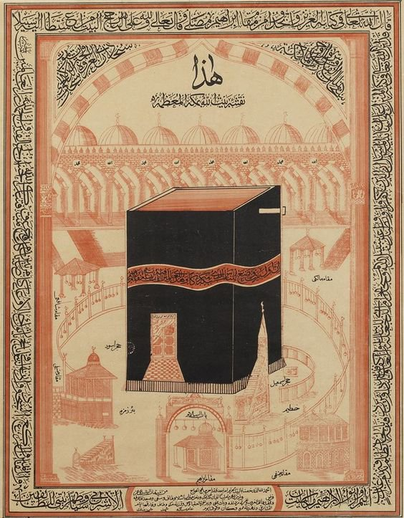
←
MS Hajj certificate for Bibi Khanum, dated 3 March 1778
Source: Treasures of the Aga Khan Museum
→
Printed Hajj certificate (unused),
late 19th c.
Source: Bonhams.com,
“Islamic & Indian Art,”
24 April 2012
Notes:
SLIDE: HAJJ CERTIFICATES, A CENTURY APART
http://thesmartlocal.com/read/treasures-of-the-aga-khan-museum-3-6
This example depicts a schematic view of the Sacred Mosque in Mecca, with the Kaaba in the centre, surrounded by the mosque building with its 7 minarets. The Persian text below this illustration reveals that this certificate belonged to one Bibi Khanum, who required a certain Sayyid 'Ali Wali to perform the pilgrimage for her as a proxy.
https://www.bonhams.com/auctions/19960/lot/132/
An Ottoman printed Hajj certificate
Ottoman Empire, late 19th Century
printed image and text on paper in black and red, the central image of the Qa'ba and surrounding shrines at Mecca, Arabic identifying inscriptions in the central section, panel at lower centre with spaces for the pilgrim's name, those of the witnesses, and the date (AH 13--), verses from the Qur'an in the border, framed
504 x 400 mm.
Footnotes
The inscription at the top reads: This is the image of the house of Allah in Mecca the Glorious One. The border text consists of Qur'an, sura IX, verse 93, and sura XXII, verses 25-27.
Printed certificates providing testimony that a person had performed the Hajj began to come into circulation around the middle of the 19th Century. This continued the existing practice of handwritten or partially block-printed versions. (See S. Aksoy & R. Milstein, 'A Collection of 13th Century Illustrated Hajj Certificates', in I. C. Schick (ed.), Ugur Derman Festschrift: papers presented on the occasion of his Sixty-Fifth Birthday, Istanbul 2000, pp. 101-134). Three types of certificate are known: those giving testimony that someone had complete the hajj; those mentioning that a person had performed it on someone's behalf; and those bearing additional testimony that the grave of the Prophet in Medina had also been visited. The present lot is of the first type.
For a manuscript certificate, dated AH 1192/AD 1778, and a printed version, dated AH 1331/AD 1912-13, see the catalogue of the current British Museum exhibition (Venetia Porter (ed.), Hajj: journey to the heart of Islam, London 2012, p. 32, fig. 8, and p. 197, fig. 144.

Slide 17
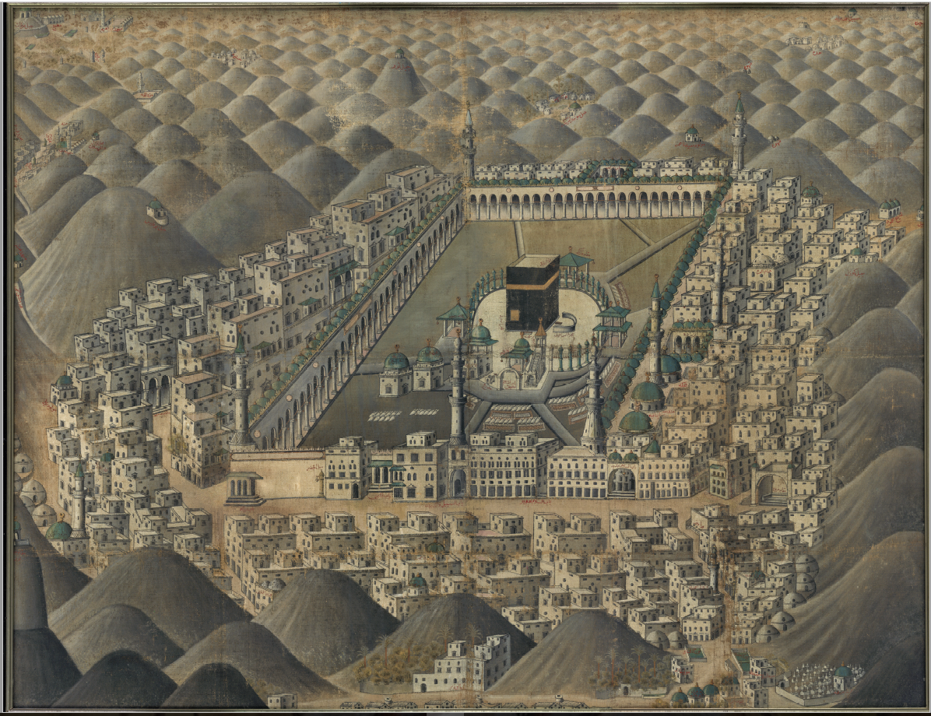
18th-century topographical view of Mecca, by an unknown artist (probably painted in Cairo)
Notes:
SLIDE: 18TH-C PAINTING, UNKNOWN ARTIST, OF MECCA & ITS ENVIRONS
http://www.alvin-portal.org/alvin/imageViewer.jsf?dsId=ATTACHMENT-0001&pid=alvin-record%3A91693&dswid=-2401
Mekka med Kaba, 18th c. (unknown painter)
Uppsala University Library
Uppsala University Inv. nr. UU2372

Slide 18
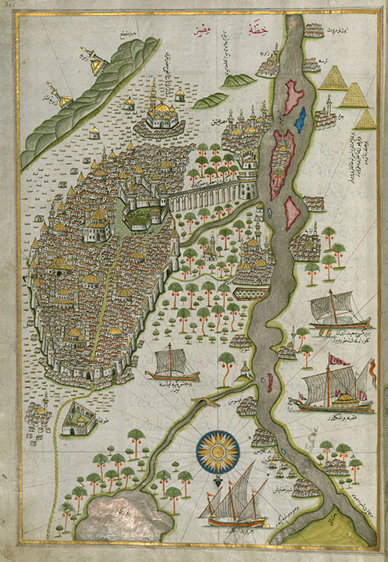
Map of Cairo, from a late 17th-c. copy of Piri Reis (d. 1555) Kitab-i bahriye
Source: Walters Art Museum (Baltimore, Md.)
Notes:
FINAL SLIDE: PIRI REIS MAP OF CAIRO & THE NILE, LATE 17TH C.
http://theancientweb.com/?portfolio=the-book-of-navigation

