Slide 1
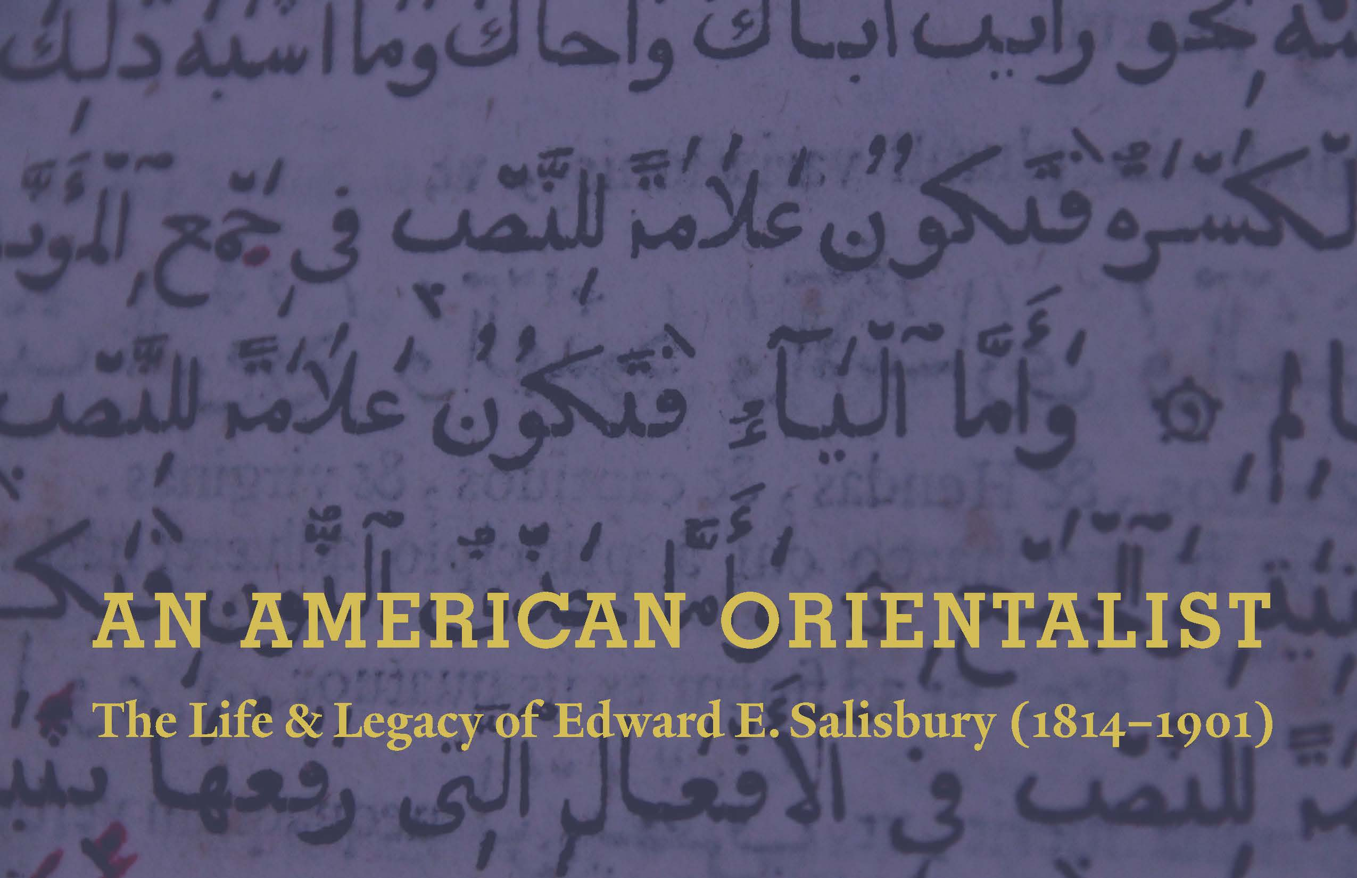
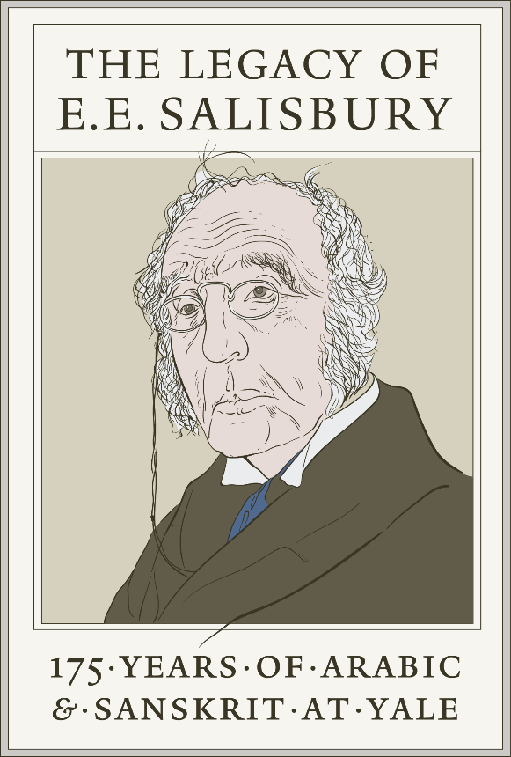

Slide 2
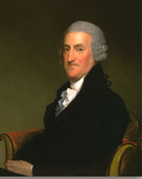
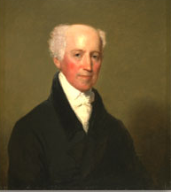
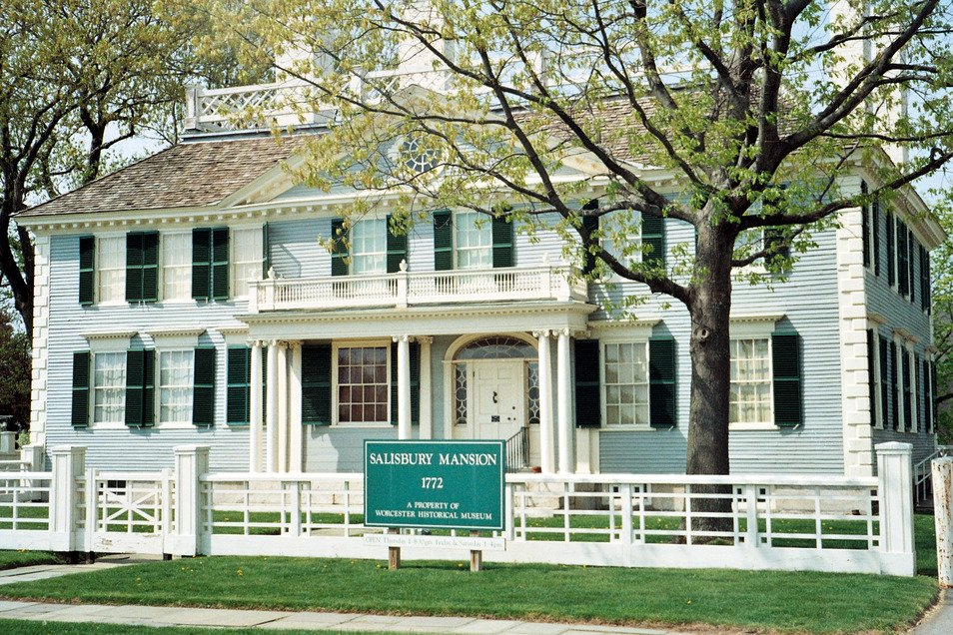
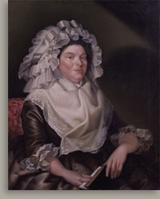
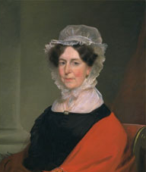
The Salisburys
of Worcester, Mass.
Notes:
The Salisburys of Worcester, Mass.
Stephen Salisbury I (1746-1829)
--his wife, Elizabeth Tuckerman Salisbury (1768-1851)
Samuel Salisbury (1739-1818)
--his wife, Elizabeth Sewall Salisbury (1750-1789)
Salisbury Mansion, built 1772 by Stephen Salisbury (1746-1829)

Slide 3
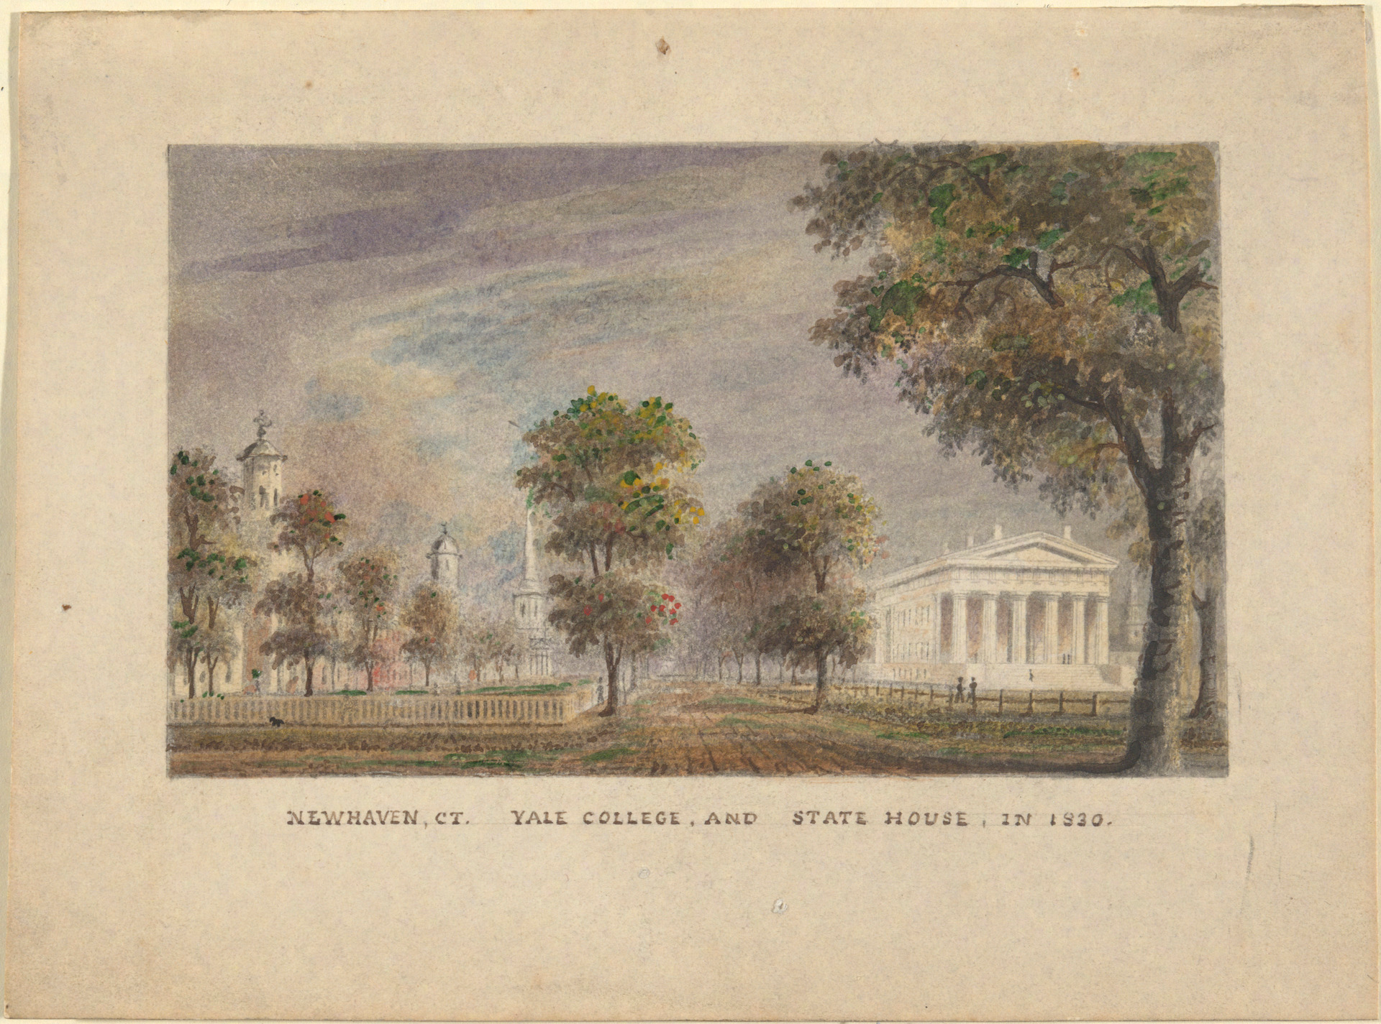
Yale College & State House, 1830
YUAG 1929.779.84
Notes:
Central New Haven in 1830; EES would have been a sophomore or junior there at that time.
The College library would have been located in the farthest chapel, the “New Chapel”
I cannot show any images of EES as a young man, however I can at least show images of the Yale campus when “she” was still only ~130 years old… less time had passed b/t founding & EES’ time, than has passed b/t then & now!)
Artist: Alexander Jackson Davis, American, 1803 - 1892
New Haven CT. Yale College and State House in 1830
ca. 1830
Watercolor on light cardboard
12.7 x 17.5 cm (5 x 6 7/8 in. ) (sheet)
Gift of Rev. Anson Phelps Stokes, B.A. 1896, M.A.(Hon.) 1900, L.L.B. 1921
1929.779.84
http://artgallery.yale.edu/collections/objects/36034

Slide 4
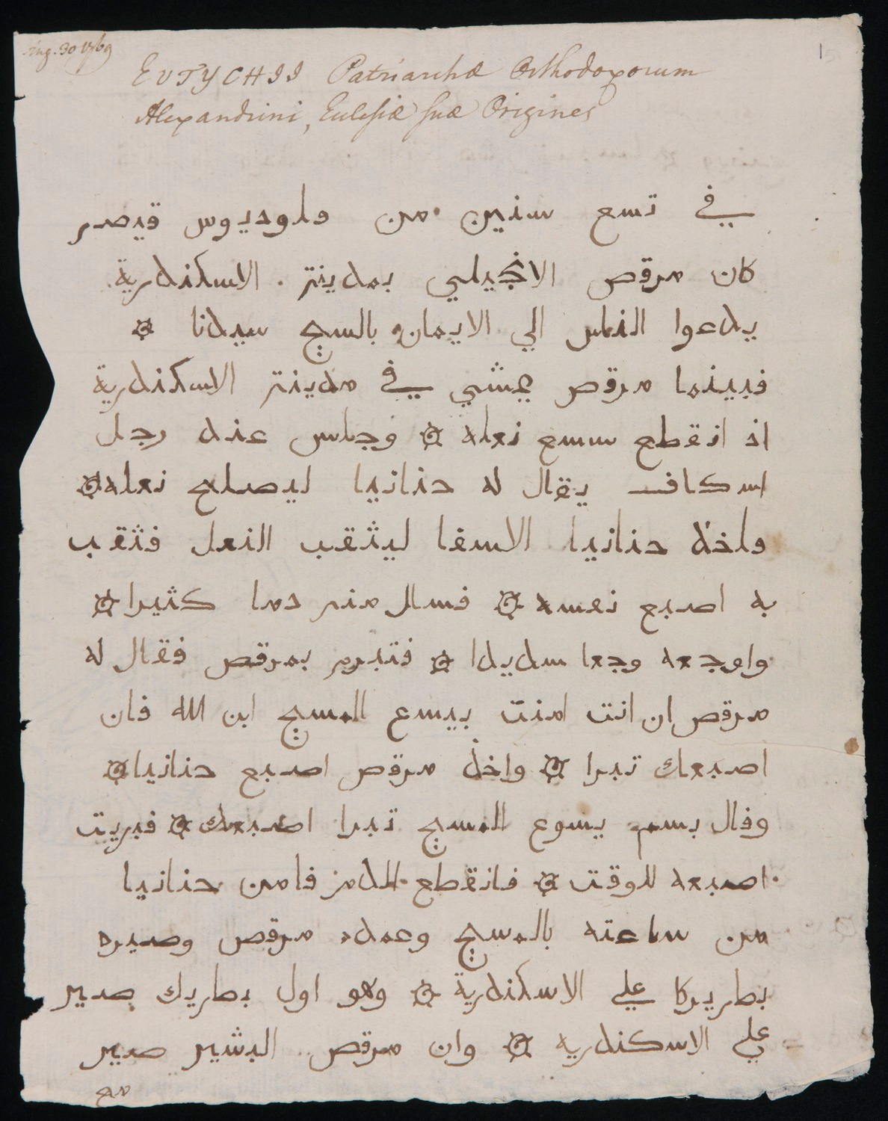
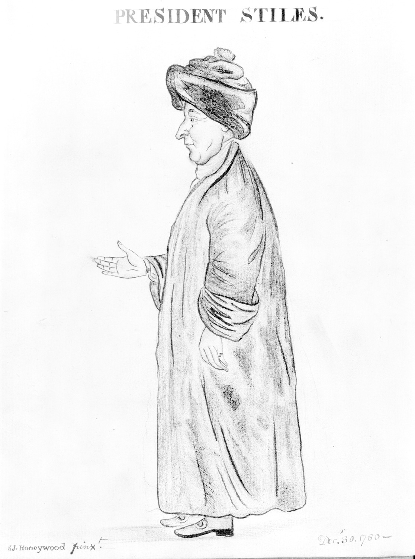
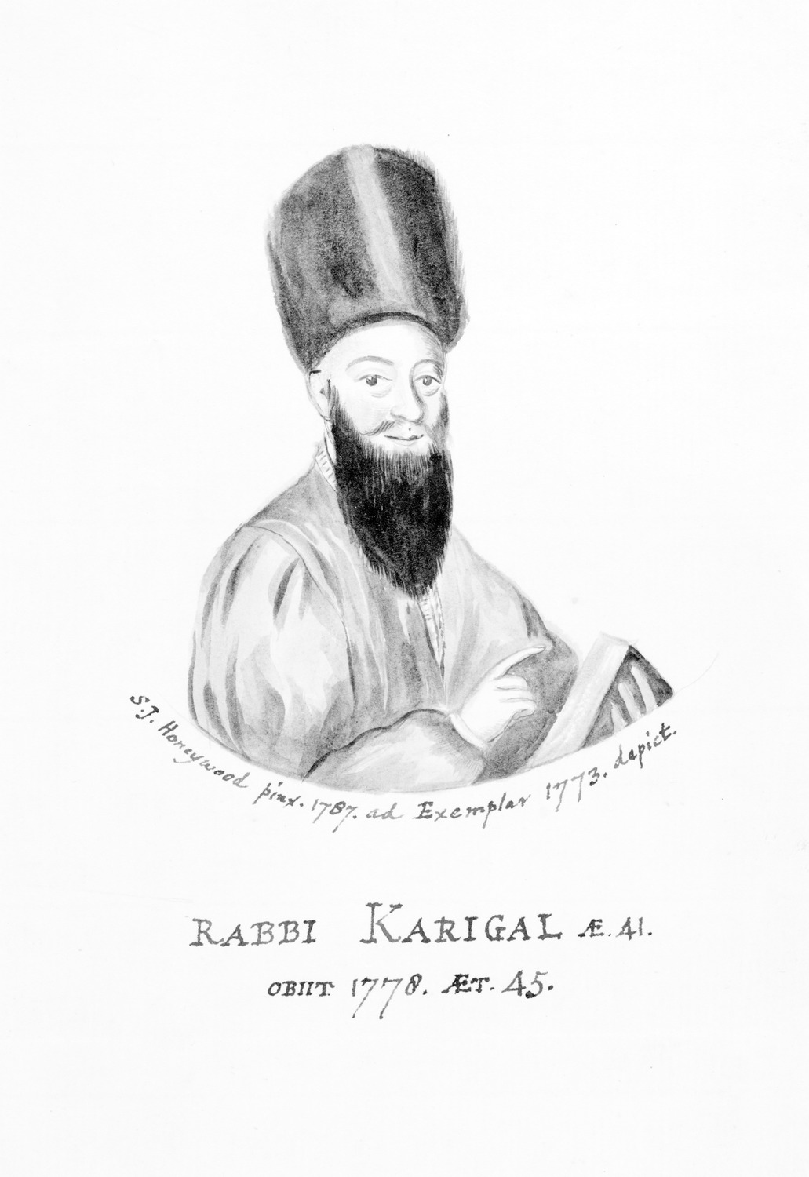
Ezra Stiles’ copy (1769)
of “The Antiquities of the Church of Alexandria”
by Eutychius, Patriarch of Alexandria, 877-940
MS Vault Stiles
Notes:
Ezra Stiles MS of The antiquities of the Church of Alexandria, [Egypt], by Eutychius, Patriarch of Alexandria, 877-940,
From Hebrew notebook 51-56. Folder marked: Theo 22.
Copied 1769.
http://brbl-dl.library.yale.edu/vufind/Record/3444959
Sketch of Rabbi Karigal MS Vault Stiles by St. John Honeywood
http://brbl-dl.library.yale.edu/vufind/Record/3772874
Ezra Stiles MS Vault Stiles by St. John Honeywood
http://brbl-dl.library.yale.edu/vufind/Record/3762042

Slide 5
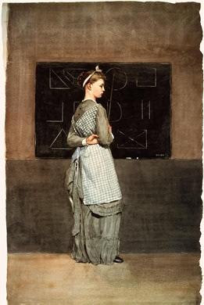
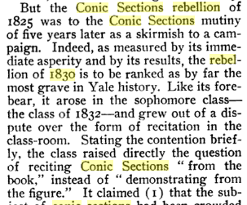
“Blackboard” (1877)
Winslow Homer, 1836-1910
From “The Yale Wars
of the Conic Sections,” 1904
Notes:
http://www.andrewgrahamdixon.com/archive/itp-177-blackboard-by-winslow-homer.html
“Blackboard,” by Winslow Homer, 1877
Clarence Deming, “Yale Wars of the Conic Sections,” in the Independent, v. 56, no. 2886 (March 24, 1904), pp. 667-669 (http://bit.ly/2cCyvwo).

Slide 6

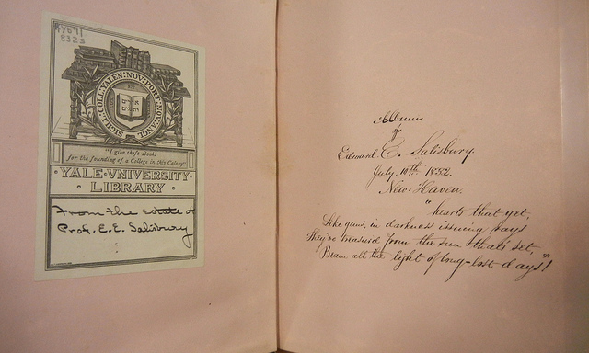
*Yb71 832s Class album MSSA
Notes:
Case 1b.2
*Yb71 832s Class album MSSA
gift of the estate of E.E. Salisbury

Slide 7
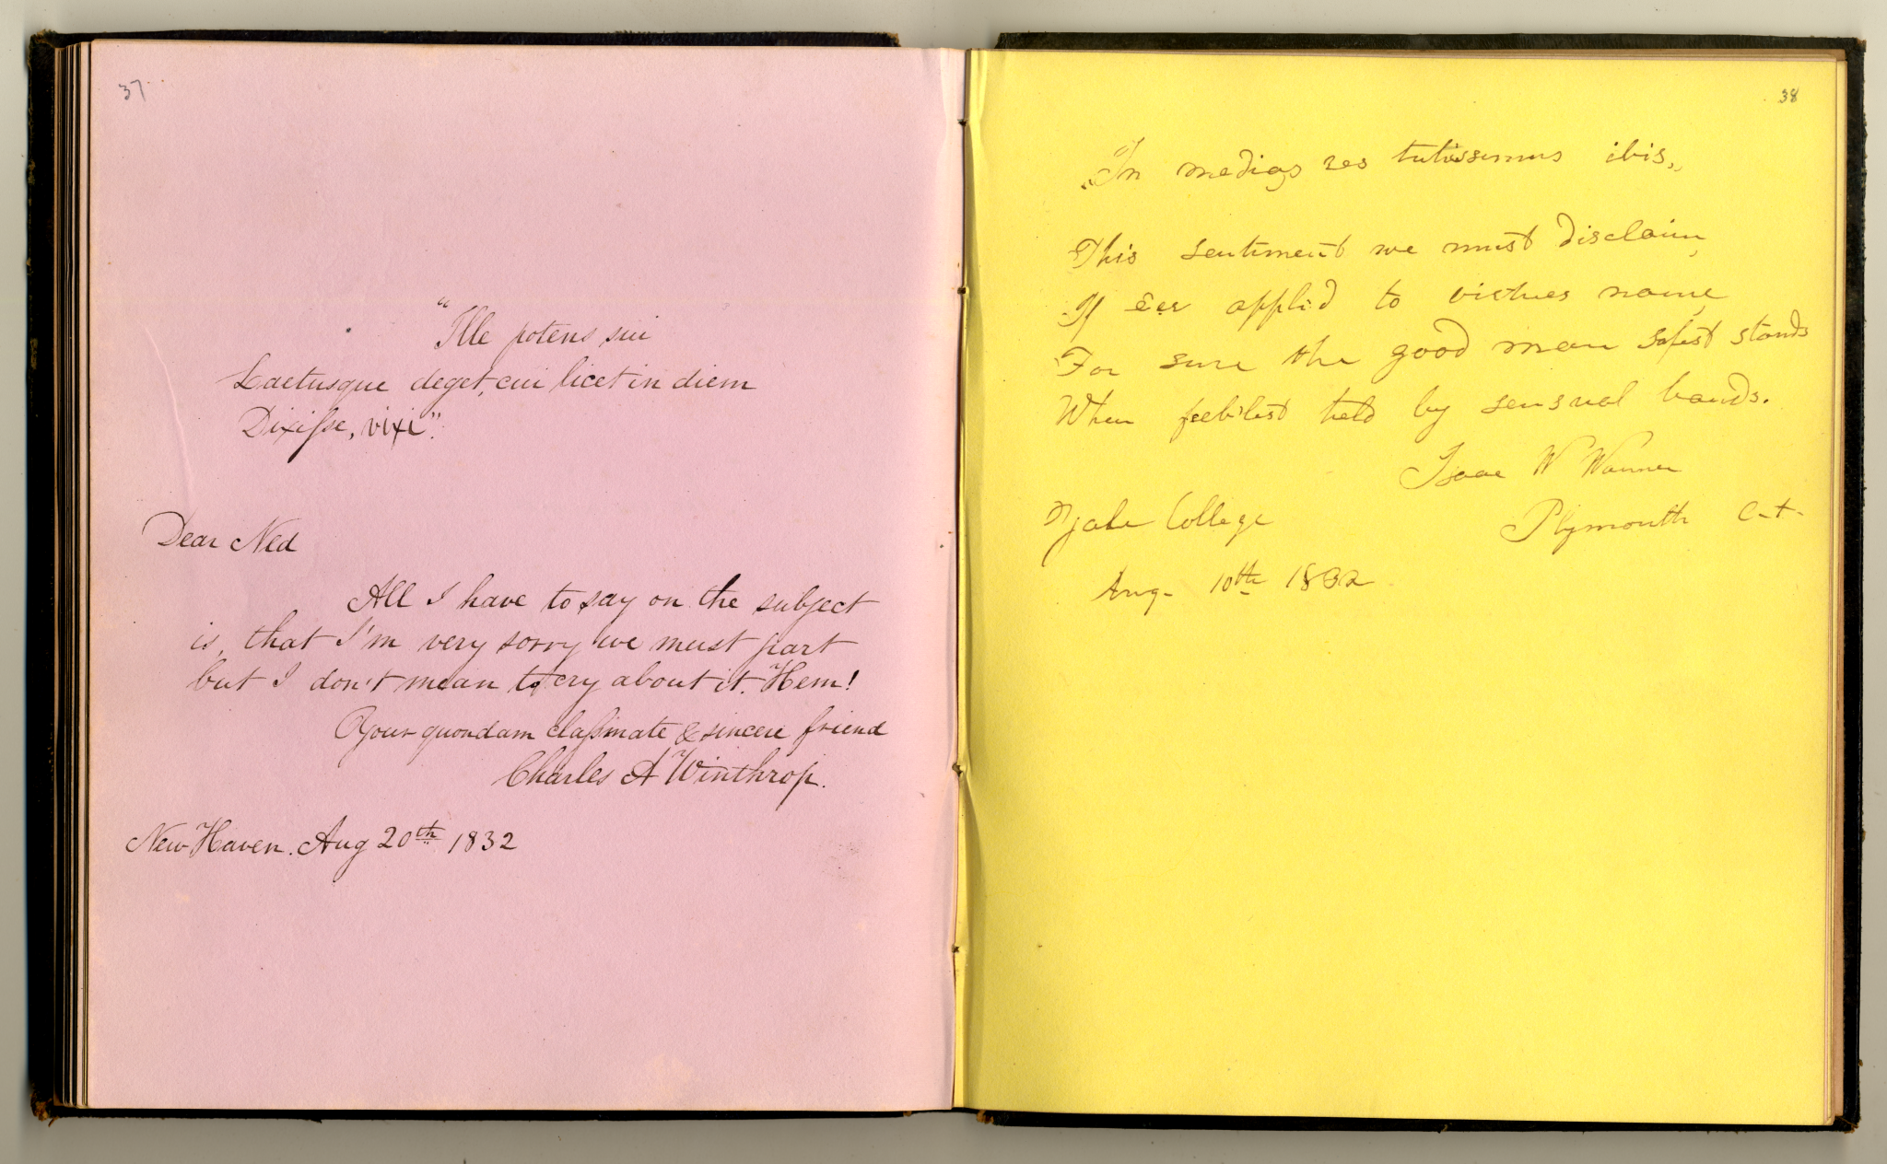
*Yb71 832s Class album MSSA
Notes:
Case 1b.2
*Yb71 832s Class album MSSA
gift of the estate of E.E. Salisbury

Slide 8
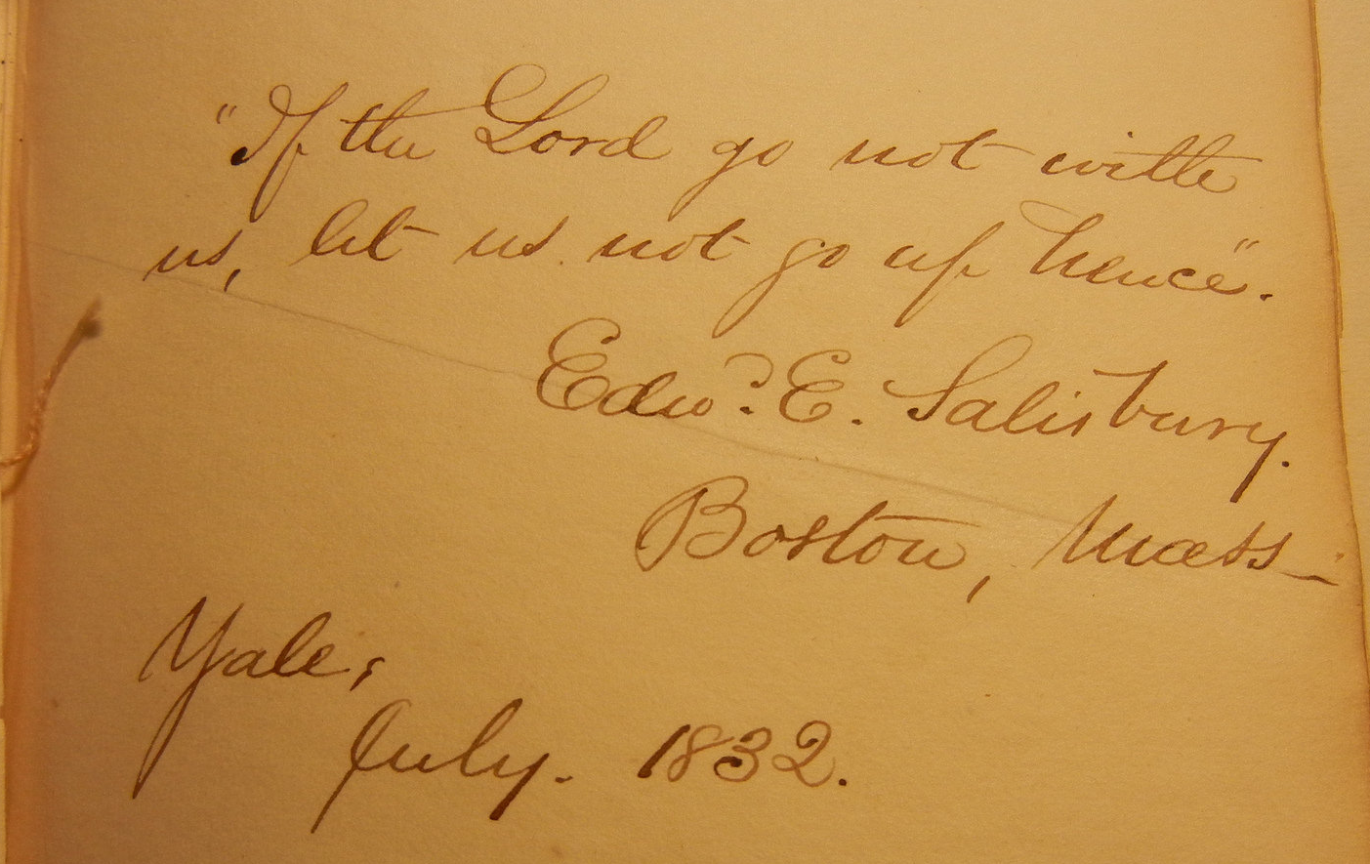
EES paraphrases Moses
(Exodus 33:15)
Yb71 832p Class album MSSA

Slide 9
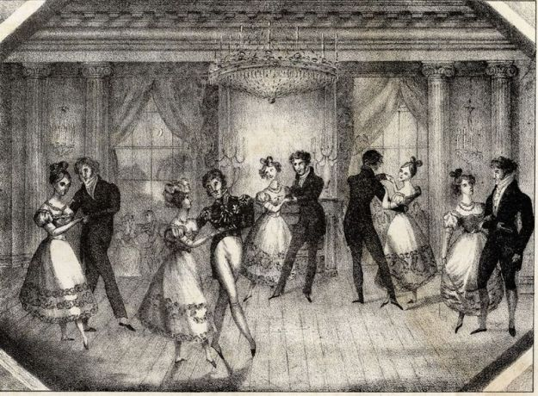
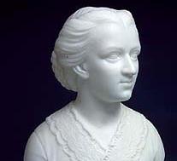
Anna Quincy Waterston (1812-1899) and her diary of 1833
“…Then came young Mr. Salisbury, with whom I hammered thro’ a dance…”
“…Then came young Mr. Salisbury,
with whom I hammered thro’ a dance…”
Notes:
http://www.americanantiquarian.org/Exhibitions/Dance/danceimages/tricolored.jpg
Bust of Anna Quincy Waterston (1812-1899), in the Smithsonian, by Edmonia Lewis (African-American sculptress, 1844-1907)
http://americanart.si.edu/collections/search/artwork/?id=14632
https://hcl.harvard.edu:8001/libraries/houghton/exhibits/emancipation/case69.cfm
http://www.aljazeera.com/indepth/features/2017/02/edmonia-lewis-african-american-trailblazer-170201071933432.html

Slide 10
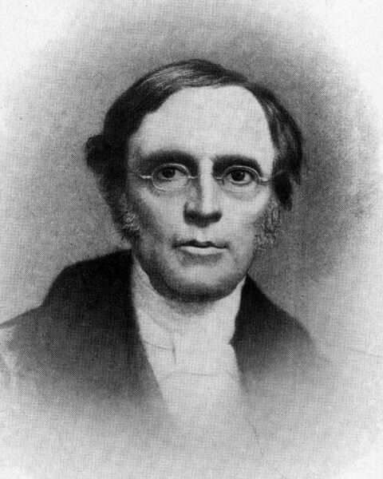
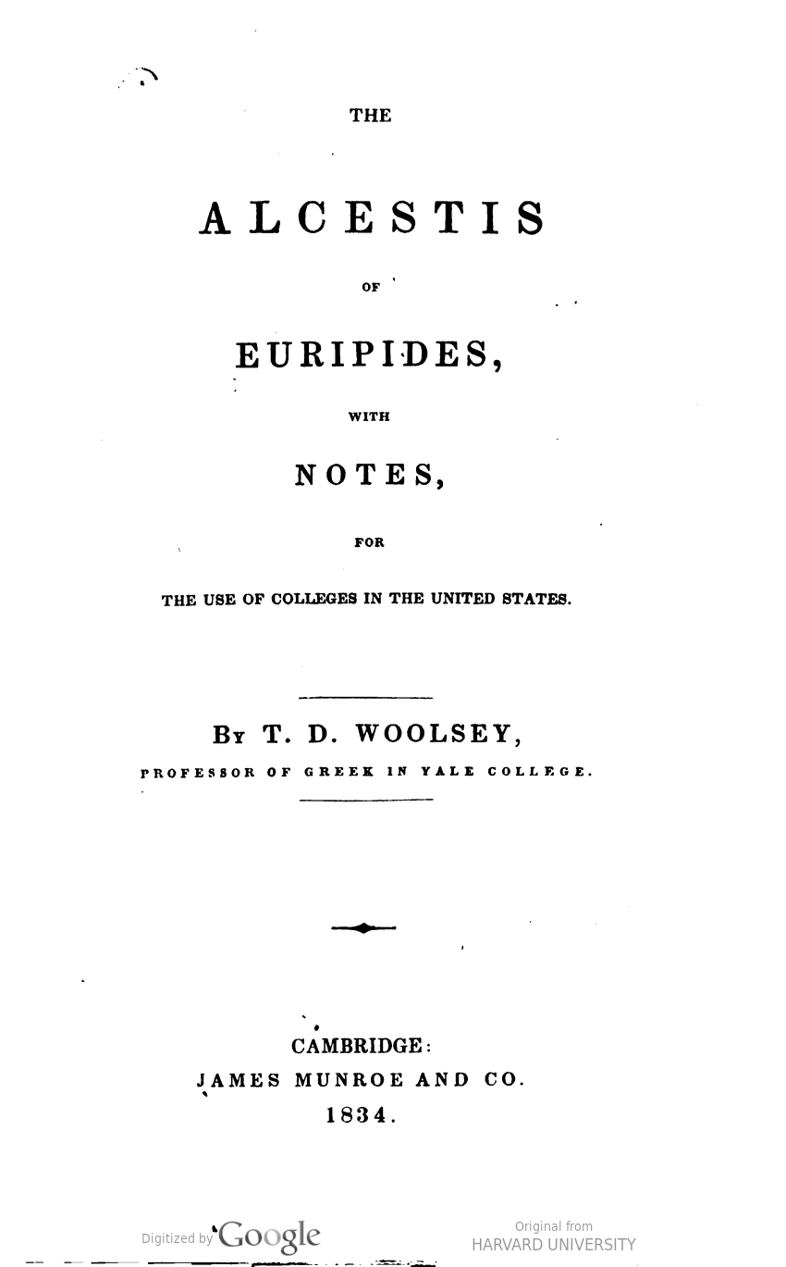
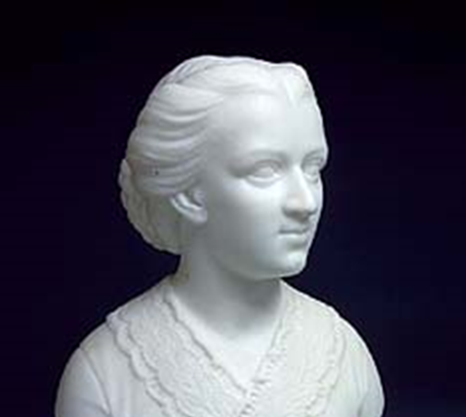
Theodore Dwight Woolsey,
1801-1889
Yale prof. of Greek,
Pres. of Yale,
1846-1871
“…a perfect stick…!”

Slide 11
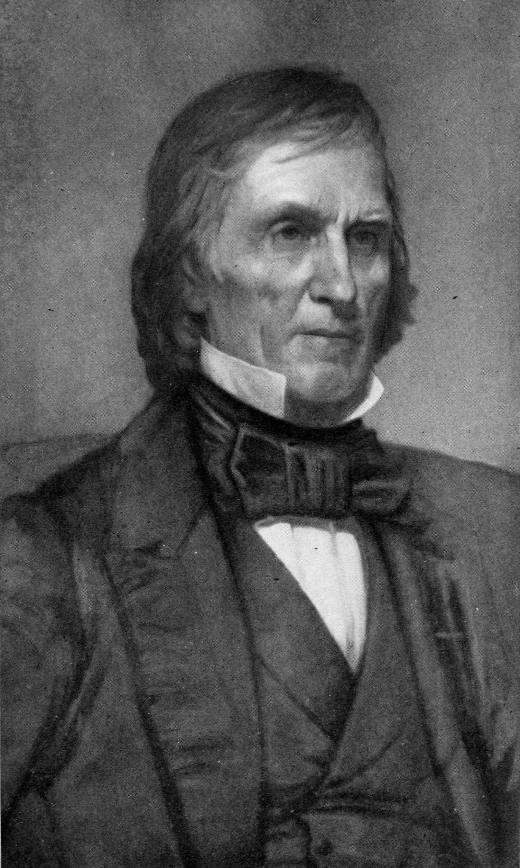
Josiah Willard Gibbs, Sr. (1790-1861)
American linguist & theologian
Professor of
Sacred Literature at Yale

Slide 12
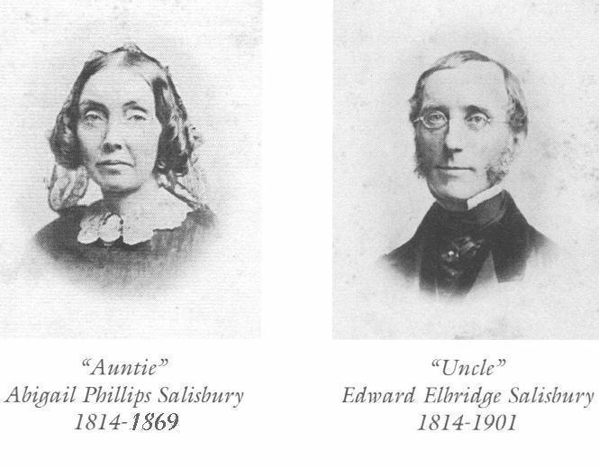
Notes:
From Agnes Woolsey, Too Young to Travel Abroad: Journal of a Year of European Travel in 1856-7 (Portsmouth, NH: Peter E. Randall, 1995).

Slide 13
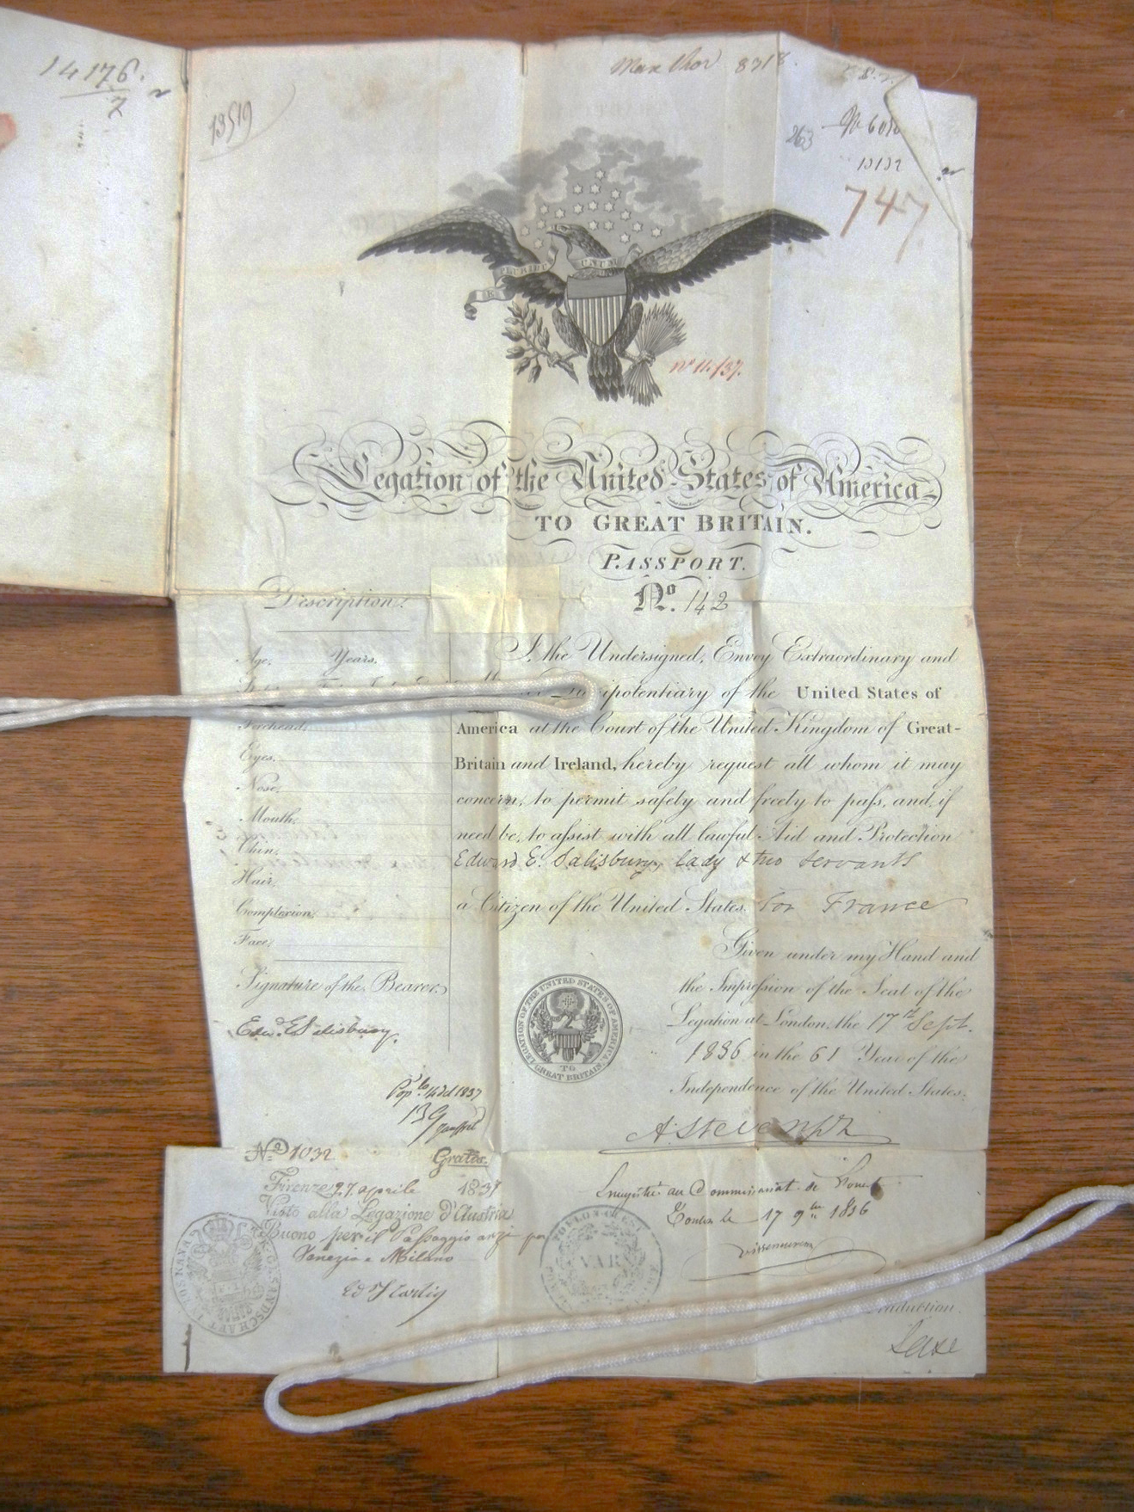
Passport for “Edward Elbridge Salisbury, lady, and two servants” issued in London

Slide 14
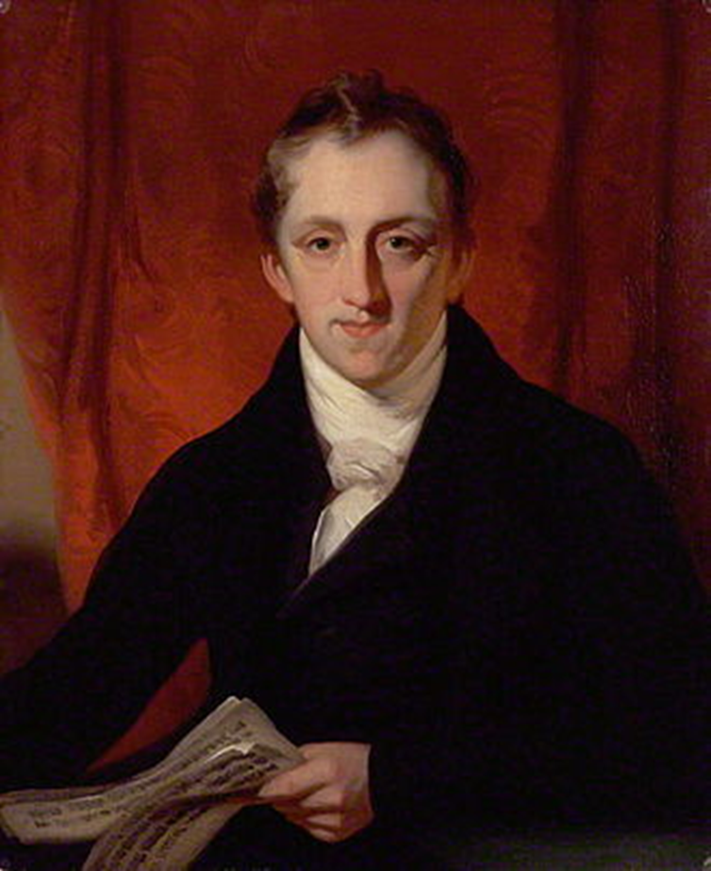
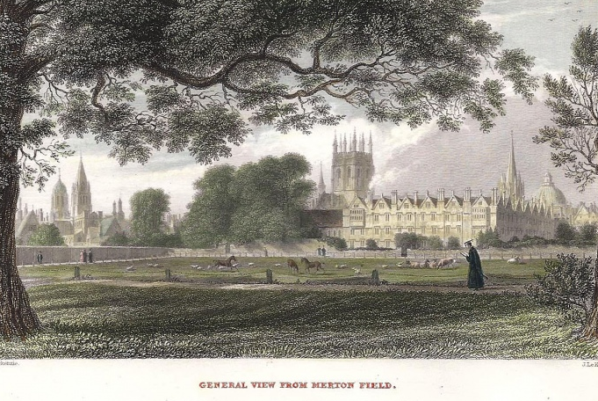
Horace Hayman Wilson,
Oxford Sanskritist
1786-1860
Notes:
http://www.wellandantiquemaps.co.uk/general-view-merton-field-oxford-f-mackenzie-j-le-keux-c1836
NO SUITABLE YALE DIGITAL COLLS IMAGE AVAILABLE

Slide 15
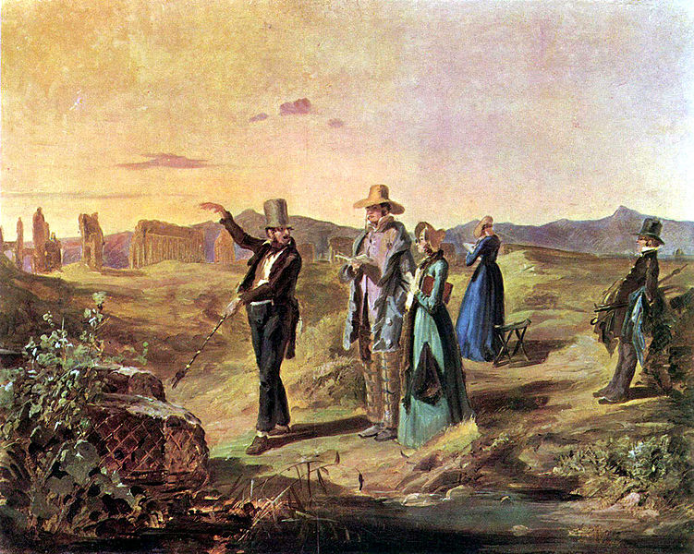
Americans on the Grand Tour,
early 19th century
Notes:
American tourists on the Grand Tour in Europe

Slide 16
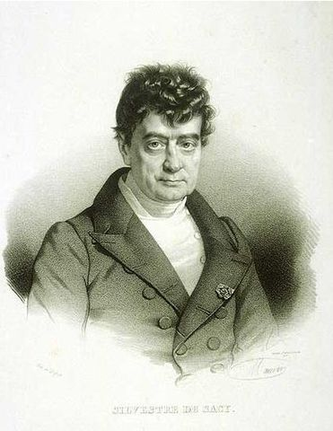
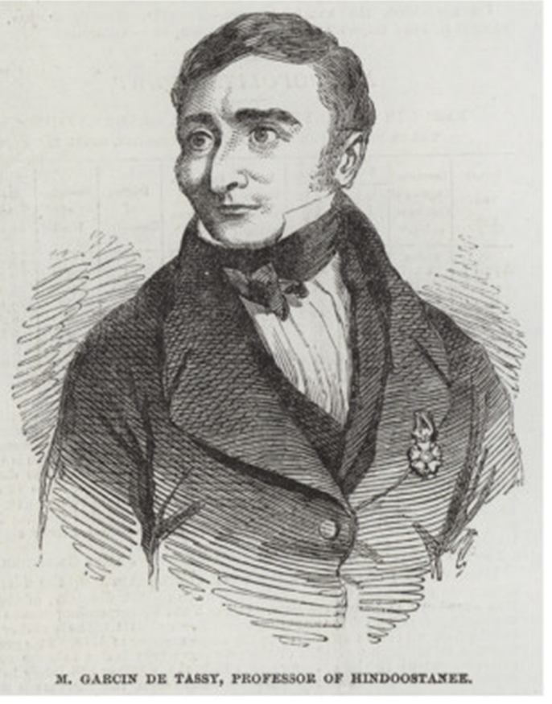
The great Orientalist scholars of Paris
Baron Silvestre De Sacy,
1758-1838,
Garcin de Tassy,
1794-1878

Slide 17
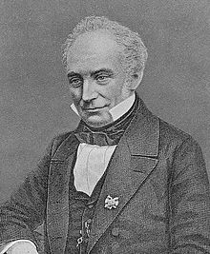
Franz Bopp, 1791-1867
Professor of Sanskrit & Comparative Grammar
at the University of Berlin, 1821-1867
Notes:
(left) Reproduction of portrait of Franz Bopp (1791-1867)
Gudeman, A. Imagines Philologorum. Berlin/Leipzig: Teubner, 1911 (p. 23).
One of Germany’s prominent experts in Sanskrit and a pioneer in the study of the comparative grammar of Indo-European languages. He held the chair of Sanskrit and comparative grammar at the University of Berlin from 1821 to the end of his life.

Slide 18
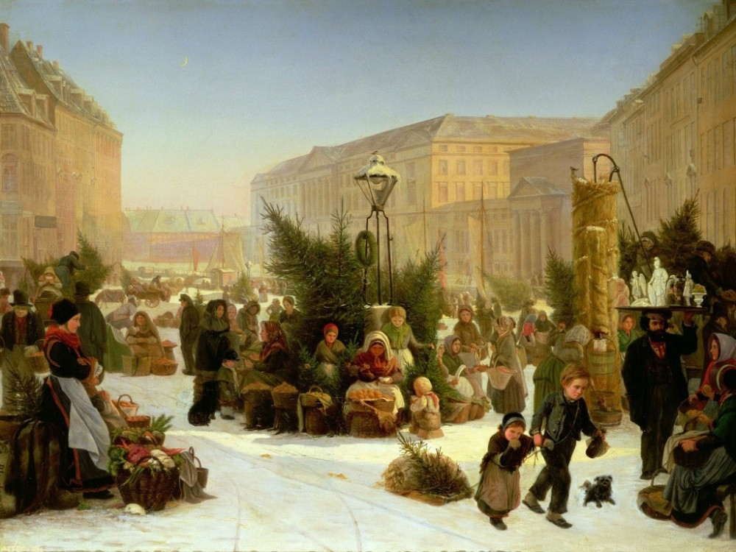
Christmas market in Germany, 19th century

Slide 19
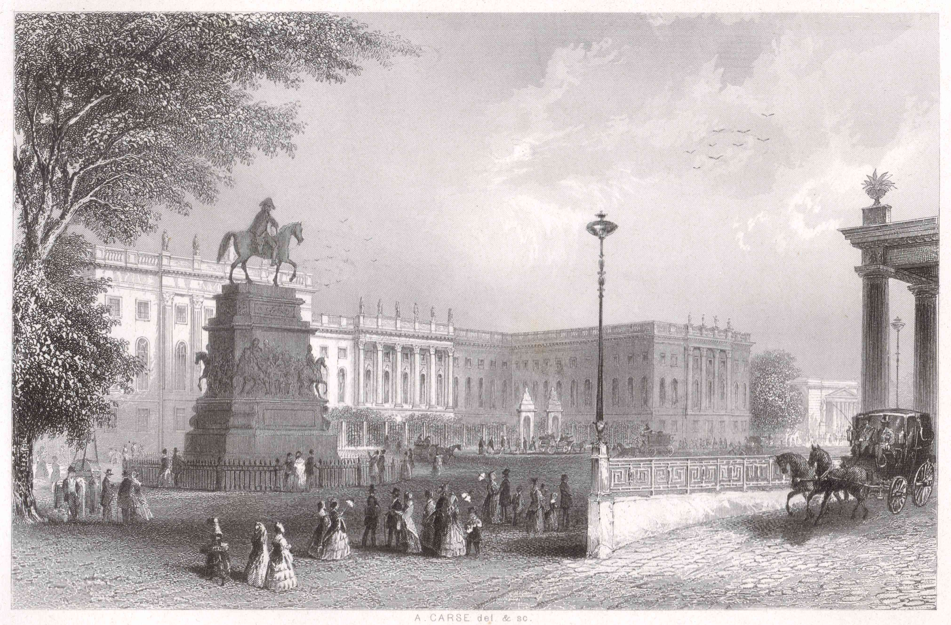
The University of Berlin, ca. 1850

Slide 20
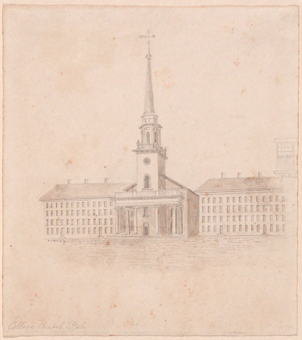
Edward dreams of Yale and prepares himself for a possible career…
YUAG 1983.1.33
Notes:
Artist: Alexander Jackson Davis, American, 1803 - 1892
College Chapel, Yale
n.d.
Graphite, pen and ink
Overall: 20.3 x 18.1cm (8 x 7 1/8in.)
Yale University Art Gallery
1983.1.33
http://artgallery.yale.edu/collections/objects/53974

Slide 21
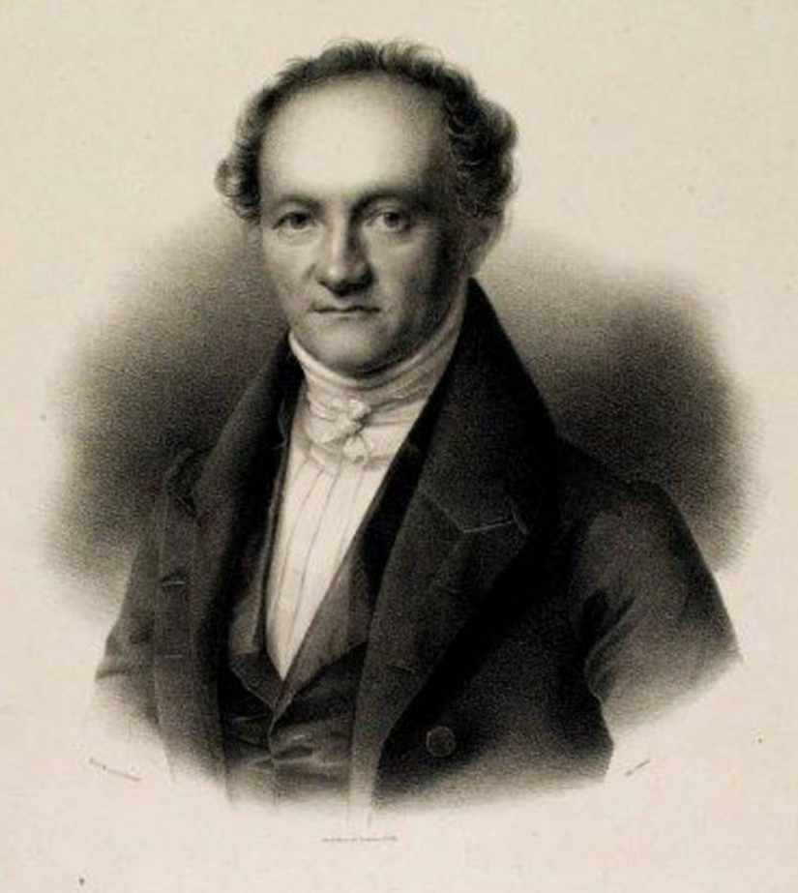
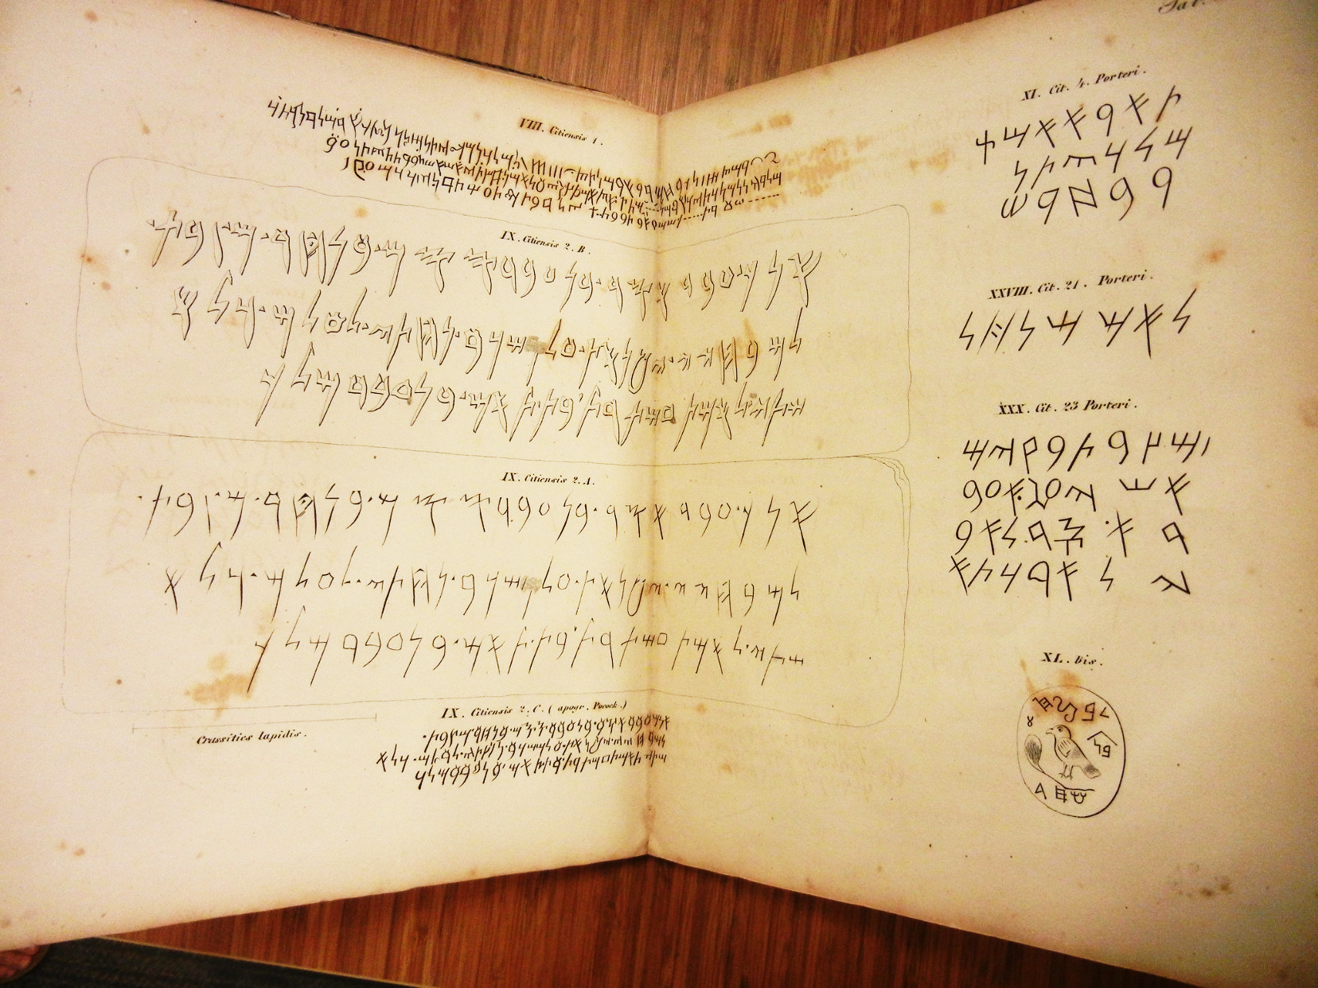
Scripturae Linguaeque Phoeniciae Monumenta (Leipzig: 1837)
Wilhelm Gesenius,
1786-1842
Professor of Theology,
Halle University
Fmk6 +G33 (presented by E.E. Salisbury in 1870)
Notes:
(right) Reproduction of portrait of Wilhelm Gesenius (1786-1842)
Deutsche Biographie Online
Professor of theology at the University of Halle from 1810 until his death, Gesenius was also an expert in Semitic philology, bringing a scientific rather than theological approach to its study, and a founder of Phoenician studies.
Wilhelm Gesenius (1786-1842). Scripturae linguaeque phoeniciae monumenta.… Lipsiae: Vogelii, 1837.
Sterling Memorial Library, General Collections, Fmk6 +G33 (presented by E.E. Salisbury in 1870)
This work, aggregating all 70 Phoenician inscriptions then known to exist, established Gesenius’ stature in Phoenician studies.

Slide 22
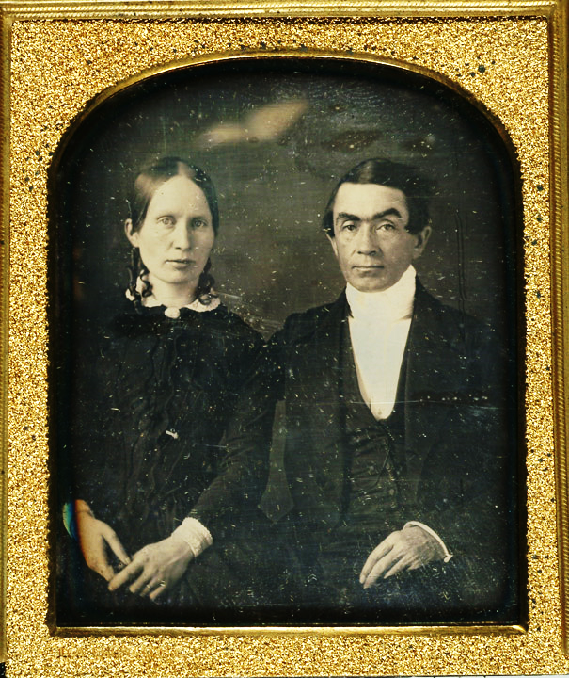
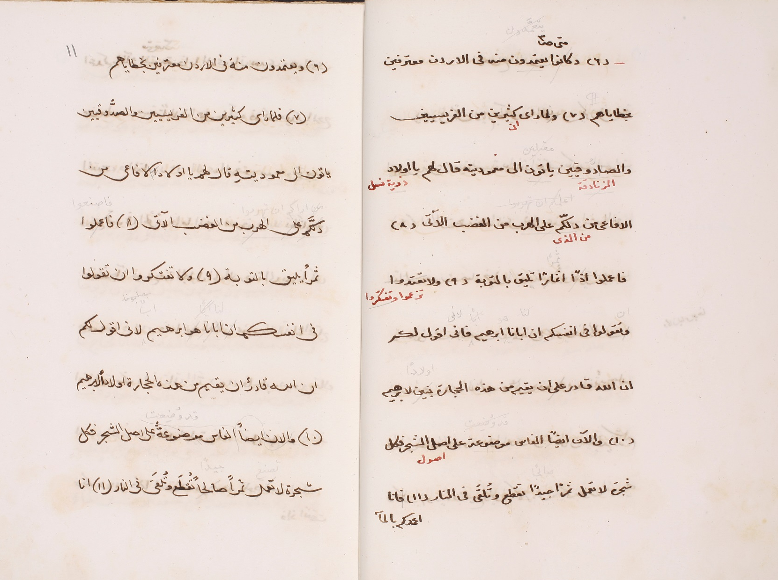
Eli Smith (1801-1857)
and the new American translation of the Bible
into Arabic
Notes:
Eli Smith (1801-1857, Class of 1821), and his wife Sarah Lanman Huntington Smith (1802-1836)
Reproduction of portrait of Eli Smith (1801-1857) with his wife Sarah Lanman Huntington Smith (1802-1836)
Andover Newton Theological School, Franklin Trask Library, Special Collections and Archives
Reproduction of manuscript of the Arabic translation of the Bible (Matthew 3:6-10), 1852-1860.
Special Collections Library, Near East School of Theology, Beirut
The right-hand page shows the translation by Smith’s assistant, the author and scholar Buṭrus al-Bustānī (1819-1883), in his own hand, with Smith’s corrections in pencil and al-Bustānī’s alternative suggestions in red. The left-hand page is a fair copy made by the poet Nāṣīf al-Yāzijī (1800-1871), with additional corrections by Smith. Both al-Bustānī and al-Yāzijī came from villages located on Mount Lebanon, and would later became important figures in the 19th-century nahḍ̣ah (revival) of Arabic literature.

Slide 23
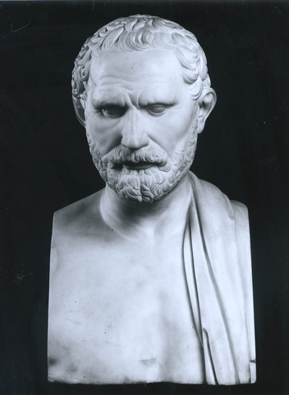
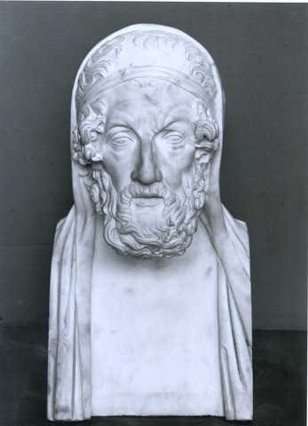
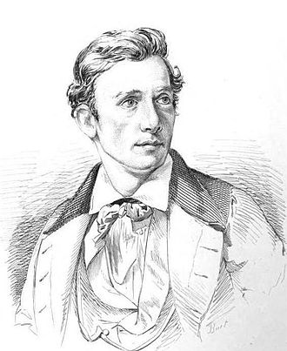
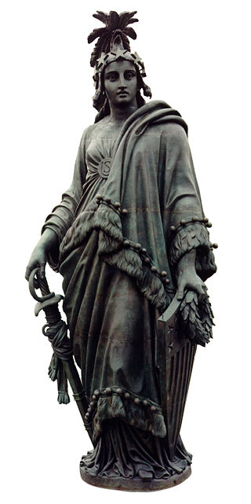
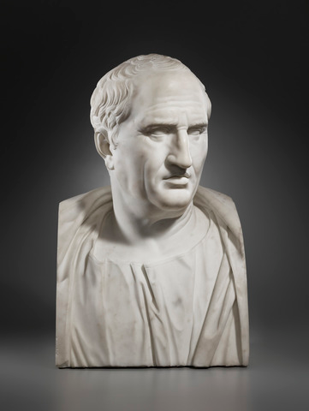
Salisbury’s first gift to Yale:
Copies of busts of Cicero, Homer, and Demosthenes
by Thomas Crawford (1814-1857)
Gifted to Yale’s new Trumbull Art Gallery
Notes:
Homer, Demosthenes, and Cicero by Thomas Crawford (1814-1857)

Slide 24
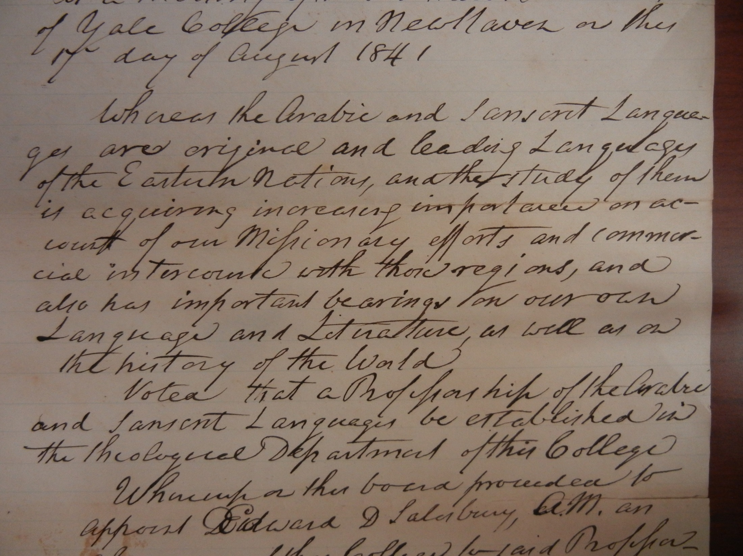
Yale Corporation vote to appoint Salisbury
as Professor of Arabic and Sanskrit
Notes:
Reproduction of copy of vote to appoint E.E. Salisbury as Professor of Arabic and Sanskrit, August 17, 1841.
Sterling Memorial Library, Manuscripts & Archives, MS 429, box 6, folder 260

Slide 25
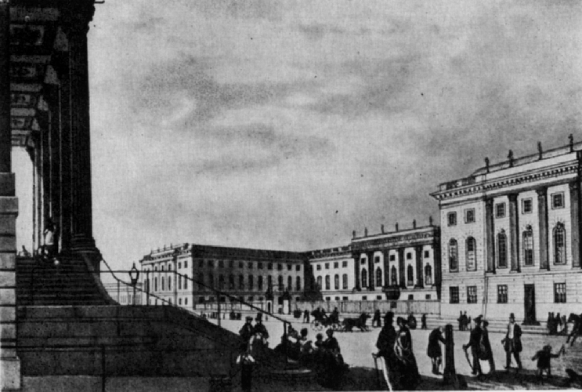
Universität Bonn, ca. 1830

Slide 26
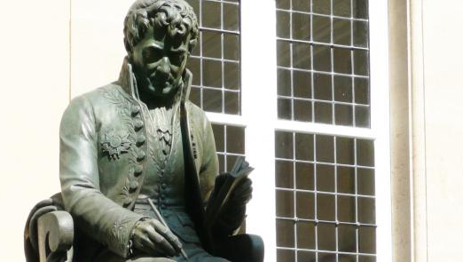
“Oh my darling books! A day will come when you are laid out on the salesroom table, and others will buy and possess you—persons, perhaps, less worthy of you than your old master. Yet how dear to me are they all! Have I not chosen them one by one, gathered them all in with the sweat of my brow? I do love you all!”
--attributed to Silvestre de Sacy

Slide 27
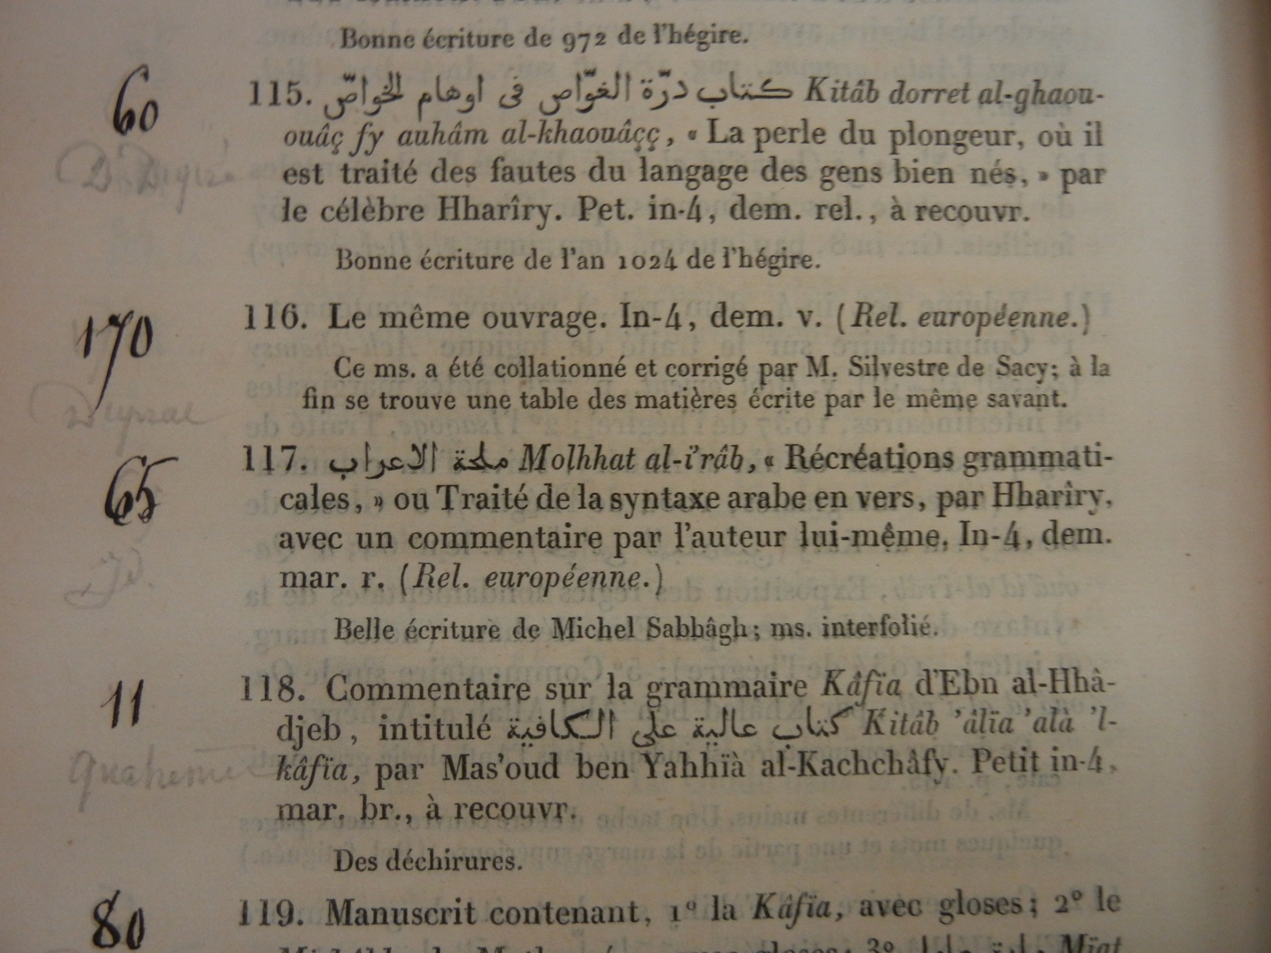
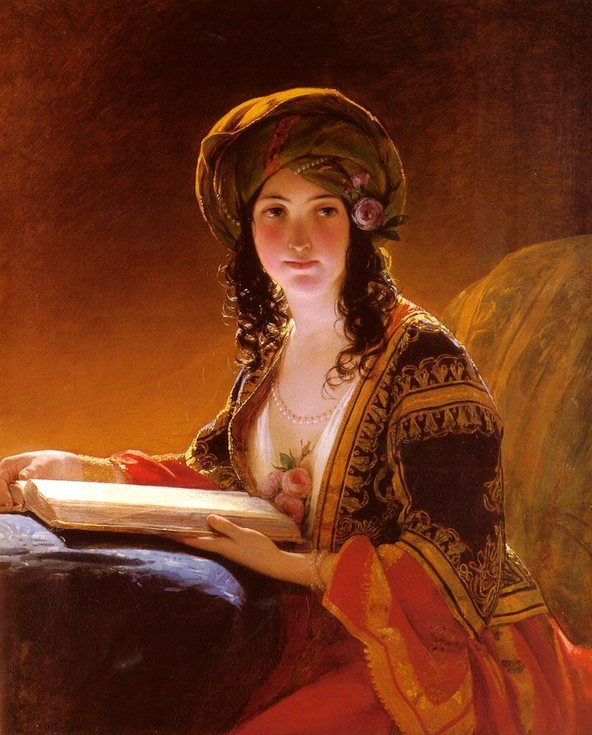
Mme Ve Dondey-Dupre
X345 S58 842 (gift of Morris F. Tyler, 1909)
Notes:
Romain Merlin (1793-1876) and Grangeret de Lagrange (1790-1859). Bibliothèque de M. le baron Silvestre de Sacy… Paris: Imprimerie royale, 1842-1847.
Sterling Memorial Library, General Collections, X345 S58 842 (gift of Morris F. Tyler, 1909)
„The Oriental“
Friedrich Ritter von Amerling (1803-1887) Austro-Hungarian Artist
Originally found here: https://www.flickr.com/photos/sunnybrook100/2057890127/

Slide 28
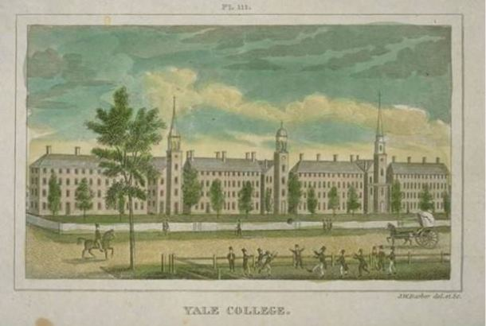
Yale College ca. 1843

Slide 29
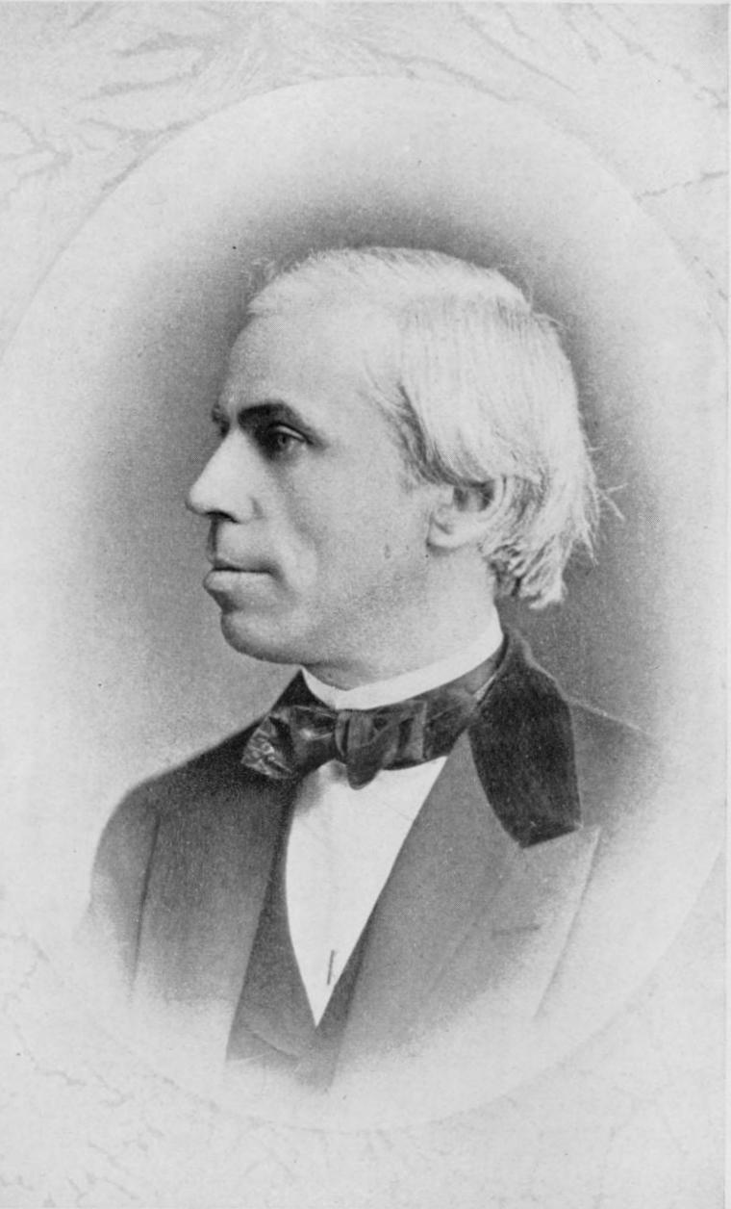
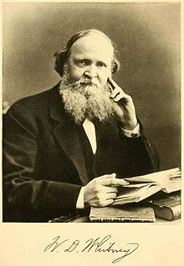
James Hadley (1821-1872)
William Dwight Whitney (1827-1894)
Notes:
Whitney graduated from Williams College in 1845. He worked in banking and on geological surveys for several years before entering Yale College in 1849 in the new Department of Philosophy and the Arts. He would become Salisbury’s most famous and brilliant student.
Hadley (Class of 1842) had been a tutor of Greek at Yale from 1845-1848. In 1848 he was made assistant professor, and succeeded Woolsey as professor of Greek when Woolsey became president of Yale College in 1851. He was well versed in Latin and several European languages, was active in the American Oriental Society, and was a contributor to Webster’s Dictionary. His popular Yale lectures on Roman law were published posthumously.

Slide 30

Editing the Atharvaveda
Semitic Reference Collection (bequest of Emily H. Whitney in memory of her father)
GEN MSS 1125
Notes:
William Dwight Whitney (1827-1894). Autograph manuscript copy in Sanskrit of the Atharvaveda, with notes about source manuscripts (ca. 1853).
Beinecke Rare Book & Manuscript Library, GEN MSS 1125
The manuscript, Whitney’s own transcription of the Sanskrit text of the Atharvaveda, shows his editorial process, including a simple paper tool he devised to keep track of line numberings. References to additional texts are indicated in purple ink.
Case 6a: Item 5
Rudolf von Roth (1821-1895) and William Dwight Whitney (1827-1894), eds. Atharva Veda Sanhita, vol. 1 (text). Berlin: F. Dümmler, 1856.
Sterling Memorial Library, Semitic Reference Collection (bequest of Emily H. Whitney in memory of her father)
Although both Roth and Whitney are credited, the Atharva’s first volume was principally Whitney’s work. Roth was to prepare the second volume of notes and critical apparatus, but was sidetracked by other Sanskrit research. Whitney finally completed the second volume himself, but it was not published until 1905, after both men had died. It was edited by Charles Rockwell Lanman (1850-1941), Professor of Sanskrit at Harvard, and one of Whitney’s students at Yale.

Slide 31

“Dear
Yale Corporation…
…very respectfully yours,
Edward”

Slide 32


James Dwight Dana
(1813-1895)
Notes:
Dana (Class of 1833) served as Yale professor of natural history and geology from 1850 to 1894. His son, Edward Salisbury Dana (1849-1935, Class of 1870 and Professor of Physics, 1890-1917), was named after his dear friend.

Slide 33

Edward Elbridge Salisbury bookplates
--found in most (all?) of the items donated to the Yale College Library in 1870

Slide 34

Yale College Library,
ca. 1846
Photo: Henry Austin, 1804-1891
http://findit.library.yale.edu/catalog/digcoll:2306250
Notes:
EES was inspired by the Trinity College Library, which he would have known from his time there in 1842. Interestingly, its appearance during his day prefigured TCL’s appearance only a decade or so later…

Slide 35

Machvmetis Saracenorvm…
Basle: 1543.
First translation of the Quran into a
European language.
Fod31 +F1543
Salisbury’s Oriental Library

Slide 36


Evelyn MacCurdy Salisbury (1823-1917)
237 Church Street, New Haven
Notes:
Reproduction of portrait of Evelyn MacCurdy Salisbury (1823-1917)
MacCurdy-Salisbury Educational Foundation

Slide 37

George Grant MacCurdy (1863-1947)
Curator of Archaeology and Anthropology,
Peabody Museum
(1902-1931)

Slide 38

Edward Elbridge Salisbury’s later donations, and reflections upon his “absurdly named professorship.”

Slide 39


Salisbury MSS 64
شرح الرسالة الزيدونية
De Sacy’s encounter with
Rifaah Rafi al-Tahtawi

Slide 40


Salisbury MSS 7
درة الغواص في أوهام الخواص

Slide 41


Carlo Landberg, 1848-1924
Prominent Swedish Orientalist
Collection gifted to Yale by
Morris K. Jessup in 1900

Slide 42

Landberg MSS 365
ذكر كلام الناس في منبع النيل

Slide 43


Landberg MSS 543
رسائل المهدي
Notes:
Muḥammad Aḥmad al-Mahdī (1848-1885). Reproduction of Rasāʾil. After 1885.
Beinecke Rare Book & Manuscript Library, Landberg MSS 543

Slide 44

Wellcome-Kraus Collection
Sold to Yale in 1949 by “bookseller extraordinaire” H.P. Kraus, 1907-1988

Slide 45


Arabic MSS 417
Quran
looted from Benin massacre, 1897
Notes:
Arabic MSS 417: Quran
Wellcome-Kraus collection (acq. 1949)

Slide 46

Arabic MSS 317
دلائل الخيرات
Notes:
Muḥammad ibn Sulaymān al-Jazūlī (d. 1465). Reproduction of Kitāb dalāʾil al-khayrāt wa-shawāriq al-anwār fī dhikr al-ṣalāh ʻalá al-Nabī al-mukhtār. Before 1865.
Beinecke Rare Book & Manuscript Library, Arabic MSS 317

Slide 47

Persian MSS +93
Khamsah of Nizami, the Red Princess
Notes:
Niẓāmī Ganjavī (1140 or 1141-1202 or 1203). Reproduction of Khamsah. 1779 or 1780. Beinecke Rare Book & Manuscript Library, Persian MSS +93

Slide 48


Oskar Rescher,
1883-1972
German-Turkish scholar
Yale’s “Rescher Collection” added
after his death in 1972

Slide 49

Arabic MSS Suppl. 80
Quran, 13th c.
Notes:
Reproduction of Qurʼān. 13th century.
Beinecke Rare Book & Manuscript Library, Arabic MSS Suppl. 80

Slide 50

Arabic MSS Suppl. 166
تعليم المتعلم في طريق التعلم
Notes:
Burhān al-Dīn al-Zarnūjī (active 12th century-13th century). Reproduction of Taʻlīm al-mutaʻallim fī ṭarīq al-taʻallum. 17th century.
Beinecke Rare Book & Manuscript Library, Arabic MSS Suppl. 166

Slide 51

Arabic MSS Suppl. 218
كتاب قوائد قرأن
Notes:
Sūdī Efendi Bosnalı (d. ca. 1596). Reproduction of Kitāb qawaʻid-i Qurʾān. 1693.
Beinecke Rare Book & Manuscript Library, Arabic MSS Suppl. 218

Slide 52

Duncan Black MacDonald (1863-1943)
& the Hartford Seminary Collection

Slide 53

Hartford Seminary Arabic MSS 1262
Notes:
Reproduction of Qurʼān, 1834.
Beinecke Rare Book & Manuscript Library, Hartford Seminary Arabic MSS 1262

Slide 54

Hartford Seminary Arabic MSS 200
إحياء علوم الدين

Slide 55


Hartford Seminary
Arabic MSS 275
مقامات الحريري
Notes:
Ḥarīrī (1054-1122). Reproduction of Maqāmāt al-Ḥarīrī, 18th cent.
Beinecke Rare Book & Manuscript Library, Hartford Seminary Arabic MSS 275

Slide 56

Bringing the story up to today: where are we now?

Slide 57


Thank you very much!
Roberta L. Dougherty
Librarian for Middle East Studies
Yale University Library
roberta.dougherty@yale.edu

