Slide 1
Visualizing Scholarly Legitimacy through Script
Edward Elbridge Salisbury
and Arabic Type for the JAOS

Slide 2
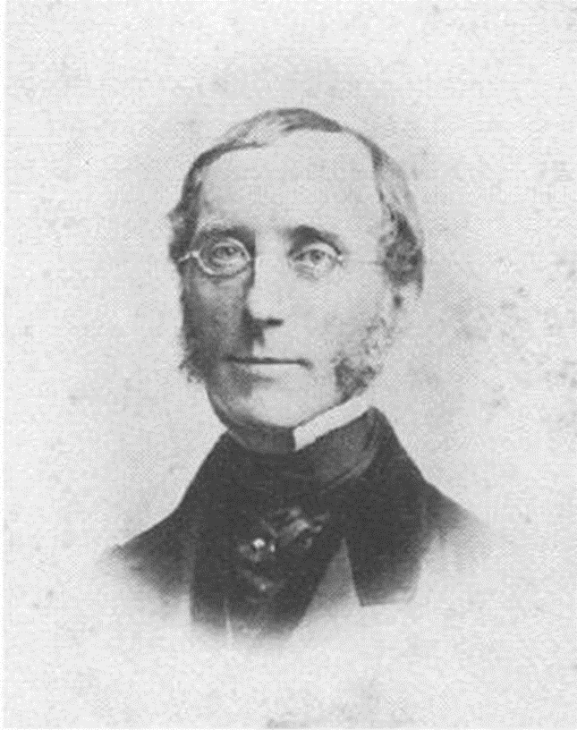
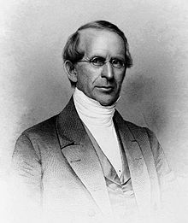
Rufus Anderson (1796-1880), missionary
Edward Elbridge Salisbury (1814-1901), first professor of Arabic and Sanskrit language and literature in the Americas
Dear Rufus…

Slide 3
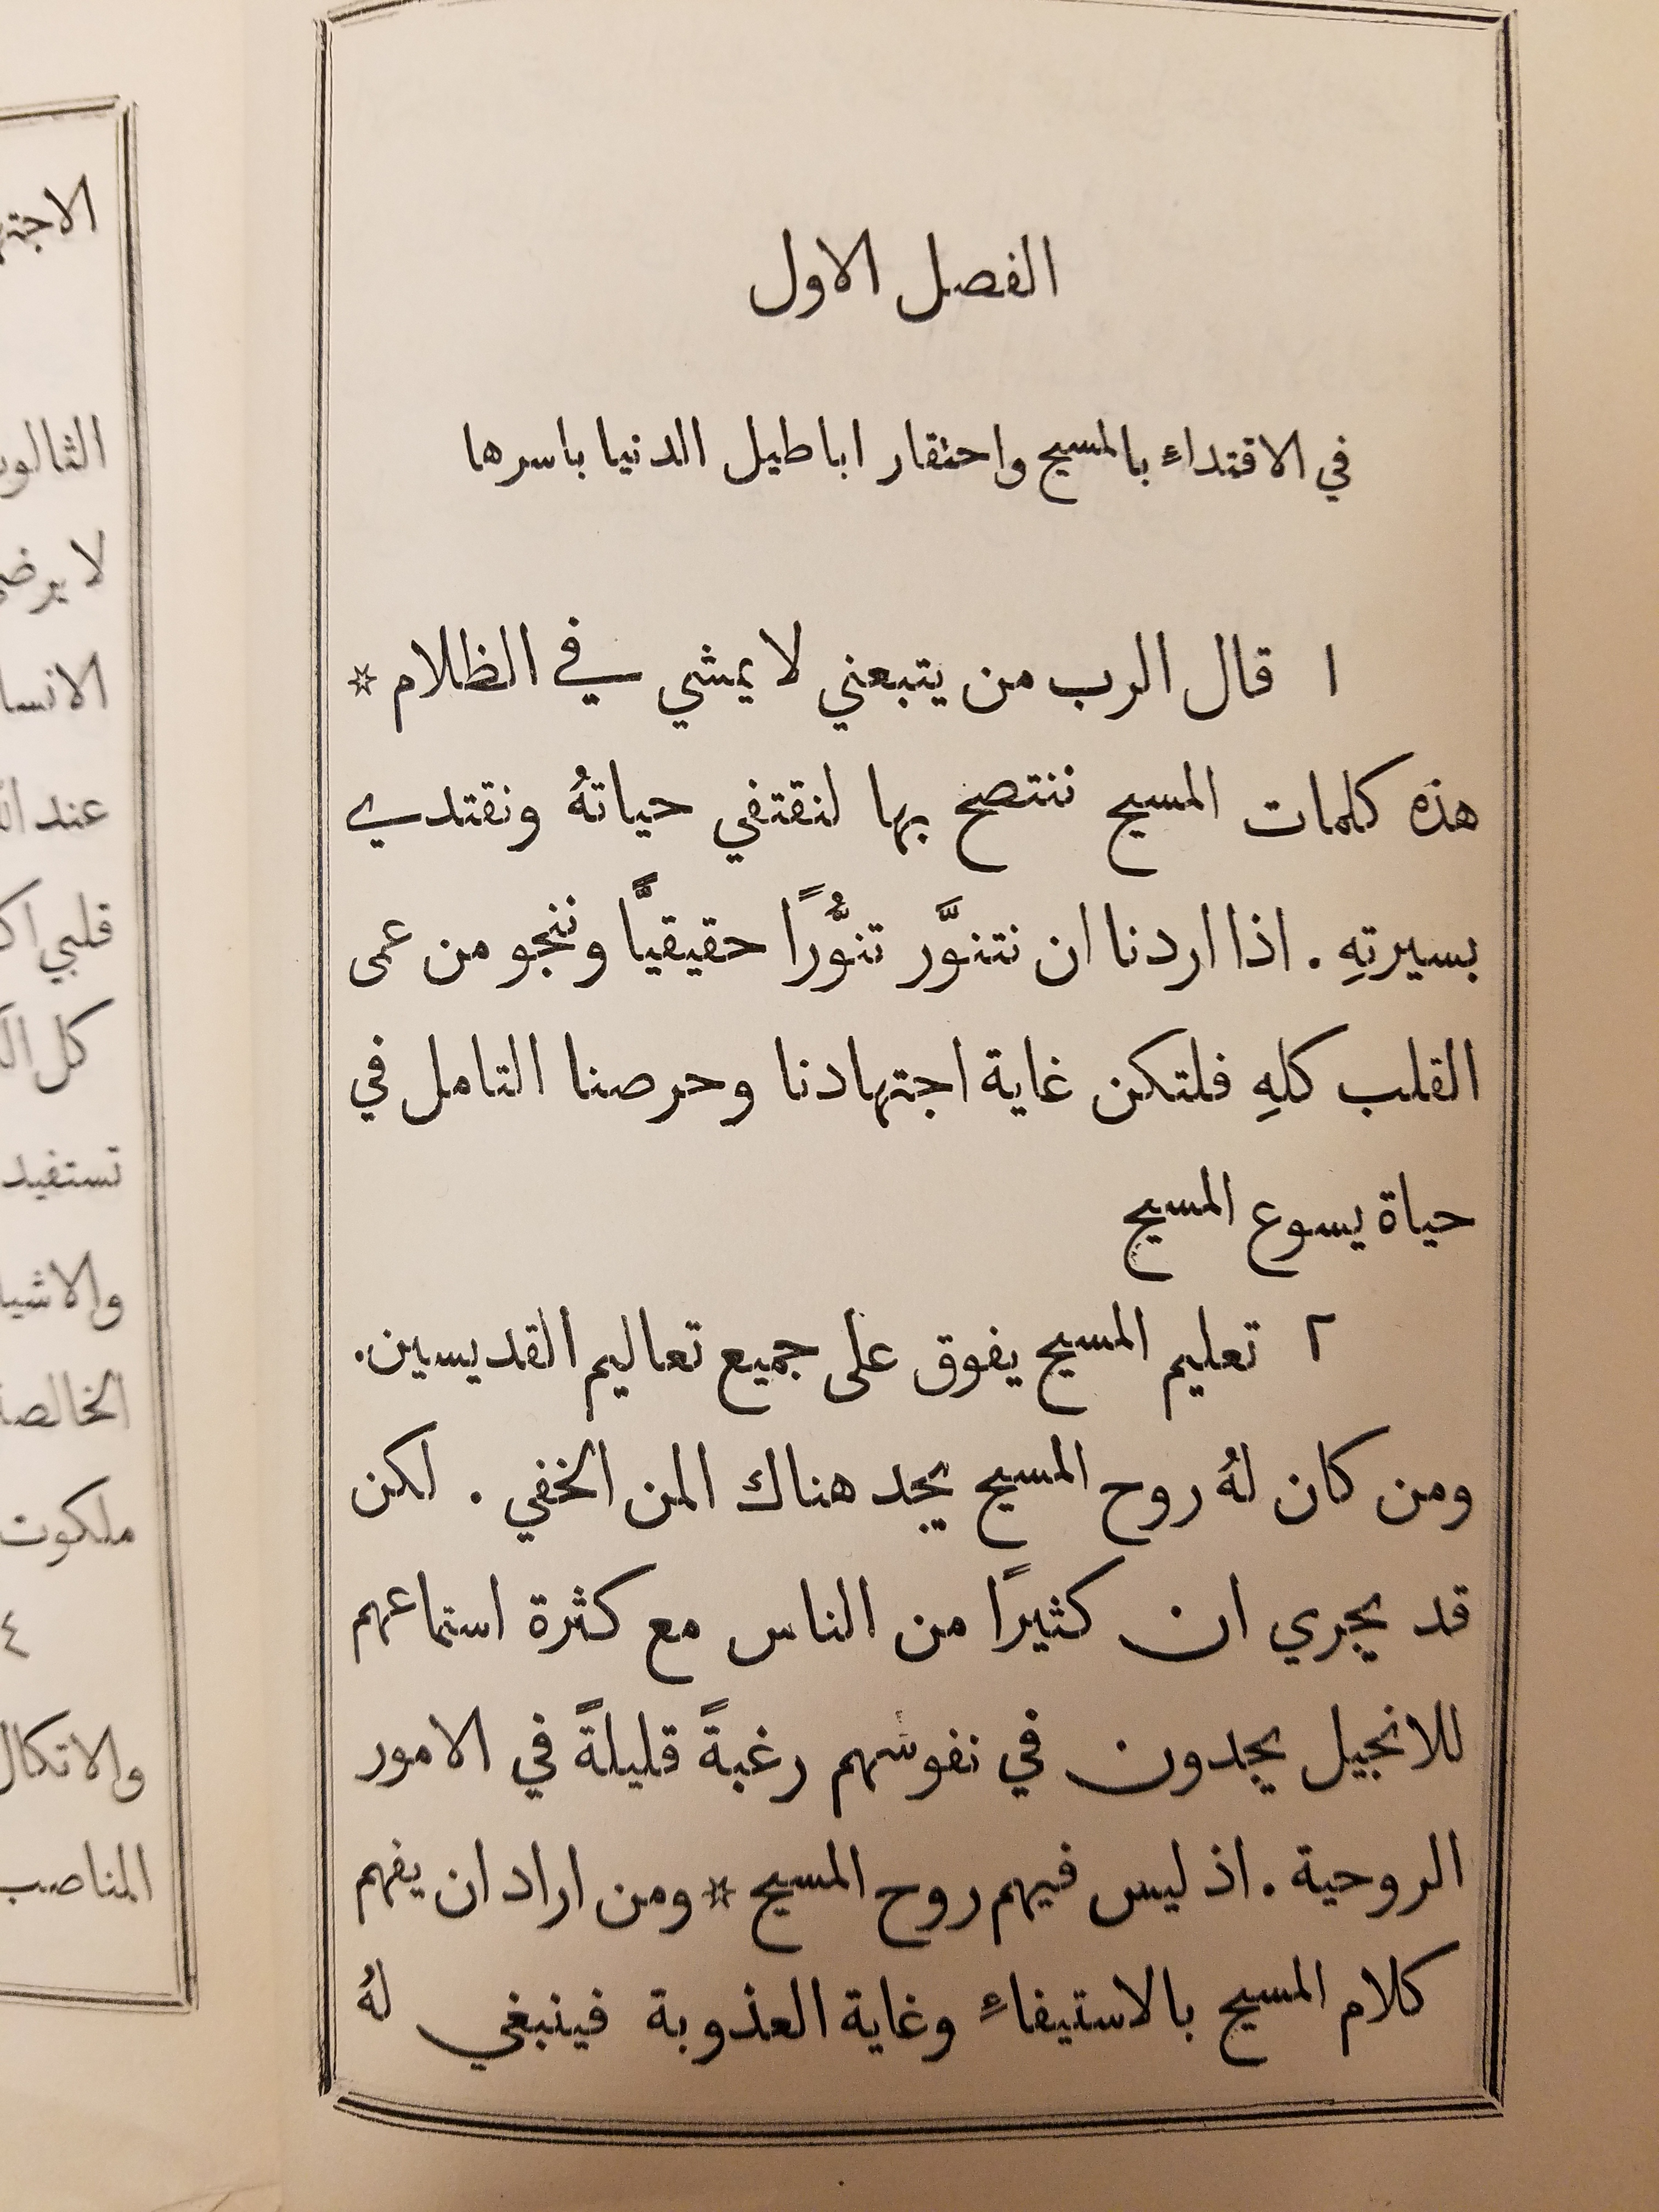

Slide 4
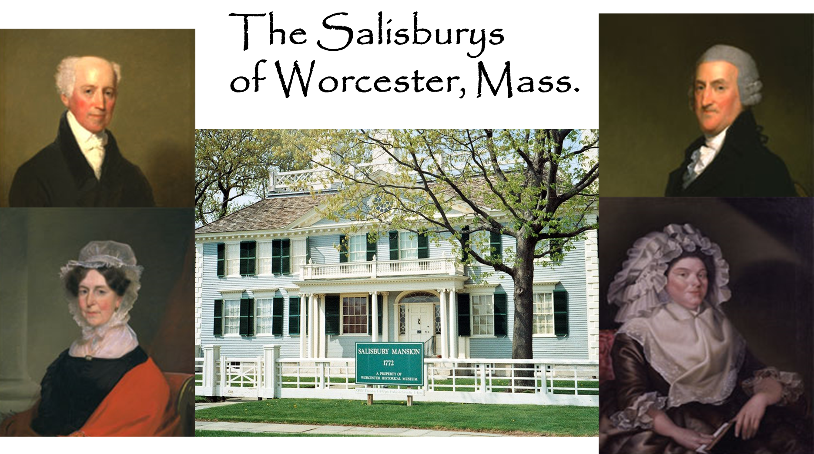

Slide 5
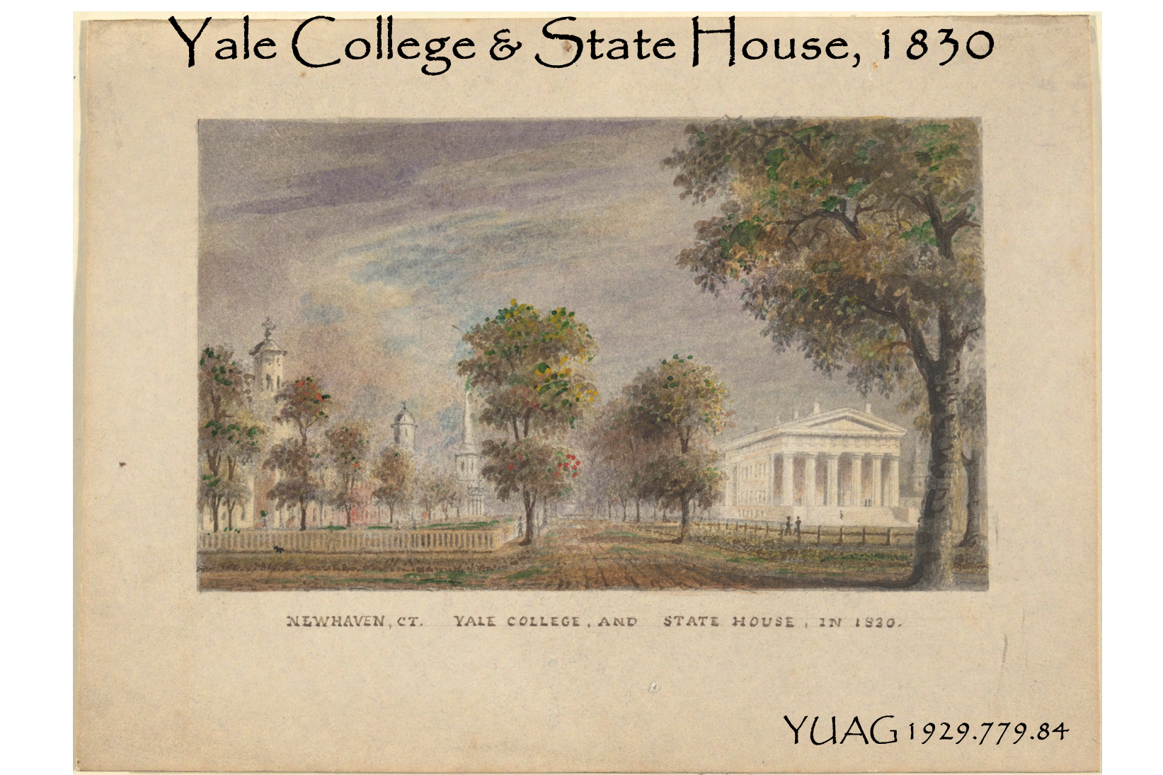

Slide 6


Slide 7
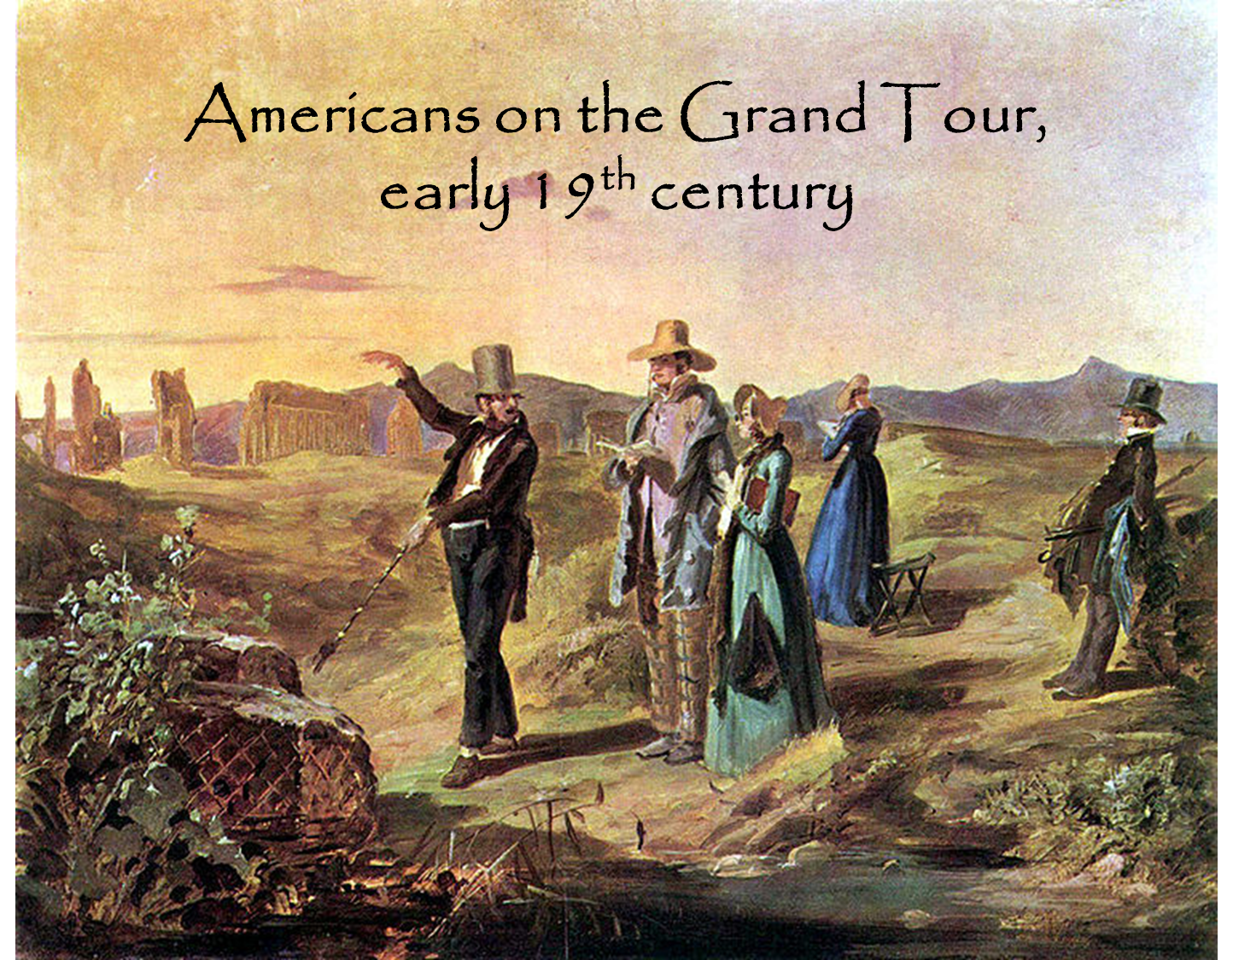

Slide 8
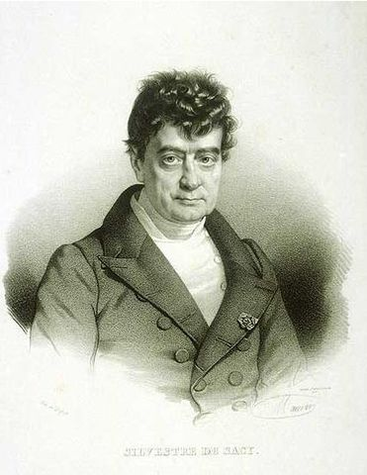
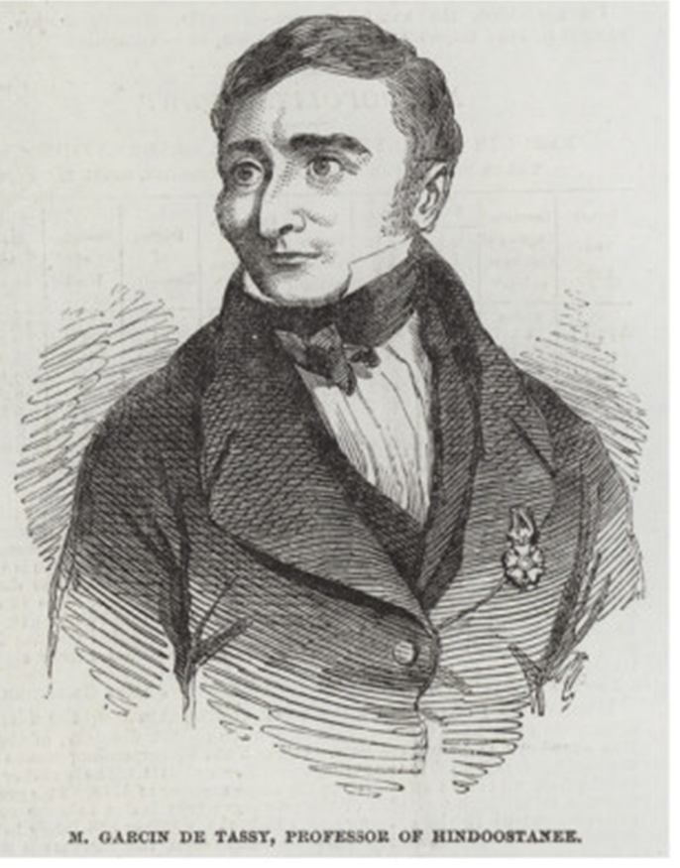
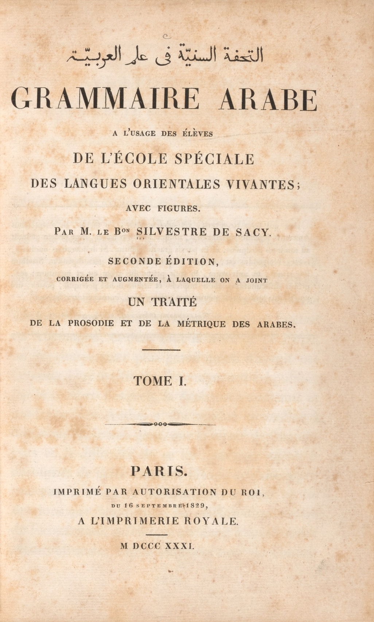
The great Orientalist scholars of Paris
Baron Silvestre De Sacy,
1758-1838
Garcin de Tassy,
1794-1878

Slide 9
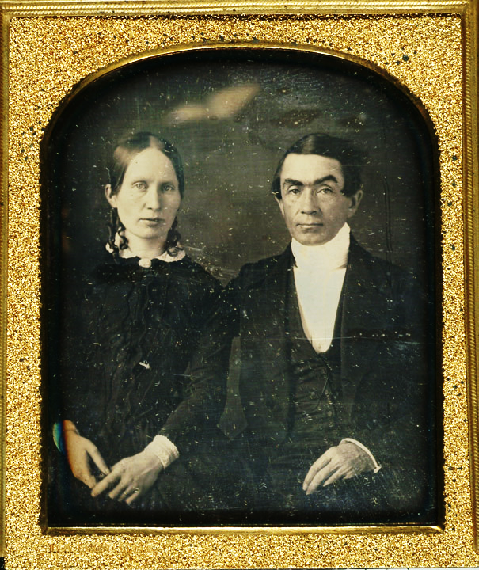
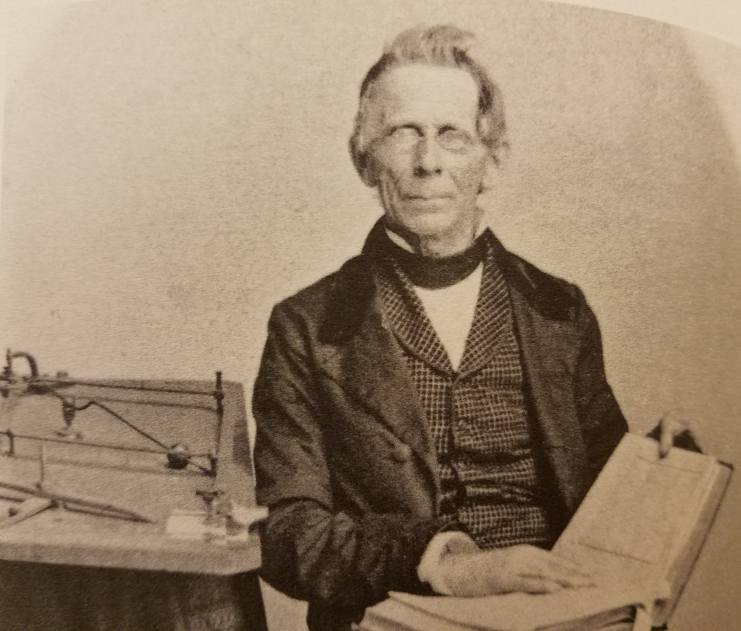
Eli Smith (1801-1857),
Homan Hallock,
and the “American Arabic” font

Slide 10
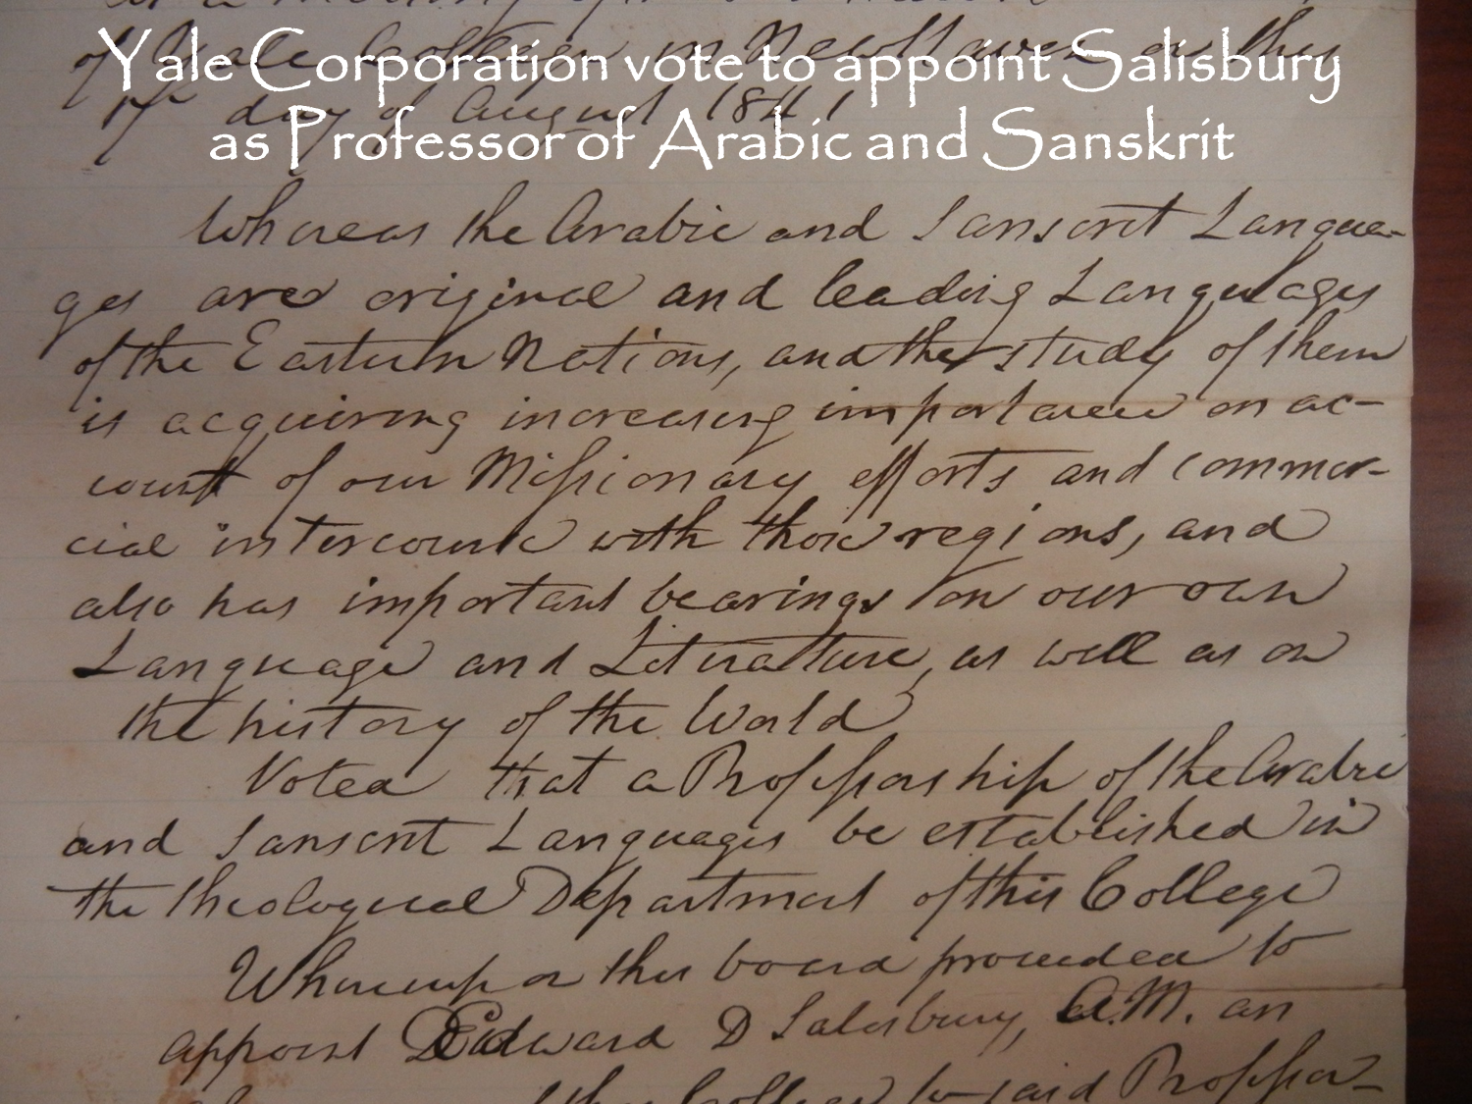
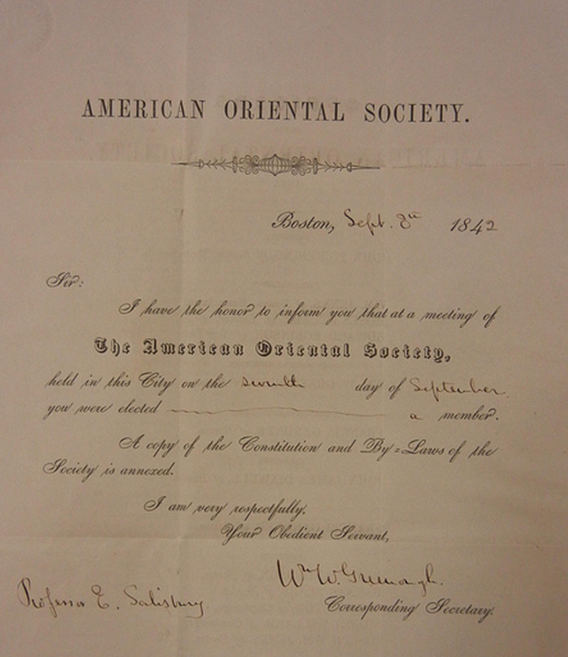

Slide 11
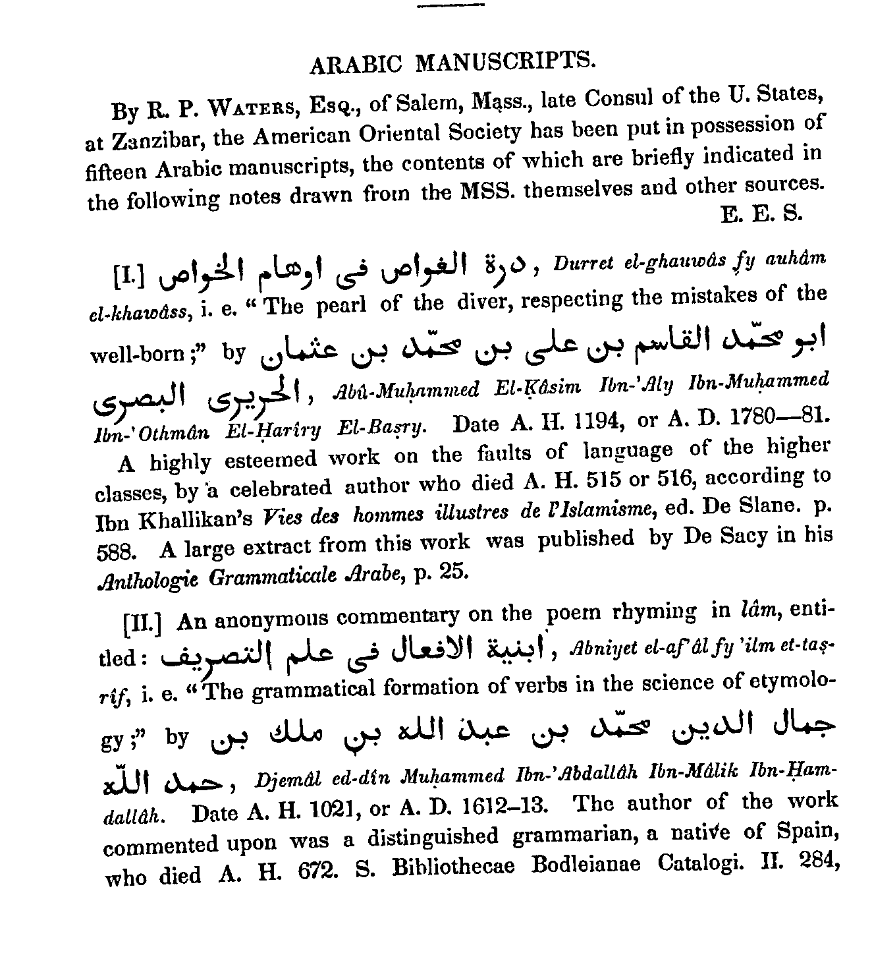
Arabic type used to print JAOS vol. 1 no. 3 (1847)

Slide 12
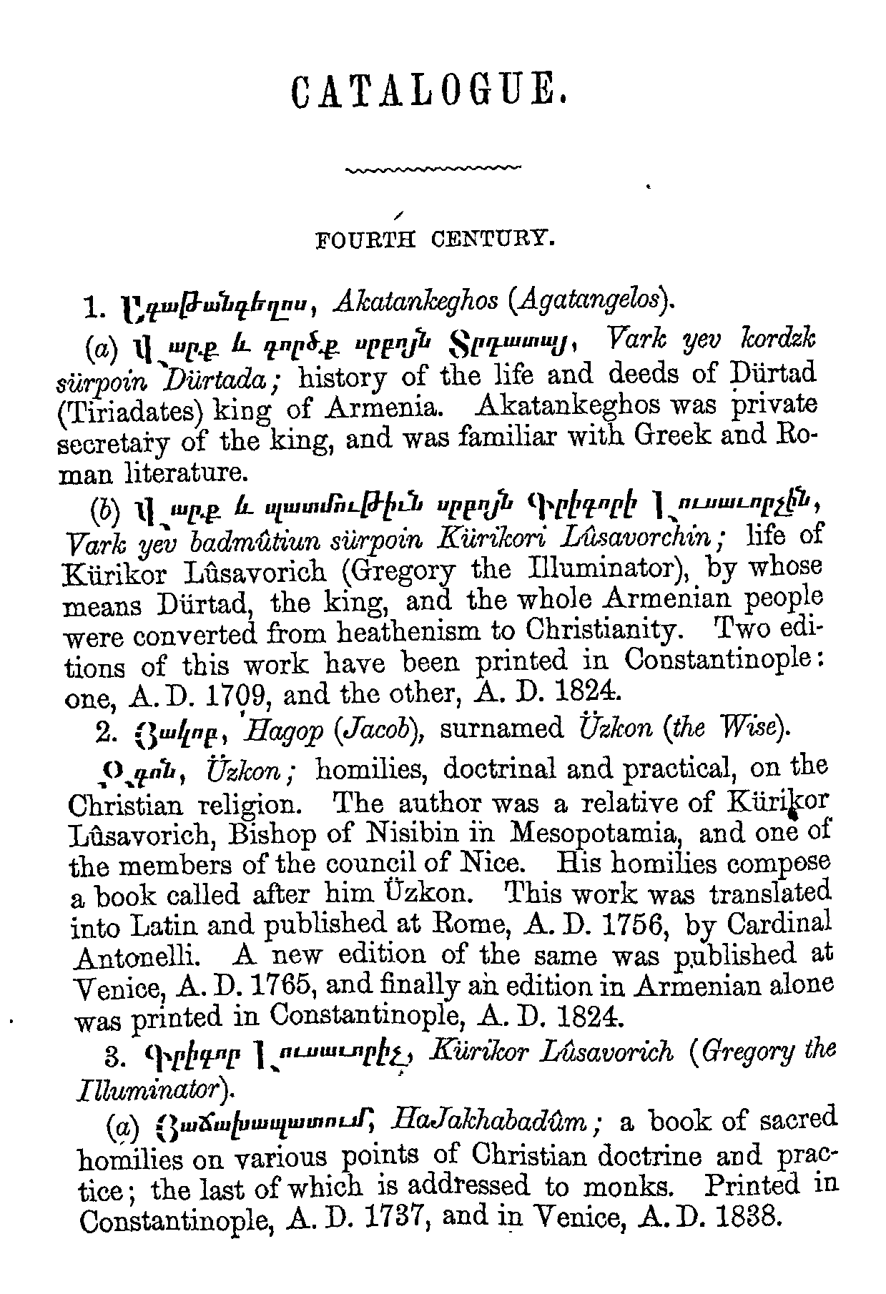
Armenian type used to print JAOS vol. 3 (1853)

Slide 13
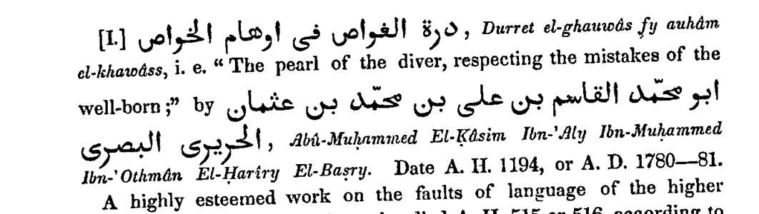
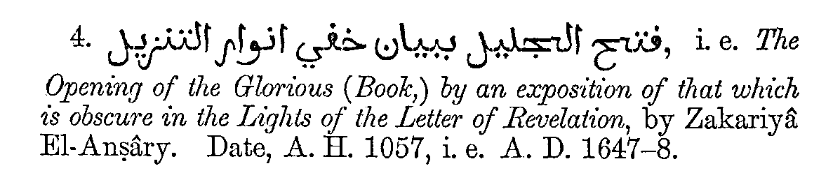
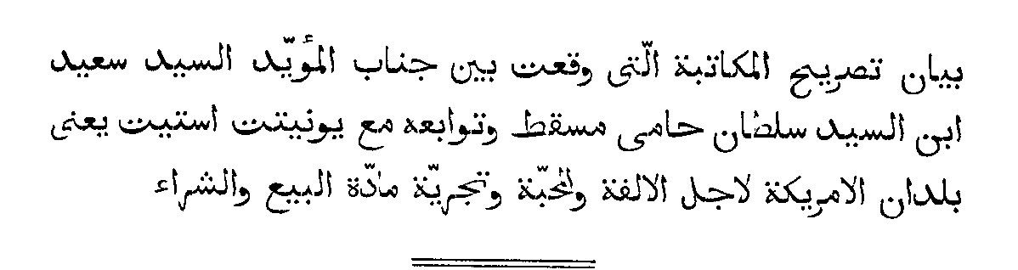
1847
1851
1854

Slide 14
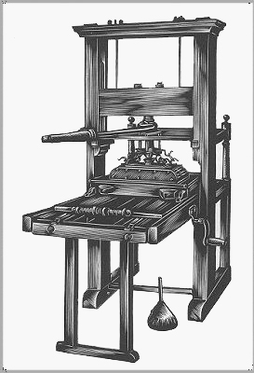
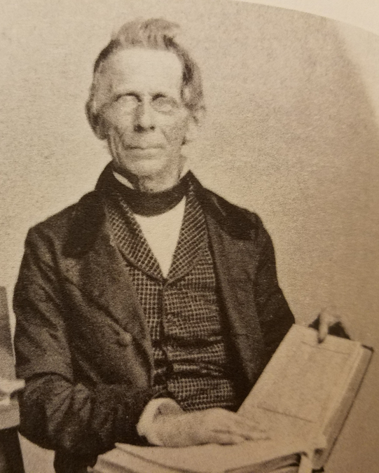
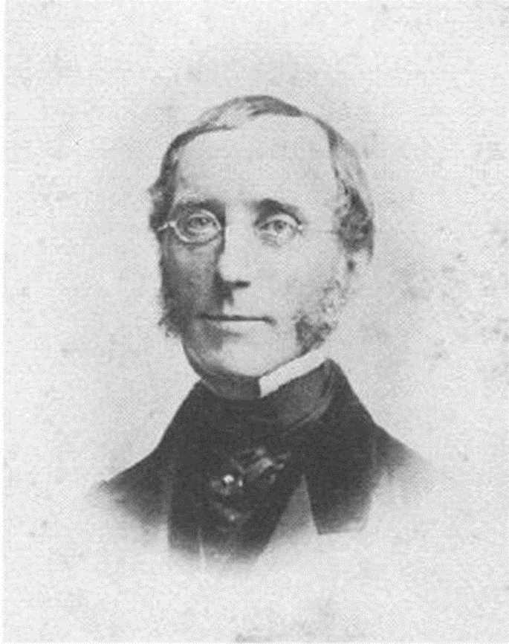
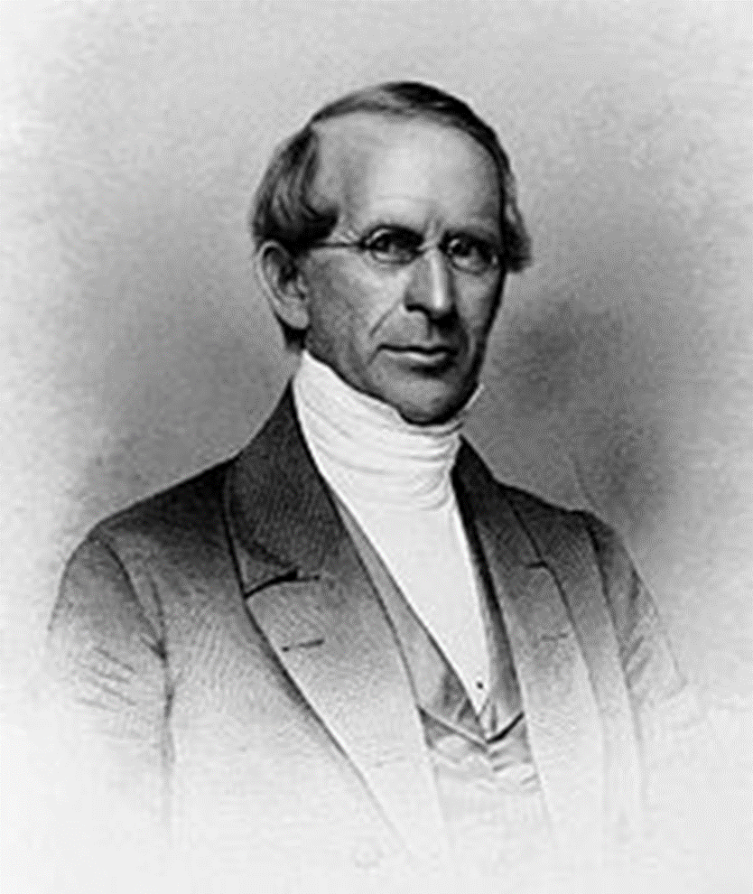
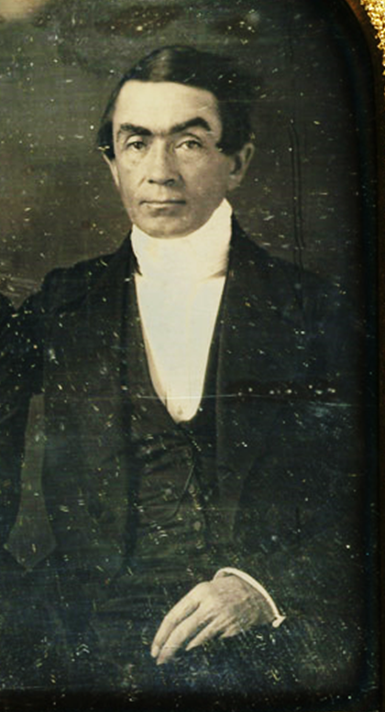

Slide 15
“American Arabic” as Salisbury first saw it, in the Arabic translation of Imitation of Christ (attributed to Thomas à Kempis), pub. Beirut, 1842

Slide 16
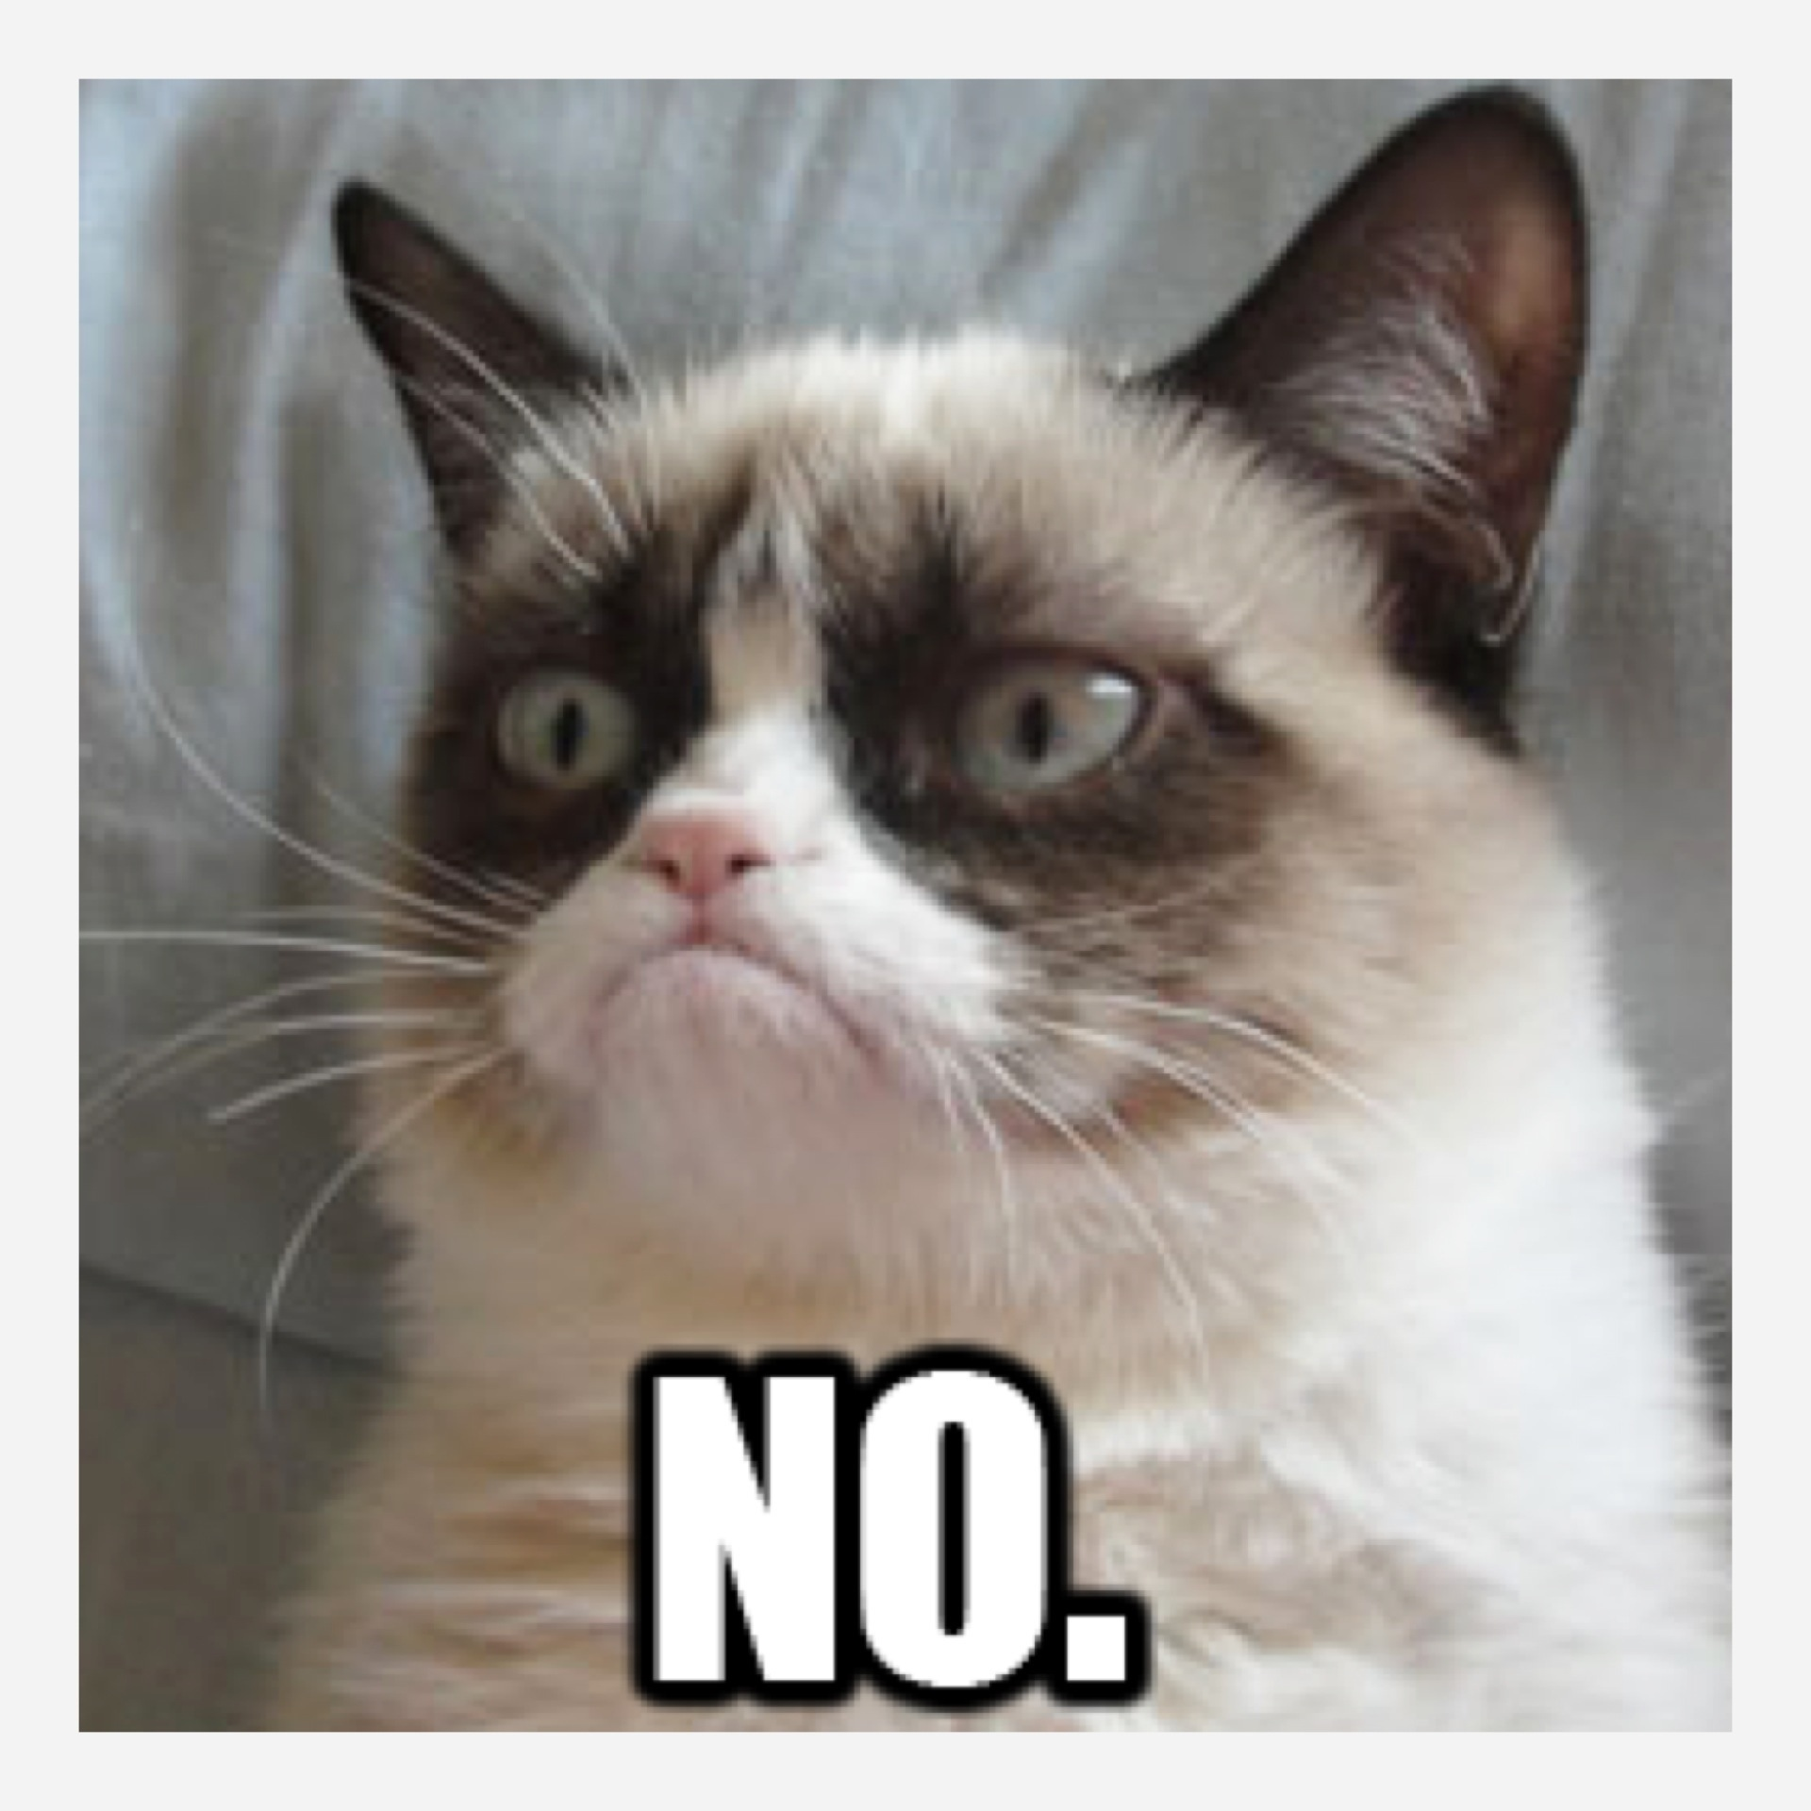

Slide 17
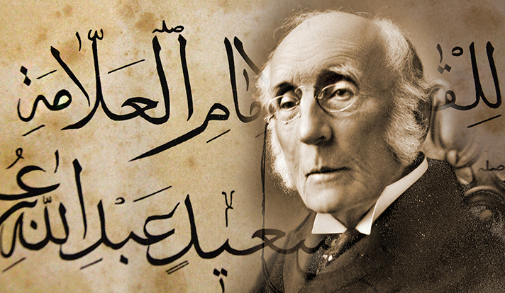

Slide 18
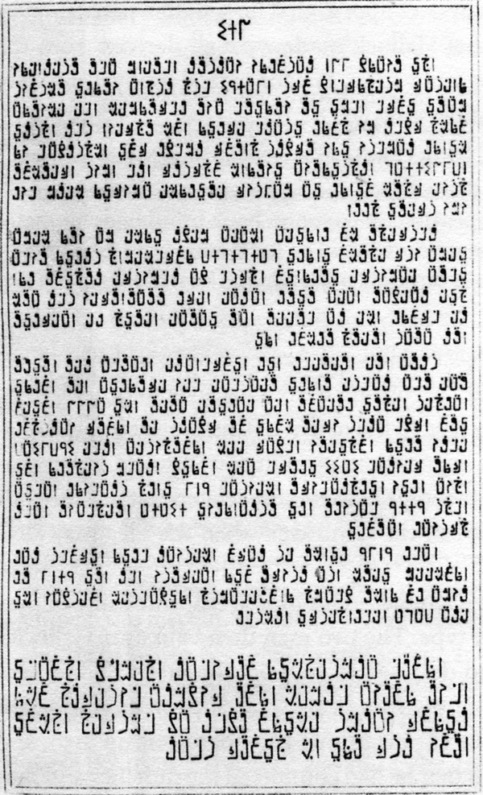
Homan Hallock’s experimental Arabic type, produced in 1864
Notes:
http://plainfieldmahistory.org/wp-content/uploads/2012/12/HallockExperimental600_3933.jpg

Slide 19
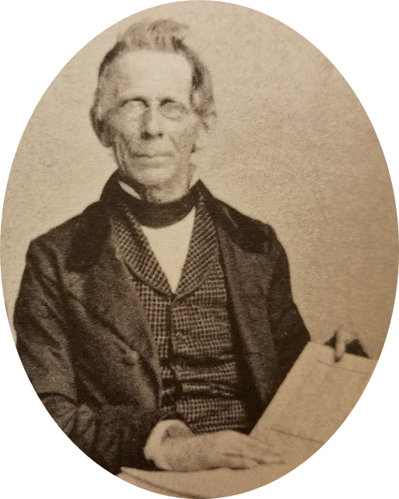
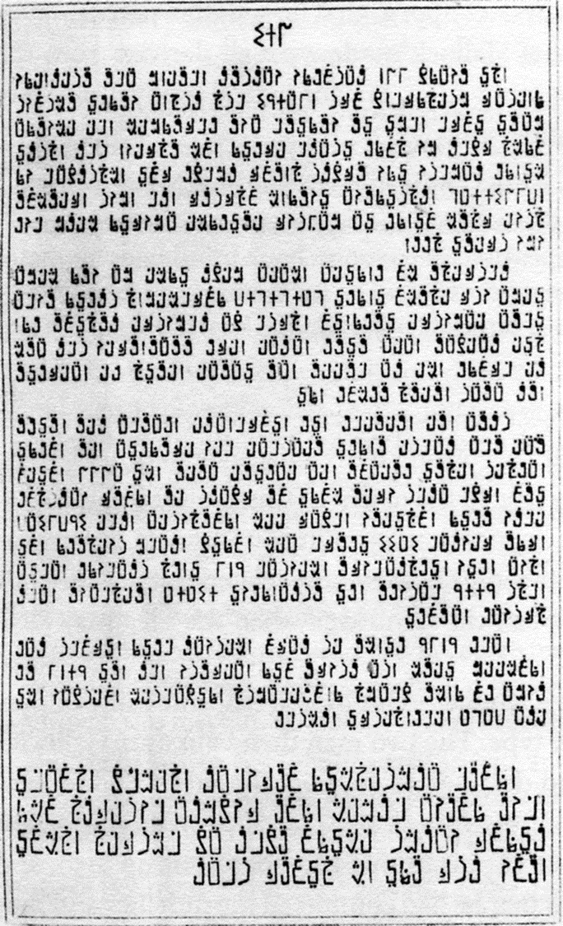
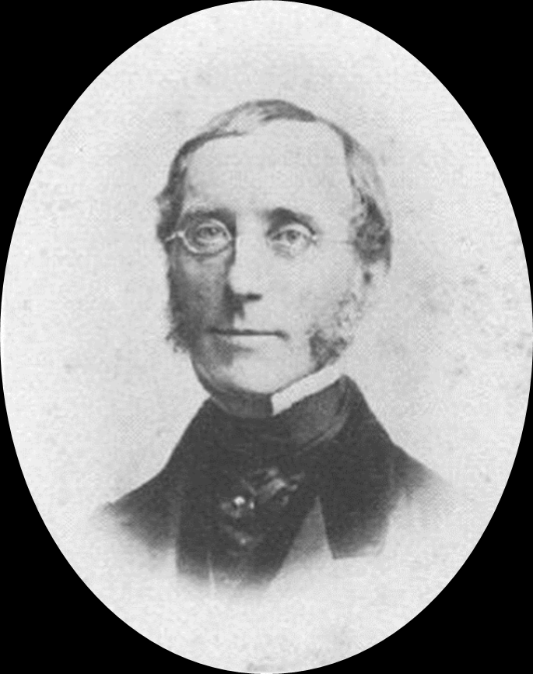
Isn’t this better?
OMG
STAHP

Slide 20
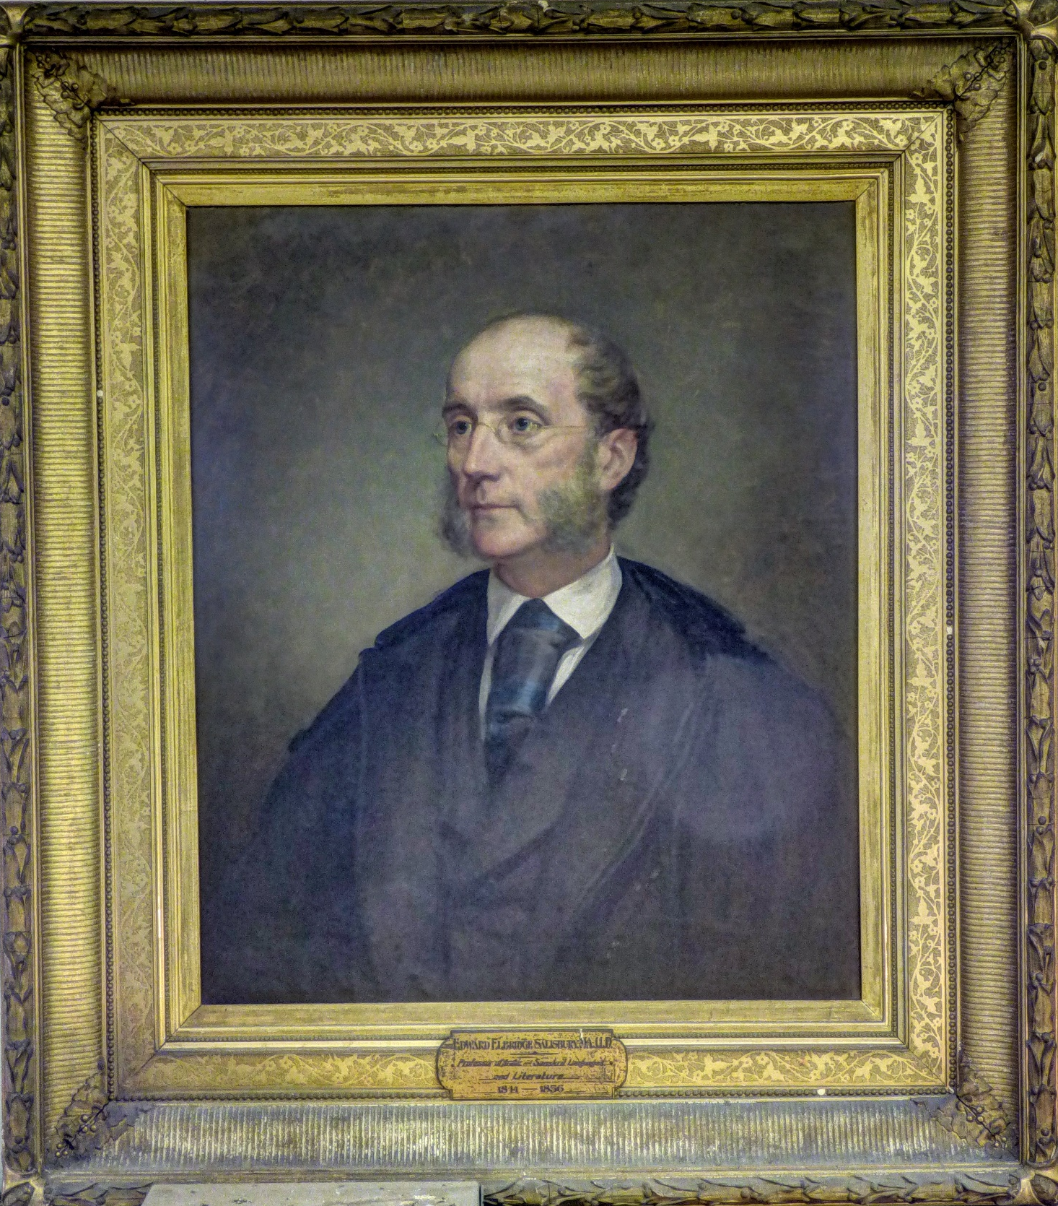
Thank you!
Roberta L. Dougherty
Librarian for Middle East Studies
roberta.dougherty@yale.edu

Slide 22
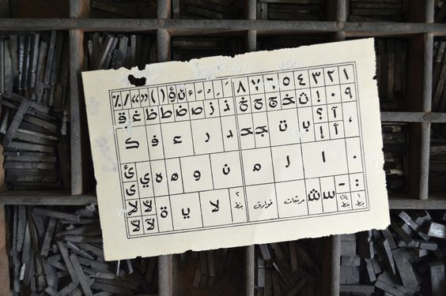

Slide 23
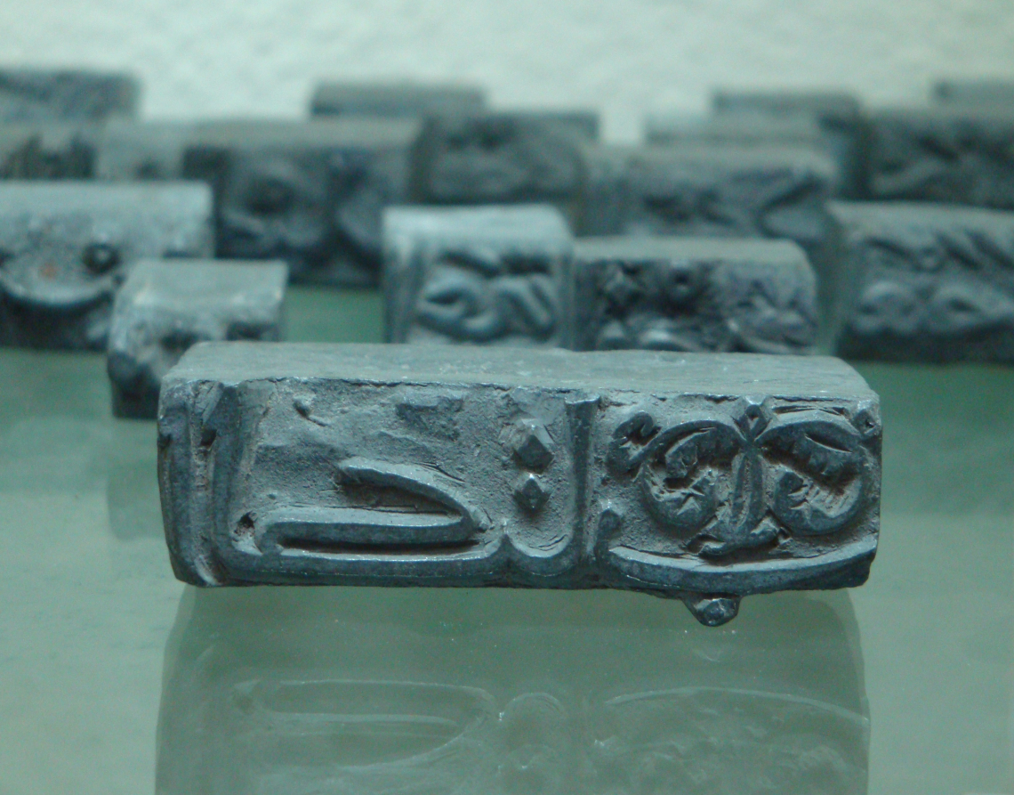
Notes:
This and the next three slides contain images from this blog post, about the first Arabic printing press in Lebanon (al-Zakhir Press at Dayr Mar Yuhanna, estab. 1734 and operating until 1899): https://blog.29lt.com/2009/01/05/the-first-arabic-press/

Slide 24
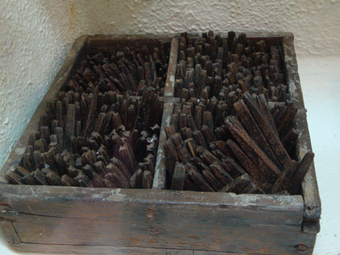
Notes:
Punches made of metal, “al-Abahat” (the fathers)

Slide 25
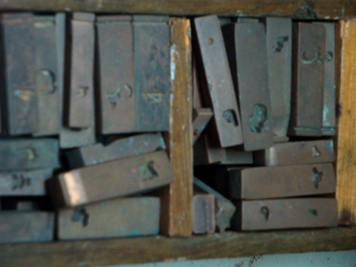
Notes:
Matrices made from punches, “al-Ummahat.” From matrices the lead letters will be created.

Slide 26
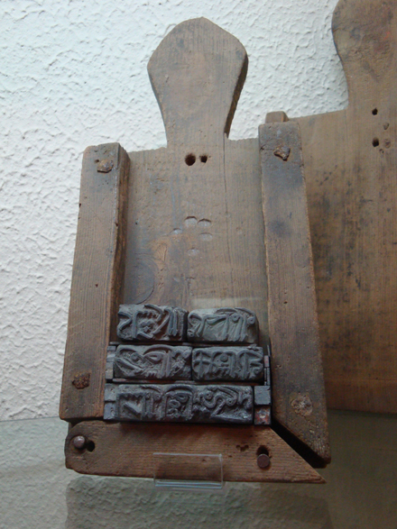
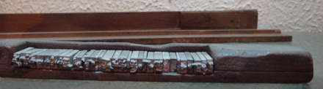
Notes:
Composing stick, composing galley

Slide 27
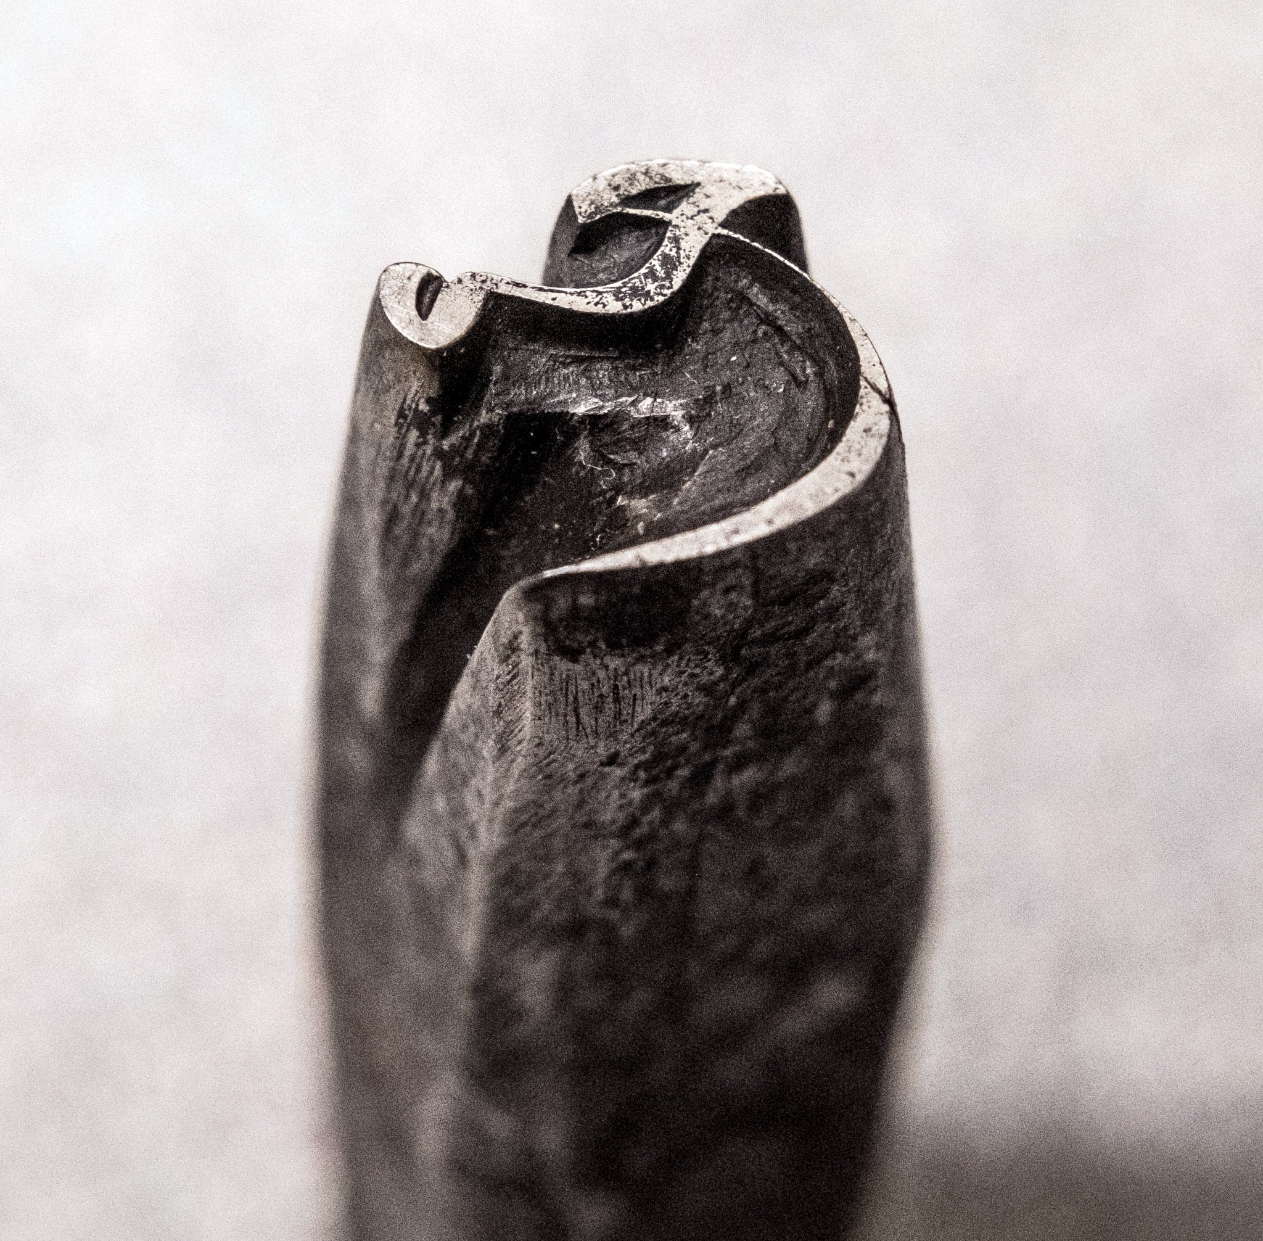
Notes:
16th-c. Arabic punch from the collection of the Imprimerie Nationale, from https://pbs.twimg.com/media/DNViIjiWsAAtNDg.jpg (Twitter page of https://twitter.com/BornaIz)

Slide 28
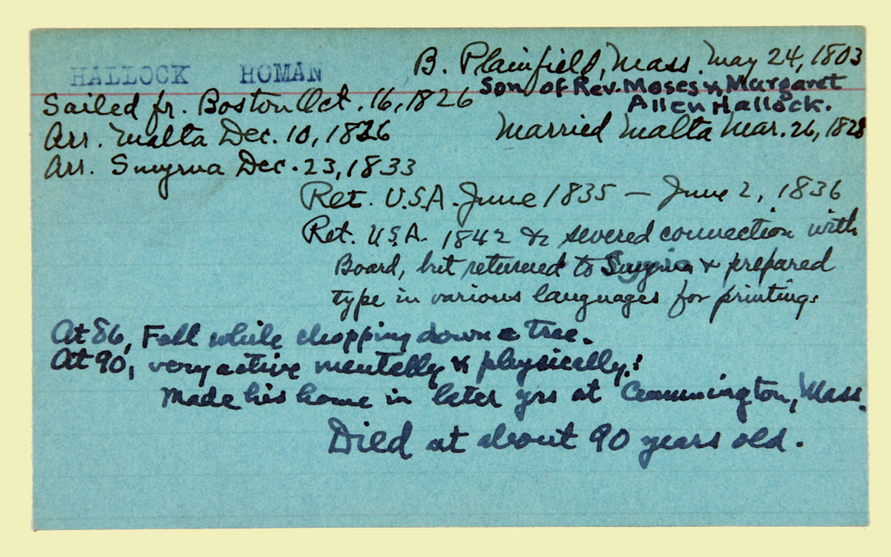
Notes:
http://www.dlir.org/archive/archive/files/06774d3f75771739fc900b07615ea5a1.jpg
Homan Hallock’s personnel card from ABCFM files (there is no portrait)

