Slide 1

Promote Campus Scholarship
Barbara Potts
Coordinator, Scholarly Communications
Jerry Falwell Library, Liberty University
bpotts3@liberty.edu
#ACLib18

Slide 2
Intro
Scholarly Communications, Research Librarian, Liaison Librarian to our Family and Consumer Sciences, College of Applied Studies and Academic Success, and Academic Affairs for Athletes. Also, Adjunct Online Professor
Started on staff at Malone College (Canton, OH), now Malone University
Followed by - Kent State University (Kent, OH), Stark Campus
Now - Liberty University (Lynchburg, VA)

Slide 3
Scripture
Romans 8:28 (NIV)
²⁸ And we know that in all things God works for the good of those who love him, who have been called according to his purpose.

Slide 4
Goals of this session
Share, inspire and learn from one another
Collaborate through discussions
Create interest and excitement

Slide 5
Recruitment, Enrollment, and Reputation
Survival in the Higher Education Arena
- Recruit new students
- Retain current students
- Build a reputation in subject areas
Notes:
Simply, how can we help our campus succeed? How can we assist with recruitment and especially reputation of a scholarly institution?

Slide 6










Scholarly Publishing Programs
https://www.bepress.com/
https://islandora.ca/
Networked Digital Library of Theses and Dissertations (NDLTD)
Cooperatives:
http://www.ndltd.org/
http://www.duraspace.org/dspace/
https://about.galileo.usg.edu/
http://www.adpn.org/
https://getfedora.org/
https://libres.uncg.edu/ir/
Notes:
Cooperatives are usually specific to areas or state. The others have some cost associated with them. There may be more, it is a big Open Access world out there. This is why a conversation is important. We can all glean from each others experience, successes and failures.

Slide 7
Promoting on Campus
How to get faculty buy in
  It is imperative for recruitment and reputation to show off your scholarship
Partner with other departments on campus
  Library partner with IT
Conversation with college administration
Notes:
If no one knows about the opportunity then no one will use it. When it comes down to it, we cannot make faculty do anything or should we. The administration has the power to suggest or request processes to be completed in departments.

Slide 8
Showcasing Student and Faculty Work
Journals (print or online)
Campus newspapers
Online forums or Blogs sponsored by university (monitored for content)
Institutional Repository (IR) cost $
ISSUU
Notes:
Thinking about what is already available and maybe we aren’t using. What do you do at your university?

Slide 9
Showcasing Faculty Scholarship
ORCID (Open Researcher & Contributor ID)– Connects Research and Researchers https://orcid.org/. Free
ResearcherID – similar to ORCID (ORCID compliant) http://www.researcherid.com/Home.action. Free
LinkedIn – online resume/CV. https://www.linkedin.com/. Free
ResearchGate – create exposure for your work. https://www.researchgate.net/ Free
Mendeley – Reference manager and academic social network. https://www.mendeley.com/ Free
And more…
Notes:
There are many portfolio types available for free with minimal benefits but can get the scholarship out there for research and collaboration. Is there a popular one your campus uses?

Slide 10
Campus Idea for Students
Start a research symposia
  Create committee to create a research day or week
    Get administration approval for funding (hidden costs).
    Create rubrics and presentation templates to assist students
    Create tutorials to assist in the process of expectations for students presenting
    Require a faculty mentor to oversee each student’s research
  Get departments interested and speak to student groups
  Promote by explaining the importance of students doing research and sharing it via oral presentation or poster presentation (students gain experience)
  Assist with Graduate School admission
Notes:
Many of our students plan to continue their education into graduate school. This is great experience for the student. Sometimes it is highly competitive for students to get into graduate programs such as Veterinary studies. Any extra they can put in their academic portfolio is a plus. Please contact me if you are interested in more details regarding this process.

Slide 11
Understanding Copyright
Coursera offers Copyright for Educators and Librarians
  https://www.coursera.org/learn/copyright-for-education.
  Excellent program
Copyright.gov
  https://www.copyright.gov/title17/
  Copyright Law for Librarians and Educators by Kenneth D. Crews Copyright for Academic Librarians and Professionals by Rebecca P. Butler
Disclaimer statement
Notes:
Coursera offers a class that is very good. At the time I took it, it was free. You only had to pay for the certificate of completion if you wanted the certificate.
US Copyright Office offers information on copyright free to the public.
Even though everyone thinks we know a little about everything, I am not lawyer and cannot give legal advice. I assist faculty with questions and lead them in the right direction to find the information they need.

Slide 12
Assisting Faculty with Publishing
SHERPA/ROMEO
- Open Access (OA) publishing in legitimate publications
DOAJ
- OA peer reviewed journals
Databases in our own collections
*****beware of predatory publishers******
Notes:
Attention needs to be given to the legitimacy of publications. Predatory publishers are very active and even offering fake conferences for those needing publishing/presentation activity for tenure. Share your experiences.

Slide 13
Discussion Questions
- What are you using to promote your university? How do you “show off” student or faculty research? (e.g. campus publications, online blogs, newspapers)
- If you are using a coop or paid publishing program on your campus, what do you use? Pros/cons?
- How can we help our campus succeed?
- How can we assist with recruitment and reputation?

Slide 14
Discussion Questions
- Has you campus considered hosting or having a consortium research symposia?
- If you already have some type of research exhibit, what do you do? How does your library assist in the process?
- What type of portfolio system does your faculty use to promote their scholarship? What is popular on your campus?

Slide 15
Discussion Questions
Copyright, what services do you offer your students/staff/faculty?
- How does your university/faculty use the Fair Use Checklist?
- What type of questions are you getting on campus?

Slide 16
More information available at https://acrl.libguides.com/scholcomm/toolkit/repositories.
© Copyright 1996-2017, American Library Association
This document may be reprinted and distributed for non-commercial and educational purposes only, and not for resale. No resale use may be made of material on this website at any time. All other rights reserved.
--------------------------------------------------------------------------------------------
The Scholarly Kitchen: What’s Hot and Cooking in Scholarly Publishing https://scholarlykitchen.sspnet.org/
Sign up for their daily blog.

Slide 17
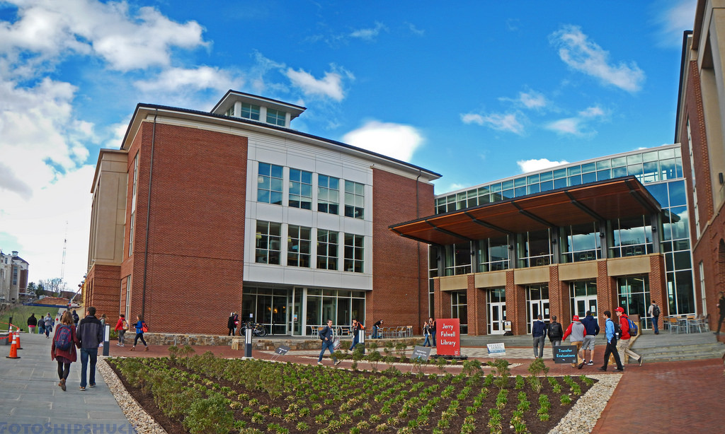

Thank
You for Attending
Jerry Falwell Library

