Slide 1
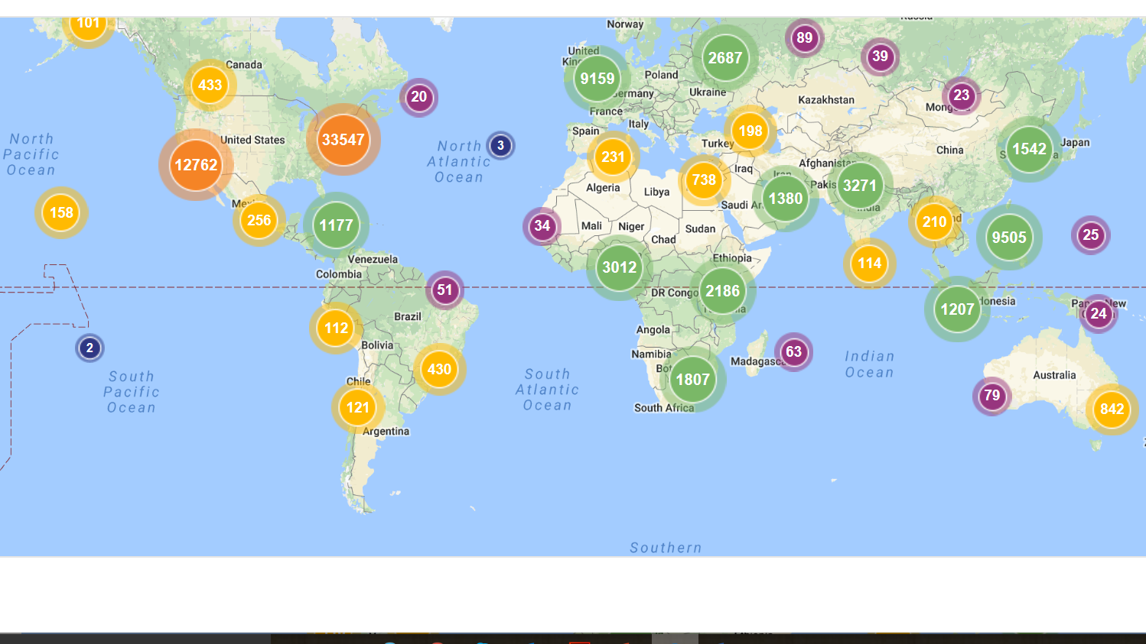
Maximize the Impact of Your Scholarship
Scholarly Communications Department

Slide 2
LU Digital Commons Statistics
As of January 1st, 2018
  Digital Commons
    Items to date: 8,586
    Total downloads to date: 10,126,874
    Downloads for December 2017: 92,304
    Number of Electronic Theses and Dissertations: 2,969
  SelectedWorks
    Works : 3,355
    Total downloads to date: 1,925,784
    Downloads for December 2017: 14,491

Slide 3
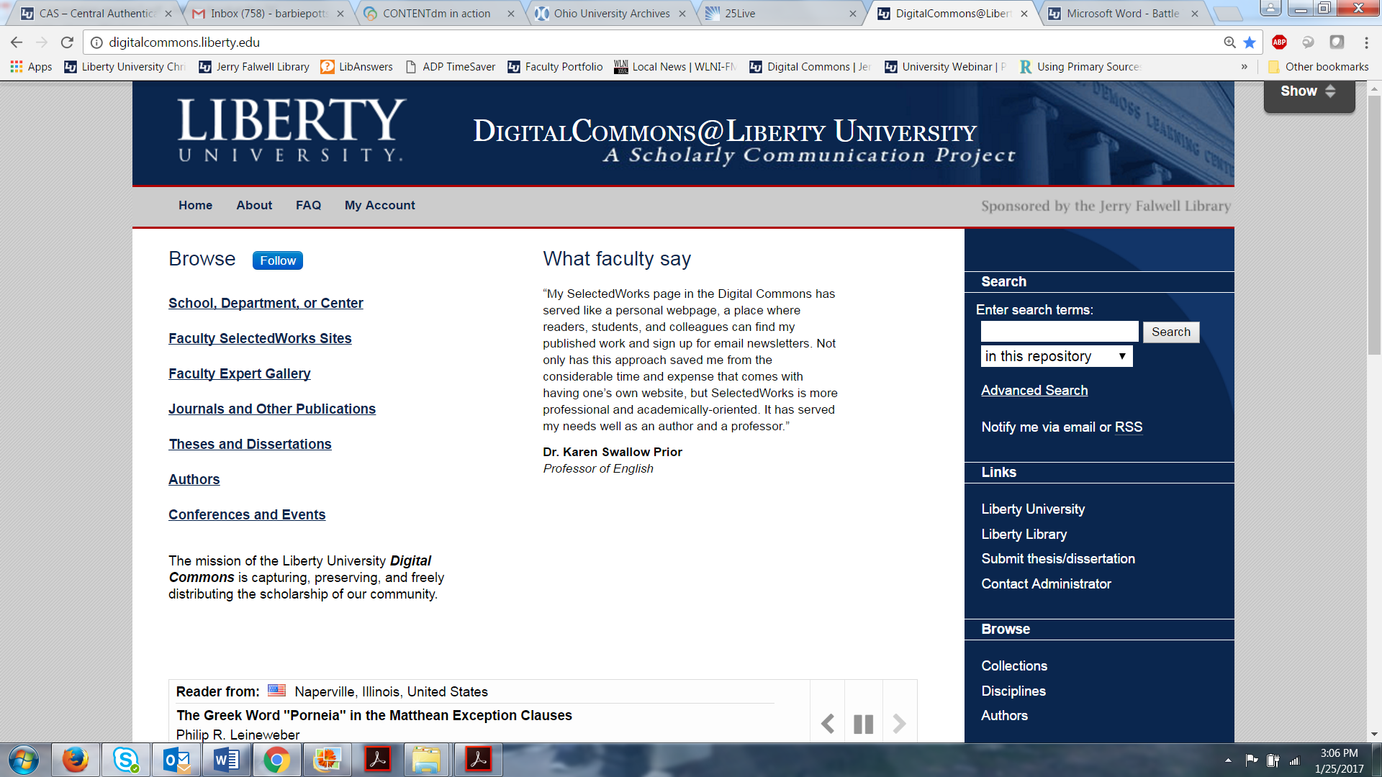
Why Publish in LU Digital Commons?
1. Display own scholarship 2. Build up reputation for your subject area at LU 3. Recruitment

Slide 4
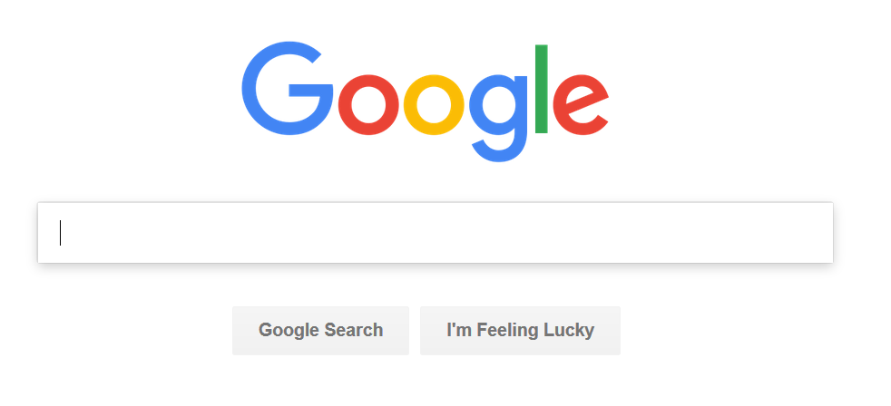
Why Use Selected Works / Digital Commons?
JFL and vendor set-up and curation
Unlimited storage
Cloud-based
Analytics
Discoverability

Slide 5
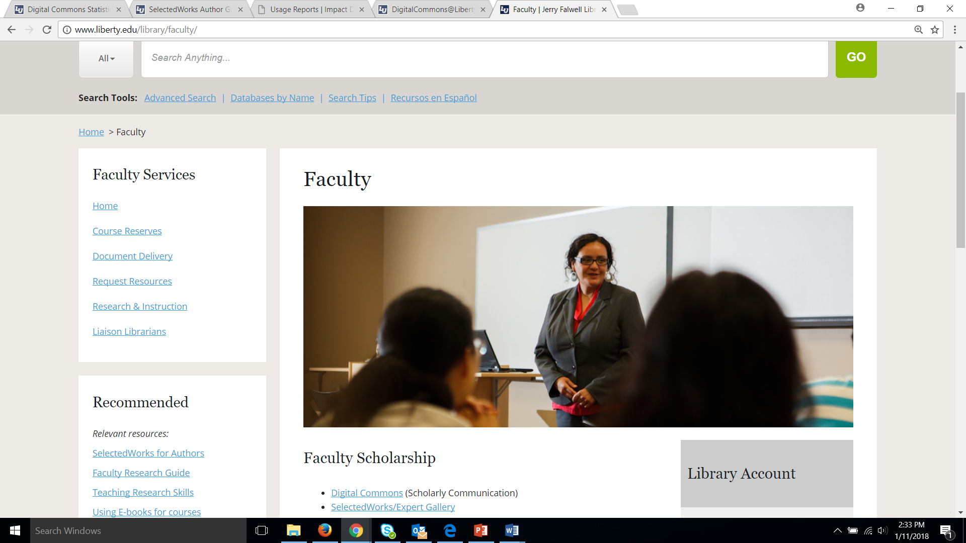
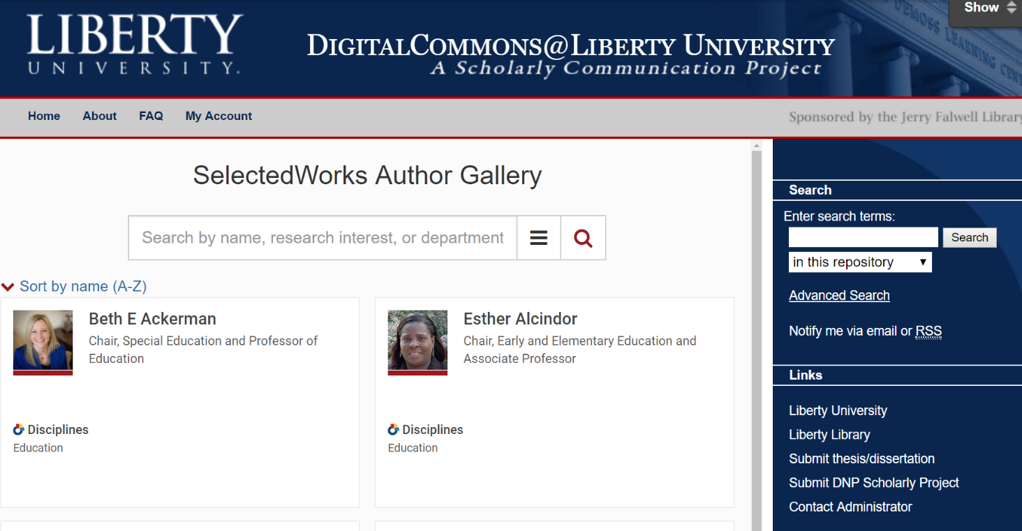
SelectedWorks
Notes:
We have obtained SelectedWorks to promote our individual faculty. This is an online portfolio that can link professors to their departments and subject areas. This too is searchable through the major search engines enabling faculty to share their work internationally. It is also a tool to showcase a department/school.

Slide 6
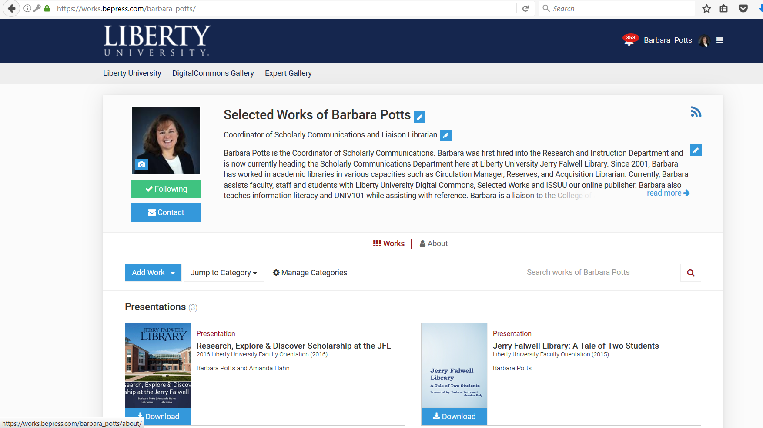
Notes:
Each individual faculty member may create a SelectedWorks page. You add your own picture, title, paragraph about self and display your work.

Slide 7
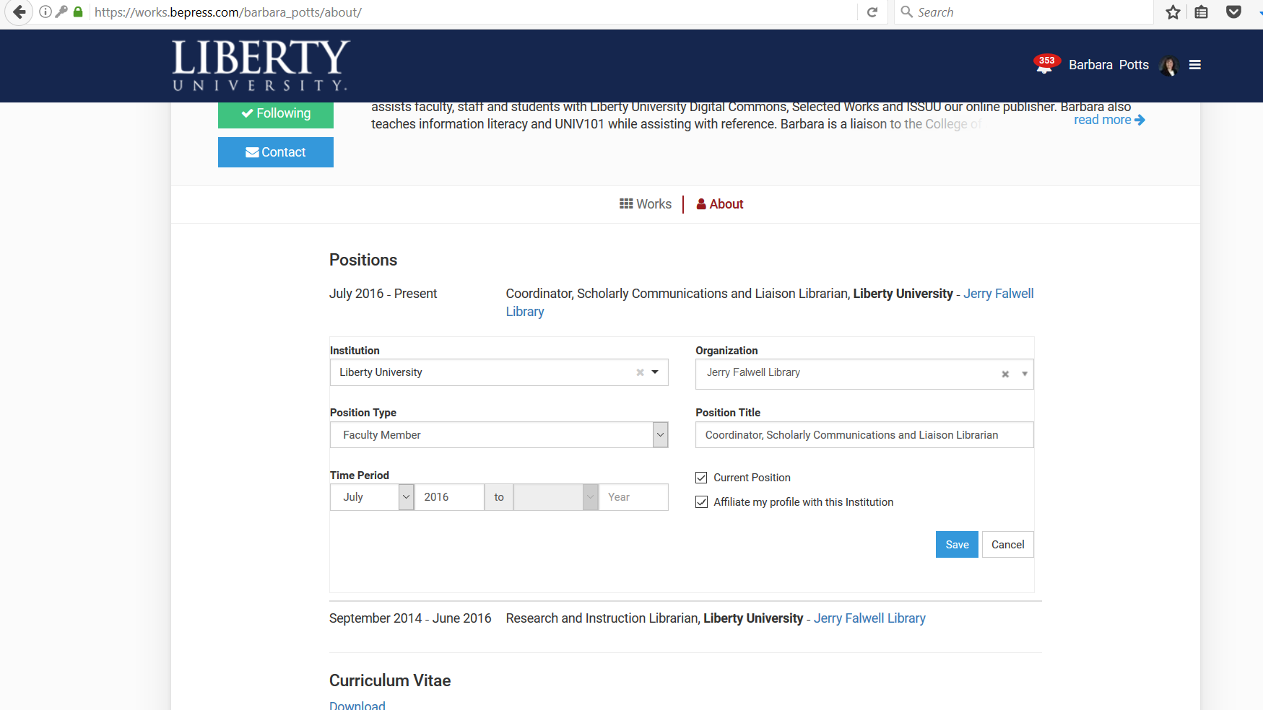
Notes:
LU only allows full time faculty to associate themselves with Liberty University. Adjuncts, staff and students may use this resource but will not be able to affiliate with Liberty University.

Slide 8
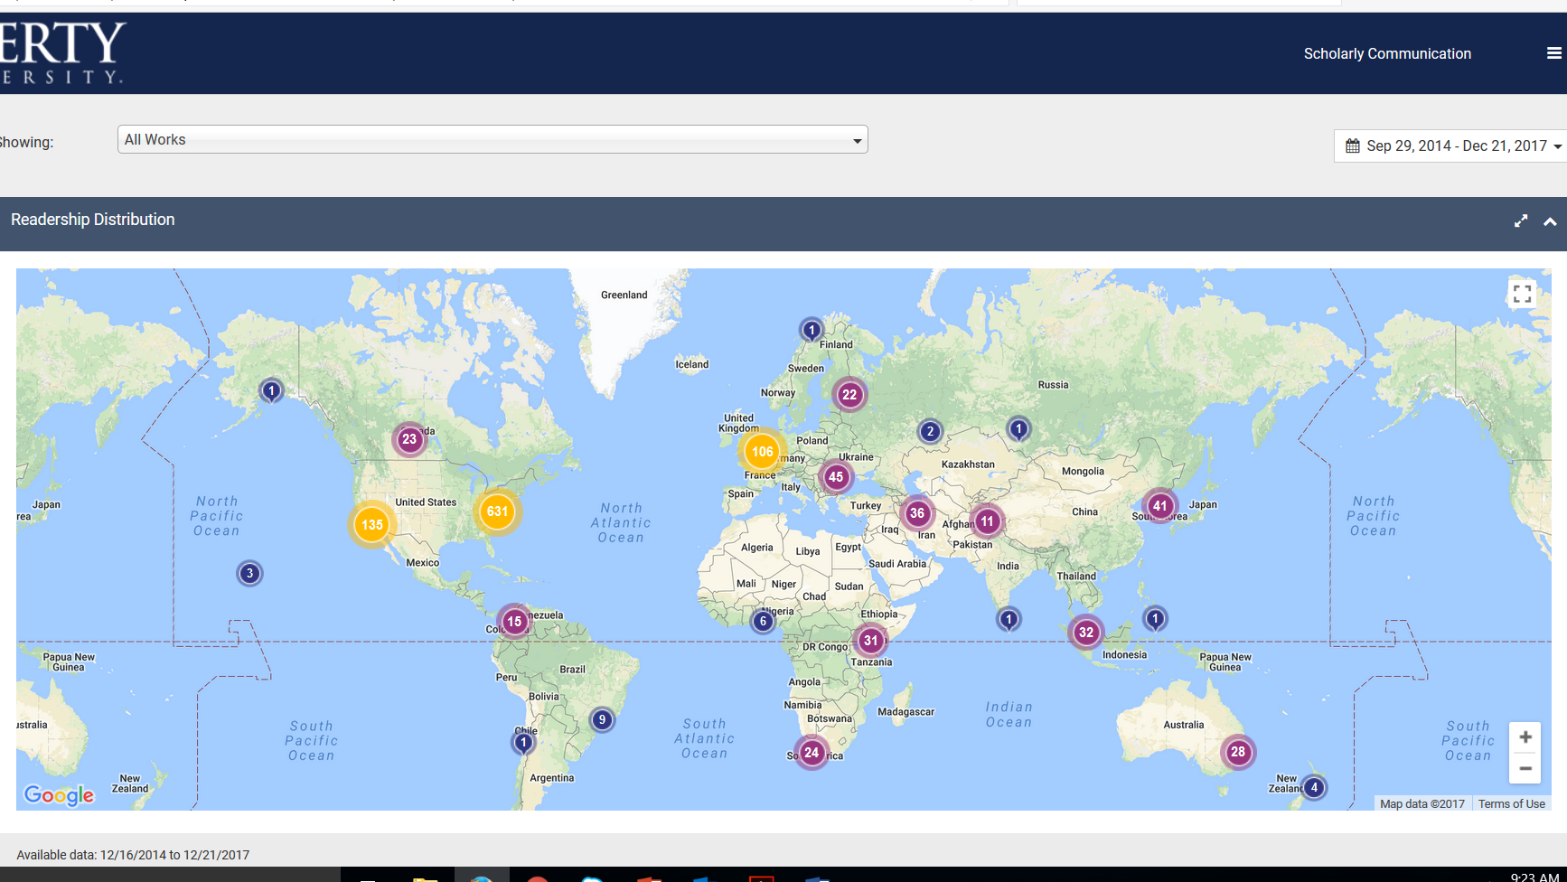
Notes:
This dashboard shows where people have downloaded you work. Once your account has been set up and established, you will receive a monthly dashboard report sent to your email with your latest statistic for your work.

Slide 9
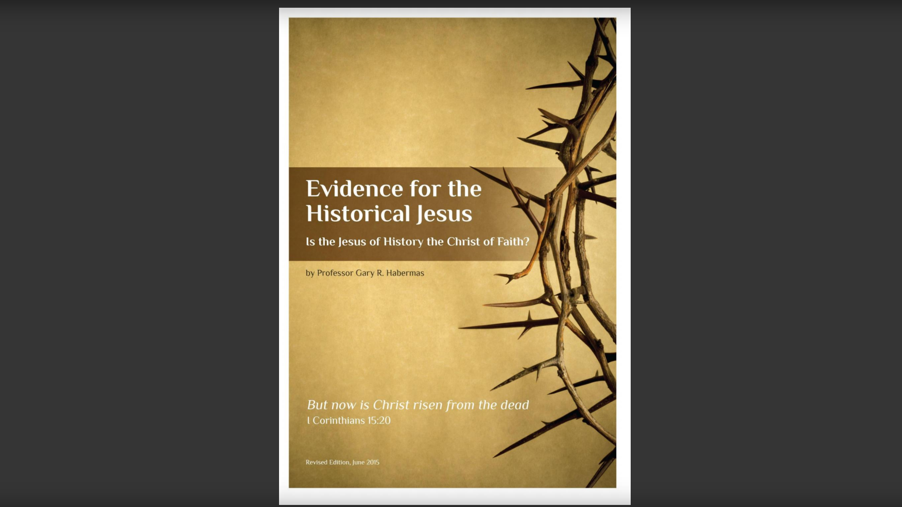
Notes:
We also offer an online book publishing called ISSUU. We are premier members which offer the author the ability to share their book online and get statistics from viewers. This is an opportunity to publish for free and have it cataloged in our JFL catalog.

Slide 10
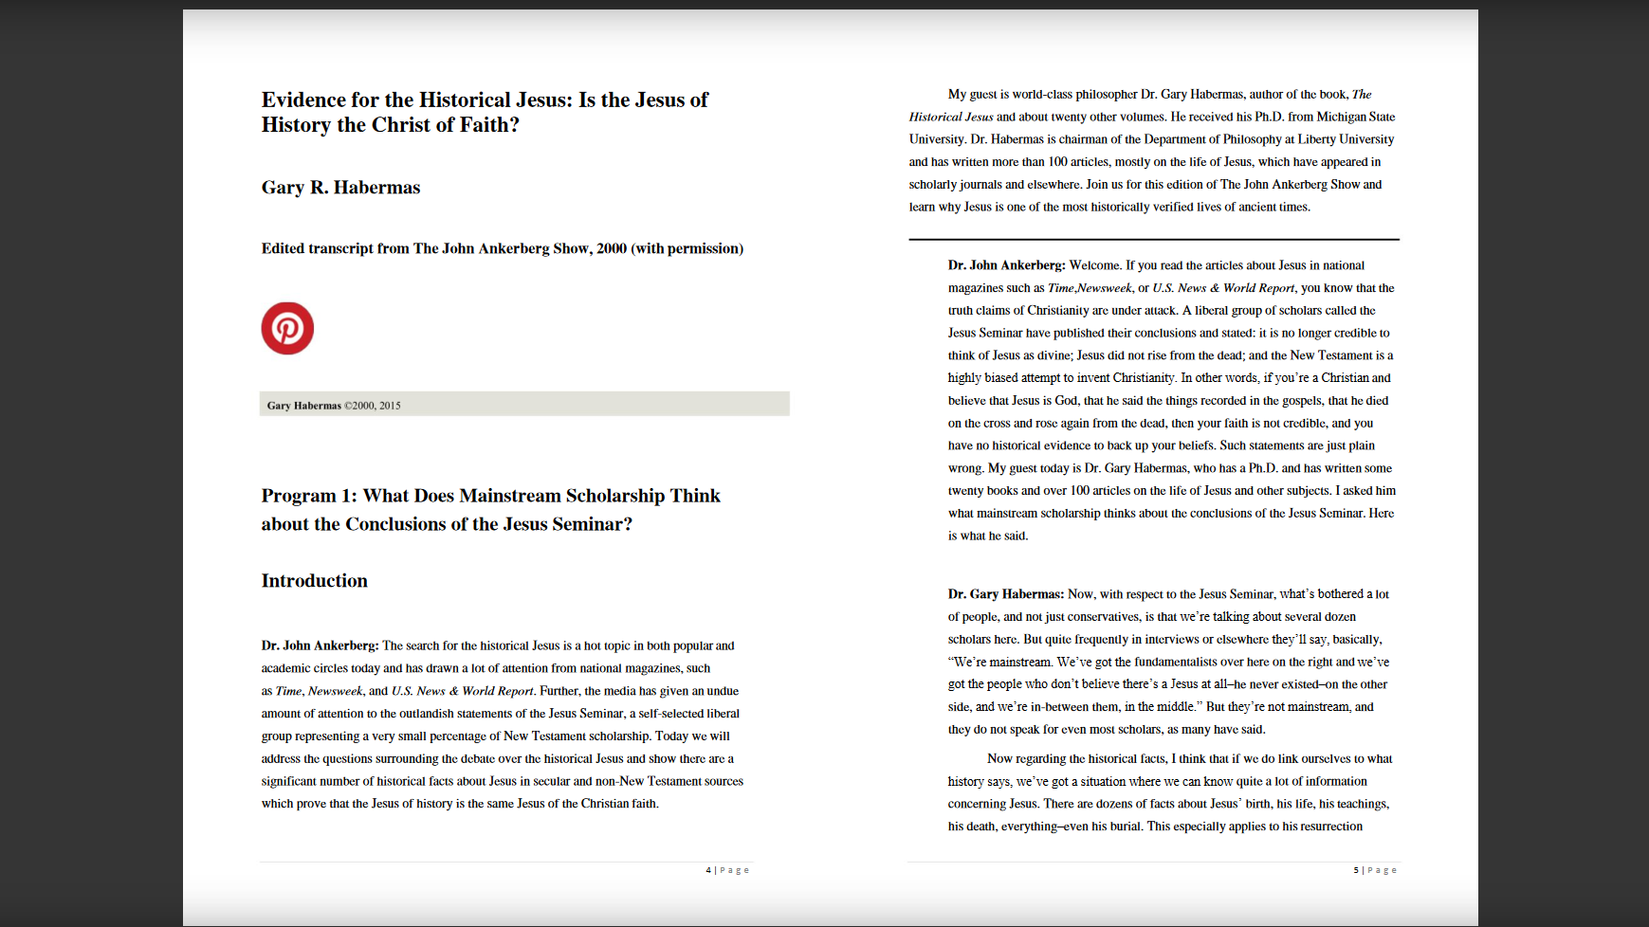
Notes:
This is a view of how the book can be displayed for readers to view. It will show the page turning to make it more book-like format.

Slide 11
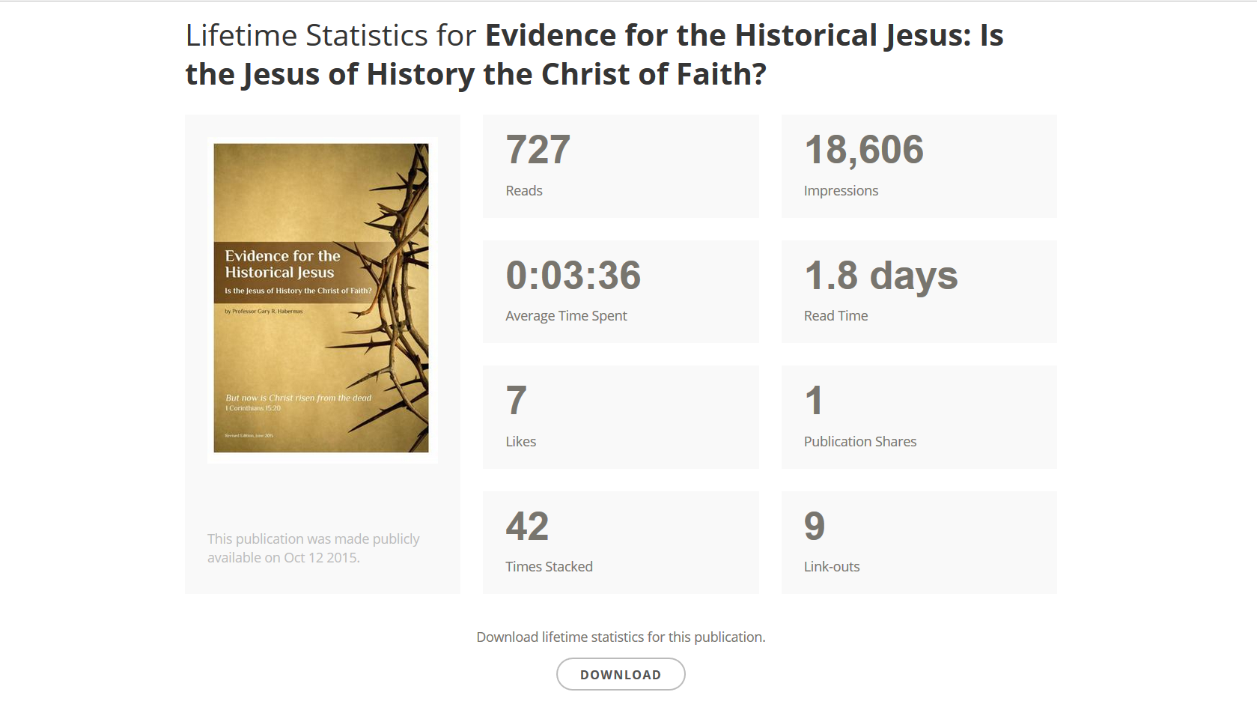
Each time reader spent >2 seconds
Counted each time displayed
Total time readers spent reading
Notes:
Here are the statistics available to authors.

Slide 12
