Slide 1
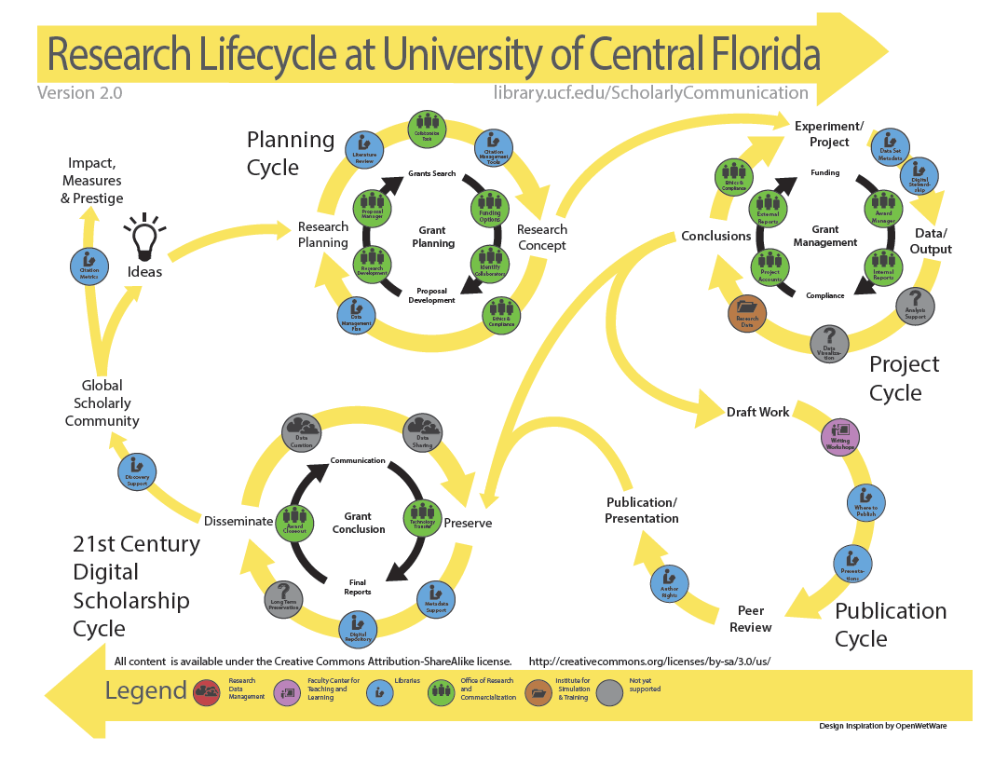
Grow Your Own Academic Library Scholarly Communication Program
Florida Library Assoc. Conference, Daytona Beach, Mar. 2, 2016
University of Central Florida Libraries
Ven Basco, Lee Dotson, Sarah Norris, Barbara Tierney, John Venecek

Slide 2
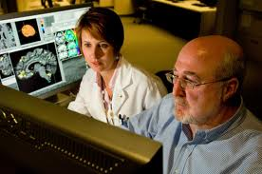
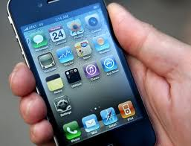
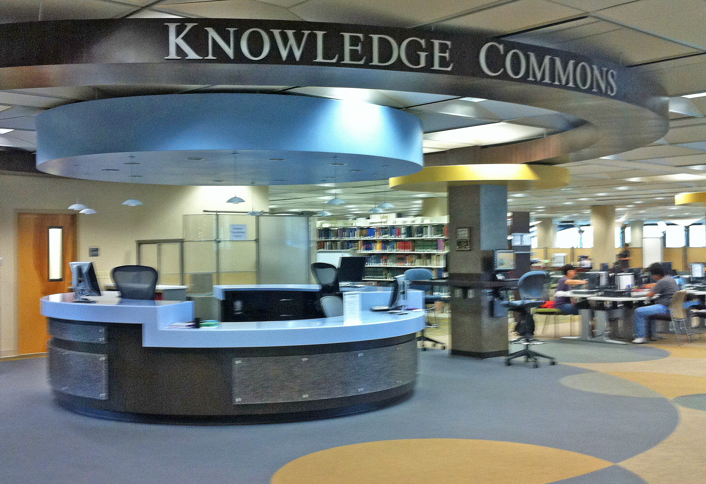
UCF Scholarly Communication Program Overview
Barbara Tierney, Head of Research Services

Slide 3
UCF Research Lifecycle
Lee Dotson, Digital Initiatives Librarian

Slide 4
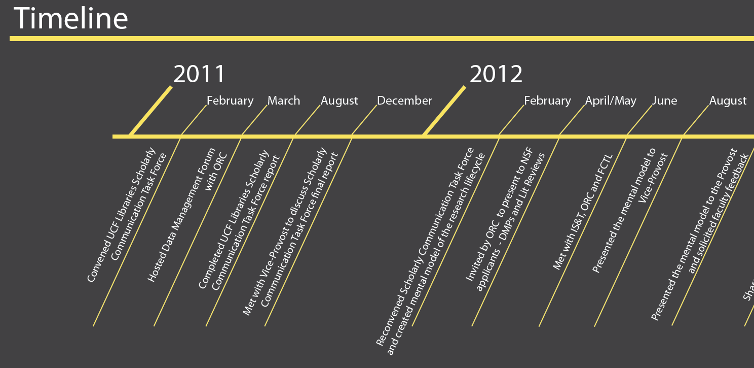

Slide 5
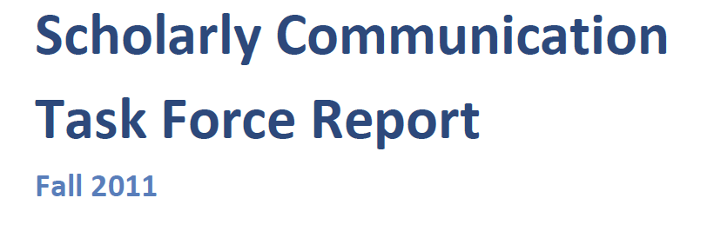
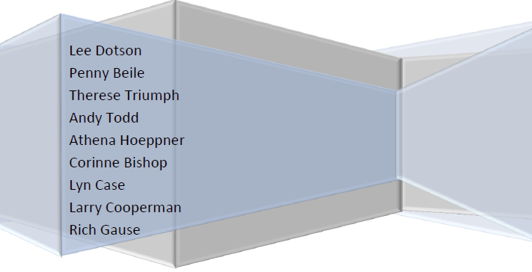

Slide 6
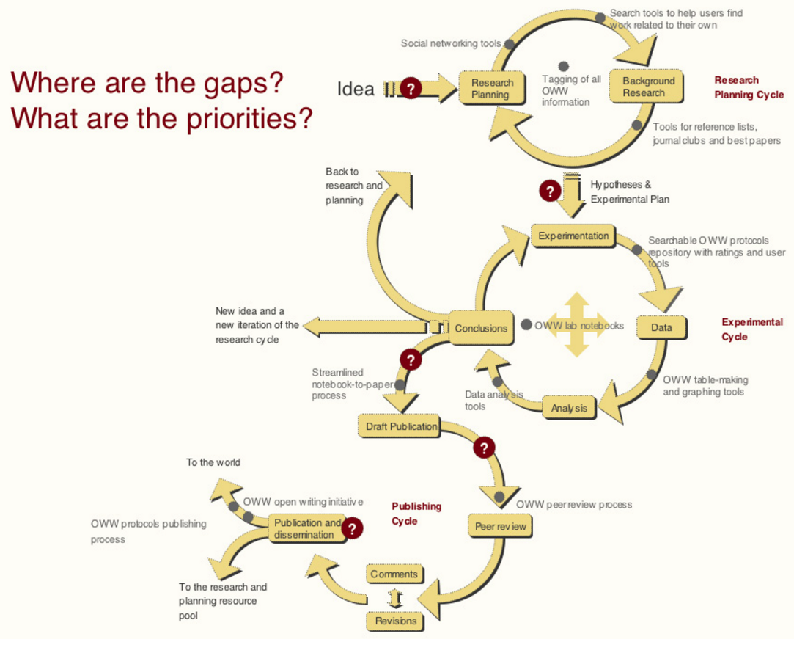
OpenWetWare:Headquarters/Research Pathway

Slide 8
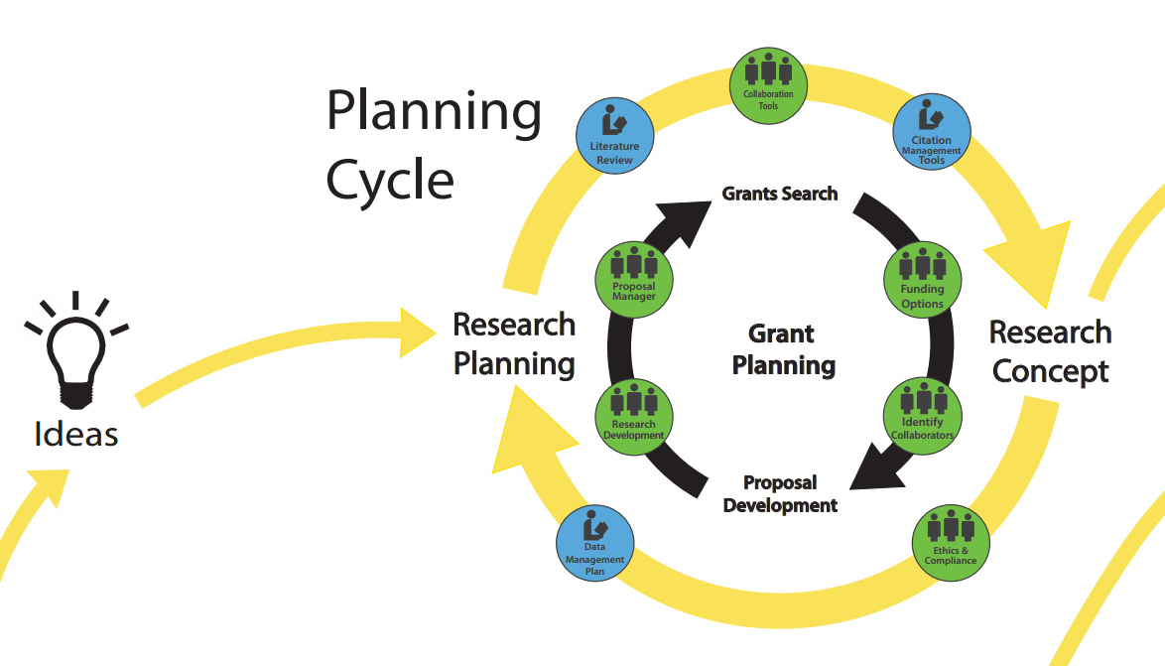

Slide 9
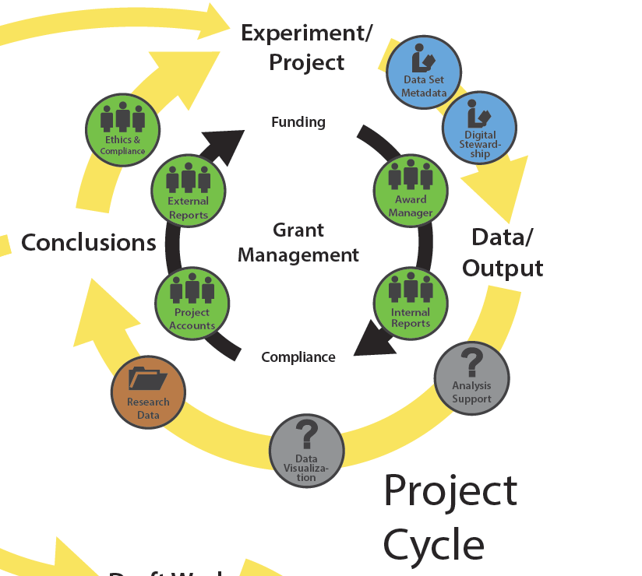

Slide 10
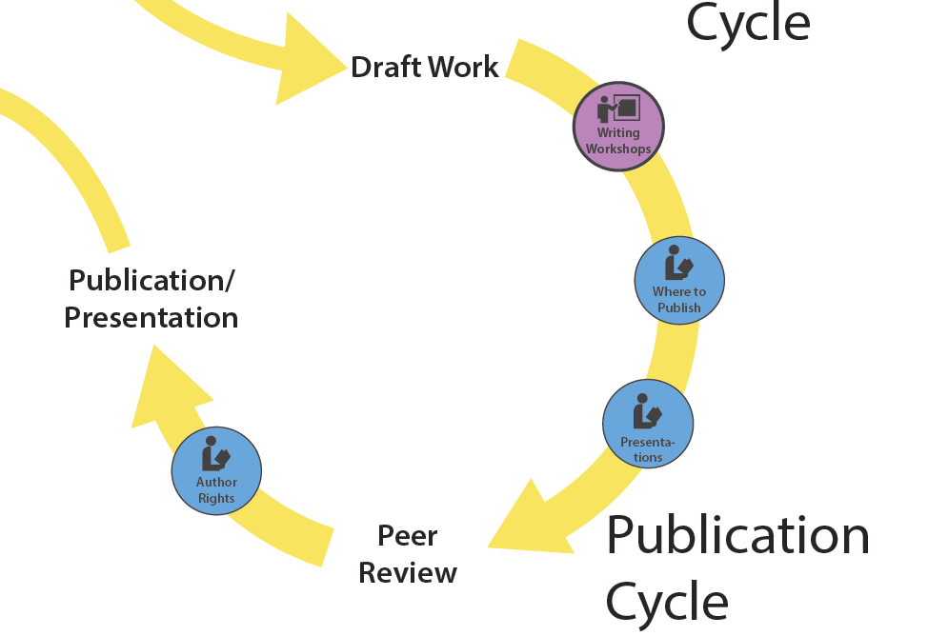

Slide 11
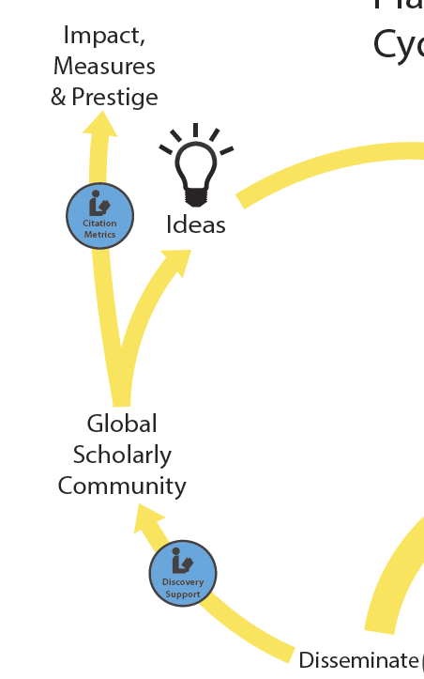

Slide 12
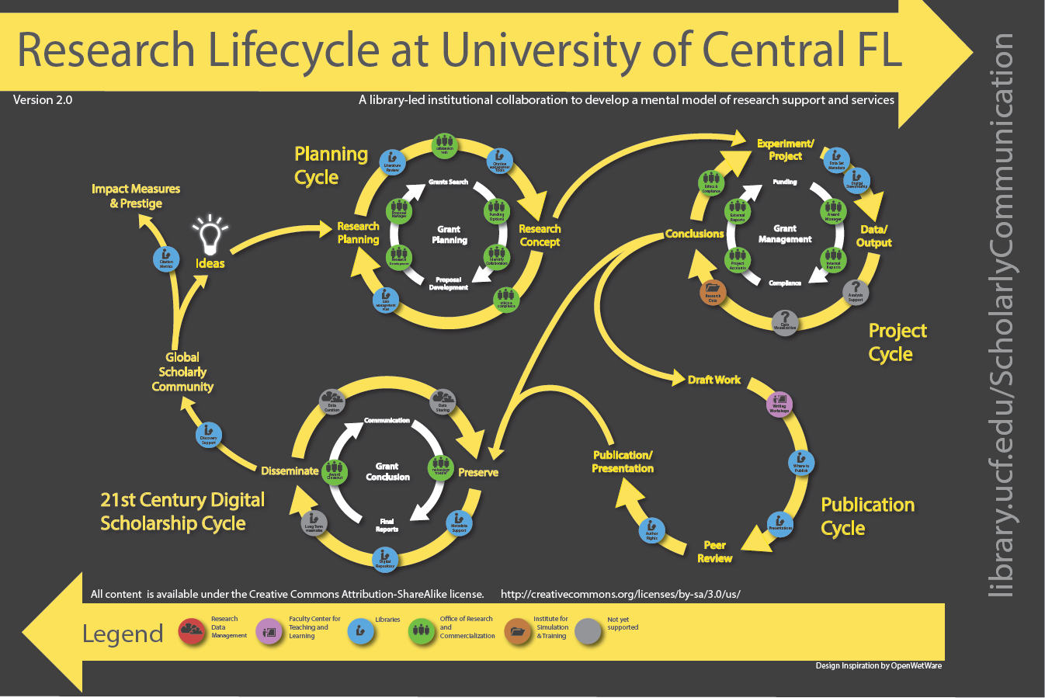
UCF “Blue Button” Experts
Ven Basco, Subject Librarian for Engineering

Slide 13

Penny Beile, AD coined the “Blue Button Expert” in the Research Life Cycle in 2012.
Who are the blue button experts?
Where do they fit in the Research Life Cycle?
  Citation Metrics
  Literature Review
  Citation Management Tools
  Data Management Plan
  Data Set Metadata
  Discovery Support
  Open Access Hosting
  Metadata Services

Slide 14
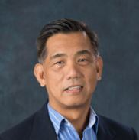
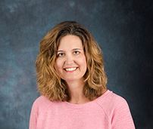
UCF “Blue Button” Experts

Slide 15
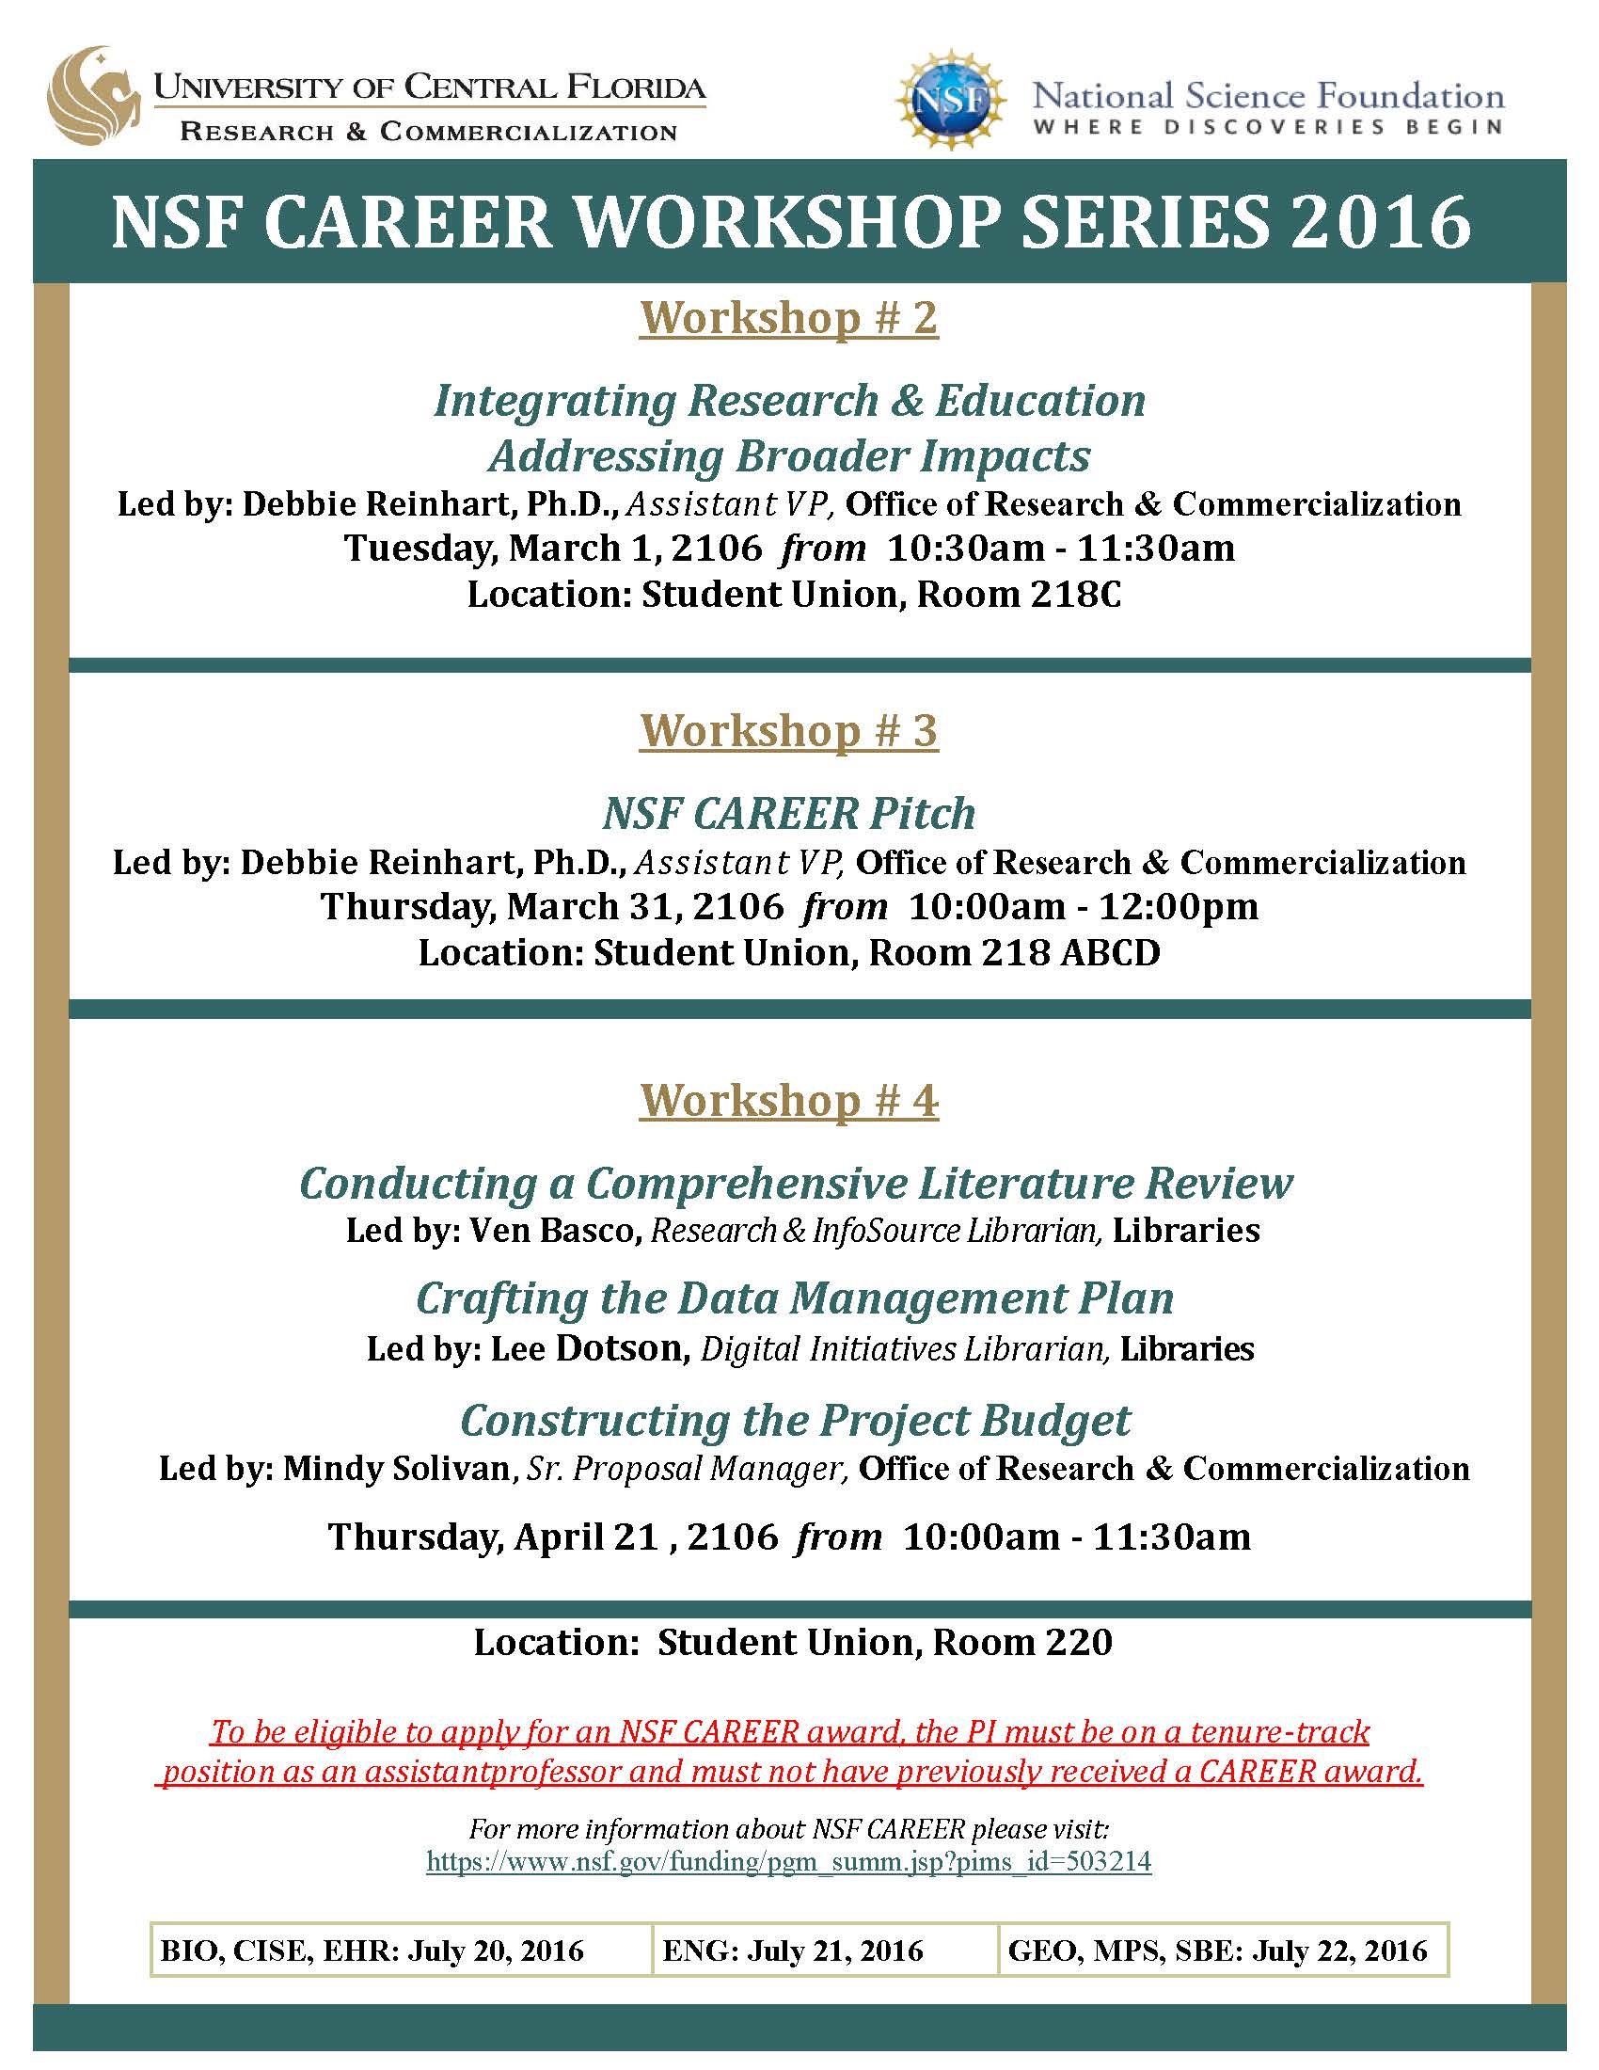
Sample Presentations

Slide 16
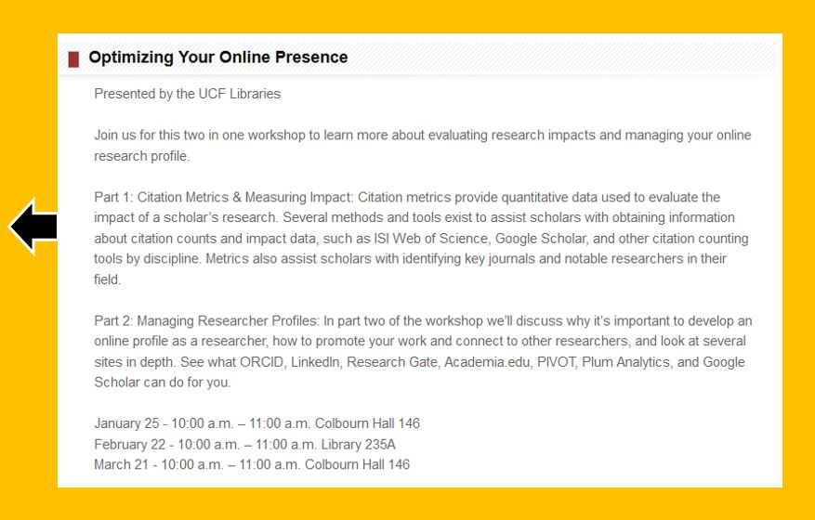
Other Presentations

Slide 17
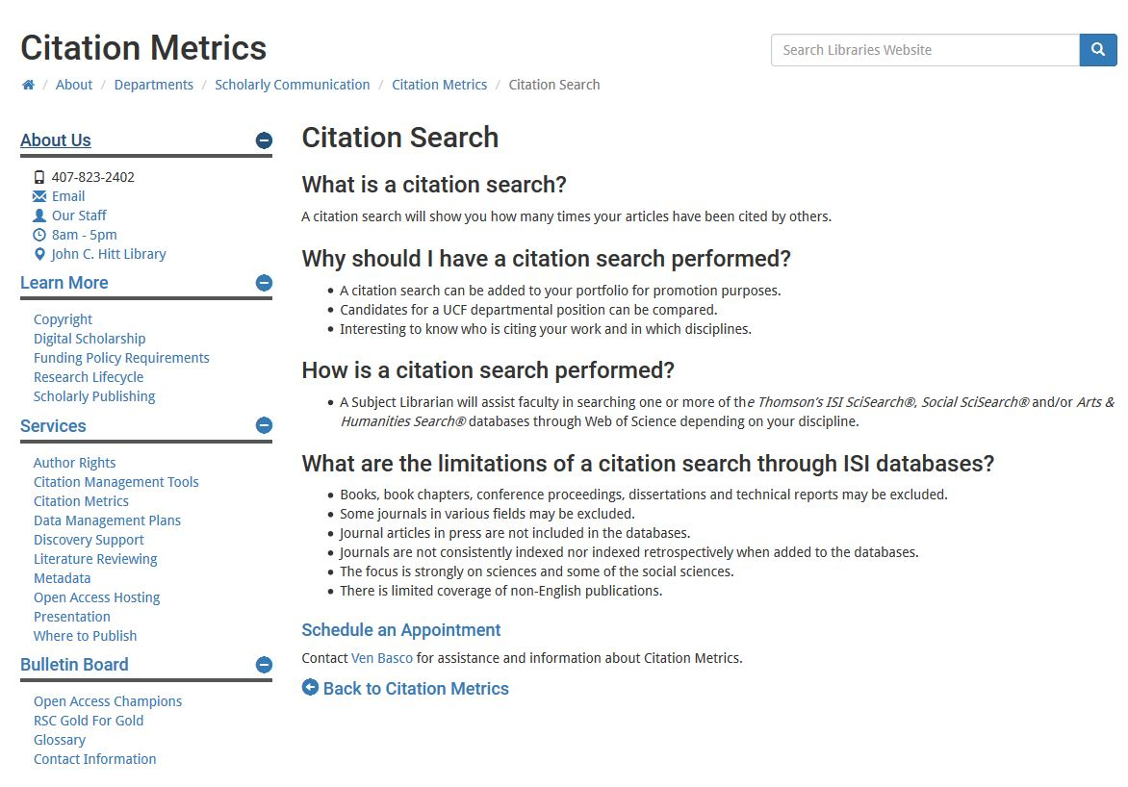

Slide 18
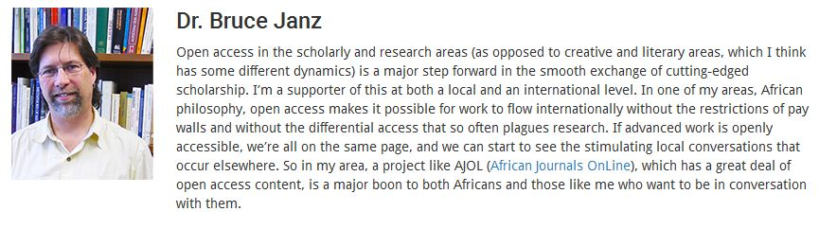
Open Access Champions
Dr. Janz is Co-Director of The Center for Humanities & Digital Research at UCF. He is also working with the University of the Witswatersrand (WiSER) to digitize South African parliamentary papers.

Slide 19
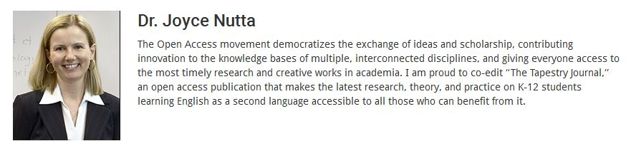
Open Access Champions
Dr. Nutta is Professor in School of Teaching, Learning, and Leadership. She edits the Open Access Tapestry Journal: An International Multidisciplinary Journal on English Language Learner Education.

Slide 20
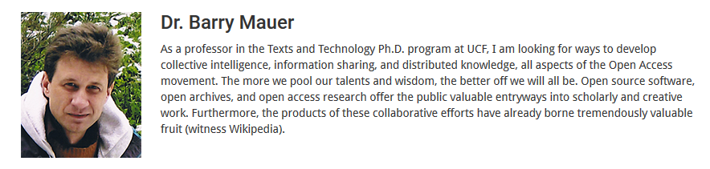
Open Access Champions
Dr. Mauer has a long history of publishing in OA journals and has written extensively on data loss.
He is co-founder of the Citizen Curator Project of Central Florida, a project that promotes the open use of digital archives within the community.

Slide 21
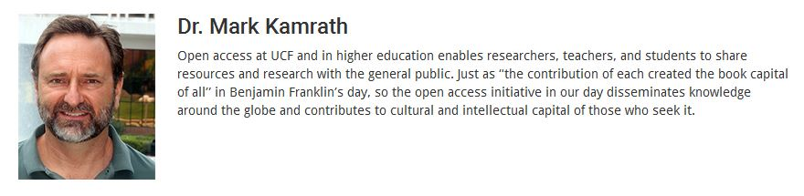
Open Access Champions
Dr. Kamrath is Co-Director of The Center for Humanities & Digital Research and General Editor of the Charles Brockden Brown Electronic Archive & Scholarly Edition.

Slide 22
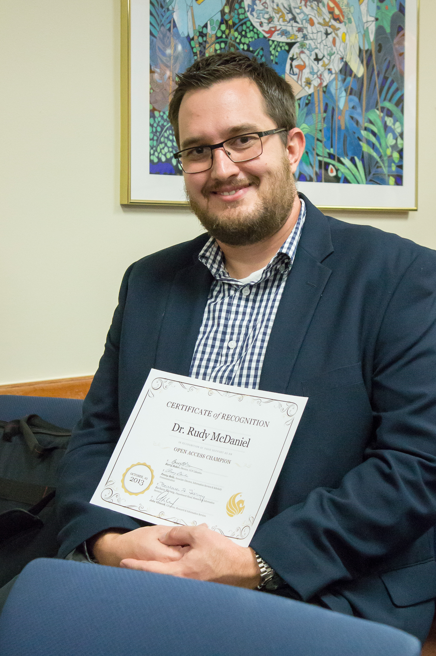
Certificates of Recognition
OA Champions received a Certificate of Recognition at the 2013 OA Week reception.

Slide 23
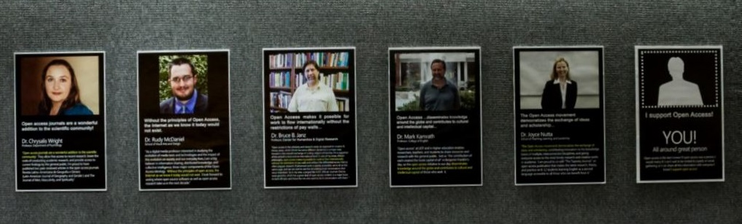
OA Week Library Exhibit
Gave us permission to use their images and quotes to promote OA on our website & exhibits.
Many presented on the OA-related activities at our 2014 OA Week extravaganza, which featured Peter Suber as the keynote speaker.

Slide 24
Transition to Scholarly Communication Advisory Board
Advisory Board consists of 11 members representing most colleges on campus;
Assembled during the summer 2015 and had their first meeting last fall;
Coincided with the launch of the STARS repository;
Their mission is to support the goals of the Office of Scholarly Communication, to advocate for us around campus, and to set the agenda for future endeavors.

Slide 25

STARS Institutional Repository
Lee Dotson, Digital Initiatives Librarian

Slide 26
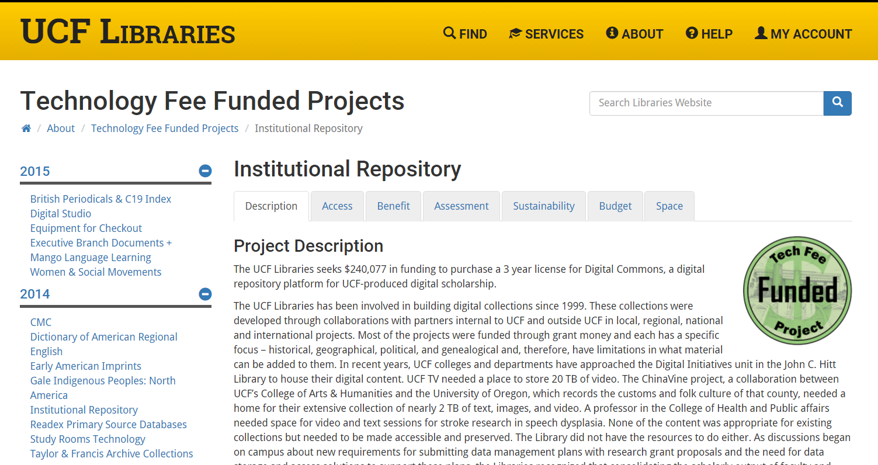

Slide 27
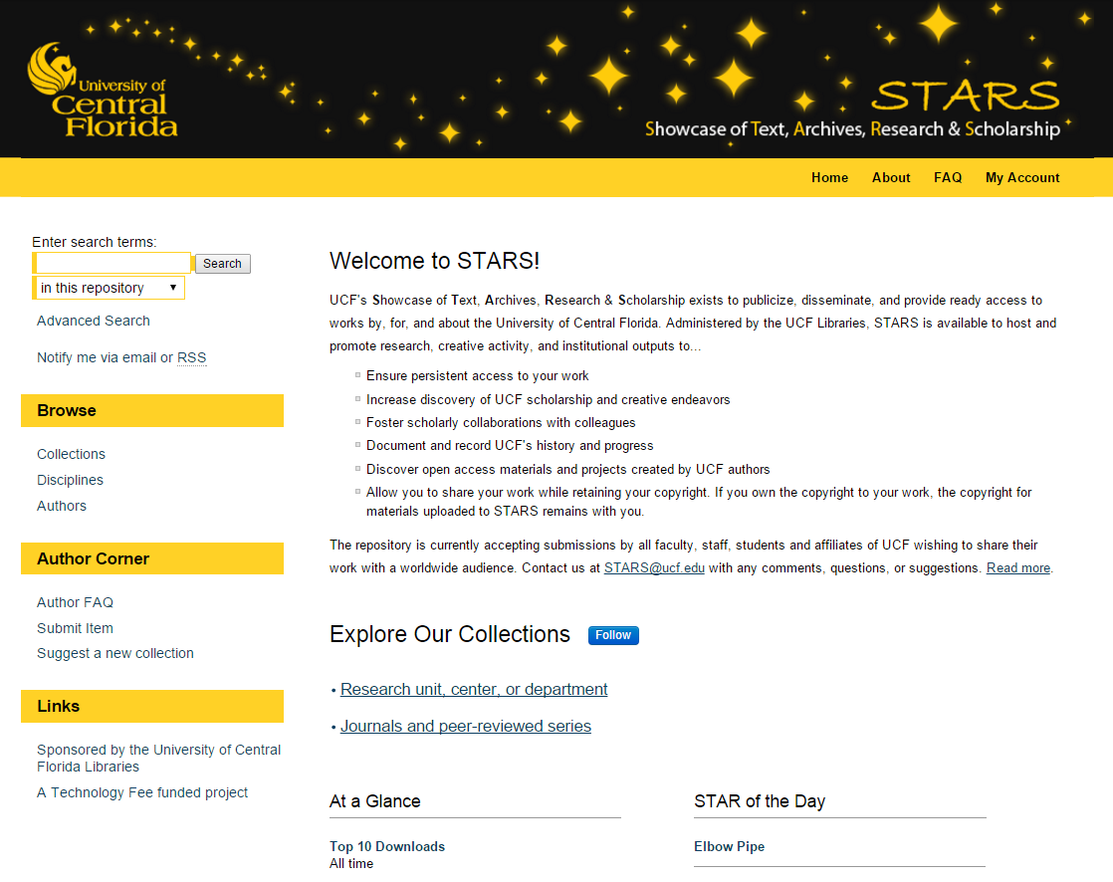

Slide 28
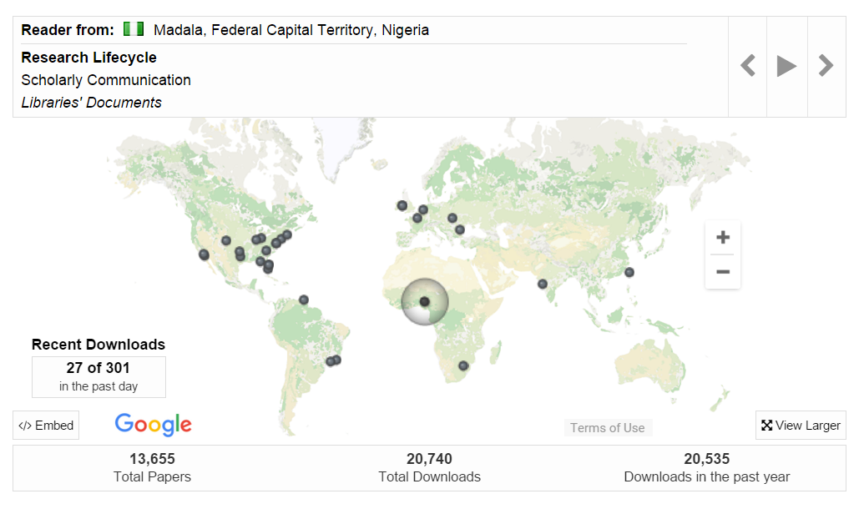

Slide 29
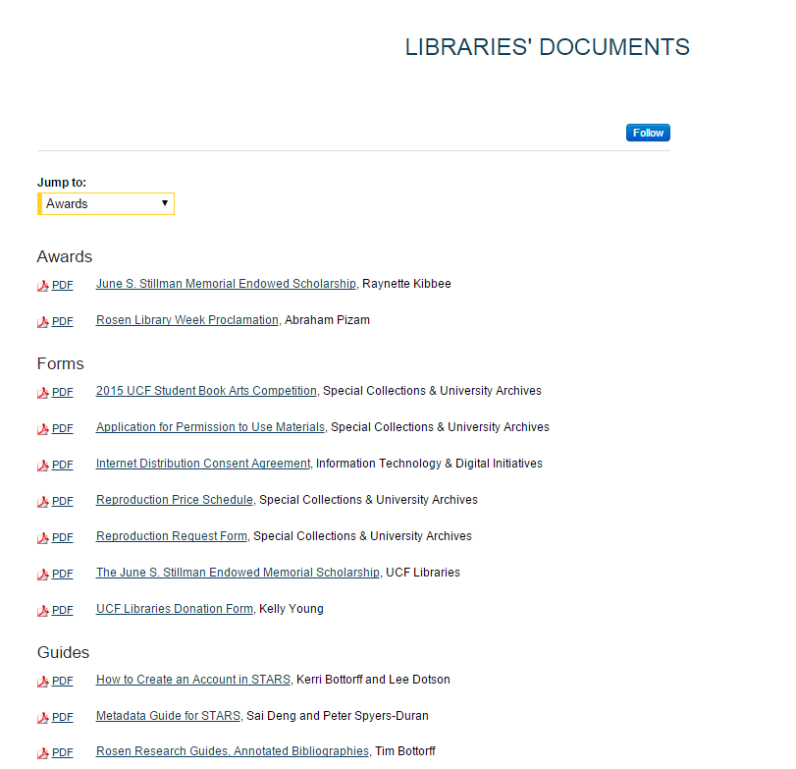

Slide 30
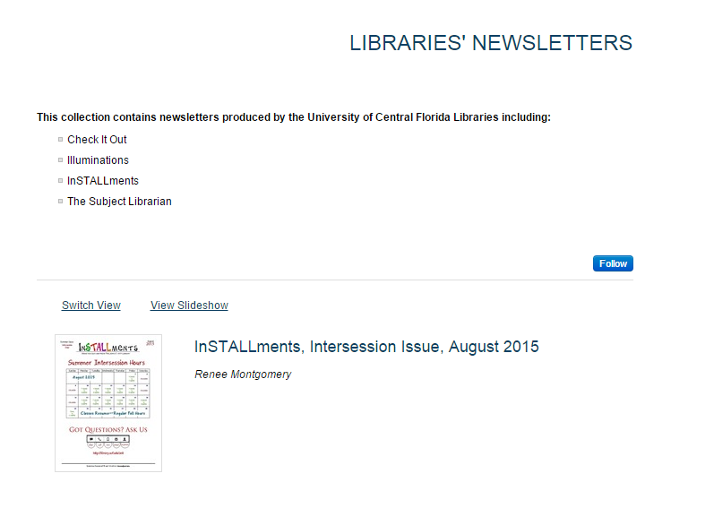

Slide 31
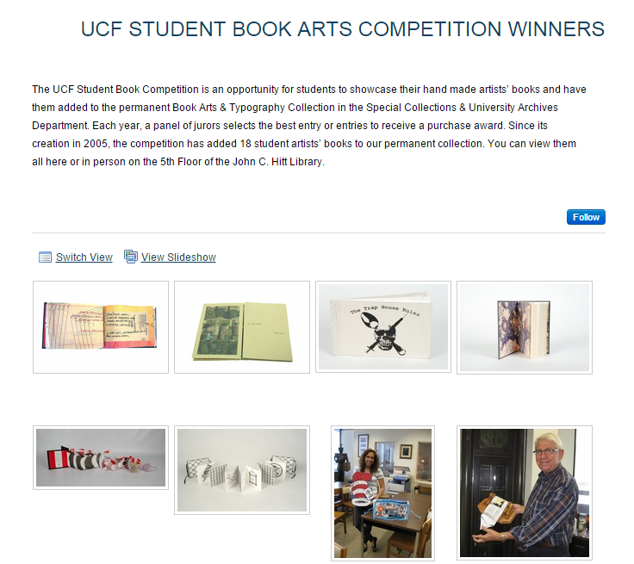

Slide 32
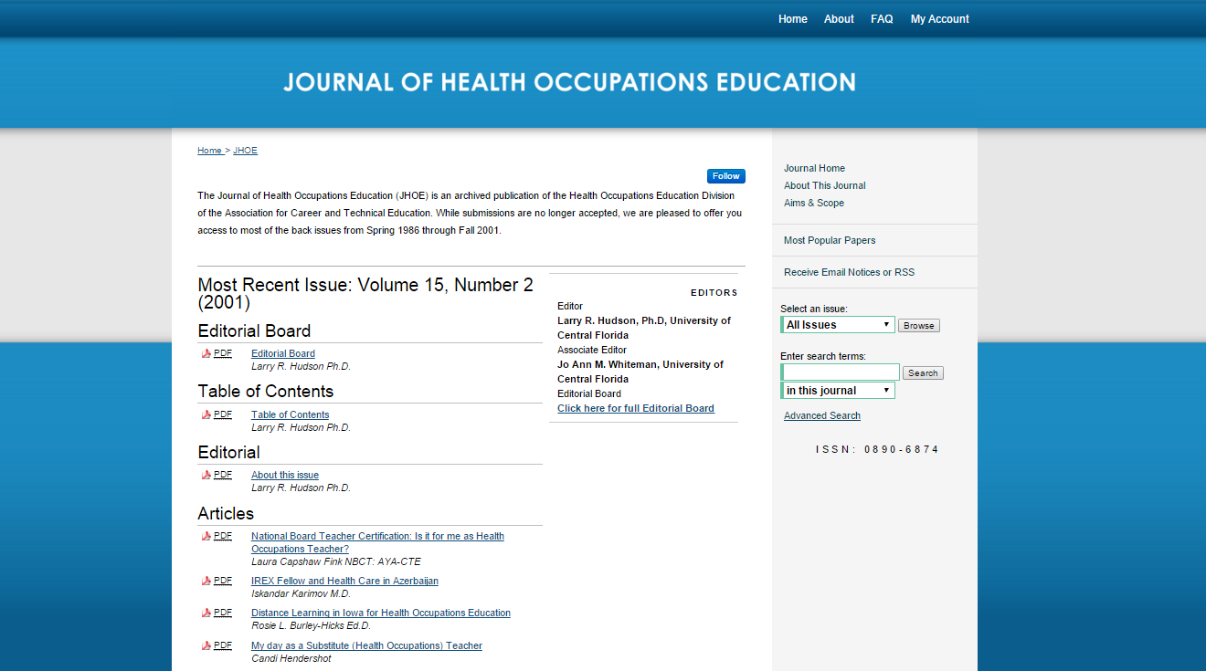
http://stars.library.ucf.edu/jhoe/

Slide 33
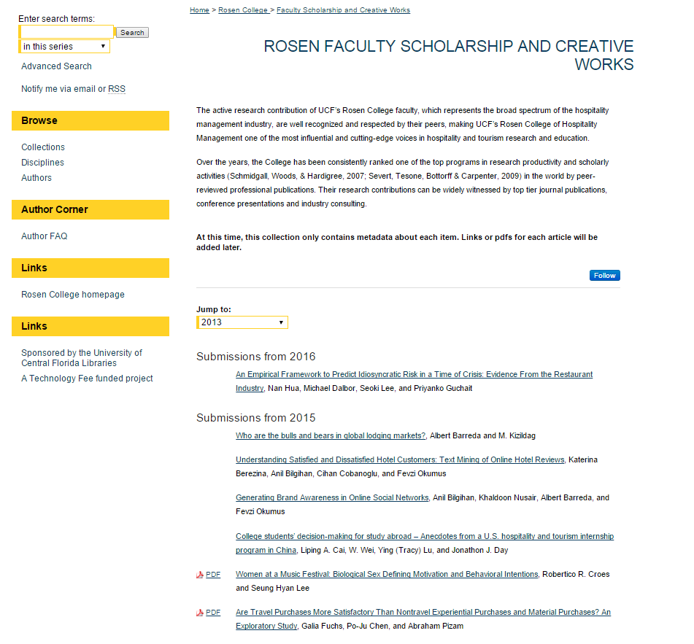

Slide 34
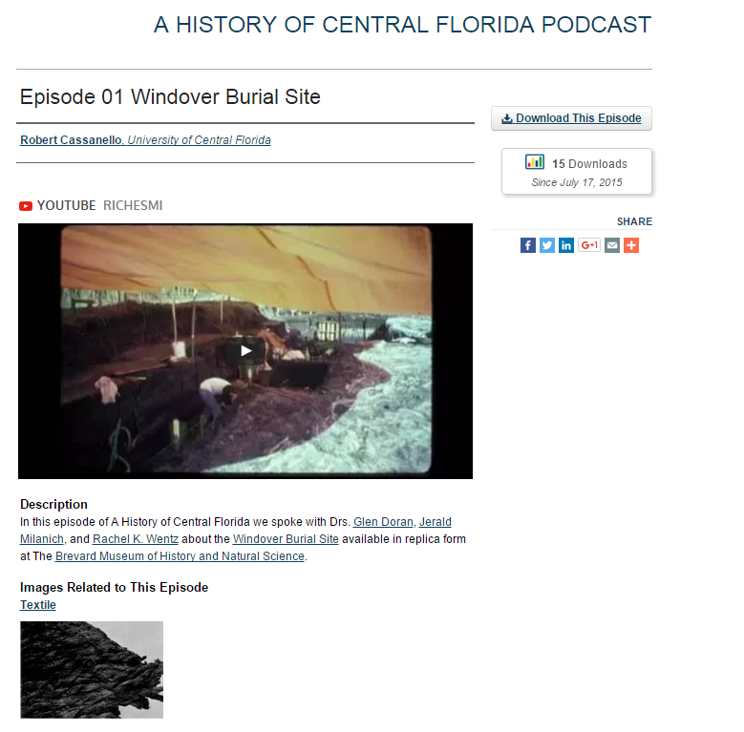

Slide 35
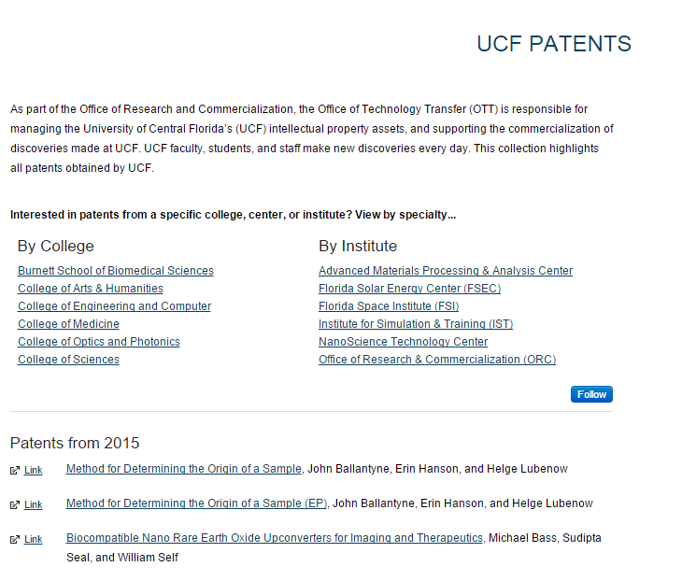

Slide 36
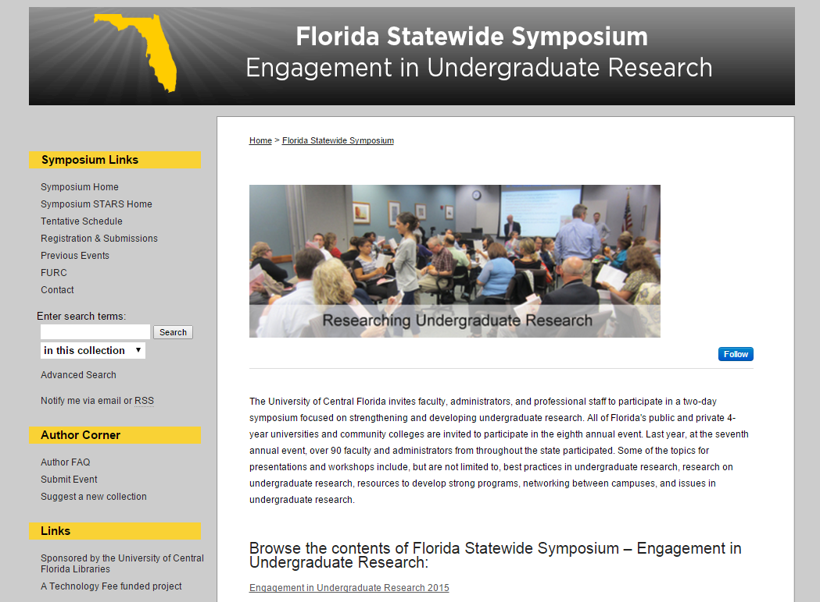

Slide 37
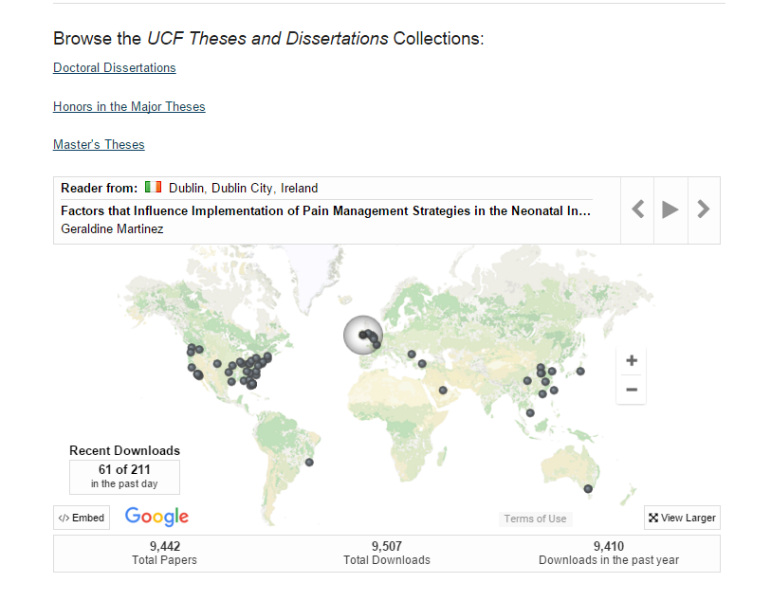

Slide 38
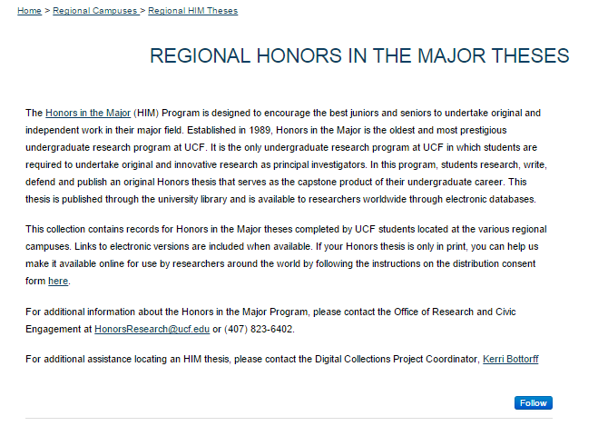

Slide 39
UCF Scholarly Communication
Website
http://library.ucf.edu/about/departments/scholarly-communication/

Slide 40
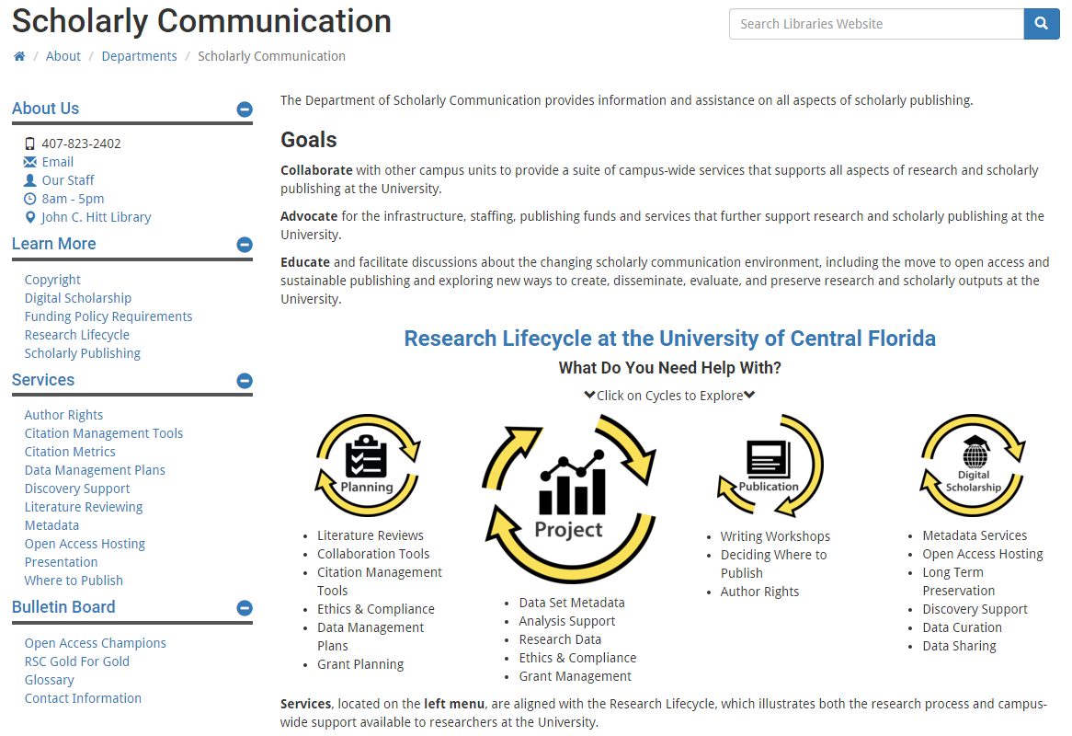
UCF Scholarly Communication Website

Slide 41
Purpose(s) of Website
Communicate goals & mission of SC at UCF Libraries
Provide a dedicated space for SC efforts & communications
Focus on expanding information on RLC services & resources
Highlight “OA Champions”
Act as SC resource for faculty, students & staff
Way for people to connect with Office of SC
Resources related to training faculty & staff

Slide 42
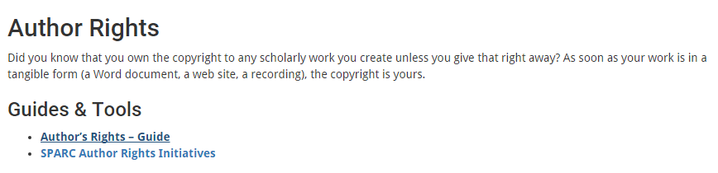
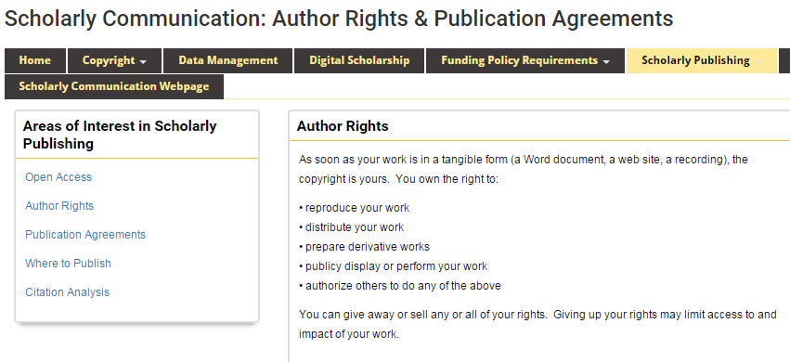

Website
Research Guides

Slide 43
Why a Website vs. Research Guide(s)?

Slide 44
Future of Website

Slide 45
Future Goals and Expectations

Slide 46
Overarching Goals & Expectations

Slide 47
Goals & Expectations 2016-2017

Slide 48
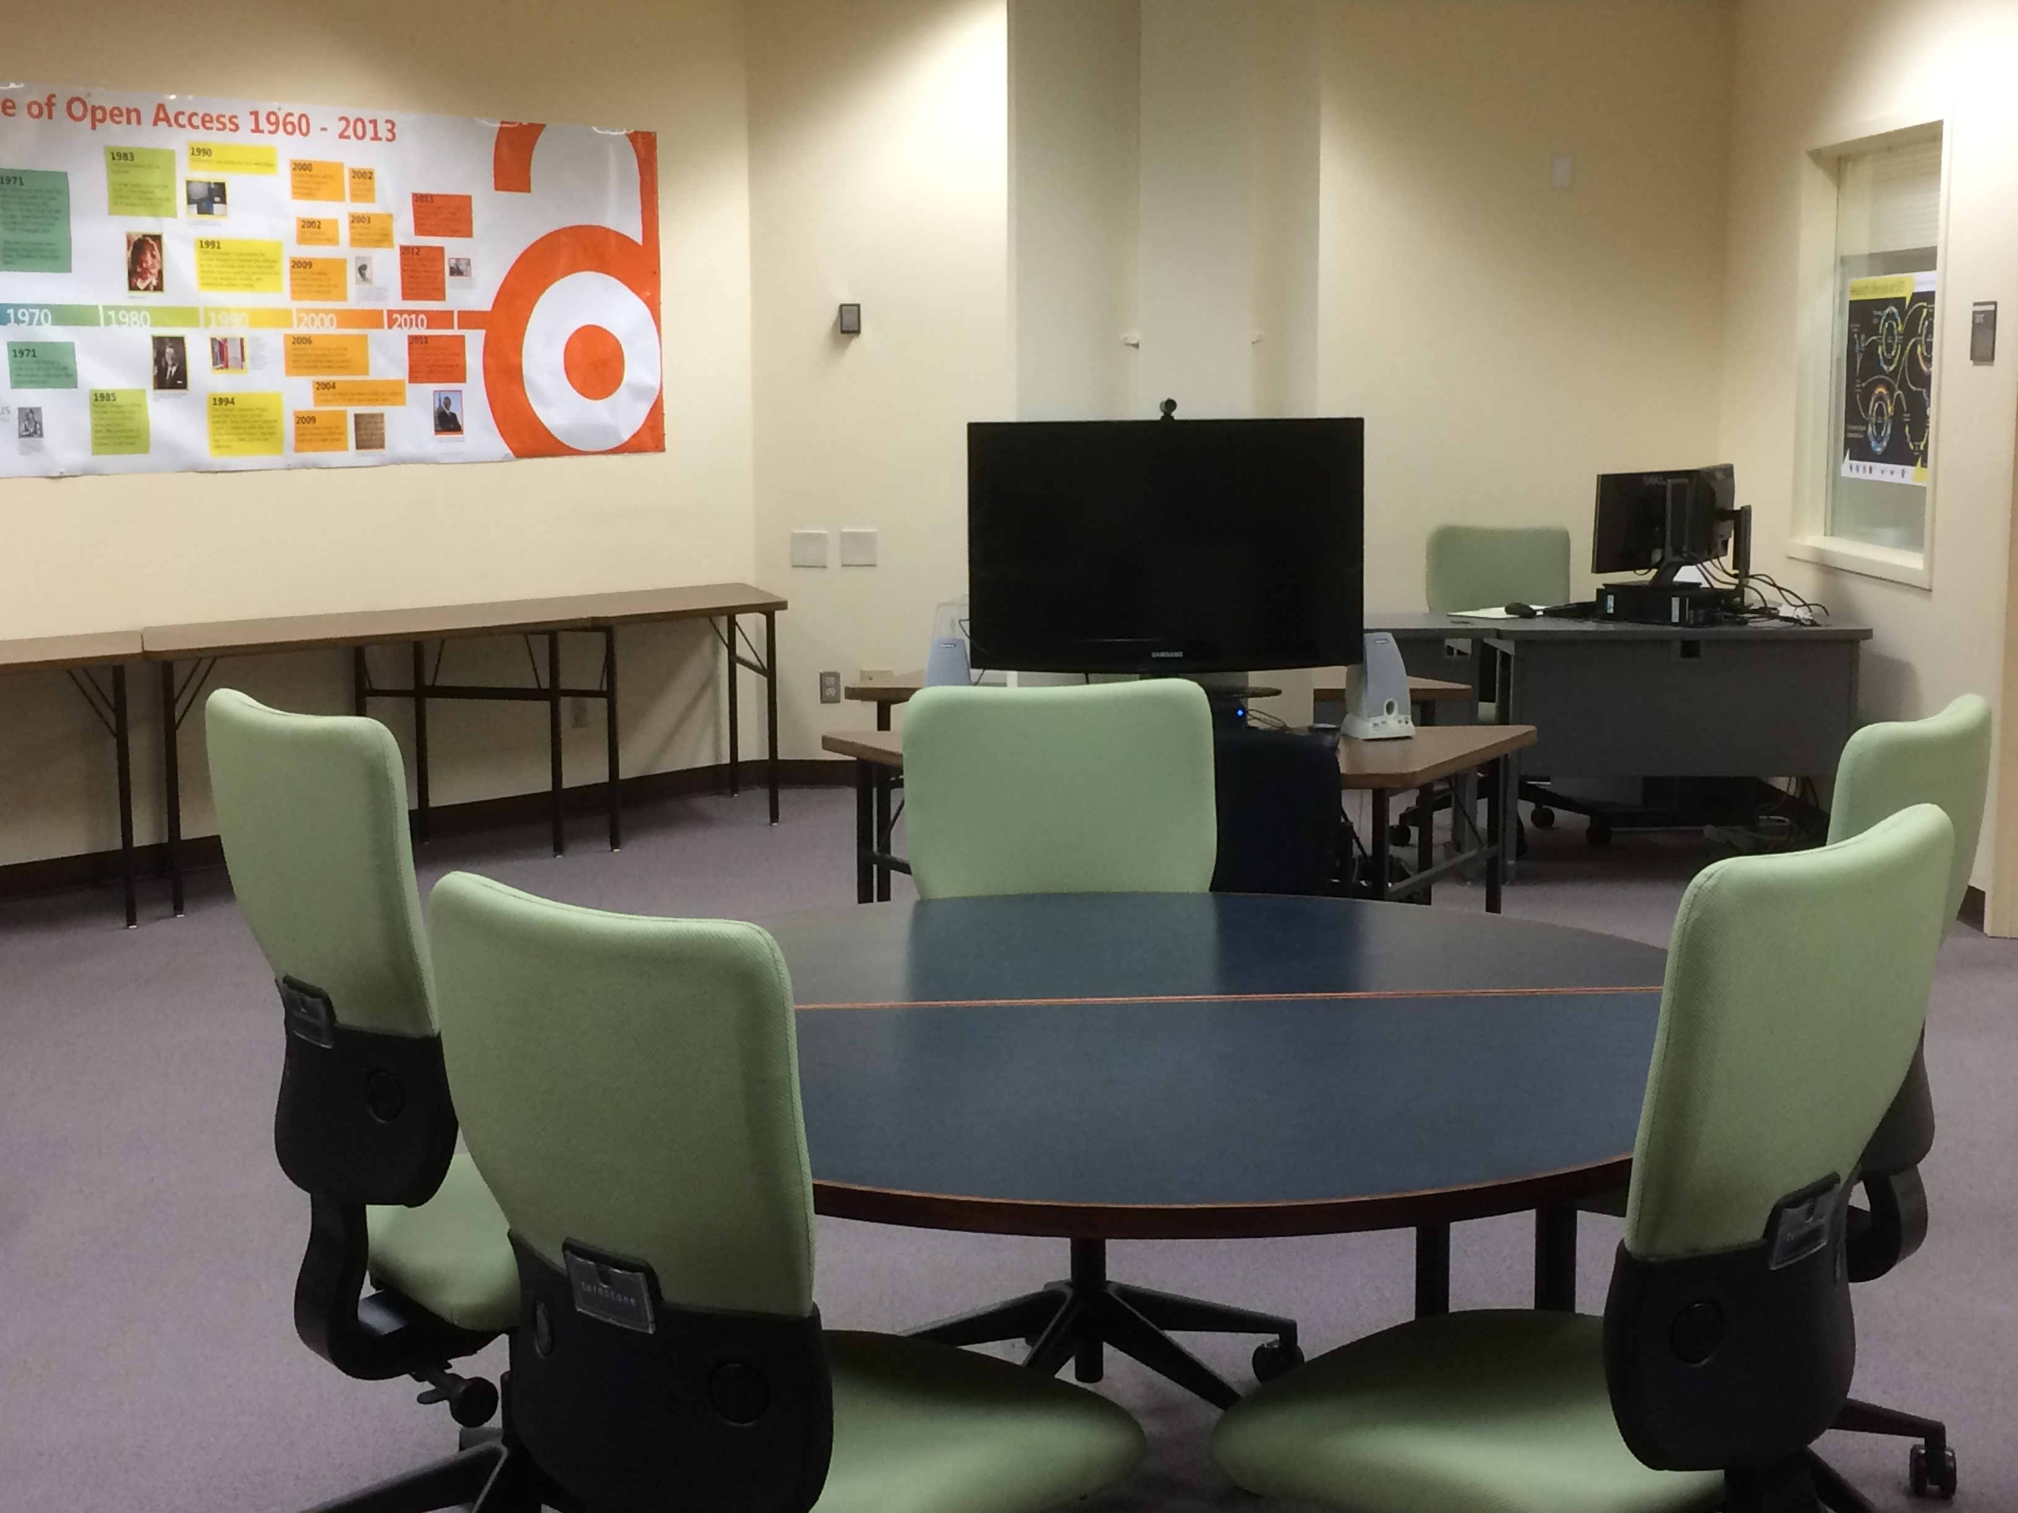
Continue to solidify SC as a unit in the library with dedicated space

Slide 49
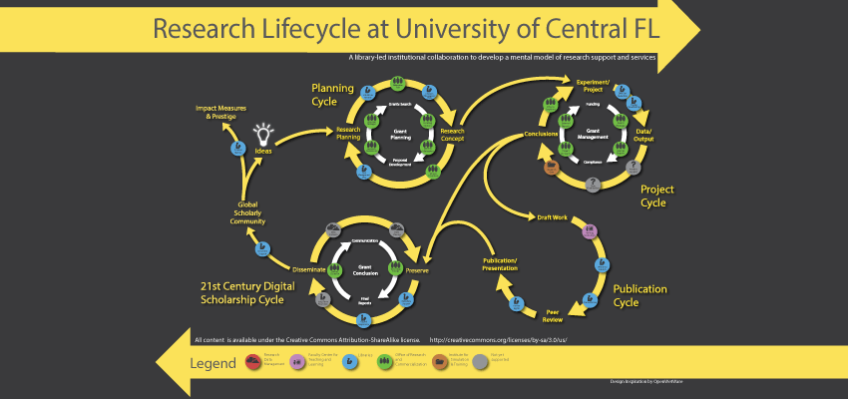
Explore expansion of RLC (develop and customize for specific departments, colleges, etc.)

Slide 50
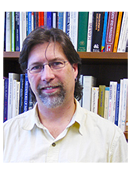
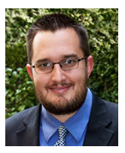


Utilize newly formed SC Faculty Advisory Board to proactively tackle goals and initiatives identified by SC

Slide 51
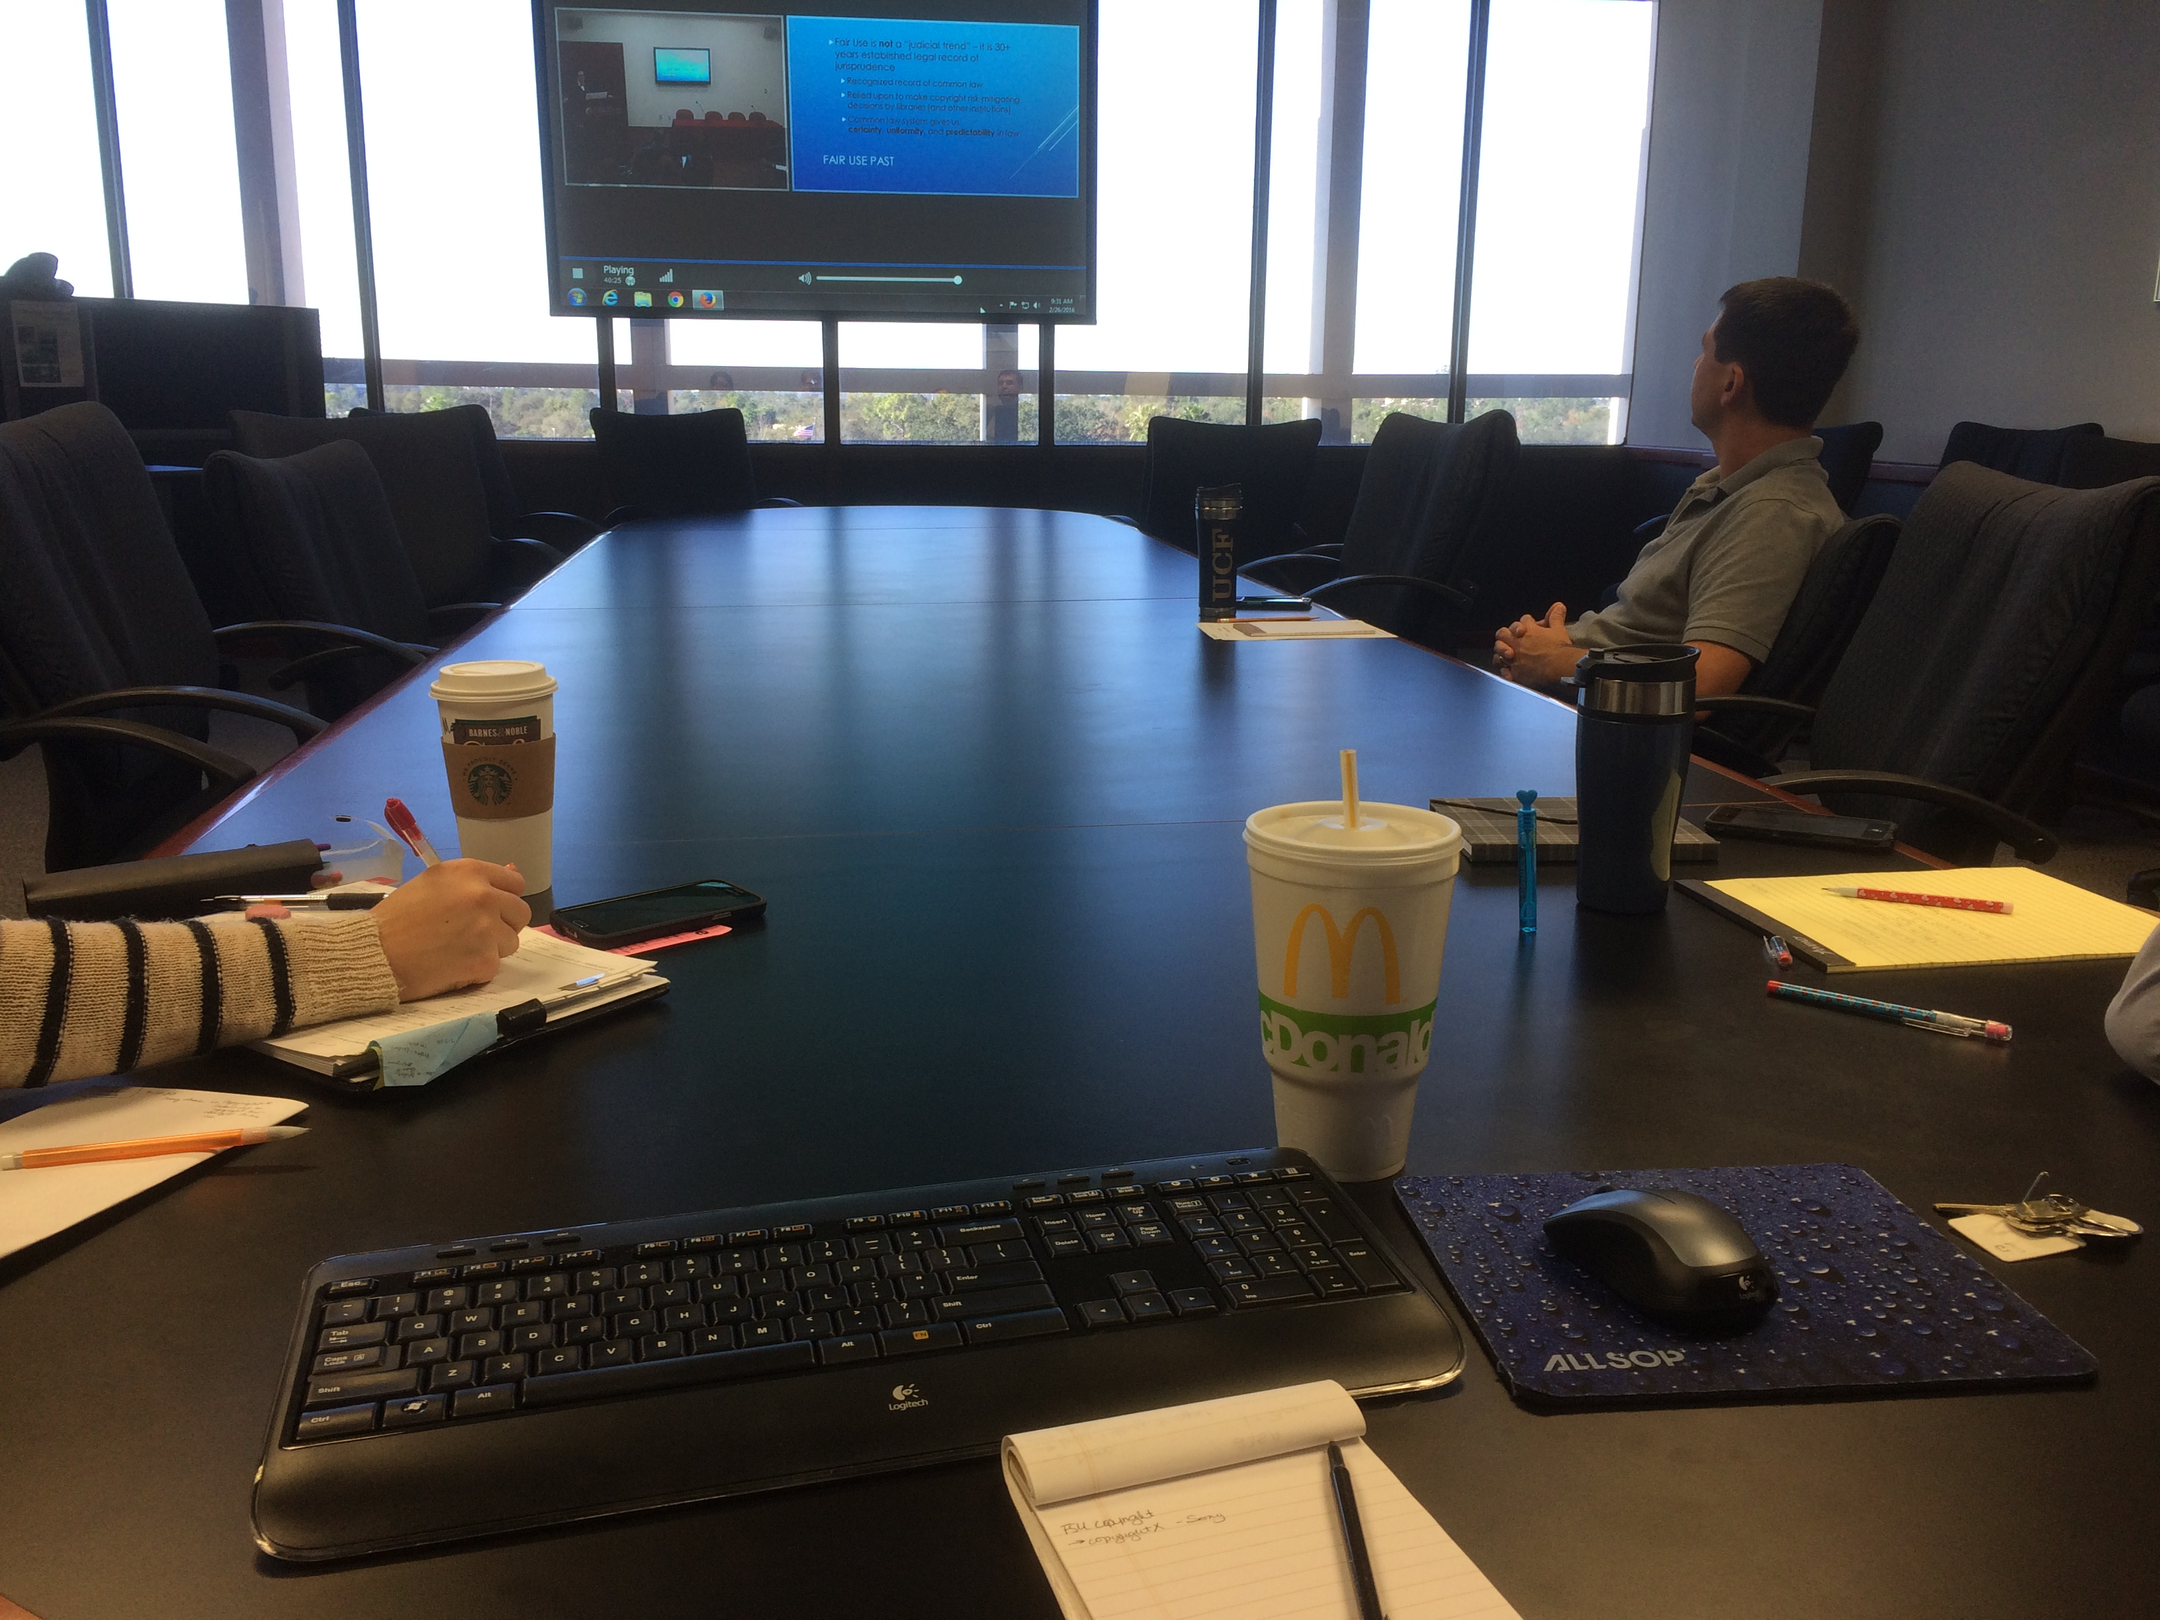
Create a more formal training program for library faculty and staff

Slide 52

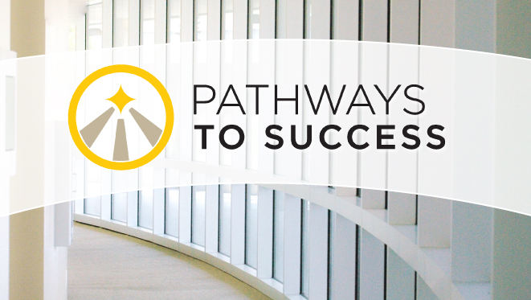

Work to cultivate strategic alliances across the campus community
  Partnering
    Grad Workshops
    Dissertation Forum
    THATCamp
  Relationship Building
    Departmental meetings (with subject librarians)
    Ad-hoc presentations

Slide 53
Work to cultivate strategic alliances across the campus community

Slide 54
Library Scholarly Communication Advisory Group

Slide 55
Questions?
University of Central Florida Libraries
Ven Basco Buenaventura.Basco@ucf.edu
Lee Dotson Lee.Dotson@ucf.edu
Sarah Norris Sarah.Norris@ucf.edu
Barbara Tierney Barbara.Tierney@ucf.edu
John Venecek John.Venecek@ucf.edu

