Slide 1
GIL Express & ILL:
Odd Couple or Match Made in Heaven?
Kiara Bynum
Interlibrary Loan
Kennesaw State University
Ashley Hoffman
Interlibrary Loan
Kennesaw State University
Monica McLaurin
Circulation/GIL Express
Kennesaw State University
Notes:
Hello and welcome, everyone, to our presentation “GIL Express and ILL: Odd Couple or Match Made in Heaven?” My name is Ashley Hoffman and these are my colleagues Kiara Bynum and Monica McLaurin. Kiara works with me in ILL and Monica works with GIL Express. We’re going to talk a little bit today about what happens when GIL Express and ILL cause confusion for patrons and staff and what libraries in the university system are doing to ensure the two services play a little bit nicer together.

Slide 2
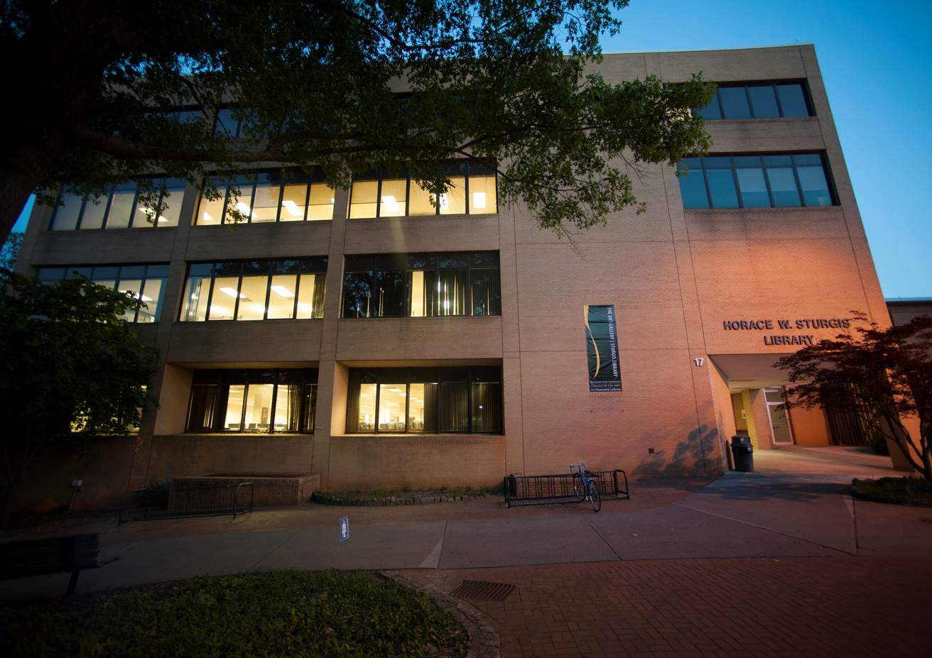
Introduction
Patrons
Process
Policies
Conclusion
BACKGROUND
Notes:
Poll the audience. How many people here do GIL Express? How many people do ILL? Or both? Chances are if you do either you’ve come across a confusing situation. Either a patron comes up to the desk wanting to know why the book they ordered didn’t come in – but they don’t know how they ordered it – or a mysterious book without a book band appears in the book drop.
Our library is no stranger to these problems. Like many of your libraries, our ILL unit and GIL Express unit are two separate entities with their own offices, contact people, and phone numbers. I can’t speak for the GIL Express unit, but our ILL department was constantly getting calls and walk ins from patrons with problems with books that ultimately turned out to be from GIL Express. Basically, Kiara and I wanted to get to the bottom of this and see if there were some solutions out there that could help GIL Express and ILL coexist peacefully at our library.

Slide 3

The Survey
Introduction
Patrons
Process
Policies
Conclusion
32 libraries contacted
5 with no responses
When possible, contacted both GIL and ILL
Notes:
Kiara and I enlisted the help of Monica in the GIL Express unit to come up with some issues that caused confusion between ILL and GIL Express in our library. We came up with a list of questions spanning issues affecting patrons, issues affecting the processing of books, and issues affecting our policies. We called or emailed 32 libraries in the USG system and were very pleased that we talked to someone from every library but 5. When possible, we talked to someone from both the GIL and ILL departments. And as we learned, that someone was often the same person!
What follows is our findings. We have divided the issues into three categories: Patron, Process, and Policies. We’ll begin first by overviewing the common complaints in that category, then we’ll reveal a list of solutions suggested by us or by some of the libraries we interviewed. We’ll also present some data on our survey, then end each section with a short discussion for you all to give your feedback on some of the suggestions presented. I’ll hand it over to Kiara to start us off discussing problems that affect patrons.

Slide 4
Introduction
Patrons
Process
Policies
Conclusion
Patron Problems

Slide 5
Common Complaints
Introduction
Patrons
Process
Policies
Conclusion
Unaware/confused about the two services
Unsure whom to contact with questions
Prefer all of their requests in one account
Prefer consistent and uniform notifications

Slide 6
Possible Solutions
Introduction
Patrons
Process
Policies
Conclusion
Combine ILL and GIL Express departments
  Schools where one person did both GIL Express and ILL had the fewest problems

Slide 7
Survey Results
Introduction
Patrons
Process
Policies
Conclusion
Notes:
11 combined, 5 one person
11 separate
5 no answer

Slide 8
Possible Solutions
Introduction
Patrons
Process
Policies
Conclusion
Combine ILL and GIL Express departments
More GIL/ILL content in instruction classes, information on the web page, and educating the professors
  STOP sign on the ILL log-in page asking patrons if they’ve tried GIL Express

Slide 9
Possible Solutions
Introduction
Patrons
Process
Policies
Conclusion
Combine ILL and GIL Express departments
More GIL/ILL content in instruction classes, information on the web page, and educating the professors
Cross-training of GIL Express and ILL staff
  Combined service desk

Slide 10
Possible Solutions
Introduction
Patrons
Process
Policies
Conclusion
Combine ILL and GIL Express departments
More GIL/ILL content in instruction classes, information on the web page, and educating the professors
Cross-training of GIL Express and ILL staff
Thoughts?

Slide 11
Introduction
Patrons
Process
Policies
Conclusion
Problems with Process
Notes:
Thank you, Kiara. We’ve just discussed how GIL Express and ILL can cause confusion for patrons, but it can also be a headache for staff. Here are some of the most common complaints we heard about processing GIL and ILL.

Slide 12
Common Complaints
Introduction
Patrons
Process
Policies
Conclusion
Hassle directing patrons to separate retrieval locations
Difficulty determining which service the patron used
Mistaken return of ILL books through GIL Express
Notes:
At some libraries, ILL and GIL books are not shelved together on the same shelf – or even behind the same desk. Libraries where ILL books were shelved separately reported the annoyance of having to direct patrons who come up to the Circulation Desk to the ILL office or Reference Room to pick up ILL books.
Another common complaint was patrons approaching the desk for help without knowing which service they had used to request a book. I have often had to ask a patron to show me the notification email they received on their cell phone! Especially at libraries where ILL software is not installed on the Circulation desk computers, a simple question from a patron on renewing a book can result in a trip to the ILL office – only to discover that it was actually a GIL Express book (or even a book on hold from their own library!!).
The most common complaint from ILL staff was the return of ILL books through GIL Express. The problem is so common that any time a patron calls to complain about a book they returned not registering in their account, I look to see if it was from a USG school before I answer. 9 times out of 10 it was returned through GIL!
So what are some possible solutions to these problems? Here are few that we heard.

Slide 13
Possible Solutions
Introduction
Patrons
Process
Policies
Conclusion
Consolidate requested items in one place
  Interfile GIL Express, ILL, and hold books on the same shelf by patron last name
Notes:
To eliminate the problem of having to direct patrons to different places to pick up requested books, many libraries keep both their ILL and GIL books behind the Circulation desk. Some even file them together with hold books by patron last name, providing a “one stop shop” for patrons to pick up books without the Circulation Staff having to figure out which shelf they need to look on.

Slide 14
Survey Results
Introduction
Patrons
Process
Policies
Conclusion
Notes:
We polled the USG libraries and found out that only 8 of them (or 25%) file all books together by patron last name. 16 libraries said they kept ILL and GIL books on separate shelves, and 8 other libraries did not provide an answer to this question.

Slide 15
Possible Solutions
Introduction
Patrons
Process
Policies
Conclusion
Consolidate requested items in one place
Cross-training of GIL Express and ILL staff
  Ask Circulation staff to set aside books from other libraries if they are missing labels
Notes:
Another solution proposed was to simply cross train staff members in both departments so that they can help stop problems before they start. For example at our library we’ve asked our Circulation staff to put any mystery books from other libraries missing a book band in our basket. This way we’re hoping to catch any books that might accidentally be returned through GIL before they go. We haven’t caught any yet, but we’re hoping this prevents mistakes in the future!

Slide 16
Possible Solutions
Introduction
Patrons
Process
Policies
Conclusion
Consolidate requested items in one place
Cross-training of GIL Express and ILL staff
Combine GIL Express and ILL departments
  Schools where one person did both GIL Express and ILL had the fewest problems
Notes:
A more extreme solution would be to combine GIL Express and ILL departments altogether. The schools where only one person did both GIL Express and ILL had the fewest problems and were the most able to easily triage patron problems. An example of a bigger school that does this is Valdosta State, where the GIL staff and ILL staff share a work room and central phone number, which helps increase communication between the two services and prevent confusion.

Slide 17
Possible Solutions
Introduction
Patrons
Process
Policies
Conclusion
Consolidate requested items in one place
Cross-training of GIL Express and ILL staff
Combine GIL Express and ILL departments
  Thoughts?
Notes:
Now that we’ve gone over common problems dealing with the processing of ILL and GIL books we’re going to open up the floor to your feedback. Do you have thoughts on these suggestions or have another suggestion to add?

Slide 18
Introduction
Patrons
Process
Policies
Conclusion
Problems with Policy

Slide 19
Common Complaints
Introduction
Patrons
Process
Policies
Conclusion
Use of ILL for GIL Express qualifying books
Duplicate requests through both services
Textbook requests through GIL Express
Blocks do not transfer between systems

Slide 20
Possible Solutions
Introduction
Patrons
Process
Policies
Conclusion
Intercept misdirected borrowing requests
  Cancel ILL requests that could be requested through GIL Express

Slide 21
Survey Results
Introduction
Patrons
Process
Policies
Conclusion
Notes:
22 % will cancel
47% will put the request through

Slide 22
Possible Solutions
Introduction
Patrons
Process
Policies
Conclusion
Intercept misdirected borrowing requests
Agree to limit textbook borrowing
  All USG libraries agree not to loan textbooks published in last few years

Slide 23
Possible Solutions
Introduction
Patrons
Process
Policies
Conclusion
Intercept misdirected borrowing requests
Agree to limit textbook borrowing
Create uniform policy for blocking
  UGA and Georgia State have a mechanism that informs ILLiad when user has block or fine in Voyager

Slide 24
Survey Results
Introduction
Patrons
Process
Policies
Conclusion

Slide 25
Possible Solutions
Introduction
Patrons
Process
Policies
Conclusion
Intercept misdirected borrowing requests
Agree to limit textbook borrowing
Create uniform policy for blocking
Thoughts?

Slide 26
Introduction
Patrons
Process
Policies
Conclusion
Long Term Solutions

Slide 27
Long Term Solutions?
Introduction
Patrons
Process
Policies
Conclusion
Limit patron usage of ILL
  Make ILL the exception, not the rule for books
ILS that incorporates Interlibrary Loan
Eliminate GIL Express and process through ILL
  ILLiad Direct Request

Slide 28
Survey Results
Introduction
Patrons
Process
Policies
Conclusion

Slide 29
Open Discussion
Introduction
Patrons
Process
Policies
Conclusion

Slide 30
THANK YOU!
Kiara Bynum
Interlibrary Loan
Kennesaw State University
(770) 794-7944
kbynum@kennesaw.edu
Ashley Hoffman
Interlibrary Loan
Kennesaw State University
(678) 797-2004
ahoffm18@kennesaw.edu
Monica McLaurin
Circulation/GIL Express
Kennesaw State University
(770) 423-6662
mmclauri@kennesaw.edu

