Slide 1
SIGCSE and computer science education research
Amber Settle
DePaul University
SIGCSE chair, 2016-2019

Slide 2
ACM and SIGCSE
SIGCSE is a Special Interest Group (SIG) of the Association for Computing Machinery
  “SIGs represent major areas of computing, addressing the interests of technical communities that drive innovation.”
  https://www.acm.org/special-interest-groups
SIGCSE is the SIG on computer science education
  SIGCSE provides a forum for educators to discuss issues related to the development, implementation, and/or evaluation of computing programs, curricula, and courses, as well as syllabi, laboratories, and other elements of teaching and pedagogy.
  https://sigcse.org/sigcse/

Slide 3
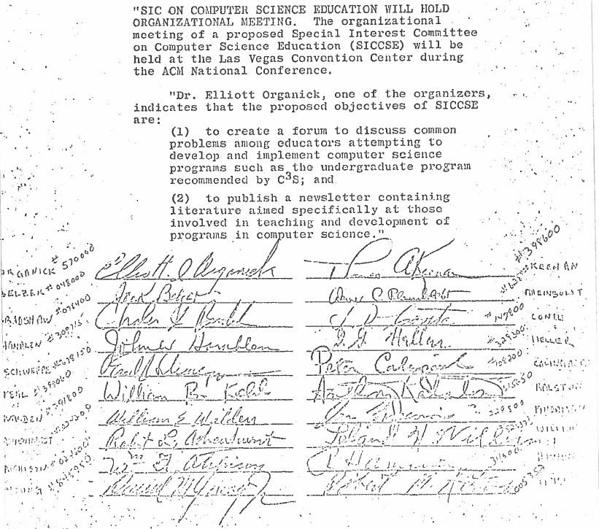
The founding of SIGCSE
In 1968 a group of computing educators met at the Fall Joint Computer Conference (FJCC) in Las Vegas to write and sign a petition that eventually led to the creation of SIGCSE.
The original petition was for the creation of a Special Interest Committee (SIC). The petition was signed by 20 ACM members.

Slide 4
SIGCSE membership
Third largest membership of all ACM SIGs
More than 2700 members from over 70 countries
Area | Count | Percent
North America | 2288 | 84%
Europe | 248 | 9%
Asia | 80 | 3%
Australasia | 55 | 2%
South and Central America | 28 | 1%
Africa | 15 | 0.6%
Caribbean, Middle East | 0 | 0.3%
Total | 2723 | 100%

Slide 5
Benefits of SIGCSE membership
Reduced registration at SIGCSE conferences
Annual CD with proceedings of all SIGCSE conferences
ACM Inroads
SIGCSE Bulletin
Free access to SIGCSE publications in ACM Digital Library
Access to SIGCSE mailing lists
Eligibility to apply for grants
See: https://sigcse.org/sigcse/membership/benefits

Slide 6
SIGCSE Technical Symposium
Four-day event
February or March
North America
Both research and practitioners
Types of submissions
  Papers
  Panels
  Workshops
  Posters
  Lightning talks
Year | Location | Attendance
2012 | Raleigh, North Carolina | 1286
2013 | Denver, Colorado | 1183
2014 | Atlanta, Georgia | 1282
2015 | Kansas City, Missouri | 1285
2016 | Memphis, Tennessee | 1253
2017 | Seattle, Washington | 1501
2018 | Baltimore, Maryland | 1731

Slide 7
Common topics at the SIGCSE Symposium
CS4All
  Policies, curricula, teacher training and support, funding, evaluation of pedagogy
  Somewhat U.S.-centric but includes contributions from around the globe
CS1
  First programming course for CS majors at a post-secondary institution
  Innovative pedagogies, recruitment and retention of underrepresented groups, impact of prior experience on success, methods of providing feedback to students, predicting performance and retention, understanding and reacting to errors

Slide 8
Common topics at the SIGCSE Symposium
Recruitment and retention of underrepresented groups
  Varies by country and culture
  Gender, ethnic background, disability, and race
  Curricula, outreach programs, mentoring, etc.
Tools for teaching computer science
  Very broad topic
  Automated grading, automated generation of exercises, etc.
Specialized courses
  Cybersecurity, systems, parallel computing, computing in the cloud, visualization, service learning, etc.

Slide 9
Innovation in Technology Education Conference (ITiCSE)
Three-day event
June or July
Mostly Europe
Both research and practitioners
Types of submissions
  Papers
  Panels
  Posters
  Lightning talks
  Working groups
Similar topics to the Symposium, but not as U.S.-centric
Year | Location | Attendance
2012 | Haifa, Israel | 215
2013 | Canterbury, UK | 182
2014 | Uppsala, Sweden | 176
2015 | Vilnius, Lithuania | 179
2016 | Arequipa, Peru | 166
2017 | Bologna, Italy | 228
2018 | Larnaka, Cyprus | TBD

Slide 10
International Computing Education Research Workshop (ICER)
Three-day event
  Single-track
  Discussion at tables
August or September
North America (every other year), Europe (every fourth year), Australasia (every fourth year)
Research only
Types of submissions
  Papers
  Posters
  Lightning talks
Year | Location | Attendance
2012 | Auckland, New Zealand | 61
2013 | San Diego, USA | 66
2014 | Glasgow, UK | 79
2015 | Omaha, USA | 119
2016 | Melbourne, Australia | 105
2017 | Tacoma, USA | 157
2018 | Helsinki, Finland | TBD

Slide 11
What is computing education scholarship?
There are multiple types of computing education scholarship:
  Experience reports
    Describe a computer science education intervention and its context
    What worked and didn’t work?
    Why?
  Computer science education (CS Ed) research papers
    Adheres to rigorous standards
    Describes hypotheses, methods, and results
    May include evaluation of interventions with statistically rigorous approaches
    May do a qualitative analysis of an intervention and its results

Slide 12
Commonalities for all computing education research
A clear description of the context for the intervention
A clear description of what the intervention entailed
Placement of the study into existing literature
Evidence that supports (or demonstrates a lack of support) for the effectiveness of the intervention
A summary of results

Slide 13
Unique to CS Ed research
A clear theoretical basis
A strong empirical basis, drawing on relevant research methods
  Large data sets and statistical analysis
  Small data sets using qualitative methods
A strong contribution to existing knowledge about computer science education
A description of the limitations of the work

Slide 14
Where do you publish computing education scholarship?
SIGCSE conferences
CS Ed journals
  For longer and more in-depth work
  ACM Transactions on Computing Education
    https://toce.acm.org/
  Computer Science Education
    https://www.tandfonline.com/loi/ncse20
ACM Inroads
  https://inroads.acm.org/
  For more accessible work, position papers, summaries
  Provided as a membership benefit for all SIGCSE members
https://sigcse.org/sigcse/resources/publications

Slide 15
Other SIGCSE communication channels
SIGCSE Bulletin
  https://sigcse.org/sigcse/about/bulletin
  Quarterly newsletter first published in 1969
  Activities, events, interviews with SIGCSE members, etc.
SIGCSE mailing lists
  https://sigcse.org/sigcse/membership/mailing-lists
  Threads about teaching, resources, questions, etc.

Slide 16
My advice to you
Attend a SIGCSE conference
  Attend panels
  Network with people
Read papers from a SIGCSE conference
  Available for free in the ACM DL during the conference
Volunteer to review for a SIGCSE conference
  Make sure you’ve read papers from that conference first!
Submit to a SIGCSE conference
  Make sure you’ve read papers from that conference first!
  Posters and lightning talks are easy ways to get started

Slide 17
Questions?
Amber Settle
  asettle@cdm.depaul.edu
  http://facweb.cdm.depaul.edu/asettle/
SIGCSE
  https://sigcse.org/sigcse/

