Slide 1
What if? Scenarios & Higher Education

Slide 2
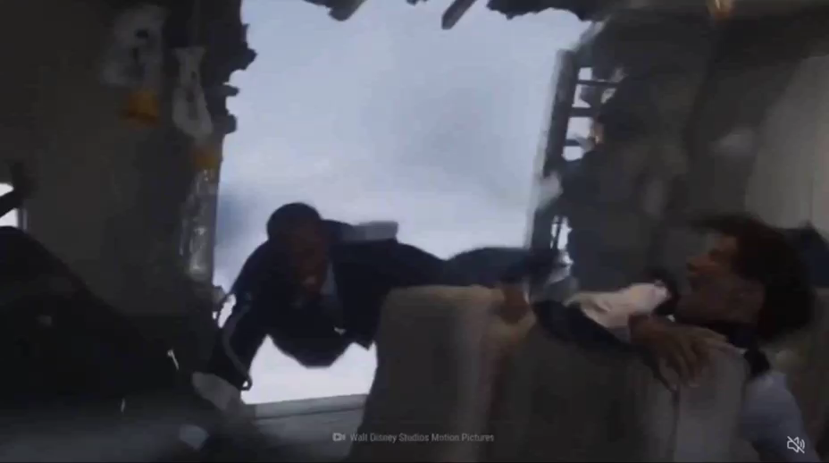
Notes:
https://www.msn.com/en-us/video/health/what-if-you-fell-out-of-an-airplane-at-30000-feet/vi-AA1e1dYV?ocid=mailsignout&t=46

Slide 3
What if we ran a microwave signal into Mexico?
-Cesar Chavez

Slide 4
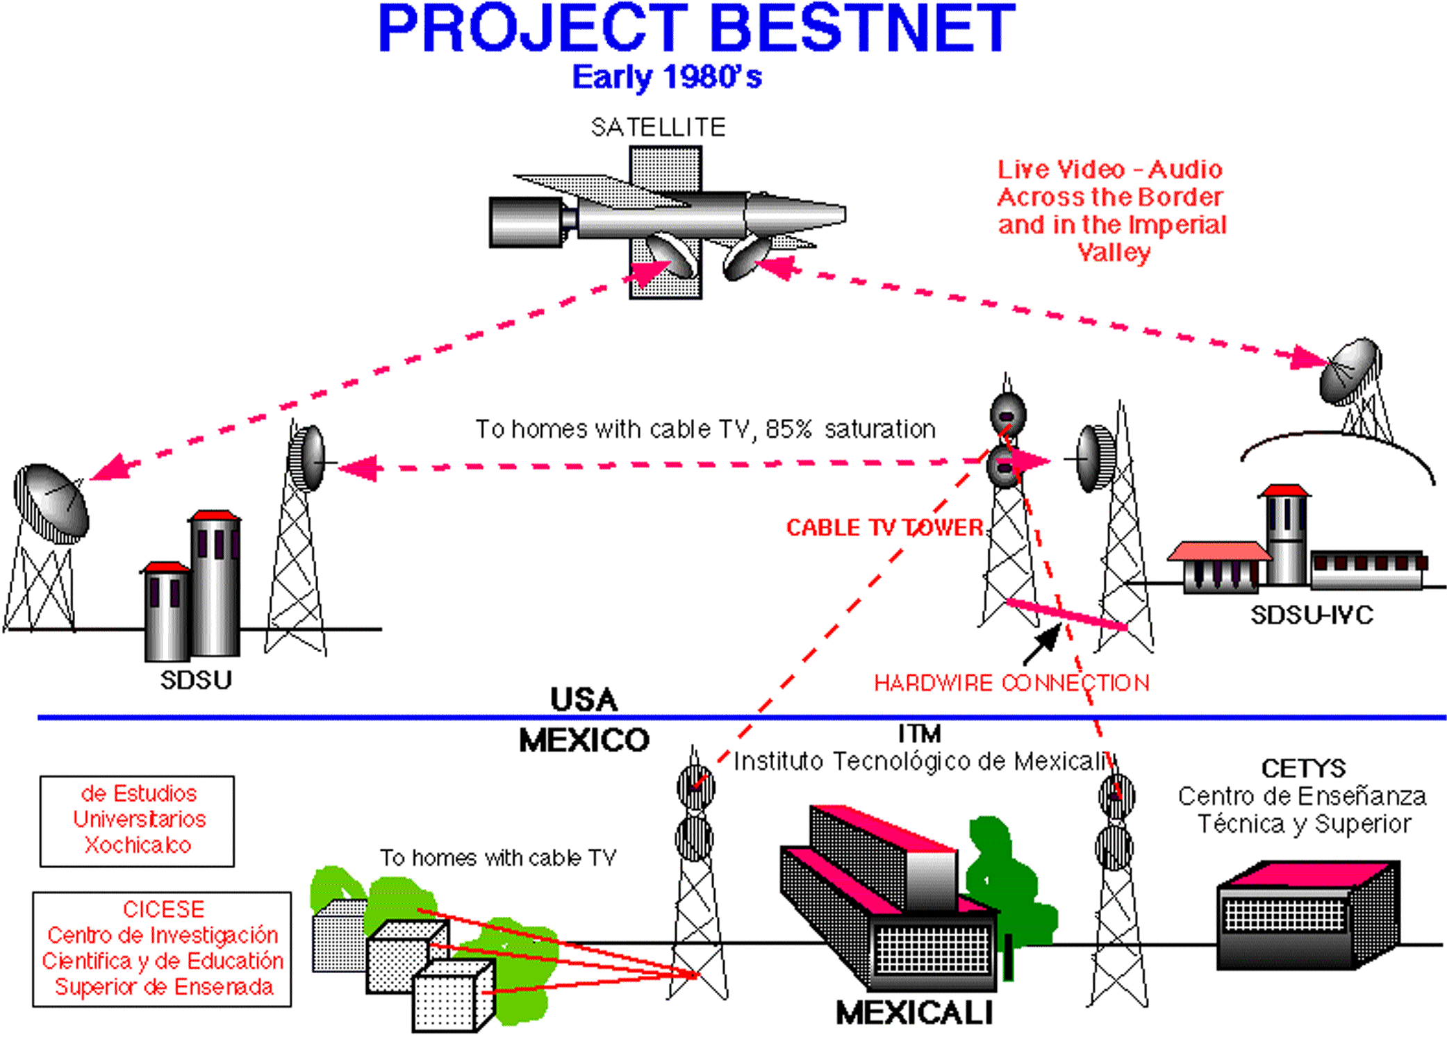
Image by A. Arias

Slide 5
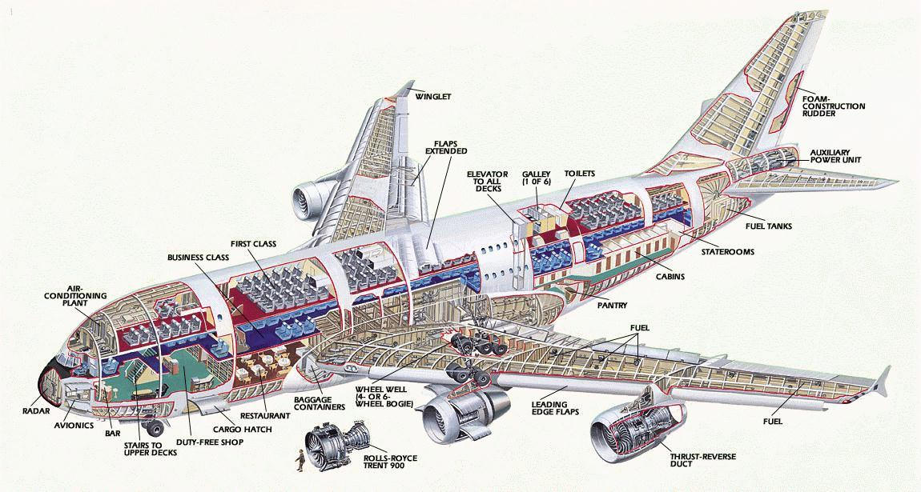
(Image of Airbus A380 from Barrie Aircraft Museum)

Slide 6
What if we took lessons learned from modelling jet aircraft and applied them to building new universities?

Slide 7
“From Swords to Plowshares”
Photo by A. Arias

Slide 8
What if? Voices of Change
Maria Montessori
John Dewey
Paulo Freire
Herbert Marcuse
Ann Richards
Salman Kahn

Slide 9
What if we started a new university with powerful core values in it’s Vision Statement?

Slide 10
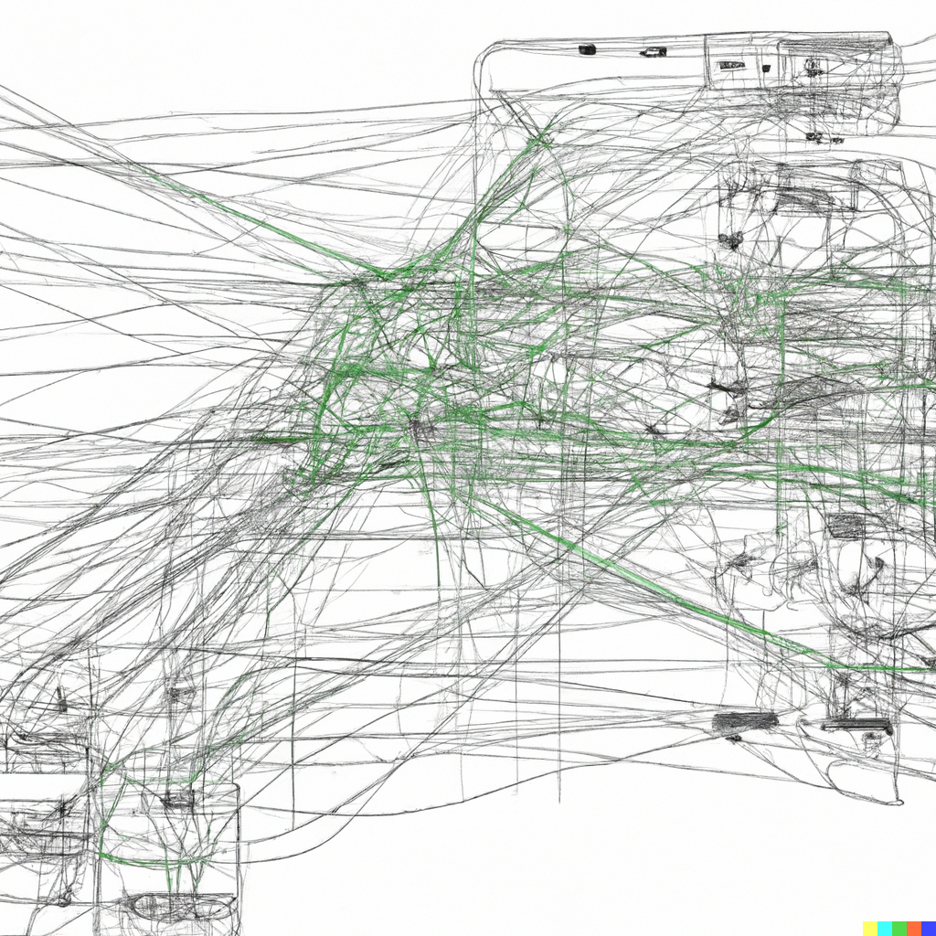
(Image created with DALL-E 2.)

Slide 11
What if we applied lessons learned from modelling jet aircraft and building new universities to the study of dementia?

Slide 12
What if we could reengineer thoughts for dementia patients?

Slide 13

What if? Scenarios as a Paradigm for Looking at Daily Life
(Image from istockphoto)

Slide 14
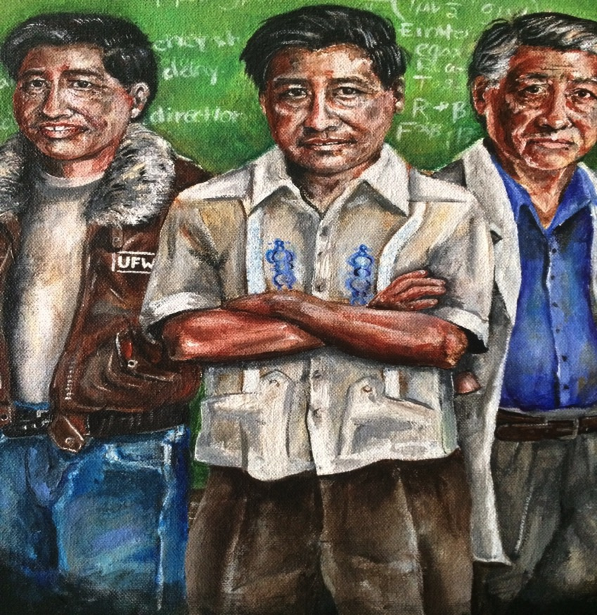
“It is my deepest belief that only by giving our lives do we find life.” - César E. Chávez

