Slide 1
Graduate Student Boot Camp
Clemson University Libraries
May 4th & 6th, 2009
Presentation for South Carolina Library Association (SCLA)
October, 2010

Slide 2

http://www.freedigitalphotos.net/images/view_photog.php?photogid=809
Notes:
Our dean got a suggestion from one of her meetings to have a boot camp to provide graduate students with information about campus resources.

Slide 3
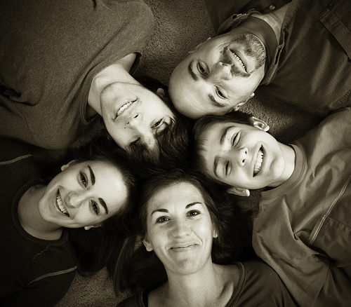
http://www.flickr.com/photos/life_is_good_pete/3068482355/sizes/m/in/photostream/
Notes:
As the instruction coordinator, I pulled together the reference unit to ask them their opinion on the workshop format.

Slide 4
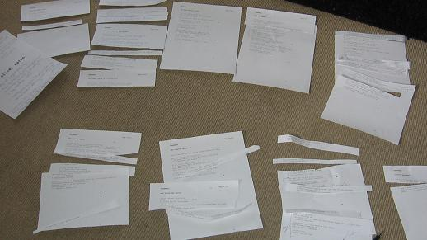
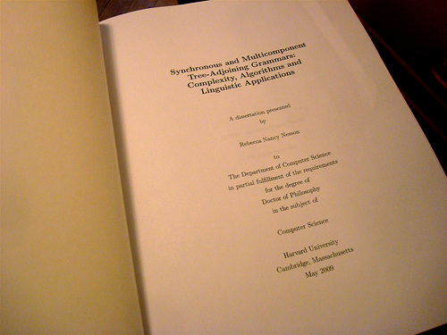
http://www.flickr.com/photos/greenlagirl/3153137546/sizes/o/in/photostream/
http://www.flickr.com/photos/wayneandwax/3573131007/sizes/m/in/photostream/
Notes:
When we looked at what other schools were doing, we noticed there was a big focus on writing for dissertations and theses. So, we decided to not only highlight library services, but also to work with other campus entities that might be able to help grad students. Initially, we sought to provide a multi-day workshop as many of the other schools, but it was difficult to find a time when we felt many graduate students would be available. We finally settled on providing a one day workshop that would fall after grades were due, but before graduation in May of 2009.

Slide 5
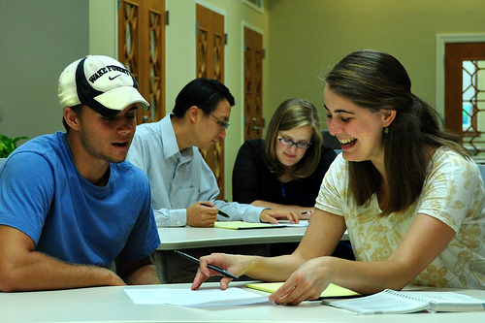

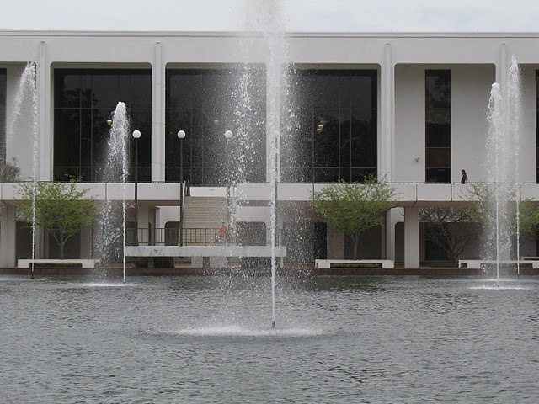


http://www.flickr.com/photos/cellphonesusie/4902772292/sizes/m/in/photostream/
Notes:
We contacted the Graduate School to ask them to come by and talk about the submission of theses/dissertations. We asked the Writing Center to come by and provide tips for writing. The Michelin Career Center came by to talk about searching for jobs after graduation. Then, from within the library, we had presentations about time management from our Psychology librarian who’s an ABD in Psychology, we had a general introduction to library resources and services, followed by meetings with subject librarians, there was a presentation on Plagiarism, copyright, and fair use, and finally, a RefWorks presentation.

Slide 6
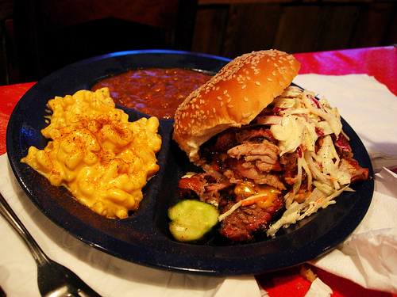

http://www.flickr.com/photos/wwny/1154890589/sizes/m/in/photostream/
Notes:
We weren’t sure what the turnout would be, so we decided to sweeten the day with lunch and a free tee-shirt.

Slide 7
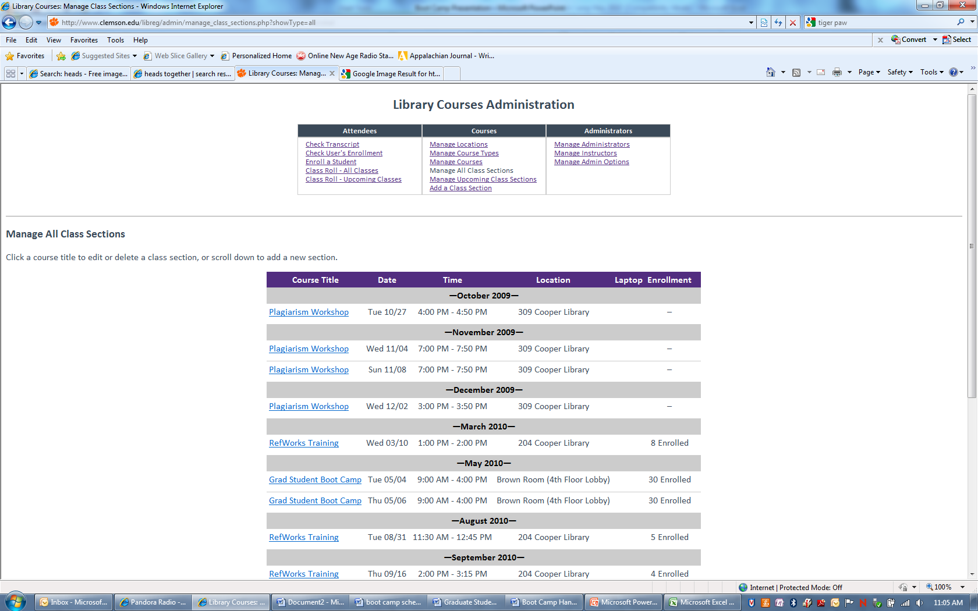
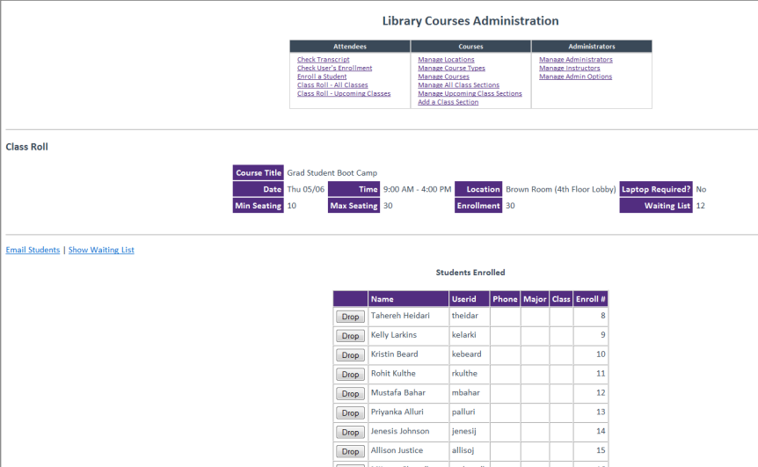
Notes:
We had a total of 37 out of 60 students show up for the boot camp. We gave them a survey to complete after the last session and got some valuable feedback. First and foremost, students said that it was a lot of information to take in for one day.

Slide 8

http://www.flickr.com/photos/andraspfaff/2266026377/sizes/m/in/photostream/
Notes:
We sent out an email to the graduate student advisors and were getting ready to make a public posting about the opportunity, but within the first 24 hours of sending the email to the grad student advisors, the session was full with a long waiting list! We immediately sought permission to offer the session a second time that week and within the next 48 hours, that one was full as well. We set the cap to the class at 30 each.

Slide 9
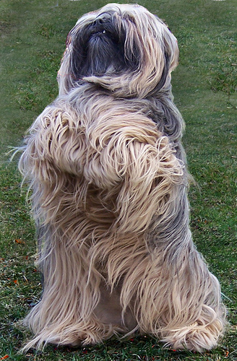
http://www.flickr.com/photos/psyberartist/2399976453/sizes/m/in/photostream/
Notes:
We had a total of 37 out of 60 students show up for the boot camp. We gave them a survey to complete after the last session and got some valuable feedback. First and foremost, students said that it was a lot of information to take in for one day.

Slide 10
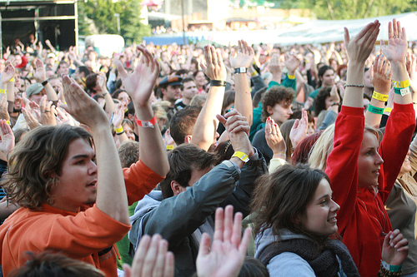
http://www.flickr.com/photos/ntr23/796311588/sizes/m/in/photostream/
Notes:
They enjoyed and appreciated lunch and they also liked seeing all of the resources available to them. Many commented that the career center was the most valuable piece of the day, as well as RefWorks.

Slide 11
Evaluation Response Summary
Notes:
Overall, we feel the day was quite successful and provided students not only with lots of useful information, but also with library contacts if they needed help. We hope to offer this workshop again in the Spring.

Slide 12
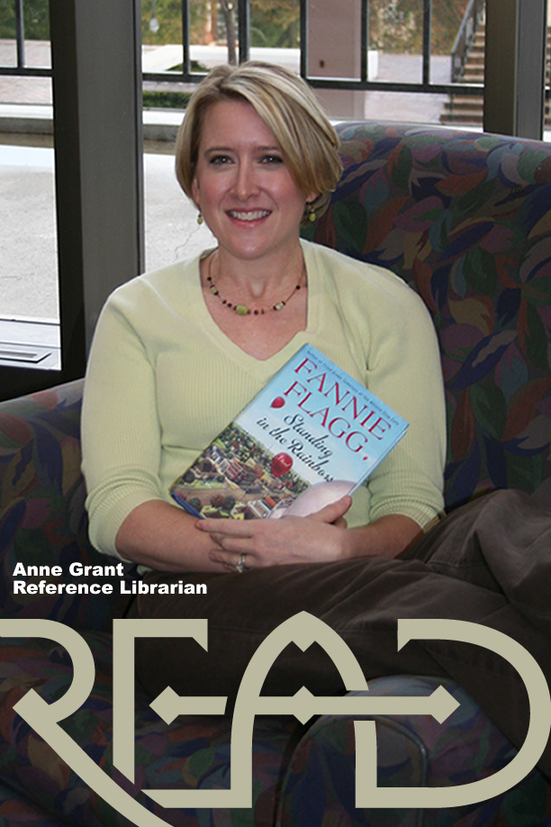
Questions?
Anne Grant
Clemson University Libraries
  864.656.6079
  anne1@clemson.edu

