Slide 1
Adventures in Assessment
LIB 100 @ Clemson University

Slide 2
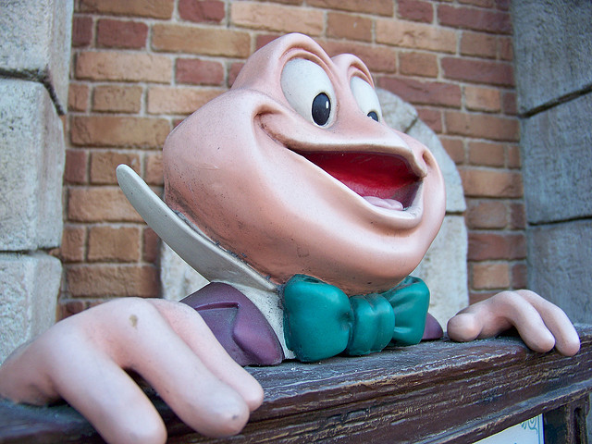
http://www.flickr.com/photos/lorenjavier/4104643327/

Slide 3
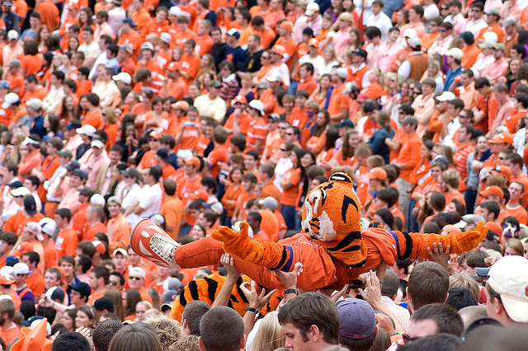
http://www.flickr.com/photos/mbsurf/3066402690/

Slide 4
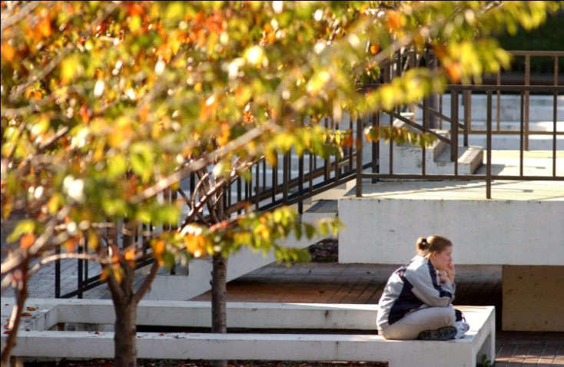
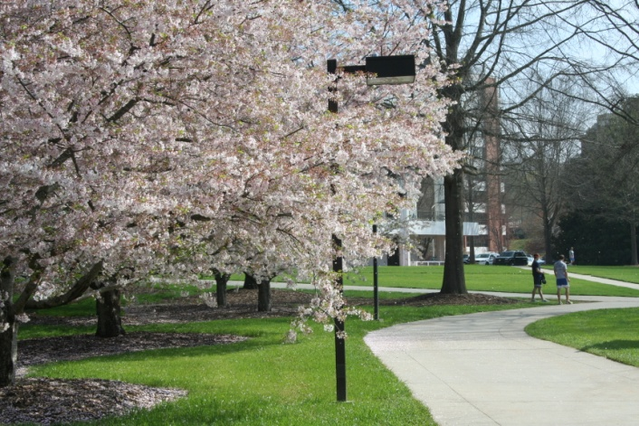
Fall Semester
= around 3,000 students
Spring Semester
= around 300 students

Slide 5
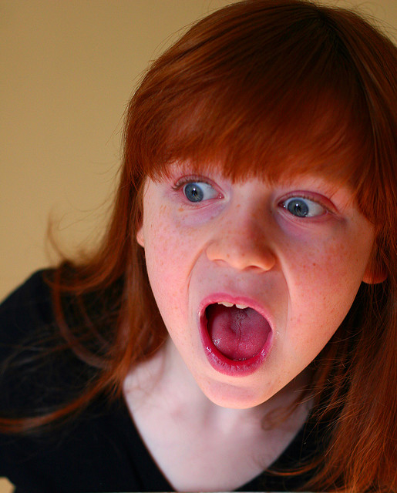
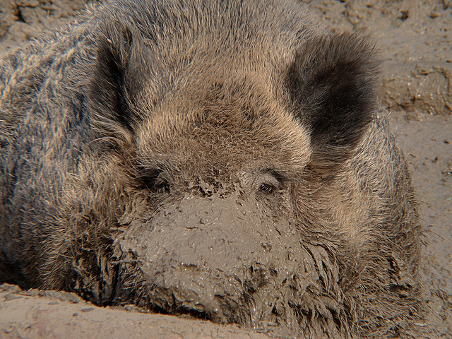
Then…and Now
Fall 2008
Fall 2011
10 Outcomes
43 Objectives
3 Outcomes
  Know about library services
  Use library to go beyond Google
  Critical Analysis of materials
http://www.flickr.com/photos/photon_de/3952153825/
http://www.flickr.com/photos/62337512@N00/4335060317/

Slide 6
In Class Activities We’ve Tried
Videos
Worksheets
Call Number activity
Article evaluation activity
Prize give-aways

Slide 7
Assessments We’ve Tried
Skills-Based
Confidence-Based
Open Ended Questions
Rubrics

Slide 8
Skills-Based Results
Fall 2008
Fall 2009

Slide 9
Confidence Based
Fall 2008
Fall 2008

Slide 10
Spring 2010

Slide 12
Open-Ended
Fall 2009
Spring2009

Slide 13

Spring 2010
http://www.flickr.com/photos/mutsmuts/4695658106/

Slide 14
Rubric
 | Basic (1) | Developing (2) | Proficient (3) | Score
Asking for help | Student is able to identify one way of asking for help, but cannot provide a good reason to ask for help | Student is able to identify two ways to contact a librarian and is able to show some idea of why they might need that help | Student is not only able to identify two ways to contact a librarian, but they also provide clear reasons why they might need help
Web Searches | Student is unable to clearly identify a viable way that the library can help supplement web searching and is unable to identify what you can find using OneSearch | Student is able to vaguely identify a way that the library can supplement web searching and can provide at least one source found in OneSearch | Student clearly identifies how the library can supplement web searching and is able to provide three sources found in OneSearch
Scholarly Resources | Student is able to offer one broad way to identify scholarly articles, but cannot provide a clear reason why is important to use them in their work | Student is able to basically articulate two ways to identify scholarly articles and shows a basic level of understanding of their importance | Student is able to clearly articulate two ways to identify a scholarly article and demonstrates a higher level of understanding of their importance
 |  |  | Total

Slide 15
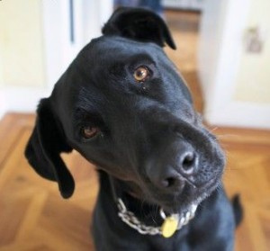

Slide 16
What’s Next?
What do we want the results to say that we are doing…or not doing?
What kinds of results do that?
  Skills? (not really…but sort of)
  Confidence (a bit more clear results)
  Open Ended (gives us…perhaps…and idea of what they are learning and what we need to focus on)
  Rubric (Not sure what this says specifically about what WE are doing)

Slide 17
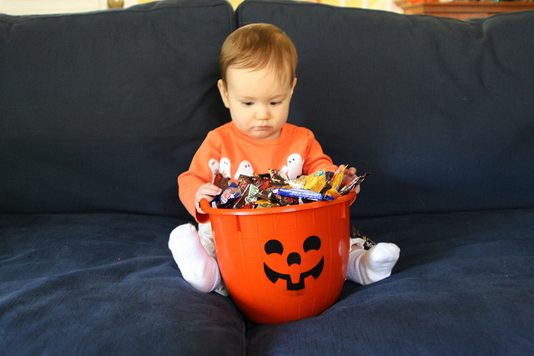
http://www.flickr.com/photos/bstark73/1857807913/

