Slide 1
Navigating the Impact Lifecycle
Ann Connolly
Director of Product
bepress
June 28, 2018

Slide 2
PROPOSE
EXPERIMENT
ANALYZE
INTERPRET
PUBLISH
VALIDATE
IMPACT

Slide 3


Slide 4
Make available
(Publish)

Slide 5


Slide 6

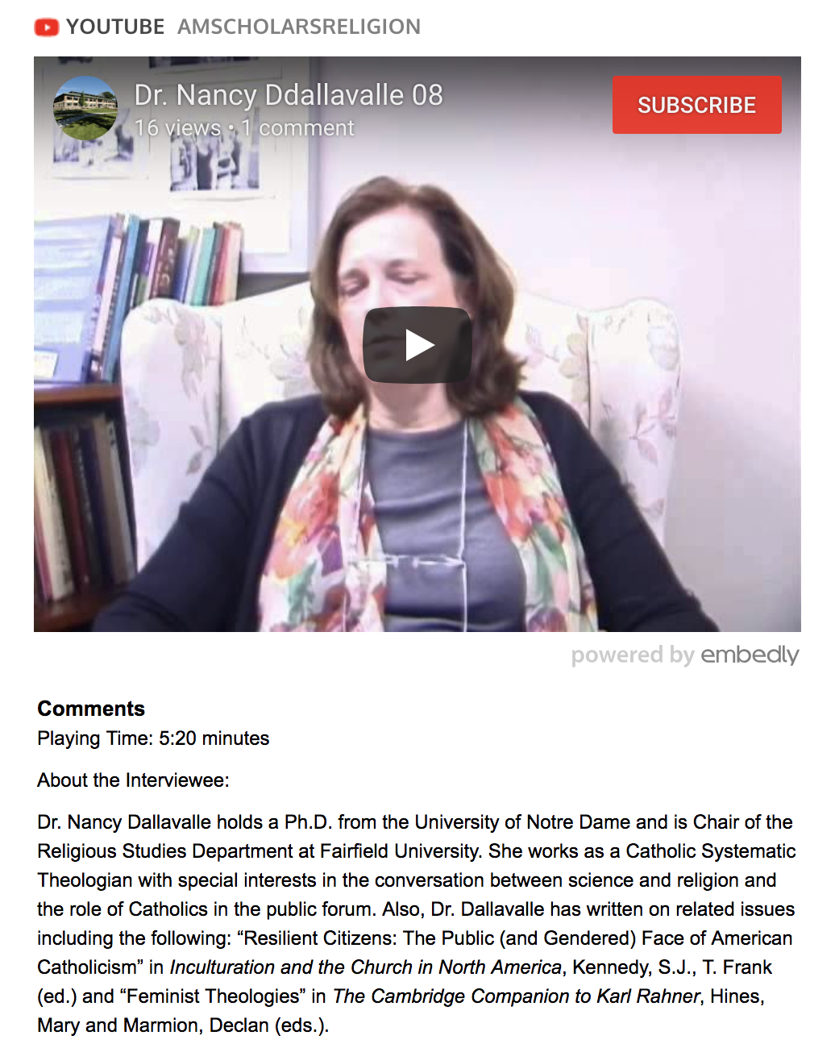


Slide 7
Make available
(Publish)
Generate impact

Slide 8


Slide 9


Slide 10
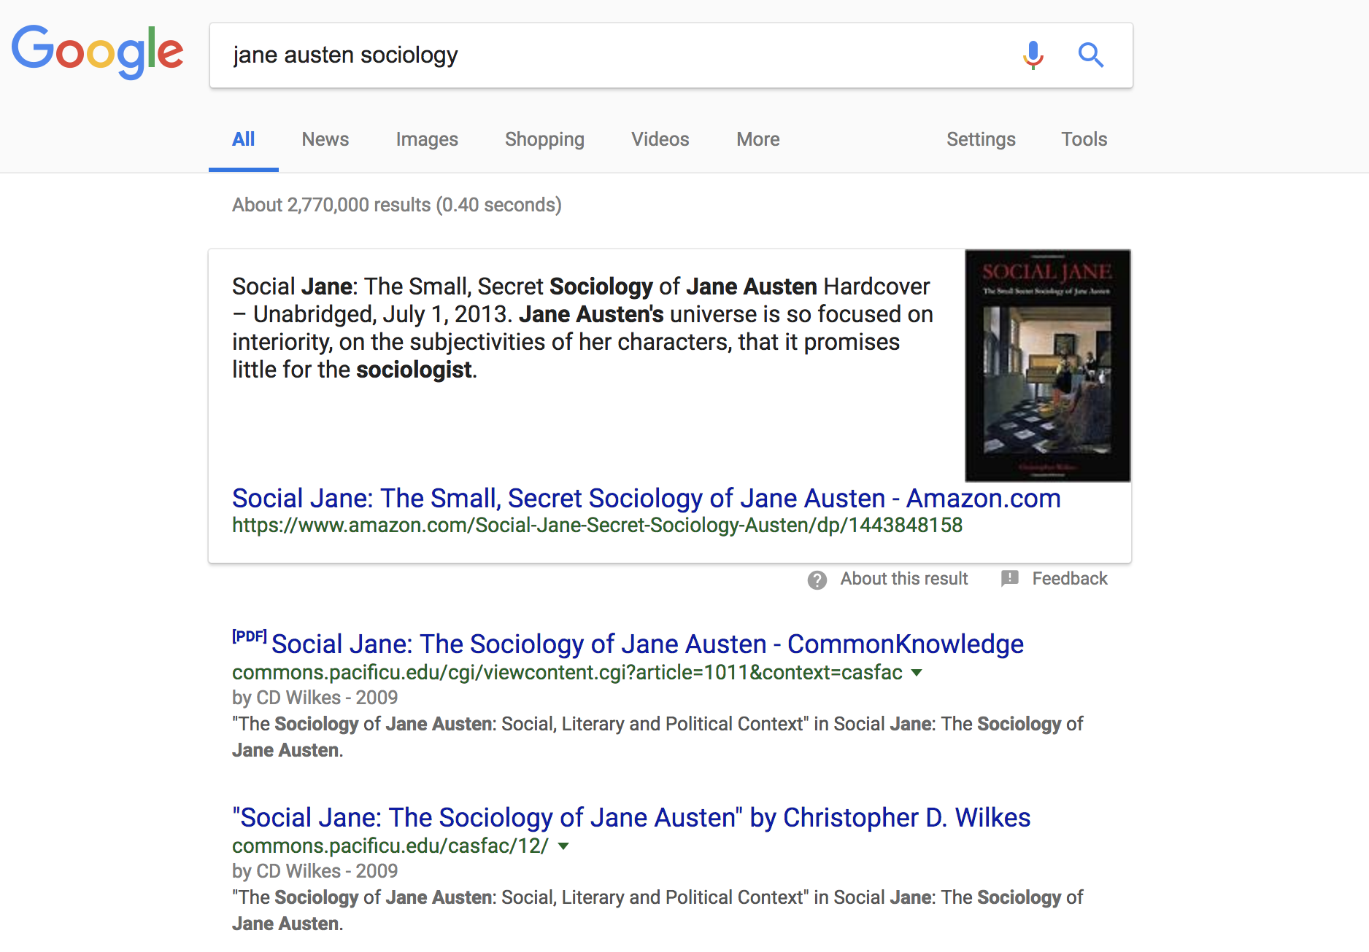

Slide 12


Slide 13
Make available
(Publish)
Generate impact
Share
Read
Share
Share
Read
Read

Slide 14
Make available
(Publish)
Generate
Measure impact

Slide 15


Slide 16
Make available
(Publish)
Generate
Measure
Share impact

Slide 17
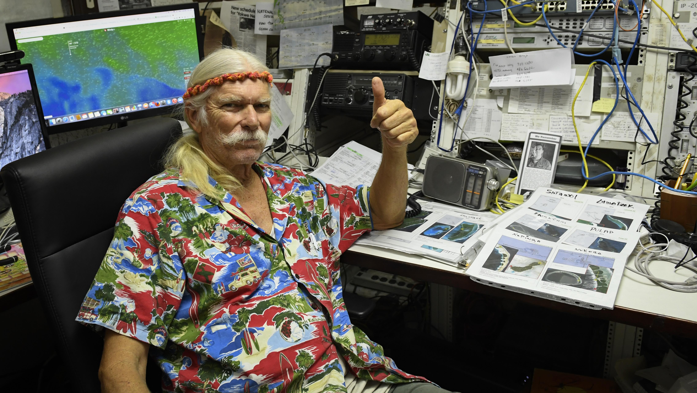

Slide 18

“What a pleasure it is to get these [readership] reports each month. It actually encourages me to write more, to keep at it. While I understand that a download doesn’t mean that someone actually read what I wrote, it is an indication of interest, and it answers the question that inevitably comes up when one is in the midst of completing something arduous---who cares, anyway?”
-Andrée Tremoulet, PhD, Research Associate & Adjunct Assistant Professor, Center for Urban Studies, School of Urban Studies and Planning at Portland State University

Slide 19

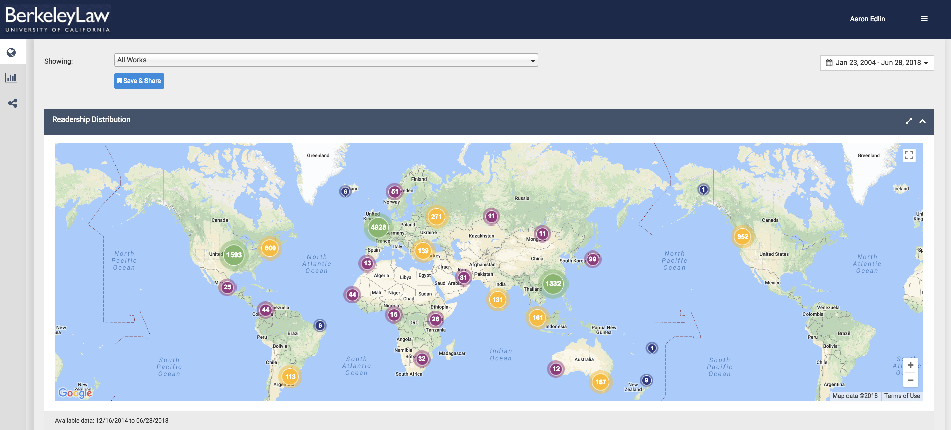

Slide 20
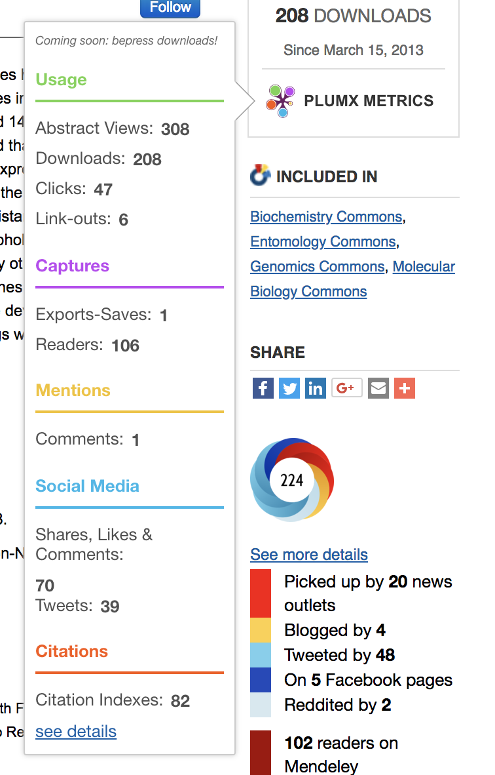

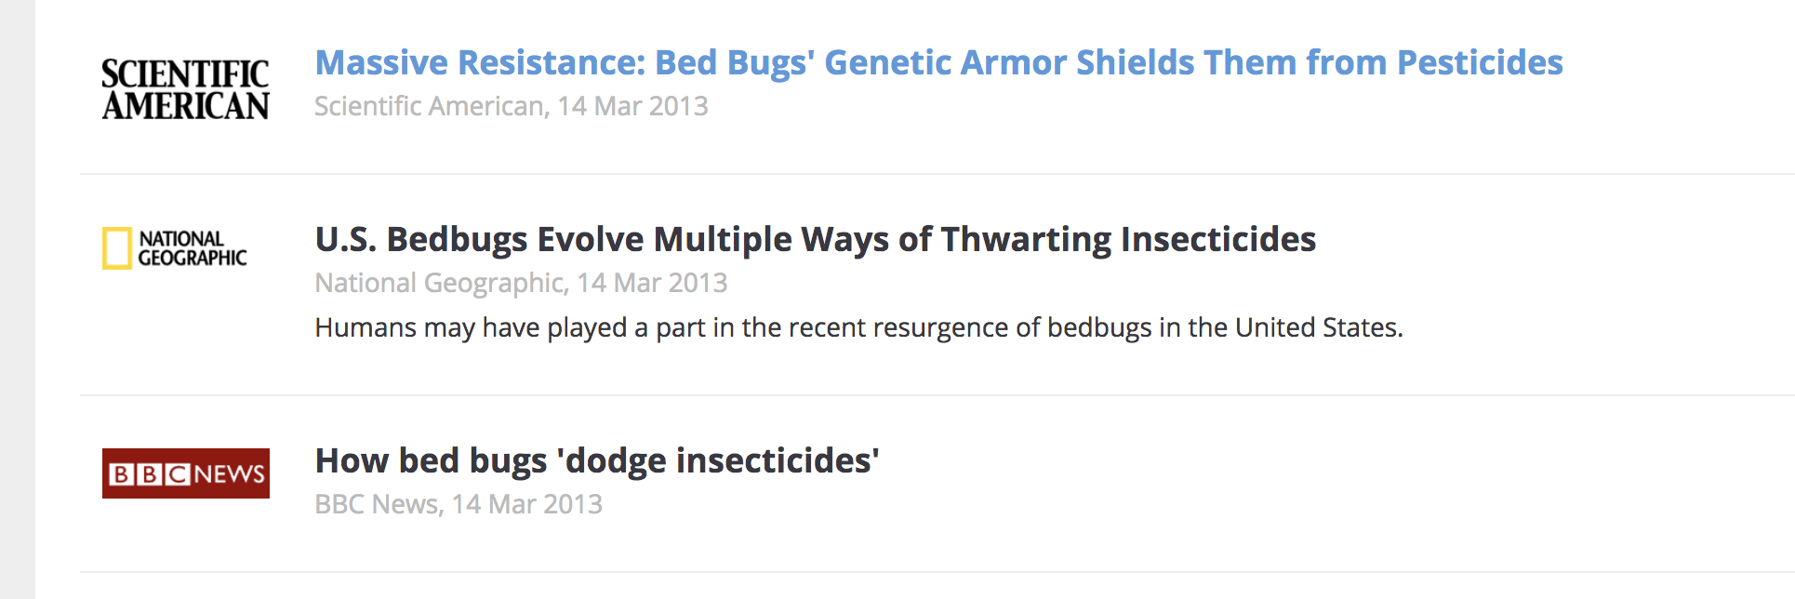
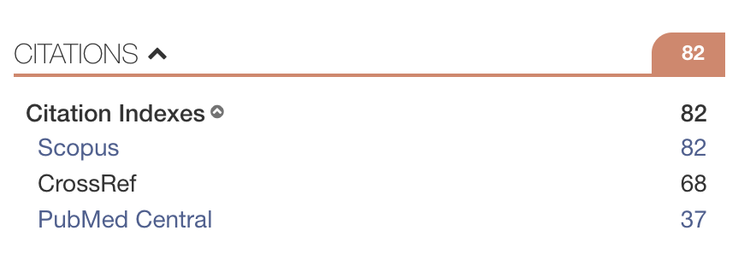

Slide 21
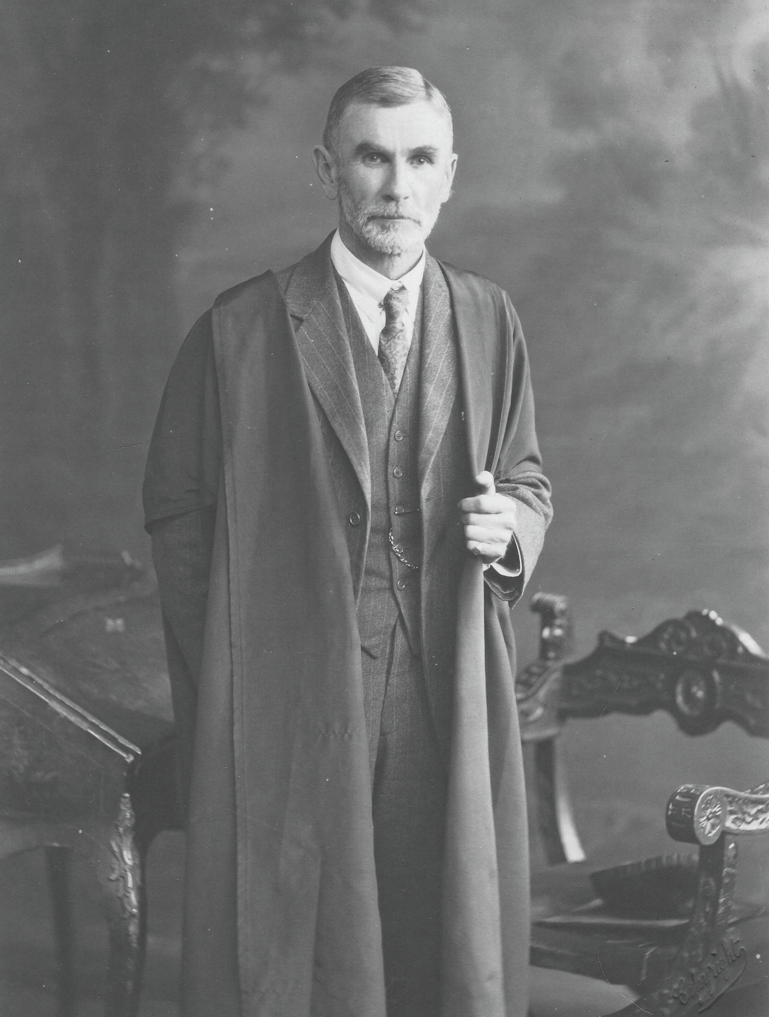
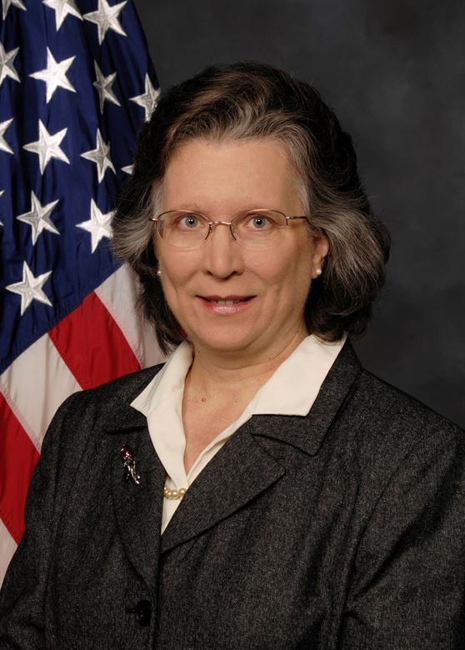


Slide 22


Slide 23
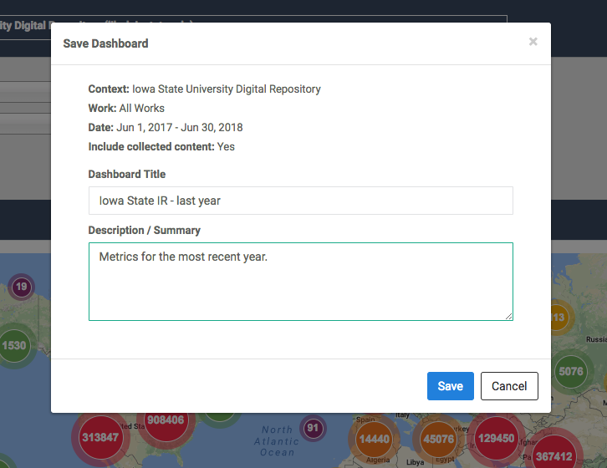
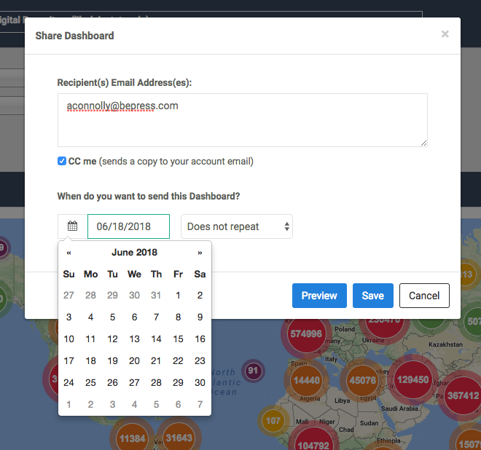
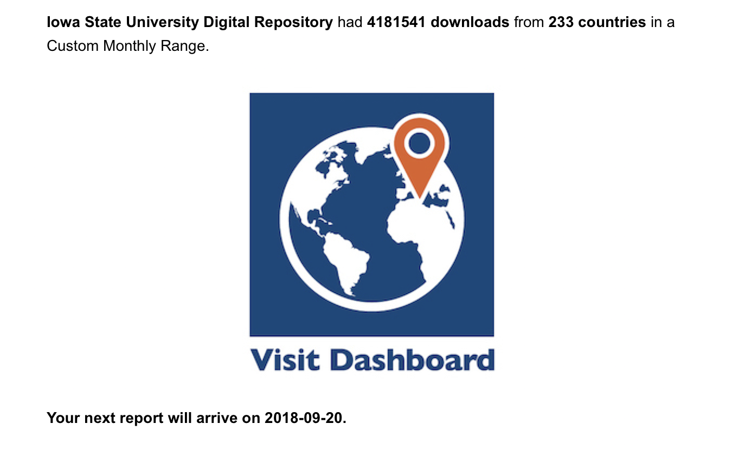
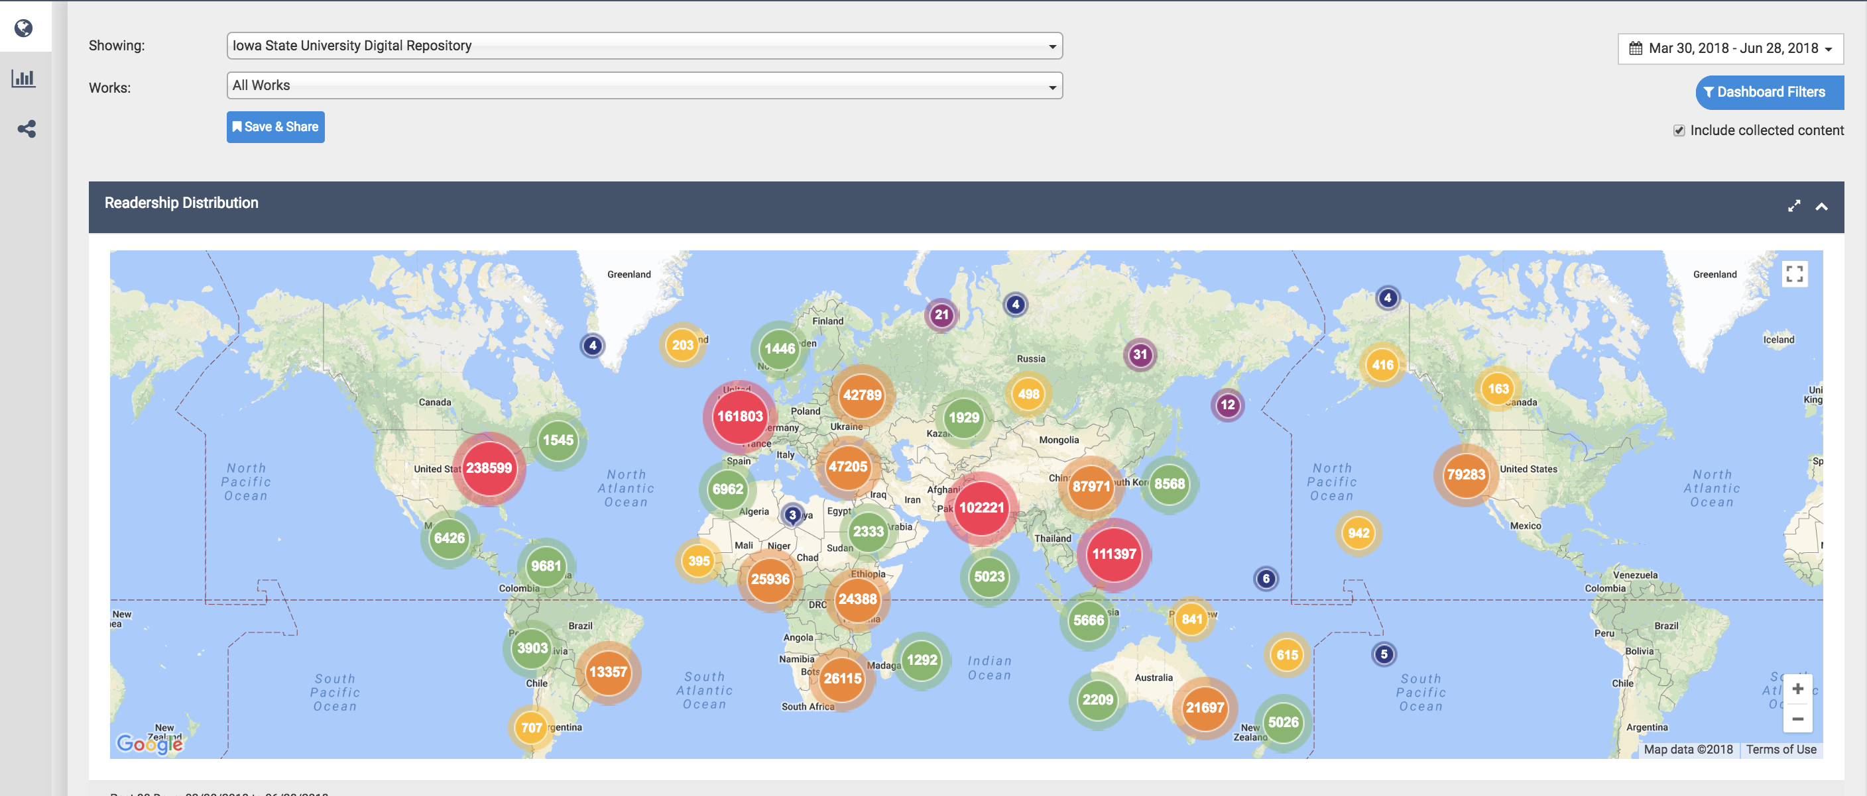
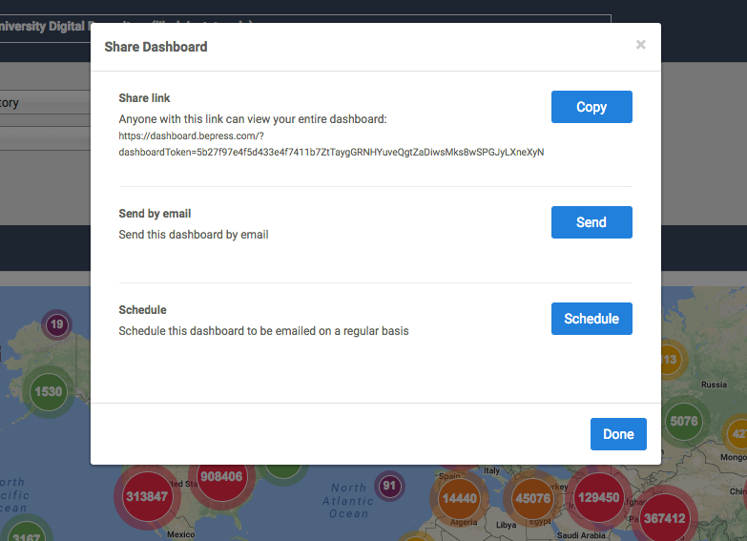
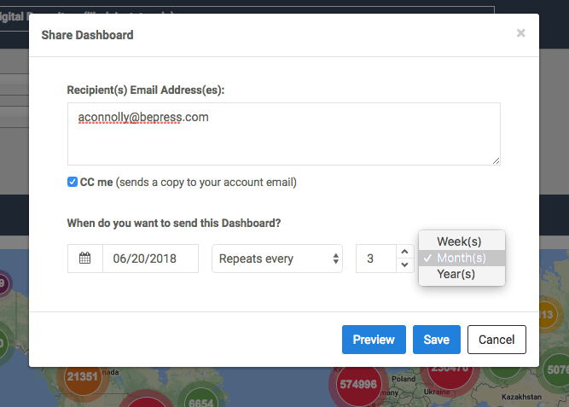
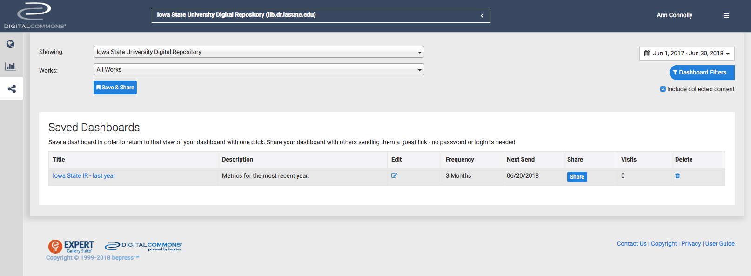

Slide 24
“The ability to customize the Dashboard view and frequency of the updates will allow us to tailor outreach to various audiences. For example, we will now have the ability to automatically schedule full STARS repository updates to be delivered to the UCF Scholarly Communications Faculty Advisory Board prior to its semi-annual meetings, share a selected journal update to be sent to editorial board members quarterly, and send discipline specific updates to our subject librarians on a monthly basis.”
– Lee Dotson, Digital Initiatives Librarian,
University of Central Florida

Slide 25
Sharing
Help visitors make decisions
Secure funding
Renew buy-in
Create excitement and engagement

Slide 26
Make available
Generate
Measure
Share

Slide 27
Make available
Generate
Measure
Share

Slide 28
Make available
Generate
Measure
Share

Slide 29
Make available
Generate
Measure
Share

Slide 30
Questions?
aconnolly@bepress.com

