Slide 1

Core Competencies at Every Stage
The Core Competencies for Electronic Resources Librarians (CCERL) has defined the role of an electronic resources librarian (ERL) and has served as a framework for additional applications. Three librarians will discuss how the competencies have impacted their careers.
Eleanor Cook, Assistant Director for Discovery & Technology Services
Angela Dresselhaus, Head of Electronic Resources
Rebecca Tatterson, Electronic Resources Librarian
East Carolina University

Slide 2
The Seasoned Career Librarian
Eleanor Cook

Slide 3

I was: Assistant Director for Collections & Technical Services
Departments that reported to me were:
Collection Development
Monographic Acquisitions/Preservation & Conservation
Electronic & Continuing Resources
Cataloging (General Collections + Special Collections)
Organizational change in 2013

Slide 4
AD for Discovery & Technology Services Departments reporting:
Cataloging (General Collections + Special Collections)
ILS Services
IT Operations
Applications & Digital Services
AD for Collections & Acquisitions Departments reporting:
Monographic acquisitions/Preservation & Conservation
Electronic & Continuing Resources
Collection Development
AD for Scholarly Communications Departments reporting:
Scholarly Communications
Three
Divisions

Slide 5
AD for Discovery & Technology Services – no change
AD for Collections & Scholarly Communications
Everything from the other two groups
Back to two Divisions, 2015

Slide 6
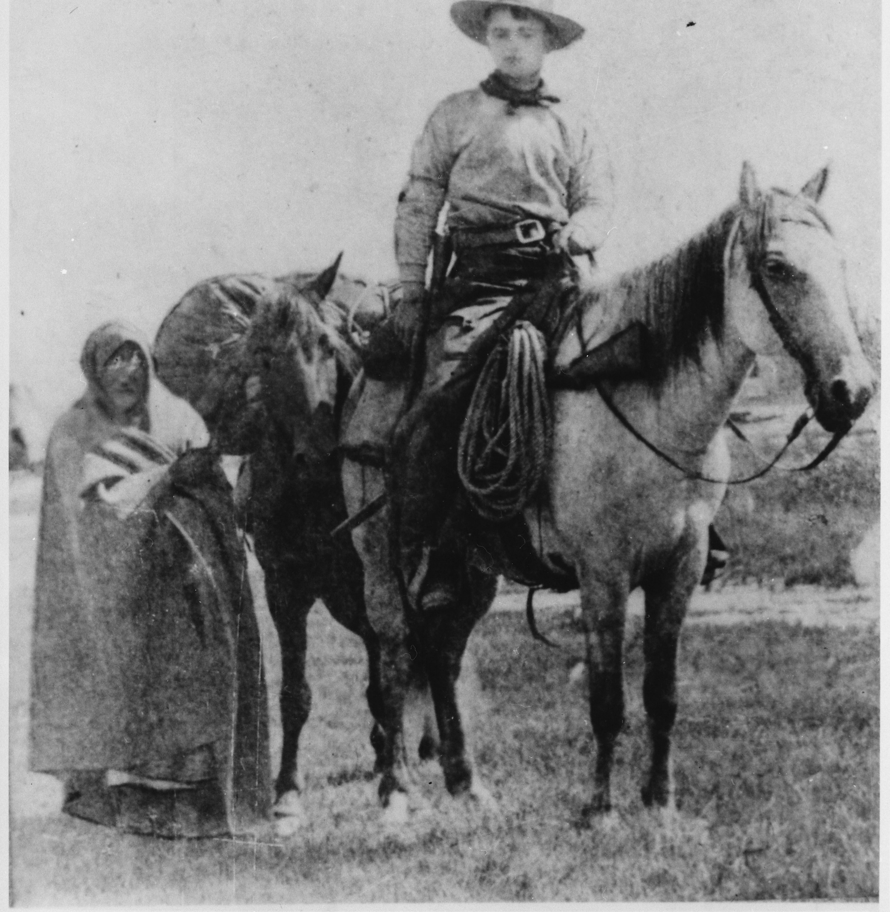
"Frank E. Webner, pony express rider," ca. 1861 - NARA - 513351.jpg wikimedia

Slide 7
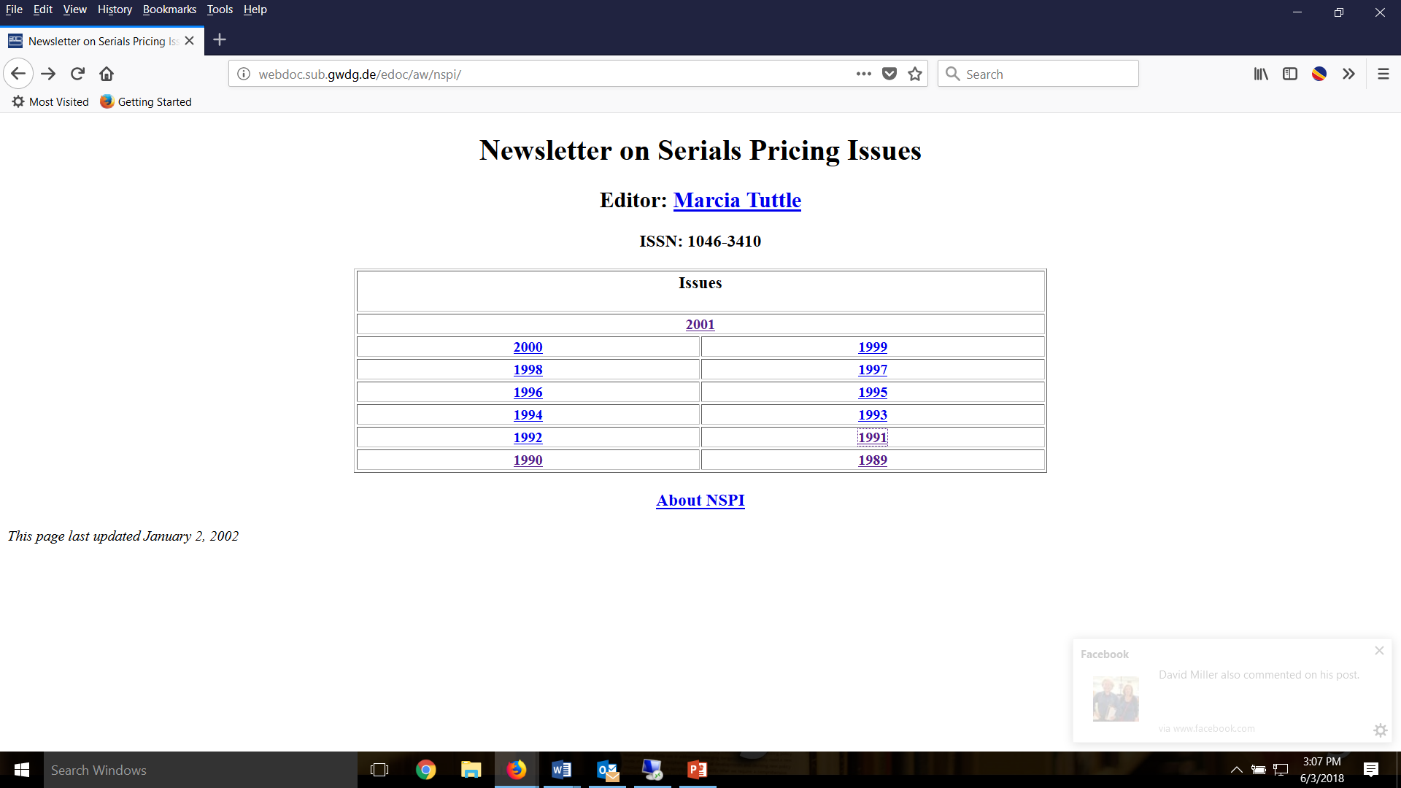

Slide 8
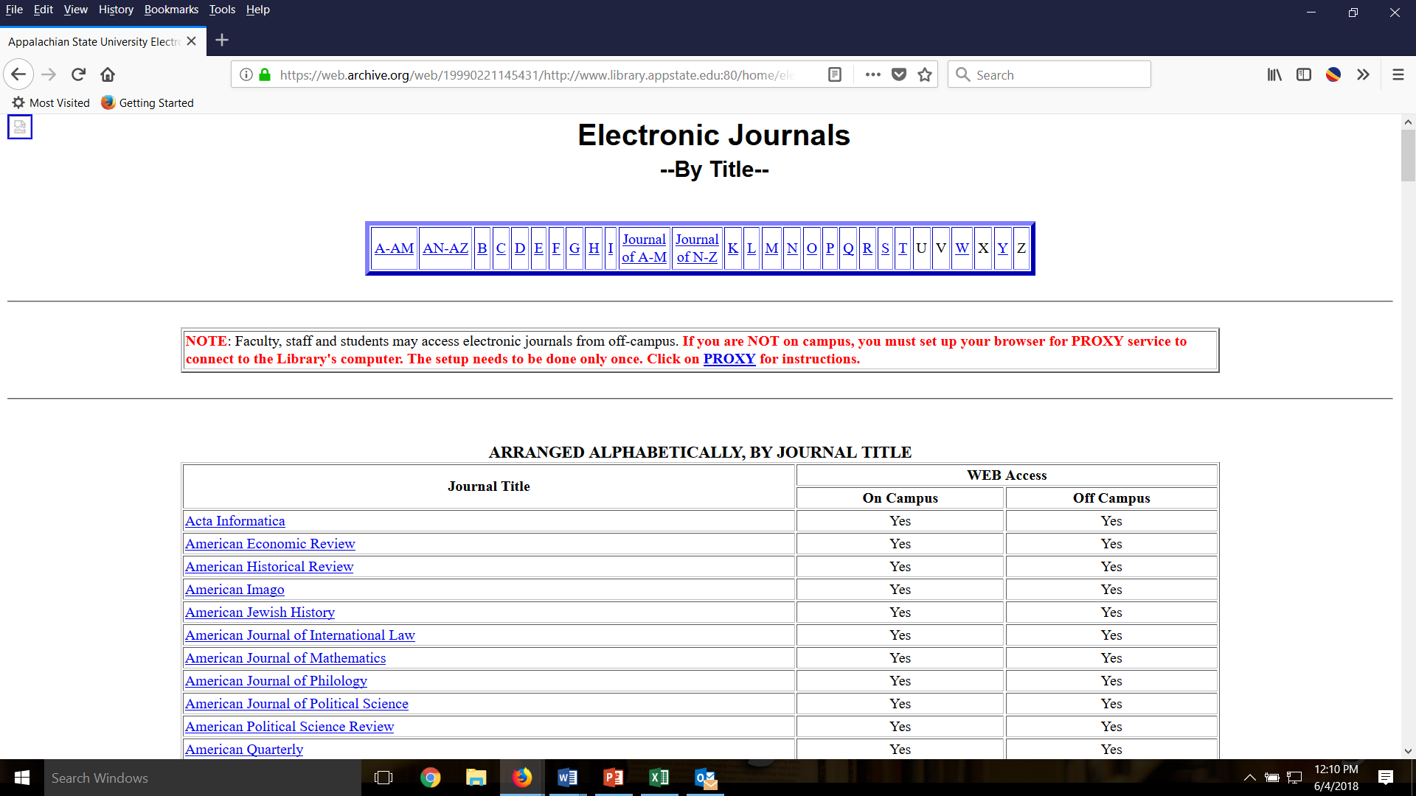

Slide 9
The Mid-Career Librarian
Angela Dresselhaus
Notes:
Hello, my name is Angela Dresselhaus and I am representing the mid-career librarian today. I wanted to provide you a bit of context about me. I am an old millennial; I first surfed the web as a sophomore in high school and I distinctly remember saying, "is this it?" I was totally underwhelmed by my first experience online.
I had typing and word-processing class in high school and had little to no exposure to card catalogs. I had to use a print index to find journal articles in college, but databases and link resolvers were available for my upper division classes. My professors back in 2001 still required us to cite the physical resources when we dared to use an online journal. To sum up my experience, I lived through the transition to the technology enhanced experience we have today.
But most relevant for this presentation, I spent my early part of my career learning how to be an electronic resources librarian without the Core Competencies, which were published in July 2013.

Slide 10

NASIG Core Competencies for ERLs
The Core Competencies for Electronic Resources Librarians (CCERL) as described on the NASIG website, “provides librarian educators with a basis for developing curriculum with a specialized focus.” Additionally, “Employers might use the Competencies as a basis for describing these specialized positions and to establish criteria upon which to evaluate the performance of those who hold them.” The CCERL is based on the extensive research of Dr. Sarah Sutton and was formulated into a cohesive document by the NASIG Core Competencies Task Force.
Notes:
Angela:
The Core Competencies for Electronic Resources Librarians has something for everyone and we have seen several presentations at NASIG that incorporate them. This section focuses on how the Competencies can be used in an evaluation context, but first I want to briefly cover the 7 main areas of competence.

Slide 11

The 7 Competencies
1. Life Cycle of Electronic Resources
2. Technology
3. Research and Assessment
4. Effective Communication
5. Supervising and Management
6. Trends and Professional Development
7. Personal Qualities
Notes:
Angela:
I will briefly introduce the Core Competencies before sharing the details on how I used them for advancement in title at East Carolina.
The 1st area covers what I consider the core of the ERL job, the Life Cycle of Electronic Resources.
The 2nd area focuses on the technology that underpins everything we do as electronic resources librarians.
The 3rd area discusses Research and Assessment, which is the key element that helps us understand the impact of our work.
The 4th area highlights the importance of Effective Communication.
Those of us who are fortunate enough to have librarians and staff can look to the Supervising and Management section to guide our work.
The section on Trends and Professional Development emphasizes the continuing education and growth required to be a successful ERL,
and finally, Personal Qualities are covered.

Slide 12
CCERL as Structure for Promotion
Advancement or promotion often requires documentation of librarianship activities to substantiate a defined level of achievement. This section seeks to provide answers to the questions below.
How do you organize and provide context for your evidence?
How do you prove mastery of ER librarianship?
Notes:
Angela:
Now that we have a foundation of knowledge, I want to provide context for the problem I needed to solve with the competencies. I have worked in both academic tenure track and non-tenure track positions. Each position has required a self-assessment document on an annual basis. A more substantive document was required when applying for advancement in title at ECU. Annual evaluations have traditionally been easier for me to assemble because they are not exhaustive and for the most part, the audience is limited to those most familiar with my work in the reporting structure. However, there would be a broader audience for my advancement in title review. Ensuring that the wider audience understood my work required careful planning.
I had an additional complication because ECU had transitioned to a non-tenure granting unit. When I joined ECU in June of 2015, advancement in title was not available to me nor could I be appointed to an associate librarian title. Within my first three months, the unit code was revised and there was a path for me to advance in title. I met the requirements for associate librarian and naturally, I began assembling my documentation for an advancement in title. Yet another challenge was that I was the first person to request an advancement in title. I would need an outstanding document to demonstrate my accomplishments as a professional electronic resources librarian to tenured faculty I had just met.
I turned to the Core Competencies for help. I will help you understand how I organized my “binder” in a way that showed a logical progression of my career and how I proved my mastery of electronic resources librarianship.

Slide 13
Two-Step Process
Organizing and Contextualizing Evidence
Proving Mastery of ER Librarianship
Notes:
Angela:
This is a two step process. First I imposed a structure to ensure I could provide context for my work. I needed to be able to engage my reviewers. As much as we would like to think that our accomplishments stand on their own, presentation and style is very important.
And second, I had to prove my expertise in the field of Electronic Resources librarianship. We are fortunate to have the CCERL to help us focuses on the skills needed to succeed. I heard from a few librarians at ECU about how nice it would be for them to have a document like the CCERL to structure their promotion and tenure documentation.

Slide 14
Organizing and Contextualizing Evidence
  Introduce the CCERL
  Include each competency area
  Connect accomplishments with the CCERL
  Methodically present evidence
Notes:
Angela:
I had the opportunity to write a letter to outline my case for advancement to associate librarian. I used a section of that letter to introduce the CCERL and explain why that document was the appropriate yardstick to judge my accomplishments.
Anyone that has assembled a binder knows that evidence is required to support your case and it is impossible to organize it. I have flipped through a number of promotion binders with seemingly random screenshots, thank you letters, appointment letters and so forth. I used the CCERL to organize all of my visual evidence of mastery that was required to support my letter.
I carefully selected my most impressive examples of mastery from each competency area. I then used my letter to draw connections between my accomplishments and the CCERL. Finally, I methodically presented evidence to ensure that there was no doubt that I had obtained a level of mastery in electronic resources librarianship. The letter was a key component that helped people understand what I did, what is normally expected my field, and why I had earned the title of associate librarian.

Slide 15
Proving Mastery of ER Librarianship
Structure documentation with the CCERL for reports, promotion, and tenure
Select 3-4 compelling examples from each area of the CCERL
Combine descriptive language with images
Notes:
Angela:
The preparation of my binder took about six months, however I knew I wanted to give this presentation so I took care in gathering materials.
My binder included compelling examples from each area of the CCERL. I did focus on finding evidence that could provide a decent visual. Unfortunately, ECU is chained to the paper binder paradigm so there were limitations there. I’m going to show you a few examples of items that can be used to highlight mastery. Some of these examples happened after my materials were submitted, but I thought they would be great for inclusion in this presentation.

Slide 16
3.9 Demonstrates problem solving, organization, and analytical skills and has an aptitude for detail-oriented work.
  Highlight financial projections and trends
  Showcase novel applications of usage statistics
  Transform complex data into simple visuals
Notes:
Angela:
Competency 3.9 states that an ERL demonstrates problem solving, organization, and analytical skills and has an aptitude for detail-oriented work. Some examples include the management of budgets. ECU needs to closely monitor our expenses, because we do not receive enough recurring state money to cover our journal commitments. Each year, we rely on about 600,000 of one-time money to keep our subscriptions going. This requires me to carefully calculate subscription increases on an individual basis using an Excel spreadsheet.
Another challenge that I handled at ECU was the impact of SciHub and other open proxy situations on our usage statistics. Fortunately, we had several years of data that enabled me to develop a method to smooth the stats and reduce the impact of illegal downloading.
In both cases, I needed to transform complex data into simple charts and graphs. The examples demonstrate that have the skills of section 3.9. The next slide shows one graph.

Slide 17
Evidence of Mastery: 3.9
This financial projection was distributed to University Administration
Notes:
Angela:
The top line is the trend line for one of our budget lines. The second line represents the growing costs of our big deal packages. The library attempted to make the case that we need to either be permitted to reduce a big deal or receive more recurring state money. Hopefully you can see how a visual such as this, and some context helps reviews understand the hidden aspects of an ERL’s job.

Slide 18
6.3 Knowledgeable about the legal framework within which libraries and information agencies operate. That framework includes laws relating to copyright, privacy, freedom of expression, equal rights (e.g., the Americans with Disabilities Act), and intellectual property.
  Highlight efforts to improve accessibility
  Showcase copyright expertise
Notes:
Angela:
According to competency 6.3 an ERL is knowledgeable about the legal framework within libraries and information agencies operate.
At both University of Montana and East Carolina University I have been interested in improving accessibility. I included accessibility addendums that I created, standard licensing language, and other examples to demonstrate my interest in this area. After I submitted my binder I became the copyright officer at ECU. I am already planning ahead for my next advancement in title and will be able to include evidence from an enhanced copyright website and online education models for copyright instruction at ECU.

Slide 19
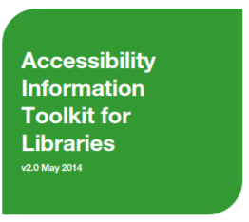
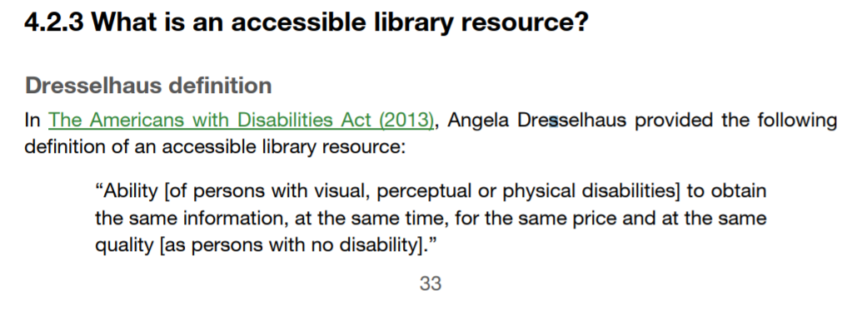
Evidence of Mastery: 6.3
Notes:
Angela:
Occasionally, you will have someone quote you in a way that could convey to reviewers that you have made an impact in a core competency. If you have this, use it.
This Toolkit was produced by the University of Toronto Libraries in partnership with Ontario Council of University Libraries with support from the Government of Ontario.

Slide 20
Final Thoughts
Use the CCERL to improve your profile by demonstrating to others your mastery
Use the CCERL to help develop skills in new ERLs
Notes:
Angela:
I’d like to wrap up my section with a few final thoughts. The CCERL is an excellent tool to help you assess your mastery and demonstrate your expertise. Additionally, you can use CCERL as a road map for your own professional development.
The CCERL is an excellent tool for developing new talent in electronic resources. Rebecca is up next to talk about her experiences in the first 8-9 months as an ERL.

Slide 21
The Early Career Librarian
Rebecca Tatterson

Slide 22
Electronic Resources Librarian at Joyner Library, East Carolina University
Maintain access points
Troubleshoot e-resources
Monitor and evaluate resources
Library Discovery (Ex Libris, Summon)
Notes:
Hello, my name is Rebecca Tatterson and I’d like to talk about beginning a new position as a first-time electronic resources librarian. This is my first position in electronic resource management. My previous position at ECU was in ILL as the borrowing manager and all prior positions were in the public library sphere in reference, circulation and later branch library management. As many of you may know, there is quite a lot to learn in any e-resource position and a great need to be flexible in the job. Change is part of the landscape of working with e-resources and even mentioned in the core competencies as personal quality of the ERL. I respond to email almost daily notifying of platform, subscription and URL changes. E-resource mergers and name changes. All contribute to the need for flexibility and the importance of monitoring trends and staying abreast of changes. This is paramount to being successful as an e-resource librarian. Much of what we do to manage e-resources involves working with various applications and requires an elevated level of technical skills. Understanding URL construction, mark up languages, link resolver software and even a dash of coding just to name a few.
I'll begin by describing a bit about my position at ECU. The Electronic Resources Dept. is comprised of two librarians and three staff members and is housed in technical services with cataloging, acquisitions and scholarly communications. My primary responsibilities are to maintain access points, troubleshoot and evaluate resources and manage our library discovery tool, Summon, which we've coined OneSearch at Joyner Library. I'd like to talk a little bit about how the Core Competencies for electronic resource librarians guided my initial training. I will end my presentation by talking about a few projects that I worked on as part of my annual goals and how the CCERL relates to them.

Slide 23
Resources
​Department Colleagues
Documentation​
Professional literature​
Meetings with vendor representatives​
Listservs
Notes:
As I have mentioned, this is my first position as an electronic resources librarian. In many ways my previous library experience has enabled me to see how discovery and access to resources is important from the user’s perspective. I have spent a great deal of time to learning about e-resource management applications, software and the administrative side of discovery systems. I’d like to talk about a few resources that I found helpful and how they guided me in my projects and learning.
Department colleagues (IT and Web Services)
I am very fortunate to work with a very skilled and experienced department head who is here speaking with me today, Angela Dresselhaus. Her guidance has contributed greatly to my work. Members of our IT and Web Services department have been willing to lend a hand helping me gain an understanding of things like Proxy configurations and the backend of our E-resource management software, CORAL and error reporting systems. It is with everyone’s input and a great team of people that the work gets done. Working in a library with people specialized in handling the various aspects of technology involved in developing the systems that manage e-resources helps make our job more manageable. It allows us to be innovative with the tools.
Documentation
Is a great resource for locating instructions on many processes involved with setting up discovery tools and other applications.
Professional literature
Is helpful to learn about best practices and keep up to date with what's going on in the field.
Meetings with vendor representatives (Discovery and Database)
Representatives are available to schedule meetings and answer questions about products and services.
Listservs
Can answer questions and be great sources for staying current on platform and vendor changes and maintenance issues associated with EZ Proxy.

Slide 24
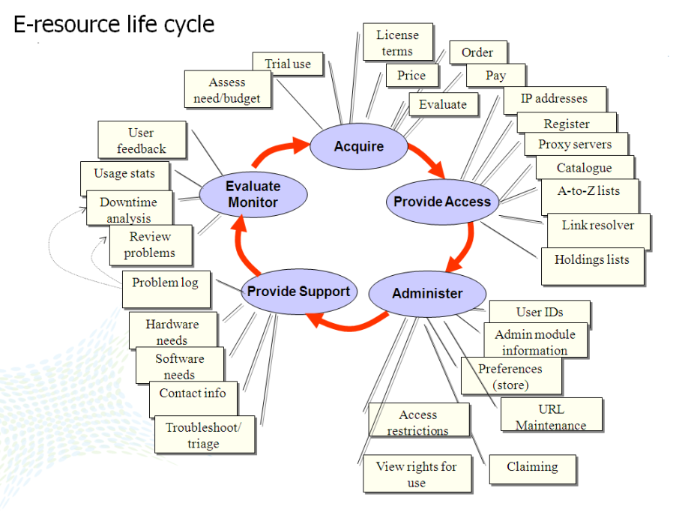
The Competencies
Competency 1
Competency 2
Notes:
Competencies 1 and 2 outline core skills for the ERL. I'd like to demonstrate two projects that I worked on and illustrate how they apply to them. During my initial training my focus has been these competencies. They have guided it and provided a checklist for what I needed to learn. Competency one of the CCERL outlines the e-resource life cycle. From Acquiring and licensing the resource to providing support to ensure that it remains accessible. At Joyner Library Resources are generally discussed with our Electronic Resources Review Committee before purchasing. Our department then manages the licensing process with input from the director. The next phase of this cycle is to add the resource to our ERM, A-Z list and Proxy. Competency two outlines technology skills and knowledge of applications that are necessary to perform effectively in the position and areas of resource management.

Slide 25
E-journal Portal and Discovery Updates
E-journal 2.0
Summon enhancements
BrowZine API
Notes:
Updates to the e-journal portal and Summon are two projects that I worked on initially as part of a discovery goal. The portal needed updated and branded and there are consistent Summon enhancements that need evaluated and implemented. BrowZine, an e-journal discovery tool was being used by the library but the release of an API required integration with Summon and the creation of a coding document to read journal availability on the platform. These projects are often discussed with our Discovery Advisory Board, a group of individuals from various departments throughout the libraries. Many of our projects are reviewed and require input from this group.

Slide 26
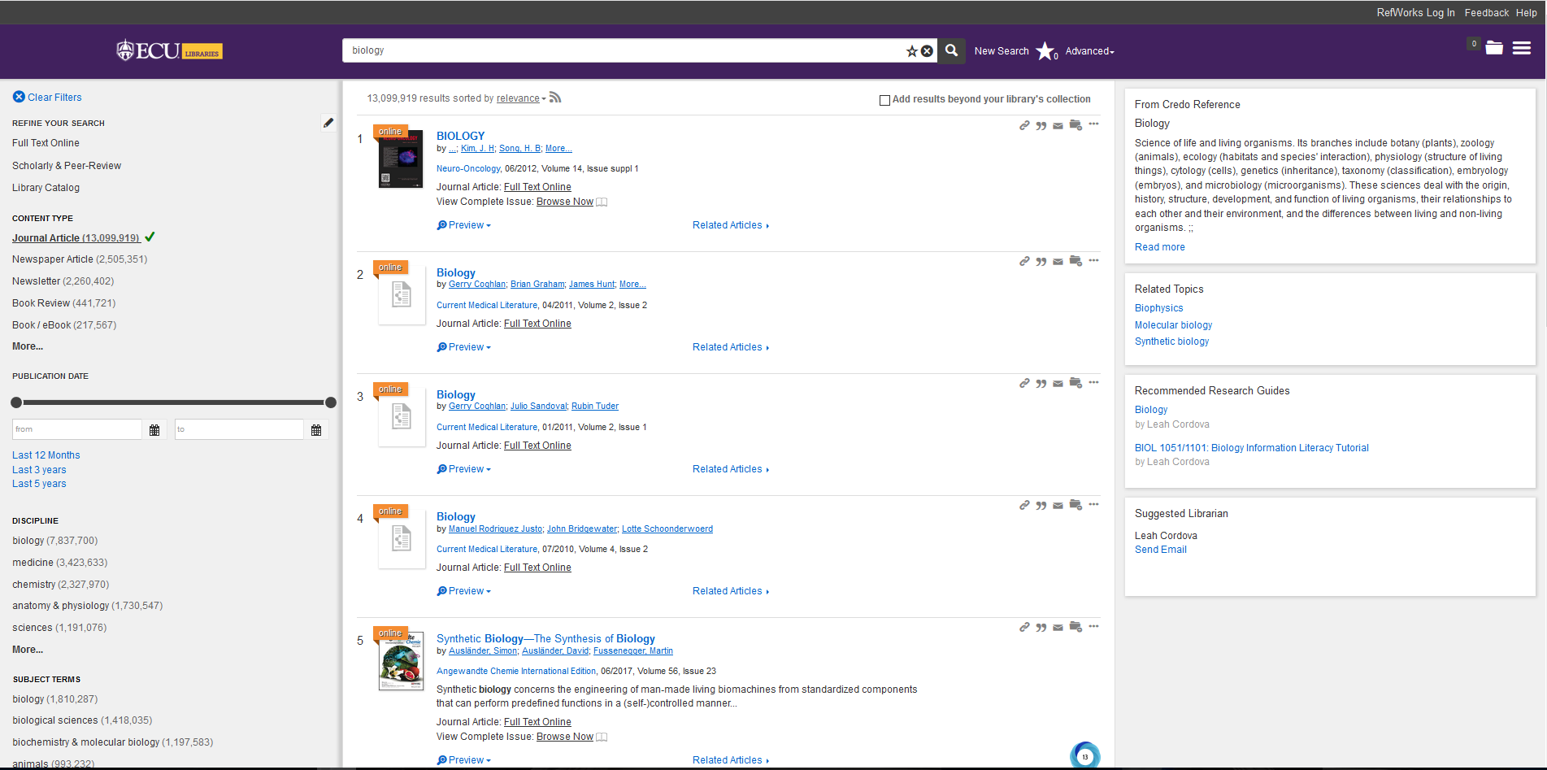
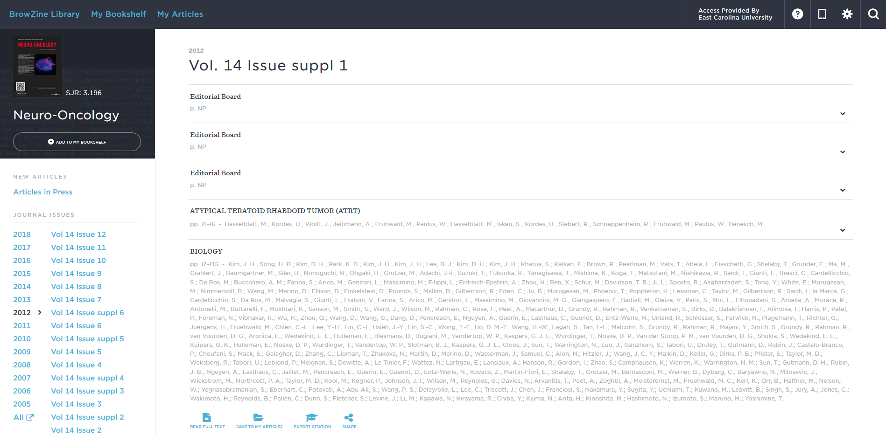
Our instance of Summon with BrowZine API, Topics Explorers, and Branding updates.
Notes:
Summon branding, Topic Explorer enhancements and BrowZine API implementation.

Slide 27
Troubleshooting
Investigate and resolve e-resource access problems
Improvements to e-resource ticket system
Utilize administration system
Notes:
Part of the life cycle and of the competencies is troubleshooting e-resources. My position resolves access problem. Our ticket system was designed by our lead developer and is consists of the error report form and an administration system. After a discussion with my colleague who works with me on error reports, we decided it was time to update the report form. The old form contained fields that we felt complicated the reporting process and added confusion for the patron, so we simplified verbiage and eliminated fields that we didn't feel were necessary any longer. We also found we were consistently needing to contact the patron for more details about the access issue, so we were addressing this concern as well. The new form captures IP and URL and asks for the most relevant information. The administrative side tracks reported issues for future reference and data can also be exported to excel for evaluation of the various fields. Reports are initially received via an email list and if necessary vetted out to other departments for assistance.

Slide 28
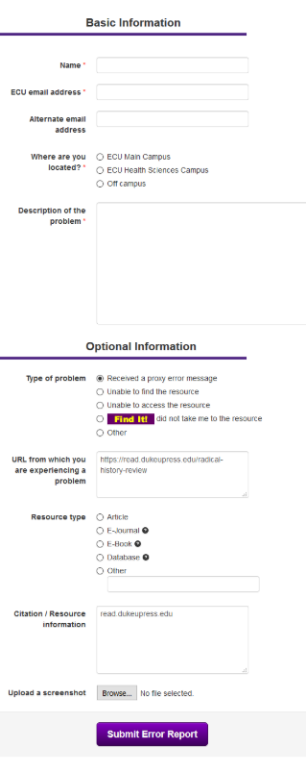
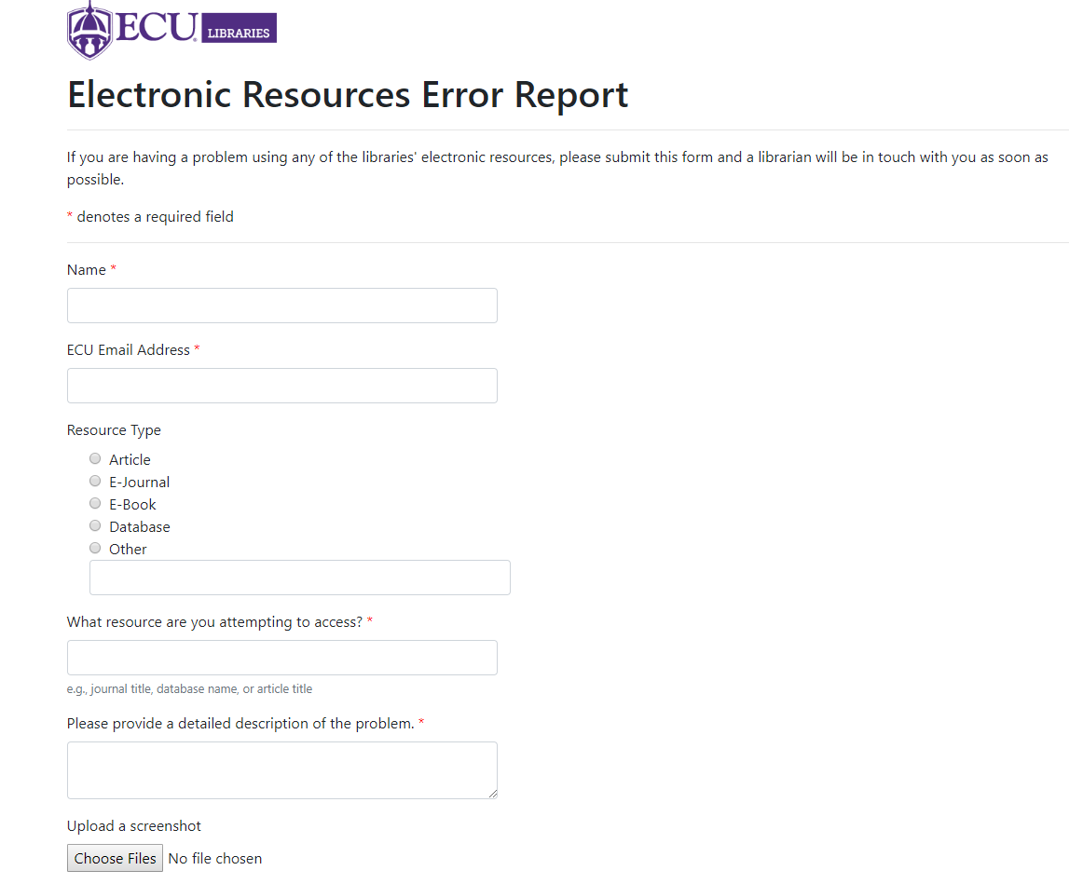
Notes:
This slide shows our original and revised error report form.

Slide 29
Resources
https://knowledge.exlibrisgroup.com/
https://www.oclc.org/support/services/ezproxy.en.html
https://thirdiron.atlassian.net/wiki/spaces/BrowZineAPIDocs/overview
http://www.nasig.org/site_page.cfm?pk_association_webpage_menu=310&pk_association_webpage=7802
Notes:
Resources. I will end by suggesting reading documentation before beginning any process as it helps provide foundational knowledge about any process or application. I know for Summon there is extensive documentation for all the functions and features. As a new member of the CORAL team I know the committee just completed revising the documentation for an upcoming release. Most of what needs to be known to work in these systems and applications can be found in the documentation.
So I would like to conclude here and if anyone has questions for any of the presents we can take them at this time. Thanks for listening and I hope you enjoyed our presentations.

