Slide 1

Competencies and the Advancement of Electronic Resource Librarians
The NASIG Core Competencies for Electronic Resources Librarians (ERLs) provides a framework defining the professional practice of electronic resource librarianship. This poster will demonstrate how the NASIG Core Competencies were applied to the advancement in title process for an experienced ERL and the initial training phase of a new ERL.
Angela Dresselhaus, Head of Electronic Resources
Rebecca Tatterson, Electronic Resources Librarian
East Carolina University

Slide 2

NASIG Core Competencies for ERLs
The Core Competencies for Electronic Resources Librarians (CCERL) as described on the NASIG website, “provides librarian educators with a basis for developing curriculum with a specialized focus.” Additionally, “Employers might use the Competencies as a basis for describing these specialized positions and to establish criteria upon which to evaluate the performance of those who hold them.” The CCERL is based on the extensive research of Dr. Sarah Sutton and was formulated into a cohesive document by the NASIG Core Competencies Task Force.

Slide 3

The 7 Competencies
1. Life cycle of Electronic Resources
2. Technology
3. Research and Assessment
4. Effective Communication
5. Supervising and Management
6. Trends and Professional Development
7. Personal Qualities
Competencies and the Advancement of ERLs | Angela Dresselhaus and Rebecca Tatterson | East Carolina University

Slide 4
CCERL as Structure for Promotion
Advancement or promotion often requires documentation of librarianship activities to substantiate a defined level of achievement. This section seeks to provide answers to the questions below.
How do you organize and provide context for your evidence?
How do you prove mastery of ER librarianship?
Competencies and the Advancement of ERLs | Angela Dresselhaus and Rebecca Tatterson | East Carolina University

Slide 5
Organizing and Contextualizing Evidence
  Introduce the CCERL
  Include each competency area
  Connect accomplishments with the CCERL
  Methodically present evidence
Competencies and the Advancement of ERLs | Angela Dresselhaus and Rebecca Tatterson | East Carolina University

Slide 6
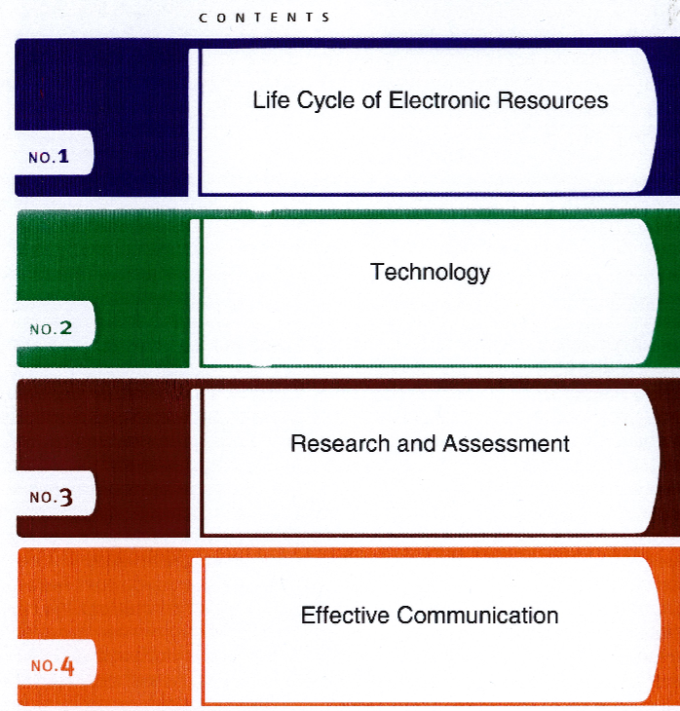
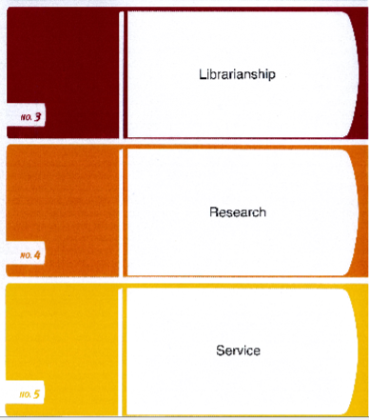
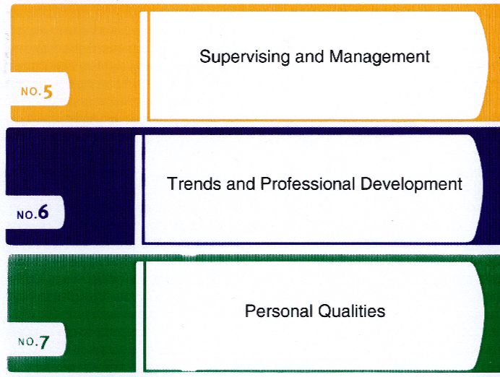
Organization
Competencies and the Advancement of ERLs | Angela Dresselhaus and Rebecca Tatterson | East Carolina University

Slide 7
Proving Mastery of ER Librarianship
Structure documentation with the CCERL for reports, promotion, and tenure
Select 3-4 compelling examples from each area of the CCERL
Combine descriptive language with images
Competencies and the Advancement of ERLs | Angela Dresselhaus and Rebecca Tatterson | East Carolina University

Slide 8
3.9 Demonstrates problem solving, organization, and analytical skills and has an aptitude for detail-oriented work.
  Highlight financial projections and trends
  Showcase novel applications of usage statistics
  Transform complex data into simple visuals
Competencies and the Advancement of ERLs | Angela Dresselhaus and Rebecca Tatterson | East Carolina University

Slide 9
Evidence of Mastery: 3.9
This financial projection was distributed to University Administration
Competencies and the Advancement of ERLs | Angela Dresselhaus and Rebecca Tatterson | East Carolina University

Slide 10
6.3 Knowledgeable about the legal framework within which libraries and information agencies operate. That framework includes laws relating to copyright, privacy, freedom of expression, equal rights (e.g., the Americans with Disabilities Act), and intellectual property.
  Highlight efforts to improve accessibility
  Showcase copyright expertise
Competencies and the Advancement of ERLs | Angela Dresselhaus and Rebecca Tatterson | East Carolina University

Slide 11
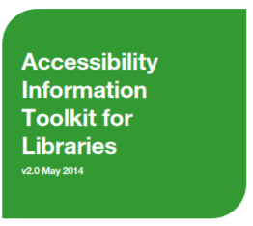
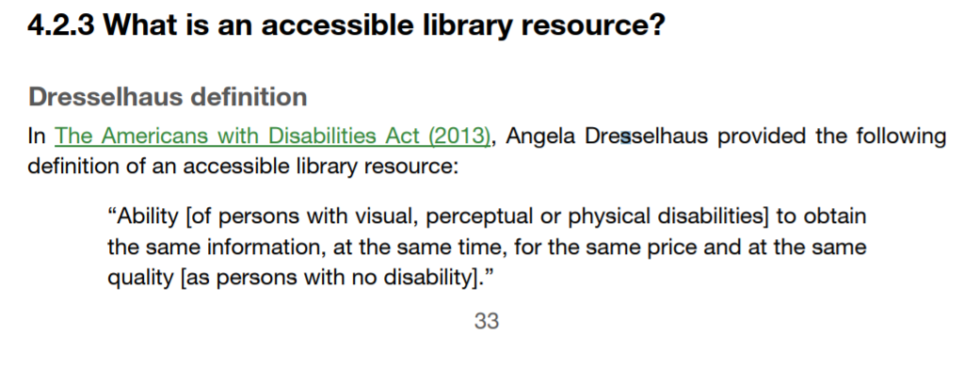
Evidence of Mastery: 6.3
Competencies and the Advancement of ERLs | Angela Dresselhaus and Rebecca Tatterson | East Carolina University

Slide 12

CCERL as Structure for Training
The CCERL acts as a manual to guide a new ERL along a path of acquiring competencies relevant to daily tasks performed in the position. Mastery of the competencies requires experience and use of the systems and tools that manage these resources. This section provides examples of projects that make use of competencies 1. Life cycle of Electronic Resources and 2. Technology.
Familiarization with the various systems used to maintain e-resources
Application of knowledge and skills toward management of e-resources
Competencies and the Advancement of ERLs | Angela Dresselhaus and Rebecca Tatterson | East Carolina University

Slide 13
Life Cycle of Electronic Resources
The ERL has extensive knowledge of the concepts and issues related to the life cycle of recorded knowledge and information from creation through various stages of use to disposition beyond that required of a generalist. The ERL understands the life cycle of electronic resources in its ongoing complexity of multiple stages and processes. This broader understanding is essential as a foundation in order for anyone to be prepared to work with and act as a bridge across the multiple units/departments involved in electronic resources management in information organizations.
Competencies and the Advancement of ERLs | Angela Dresselhaus and Rebecca Tatterson | East Carolina University

Slide 14
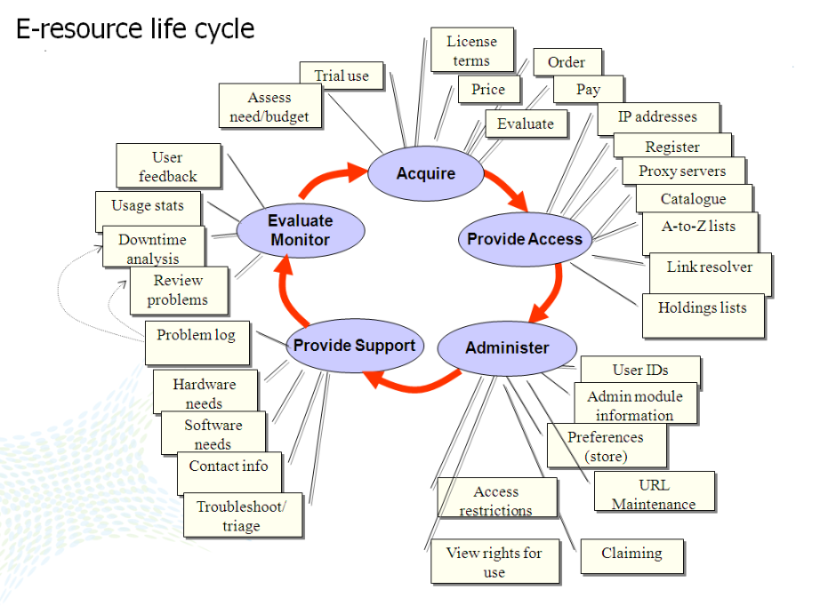
Training Resources for New ERL
Department colleagues
Listservs
Knowledge Centers and Documentation
Professional literature
Meetings with vendor representatives
Competencies and the Advancement of ERLs | Angela Dresselhaus and Rebecca Tatterson | East Carolina University

Slide 15
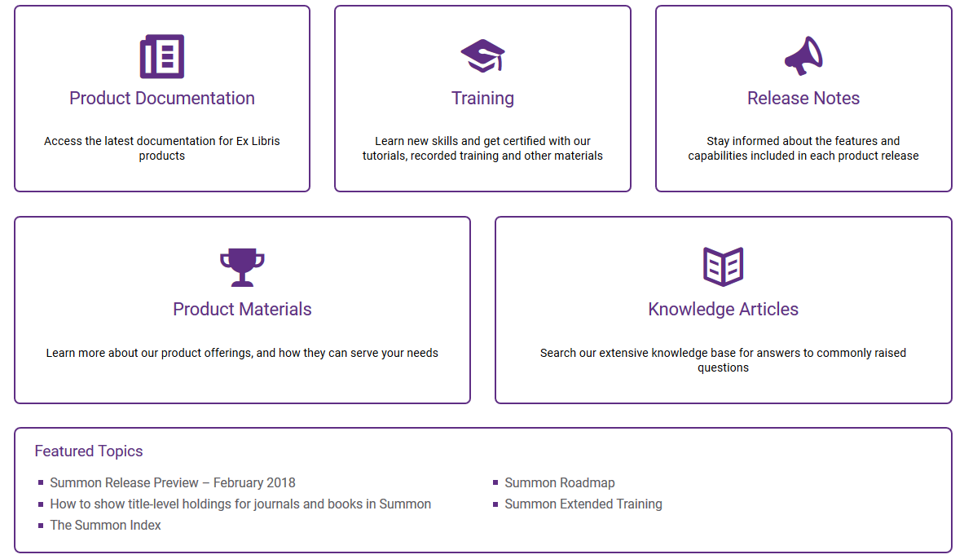
1.6 A commitment to maintain awareness of trends and ongoing developments in areas related to the entire life cycle of electronic resources.
Maintain current awareness with on demand resources
https://knowledge.exlibrisgroup.com/

Slide 16
Discovery Services
2.7 Software such as: link resolver software, metasearch software, data collection software, discovery services, electronic resources management software (ERMS), the administrative functions of proprietary databases, and bibliographic utilities.
Utilization of enhancements, Best Bets, Topic Explorers
Institutional branding
Monitor new Summon enhancements and customizations for use
Implementation of BrowZine’s Summon API

Slide 17
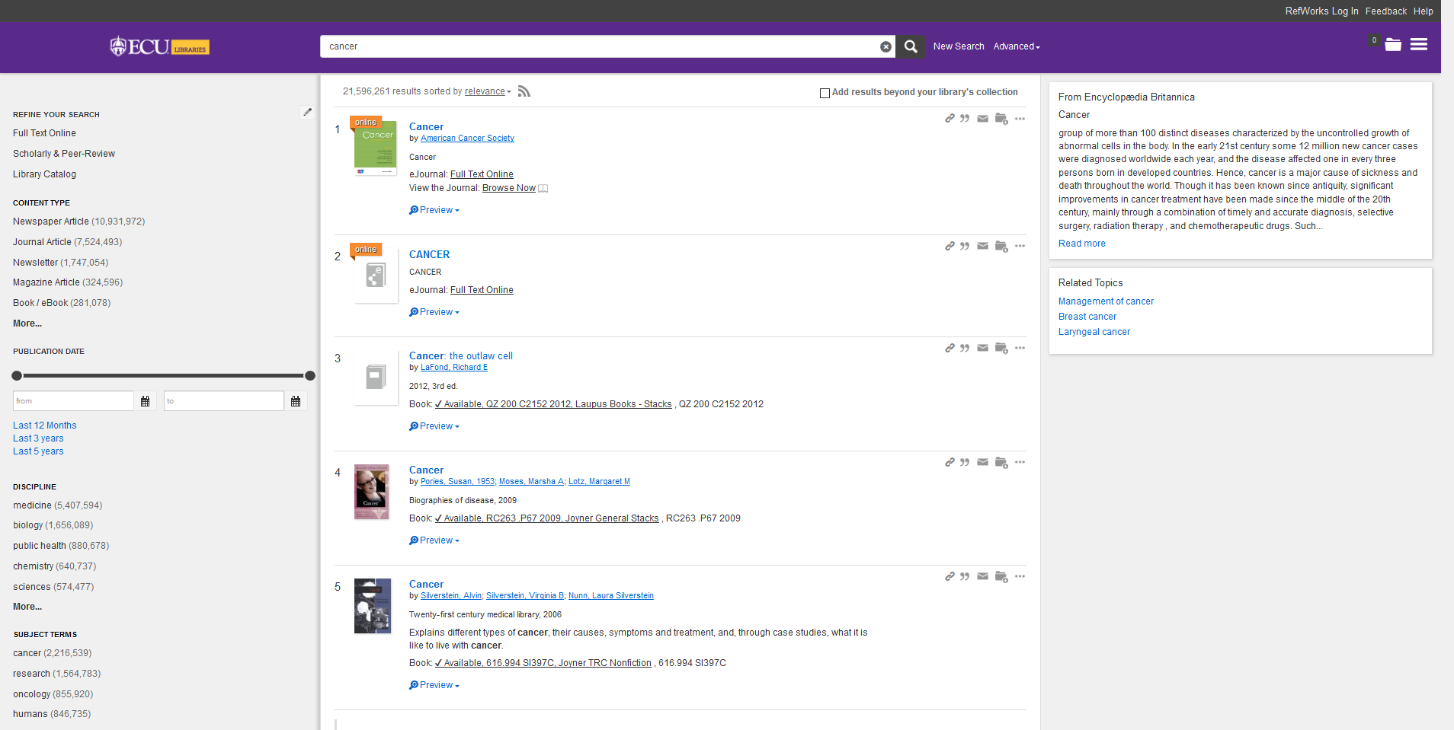
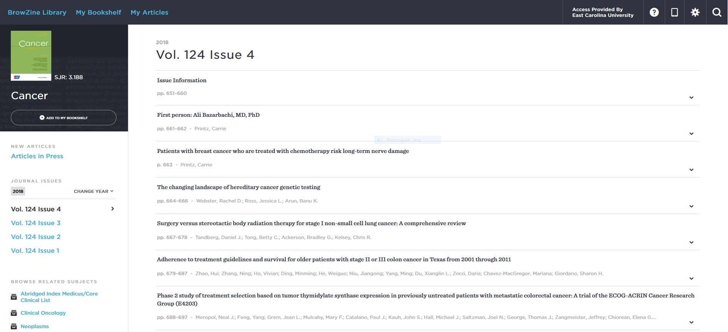
Examples
Our instance of Summon with BrowZine API implemented, Topics Explorers, and Branding.
Images

Slide 18
ERMS: Project to Integrate CORAL and A-Z Database List
2.7 Software such as: link resolver software, metasearch software, data collection software, discovery services, electronic resources management software (ERMS), the administrative functions of proprietary databases, and bibliographic utilities.
Update all resource data in CORAL to facilitate mapping
Assign subject headings in CORAL for all resource records
Map data between CORAL and A-Z database list. Goal is to merge for a single management point. CORAL to manage backend and a database list for patron facing access point

Slide 19
Support and Troubleshooting
1.5 A thorough understanding of records management necessary for actively coordinating and managing the often-complicated records needed to track electronic purchases, subscriptions, access set-up and maintenance, and licenses.
Manage error reporting system
Continuously improve system to expedite troubleshooting of access issues
Utilize administration system for tracking reported issues to analyze trends, identify recurring issues, and curate data for future reference

Slide 20
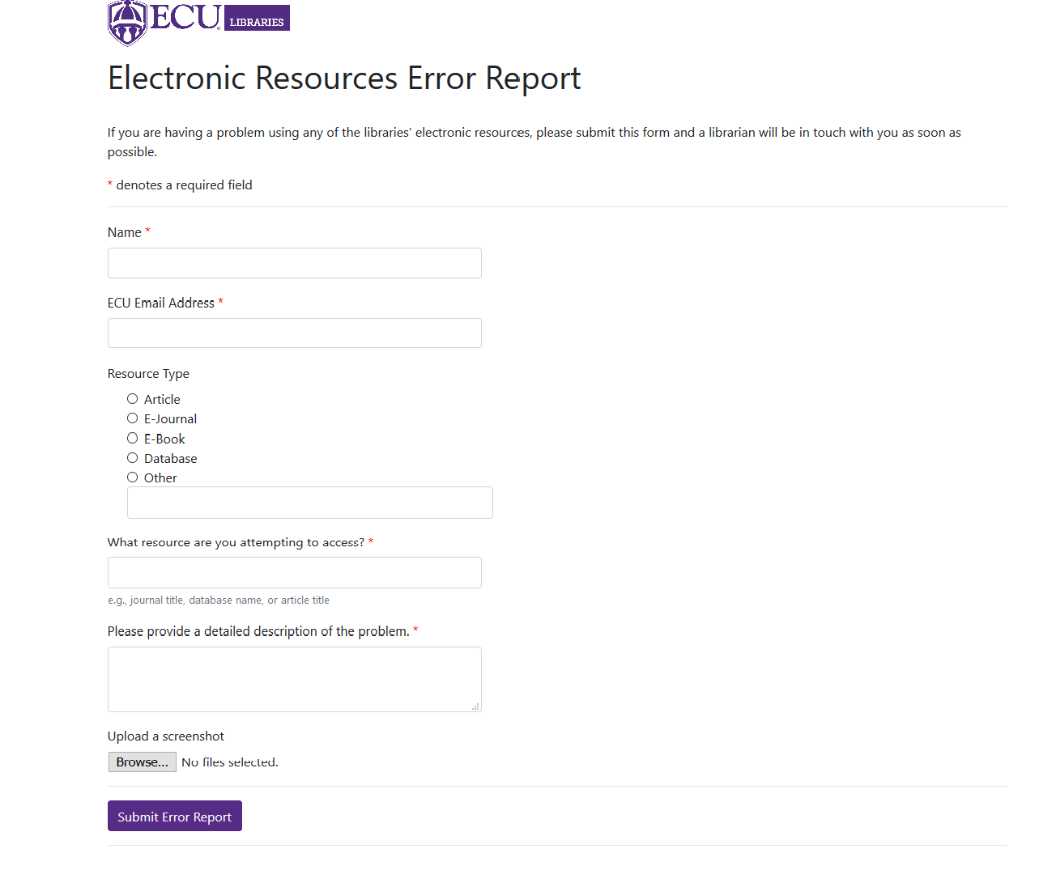
This is where patrons interact with our locally developed error reporting system.
Administration system tracks reported issues, comments and resolutions for future reference point
Error report form captures essential information to diagnose and resolve issues

Slide 21
References
Slide Two
  NASIG CCERL: http://www.nasig.org/site_page.cfm?pk_association_webpage_menu=310&pk_association_webpage=1225
  Sutton Dissertation: https://tamucc-ir.tdl.org/tamucc-ir/bitstream/handle/1969.6/33/Sutton_dissertation_final.pdf?sequence=1
Slide Twelve
  Accessibility Information ToolKit for Libraries, OCUL: https://ocul.on.ca/accessibility/sites/default/files/OCUL%20Accessibility%20Toolkit%20-%20ENG%20-%20v2.0%20(May%202014).pdf

