Slide 1
Opportunities Beyond Electronic Resource Management:
An Extension of the Core Competencies for Electronic Resources Librarians to Digital Scholarship and Scholarly Communications.
Angela Dresselhaus
Assistant Professor
Acquisitions and eResources
University of Montana, Missoula
http://works.bepress.com/angela_dresselhaus/
Notes:
Abstract
This presentation will provide an overview of current topics in digital scholarship and scholarly communications and draw connections between these new areas and the traditional skill sets of acquisitions and electronic resources employees. Commonalities between the skills outlined in the Core Competencies for Electronic Resources Librarians and those needed for success in digital scholarship and scholarly communications will form the basis of the presenter's recommendations for staff involvement in digital scholarship and scholarly communications.
An inventory of skills and talents among acquisitions staff will provide insight into the best ways to leverage existing human resources for the expansion of acquisitions duties into digital scholarship and scholarly communications. The presenter will outline new opportunities for acquisitions staff based on external research and internal staffing practice at the University of Montana.

Slide 2
Outline
Definitions
New Opportunities in Digital Scholarship & Scholarly Communications
Connections Between Existing Skills and New Opportunities
Future Steps

Slide 3
Definitions
What is Digital Scholarship?
What is Scholarly Communications?
What are the NASIG Core Competencies for Electronic Resources Librarians?

Slide 4
What is Digital Scholarship?
“Digital humanities is an emerging field revolving around the intersection of traditional humanities disciplines and technology.”
- Jennifer Adams & Kevin Gunn,
Catholic University of America

Slide 5
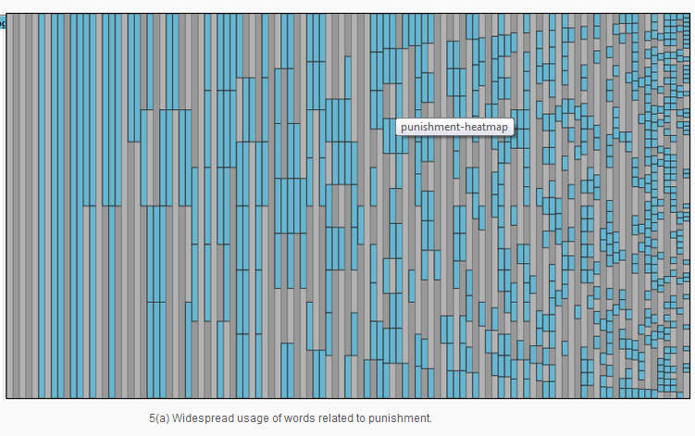
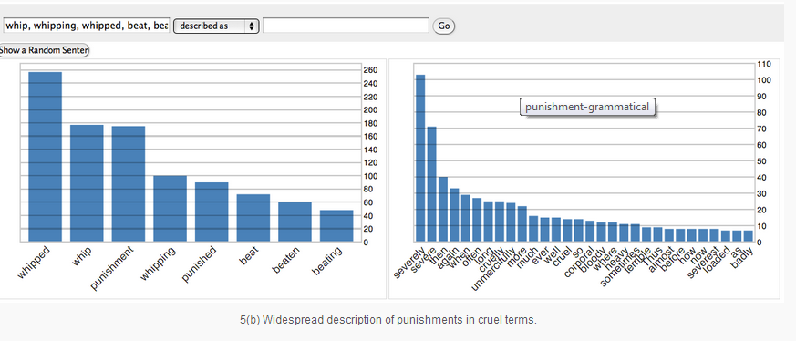
Data Visualization: The use of words that describe cruel punishment
WordSeer. 2014. Example: Slave Narratives. Electronic Document. Accessed: April 24, 2014. http://wordseer.berkeley.edu/example-slave-narratives/

Slide 6

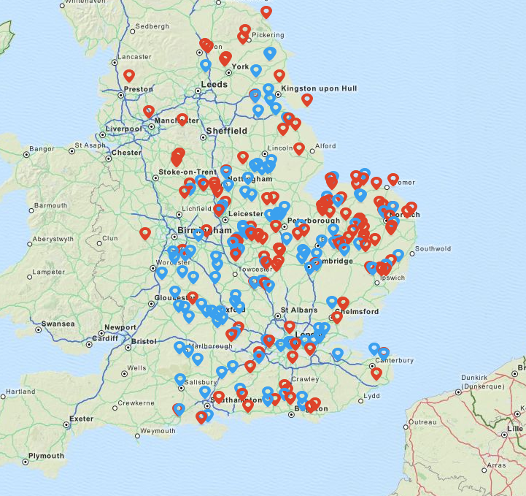
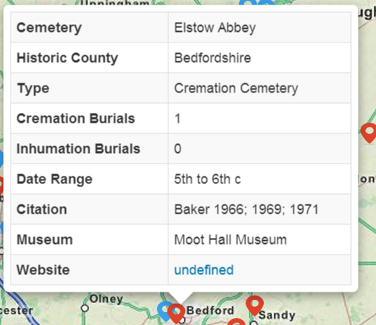
The Early Anglo-Saxon Cemetery Mapping Project provides locations, summaries, and information about citations and collections for numerous cemeteries from the mid-5th to early 7th century in England.
Meyers, Katy and Matt Austin 2014.
ieldran: The Early Anglo-Saxon Cemetery Mapping Project. Electronic Document.
Accessed: April 24, 2014. http://ieldran.matrix.msu.edu
Notes:
Welcome to the ieldrandatabase
The Early Anglo-Saxon Cemetery Mapping Project provides locations, summaries, and information about citation and collections for numerous cemeteries from the mid-5th to early 7th century in England. Each site can be clicked on to reveal more information about the cemetery, the burials, associated artifacts, references for books and journal articles written about the cemetery, and where the original excavation materials, human remains, and artifacts are kept

Slide 7
Resources
National Endowment for the Humanities: Office of Digital Humanities: http://www.neh.gov/divisions/odh
Library Affiliated Resources
  ACRL Digital Humanities Discussion Group: http://www.ala.org/acrl/aboutacrl/directoryofleadership/discussiongroups/acr-dgdh
  Digital Library Federation: http://www.diglib.org/
  dh+lib : http://acrl.ala.org/dh/dhlib/

Slide 8
Resources
Jennifer Adams and Kevin Gunn
  Keeping up with...Digital Humanities: http://www.ala.org/acrl/publications/keeping_up_with/digital_humanities
  Digital humanities: Where to start. Coll. Res. Libr. News College and Research Libraries News 73 (9): 539+569. http://crln.acrl.org/content/73/9/536.full
  Digital Humanities Research Guide http://guides.lib.cua.edu/digitalhumanities

Slide 9
What is Scholarly Communications?
The exchange of scholarly ideas
The expression of scholarly works has evolved over time
  Print journals to online journals
  Paid Online journals to open access
  Books and journals to interactive databases
This presentation will focus on library directed institutional repositories.

Slide 10
IR Presentations in the NASIG Proceedings
Bankier, Jean-Gabriel, Connie Foster, and Glen Wiley. 2009. Institutional Repositories—Strategies for the present and future. The Serials Librarian 56 (1-4): 109-15.
Hixson, Carol, and Linda Cracknell. 2007. How to implement an institutional repository. The Serials Librarian 52 (1-2): 37-54.

Slide 11
IR Presentations in the NASIG Proceedings
Tosaka, Yuji, Cathy Weng, and Eugenia Beh. 2013. Exercising creativity to implement an institutional repository with limited resources. The Serials Librarian 64 (1-4): 254-62.
Wesolek, Andrew. 2013. Who uses this stuff, anyway? an investigation of who uses the DigitalCommons@USU. The Serials Librarian 64 (1-4): 299-306.

Slide 12
What are the NASIG Core Competencies for Electronic Resources Librarians?
1. Life cycle of electronic resources
2. Technology
3. Research and Assessment
4. Effective communication
5. Supervising and Management
6. Trends and Professional Development
7. Personal Qualities
Nasig Core Competencies for Electronic Resources Librarians: Available at: http://digitalcommons.usu.edu/nasig/vol28/iss5/1

Slide 13
New Opportunities in Digital Scholarship & Scholarly Communications
Library Publishing
  Institutional repository
  Hosting/Publishing faculty journals
  Hosting/Publishing University Publications
Digital Humanities
  Data Curation
  Research Partnerships
  Digitization projects guided by researcher needs

Slide 14
New Opportunities in Digital Scholarship & Scholarly Communications
Consulting
  Author Rights/Fair Use/Copyright
  Data Management Plans
  Grant Preparation
  Grant requirement compliance

Slide 15
Connections Between Existing Skills and New Opportunities
1. Life Cycle of e resources: copyright, fair use, metadata, organization of information, rights management and preservation metadata, records management
2. Technology: Networked technology, general computing, ability to apply standards, database design, html, preservation,
  2.8 As digital scholarship becomes the norm, future ERLs may also need a thorough understanding of emerging digital preservation techniques and technologies such as Data visualization, Cloud computing, and Text mining.

Slide 16
Connections Between Existing Skills and New Opportunities
3. Research and Assessment
Ability to work with data, evaluate resources and run data analysis, use technology to make meaningful interpretations of data
4. Effective communication
Ability to communicate with different groups of people and work collaboratively
5. Supervising and Management
Project management, effective leadership, ability to meet deadlines, developing policy

Slide 17
Connections Between Existing Skills and New Opportunities
6. Trends and Professional Development.
  6.1 Committed to maintaining knowledge of current issues and trends in scholarly communication and the library’s dual role as content access provider and content generator
7. Personal Qualities
A high level of tolerance for complexity and ambiguity, flexibility, open-mindedness and the ability to function in a dynamic, rapidly changing environment.

Slide 18
Robertson & Simser
How Being a Serialist Helps in Daily Work
Familiarity with academic publishing, the journal volume lifecycle, scholarly journals, and peer review processes
Understanding the role of serials, articles, and monographs in scholarly publishing
Familiarity with standards (existing and developing)
Robertson, Wendy C., and Charlene N. Simser. 2013. Managing E-publishing: Perfect harmony for serialists. The Serials Librarian 64 (1-4): 118-28.

Slide 19
Robertson & Simser
How Being a Serialist Helps in Daily Work
Familiarity with technology including work on administrative clients of the integrated library system (ILS) or using a variety of vendor platforms to manage e-journal knowledge bases or to customize database front ends for users
Organizational skills and attention to detail
Robertson, Wendy C., and Charlene N. Simser. 2013. Managing E-publishing: Perfect harmony for serialists. The Serials Librarian 64 (1-4): 118-28.

Slide 20
Robertson & Simser
How Being a Serialist Helps in Daily Work
Familiarity with issues related to scholarly communication, open access, and licensing
Experience working with vendors enables the development of vital communication skills over e-mail and telephone
As in serials troubleshooting, some problems are resolved quickly; others take days or weeks of investigation and the patience learned from working with serials is a definite plus
Robertson, Wendy C., and Charlene N. Simser. 2013. Managing E-publishing: Perfect harmony for serialists. The Serials Librarian 64 (1-4): 118-28.

Slide 21
Scholarly Communications Work at the University of Montana http://scholarworks.umt.edu/
Hosted Undergraduate Research Conference
Rural Health Workshop
Montana Law Review (Peer Review Journal)
Student Government Papers
Faculty Articles
Electronic Thesis and Dissertation Collection
Course Syllabi
University of Montana Publications

Slide 22
Future Steps
Should NASIG Develop a Core Competencies for Scholarly Communications librarians?

Slide 23
Digital Scholarship & Scholarly Communications Core Competencies
Open access
  Help authors make their works open access
  Understand a variety of publishing models
Copyright and publishing agreements
  Help patrons use copyright materials fairly and legally
  Consult with authors on their publishing agreements
Thomas, Wm Joseph. 2013. The structure of scholarly communications within academic libraries. Serials Review 39 (3) (September 1): 167.

Slide 24
Digital Scholarship & Scholarly Communications Core Competencies
Research support
  Help users evaluate OA resources for their literature reviews
  Help authors comply with funding mandates
Thomas, Wm Joseph. 2013. The structure of scholarly communications within academic libraries. Serials Review 39 (3) (September 1): 167.

Slide 25
Conclusion
NASIG is ready for Digital Scholarship and the evolving demands of Scholarly Communication.

