Slide 1
The Americans with Disabilities Act compliance and library acquisitions
By: Angela Dresselhaus
The University of Montana
Notes:
Abstract: The move from print to electronic materials was the catalyst for many changes in the library community. Libraries have reorganized staff to accommodate electronic workflows, have grappled with digital preservation and have considered the changing roles of libraries in digital scholarship. Vendors have developed electronic resource management systems, link resolvers, discovery layers, and other tools to help libraries manage the transition from print to electronic collections. This talk will address one of the remaining issues of the print to electronic transition: accessibility for patrons with differing abilities.
ADA compliance issues are well addressed in the print realm, but the transition to electronic collections has created a need to reevaluate ADA compliance. This talk will address efforts to provide equal access to electronic databases, streaming media and other online materials. You will learn the basic steps of conducting an accessibility audit and a few tools to facilitate evaluation. Finally, the speaker will outline a strategy to develop a procurement and collection development policy that fosters the maintenance and growth of accessible library collections.

Slide 2
Providing Equal Electronic Resource Access to all Patrons
By: Angela Dresselhaus
The University of Montana

Slide 3
Introduction
Notes:
Today I am going to talk about Americans with Disabilities Act compliance and electronic resource collection development. Ultimately this talk is about access; access for all individuals regardless of abilities. The move from print to electronic format had the potential to increase immediate access to materials for patrons with disabilities, however many devices and formats emerged that were just as inaccessible without intervention as the printed word on paper. Streaming videos without captions are still common despite advances and standardization of captioning.
In this half hour I hope to address key accessibility issues for individuals, provide education addressing electronic text formats, electronic devices, evaluation tools, and creating a collection development policy to support access for all users. Finally, I hope to leave you with the idea that ADA accessibility in the digital age isn’t about providing accommodations or other intervention, but is really about immediate access for all individuals.

Slide 4
What is Accessibility
Ability to obtain the same information, at the same time, for the same price and at the same quality.
Notes:
I would like to reframe ADA compliance and apply a user perspective to the discussion. I attended an un-conference on accessibility and what spoke to me most about the day was the concept that accessibility is about obtaining the same information, at the same time, for the same price and at the same quality.
The same information would be analogous to verbatim captions or documents fully readable by text to speech software. The Described and Captioned Media Program will caption educational and general interest films and make them available for qualified individuals at no cost. The NLS: National Library Service provides talking and Braille books for no charge. These are examples of the same information; however each scenario introduces a time lag in access. Is a lag time between the point of need and the fulfillment acceptable?
Cost is simple, no markups for accessibly features. I think it is easy to ask, “who would charge extra for accessibility?” In 2009 when the Authors Guild claimed that Amazon’s text to speech feature was a violation of copyright one of the suggestions from the Authors was to create a registry of disabled users or charge the disabled population extra for an accessible version.
Amazon chose to allow publishers to opt out of text to speech feature in order to protect their audio book sales. Subsequently, the Joint Statement on Access to Books by Americans with Print Disabilities was released by the Reading Rights Coalition, the Authors Guild, and the Association of American Publishers. The statement recognized the buying power of print disabled Americans and agreed to work towards more accessible eBooks.

Slide 5
Who?
Everyone!
“As gatekeepers of information and research resources, librarians should want to be the first to provide unrestricted and unhindered access to all patrons despite their ability.” P. 38
Fulton, C. (2011). Web accessibility, libraries, and the law. Information Technology and Libraries, 30, 1, 34-43.
Notes:
People who are blind or deaf require access just as anyone else, but the ways they interact with materials are different. People with seizure disorders have certain requirements to keep their media consumption safe. Physical limitations also require alternate methods. For example the NLS service that provides talking books also serves individuals with physical difficulties that prevent them from holding or manipulating books.
When the library cares about how each individual interacts with materials we become an inclusive environment. There are benefits to fostering inclusiveness. I’ll share a personal example. I use text to speech features to mitigate my reading disorder. I have extreme difficulties with proofreading. Some people in the room are probably aware that I am the editor-in-chief of the NASIG Newsletter and I do copyediting in a pinch. I almost turned down the position because I thought a dyslexic person should never be an editor, but Text to Speech capabilities enabled me to accept a service position that I find deeply rewarding. When I tell others about how I proofread, they try out text to speech and often find benefits. Accessibility features can aid everyone.

Slide 6
Laws and Standards to Care About
Notes:
Providing accessible electronic resource access is complicated and the federal government provides little guidance to state agencies on how to meet accessibility requirements. Fulton suggests, “Section 508 of the Rehabilitation Act could serve as a blueprint for information technology guidelines that state agencies should follow.” p. 35
Fulton, C. (March 01, 2011). Web accessibility, libraries, and the law. Information Technology and Libraries, 30, 1, 34-43.

Slide 7
Rehabilitation Act
1973
Section 504
  No disabled person can be excluded from programs or activities that are funded by federal funds
Section 508
  Federal employees with disabilities must have access to and use of information and data that is comparable to the access and use by federal employees who are not individuals with disabilities, unless an undue burden would be imposed on the agency.
Notes:
http://webaim.org/standards/508/checklist

Slide 8
Americans with Disabilities Act
1990
  No qualified individual with a disability shall, by reason of such disability, be excluded from participation in or be denied the benefits of the services, programs or activities of a public entity, or be subjected to discrimination by any public entity.

Slide 9
Functional Web Requirements
Text Equivalent (have a text equivalent for any graphical elements)
Synchronized Equivalent Alternatives (have captioned video, transcripts of any audio, or other alternatives for multimedia)
Use of Color (color should not be used as the only method for identifying elements of the web page or any data)
Screen Flicker Frequency (limit or eliminate the use of flickering, which can provoke seizures)
Notes:
Lazar, J., Wentz, B., Akeley, C., Almuhim, M., Barmoy, S., Beavan, P., Beck.., P., & Blair, A. (2012). P. Langdon & Cambridge Workshop on UA and AT (Eds.), Equal access to information? Evaluating the accessibility of public library web sites in the state of MarylandLondon: Springer.

Slide 10
Functional Web Requirements
Online Electronic Forms (all forms must be properly labeled and accessible)
Method to Skip Repetitive Navigation Links (all web pages should have a link which allows a user to skip directly to the main content, bypassing any site navigation information)
Alerts on Timed Responses (if any page responses are timed, the user should be given the opportunity to indicate that more time is needed)
Notes:
Lazar, J., Wentz, B., Akeley, C., Almuhim, M., Barmoy, S., Beavan, P., Beck.., P., & Blair, A. (2012). P. Langdon & Cambridge Workshop on UA and AT (Eds.), Equal access to information? Evaluating the accessibility of public library web sites in the state of MarylandLondon: Springer.

Slide 11
American Library Association
ALA Policy 54.3.2
“Library materials must be accessible to all patrons including people with disabilities.”
Purchasing of Accessible Electronic Resource Resolution:
Libraries should require vendors to guarantee the accessibility of products
Libraries ensure accessibility through their own testing or by requiring vendors to test
Funding bodies provide adequate financial resources for accessibility issues

Slide 12
WCAG 2.0 (Web Content Accessibility Guidelines)
Goal: To make the web more accessible
Perceivable: Available to the senses
Operable: Users can interact with all controls and interactive elements using either the mouse, keyboard, or an assistive device.
Understandable: Content is clear and limits confusion and ambiguity.
Robust: A wide range of technologies (including old and new user agents and assistive technologies) can access the content.
Notes:
http://www.w3.org/WAI/intro/wcag.php
Goal: To make the web more accessible

Slide 13
(WAI-ARIA) Accessible Rich Internet Application
Goal: To make the web more accessible
Address problems with advanced user interface controls that are often not available to people who can’t use a mouse or use a screen reader
Improve Drag and Drop
Alert screen readers and respond consistently to updated website content
Date sliders—as seen on article databases
Pull-down menus
Notes:
http://www.w3.org/WAI/intro/aria
Goal: To make the web more accessible
Address problems with advanced user interface controls are often not available to people who can’t use a mouse or use a screen reader

Slide 14
Streaming Media

Slide 15
Captions
Purchase captioned media if at all possible
  Captions and Descriptive dialog offer the best access to media for individuals with hearing impairments
Captions can be added to materials by a third party
Notes:
Captions are extremely important to the deaf and hard of hearing community. Verbatim texts are the most helpful type of captions. Edited captions and/or transcripts do not give full access to the media.
Types of captions:
Subtitles vs. captions
Subtitles can function similarly to true captions.
Descriptive Video Services
Descriptive Video involves trained professionals who use the pauses in dialogue to describe the scene. The primary users of descriptive video services are individuals with vision limitations.
Libraries should make every attempt to purchase media that is already captioned. If it cannot be purchased, the media should be captioned by a third party. This is how we caption materials at UM:
Request permission from the owner of the media (to follow copyright law)
Create the transcript (to recommended standards)
Synchronize the transcript with the recording
Produce the final captioned video for
iTunesU
The web
YouTube

Slide 16
Websites/Journals/Databases

Slide 17
The Problem: Websites
Lazar, et. al. (2012) conducted a study using established web guidelines set forth in 508 (1194.22) of the US Rehabilitation Act. They found that all 24 public library websites in the study failed to meet all accessibility requirements.
Notes:
Lazar, et. al. (2012) conducted a study using established web guidelines set forth in 508 (1194.22) of the US Rehabilitation Act. They found that all 24 public library websites in the study failed to meet all accessibility requirements. All libraries failed to meet at least two requirements and some websites failed up to six requirements. The most common violations were:
Text Equivalent (have a text equivalent for any graphical elements)
Online Electronic Forms (all forms must be properly labeled and accessible)
Method to Skip Repetitive Navigation Links (all web pages should have a link which allows a user to skip directly to the main content, bypassing any site navigation information)
Lazar, J., Wentz, B., Akeley, C., Almuhim, M., Barmoy, S., Beavan, P., Beck.., P., & Blair, A. (2012). P. Langdon & Cambridge Workshop on UA and AT (Eds.), Equal access to information? Evaluating the accessibility of public library web sites in the state of MarylandLondon: Springer.

Slide 18
The Problem: Databases
Tatomir and Durrance (2012) evaluated 32 library databases with a checklist method created by Tatomir. The study concluded that 72 percent of the evaluated databases were rated as marginally accessible or inaccessible. These databases failed 3 or more of the 10 accessibility elements outlined on the checklist.
Notes:
Tatomir and Durrance (2012) evaluated 32 library databases with a checklist method created by Tatomir. The study concluded that 72 percent of the evaluated databases were rated as marginally accessible or inaccessible. These databases failed 3 or more of the 10 accessibility elements outlined on the checklist.
Tatomir, J., & Durrance, J. C. (November 23, 2010). Overcoming the information gap: Measuring the accessibility of library databases to adaptive technology users. Library Hi Tech, 28, 4, 577-594.

Slide 19
Screen Reader
Show video
http://www.youtube.com/watch?v=vIWJpXvQmHQ
Notes:
I want share a complete website fail. The beginning of the video will show how a sighted individual interacts with a website. Then a screen reader will be used to access the same site.

Slide 20
Electronic book Formats and readers

Slide 21
File Formats
DAISY (Digital Accessible Information System)
  Specifically designed for people with print disabilities
  Format used in talking books
EPUB 2 & EPUB 3 (Electronic PUBlication)
  EPUB 2
    Most commonly used ebook format
    Similar to HTML
    Does not support rich media and interactivity
    Used natively on most platforms and devices except Kindle

Slide 22
File Formats
  EPUB 3
    Based on XHTML 5 and will support rich media and interactivity including audio and video, math formulas, and pronunciation suggestions (an example of where this is important, on my resume MLS, my degree, is read “milliliters” by screen readers).
TXT
  Universal format and easily read by screen readers
HTML
  Universal format for webpages and easily read by screen readers

Slide 23
File Formats
PDF
  Complicated: Files have the potential to be easily read by screen readers if:
    Documents are properly saved into PDF format
    Scanned documents are processed with an OCR utility
  Unfortunately many documents are not accessible
MOBI/AZW
  Used by Kindle, can be read by screen readers with appropriate applications (accessibility plug-in for PC and Kindle app on Mac)

Slide 24
Electronic Book Readers
Apple Products
  Most accessible and widely known devices
BLIO (Software only)
  Created by the NFB (National Federation of the Blind) and Kurzweil Technology and designed for the blind
Kobo, Nook, Sony Reader, Kindle
  All have usability problems
    Lack Text to Speech Menus
    Features available to able users are not always available to blind readers

Slide 25
What Can Go Wrong

Slide 26
NFB and Kindle
First Kindle Fire does not have native text to speech
Kindles used in many K-12 school programs do not offer blind students the same learning experience
Kindle software requires a special accessibility plug-in for PC
Kindle finally released an accessible iOS app on May 1, 2013
Notes:
The NFB has lobbied Amazon since the inception of the Kindle because of a lack of accessibility features. The original Kindle Fire does not have a native text to speech option. The newer Kindle Fires do have text to speech, but Amazon permits publishers to disable text to speech.
The Kindle application for PC requires an accessibility plugin and must be used with screen reader software. Kindle developed their own hotkeys for activating the read aloud features, which renders the Braille output useless.
When Kindles entered the K-12 market and schools began implementing Kindles in classrooms the NFB mobilized. Many Kindles used in the programs were not fully accessible to students. Blind students were unable to enable text to speech without assistance and they were unable to use footnotes, the dictionary, or participate in any collaborative note taking.
On May 1st Kindle finally released an accessible iOS kindle application for Apple Devices. However, footnotes/endnotes, text selection, notes and highlights, the dictionary, and most unfortunately the Braille output have several critical flaws.
For further information about the issues surrounding ebook readers and accessibility please refer to the electronic book reader Dear Colleague Letter issued by the Department of Education Office for Civil Rights. http://www2.ed.gov/about/offices/list/ocr/letters/colleague-20100629.html

Slide 27
Department of Education-Office for Civil Rights Investigations
Library Responsibility
Will continue to scan and create accessible PDF documents for faculty on a case-by-case basis
Will monitor the accessibility of online databases and work to provide universal access to library collections and services
Will purchase captioned and audio described versions of new instructional media and other audiovisual media
Will update any non-captioned, non-described media with captioned and audio described media
Notes:
There are several current lawsuits regarding accessibility in educational settings. I will only discuss the general nature of the complaint filed against the University of Montana. Blind students in conjunction with the disability student rights group on campus filed a complaint with the Department of Education and the complaint is under investigation by the Office for Civil Rights. The library databases were named as inaccessible resources. In response to the investigation several members of the campus community gathered to draft a document addressing technology accessibility. Our document and plan calls for aggressive actions to resolve a long term problem on campus.

Slide 28
Department of Education-Office for Civil Rights Investigations
Will maintain a library of captioned media resources that are available for faculty, staff, and student use
Will maintain a record of all permissions for captioning and digitization of copyrighted media resources
Will assist faculty by:
  Identifying materials that are captioned prior to purchase
  Finding suitable, alternative media products that are captioned
Notes:
As the acquisitions and electronic resources librarian I will soon begin a process to accommodate the changes in our media and acquisitions workflow. At this time I am unsure about how to begin monitoring the accessibility of electronic databases. Current staffing levels are not sufficient and I will likely hire student workers for the electronic resources area.
The recent settlement between the Regents of the University of California and disability rights advocates addresses library databases well. The settlement outlines that the library will make library controlled resources accessible, but are not held liable for third party databases. The University of Montana technology document does not include this type of provision at this time and this presents one of the bigger challenges for the library.

Slide 29
Tools to Evaluate
Notes:
People
While there are tools to assess accessibility automatically the best method is the use of human evaluators. Additionally robot accessibility tools generally only focus on technical requirements. A human user can evaluate the technical requirements and also give feedback on the user experience. Librarians are concerned about the user experience and this is a chance to get a holistic view of the user population. Including individuals with disabilities in routine user focus groups or other testing methods would provide valuable information for new library interfaces.
Web Tools
The disability services director at UM recommends the wave tool. I’ll show a few screen shots from the program.
Photosensitive Epilepsy Analysis Tool (PEAT)
PEAT analyzes video clips for risky material. PEAT is capable of detecting general flash failures, red flash failures, and extended flash warnings.
Checklist
Two popular checklists will get you started. The Tatomir Accessibility Checklist is a basic evaluation of library databases. ASCLA (The Association of Specialized and Cooperative Library Agencies) published an extensive toolkit that includes a checklist for evaluating Computer Software and Internet and Web-based Content. http://www.ala.org/ascla/asclaprotools/thinkaccessible/default
Tatomir Accessibility Checklist (TAC)
Accessible versions of PDF web pages and documents.
Skip navigation and jump-to links.
Clearly labeled page elements.
Text captions for tables, images, graphics, graphs and charts.
Limited use of incompatible programming languages and scripts.
The absence of identically named page elements.
Text transcripts of videos, animations and podcasts.
Logical and consistent page organization.
Absence of timed responses.
Digital forms and functionalities accessible and usable with adaptive technologies.
Tatomir, J., & Durrance, J. C. (November 23, 2010). Overcoming the information gap: Measuring the accessibility of library databases to adaptive technology users. Library Hi Tech, 28, 4, 577-594.
VPAT/Buy Accessible Wizard
The Voluntary Product Accessibility Template (VPAT) is a template vendors can use to describe how their products meet accessibility guidelines. The US government maintains a list of library vendors and publishers and their VPATs or accessibility statements.
Home: http://www.buyaccessible.gov/ VPAT List: http://buyaccessible.net/VARC/

Slide 30
Methods
People
Automated Tools
  Wave
  PEAT
Checklist
VPAT (Voluntary Product Accessibility Template)

Slide 31
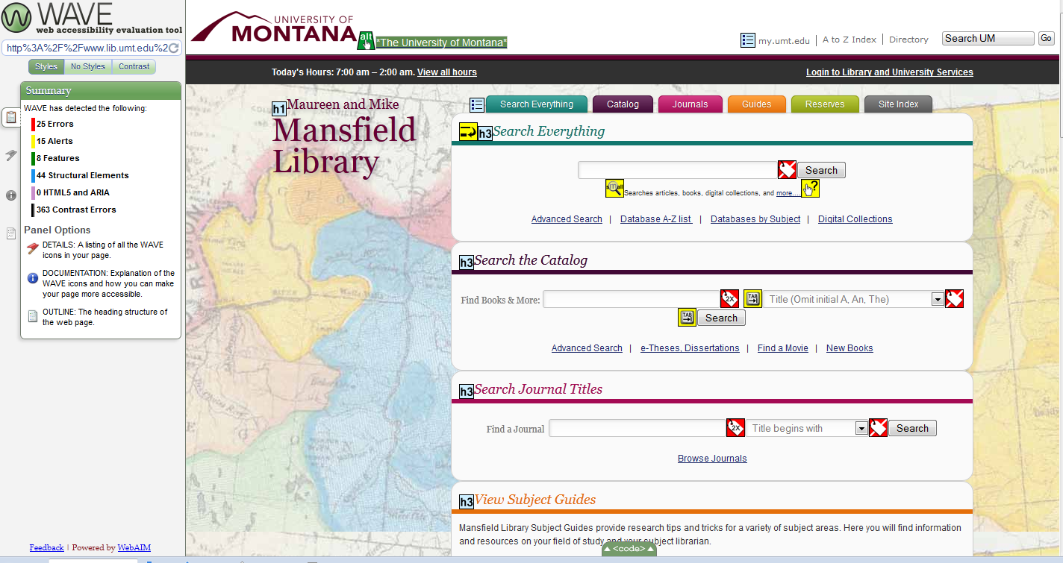
WAVE

Slide 32
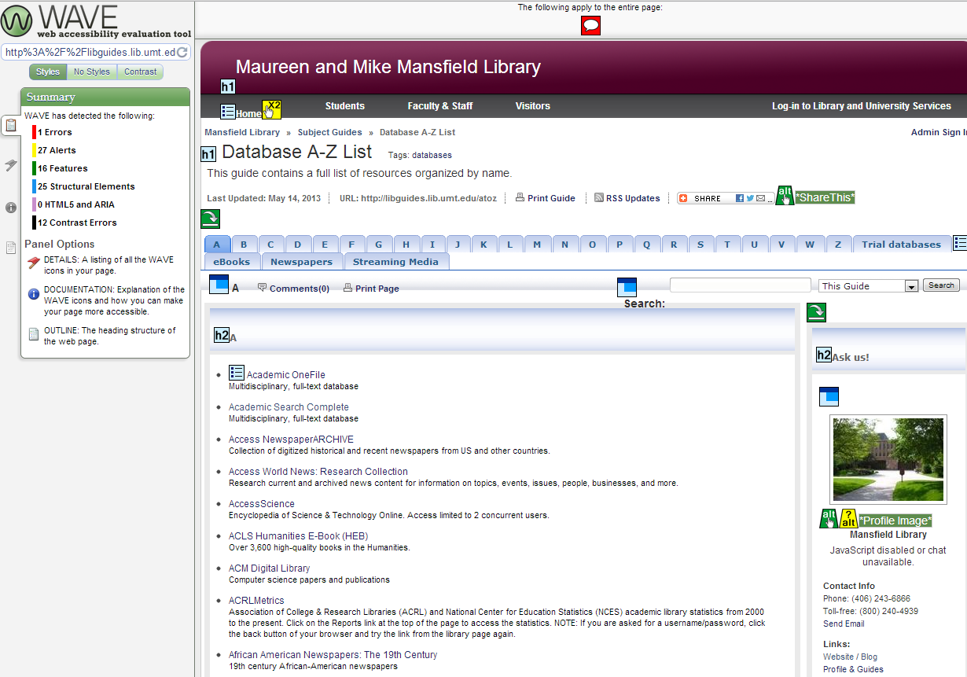
Wave

Slide 33
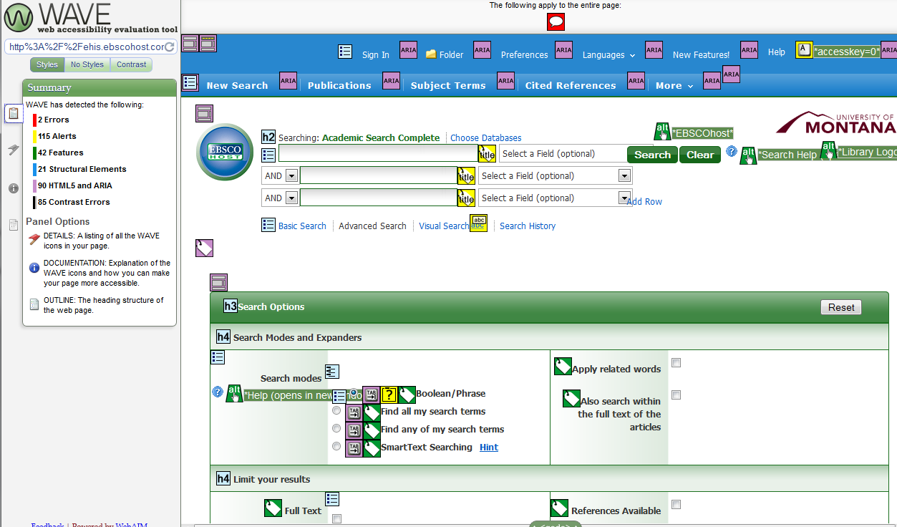
WAVE

Slide 34
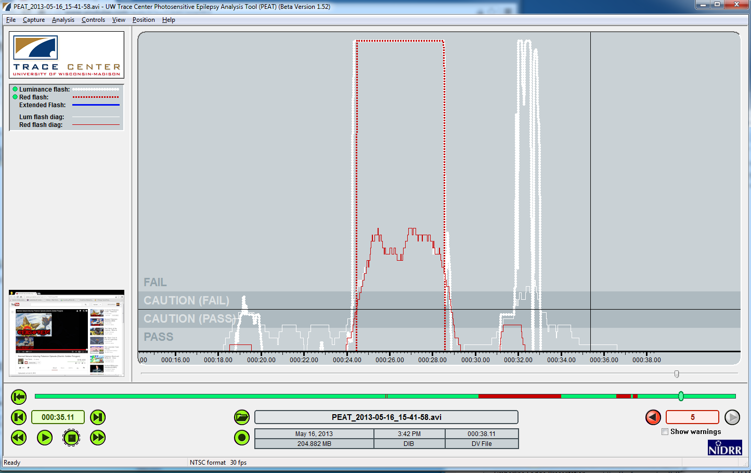
PEAT

Slide 35
Accessible collections for all

Slide 36
Collection Development
Print
Media
Electronic Resources
Electronic Book Readers
Notes:
Print:
Our legacy print collections will be subject to established accommodations. If we digitize these materials, they should be developed with accessibility in mind. New print materials will simply add to the collection of materials that will be accessed via scanning and/or readers.
Media:
Media should be purchased with captions if possible. Media with out captions should be captioned by a third party.
Electronic resources that have accessible web interfaces are a must. Many of the functional criteria outlined earlier in this presentation should be available.
Electronic Readers: Apple’s iPad and iBooks are highly accessible and popular among people with print disabilities.

Slide 37
Licensing
Provider will [make reasonable efforts to]comply with The Americans with Disabilities Act (ADA) requirements, Section 508 of the Rehabilitation Act Amendments by supporting assistive technologies or devices such as large print interfaces, voice-activated input, screen readers, and alternate keyboard or pointer interfaces in a manner consistent with the Web Content Accessibility Guidelines published by the World Wide Web Consortium's Web Accessibility Initiative, which may be found at http://www.w3.org/WAI/GL/#Publications and provide Licensee current completed Voluntary Product Accessibility Template (VPAT)http://www.state.gov/m/irm/impact/126343.htm.
Notes:
There are a few ways to address the licensing of electronic resources. My first course of action was to develop an addendum that states the libraries support for accessibility. The document included some of the functional requirements listed earlier in the presentation. I sent the addendum to several vendors in order to open the conversation about accessibility. The library approached the addendum as non binding, however several vendor’s legal departments declined to recognize the addendum.
After the complaint was filed against the University, I searched the web for established language andI worked in conjunction with the disability services coordinator, the library dean, and the legal department to tweak the statement. This language will be included on all new license agreements. At this point it is unclear if I will be required to renegotiate every license.
Provider will [make reasonable efforts to]comply with The Americans with Disabilities Act (ADA) requirements, Section 508 of the Rehabilitation Act Amendments by supporting assistive technologies or devices such as large print interfaces, voice-activated input, screen readers, and alternate keyboard or pointer interfaces in a manner consistent with the Web Content Accessibility Guidelines published by the World Wide Web Consortium's Web Accessibility Initiative, which may be found at http://www.w3.org/WAI/GL/#Publications and provide Licensee current completed Voluntary Product Accessibility Template (VPAT)http://www.state.gov/m/irm/impact/126343.htm.

Slide 38
Education
Educate everyone
In our digital environment a reasonable accommodation is instant access
Technology provides an opportunity to make electronic resources accessible to all patrons
Remember: Same material, same time, same price, & same quality
Notes:
Educating all library employees on accessibility issues is important. The digital transition in libraries presented an opportunity to provide an increased level of accessibility, but this did not happen. Assuming all electronic materials are accessible will lead to complacency.
Most people have heard the term “reasonable accommodation.” I hope that everyone leaves this presentation with the realization that reasonable accommodation often happens after the point of need and in a digital instant gratification environment the old notions of accommodation are no longer acceptable in many communities. Calling back to the beginning of the presentation, accessibility should be same material, same time, same price, same quality.

