Slide 1

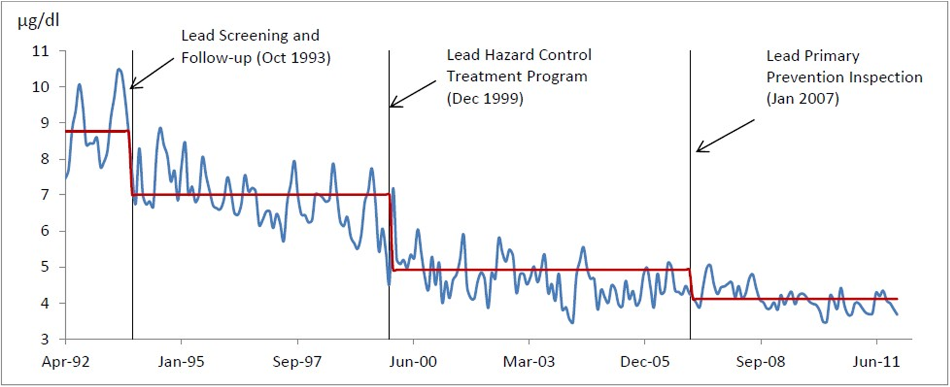
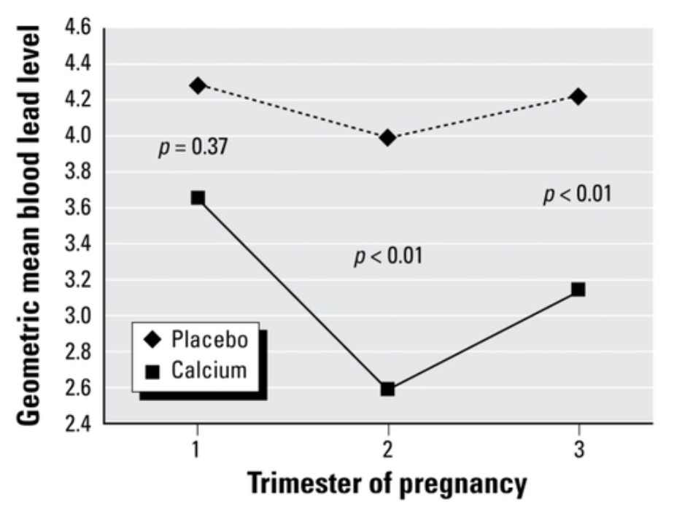
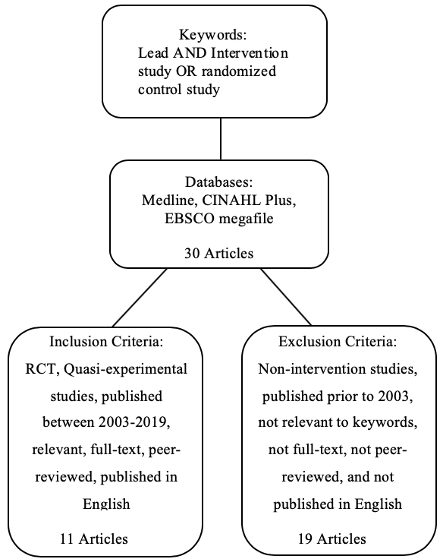
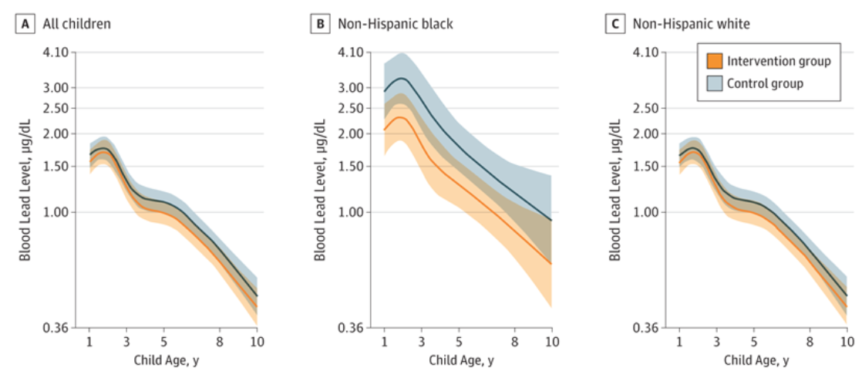
Evaluating Interventions to Reduce Lead Poisoning among Vulnerable Population:
Systematic Review
10.1001/jamapediatrics.2018.2382
Erin Cutts, Katelynn Mann, Alyssa Peterson, Erica Urbina, Angela U. Ekwonye
Public Health Department
Background
Results
Pregnant women who took calcium supplementation, decreased their BLLs by an average of 15% compared to the women who received the placebo (Fig. 3).⁹
Lead poisoning is when a person’s health or body functions are negatively affected by lead contamination in what they eat, drink, touch, or breathe.¹
In 2017, lead exposure accounted for 1.06 million deaths and 24.4 million years of healthy life lost (disability-adjusted life years (DALYs)) worldwide.²
With estimated societal costs in the billions, lead poisoning has a disproportionate impact on low-income and minority children.³
Removing lead-based paint through the replacement of siding, windows, and doors in homes was effective in reducing residential lead exposure and BL concentration (Fig. 1).⁴
Figure 3. Effect of calcium supplementation on maternal blood lead levels at each trimester during pregnancy.⁹
Figure 1. Average shift of children’s BLLs after various interventions in Syracuse, NY.⁴
Objective
In a study to investigate the extent of lead exposure via tap water, women were asked to minimize exposure by flushing water or to exclude it by consuming bottled water. Intervention lowered blood lead-level significantly (median decrease of 11μg/L, p<=0.001).⁵
Household strategies, such as covering contaminated soil, installing water filters, and lead dust management reduced residential dust lead loadings in non-Hispanic black children, without elevating the lead body burden (Fig. 2).⁶
This systematic review seeks to determine effective interventions to reduce lead exposure and ultimately blood lead levels (BLLs) in the vulnerable population.
Discussion
Residential renovations, certain household strategies, and boil advisories were effective at reducing lead exposure through different routes. ^{4,5,6}
Lead screening and supplementation were effective in reducing BLLs among vulnerable populations; whereas chelation therapy was ineffective. ^{8,9}
The effectiveness of education was dependent upon the population of interest, therefore results for this intervention were inconclusive. ⁷
Methods
Figure 2. Childhood Blood Lead Concentrations Ranging From 1 to 8 Years of Age by Race/Ethnicity.⁶
Conclusions
A multicomponent intervention is recommended to reduce BLLs in the vulnerable population.
Residential lead exposure reduction coupled with medical interventions such as screening and calcium carbonate supplementations will effectively lower BLLs.^{4,5,6,9}
A randomized trial of education to prevent lead burden in children at high risk for lead exposure found that education was not a reliable source to prevent lead burden among the high-risk, low income population.⁷
Chelation therapy confirms no proven developmental benefits in children with blood lead levels between 20 and 45 μg/dL.⁸
Limitations
Study limitations include: poor quality surveillance data, loss to follow up, and selection bias in the quasi-experimental studies.
Contact
References
Erin Cutts
St. Catherine University
2004 Randolph Ave, St. Paul, Minnesota
emcutts284@stkate.edu
1. Centers for Disease Control and Prevention. (2019). Childhood Lead Poisoning Prevention. Retrieved from https://www.cdc.gov/nceh/lead/faqs/lead-faqs.htm
2. World Health Organization. (2019). Lead Poisoning and Health. Retrieved from https://www.who.int/news-room/fact-sheets/detail/lead-poisoning-and-health
3. Hanna-Attisha, M., LaChance, J., Sadler, R. C., & Champney Schnepp, A. (2016). Elevated blood lead levels in children associated with the Flint drinking water crisis: a spatial analysis of risk and public health response. American journal of public health, 106(2), 283-290.
4. Shao, L., Zhang, L., & Zhen, Z. (2017). Interrupted time series analysis of children’s blood lead levels: A case study of lead hazard control program in Syracuse, New York. Plos One, 12(2).
5. Fertmann, R., Hentschel, S., Dengler, D., Janßen, U., & Lommel, A. (2004). Lead exposure by drinking water: an epidemiological study in Hamburg, Germany. International Journal of Hygiene and Environmental Health, 207(3), 235–244.
6. Braun, J. M., Hornung, R., Chen, A., Dietrich, K. N., Jacobs, D. E., Jones, R., ... Lanphear, B. P. (2018). Effect of Residential Lead-Hazard Intervention on Childhood Blood Lead Concentrations and Neurobehavioral Outcomes: A Randomized Clinical Trial. JAMA Pediatrics, 172 (10), 934-942.
7. Jordan, C. M., Yust, B. L., Robison, L. L., Hannan, P., & Deinard, A. S. (2003). A randomized trial of education to prevent lead burden in children at high risk for lead exposure: efficacy as measured by blood lead monitoring. Environmental Health Perspectives, 111(16), 1947-1951.
8. Dietrich, K. N., Ware, J. H., Salganik, M., Radcliffe, J., Rogan, W. J., Rhoads, G. G., … Jones, R. L. (2004). Effect of Chelation Therapy on the Neuropsychological and Behavioral Development of Lead-Exposed Children After School Entry. Pediatrics, 114 (1), 19-26.
9. Ettinger, A., Lamadrid-Figueroa, H., Téllez-Rojo, M., Mercado-García, A., Peterson, K., Schwartz, J., Hu, H., Hernández-Avila, M. (2009). Effect of Calcium Supplementation on Blood Lead Levels in Pregnancy: A Randomized Placebo-Controlled Trial. Environmental Health Perspectives, 117 (1).

