Slide 1

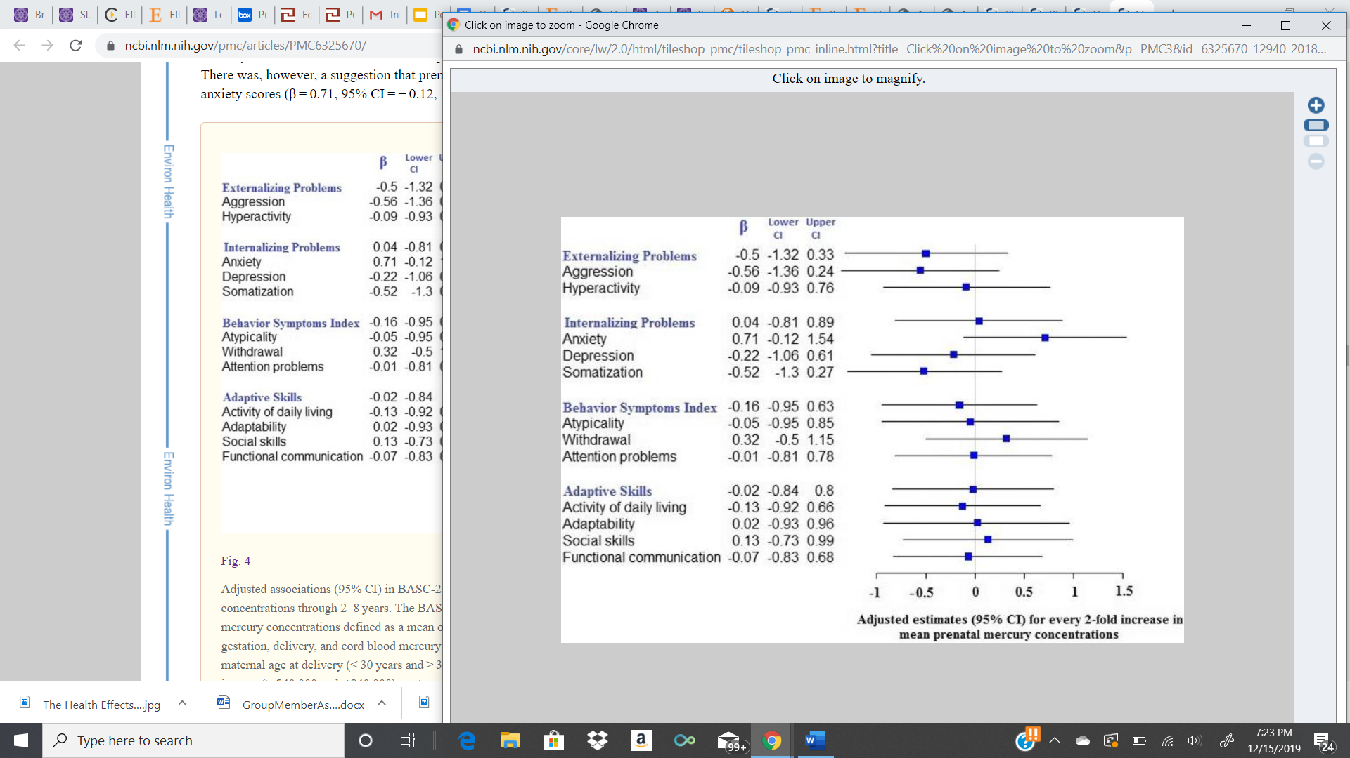
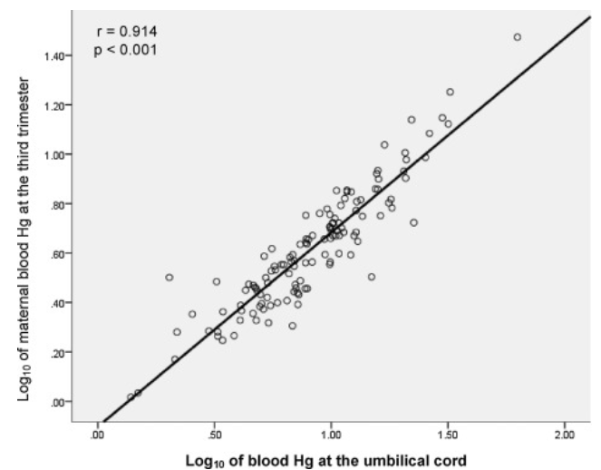
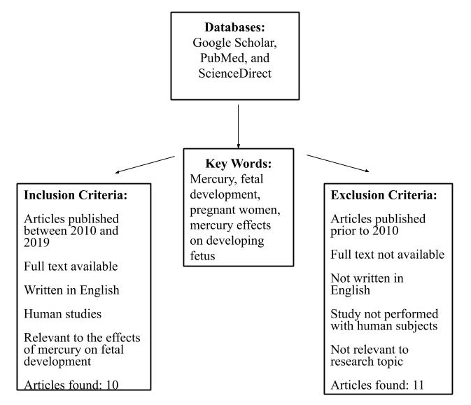
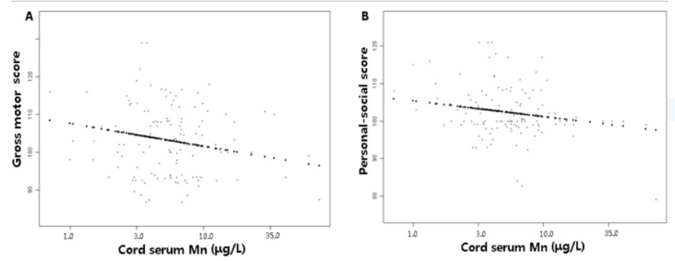
The Health Effects of Fetal Mercury Exposure- A Systematic Review
Addison Mommsen, Raw Raen, De Paw, Georgianne Kinsman & Angela U. Ekwonye, PhD, CPH
Public Health Department, St. Catherine University
Background
Results
Figure 4. Adjusted estimates (95% CI) for every 2-fold increase in mean prenatal mercury concentration ⁷
Mercury is one of the top ten chemicals that pose a public health concern (World Health Organization¹.
More than 600,000 newborns per year experience in utero mercury exposures¹
Mercury exposure can affect anyone, but exposure is higher when certain fish types are regularly consumed or when living in close proximity to factories ^{2, 3}
Pregnant women are exposed to a high level of mercury through ingestion of the metal in water, medicine, or fish consumption ⁴.
Consumption of fish 5 times per week was strongly and positively correlated with high mercury levels in umbilical cord blood, indicating a high placental transfer of maternal mercury to the fetus (Fig. 2)⁵.
Figure 2. Relationship between blood mercury contents and fish consumption
Objective
Discussion
This review seeks to determine and assess the health effects of fetal mercury exposure through a systematic review of current literature.
Methylmercury affect the neurological system, behavior, and birthweight in children ⁵.
Mercury exposure delayed psychomotor and mental performance in infants and later neurocognitive development in children (Minai, 2016).⁶
Low levels of mercury exposure lead to BASC-2 anxiety in some children ⁷
Prenatal mercury exposure is associated with low levels of 5hmC in DNA. 5hmC is crucial in embryogenesis and cell lineage commitment ⁸
Lower brain-derived neurotrophic factor (BDNF) level was correlated with poor neurodevelopment in children at 1 year of age (Fig. 3) ⁹
Fetuses and infants are particularly vulnerable to mercury as it can cross the placental barrier during pregnancy and can be in breast milk after birth ⁵
Mercury exposure is associated with reduced neurocognitive development, low birth weight, and preterm birth ¹⁰
Fetal mercury exposure is also linked to anxiety in some children, and girls are more prone to the negative effects than boys ⁷.
Mothers can minimize the risk of exposure to mercury through reduction in the consumption of fish and the termination of use of household items such as anti-aging products and skin lighteners. ⁵
Methods
Conclusions
Figure 3. BDNF level correlation with poor neurodevelopment
To combat the adverse health effects of methylmercury exposure, food and water could be tested more often for mercury.
Stronger regulations at the state level to reduce the use of methylmercury in factories and limit the inhalation of methylmercury.
Healthcare professionals can educate women who are pregnant or could become pregnant on the effects of methylmercury and how they can avoid exposure in their daily lives.
Public Health Implication
This literature review call for policymakers to increase regulation of seafood for the presence of mercury and implement educational health promotion programs to better educate pregnant mothers.
Limitations
Figure 1. The process of article selection.
Loss to follow up; Women with chronic diseases, had more than one child, and who were under 20 were excluded
Contact
References
Addi Mommsen
St. Catherine University
2004 Randolph Ave, St. Paul, Minnesota
amommsen219@stkate.edu
(612)-751-7907
1The World Health Organization. (2017). Mercury and Health. Retrieved from https://www.who.int/news-room/fact-sheets/detail/mercury-and-health
2Gong X., Lin, Y., Bell M.L., Zahn F.B. (2018). Associations between maternal residential proximity to air emissions from industrial facilities and low birth weight in Texas, USA. 120: 181–198.
3Koren, G., & Bend., R. J. (2010). Fish consumption in pregnancy and fetal risks of methylmercury toxicity. The National Institute of Medicine, 56(10): 1001–1002.
4Kim, Y., Ha, E.H., Park, H., Ha, M., Kim, Y., Hong, Y.C...Kim, B.N. (2018). Prenatal mercury exposure, fish intake and neurocognitive development during the first three years of life: Prospective cohort mothers and Children's environmental health (MOCEH) study. Science of the Total Environment, (615),1192-1198.
5Vigeh, M., Nishioka, E., Ohtani, K., Omori, Y., Matsukawa, T., Koda, S., Yokoyama, K.(2018). Prenatal mercury exposure and birth weight. Reproductive Toxicology, 76,78-83.
6Minai., M. (2016). Methylmercury and Human Embryonic Development. The Embryonic project Encyclopedia. Retrieved from https://embryo.asu.edu/pages/methylmercury-and-human-embryonic-development
7Patel, N.B., Xu, Y., McCandless, L.C., Chen, A., Yolton, K., Braun, J... Lanphear BP.(2019). Very low-level prenatal mercury exposure and behaviors in children: the HOME Study. Environmental Health: a global access science source, 18(1)4.
8Cardenas, A., Rifas-Shiman, S.L., Godderis, L., Duca, R.C., Navas-Acien, A., Litonjua, A.A…Baccarelli, A.A. (2017). Prenatal exposure to mercury: associations with global DNA methylation and hydroxymethylation in cord blood and in childhood. Environmental Health Perspect, 29;125(8):087022.
9Yu, X., Chen, L., Wang, C., Yang, X., Gao, Y., & Tian, Y. (2016). The role of cord blood BDNF in infant cognitive impairment induced by low-level prenatal manganese exposure: LW birth cohort, China. Chemosphere, 163, 446-451.
10Xiang, H, Tao, Y., Zhang, B., Liang, C., Li, Z., Feng, L...Tao, F. (2019). Protective effect of high zinc levels on preterm birth induced by mercury exposure during pregnancy: A birth cohort study in China. Journal of Trace Elements in Medicine and Biology, 55, 71-77.

