Slide 1
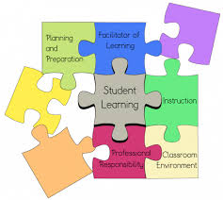

Be Prepared: Do Secondary Teachers Relate SCRIP to the Classroom
Virginia Educational Research Association--2014
Kristina DeWitt, Ph.. D.
Andrea Beam, Ed. D.

Slide 2
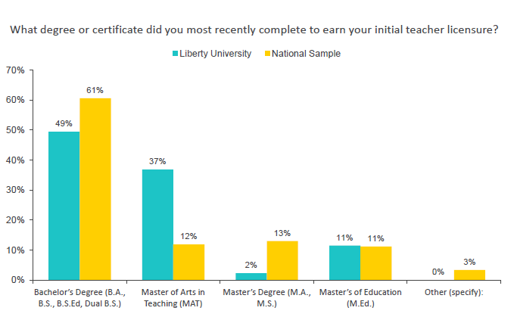
Program Completion
Comparison with National Average

Slide 3
Theoretical Discussion
Dispositions defined by NCATE (now CAEP)
Professional attitudes, values, and beliefs demonstrated through both verbal and nonverbal behaviors as educators interact …(paragraph)
Based on observable measures and through educational settings.
Professional dispositions relate to
Teacher’s educational preparedness and activities

Slide 4
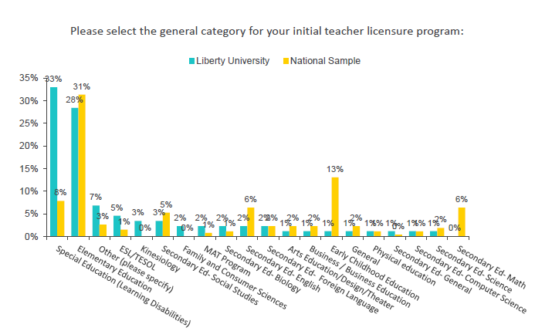
Program Completion by Category

Slide 5

What is S-C-R-I-P?
Commitment/Work Ethic
CONCEPTUAL FRAMEWORK
LIBERTY UNIVERSITY
SCHOOL OF EDUCATION
Social responsibility
Integrity
Reflective Practice
Professionalism

Slide 6
Teacher Preparation Highlights
Learner Development
  Take responsibility for promoting learners’ growth and development.
Learning Differences
  Make learners feel valued, help them learn to value each other, and integrate diverse languages and dialects into instruction.
  Work with students to identify challenges and make progress on IEP goals.

Slide 7
Teacher Preparation Highlights
Assessment
  Differentiate assessments or testing conditions for learners with disabilities.
Professional Leaning and Ethical Practice
  Understand and incorporate current research and policy implications into own practice.
Leadership and Collaboration
  Work to maintain harmony between family, school, and community values and interests.

Slide 8
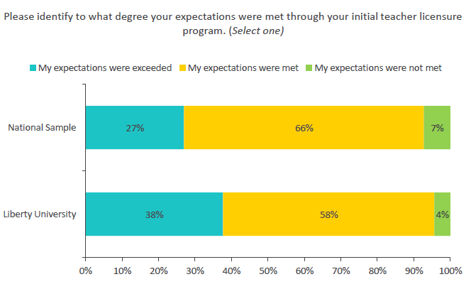
Teacher Preparation
Overall Expectations

Slide 9
Q & A

Slide 10
Contact Information
Dr. Kristina DeWitt
  Liberty University
  434-582-2194
  kdewitt@liberty.edu
Dr. Andrea Beam
  Liberty University
  434-582-2192
  abeam@liberty.edu

