Slide 1


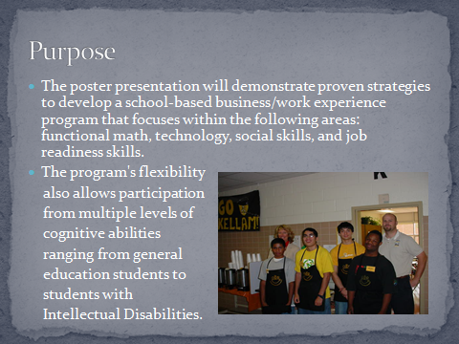
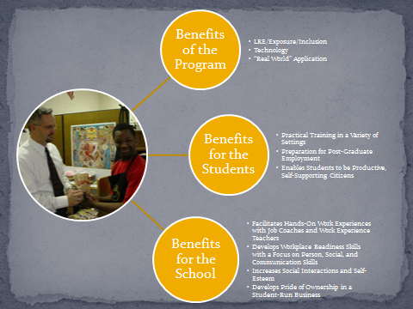
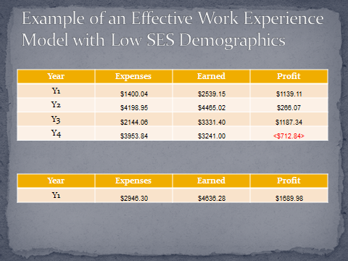
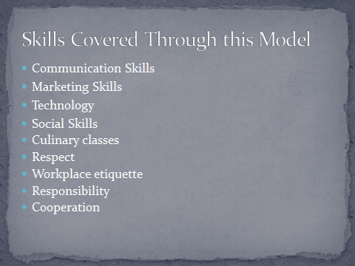
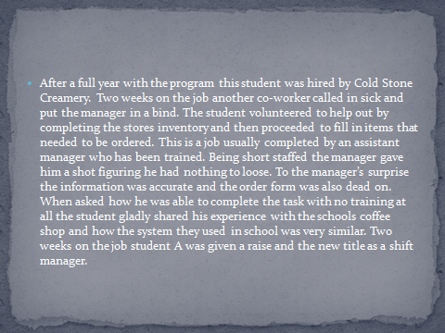
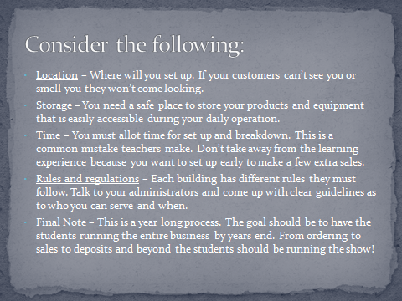
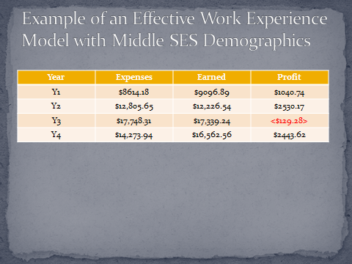
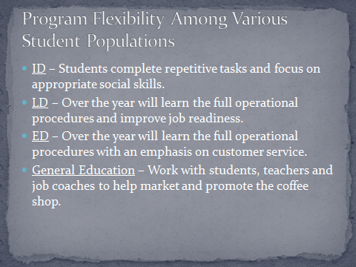
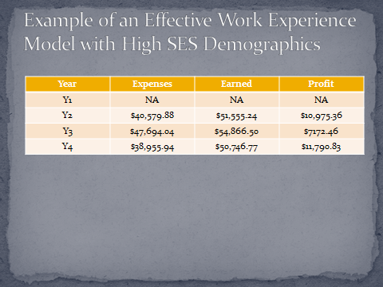
Designing a School-Based Business/Work Experience Program for Students with Disabilities
Andrea P. Beam, Ed.D.
Liberty University, Lynchburg, VA
INTRODUCTION
BENEFITS
RESULTS
CROSS-CUTTING THEMES
HOW TO DESIGN A BUILDING-APPROPRIATE MODEL
SUCCESS STORY
CONTACT
Andrea P. Beam, Ed.D.
Liberty University
abeam@liberty.edu
Allen R. Hackmann, M.Ed.
Lynchburg City Schools
hackmannar@lcsedu.net

