Slide 1
Differentiation and Faith: Finding Every Student’s God Given Talents to Improve the Learning Process
ICCTE Conference 2010
Andrea P. Beam, Ed. D.
Deanna L. Keith, Ed. D.

Slide 2
Agenda
1
Welcome
2
Multiple Intelligence Test
3
Differentiation
4
Integration of Faith and Learning

Slide 3
What is Differentiation?
Diversity
Addresses the Issues of . . .
Academic Ability/Learning Styles
Interests
Culture
Motivation
By utilizing multiple modes of instruction and assessment to meet learning needs.

Slide 4
Why Use Differentiation?
Freedom of choice
Students learn best in environments that allow
Open-ended exploration
Freedom from judgment
Validation of every student’s experience
Belief in every student’s genius

Slide 5
Multiple Intelligences in Children
Linguistic
Think in words; Love reading, writing, telling stories; Need books, tapes, discussion, debates
Logical-Mathematical
Think by reasoning; Love experimenting, questioning, puzzles; Need manipulatives, trips to planetarium/museum
Spatial
Think in images and pictures; Love designing, drawing, visualizing; Need art, videos, movies
Bodily-Kinesthetic
Think through somatic sensations; Love dancing, running, jumping; Need role play, movement, hands-on
Musical
Think via rhythm and melodies; Love singing, whistling, humming; Need sing-along time, music playing

Slide 6
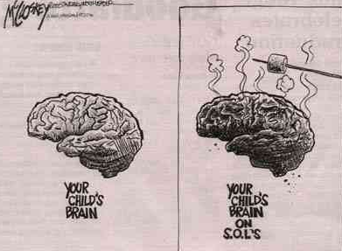
Standards of Learning

Slide 7
How to Differentiate
1
Independent Study
2
Tiered Activities
3
Flexible Grouping
4
Alternative Assessment

Slide 8
Integration of Faith and Learning
Psalm 139:13-16
Fearfully and wonderfully made
Verse
Mark 7: 31-37
The healing of the deaf and mute man
Verse
Luke 14:13-14a
Inviting the poor
Verse

Slide 9
Thank You !
Andrea P. Beam, Ed. D. Deanna L. Keith, Ed. D.
Liberty University Liberty University
(434) 582-2192 (434) 582-2417
abeam@liberty.edu dlkeith@liberty.edu

