Slide 1

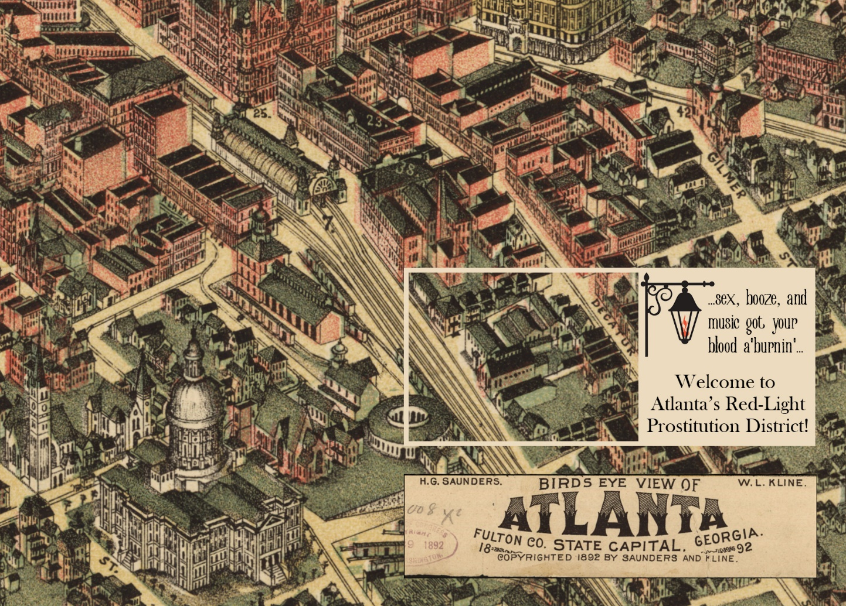
SIN in a SOUTHERN CITY
The Unearthed History of Atlanta’s Postbellum-to-Progressive Era
Prostitution Trade
presented by
Dr. Mandy Swygart-Hobaugh &
Allyson Stephens
This work is licensed under a Creative Commons CC BY-NC-ND International License.
Atlanta Studies 2022 Symposium | May 6
Notes:
This presentation was given by Dr. Mandy Swygart-Hobaugh (Georgia State University Library faculty member) and Allyson Stephens (Georgia State University Sociology graduate student) at the 2022 Atlanta Studies Symposium. The presenters describe the methodology and share preliminary analyses of US Census data on Atlanta’s prostitution trade from 1880 through 1910. The presented research is a component of a larger project to reconstruct the lost history of the rise and fall of Atlanta’s prostitution trade from the Postbellum Era through the Progressive Era, drawing from newspapers, US Census data, city directories, property records, maps, and more. This site provides a fuller narrative of this history and will be updated as the research project continues: lib.gsu.edu/historicharlots
NOTE: The presentation slides are best viewed using the PowerPoint Slide Show mode, as many of the individual slides have animation effects. We also recommend reading the Presenter Notes fields, as they further annotate the slide content.
This work is licensed under a Creative Commons CC BY-NC-ND International License.

Slide 2

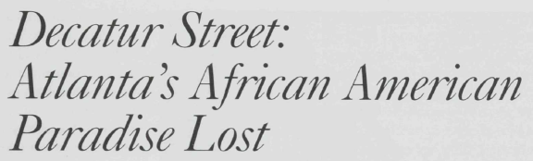


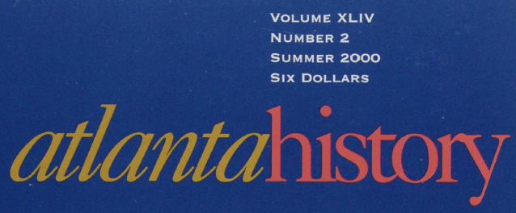



Down the rabbit hole…
Historic harlots?! Literally where I now work?! Oooo!
KUDOS to GSU Library folx!
Electronic Resources:
Braegan Abernethy
Whitney Bates-Gómez
Omr’e Harris
Norman Melville
Brenda Wakefield
Digital Projects & Collections:
Michelle Asci
Hal Hansen
Rachel Senese
Collection Development:
Skye Hardesty
Atlanta Studies 2022 Symposium | May 6
Notes:
Impetus for this research project: GSU University Library Associate Dean Bryan Sinclair shared GSU Emeritus Professor Harvey Newman’s article – “Decatur Street: Atlanta’s African American Paradise Lost” – with presenter Dr. Mandy because it had a brief discussion of the turn-of-the-19th-to-20th century Collins Street prostitution district; he knew of Dr. Mandy’s dissertation research on Chicago anti-prostitution crusades and her interest in the New Orleans Storyville red-light district, both during the same historical period → led Dr. Mandy down the rabbit hole of exploring digital resources (e.g., Atlanta Constitution newspaper database; Ancestry Library Edition database for census records, city directories, property records, wills, etc.; Digital Sanborn Maps collection) to unearth this largely unknown history of Atlanta’s prostitution trade in this time period.

Slide 3
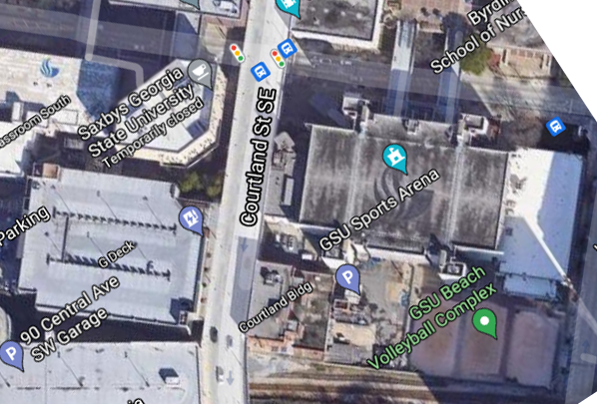
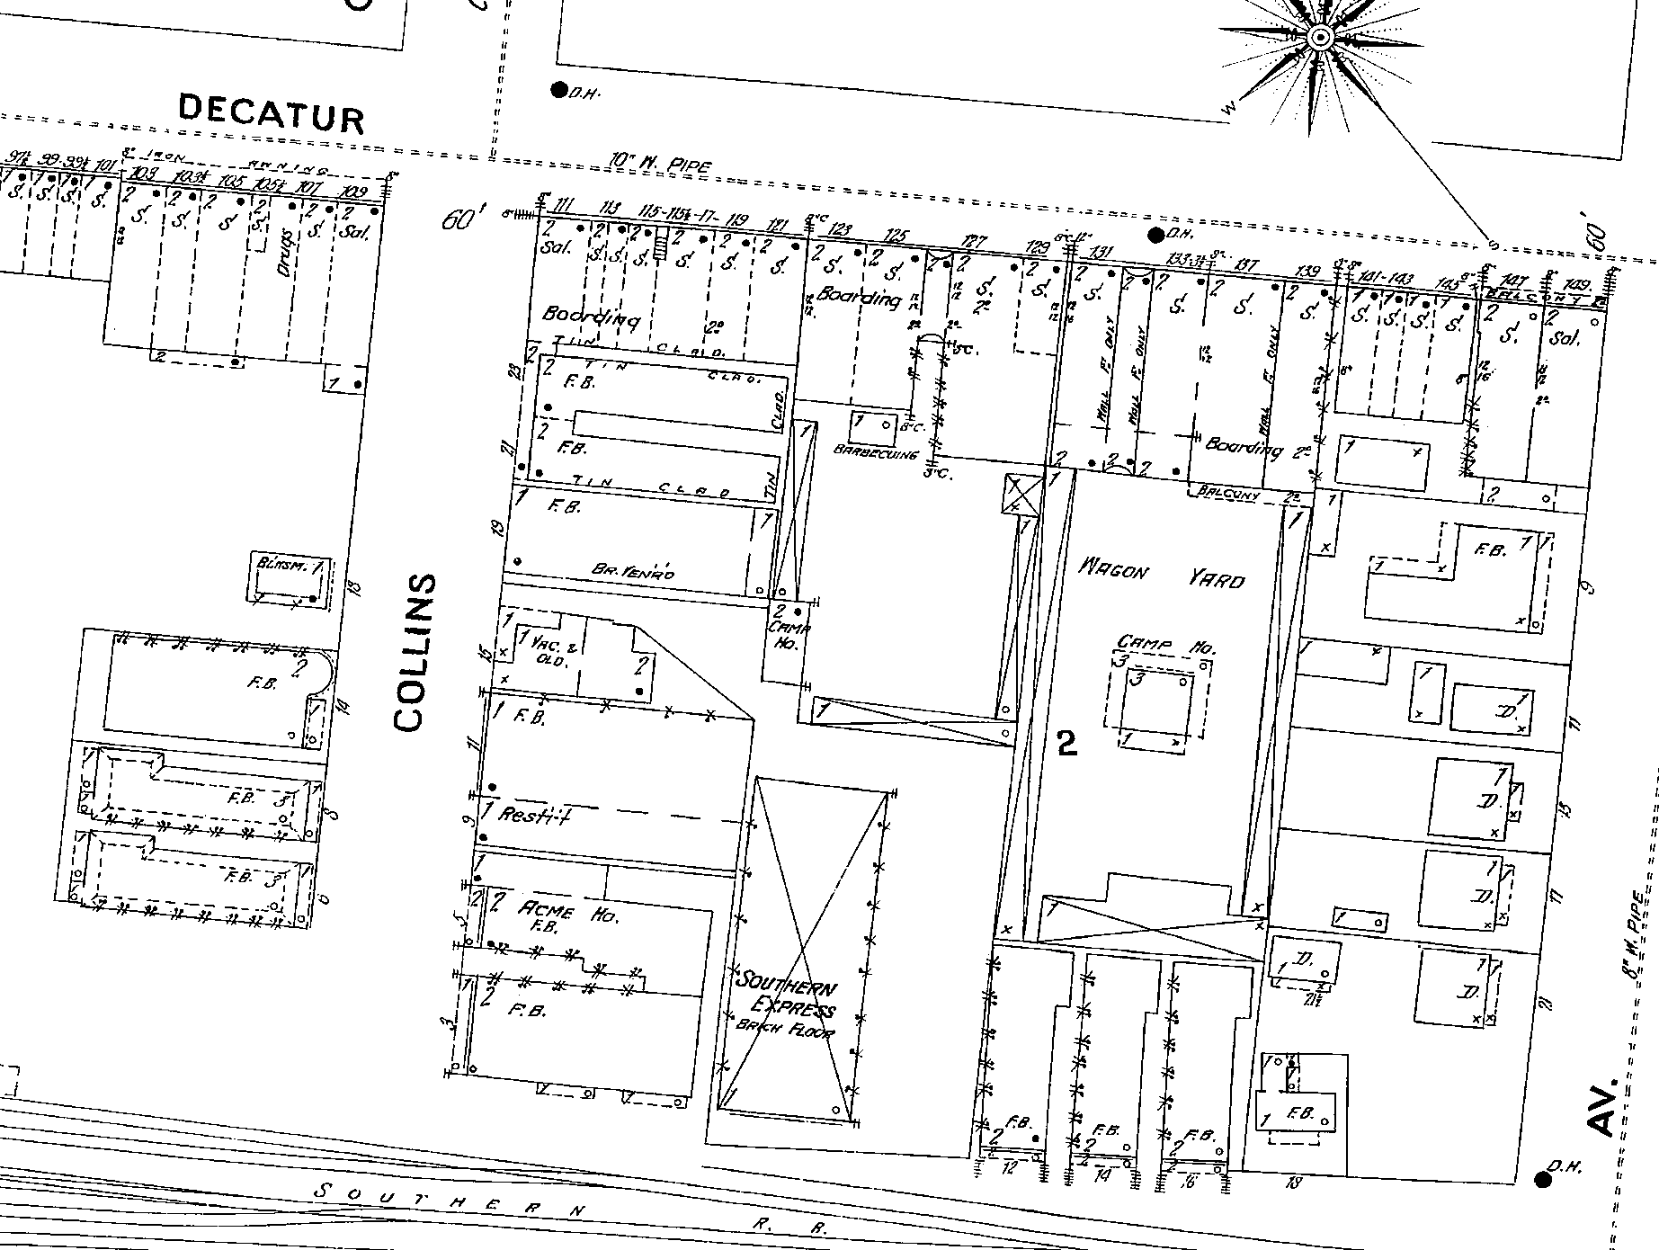
“Female Boarding”
or “F.B.” = brothels
NOW
THEN
1899
Atlanta Studies 2022 Symposium | May 6
Notes:
Map of Collins Street area today (from Google Maps) overlayed on an 1899 map (from Digital Sanborn Maps). The Courtland Street Bridge pictured in the contemporary map runs parallel over Collins Street; originally called the Washington Street viaduct because it connected Courtland Street to Washington Street over the railroad tracks, the bridge was built in 1907. NOTE: Other researchers have documented that Sanborn Map makers were known to denote dwellings used for prostitution as “female boarding” or “F.B.” for short.

Slide 4
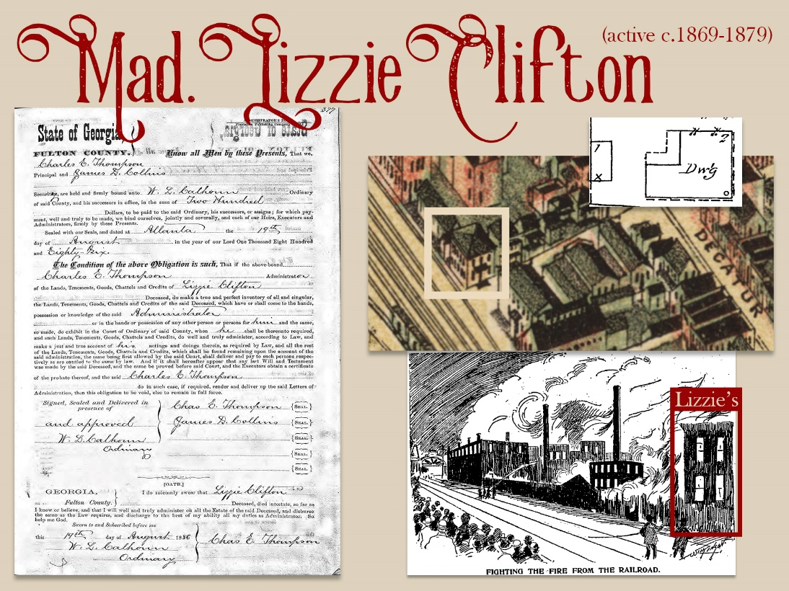
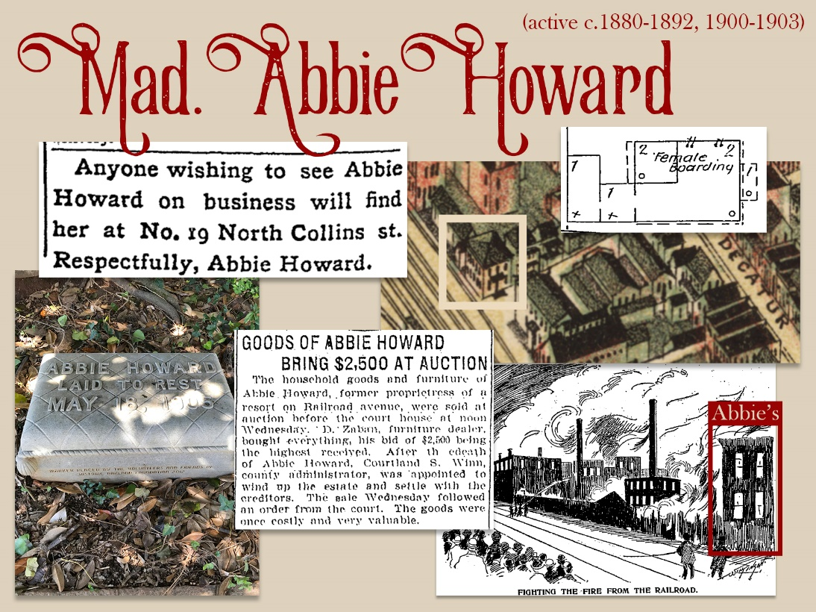
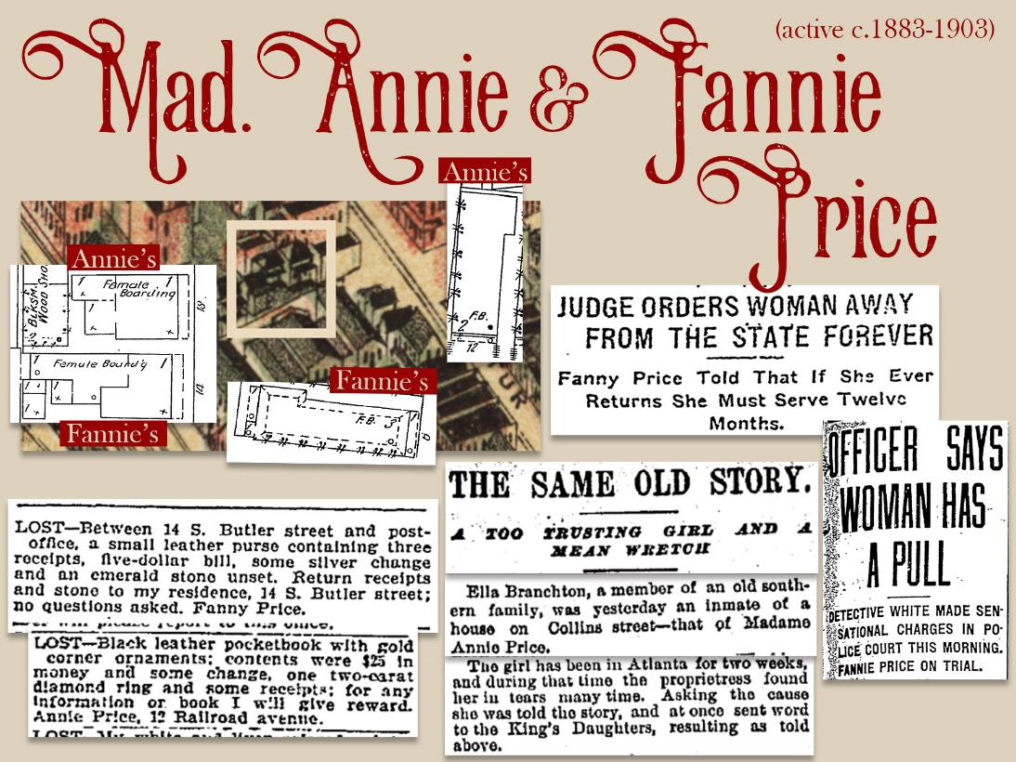
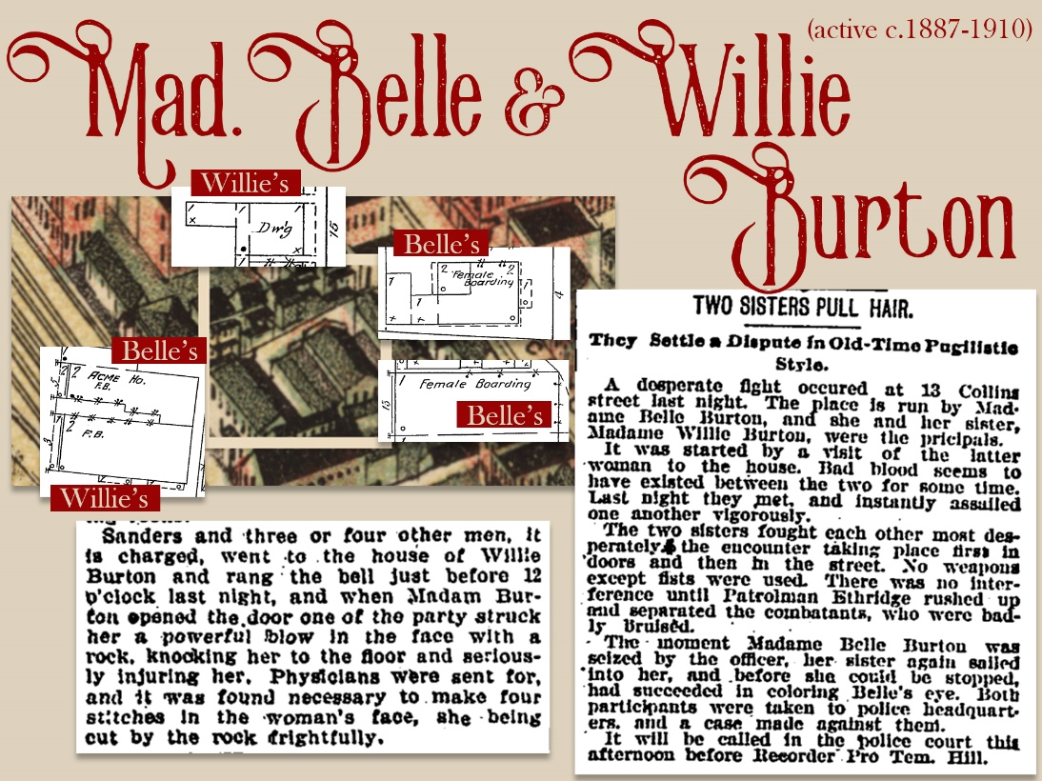

lib.gsu.edu/historicharlots
Atlanta Studies 2022 Symposium | May 6
Notes:
While this presentation focuses specifically on exploring the Atlanta US Census data for the time period, Dr. Mandy’s digital story map site (https://lib.gsu.edu/historicharlots) provides a fuller narrative drawn from newspapers, census records, city directories, property records, maps, and more digital resources – Dr. Mandy will continue to develop this site as she continues her research.

Slide 5
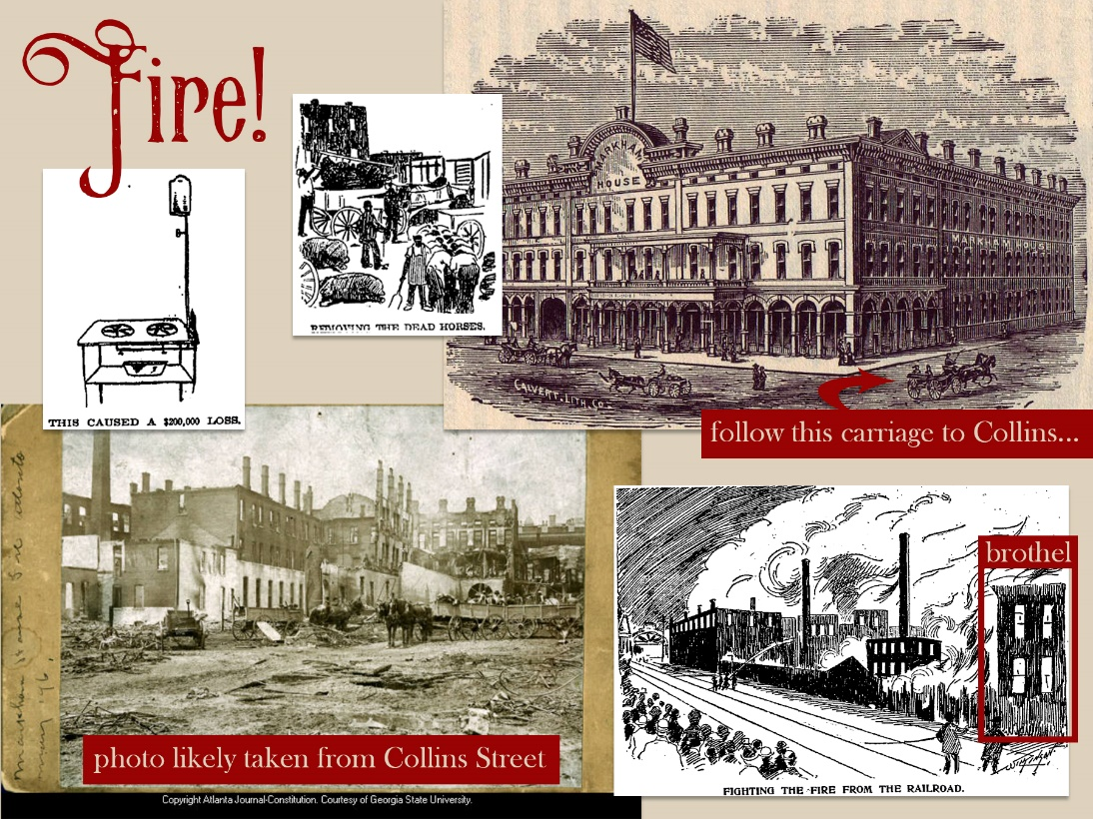
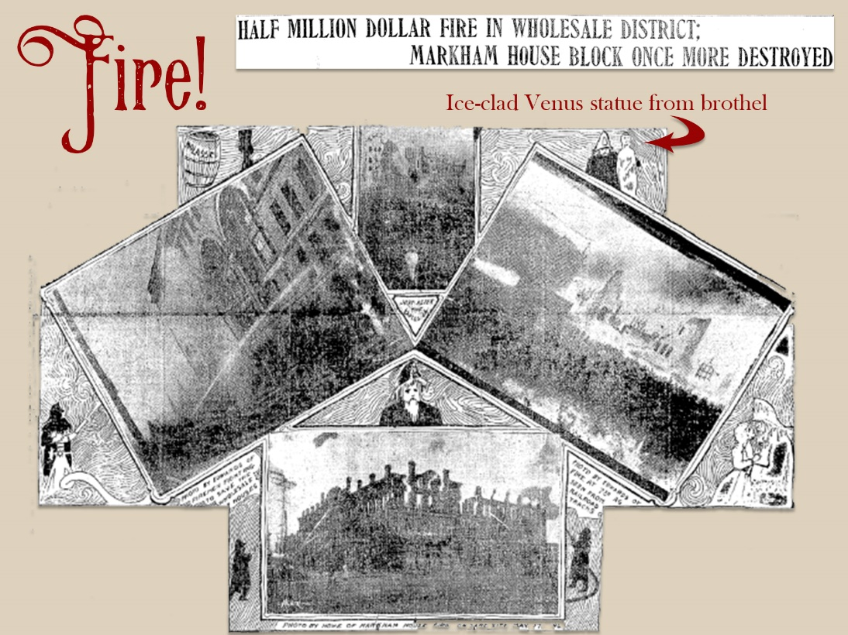
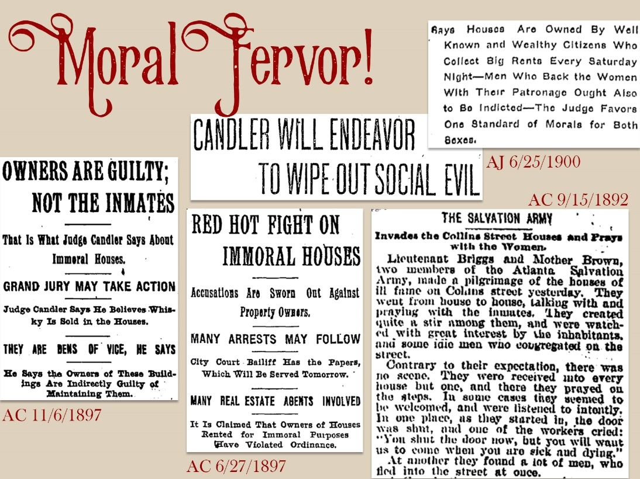
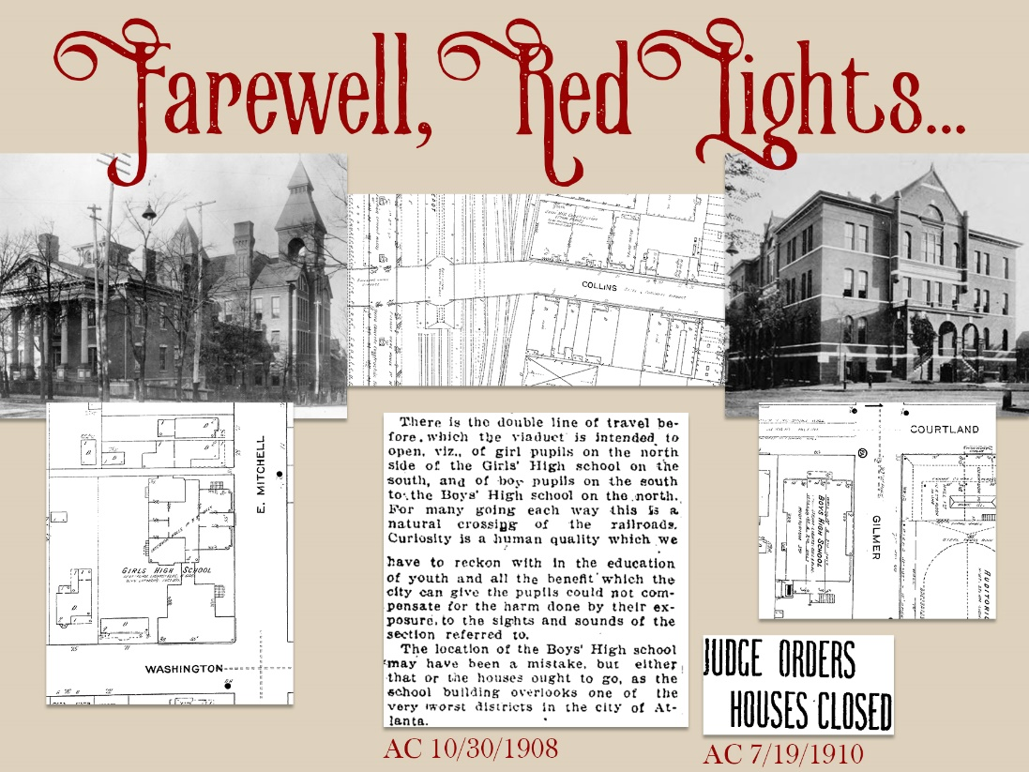
lib.gsu.edu/historicharlots
Atlanta Studies 2022 Symposium | May 6
Notes:
While this presentation focuses specifically on exploring the Atlanta US Census data for the time period, Dr. Mandy’s digital story map site (https://lib.gsu.edu/historicharlots) provides a fuller narrative drawn from newspapers, census records, city directories, property records, maps, and more digital resources – Dr. Mandy will continue to develop this site as she continues her research.

Slide 6
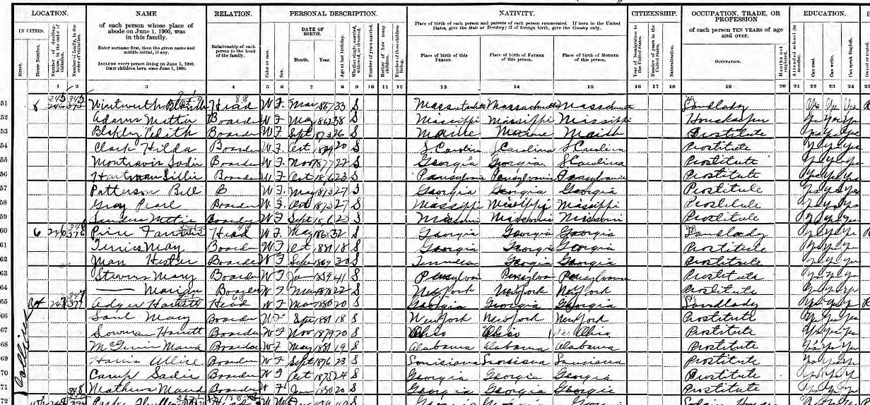
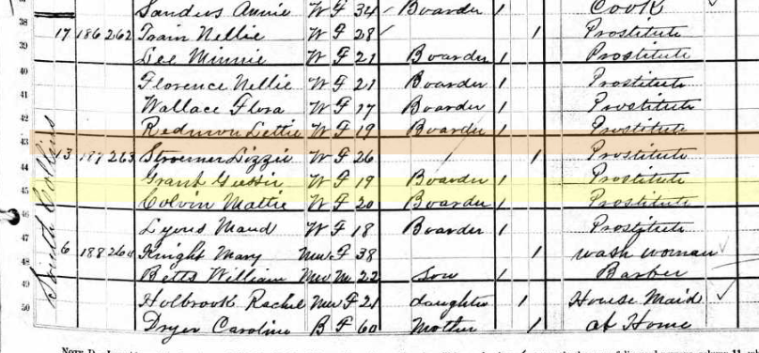
Madam? Prostitute…?
ATL US Census: Houses with women residents w/ Occupation of “Prostitute” & “Landlady” (aka Madam)
ATL 1900 US Census
ATL 1880 US Census
Notes:
Overview of how the presenters were able to identify madams and prostitutes from the Atlanta US Census records – explicit occupation enumeration. NOTE: While it’s possible that other cities for this time period may have enumerated occupations/industry information that explicitly represented persons as engaging in the prostitution trade, it is clear from some exploration of other cities (e.g., Chicago and New Orleans) that there is variation in practices.

Slide 7
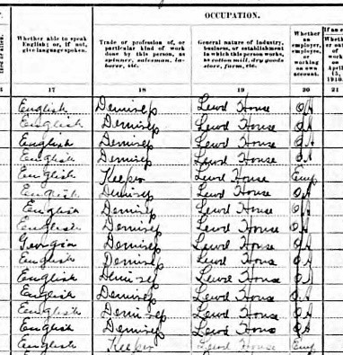
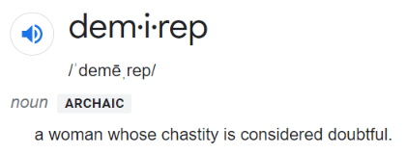
Madam? Prostitute…?
ATL 1910 US Census:
Madam = “Keeper”
Prostitute = “Demirep”
“Lewd House” = “general nature of industry”
Notes:
Overview of how the presenters were able to identify madams and prostitutes from the Atlanta US Census records – explicit occupation enumeration. NOTE: While it’s possible that other cities for this time period may have enumerated occupations/industry information that explicitly represented persons as engaging in the prostitution trade, it is clear from some exploration of other cities (e.g., Chicago and New Orleans) that there is variation in practices.

Slide 8
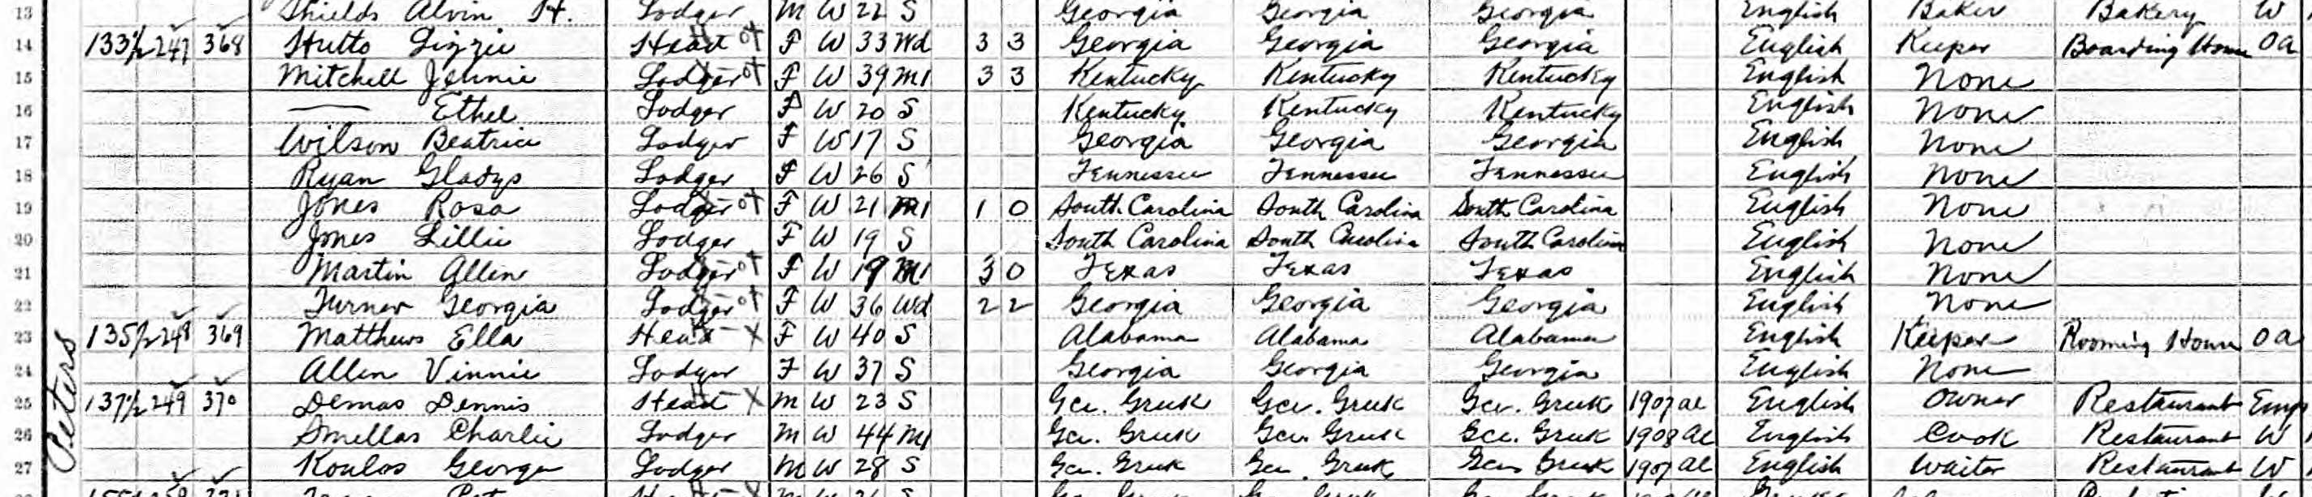
Madam? Prostitute…?
ATL 1900 & 1910 US Census: Woman “Keeper” or “Proprietor” of “Boarding” or “Lodging House” w/ multiple young women boarders/lodgers indicating an occupation of “None”…
→ cross-check household head name and street address against listing in the City Directory* to see if indicated as “Madam” or “Mad.”
*1880 Atlanta city directory not yet indicating if a woman was a madam.
Notes:
Overview of how the presenters were able to identify madams and prostitutes from the Atlanta US Census records – cross-checking with the Atlanta city directory listings, which denoted women running known houses of prostitution as “Madam”, ”Madame”, or ”Mad” for short (e.g., screenshot from city directory listing for Madam Lizzie Huttz at 133 ½ Peters Street). NOTE: While it’s possible that other cities for this time period may have enumerated occupations/industry information that explicitly represented persons as engaging in the prostitution trade, it is clear from some exploration of other cities (e.g., Chicago and New Orleans) that there is variation in practices.

Slide 9
US Federal Census – Information Collected* | 1880 | 1900 | 1910
Street Name |  | X | X
House No. | X | X | X
Race | X | X | X
Sex | X | X | X
Age | X | X | X
Marital Status | X | X | X
Years Married |  | X | X
Children – Births |  | X | X
Children – Living |  | X | X
Place of Birth – Self, Father, Mother | X | X | X
Occupation | X | X | X
Industry |  | X | X
Can Read? Can Write? | X | X | X
Home Owned or Rented |  | X | X
Harmonizing Data across Census Years
RACE
1880 & 1910: Black recorded as Black (B) or “Mulatto” (M); 1900: Only recorded Black (B)
Race could be decided by census enumerator, not necessarily self-reported
MARITAL STATUS
1880: Widowed and Divorced collapsed; 1900 & 1910: Widowed and Divorced recorded separately – Single (S), Married (M), Divorced (D), Widowed (Wd)
READ/WRITE
1880: Tick mark if Cannot Read/Write; 1900 & 1910: Recorded as Can Read/Write? Yes or No
*X = data collected; blank = not collected
Notes:
Overview of what information was collected for each year of the census (X in a cell indicates data collected for that year) and considerations for harmonizing the data across the years for data exploration. Presenters entered data into an Excel spreadsheet and then imported into SPSS statistical software for data exploration. Data transformations included:
Some textual data was left as “string” data type because it allowed for generating basic descriptive statistics (counts/frequencies and percentages), while other textual data was recoded to “numeric” with number values representing categories to allow for appropriate tests of statistical difference (means comparisons and crosstabs/chi-square tests).
The race variable was recoded into a two-category variable to harmonize the data across years.
The 1900 & 1910 marital status categories of “widowed” and “divorced” were collapsed for harmonization with the 1880 data.
The 1880 literacy data (tick mark if cannot read or write) was reverse coded to harmonize with the 1900 & 1910 data (yes/no if can read or write).

Slide 10
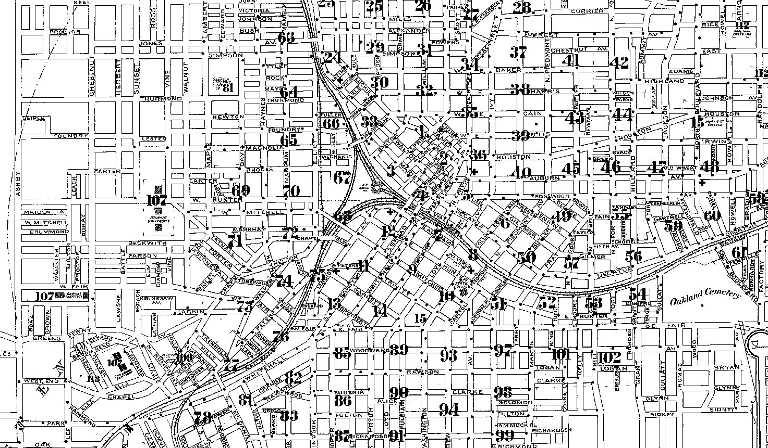

Map of Atlanta – 1899
Most Popular Streets | Count | % TTL
Collins St / Georgia RR St | 196 | 45.8%
Courtland St | 47 | 11.0%
Decatur St | 53 | 12.4%
Line St | 23 | 5.4%
Thompson St / Madison Ave | 16 | 3.7%
Peters St | 20 | 4.7%
S Broad St | 14 | 3.3%
We are here!
Post-1910s
Scattered in 1880 –
often rooms/apts in
multi-family dwellings
Collins District
(1880s-1910s)
 | 1880 | 1900 | 1910 | ALL
Madam/Prostitutes Madams Prostitutes | 98 9 89 | 149 23 126 | 181 23 158 | 428 55 373
Households | 33 | 25 | 23 | 81
Avg per Household | 2.97 | 5.96 | 7.87 | 5.28
Atlanta Studies 2022 Symposium | May 6
Notes:
1899 Atlanta map (from Digital Sanborn Maps) and descriptive statistics regarding areas where madams/prostitutes were residing in this time period plus statistics (parsed by year and all years combined) of counts of madams, prostitutes, households, and average persons per household.

Slide 11
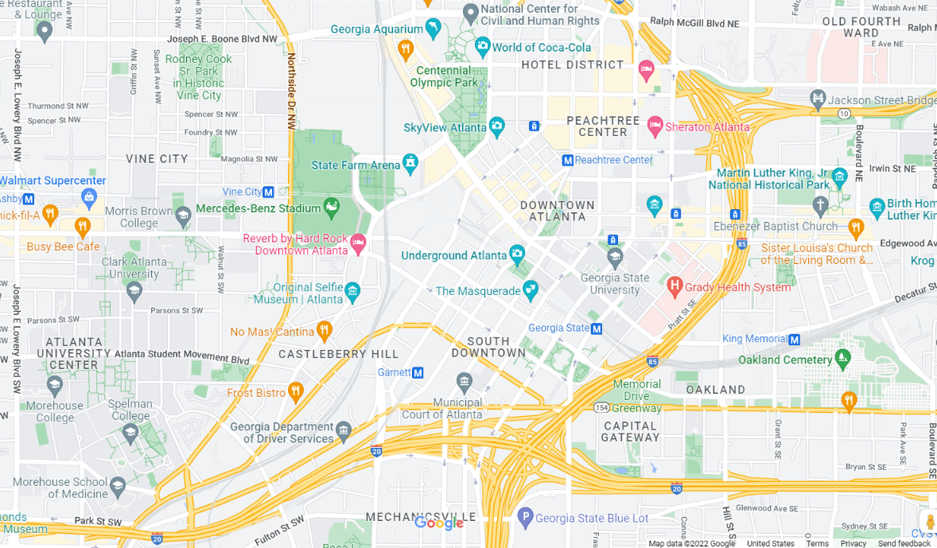
Map of Atlanta – NOW
Most Popular Streets | Count | % TTL
Collins St / Georgia RR St | 196 | 45.8%
Courtland St | 47 | 11.0%
Decatur St | 53 | 12.4%
Line St | 23 | 5.4%
Thompson St / Madison Ave | 16 | 3.7%
Peters St | 20 | 4.7%
S Broad St | 14 | 3.3%
We are here!
Post-1910s
Scattered in 1880 –
often rooms/apts in
multi-family dwellings
Collins District
(1880s-1910s)
 | 1880 | 1900 | 1910 | ALL
Madam/Prostitutes Madams Prostitutes | 98 9 89 | 149 23 126 | 181 23 158 | 428 55 373
Households | 33 | 25 | 23 | 81
Avg per Household | 2.97 | 5.96 | 7.87 | 5.28
Atlanta Studies 2022 Symposium | May 6
Notes:
Same information from previous slide, overlayed on a 2022 Atlanta map (from Google Maps) to spatially ground the information in the contemporary landscape.

Slide 12
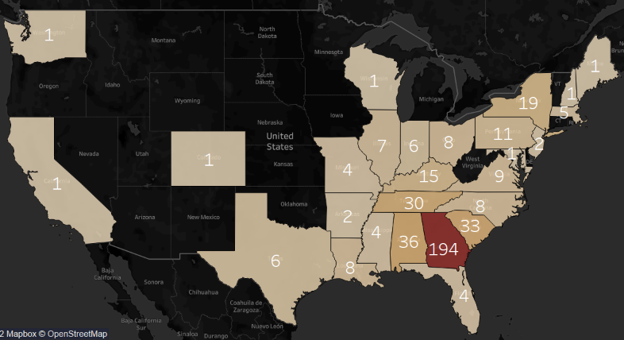
Place of Birth (POB)
Overwhelmingly US Born & South/Southeast region
Non-US Countries | Count
Austria | 1
Canada | 1
England | 2
France | 2
Ireland | 1
Scotland | 1
Spain | 1
PARENTS mostly US-born & South/Southeast
  Father’s POB – 8 non-US countries (24)
  Mother’s POB – 7 non-US countries (6) and an “Indian Territory” (1)
Notes:
Tableau-generated map of compiled 1880, 1900, and 1910 counts on place of birth of enumerated madams/prostitutes, plus counts of madams/prostitutes born in non-US countries and information on their parents’ place of birth.

Slide 13
Data of the Demimonde…
RACE | 1880 | 1900 | 1910
White | 88 | 129 | 181
Percentage | 89.8% | 86.6% | 100%
Black/ “Mulatto” | 10 | 20 | 0
Percentage | 10.2% | 13.4% | 0%
1880 – Some multi-family dwellings (boarding houses, tenements) with prostitutes had Black & White residents
1900 – Four Black madams total; two with houses in Collins/GA RR district
No houses of prostitution with madams/prostitutes of different races (i.e., either all Blacks or all Whites), but sometimes Black domestic workers in White houses
Notes:
Descriptive statistics generated from census data broken down by year – counts and percentages of madams/prostitutes broken down by race.

Slide 14
Data of the Demimonde…
RACE | 1880 | 1900 | 1910
White | 88 | 129 | 181
Percentage | 89.8% | 86.6% | 100%
Black/ “Mulatto” | 10 | 20 | 0
Percentage | 10.2% | 13.4% | 0%
1910 – ZERO Black madams/prostitutes? Doubtful…what’s going on here?
  Census enumerators judging race of residents → underreporting, particularly of mixed-race persons?
  Atlanta Race Massacre of 1906 → underreporting due to increased fear of retaliation or arrest?
Notes:
Descriptive statistics from previous slide plus talking points speculating as to possible explanations for why there were zero Black madams/prostitutes enumerated in the year 1910.

Slide 15
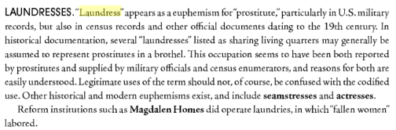
Data of the Demimonde…
RACE | 1880 | 1900 | 1910
White | 88 | 129 | 181
Percentage | 89.8% | 86.6% | 100%
Black/ “Mulatto” | 10 | 20 | 0
Percentage | 10.2% | 13.4% | 0%
LOTS of Black women with occupation of “Laundress”→ some may be euphemism for prostitutes?
From Encyclopedia of Prostitution and Sex Work, Vol. 1
Notes:
Descriptive statistics from previous slide plus talking point with screenshot from an Encyclopedia of Prostitution and Sex Work, Vol. 1 entry (p. 247) discussing how the occupation of ‘laundress’ as well as ‘seamstress’ and ‘actress’ were sometimes used as euphemisms for prostitutes in US military and census records – and whether notable prevalence of ‘laundresses’ among Atlanta’s 1910 enumerated Black women may indicate potential madams/prostitutes and perhaps warrants further exploration.

Slide 16
Data of the Demimonde…
AGE (in years) | 1880 | 1900 | 1910 | ALL
Mean | 24.72 | 24.66 | 24.66
Madams | 33.33 | 32 | 30.32 | 31.82
Prostitutes | 23.85 | 23.39 | 23.86 | 23.61
White | 24.73 | 25.23 | 24.66 | 24.86
Black/”Mulatto” | 24.7 | 21 | --* | 22.23
Range
Madams | 23-48 | 20-60 | 22-49 | 20-60
Prostitutes | 16-49 | 15-65 | 17-39 | 15-65
White | 16-49 | 16-65 | 17-49 | 16-65
Black/”Mulatto” | 16-48 | 15-30 | -- | 15-48
SIG. difference [Mann-Whitney U = 3343, z = -8.058, p < .001]
Madams 8.21 years older than prostitutes on average.
SIG. difference [Mann-Whitney U = 4130.5, z = -2.774, p < .01]
Black/”Mulatto” madams and/or prostitutes were 2.63 years younger than White madams and/or prostitutes on average.
*-- indicates no data available.
Notes:
Descriptive statistics generated from census data broken down by year and all years combined – mean age and age ranges (youngest age to oldest age) broken down by prostitution role (madam or prostitute) and race. Includes reporting on means comparison tests (nonparametric Mann-Whitney U test), indicating:
Statistically significant difference between madams and prostitutes in terms of age (madams were 8.21 years older than prostitutes on average).
Statistically significant difference between whites and Blacks/mixed-race in terms of age (Black/”Mulatto” madams/prostitutes were 2.63 years younger than white madams/prostitutes on average).

Slide 17
Data of the Demimonde…
MARITAL STATUS | 1880 | 1900 | 1910
Single | 63 | 131 | 109
Percent | 64.3% | 87.9% | 60.2%
Divorced/Widowed | 21 | 15 | 26
Percent | 21.4% | 10.1% | 14.4%
Married | 14 | 3 | 46
Percent | 14.3% | 2.0% | 25.4%
Avg Age when Married (in years) | --* | 19.67 | 18.45
Age Range when Married (in years) | -- | 17-24 | 13-33
SIG. moderately strong relationship between year and marital status [X² (4, N = 428) = 45.308, p < 0.001; Cramer’s V = 0.23, p < 0.001]
Standardized residuals indicate:
1900 had comparatively more single and comparatively less married madams/prostitutes than 1880 & 1910 than would be expected by chance.
1910 had comparatively more married madams/prostitutes than 1880 & 1900 than would be expected by chance.
*-- indicates no data available.
Notes:
Descriptive statistics generated from census data broken down by year – counts, percentages, average age when married, and age range when married (youngest age to oldest age) of madams/prostitutes broken down by marital status. Includes reporting on crosstabs and chi-square tests, indicating a statistically significant and moderately strong relationship between year and marital status. Standardized residuals indicate:
1900 had comparatively more single and comparatively less married madams/prostitutes than 1880 & 1910 than would be expected by chance.
1910 had comparatively more married madams/prostitutes than 1880 & 1900 than would be expected by chance.

Slide 18
Data of the Demimonde…
CHILDREN BORN/LIVING | 1880 | 1900 | 1910
Enumerated as having had children | --* | 11 | 34
Average Births | -- | 2 | 2.15
Range | -- | 1-9 | 1-7
Average Living Children | -- | 1.45 | 1.68
Range | -- | 1-4 | 1-4
*-- indicates no data available.
Notes:
Descriptive statistics generated from census data broken down by year – counts of those enumerated in 1900 & 1910 as having had children; average number and range of birth counts (minimum number of births to maximum number of births); and average number and range of living children counts (minimum number of living children to maximum number of living children).

Slide 19
Data of the Demimonde…
READ/WRITE | 1880 | 1900 | 1910
Cannot Read? | 19 | 2 | 3
Percent | 19.4% | 1.3% | 1.7%
Cannot Write? | 25 | 2 | 5
Percent | 25.5% | 1.3% | 2.8%
SIG. moderately strong relationship between year and not being able to read [X² (2, N = 428) = 45.616, p < 0.001; Cramer’s V = 0.326, p < 0.001] or write [X² (2, N = 428) = 59.992, p < 0.001; Cramer’s V = 0.374, p < 0.001]
Standardized residuals indicate:
1880 had comparatively more madams/prostitutes not being able to read or write than 1900 & 1910 than would be expected by chance.
1900 & 1910 had comparatively less madams/prostitutes not being able to read/write than 1880 than would be expected by chance.
1880 – a big difference from 1900 & 1910…true reflection of increasing literacy over years, or something else?
  1880 tallying cannot read/write, 1900 & 1910 marking “Can read/write?” Yes or No → more data entry errors in 1880?
Notes:
Descriptive statistics generated from census data broken down by year – counts and percentages of madams/prostitutes broken down by literacy measure of cannot read or write. Includes reporting on crosstabs and chi-square tests, indicating a statistically significant and moderately strong relationship between year and not being able to read or write. Standardized residuals indicate:
1880 had comparatively more madams/prostitutes not being able to read or write than 1900 & 1910 than would be expected by chance.
1900 & 1910 had comparatively less madams/prostitutes not being able to read/write than 1880 than would be expected by chance.
Includes talking point regarding whether noticeable increase in literacy between 1880 and both 1900 & 1910 was an accurate reflection, or could be a misleading artifact of the way these literacy measures were coded in 1880 (tallying cannot read/write) as compared to 1900 & 1910 (can read/write).

Slide 20
SIN in a SOUTHERN CITY
THANKS!
Questions?
Mandy
aswygarthobaugh@gsu.edu
Allyson
astephens34@gsu.edu
Atlanta Studies 2022 Symposium | May 6

