Slide 1
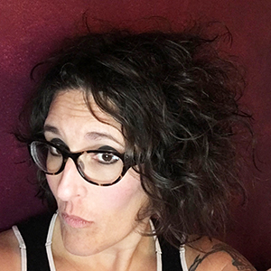
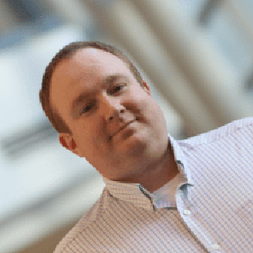

It’s Big, It’s Messy, and It’s Complicated: An Assessment of “Big Data” Research Support Needs
MANDY
SWYGART-HOBAUGH
JEREMY
WALKER
SOUTHEAST DATA LIBRARIAN SYMPOSIUM (SEDLS) 2021 | WEDNESDAY, OCTOBER 13, 2021 | 11:15 AM – 12:15 PM SESSION
Notes:
[JEREMY]

Slide 2


It’s Big, It’s Messy, and It’s Complicated: An Assessment of “Big Data” Research Support Needs
SEDLS 2021 | WEDNESDAY, OCTOBER 13, 2021 | 11:15 AM – 12:15 PM SESSION
ITHAKA S+R’s Supporting Big Data Research Study
21 higher ed institutions
GSU’s aims:
Identify the key research support needs and associated challenges faced by GSU faculty who engage in “Big Data” research, and
Offer possible paths toward improved support of GSU researchers in this area that capitalize on the Library’s strengths and have feasible return on investment.
GSU Team: Kelsey Jordan, Bryan Sinclair, Mandy Swygart-Hobaugh, Jeremy Walker
REPORT: scholarworks.gsu.edu/univ_lib_facpub/141/
Notes:
[JEREMY]
From Summer 2020 to Summer 2021, a team of Georgia State University (GSU) University Library faculty took part in a multi-institutional research study coordinated by the Ithaka S+R research and consulting organization to examine the research support needs of faculty doing “big data” research.
What’s “big data” research?
data high in volume, velocity, and variety
large, diverse, semi/unstructured datasets that typically require high performance computing infrastructure for data processing and advanced computational methods for data analysis
may include machine learning/artificial intelligence, data/text mining, modeling, analytics, informatics, and other data science techniques
data types may include but are not limited to physical specimens, text, or images
NOTE: Throughout our local report and this presentation, we denote “big data” with quotations marks to reflect our critique of this term as representing a cohesive, demarcated, universally-defined and agreed-upon research area.

Slide 3

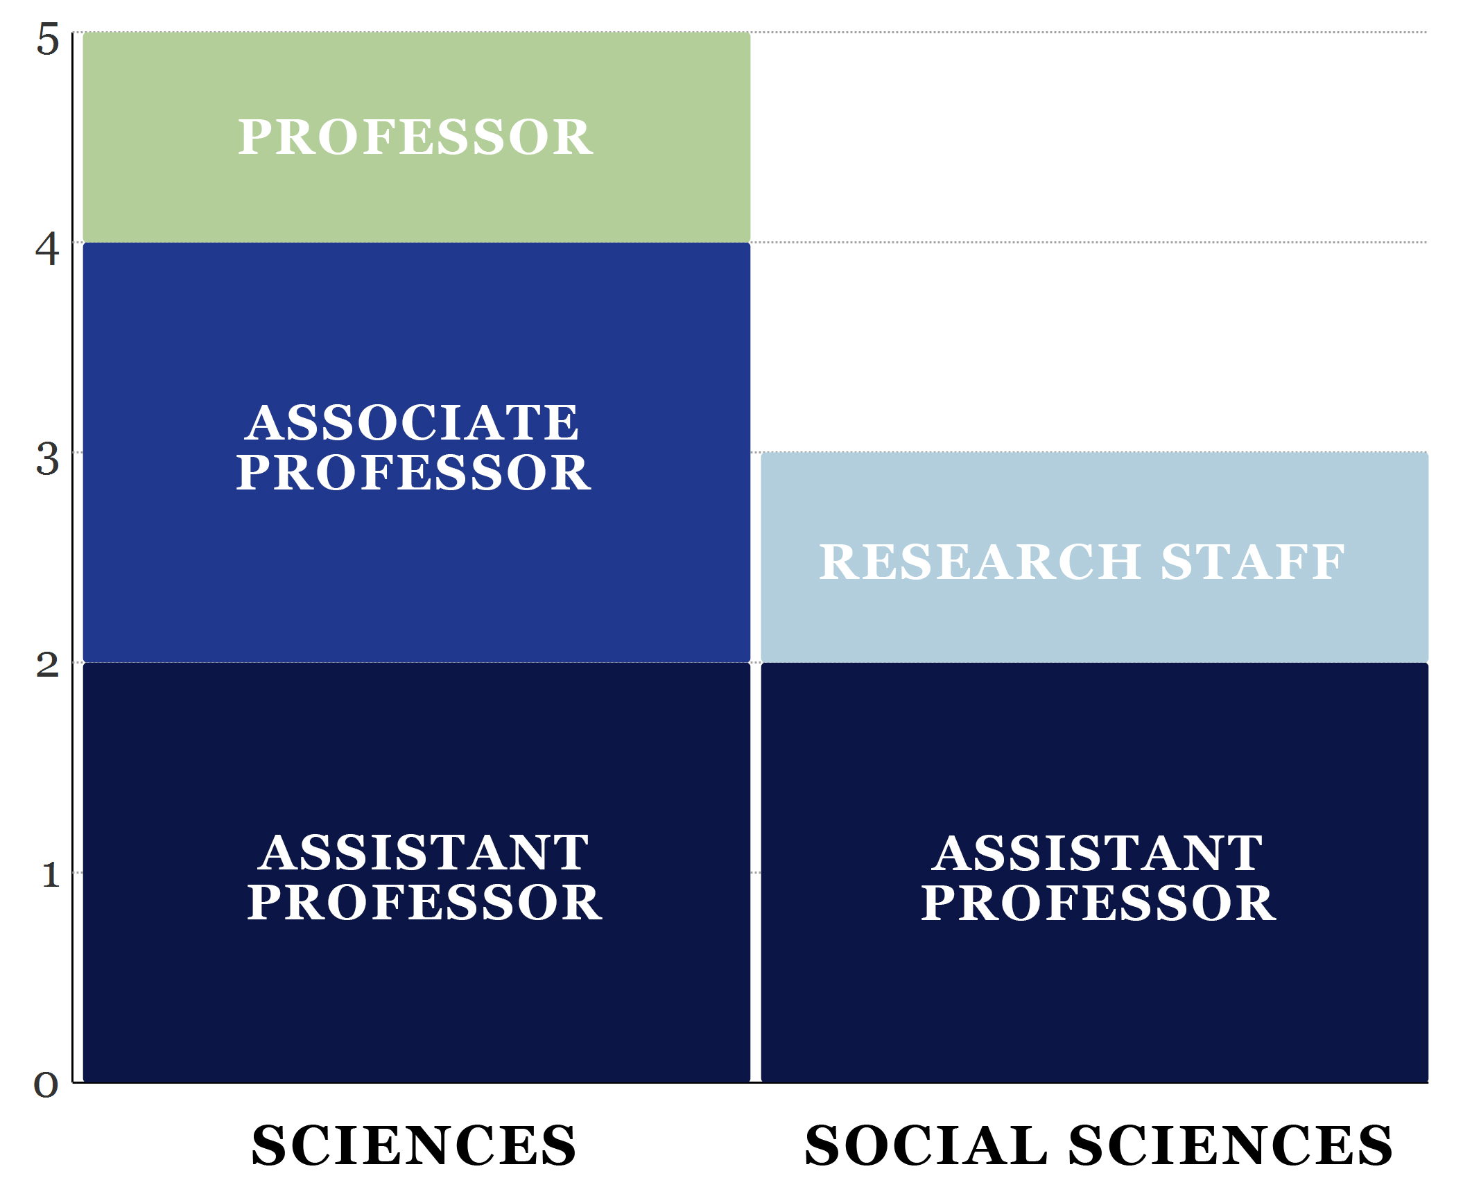
It’s Big, It’s Messy, and It’s Complicated: An Assessment of “Big Data” Research Support Needs
SEDLS 2021 | WEDNESDAY, OCTOBER 13, 2021 | 11:15 AM – 12:15 PM SESSION
Interviews with 8 GSU researchers
Accountancy, Chemistry, Communication, Computer Science (2), Physics & Astronomy, Policy Studies, and one cross-disciplinary researcher with joint appointments in Gerontology, Psychology, and Neuroscience
Notes:
[JEREMY]
See Appendix B: Study Methodology in Detail of our local report for detailed discussion of participant recruitment, data collection, and data analysis processes.

Slide 4



It’s Big, It’s Messy, and It’s Complicated: An Assessment of “Big Data” Research Support Needs
SEDLS 2021 | WEDNESDAY, OCTOBER 13, 2021 | 11:15 AM – 12:15 PM SESSION
Defining “Big Data” Research at GSU
Volume was a key characteristic of many researchers’ “Big Data” projects; often citing terabyte and petabyte-sized datasets.
Not all data is equal. For some research, individual samples are small and cheap to produce. For other research, individual samples are very expensive to collect and require extremely large computer storage.
“Big Data” research often requires high-powered computing and parallelized analytic code.
Notes:
[JEREMY]

Slide 5


It’s Big, It’s Messy, and It’s Complicated: An Assessment of “Big Data” Research Support Needs
SEDLS 2021 | WEDNESDAY, OCTOBER 13, 2021 | 11:15 AM – 12:15 PM SESSION
…when we talk about big data and when we read it in popular magazines, popular press and how it started, it's sort of Twitter, right? It's a lot a lot of small cheap samples and …there are millions of people who create them for free….In brain imaging, the big data is kind of flipped on its head because our data is expensive and each sample is like very expensive to collect. And it's very heavy, it's not like small. It’s [60,000] to 100,000 [datum points] per human brain for per time point [GSU2]
The paradox of defining “Big Data”...
Notes:
[JEREMY]

Slide 6
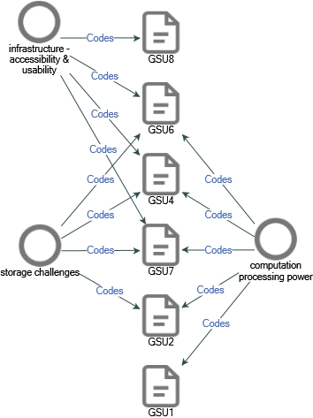
It’s Big, It’s Messy, and It’s Complicated: An Assessment of “Big Data” Research Support Needs
SEDLS 2021 | WEDNESDAY, OCTOBER 13, 2021 | 11:15 AM – 12:15 PM SESSION
Infrastructure – Needs & Challenges
Researchers had consistent praise for the staff and specialists working in the university’s HPC unit.
Challenges associated with the high cost of hardware and networking infrastructure required to store and transfer large datasets.
Advanced analysis requires access to HPC and supercomputing clusters. Some researchers reported being dependent on renting computing resources at other institutions.
Challenges associated with the usability and accessibility of HPC systems for both on-demand data analysis and teaching/learning activities.
Notes:
[JEREMY]

Slide 7
It’s Big, It’s Messy, and It’s Complicated: An Assessment of “Big Data” Research Support Needs
SEDLS 2021 | WEDNESDAY, OCTOBER 13, 2021 | 11:15 AM – 12:15 PM SESSION
We can collect even more data of higher, finer resolution. And we're getting to petabytes per [sample] and petabytes on AWS Cloud will cost [$20,000] a month to store. [GSU2]
Commercial cloud systems (e.g. AWS) are not a sustainable solution…
Notes:
[JEREMY]

Slide 8
It’s Big, It’s Messy, and It’s Complicated: An Assessment of “Big Data” Research Support Needs
SEDLS 2021 | WEDNESDAY, OCTOBER 13, 2021 | 11:15 AM – 12:15 PM SESSION
When I was setting up the computer that I mentioned, I had to buy a 10 gigabyte cable, so otherwise the computer system would have been fairly useless. I couldn't move data anyplace else. So it would be great if the university were going to upgrade the speed of Internet connections everywhere, that would be a help for everybody. [GSU4]
Specific asks for improved infrastructure…
I would certainly benefit a lot from maybe a more open ecosystem of things. Like, so, like more interactive computing resources where I could do stuff on GSU servers where I can do it in real time instead batch computing. [GSU6]
Notes:
[JEREMY]

Slide 9
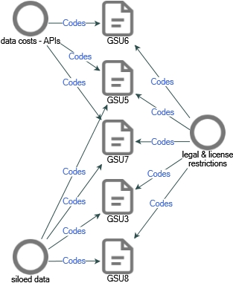
It’s Big, It’s Messy, and It’s Complicated: An Assessment of “Big Data” Research Support Needs
SEDLS 2021 | WEDNESDAY, OCTOBER 13, 2021 | 11:15 AM – 12:15 PM SESSION
Data Access – Needs & Challenges
Challenges with securing and adhering to data licensing agreements – often limit the volume of data accessible altogether or in a given access iteration.
High cost and often siloed licensing agreements associated with secondary dataset access from social media and other data outlets.
Present solution? Collaborate with researchers at other institutions with better financial and infrastructural resources.
Notes:
[MANDY]

Slide 10
It’s Big, It’s Messy, and It’s Complicated: An Assessment of “Big Data” Research Support Needs
SEDLS 2021 | WEDNESDAY, OCTOBER 13, 2021 | 11:15 AM – 12:15 PM SESSION
Oh, and again, I will say again, better infrastructure for data acquisition in GSU library. If this is something you can solve, that will put us ahead of even bigger, better institutions that don't have anything like that. And this is something which, if we can get done, it's basically, it's fertilizing papers. Like basically the second that you have this Twitter data, you're going to find [researchers] who are going to take this Twitter data and going to churn out papers from it. And I think that's, in the end, the goal of every department, because every department is actually being evaluated by their research output. And I think that's one of the best ways to get research output. Because data creates output. [GSU7]
Library provide institution-wide data licensing?
Notes:
[MANDY]

Slide 11
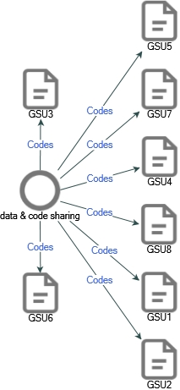
It’s Big, It’s Messy, and It’s Complicated: An Assessment of “Big Data” Research Support Needs
SEDLS 2021 | WEDNESDAY, OCTOBER 13, 2021 | 11:15 AM – 12:15 PM SESSION
Data/Code Sharing – Needs & Challenges
Interested in promoting open scholarship and having their work (data & coding) cited by more people, but…
Concerns about “scooping”, “maintaining one’s…advantage over competitors”, and not being credited.
Preparation/documentation/maintenance to make data/code shareable is significant hurdle.
Licensing agreements (secondary data) often prohibit open sharing.
Impracticality of sharing “Big Data”…
Notes:
[MANDY]

Slide 12
It’s Big, It’s Messy, and It’s Complicated: An Assessment of “Big Data” Research Support Needs
SEDLS 2021 | WEDNESDAY, OCTOBER 13, 2021 | 11:15 AM – 12:15 PM SESSION
So there are lots of grants or publications, journals that will require that you make your data publicly available. And they don't really define at this point what that means or how you can do it…I, in a very productive year, might produce a petabyte of data, and there's no place that will let you save a petabyte of data and make it open to the public. So usually the raw data is something that it's impossible to follow those rules about. The kind of data that I do share then in those cases is the data that goes directly into making figures or papers. And that's small amounts of data. This is an issue that might really impact on sort of big data practices just because there's no place to share big data, there's no functionality to do that. [GSU4]
How do you expect me to share “Big Data”?
Notes:
[MANDY]

Slide 13
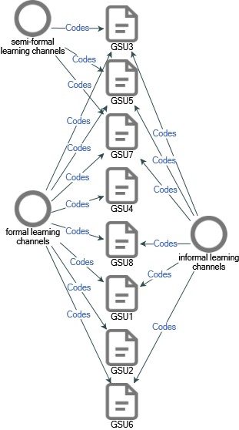
It’s Big, It’s Messy, and It’s Complicated: An Assessment of “Big Data” Research Support Needs
SEDLS 2021 | WEDNESDAY, OCTOBER 13, 2021 | 11:15 AM – 12:15 PM SESSION
Learning & Professional Networking – Needs & Challenges
Informal – self-taught, need-at-hand troubleshooting via googling, Stack Overflow, YouTube, etc.
Semi-formal – peer groups, meetups, etc.
Formal – coursework, workshops, etc.
Notes:
[MANDY]

Slide 14
It’s Big, It’s Messy, and It’s Complicated: An Assessment of “Big Data” Research Support Needs
SEDLS 2021 | WEDNESDAY, OCTOBER 13, 2021 | 11:15 AM – 12:15 PM SESSION
We had the Scientific Computing Day…you got to meet people in all kinds of other departments, kind of share methods with them. I found people doing in psychology, and people in the business school, doing things which are very similar and helpful to me, which I would not get to meet the other way. There was the library event where people presented their research…we get to see what other people are researching and you can now get to talk with people and see whether you can collaborate. So, I think jumping from these events and finding a way to have a more kind of like an established collaborative network of computational researchers in [GSU] would be amazing. [GSU7]
Foster networking opportunities?
Notes:
[MANDY]

Slide 15
It’s Big, It’s Messy, and It’s Complicated: An Assessment of “Big Data” Research Support Needs
SEDLS 2021 | WEDNESDAY, OCTOBER 13, 2021 | 11:15 AM – 12:15 PM SESSION
We're still at a point where we don't even require R classes yet. That's something that many students are sort of doing on their own, is taking classes in R or classes in Python. To sort of go, “You know what? These are the skills that I'm going to need moving forward and I need to do something.” But we don't offer them. You know? They have to go over to [another GSU department] or something to get them. [GSU8]
A better “big data” curriculum…
I think in terms of training, we need more computational courses…especially in social sciences, because I think taking a course in computer science is fine and nice, but not of your first computational course. You can't take NLP in computer science courses. You're going to be lost, you're going to drown, and you're going to basically quit after two weeks. [GSU7]
Notes:
[MANDY]

Slide 16

It’s Big, It’s Messy, and It’s Complicated: An Assessment of “Big Data” Research Support Needs
SEDLS 2021 | WEDNESDAY, OCTOBER 13, 2021 | 11:15 AM – 12:15 PM SESSION
Possible Paths toward Improved Support of GSU “Big Data” Researchers
Data Access: Explore options to fund and manage campus-wide data access and licensing (e.g., APIs, proprietary datasets) to alleviate cost burden and promote cross-departmental access to data that is relevant to a critical mass of campus researchers.
Building Research Community: Explore possibilities of creating cross-disciplinary networking opportunities for GSU campus researchers – e.g., social events, symposiums/mini conferences, meetup groups – to foster potential research collaborations, skills-building opportunities, etc.
Notes:
[MANDY]

Slide 17
It’s Big, It’s Messy, and It’s Complicated: An Assessment of “Big Data” Research Support Needs
SEDLS 2021 | WEDNESDAY, OCTOBER 13, 2021 | 11:15 AM – 12:15 PM SESSION
Possible Paths toward Improved Support of GSU “Big Data” Researchers
Learning/Training Support: Explore possibilities of the Research Data Services Team to collaborate with GSU “Big Data” researchers to offer discipline- or method-specific workshops to contextualize and de-abstract the content and create more task- or problem-driven sessions for their specific research project goals – keeping in mind current limitations related to skills capacity, sustainability, and scalability.
Advocacy: Share our report with campus IT staff who oversee computing and data storage infrastructure to advocate for improvements to system accessibility and usability.
Notes:
[JEREMY]

Slide 18

It’s Big, It’s Messy, and It’s Complicated: An Assessment of “Big Data” Research Support Needs
MANDY
SWYGART-HOBAUGH
JEREMY
WALKER
SOUTHEAST DATA LIBRARIAN SYMPOSIUM (SEDLS) 2021 | WEDNESDAY, OCTOBER 13, 2021 | 11:15 AM – 12:15 PM SESSION

