Slide 1
Archivists and Technological Competencies: A conversation about Archival Education
Amanda Oliver
Amanda Jamieson
Anne Daniel

Slide 2
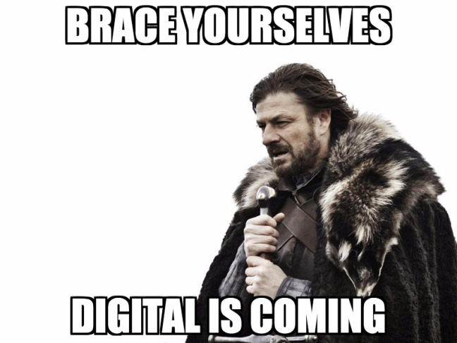
Objective
The objective of today's session is to share results from our research and to foster discussion on what technological competencies might be expected of archivists and the role that these play in education and professional practice.
https://saaers.wordpress.com/2017/07/11/digital-archivist-in-disguise

Slide 3
Outline
Competency profiles and literature review
Technological competencies: reflection exercise
Graduate education
Professional development opportunities
Education: reflection exercise
Job postings
Challenges and opportunities
The future: reflection exercise and discussion

Slide 4
Alternative titles for this session
The Struggle is Real: Archivists and Technological Competencies
What would Nancy McGovern do?
Did you try unplugging it?
We’re experiencing technical difficulties…

Slide 5
Competency Profiles
Australia (ALIA): The library and information sector: Core Knowledge, skills and attitudes, and work level guidelines 2005
Australia (ASA; RMSAA): Statement of knowledge for Recordkeeping Professionals, 2005
Canada (CARL): Core Competencies for 21st Century Librarians, 2010
United States (SAA): Guidelines for a Graduate Program in Archival Studies; Digital Archives Specialist Curriculum Structure Core Competencies, 2018
United States (ARMA International): Records and Information Management Core Competencies, 2007

Slide 6
CARL: Core competencies for 21st Century librarians
Integrated library systems (ILS) – knowledge of basic structure, content and use of an integrated library system
Emerging web technology – knowledge of major trends in web development including online social networking tools (as of 2010, would include Twitter, Facebook, MySpace, etc.)
Electronic resources management – knowledge of how digital resources are acquired, managed and accessed
Web page development – understanding of principles of web page design and maintenance
Institutional repositories – Understanding the basic structure, content and use of campus institutional repositories
Learning management system (LMS / CMS) – knowledge of the structure and the use of campus LMS / CMS
Database management – understanding how databases are designed and structured for convenient data and/or information retrieval

Slide 7
Saa: Guidelines for a graduate program in Archival Studies
Core archival knowledge
Knowledge of archival material and functions
Knowledge of the profession
Contextual knowledge
Complementary knowledge
Information technology
Allied professions

Slide 8
SAA: Digital Archives Specialist Curriculum Core Competencies
Understand the nature of records in electronic form, including the functions of various storage media, the nature of system dependence, and the effect on integrity of records over time.
Communicate and define requirements, roles, and responsibilities related to digital archives to a variety of partners and audiences.
Formulate strategies and tactics for appraising, describing, managing, organizing, and preserving digital archives.
Integrate technologies, tools, software, and media within existing functions for appraising, capturing, preserving, and providing access to digital collections.
Plan for the integration of new tools or successive generations of emerging technologies, software, and media.
Curate, store, and retrieve original masters and access copies of digital archives.
Provide dependable organization and service to designated communities across networks.

Slide 9
Literature Review
Literature on emerging roles for information professionals is predominately from the library community
Focus on curriculum of archival graduate education, with very little written about professional development
Discussion about redefining the role of archivists in the digital age, with little emphasis on the necessary skills required in this new environment

Slide 10
Discussion
Reflecting upon the competency profiles for information professionals and reflecting upon your experience, discuss the technological competencies that are core to the role of an archivist.
#1

Slide 11
Graduate Education: Methodology
10 information science related graduate programs in Canada
Learning outcomes
Required courses

Slide 12
Graduate Education: Learning outcomes
“to prepare graduates to select, evaluate and use current and emerging information and communication technologies in constantly changing information workplaces”
“apply knowledge of current and emerging technologies to real world situations”

Slide 13
GRADUATE EDUCATION: REQUIRED COURSES
59 required courses
Fall 2016 to Winter 2018

Slide 14
Graduate education: syllabi
21 syllabi contained 0 references to technology
7 syllabi contained 1 reference to technology
4 syllabi contained 2 references to technology
8 syllabi contained 10+ references to technology

Slide 15
Graduate Education: Themes
Data – 37 references
Application of archival principles – 14 references
Digital preservation – 14 references

Slide 16
Graduate Education – SAA Digital Archivist Specialist certificate
Key terms
Preservation
Retrieval
Electronic records
Digital Archives
Appraisal

Slide 17
Graduate Education – SAA Digital Archivist Specialist certificate
Preservation – 12 instances
Retrieval – 9 instances
Electronic Records – 8 instances
Digital Archives – 7 instances
Appraisal – 7 instances

Slide 18
Professional Development
50 workshops across the country from 2016-2018
6 workshops online
44 workshops in-person
Average duration was 1.18 days
50% of the workshops were held in-person in Ontario and Quebec
But, zero workshops were held in the territories

Slide 19
Discussion
Reflect upon these findings. Did you find anything surprising?
Are there any gaps in your knowledge? If you have these skills, how did you get them?
#2

Slide 20
Job postings
Methodology
Disclaimer
Fast facts:
67% of the jobs were located in either British Columbia or Ontario
38% of the jobs were with the government, 29% with an academic institution
Most of the jobs required between 1-4 years of experience
87% of the positions were full-time
56% of the positions were permanent, 44% of the positions were contract

Slide 21
Trends
Education requirements
Very basic technological skills
Microsoft Office Suite
“at ease in a computerized environment”
Most common technological competencies:
Databases
Digitization
Digital preservation
No standard or core technological competencies

Slide 22
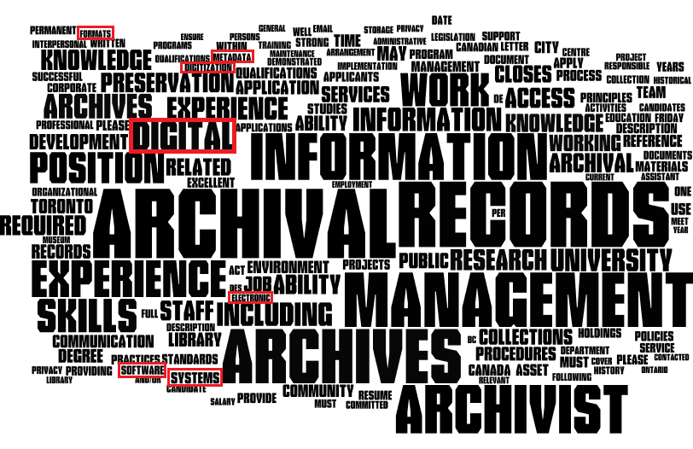

Slide 23
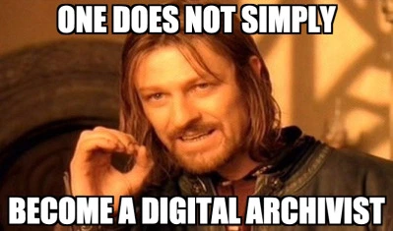
Challenges
Education
Expectations
Competency Framework
Accessibility
https://saaers.wordpress.com/2017/07/11/digital-archivist-in-disguise

Slide 24
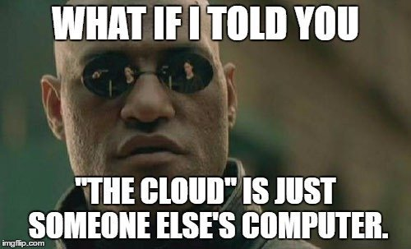
Opportunities
Conversation
Partners
Certification
Self-examination
https://saaers.wordpress.com/2017/07/11/digital-archivist-in-disguise

Slide 25
Discussion
Where do we go from here?
Technology is a core aspect of our professional practice. How do we ensure that our profession evolves as technology evolves?
#3

Slide 26
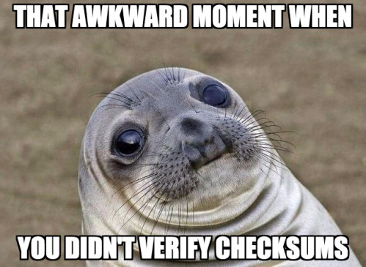
Conclusion
https://saaers.wordpress.com/2017/07/11/digital-archivist-in-disguise/

