Slide 1
Applying System Dynamics to Confront Complex Decision Making in R&D Systems
A Knowledge Based Approach
Arash Golnam, Nader Ale Ebrahim
Iran Khodro Diesel Co.
14th Km, Azadegan High Way, Tehran, Iran
a.golnam@ikd-co.com
al_e_ebrahim@ikd-co.com

Slide 2
Some Questions
Why do so many business strategies fail?
Why do many businesses suffer from periodic crises and fluctuating sales, earnings, and morale?
Why do some firms grow while others stagnate?
How do once-dominant firms lose their competitive edge?
…?

Slide 3
Need for new ways of thinking
The human race has not yet started to think. Edward de Bono
The way organizations are is product of how we think and how we interact; they cannot change in any fundamental way unless we can change our basic patterns of thinking and interacting. Peter Senge

Slide 4
Why Organizations Fail?
The McKinsey Study (2001)
In 25 years, they predict,two-thirds of today’s most prominent corporations will have died or been acquired. “They are too damn slow to keep pace with changes in the markets.”
The New Your Times,

Slide 5
Why Organizations Fail?
A typical organization uses only about 5% of its potential.
Jay Forrester (1993)
“The rate at which individuals and organizations learn may become the only sustainable competitive advantage.”
Ray Stata (1989)

Slide 6
Complexity and Managerial Decisions
Managers in a simple production-distribution system generate costly fluctuations, even when consumer demand is constant.
Sterman, MacNeil et al, MIT1989
Managers of simulated consumer product markets often generate the boom and bust, price war, and bankruptcy. Paich et al 1990
Notes:
A vast body of experimental work demonstrates that individuals make significant, systematic errors in divers problems of judgement and choice (Kahneman et al 1982, Hogarth 1987).
In these studies performance deteriorates markedly as the time delays grow longer. market mechanism and financial incentives do not eliminate the errors. Experience and training do not solve the problem.

Slide 7
Business=Systems
Business can be regarded as systems, bound by interrelated actions which often take years to fully play out their effects
(Senge, 1990)

Slide 8
Why R&D Strategies Fail?
Due to some unexpected problems R&D strategies in a company, although well considered, fail, in other words a well intended action turns out to be a complete disaster after passing of time.
In order to find a way of dealing with these complexities we should first become familiar with systems and complexity in systems .

Slide 9
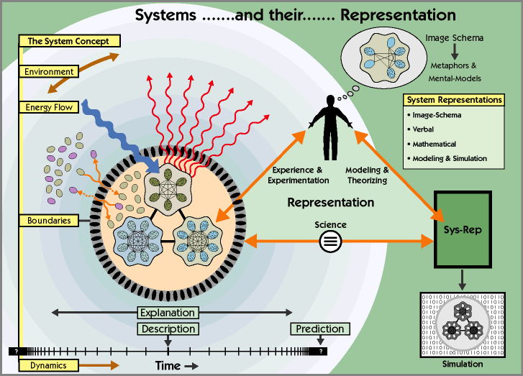

Slide 10
What is a System ?
A system is “a group or combination of inter-related, interdependent, or interacting elements forming a collective entity” Collins dictionary
System is a ‘whole’ which is greater than the sum of its parts.
When a system is taken apart, it loses its essential properties,so do the parts.
Russell Ackoff

Slide 11
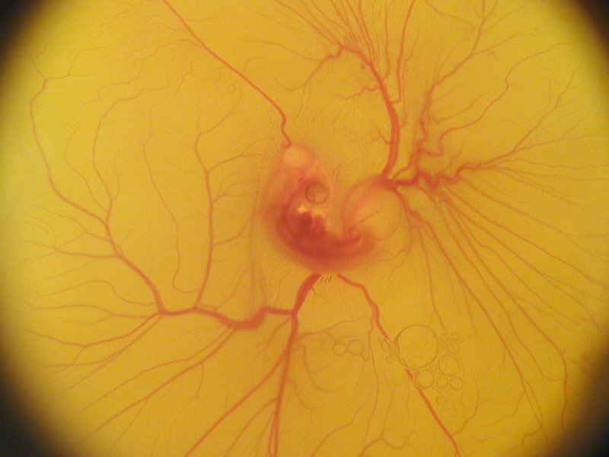
A chicken embryo is a system
Its purpose is to continue chicken life.
It is highly organized,.
The subsystems are related to each other
A chicken embryo is a whole

Slide 12
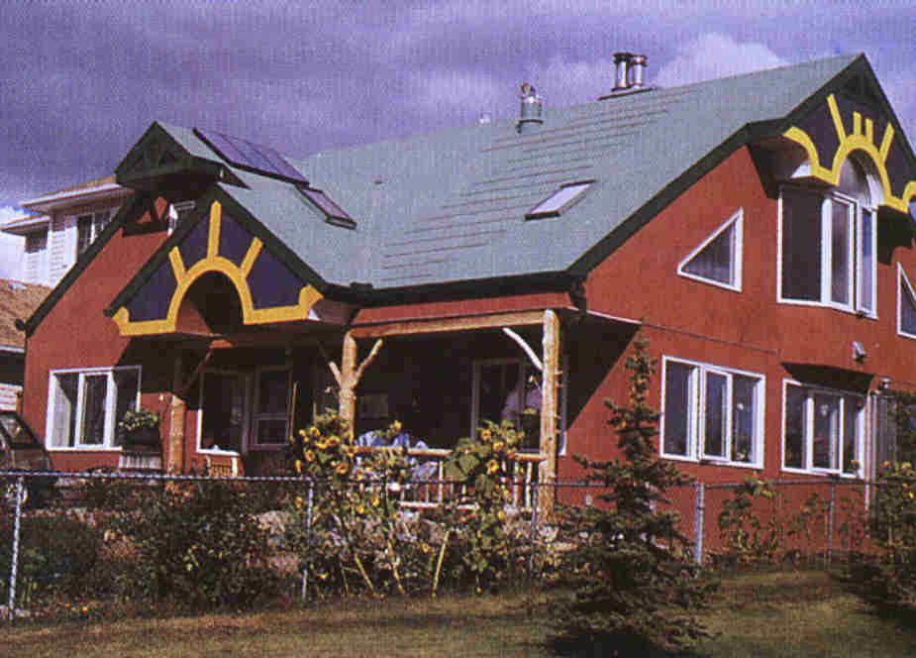
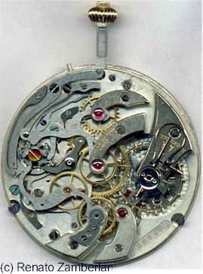
Examples of Systems
It has purpose
It is organized
Its parts are interrelated

Slide 13
Examples of Systems
The R&D Department is also a system because it is organized Its parts are interrelated and its Purposes are as follows:
To defend, support, and expand existing business
To drive new business
To broaden and deepen a company’s technological capabilities

Slide 14
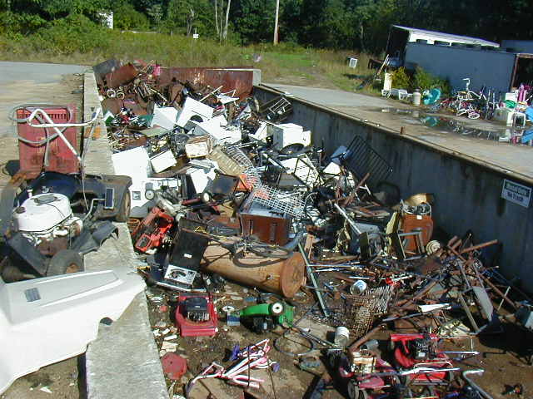
A pile of stuff is not a whole, but a “heap”

Slide 15
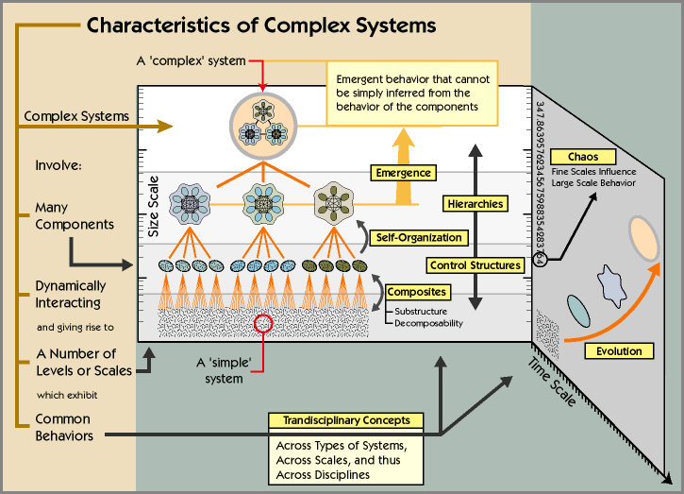

Slide 16
Characteristics of Complex Systems
Tightly Coupled
“Everything influences everything else”
“You can’t just do one thing”
Dynamic
Change occurs at many time scales
Policy Resistant
Many obvious solutions to problems fail or actually worsen the situation.
Counterintuitive
Cause and effect are distant in time and space
Exhibit Tradeoffs
Long term behavior is often different from short term behavior

Slide 17
Understanding Systems
We sometimes fixate on our part of the system, and miss the whole

Slide 18
Understanding Systems
We sometimes fixate on our part of the system, and miss the whole

Slide 19
Understanding Systems

Slide 20
Don’t worry, the hole is in
the other side of the boat

Slide 21
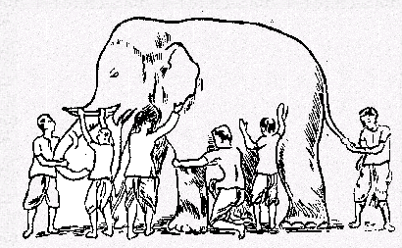
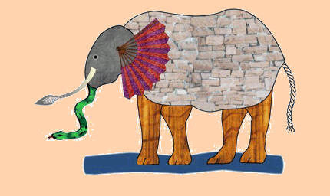
The Blind Men and the Elephant

Slide 22
“No Shared Understanding!”
A car company lost money and went bankrupt:
The marketing group thought the problem was due to lack of advertising and promotional support
The sales group blamed lack of promotion and dealer support
The manufacturing and dist. group blamed inaccurate forecasting by the marketing and sales groups, causing poor production planning and high cost
The Finance department blamed budget overruns by all departments and unreliable forecasting from the marketing group
Notes:
People daily work can be a strong force in framing problems

Slide 23
Connectedness
“If you wish to understand a system, and so be in a position to predict its behavior, it is necessary to study the system as a whole.
Cutting it up into bits for study is likely to destroy the system’s connectedness, and hence the system itself.
(Sherwood)

Slide 24
A leverage point – where small action yields large results
“Maybe we should write that spot down.”

Slide 25
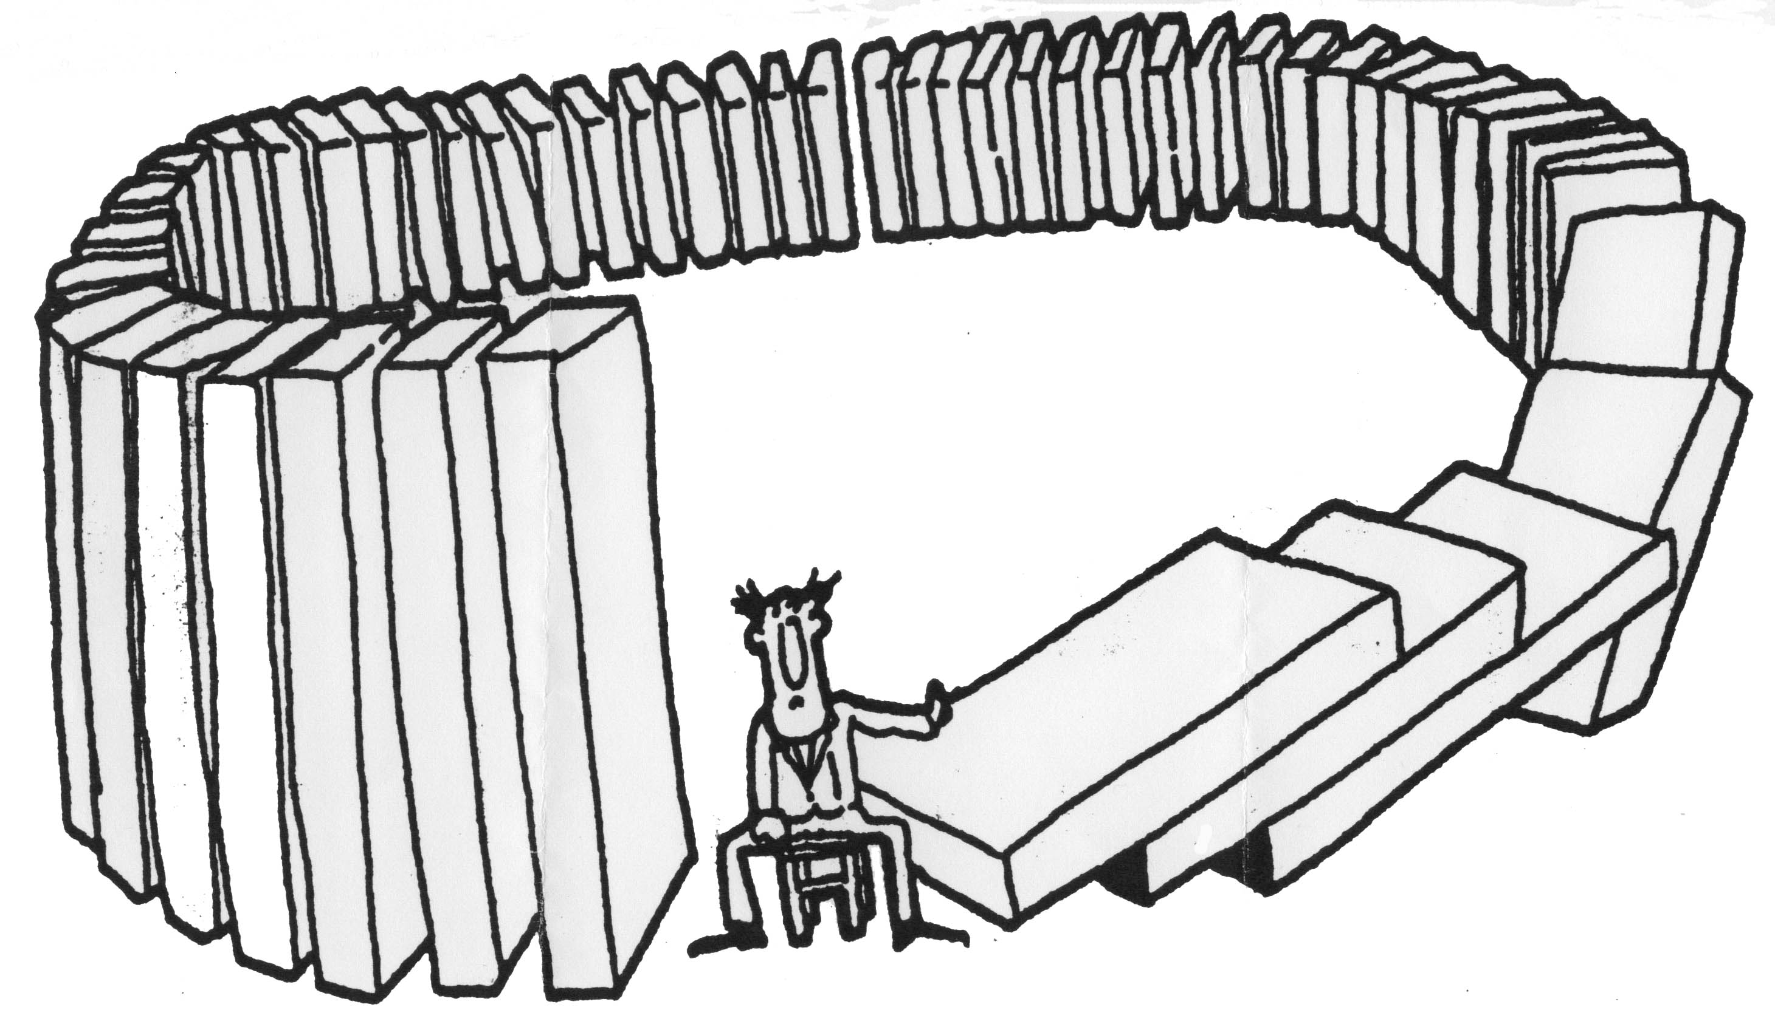
Behavior Over Time
In complex systems, cause and effect
are distant in time and space

Slide 26
Behavior Over Time

Slide 27
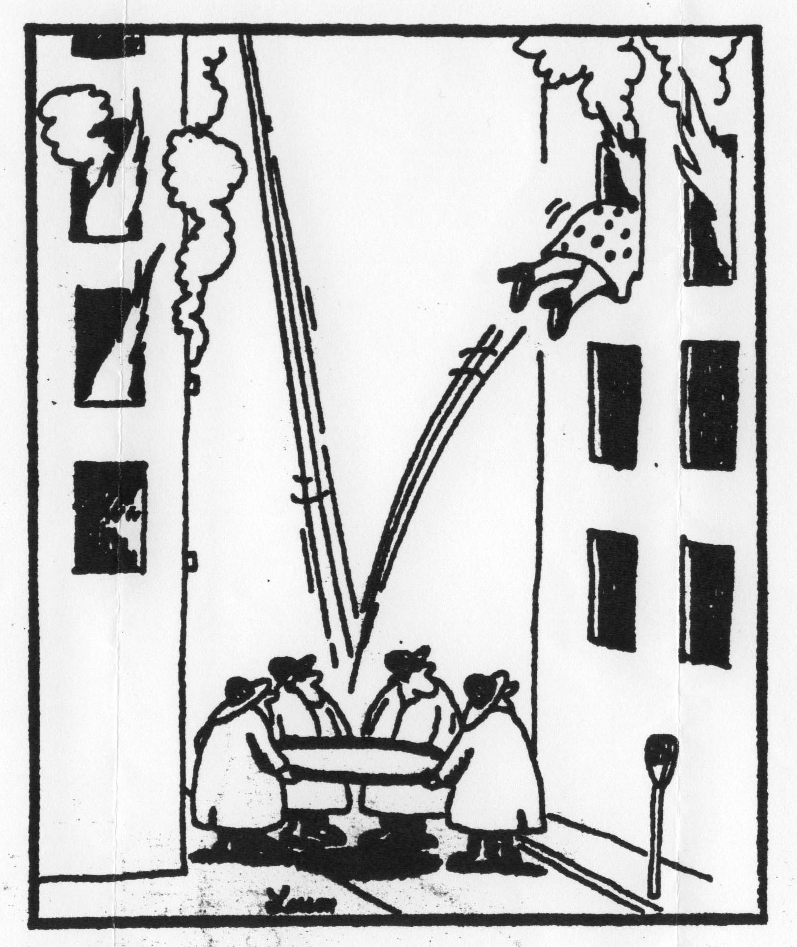
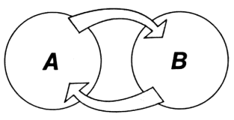
Feedback

Slide 28
Throwing things
If you want to throw an object to land in a particular place you can use Newton’s laws of motion to calculate how to do so
  this works well for things like a rock
but it fails utterly if you are throwing a bird!
  the bird is a complex adaptive system
even though the bird is subject to all the same laws of physics as the rock
Control freaks suggest tying the birds wings and a rock - to make it land at the right place!
Notes:
I can illustrate the difference between a mechanical view and a systemic view by an example first used by Richard Dawkins. It involves throwing objects to land at a specified location.
Newton’s Laws of gravitation and motion can be used to calculate the exact force and angle required to get a rock to the required destination. But these calculations fail totally when you want to throw a bird - even though it is subject to exactly the same laws of physics. This highlights the real difference between mechanical systems and complex adaptive systems.
When they are presented with this example control freaks say “I know how to get the bird to the final location” and contemplate tying it up with a brick on its back. This works - but of course it kills the bird! The system is completely disabled by this control freakery.
There is actually a way to get the bird to a desired location …
one of the better strategies is to build a bird table there and place its favourite food on the table. This is an attractor and is a good strategy for a lot of complex systems.

Slide 29
R&D Management Systems
Similar to other business models, R&D systems are characterized by complex structure and dynamic behavior.
Sometimes the effect of making a decision in one part of the R&D function can manifest itself in another part of the business system at an unexpected time.

Slide 30
What are the origins of decision making complexity in R&D?
Organizational complexity-intra and inter complexity has implications for how R&D policies are developed and aligned with broader organizational objectives and market dynamics.
Resource complexity-volume or scale of human, capital and technological resources required to move projects along an R&D pipeline through to commercialization.
Technological complexity- level of innovation involved in the product or process.

Slide 31
Dealing with Complexities
Effective learning in such environments requires methods and tools to represent and assess such dynamic complexity and tools managers can use to accelerate learning throughout an organization

Slide 32
Learning is a Must!
We must increasingly learn how to design and manage complex systems with multiple feedback effects, long time delays, and nonlinear responses to our decisions.

Slide 33
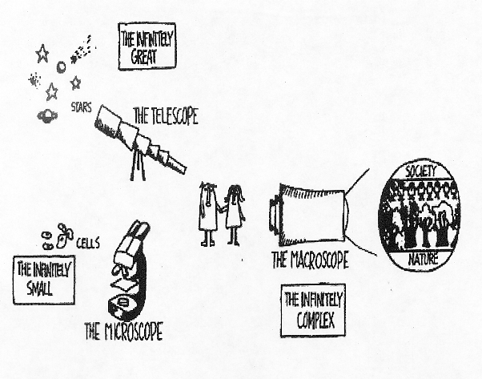
We need new tools!

Slide 34
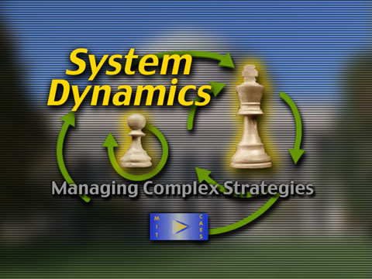

Slide 35
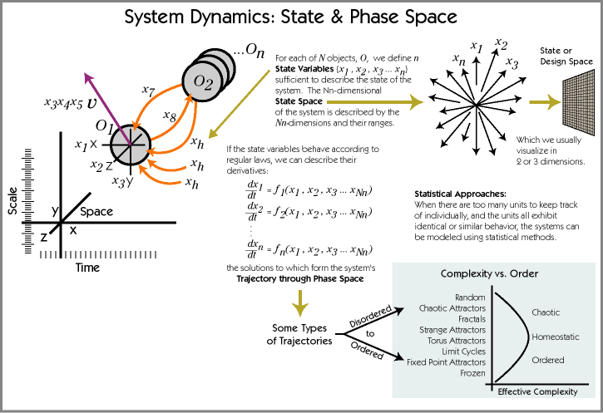

Slide 36
What is Systems Thinking?
Systems Thinking is a language for understanding change, uncertainty and complexity and creating harmony of thoughts and actions.

Slide 37
Why do we need
Systems Thinking ?
Increasing interdependence and complexity of the World.
Need for leadership and decision-making at all levels of work.
Need for shared vision and alignment of thoughts and action.
Need for a common language for understanding uncertainty and complexity.

Slide 38
Systems Thinking helps
Surface unseen & unintended consequences
Challenge individual and organizational mental models
Identify dynamic behavior
Identify and highlight hidden delays
Identify key leverage points for intervention
Help improve group dynamics and team learning

Slide 39
Systems Thinkers
System Thinkers study things in a holistic way.
  Reductionist seeks to understand the parts.
  Constructivist seeks to understand the wholes.
  System Thinkers seeks to understand the parts, the wholes, and more so, the complex relationships that enable the ‘parts’ to become the ‘wholes’.
2 > 1 + 1
The whole is greater than the sum of parts.

Slide 40
Four levels of seeing reality
Increasing
Leverage
Events
Patterns
of Behavior
Systemic
Structure
Mental Models

Slide 41
Some Definitions
Events. The things we see happening (and sometimes wonder why).
Patterns of Behavior. Consistent and regular actions or events over space and/or time.
Systemic Structure. “Permanent” relationships and flows of information between parts of the system. Such as roads, policies, laws, organizations, buildings, classroom set up.
Mental Models. The shared belief systems, ideas, assumptions and goals of a system. Usually unstated but universally understood.

Slide 42
Systems thinking looks below events and patterns of behavior – finding the mental models
Events
Patterns
of Behavior
Systemic
Structure
Mental Models

Slide 43
Laws of Systems Thinking
Today’s problems come from yesterday’s solutions.
  Moving the problem around.
The harder you push, the harder the system pushes back.
  Compensating feedback.
Behavior grows better before it grows worse.
The easy way out usually leads back in.
Senge, 1990

Slide 44
Laws of Systems Thinking
The cure can be worse than the disease.
Faster is many times slower.
Cause and effect are not closely related in time and space.
Small changes can produce big results—but the areas of highest leverage are often the least obvious.
Dividing the elephant in half does not produce two small elephants.
Senge, 1990

Slide 45
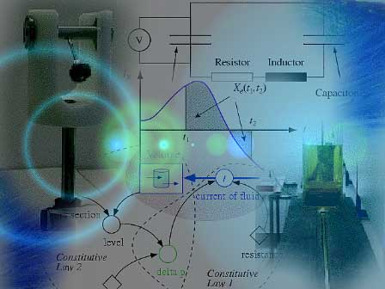
Archetypes

Slide 46
The patterns that control events in Complex Systems
Reinforcing Loops
  Engines of growth and decline (Feedback Structure)
Balancing Loops
  Goal seeking processes and limits to growth
Delays
  When results take time

Slide 47
Reinforcing Loops
(Exponential Growth)
state of
the system
Time
+
Net Increase
Rate
R
State of
The System
+

Slide 48
Reinforcing feedback loops are powerful
  But, with these loops…
Notes:
These loops are powerful.

Slide 49
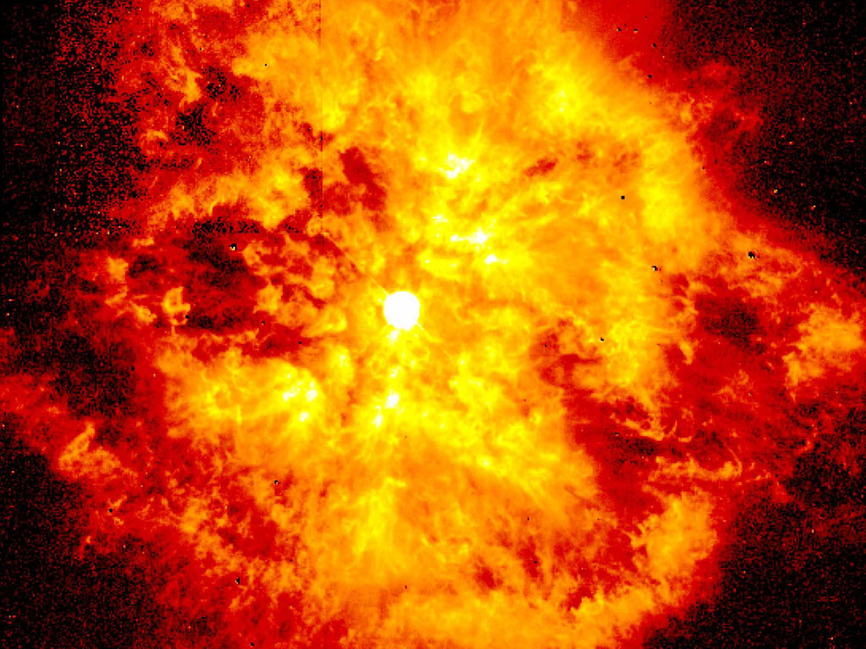
Something always happens…..
Notes:
Something always happens…..

Slide 50
R&D Management Work Cycle
R&D Intensity
R&D
Budget
Resource
Allocation
Revenues
R
R&D
Activity
Technology Stock
Market
Demand

Slide 51
R&D Policy Settings
Leverage Points
R&D Intensity
Resource Allocation
Market Demand
Other Leverage Points
Incentive Schemes
Investment in Training
Job Security

Slide 52
Balancing Loop (Goal Seeking)
Goal
Goal (desired
state of
the system)
state of
the system
state of
the system
+
Time
-
+
B
discrepancy
Corrective
action
+

Slide 53
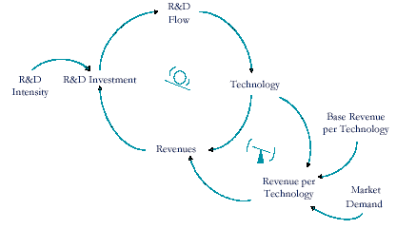
Balancing Loop

Slide 54
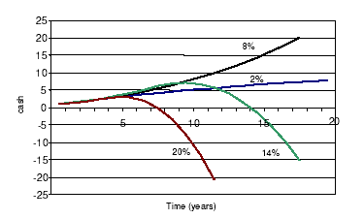
The effect of 4 different R&D intensity policies on Cash-Flow for a fixed market growth condition

Slide 55
Boom & Bust
This case often results from the non-existence of an R&D management system.
In other words a business expansion which is not on an R&D base that in almost all cases accelerates to succeed then leads to bankruptcy and failure with more speed.

Slide 56
Growth Limit
Carrying capacity
Growth & overshoot
Consumption
Effect on capacity
State of
System
Net rate increase
Carrying Capacity
Fractional
impact
Resource adequacy
delay

Slide 57
Delays (Oscillation)
Oscillation
State of system
Goal
desired
delay
discrepancy
Corrective
action
delay

Slide 58
Delays in Systems
Managing Water in a Shower
Water Temperature
Desired Temperature
B
Tap setting
T Gap

Slide 59
Managing Water T in a Shower
What do you think would happen in a more complicated setting,
where you have to share the supply of hot water (critical resource) with someone/something else?

Slide 60
Managing Water T in Two Showers
Desired Temperature B
Desired Temperature A
O
S
Water Temperature A
Tap setting B
S
T Gap B
(A-D)
B
B
O
O
Tap setting A
T Gap A
S
Water Temperature B
(A-D)
S
O

Slide 61
Managing Water in Two Showers

Slide 62
A more complicated setting
What do you think would happen in a more complicated setting, where you have to share the supply of hot water (critical resource) with someone/something else?
The effect of price setting policies
R&D intensity determination
Resource allocation to R&D Projects

Slide 63
Summary of Structure & behavior of dynamics
Exponential Growth
Goal-Seeking
Oscillation
+
State of
system
Goal
desired
State of system
State of system
Goal
desired
delay
discrepancy
discrepancy
Net
increase
rate
Corrective
action
delay
+
Corrective
action

Slide 64
System Dynamics Models
Initial values
e.g. initial soil water content
Output
Parameters
e.g. rate constants
Time
Model
Outputs (indicators of performance)
e.g. amounts, rates....
Exogenous variables
e.g. climatic variables
Model uses:
- prediction
- testing of understanding
- management
- optimisation (through iteration)
- sensitivity analysis
- back-casting
Site conditions
e.g. soil type
Management options
(policy levers)
e.g. harvesting rate

Slide 65
System Dynamics Modeling
1) Identify a problem
2) Develop a dynamic hypothesis explaining the cause of the problem
3) Create a basic structure of a causal graph (Casual Loop Diagrams)
4) Augment the causal graph with more information
5) Convert the augmented causal graph to a System Dynamics flow graph (Stock and Flow Diagrams)
6) Translate a System Dynamics flow graph into computer programs or equations

Slide 66
System Dynamics Simulation
Use expert input to develop a system map of cause-effect relationships
Loss
2001
2002
2003
2004
2005
Probability %
Quantify each cause-effect relationship using a combination of data and expert input
Computer simulate the range of outcomes
Loss in 2002

Slide 67
Computer Software
Vensim
I think
Mapsys

Slide 68
Thanks for your Patience

