Slide 1

Wikipportunities
ASECS 2010
Adrianne Wadewitz, English Department, Indiana University

Slide 2


Slide 3
Wikipedia
Over 270 languages
40,000 active editors on the English Wikipedia
Over 3 million articles on the English Wikipedia
One of the 10 most-visited sites on the internet
Most popular reference site on the internet
Freely accessible

Slide 4
Enable scholarship
Create lists of works of authors
Create annotated bibliographies of scholarship on various topics
Create annotated editions of pieces of literature
Assemble anthologies of literature
Write books about your specialty

Slide 5
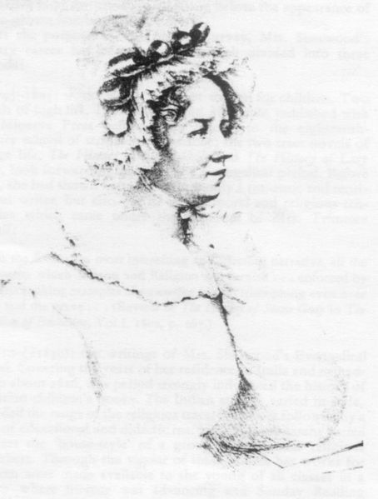
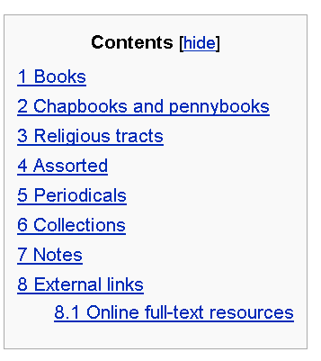
List of works by Mary Martha Sherwood
Notes:
List of works by Mary Martha Sherwood – table of contents

Slide 6
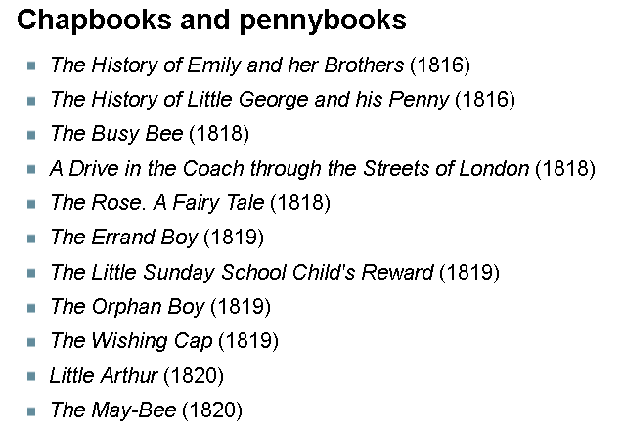
List of works by Mary Martha Sherwood
Notes:
List of works by Mary Martha Sherwood - sample

Slide 7
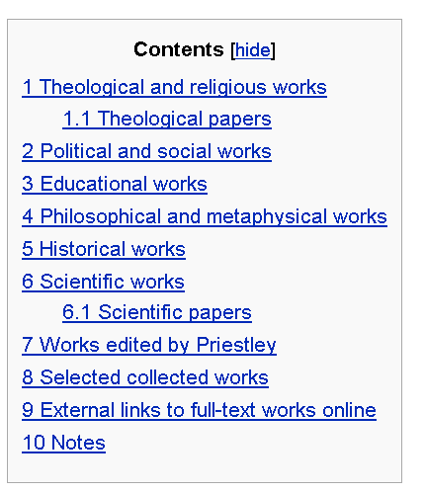
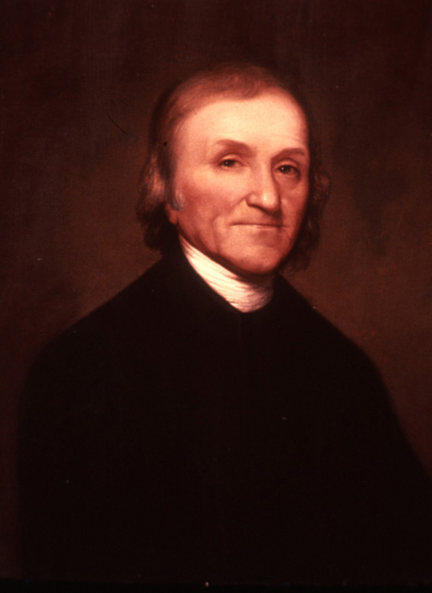
List of works by Joseph Priestley
Joseph Priestley, Rembrandt Peale, 1803
Notes:
List of works by Joseph Priestley – table of contents

Slide 8
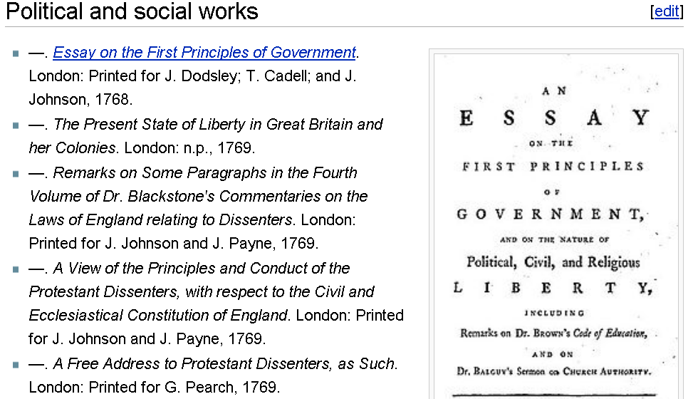
Notes:
List of works by Joseph Priestley - sample

Slide 9
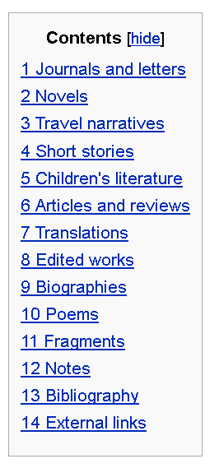
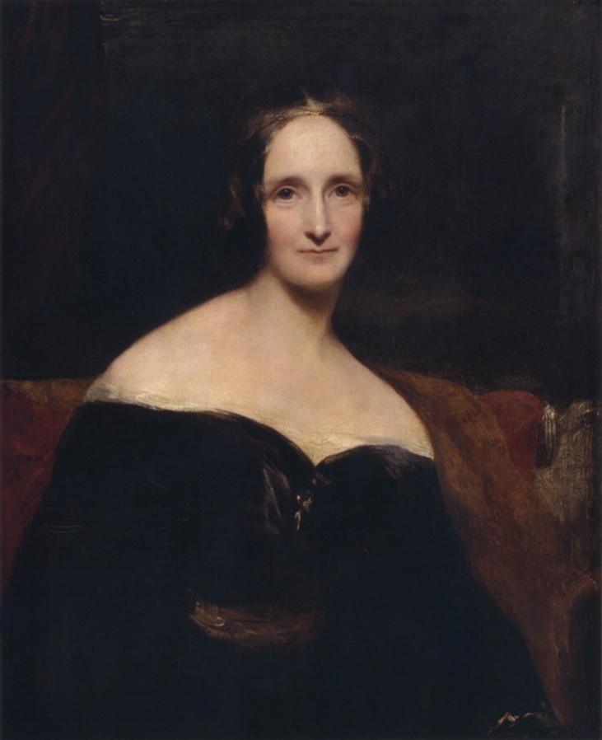
List of works by Mary Shelley
Notes:
List of works by Mary Shelley – table of contents

Slide 10
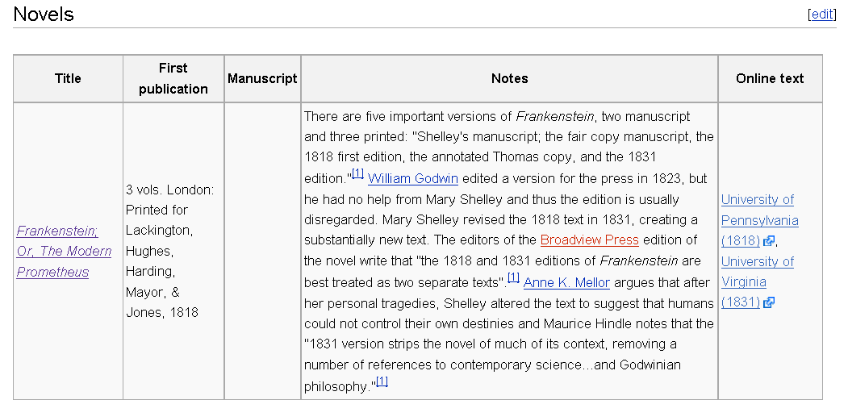
List of works by Mary Shelley
Notes:
List of works by Mary Shelley - Novels

Slide 11
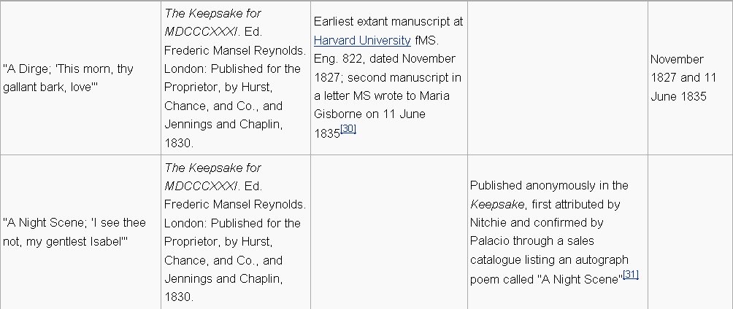
List of works by Mary Shelley
Notes:
List of works by Mary Shelley - Poems

Slide 12
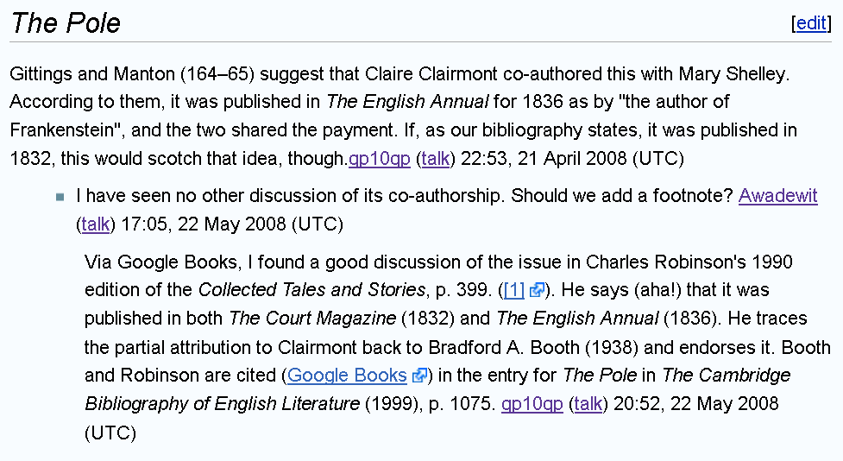
Notes:
List of works by Mary Shelley – talk page

Slide 13
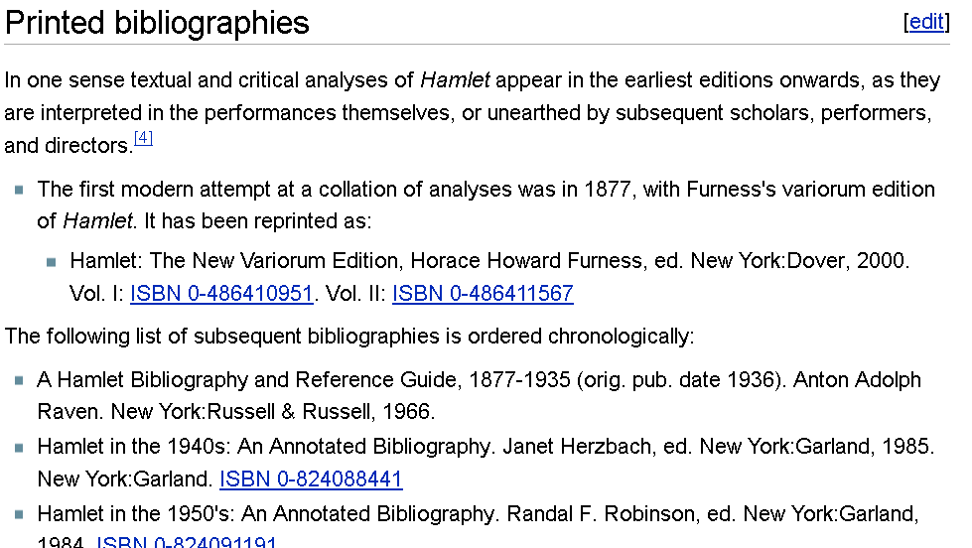
Notes:
Hamlet (bibliographies) article

Slide 14
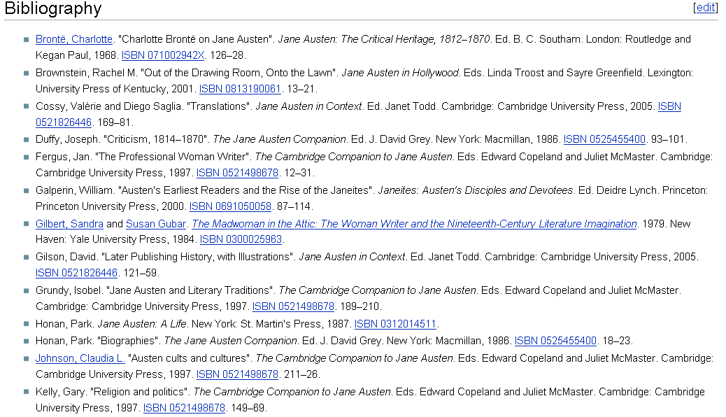
Notes:
Reception history of Jane Austen bibliography

Slide 15
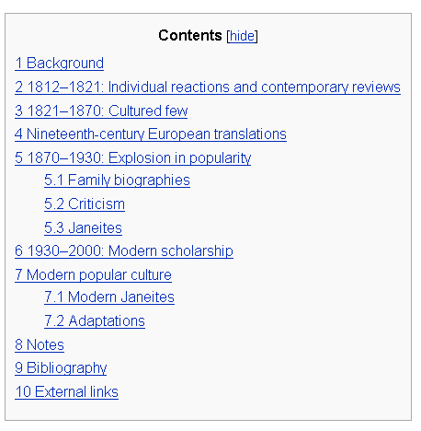
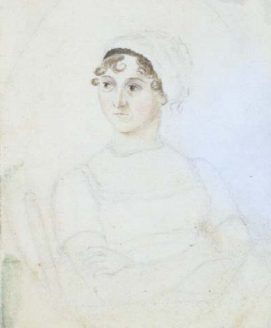
Reception history of Jane Austen
Notes:
Reception history of Jane Austen table of contents

Slide 16
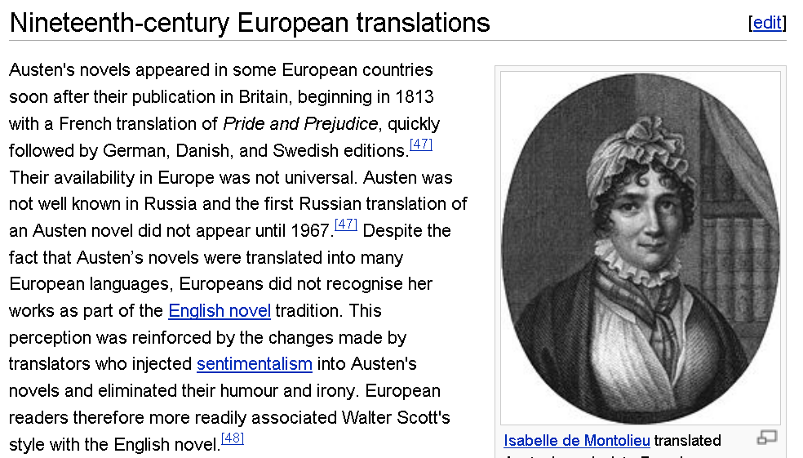
Notes:
Reception history of Jane Austen – translation section

Slide 17
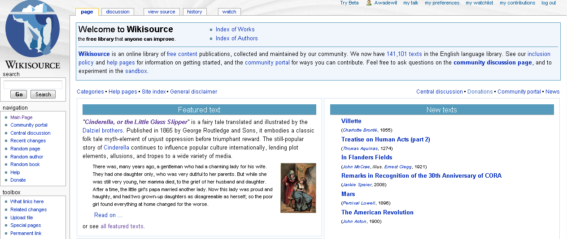
Wikisource

Slide 18
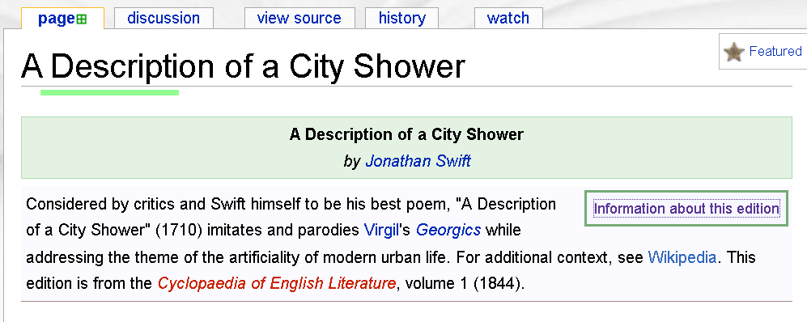
Wikisource

Slide 19
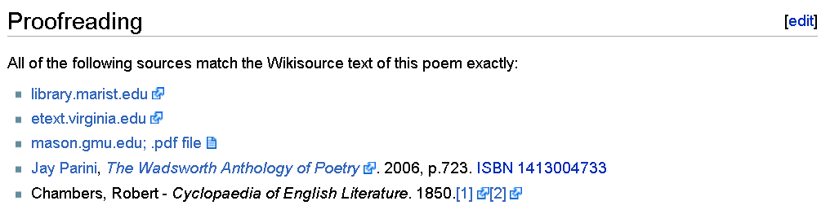
Wikisource

Slide 20
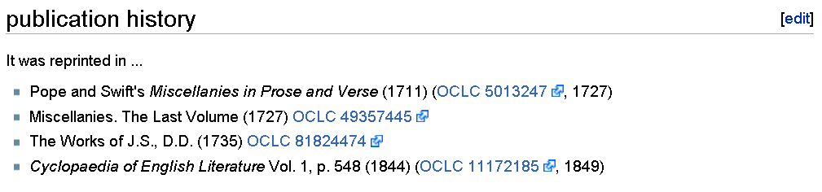
Wikisource

Slide 21
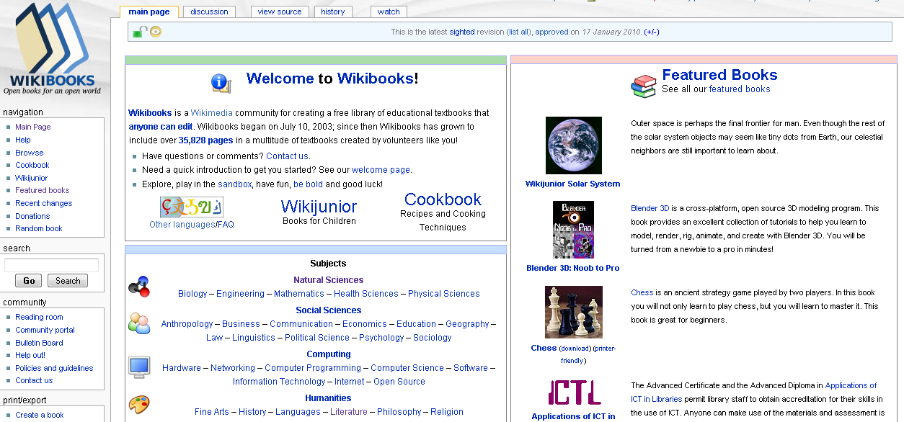
Wikibooks

Slide 22
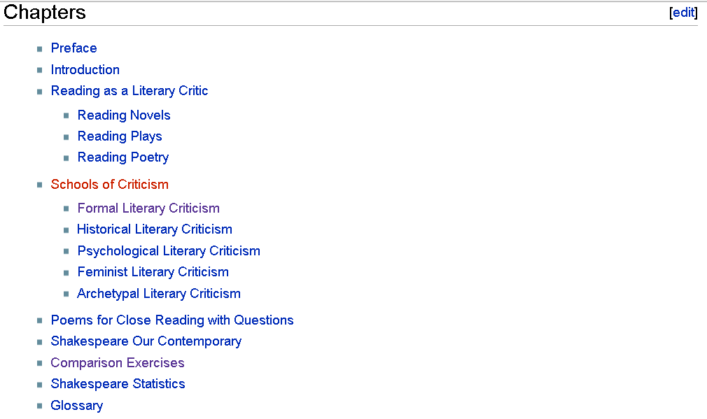
Wikibooks
Notes:
Literary criticism

Slide 23
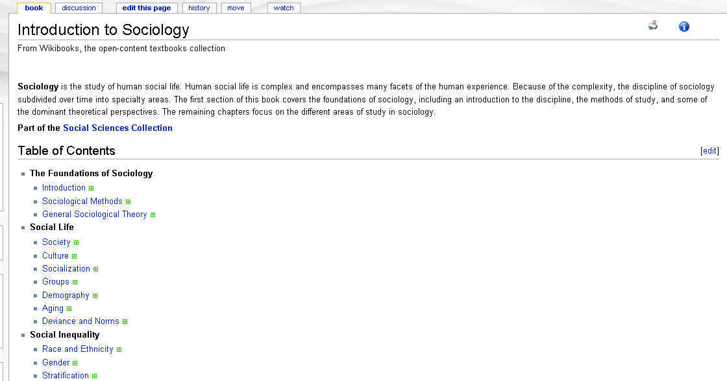
Wikibooks

Slide 24
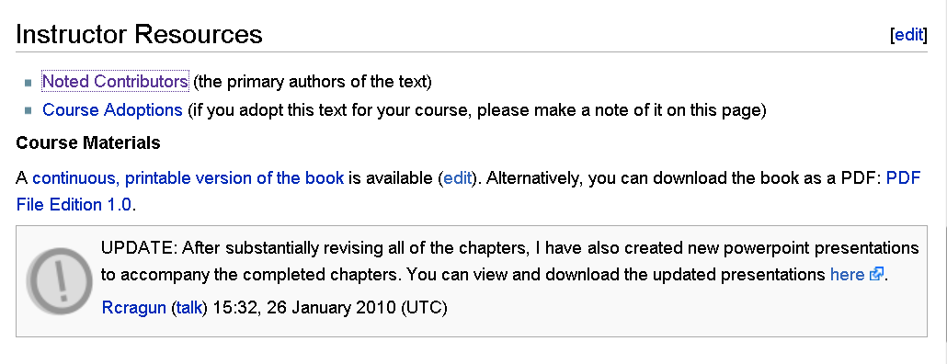
Wikibooks
Notes:
Powerpoint provided and primary contributors listed

Slide 25
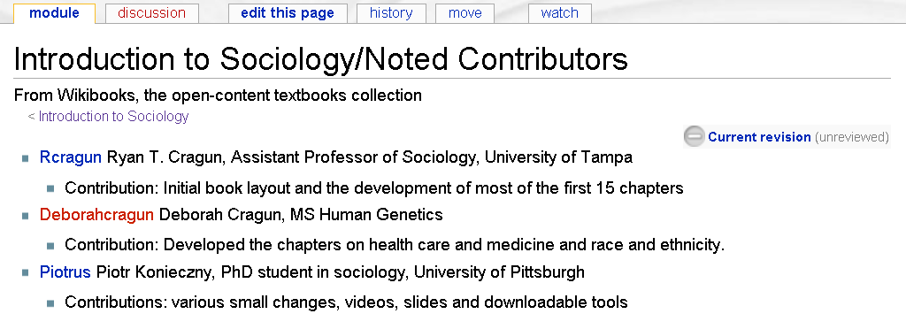
Wikibooks
Notes:
Contributors are people working in the field

Slide 26
Teach students…
To assess the reliability of sources
To organize information
To write collaboratively
To respond to a variety of actual readers
To see their writing fail and succeed in communicating their meaning
To participate in the construction of knowledge

Slide 27
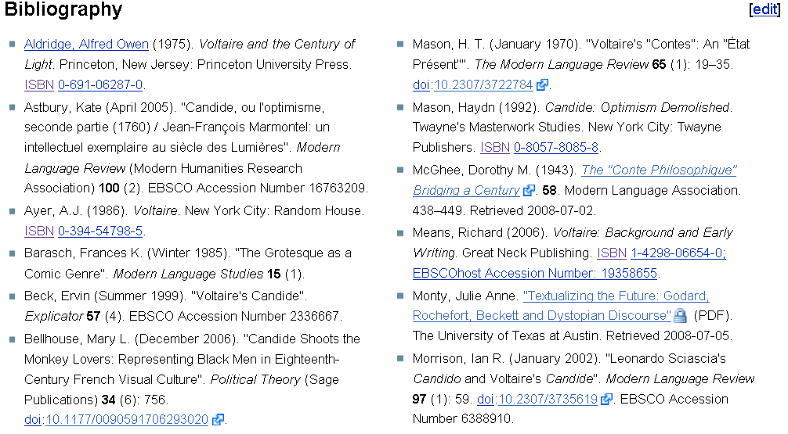
Notes:
Candide bibliography

Slide 28
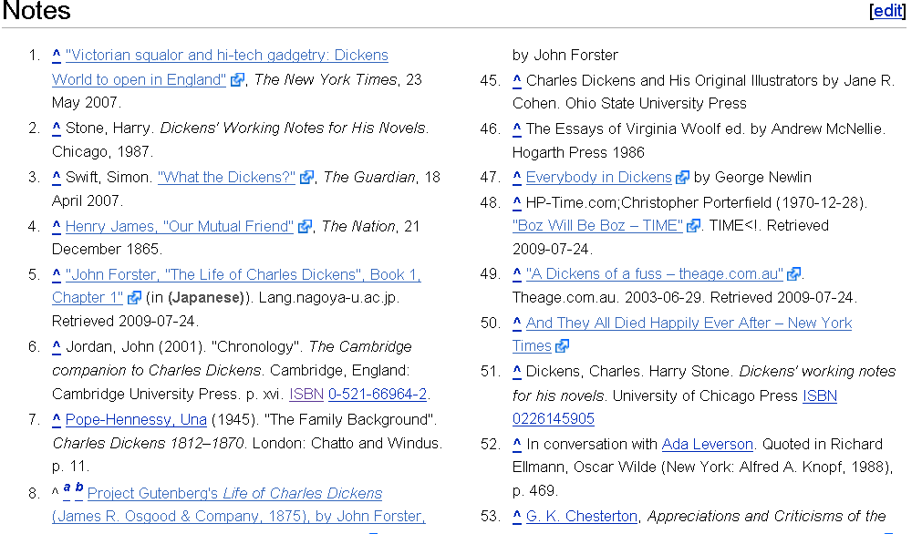
Notes:
Charles Dickens Notes

Slide 29
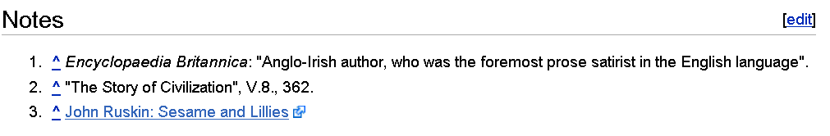
Source analysis
Notes:
Jonathan Swift - Notes

Slide 30
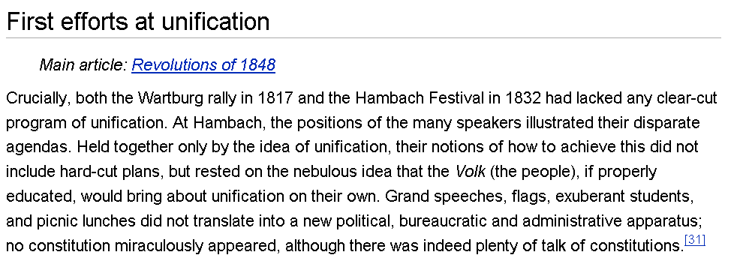
Copyediting
Notes:
Unification of Germany - tone

Slide 31
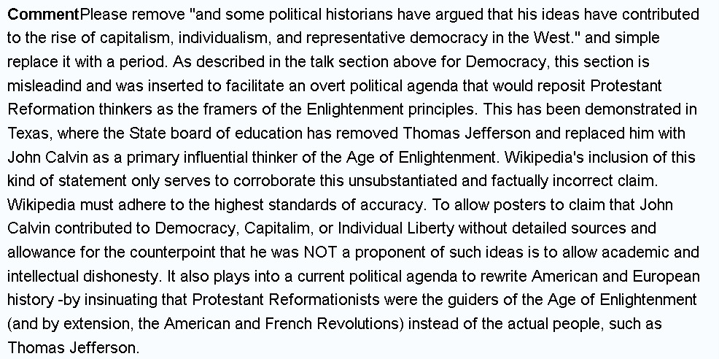
Notes:
Talk:John Calvin

Slide 32
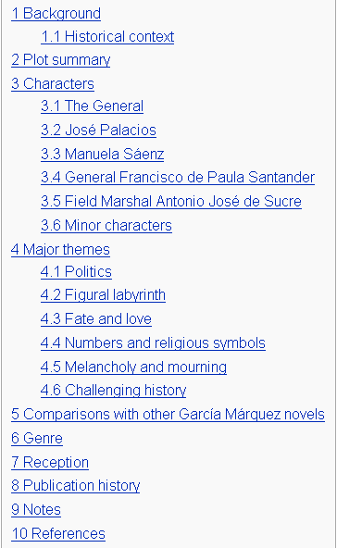

The General in His Labyrinth
Notes:
The General in His Labyrinth table of contents

