Slide 1
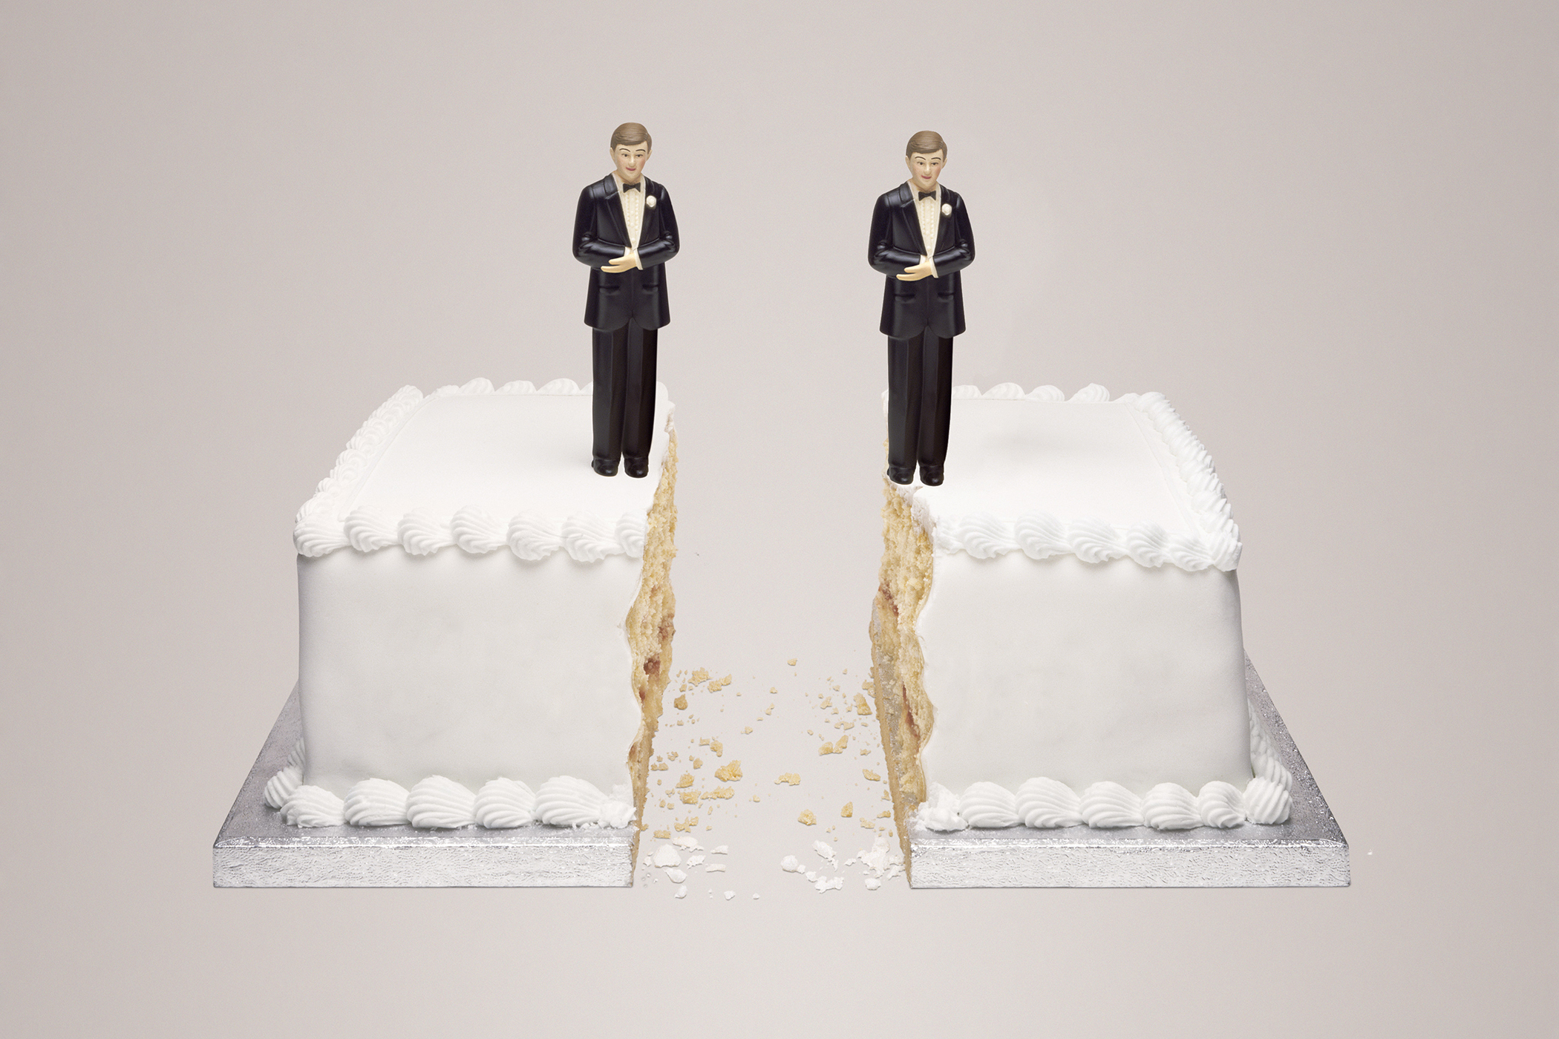
Accounting for Same-Sex Divorce: Relationship- Versus Self-Focused Divorce Accounts and the Meanings of Marriage among Gay Men and Lesbians
Aaron Hoy, Ph.D.
Minnesota State University, Mankato
MSS 2021

Slide 2
Same-Sex Marriage and Divorce
Same-Sex Marriage –
  Hopes and expectations (Hull 2006; Lannutti 2005)
  Motivations for marrying (Kimport, 2014; Richman 2014; Rostosky et al. 2016)
  Effects of marital transition – health (LeBlanc et al. 2018), relationship dynamics (Garcia & Umberson 2019), family relationships (Ocobock 2013)
Same-Sex Divorce - ?
  Obergefell v. Hodges – June 26, 2015
  Divorce rates comparable to different-sex couples (Badgett & Mallory 2014)

Slide 3
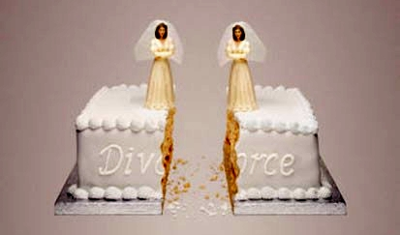
How do gay men and lesbians account for their divorce experiences? And what do these accounts suggest about the meanings they attach to marriage?

Slide 4
Accounts
Accounts are the ways that people explain and justify their actions or experiences, especially those that defy social norms or expectations (Orbuch 1997; Scott & Lyman 1968)
  May not reflect the events that transpired (Hopper 1993; Vaughn 1986)
  Reflect instead how individuals understand their divorce experiences (Hopper 1993, 2001)
  Draw on dominant meanings → Save face (Goffman 1963; Orbuch 1997)

Slide 5
The Evolving Meanings of Marriage
Companionate Marriage (Burgess & Locke 1945) –
  Romantic love
  Highly integrated and interdependent – “Two become one”
Individualized Marriage (Cherlin 2004) –
  Self-development
  Relatively autonomous and interdependent – “Alone together”
  Non-marital same-sex relationships highly individualized (Green et al. 2016; Orne 2017; Stacey 2008; Weeks et al. 2001)

Slide 6
Methods
Semi-structured, in-depth interviews with non-random sample of 6 recently divorced gay men and lesbians
  1 in-person, 5 via telephone
  3 women, 3 men – all cisgender
  5 White, 1 African American
  Divorced, on average, for 2.5 years by interview
Inductive, grounded theory analysis
  Open coding and memoing

Slide 7
Relationship- vs. Self-Focused Accounts
Relationship-Focused
  Emphasize relationship problems – the coming undone of a formerly intimate bond
  Attach companionate meanings to marriage
Self-Focused
  Emphasize problems the marriage created for the account-teller – negative impacts of bad marriage
  Attach individualized meanings to marriage

Slide 8
Relationship-Focused
Rodney – 54, African American, Florida
  Divorced his husband, Craig, following Craig’s infidelity and dishonesty
I felt hurt. I had been duped in so many ways, and that was just like a punch in the stomach, it really was. You’re so in love with this person, but it’s not even the person you married.
As far as I was concerned, if you’re not doing it for us and to save this marriage, then why do it? And that was actually my comment to him. I said: ‘If you’re not doing this for us, I’m not gonna bother because I’m not doing this relationship myself.’

Slide 9
Relationship-Focused
Larry – 63, White, New York
  Divorced his husband, Dan, after the two drifted apart
He was working seven days a week, and then what little time he had, he would spend with his biker friends, and in third place came his parents. And then I was a fourth-place interest, way behind everybody else. And I just kind of got tired of sitting around the house on my own, not having a partner anymore.
We didn’t do anything together, even around the house. I did the grocery shopping, and he did the laundry, so it wasn’t even like we were a couple. We were more like roommates.

Slide 10
Self-Focused
Sandy – 44, White, California
  Divorced her wife, Dana, because the relationship “wasn’t enough”
…I got to a place where I felt like I was spending more time working on my relationship than being in my relationship. And that was just frustrating and exhausting.
I wanted more than that out of my primary relationship. What we had – and we had a lot – it just wasn’t enough for me. I needed something more. Like none of this is right for me and I just have to step up and make a decision.

Slide 11
Self-Focused
Lauren – 45, White, Massachusetts
  Divorced her wife, Margaret, due to their “different ways of existing”
I was like, ‘Let’s move to California!’ I sort of thought, ‘I have this partner, the world is our oyster, we’re going to go do all these things.’ And her vision is like, ‘Oh I have this partner, and now we’re going to stay home and build a white picket fence.’
Like, I wanted to be able to keep doing my career, and I couldn’t do that with two kids. I knew I would end up not doing the things that I wanted to do with my life. At that point, I was already, like, kicking and screaming to be able to carve out my own existence or something.

Slide 12
Self-Focused
Jay – 39, White, California
  Divorced his husband, David, following Jay’s infidelity and feelings of stagnation and frustration
I’d lost myself and I decided, I’m going to find myself. I’ve lost my career. I should have been in management; I should have been full-time teaching. I wanted to have a business; I wanted to have all these things in my field, never did, because I didn’t have to, because David paid the bills. I didn’t need to work. I should have for my self-worth. For my self-worth, I should have done it. But my marriage made me lazy; it made me complacent.

Slide 13
Conclusions
Multiple, complex ways of making sense of same-sex divorce
  Not mutually exclusive – e.g., Sandy
Both companionate and individualized meanings of marriage

Slide 14
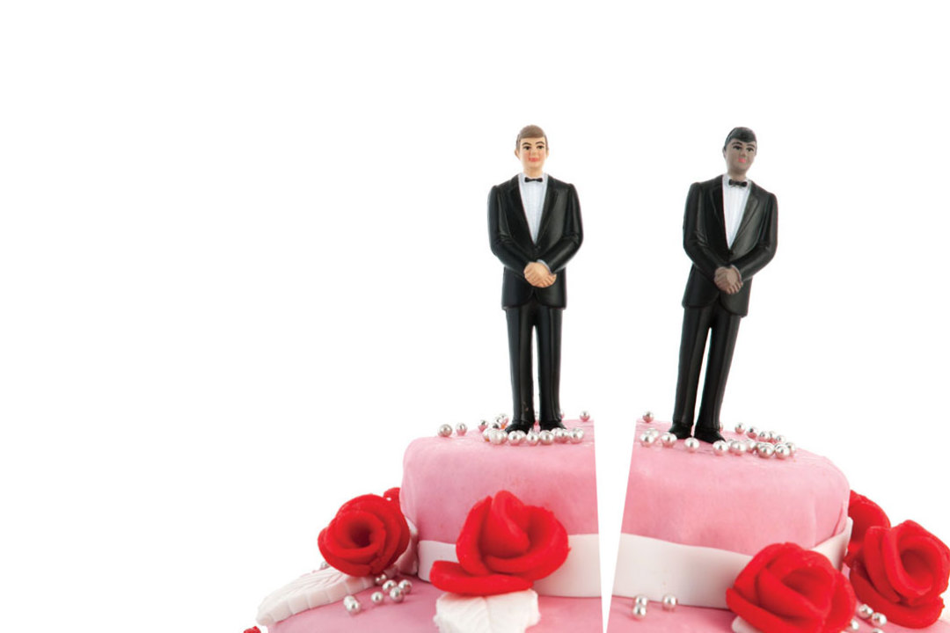
Thank you! Questions? Comments?
If interested, this paper was published in the Journal of Divorce and Remarriage in 2020.
Aaron Hoy, Ph.D.
Minnesota State University, Mankato
aaron.hoy@mnsu.edu

