Slide 1
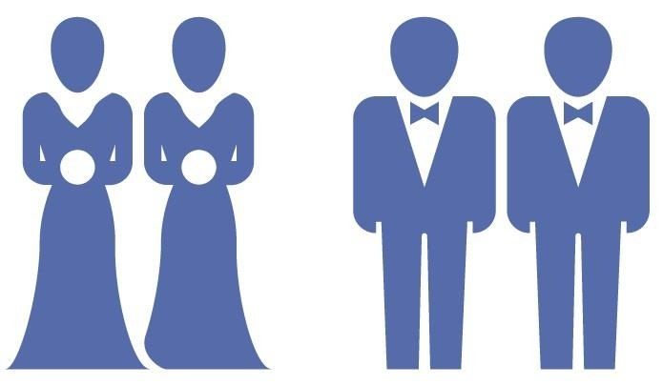
‘It Feels Like We’re Together as a Team’
Communal Orientations to Marriage among Gay Men and Lesbians
Aaron Hoy, Ph.D.
Assistant Professor, Dept. of Sociology & Corrections
Scholars at Work Conference 2019

Slide 2
Same-Sex Marriage
With the recent legalization of same-sex marriage across the US (2004-2015), sociologists and other scholars have begun to develop a body of literature on same-sex marriage –
  Motivations for marrying (Kimport 2014; Richman 2014)
  Marriage and family relationships (Ocobock 2013; Riggle et al. 2018)
  Marriage and health (Kim and Fredriksen-Goldsen 2014; LeBlanc et al. 2018)
However, scholars have yet to explore how gay men and lesbians approach their marital relationships.

Slide 3
Relationship Orientations
Communal Orientations → Prioritize the solidarity and stability of the relationship
  Entails a sense of “we-ness” (DeMaris 2007)
  Low levels of individual autonomy, high levels of interdependence
Individual, or Individualistic, Orientations → Prioritize the happiness and well-being of each partner
  High levels of individual autonomy, low levels of interdependence

Slide 4
Same-Sex Relationships
Research suggests that gay men and lesbians tend to approach their non-marital relationships with an individual(istic) orientation –
  Report that monogamy and lifelong commitment are less important (Green et al. 2016; Meier et al. 2009; Stacey 2008)
  Less likely to share a residence (Strohm et al. 2009)
  Less likely to adopt a shared last name (Clarke et al. 2008; Patterson and Farr 2017; Suter and Oswald 2003)
As such, scholars have characterized gay men and lesbians as “pioneers” of “radical individualism” (see Giddens 2014; Orne 2017)

Slide 5
Research Questions
In this paper, I address two research questions –
  How do gay men and lesbians approach their marital relationships?
  Are their orientations to marriage more individual(istic), as the existing research would suggest, or more communal?

Slide 6
Methods
In-depth interviews with 28 currently married gay men and lesbians
  Participants recruited through non-profit organizations and law firms, snowball sampling
  Conducted in person and via telephone
  Lasted between 1 and 2.5 hours
Sample characteristics –
  16 women, 12 men
  Predominantly White
  Ages range between 28 and 78, though most between 35 and 55
Analyzed using grounded theory (Charmaz 2006)
  3-step inductive process: line-by-line coding, focused coding, analytic memos

Slide 7
Communal Orientations
“It feels like we’re together as a team. It’s not, you know, she’s over here and I’m over here kind of separated. It feels very much like everything we do we do together, whether it’s work or school or purchases or whatever. Like, I always tell my wife, you know, ‘We’re almost done,’ and ‘Now we have to do this part of the dissertation,’ or whatever”
– Jenny (55, White, Oregon)

Slide 8
Communal Orientations
“We just work really well together, kind of like a team in a way. Like, we support one another really well, and we depend on one another for everything…And it’s just overall a good balance of us doing everything together and making it work”
– Nate (34, White, New Hampshire)

Slide 9
Collaboration and Interdependence
“We just really work together and rely on one another. If one is lacking in an area, the other can help to compensate. Like, I’m very handy. [My husband] is not. So if something isn’t repaired, I can take care of that. But even with family, his family is social whereas mine isn’t, so he ends up doing a lot of the coordinating and dealing with family…That ends up making a good mix for us”
– Stuart (31, White, New Hampshire)

Slide 10
Collaboration and Interdependence
“There was a day in the beginning of April when it was just a crappy day, and I was like, ‘OK, this is the day.’ And I went and I got my papers and handed them in, and I resigned that day…But that was tricky because, you know, we always discuss things beforehand. I mean, I was talking about it because it had been boiling for about three years. But you know, I should have communicated about it more and, like, we should have decided when exactly I was going to do it”
– Susan (42, White, Pennsylvania)

Slide 11
Communal Complications
“You know, completely coming together and being on the same page certainly has been challenging because think about it – when two people come together, both people take their own upbringing into the relationship, their own experiences, their own childhood. So, you know, there are some kinks we certainly had to iron out”
– James (42, White, New York)

Slide 12
Marital Work – Communication
“[Marriage] takes a lot of work, and it might not be a lot of visible, physical work but just a lot of mental stuff…You know, a lot of it is communication. That’s a huge part of it, and you know, I think that takes a lot of work. You can’t just expect that to happen, to know what someone’s thinking. You just have to communicate about it”
– Dean (46, White, New York)

Slide 13
Martial Work – Sacrifice
“I mean, [marriage] always takes work because, you know, you’re putting yourself at least equal if not behind another person, and that’s not always easy to do. You have to give up things maybe you want to make the other person happy. Now, you get your way sometimes, too, but it won’t always be like that”
– Carol (64, White, Ohio)

Slide 14
Conclusions
Gay men and lesbians do not necessarily approach their marriages in individual(istic) ways – in fact, many articulate communal orientations to marriage
Selection effects seem likely –
  Those with more communal relationship orientations “select” into marriage, given the companionate model of marriage (see Lauer and Yodanis 2011; Loscocco and Walzer 2013; Michlaka et al. 2017; Smart and Shipman 2014; Yodanis and Lauer 2014)

Slide 15
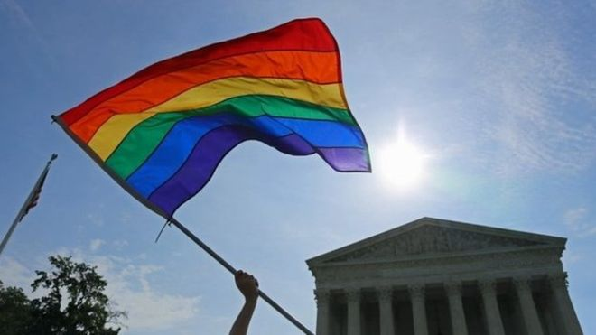
Thank You!
Questions? Comments?
Email: aaron.hoy@mnsu.edu

