Slide 1
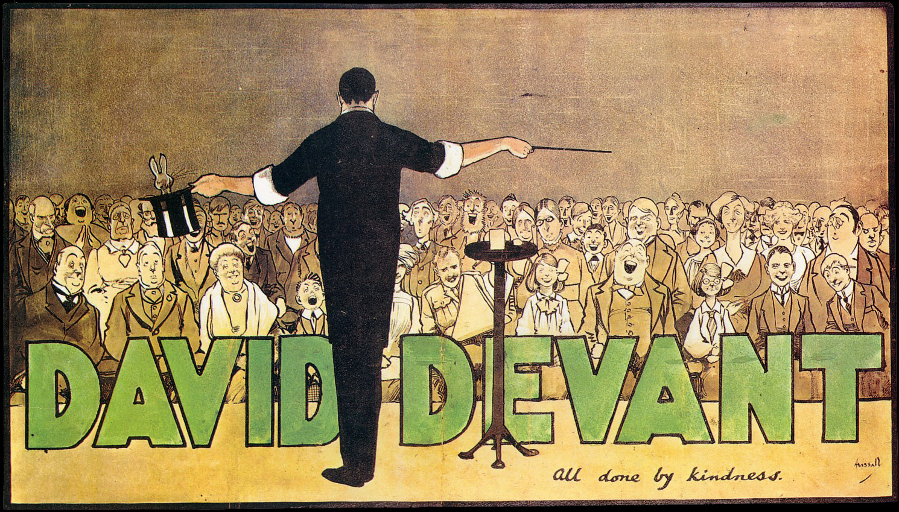

The Magic of
Open Education Resources
A. Carey Huddlestun
Oct. 21, 2019
Open Access Week
Kennesaw State University
Licensed under CC BY 4.0
“David Devant: All Done with Kindness, by John Hassall, Public Domain
Notes:
Introduction: We as teacher and student scholars can do many wonderful things. However, we cannot put money out of the air. Although, through Open Education Resources, we can do the next best thing!

Slide 2
“David Devant: All Done with Kindness, by John Hassall, Public Domain
Notes:
Introduction: I love this poster of the famous English magician David Devant (b.1863 d.1941) for a number of reasons. First of all, the poster’s title, “All Done with Kindness” resonates with me. And secondly, the painting’s perspective shows the many reactions to magic. There are those laughing with delightful surprise; those staring in stunned disbelief; and those obviously frustrated to the point of anger.
While this poster shows the many types of reactions to magic, the reactions are similar to those provoked by Open Educational Resources, or OER. There are those who are uniformed about OER so they look somewhat shocked; there are those who are delighted by and welcome OER (such as students); and then there are those who are skeptical of OER – such as instructors who are not sure of their value and/or for profit publishers who are taking what academics give them for free (research, study, writings, reviewing of peer material) and sell it to the academic community for a profit.
So, when you think about Open Education Resources, which audience member are you?
[Allow for feedback]
In this presentation we will cover the following:
The Why of OER
The What of OER
Highlights from the University System of Georgia’s OER efforts, Affordable Learning Georgia. We will briefly look at ALGs in Georgia as a whole and then specifically at KSU;
and finally,
The Where of OER – or where you can find OER material and resources.

Slide 3
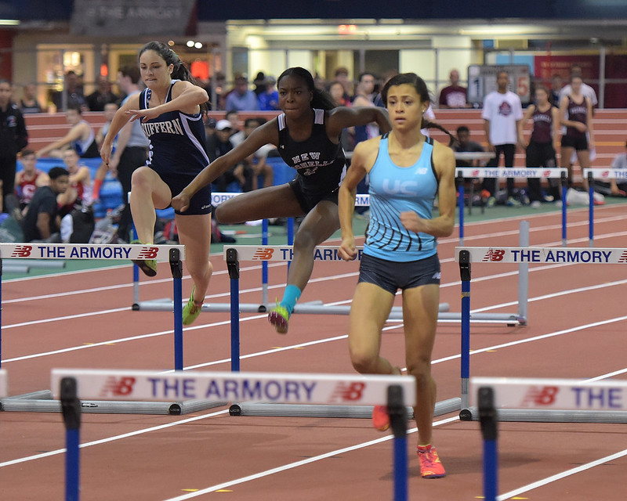
The Magic of OER . . . Why
“Indoor Track and Field,” by Steven Pisano, is licensed under CC BY 2.0 , Adapted by Carey Huddlestun–cropped
Notes:
With the rising cost of textbooks, students' ability to access their required learning materials can often be a barrier to fully participating in their courses and success in their studies. At the same time, the rapid change in technology continues to adapt how we engage with information.
[Chat service – textbooks available in the library always requested at the beginning of the semester]

Slide 4
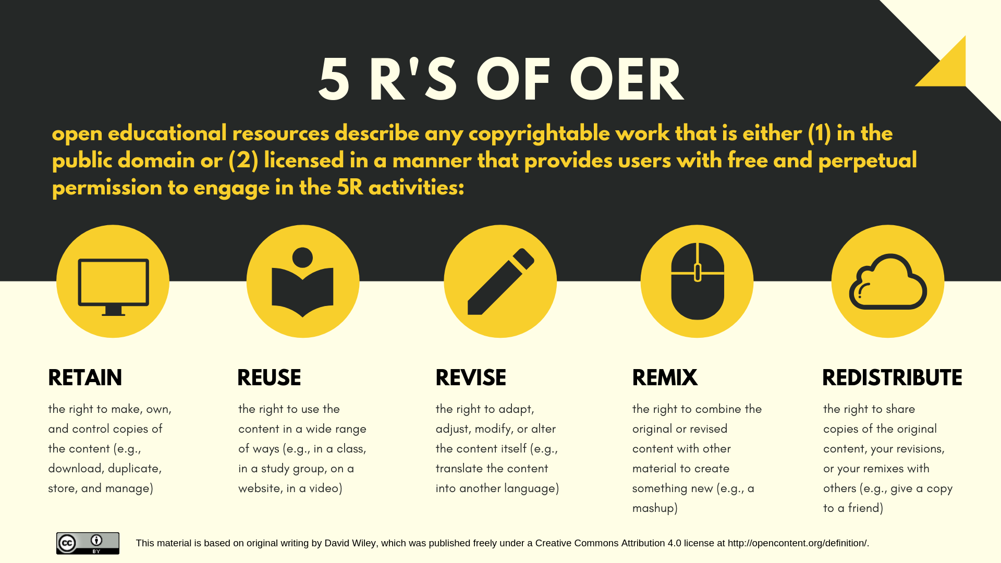
Magic of OER . . . What
Notes:
"Open Education Resources encompasses resources, tools and practices that are free of legal, financial and technical barriers and can be fully used, shared and adapted in the digital environment. Open Education maximizes the power of the Internet to make education more affordable, accessible and effective." They are characterized by the 5 R's (refer to graph).
Source: Scholarly Publishing and Academic Resources Coalition (SPARC)

Slide 5
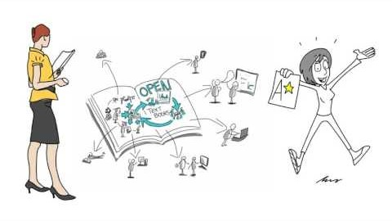
The Magic of OER . . . Why, What, and Quality
“A Review of the Effectiveness & Perceptions of Open Educational Resources As Compared to Textbooks” by George Veletsianos and The Digital Learning and Social Media Research Group, posted on YouTube Channel Research Shorts, is licensed under CC BY 3.0.
Notes:
This 4 minute video give a succinct overview of open education resources by reporting on a review of the research on efficacy and perceptions of OER done by John Hilton and published in 2016.
“A Review of the Effectiveness & Perceptions of Open Educational Resources As Compared to Textbooks” by Research Shorts, CC Reuse Allowed.
Original article: “Open educational resources and college textbook choices: a review of research on efficacy and perceptions,” by John Hilton (johnhilton@byu.edu), Educational Technology Research & Development, Aug. 2016, Vol. 64, Issue 4, p. 573-590. At: https://login.proxy.kennesaw.edu/login?url=http://search.ebscohost.com/login.aspx?direct=true&db=eue&AN=116917798&site=eds-live&scope=site

Slide 6
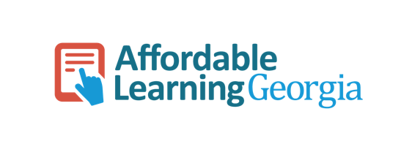
The Magic of OER . . . ALG
https://www.affordablelearninggeorgia.org/
Notes:
Let’s look at the University System of Georgia’s OER work through Affordable Learning Georgia (ALG). ALG is a USG initiative to promote student success by supporting the implementation of affordable alternatives to expensive commercial textbooks, particularly Open Education Resources (OER) and open textbooks such as OpenStax Textbooks, that are both free and customizable for exactly what a faculty member would like to teach within their courses. ALG also encourages the use of electronic resources made available through GALILEO.
ALG pursues these goals in a few primary ways:
Awarding Textbook Transformation Grants to teams of faculty and professional staff to provide the time and support they need to transform their courses from requiring a commercial textbook to requiring OER, library, and other no- or low-cost resources.
Working with the University of North Georgia Press to create new open textbooks for high-enrollment courses without an open textbook already available.
Making all grant-created and UNG Press-created open materials available and searchable through GALILEO Open Learning Materials, an OER repository.
Raising awareness of textbook affordability on each campus through our ALG Campus Champions and Library Coordinators.
ALG began as a GALILEO pilot initiative in 2013 addressing both Complete College Georgia and the USG 2013-2018 Strategic Plan’s Imperativ1.
ALG was funded in 2014 by the state legislature.

Slide 7

The Magic of OER . . . ALG Report Card
This Photo by Unknown Author is licensed under CC BY-SA-NC 3.0
Notes:
Earlier we saw a summary of the national research on OER efficacy and perceptions published in 2016. Let's look at the these same issues related to Georgia as reported in the ALG Data Dashboard Report from Spring 2019.

Slide 8

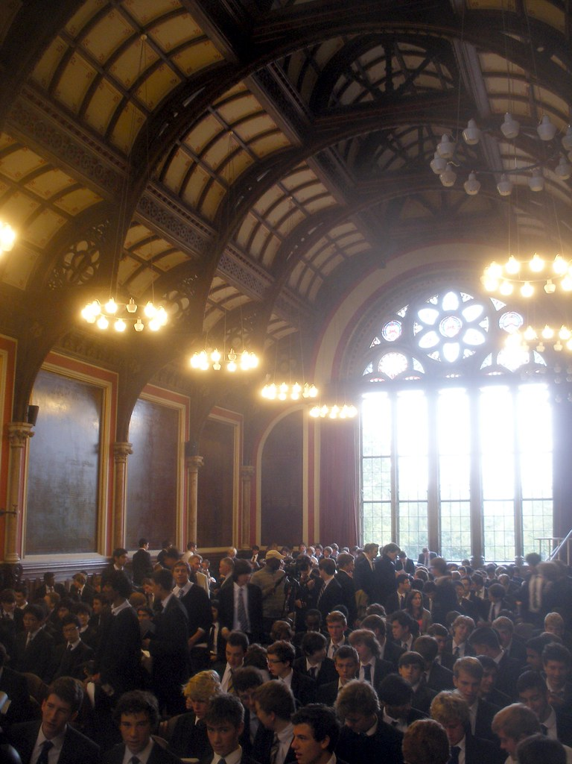
The Magic of OER . . . ALG Report Card
Textbook Transformation Grants: Data Dashboard
"All in a Day's Work" by Damian Gadal is licensed under CC BY 2.0
"Audience" by Arenamontanus is licensed under CC BY-NC 2.0 Adapted by Carey Huddlestun-cropped
Notes:
[Ctrl Click image to bring up: ALG Data Dashboard https://www.affordablelearninggeorgia.org/about/powerbi]
The Data Dashboard looks at four key indicators:
Total Student Savings
Total Number of Students Affected
Total Grants Awarded
Student Perceptions / Learning Outcomes / Retention → SEE pages 5, 6, & 7 of AFG Final Report Summary

Slide 9
The Magic of OER . . . Resources Available
OER Research Guide (http://libguides.kennesaw.edu/oer/affordablelearninggeorgia)
  Open Textbooks page
  OER Repositories page
  Learn More page
ALG Webpage (https://www.affordablelearninggeorgia.org/)
  About : Textbook Transformation Grants
Notes:
OER - Research Guide Presentation Guide (http://libguides.kennesaw.edu/oer/affordablelearninggeorgia)
Brief overview of these tabs:
Home (Basically it's all "What is OER?“)
Guide to OER Terms (Creative Common's licenses, Public Domain, Glossary) → PROMOTE Friday’s Creative Commons presentation
ALG (Links to info about Textbook Transformation Grants)
More in-depth overview of these tabs:
Open Educational Resources: Open Textbooks & Open Access Books (DOAB)
OER Repositories: "These open materials can be adapted to make your own OER."
Demo a search using "Mason OER Metafinder (MOM)" --> search for "music appreciation" (MOM searches several of OER dbases)
Promo "Georgia Repositories"
Open Digital Commons: Select "Collections" --> "Open Educational Resources“
Open "GALILEO Open Learning Materials:" --> All USG Open Textbooks
End with “Learn More” tab → “Additional Resources” has Tutorials about finding and creating OER.

Slide 10

The Magic of OER . . . You Have Magic Powers!
“Woman Reading a Book Sitting on Mattress Near the Blue String Light Inside the Room,” by Ivandrei Pretorius, Pexels Free to Use.
Notes:
So, while we can’t pull money out of the air, we do have the power to choose low or no cost OER in the course we teach and the courses we take [students - ask for 'no cost' or 'low cost' courses when you register].

