Slide 1
What's in Our Assessment Utility Belts
Presented by
LaTiffany Davis
Learning Commons Librarian, Assistant Professor
ldavi211@kennesaw.edu
A. Carey Huddlestun
Research and Instruction, Assistant Professor
ahuddle3@kennesaw.edu

Slide 2

What's in Our Assessment Utility Belts
Presented by
LaTiffany Davis
Learning Commons Librarian, Assistant Professor
ldavi211@kennesaw.edu
A. Carey Huddlestun
Research and Instruction, Assistant Professor
ahuddle3@kennesaw.edu
Get a mobile device ready.

Slide 3
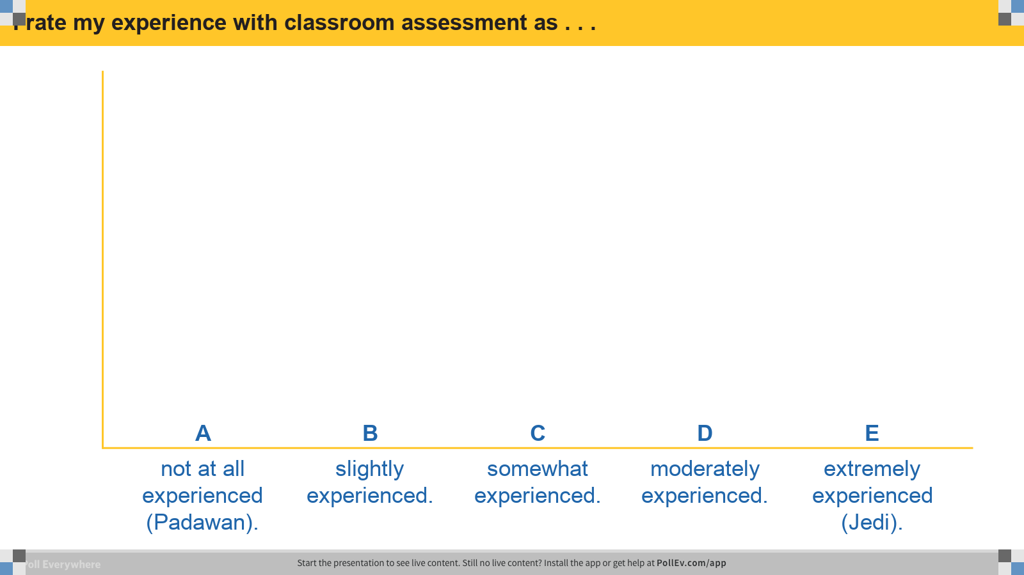
Notes:
Poll Title: I rate my experience with classroom assessment as . . .
https://www.polleverywhere.com/multiple_choice_polls/CPo0dmC81XE09mmv9i71a

Slide 4
Learning Outcomes
Awareness of practical assessment resources
Awareness of characteristics of assessment resource
Awareness of ways resources are used
Notes:
T

Slide 5
Characteristics of Assessment
Easy Instructions
Time Sensitive
Assess Learning Outcomes
Notes:
T

Slide 6

Practical Assessment Resources
ACRL Framework for Information Literacy Sandbox
A platform and repository for sharing Framework materials
http://sandbox.acrl.org/resources
Notes:
C

Slide 7
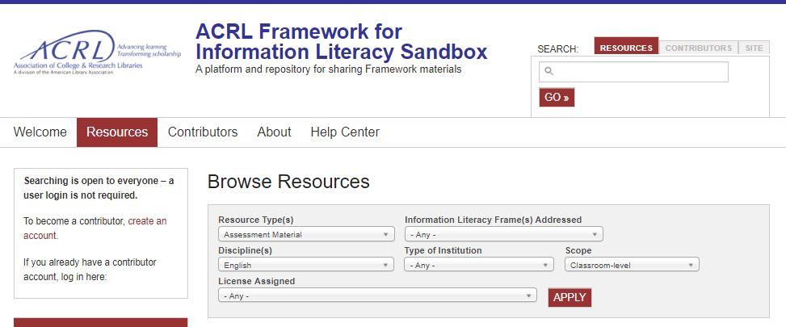
Practical Assessment Resources
Notes:
C

Slide 8
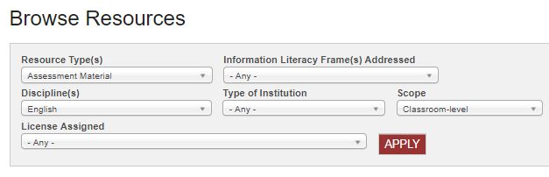
Practical Assessment Resources
Notes:
C

Slide 9
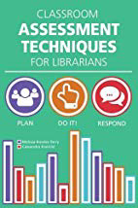
Practical Assessment Resources
Bowles-Terry, Melissa, and Cassandra Kvenild. Classroom Assessment Techniques for Librarians. 2015.
https://www.alastore.ala.org/content/classroom-assessment-techniques-librarians
http://www.librarything.com/work/16247598
Notes:
C & T

Slide 10
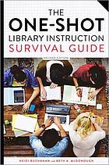
Practical Assessment Resources
Buchanan, Heidi E., and Beth A. McDonough. The One-Shot Library Instruction Survival Guide. Second ed., 2017.
https://www.alastore.ala.org/content/one-shot-library-instruction-survival-guide-second-edition
http://www.librarything.com/work/14908881

Slide 11
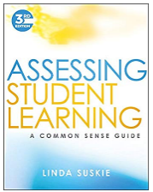
Practical Assessment Resources
Suskie, Linda. Assessing Student Learning. 3rd Ed. 2018.
https://www.librarything.com/work/558756
Notes:
T

Slide 12




Practical Assessment Resources
Assessment & Involvement -Online Polling Sites
https://www.polleverywhere.com/
Summary –Poll Everywhere Reviews at CommonSenseMedia.org
https://socrative.com/
Summary –Socrative Reviews at CommonSenseMedia.org
https://kahoot.com/
Summary –Kahoot! Reviews at CommonSenseMedia.org
https://www.qualtrics.com/
Notes:
C

Slide 13

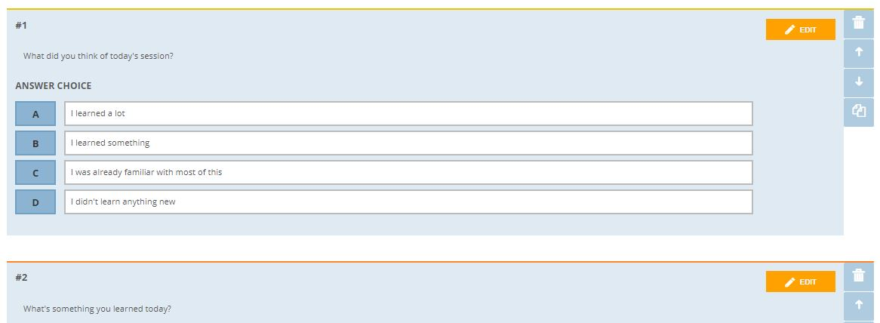
Practical Assessment Resources
Notes:
C

Slide 14
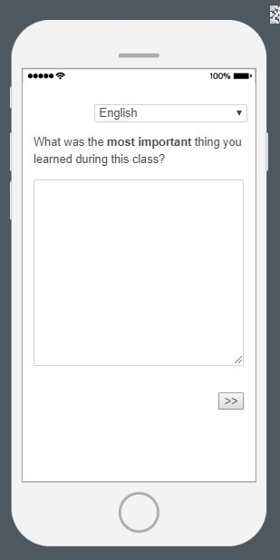
Practical Assessment Resources

Slide 15
Miscellaneous Assessment Techniques
Physical Backup / Option
Question → Wait Time → Prize
Wireless Keyboard
Notes:
T

Slide 16

Preferred Assessment Resources
What have you found useful?
Notes:
T

Slide 17
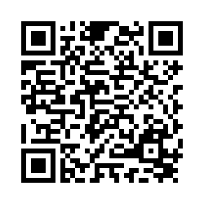
Minute Paper
Instructor: Hudvis Today’s Date: 06/07/2019
https://tinyurl.com/huddlelibrary
Notes:
C

Slide 18

What's in Our Assessment Utility Belts
Notes:
C & T

Slide 19
What's in Our Assessment Utility Belts
Presented by
LaTiffany Davis
Learning Commons Librarian and Librarian, Assistant Professor
ldavi211@kennesaw.edu
A. Carey Huddlestun
Research and Instruction, Assistant Professor
ahuddle3@kennesaw.edu

