Slide 1

Assessing the Strategic Credibility of Special Collections
Erin Passehl
Western Oregon University
Rick Stoddart
Oregon State University
AAAS Pacific Division Meeting
Boise, ID
June 25, 2012
Notes:
Introductions

Slide 2
Why is strategic credibility important now?
In time of justifying budgets, people, positions, services, and space, how do we communicate our value and place within parent institutions (the university)?
Necessary shift from just informing to influencing the stakeholder’s point of view (“talk their talk”)
Accountability, assessment

Slide 3
Strategic Credibility
“…refers to how other others view the company’s overall corporate strategy and its strategic planning capability.”
Higgins and Diffenbach, “Communicating corporate strategy: the payoffs and the risks,” Long Range Planning (1989).

Slide 4
Benefits of Strategic Credibility
Improved relations with stakeholders
Better morale of employees
More goal focused employees
Attracting talented people motivated by the strategy
Higgins and Diffenbach (1989)

Slide 5
Strategic Credibility Factors
Demonstrated performance
Communication of organizational strategy to key stakeholders
Credibility of organizational leadership
Capability to strategize
Higgins (2002)

Slide 6
Library Strategic Credibility Factors
Assessment
Credibility of organizational leadership
Leadership
Capability to strategize
Annual reports
Communication of organizational strategy to key stakeholders
Mission statement
Vision
Strategic planning
Collection policies
Website
Newsletters
Active librarians
Accessibility of information
Demonstrated performance
Performance
Higgins (2002)

Slide 7
Strategic Credibility of Academic Libraries
"Are academic libraries following through with their planning and objectives?”
Gail Staines, "Towards an assessment of strategic credibility in academic libraries." Library Management (2009)
Decline in annual reports, rise in strategic plans
Canadian libraries were user-focused vs. U.S. libraries more trend focused
            Themes: space, assessment, information literacy, offsite storage
    Overall limited communication of strategic planning

Slide 8

Library vs. Library Units
Budget
Resource Allocation
Collaboration opportunities
During times of transition
Notes:
Some of you may be thinking -- well the Library covers my unit in the mission. Why should I be concerned what my mission statement says or even about strategic credibility. Imagine Gov Docs with a University aligned mission statement.

Slide 9
If a university administer asked you how your library unit contributes value to the overall university mission, vision, and strategic goals... how would you respond, and with what evidence?

Slide 10
Our paper focuses on
Demonstrated Performance (evidence)
Capability to Strategize (evidence)
Communication to Stakeholders (action/use)
Leadership (who)
*A note on subjectivity
Notes:
For the purposes of this presentation and intial part of the paper we are going to focus on these two areas.
Looked at top 3, leadership is hard to quantify, will be doing interviews with IRB approval as next step of study

Slide 11
Methodology: Population
Orbis Cascade Alliance
(by institution type)

Slide 12
Strategic Planning: Population

Slide 13
Who had mission statements?
[only 13 out of 37]

Slide 14
Methodology for “strategic planning”
Individually examined College/University mission statements for themes
  Discussed findings and reached consensus
Invidividually examined Special Collections/Archives mission statements
  Included multiple departments at one institution if they had mission statements (N=18, not 13)
  Discussed findings and reached consensus
Negotiated common themes (how well aligned)
Notes:
Percentage of alignment -- help with subjectivity of exercise -

Slide 15
Example: OSU Mission Statement
"As a land grant institution committed to teaching, research, and outreach and engagement, Oregon State University promotes economic, social, cultural and environmental progress for the people of Oregon, the nation and the world…”
http://oregonstate.edu/main/mission
Teaching
Outreach/engagement/land grant/Oregon serving
Economic/promoting economic growth
Cultural/social/social progress
Competitive grads/academic excellence
Search for new knowledge/research
Notes:
"teaching
outreach/engagement/land grant/Oregon serving
Economic/promoting economic growth
Cultural/social/social progress
environment/environmental ecosystems
competitive grads/academic excellence
search for new knowledge/research"

Slide 16
Example OSU: Archives
Mission Statement and Access Policy
The University Archives is authorized to collect, describe, preserve, make accessible to the public, and display historical records created or received in connection with the transaction of University affairs.
Canned language
Historical records
Internal serving
http://archives.library.oregonstate.edu/handbook/chapter4/mission.html
Notes:
Canned Response and Public Serving --- 2 in alignment

Slide 17
What are most archives/special collections mission statements saying?

Slide 18
Overall Special Collections/Archives Alignment with
College/University Mission
N = 18

Slide 19
Percentages of Alignment Between College/University and
Special Collections/Archives
N = 18

Slide 20
Common Aligned Themes in
Mission Comparison
College/University mission statements
Special Collections/Archives mission statements
Research (7)
Subject area (4)
Teaching, Education, Scholarship (3)
Denomination/Faith, Service (2)

Slide 21
Documenting Past Performance
“No single publication of a library can do more to enhance its reputation and increase its budget than its annual report.”
Mersky (1983), Staines (2009)
Staines study found a decline in annual reports and a rise in strategic plans in academic libraries
Public relations piece, brief reviews of current issues and need for additional resources, present historical information, and share future plans
Used internally and externally for stakeholders
Notes:
Staines (2009) "Towards an assessment of strategic credibility in academic libraries." Library Management.
Study of ARL libraries. Staines (2009)

Slide 22
Methodology: Documenting
Past Performance
Annual reports, assessment
How are they publicized (to stakeholders, internal documents)?
Library annual report is usually condensed with good information lost; make available and usable
0
found
online
Notes:
We could analyze collections but unsure of how assessed

Slide 23
Communicating Mission
"Are academic libraries presenting their mission statements online? How much worth is assigned through this communication?”
Triveni Kuchi, “Communicating Mission”
Journal of Academic Librarianship (2006)
Study looked at 111 ARL library websites, examined for presence and location of mission statements
78% of these academic libraries had a mission statement on their websites, although most were through indirect links (“locations were far from effective”)
Notes:
Staines (2009) "Towards an assessment of strategic credibility in academic libraries." Library Management.
Study of ARL libraries. Staines (2009)

Slide 24
Methodology: Accessibility of mission statements
Does the location of the mission statement on the website signify how much value the department placed on it?
Judged the position and access to mission statements on each website
  Counted number of “clicks” from main webpage
  Looked at where mission statements were located
  If not directly linked, we explored where it existed

Slide 25
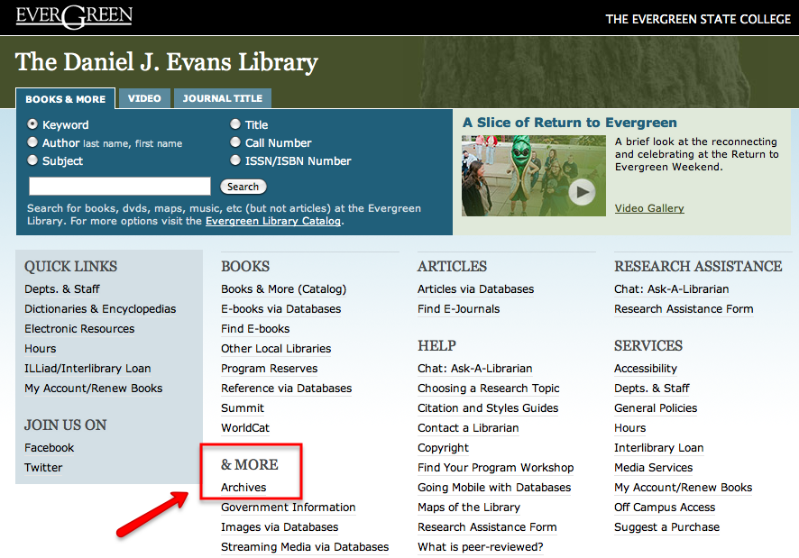
Prominence of Special Collections/Archives
39%
of libraries directly linked to Special Collections/Archives from their main page
Notes:
Of those with mission statements…
[ 50% linked within 1 click, 1 linked within 2 clicks, and 1 had no other web presence ]
Most common indirect link? Under “Collections”

Slide 26
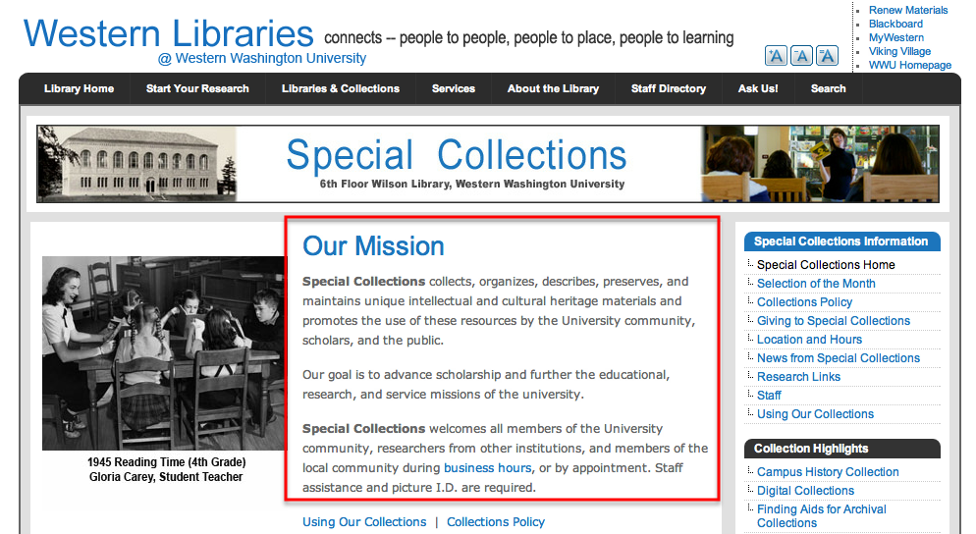
Prominence of mission statement
Only 1 institution directly stated their missions on their main pages

Slide 27
And the rest of Special Collections mission statements?
58%
Within 1 click from the Archives main page
18%
Within 2 clicks of the Archives main page
18%
Within 3 clicks from the Archives main page

Slide 28
Strategic Credibility Summary
Demonstrated performance
59% of Alliance Special Collections/Archives do not have easily accessible mission statements online
Capability to strategize
Of those with mission statements, many are indirectly linked on the website
Communication to stakeholders
Most state WHAT they do (preserve) but not WHY (for learning, research)
Notes:
We thought mission statements would be the easy part. We doubt that assessment or annual reports are necessarily listed as part of documenting performance in many libraries.

Slide 29
We know – mission statements aren’t everything – but it’s a good start.
Portland State University
“Students, faculty, and staff are encouraged to utilize this rich collection in their scholarly and creative work.”
University of Oregon
“…promote learning and discovery and to advance research and scholarship.”
“Our diverse collections support all types of research, from K-12 education to international scholarship.”
“We strive to play an active and creative role in the teaching, research, and serve missions of the University.”
Notes:
Read WOU’s mission statement to compare the power of a well thought out statement:
The University Archives collects, stores, organizes, promotes and makes accessible a wide variety of records, publications, photographs, and artifacts about the history of the university.”

Slide 30
Other types of value communicated through Special Collections/Archives websites
Oregon Institute for Technology
Library mission running along bottom of all web pages
University of Oregon
Western Washington University
Special Collections and Curriculum Support
Clearly displayed mission statements for each department
Willamette University
Instructional service webpage
Notes:
Other ways currently communicating value:

Slide 31

Recomendations
Process of reflection is worthwhile
(Re)Develop
(Re)Align
(Re)Deploy your mission
Notes:
Consider benefits of rephrasing mission around institutional mission
Archives/Special Collections has great ideas, just need to “talk their talk”
Place more value on these strategic documents and make more prominent in web presence

Slide 32
References
Hernon, Peter and Altman, Ellen. Assessing service quality: Satisfying the expectations of library customers. American Library Association, 2010.
Higgins, Richard B. The Search for Corporate Strategic Credibility: Concepts and Cases in Global Strategy Communications. Westport, CT: Quorum Books, 2002.
Higgins, Richard B. and Diffenbach, J. “Communicating corporate strategy: the payoffs and the risks,” Long Range Planning 12, no. 3 (1989): 133-139.
John K. “Nesting dolls.” Flickr, May 17, 2009, http://www.flickr.com/photos/johnkay/3539939004/ , (3 June 2012).
Kuchi, Triveni. “Communicating Mission: An Analysis of Academic Library Web Sites.” The Journal of Academic Librarianship 32, no.2 (2006): 148-154.
“Nesting dolls.” Deliver Magazine, April 25, 2011,
http://www.delivermagazine.com/2011/04/are-you-optimized-to-the-max/ , (3 June 2012).
“Russian nesting dolls.” iStockPhoto, Microsoft Office Images, http://office.microsoft.com/en-us/images/results.aspx?ex=2&qu=newsting#ai:MP900443047|mt:0| , (3 June 2012).
Staines, Gail. "Towards an assessment of strategic credibility in academic libraries." Library Management 30, no. 3 (2009): 148-162.

