Slide 1
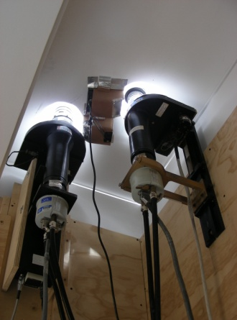
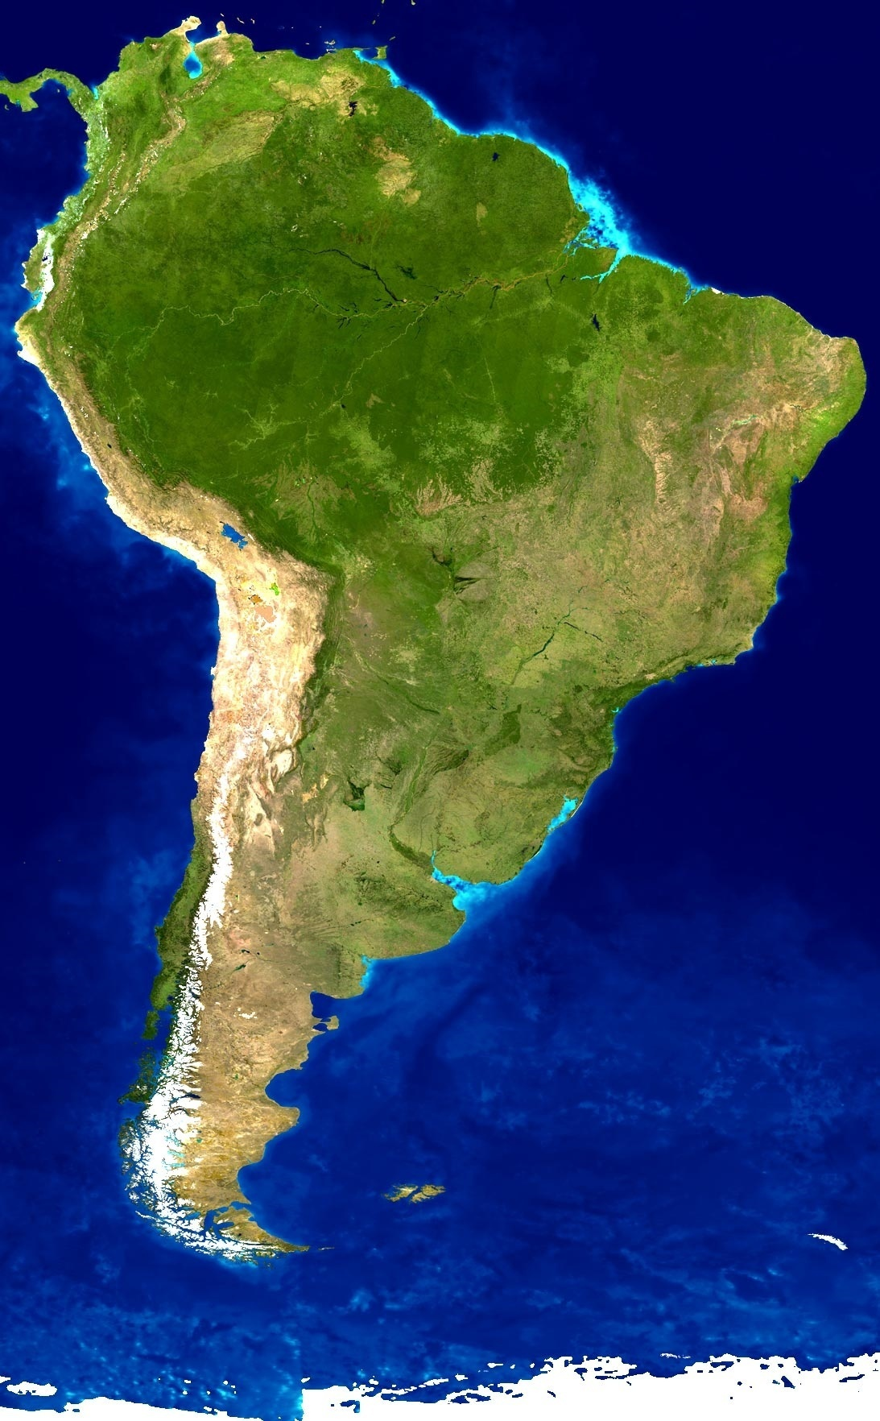
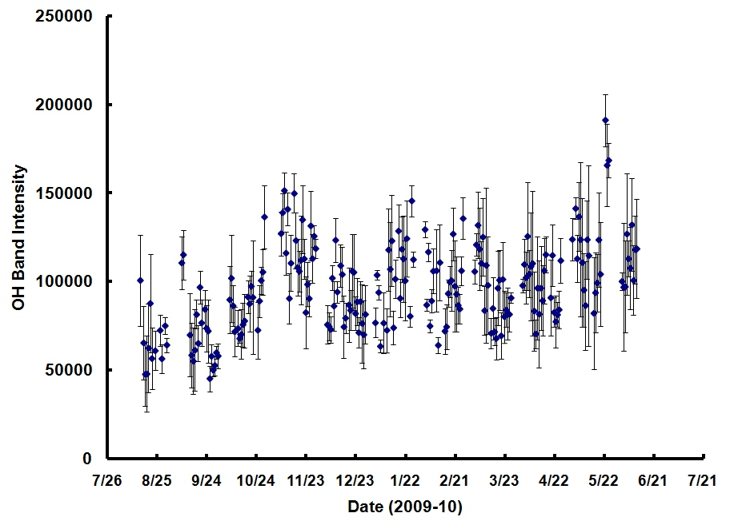

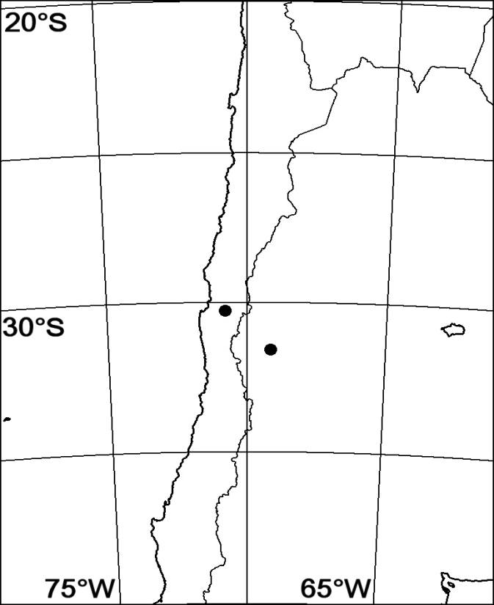
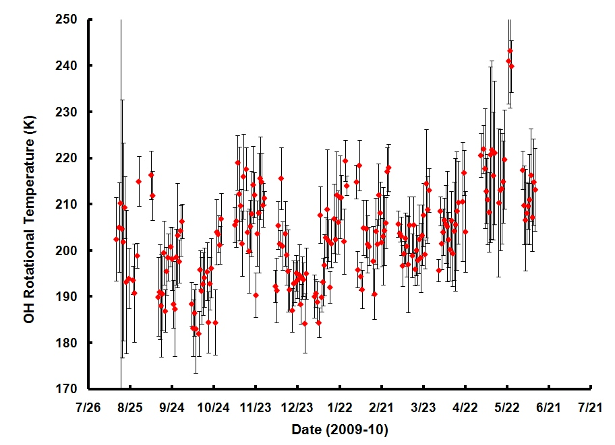
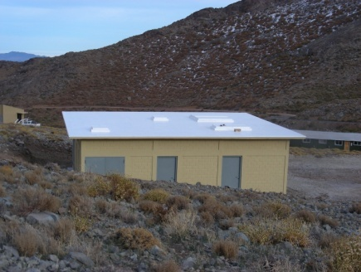
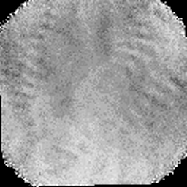
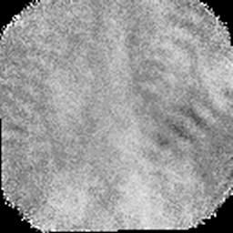
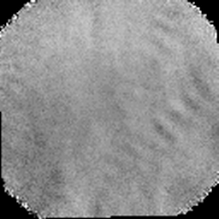
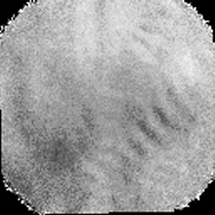
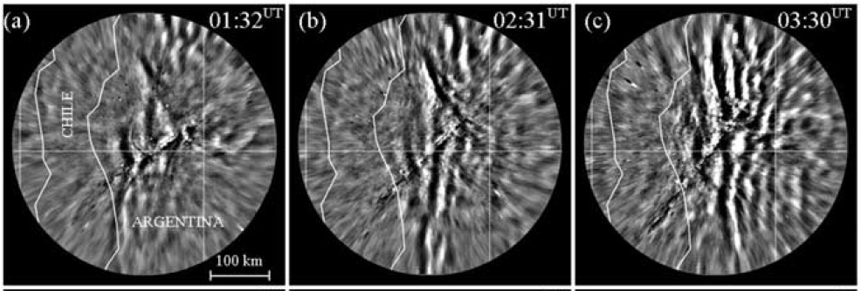
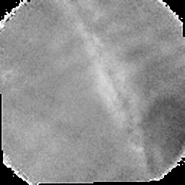
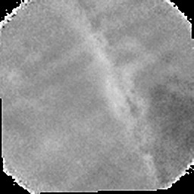
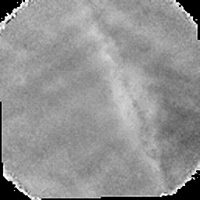
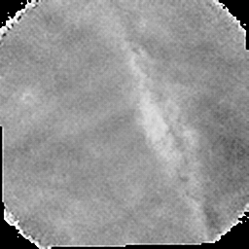
The First Ten Months of Investigation of Gravity Waves and Temperature Variability Over the Andes
Jonathan R. Pugmire, Neal Criddle, M.J. Taylor, P.-D. Pautet, Y. Zhao; Center for Atmospheric and Space Sciences, Utah State University
Introduction
Seasonal Results to Date
The Andes region is an excellent natural laboratory for investigating gravity wave influences on the Upper Mesospheric and Lower Thermospheric (MLT) dynamics. The instrument suite that comprised the very successful Maui-MALT program was recently re-located to a new Andes Lidar Observatory (ALO) located near the Cerro Pachon telescopes, Chile (30.2°S, 70.7°W) to obtain in-depth seasonal measurements of MLT dynamics over the Andes mountains. As part of the instrument set the Utah State University (USU) CEDAR Mesospheric Temperature Mapper (MTM) has operated continuously since August 2009 measuring the near infrared OH(6,2) band and the O₂(0,1) Atmospheric band intensity and temperature perturbations. The primary goals of the program are to:
  Quantify the impact and seasonal variability of a broad spectrum of waves over the Andes using coordinated wave, wind, and temperature measurements
  Perform an in-depth investigation of mountain waves present at MLT heights during winter months, quantifying their characteristics and associated momentum fluxes
  Compare with similar measurements during the summertime due to convective forces
This poster focuses on an initial analysis of nightly OH (6,2) band intensity and rotational temperatures and their seasonal variability (10 months of data to date), as well as selected gravity wave events illustrating the high wave activity and its diversity.
USU CCD Camera System in ALO at Cerro Pachon.
Cerro Pachon
.
Plot showing the nightly averaged OH band intensity from mid August 2009 to early June 2010. The “error bars” depict nocturnal variation in emission intensity.
Instrumentation
El Leoncito
    The USU CEDAR Mesospheric Temperature Mapper (MTM) is a high performance CCD imaging system designed to provide accurate mesospheric temperature and intensity measurements on gravity waves using precise observations of the OH (6,2) band and 0₂ (0,1) airglow emissions at nominal altitudes of ~87 and ~94 km. The MTM utilizes a high performance 1024 x 1024 pixel, bare CCD array. The collected data allows for a unique capability to quantify wave propagation, wave growth and dissipation at MLT heights. The camera uses a wide-angle telecentric lens system to observe selected emission lines in the OH and the 0₂ bands:
    NIR OH (6,2) (~87 km)
      P₁(2) λ-doublet at 840.0 nm
      P₁(4) λ-doublet at 846.5 nm
ALO
  0₂ (0,1) (~94 km)
    866.0 nm
    868.0 nm
Example Data Analysis
Plot of the nightly averaged OH rotational temperature corresponding to intensity data (plotted above) for the ~10 month period observations to date. Note the unusual wave-like variations in the seasonal intensity and temperature variability.
Panoramic view from roof of ALO
Method
The MTM took sequential 60 second exposures using narrow-band filters centered at 866.0 nm, 868.0 nm for the O₂ emission and centered on the P₁(2), and P₁(4) lines for the OH (6,2) emission. In addition a background measurement and a dark image were also recorded resulting in a cadence time of ~5.5 minutes. These data were recorded for ~25 days per month, except during the full moon period. To date we have obtained nearly 10 months of data.
The data was analyzed using software developed at USU to determine the band intensity and rotational temperatures variability during each night. Rotational temperatures were computed separately for the OH and O₂ emissions using the well-established "ratio method." Comparisons of the MTM OH temperatures with those obtained by other well calibrated instruments (Na temperature lidars, AIM satellite, and FTIR spectrometers) indicate that our absolute temperatures referenced to the 87 km lidar temperatures are accurate to ± 5 K [Pendleton et al., 2000]. For this study we have focused our analysis on the OH emission.
Example showing a large amplitude perturbation in the intensity and temperature data recorded on the 13 January 2010, UT. The temperature variation is large ~40 K during the night. The associated intensity change is also large and lags behind the temperature perturbation suggesting a long-period gravity wave or tidal harmonic.
Summary and Future Work
These two figures show the results in band intensity (left) and rotational temperature derived from the data as a function of UT time. Note the strong wave activity in intensity with weaker signatures in temperature on this night.
The 10 months of mesospheric OH temperature data acquired to date exhibit unexpected short-term oscillations that persist during the seasons. This is unlike that expected from superposed annual and semi-annual oscillation observed at other sites of similar latitudes (e.g. Starfire Optical Range, NM). Similar variability (not shown) appears to be present in OH spectrometer data from El Leoncito, Argentina (J. Scheer, private communication). Further measurements will help quantify the seasonal variability at this important site.
Nocturnal variations at Cerro Pachon are highly variable and at times can exhibit large amplitudes, exceeding 40 K during the course of a night observations. Other nights show evidence for large amplitude gravity waves in intensity and temperature data with periods of ~1-2 hours.
MTM image data also reveal a wealth of short-period (< 1 hour) gravity waves as well as an abundance of ripple instability structures indicating that the mesosphere over the Andes mountain region is very dynamic. No evidence to date of Mountain Waves but they only penetrate into the mesosphere during the winter months ans we have yet to observe this period.
Detailed comparison of MTM temperature data with Na lidar temperature measurements as well as ongoing OH spectrometer measurements at El Leincito, Argentina. We will also perform a detailed comparison with SABER temperatures from the TIMED satellite as we conducted during the Maui-MALT program.
Investigation of long-and short period gravity waves using MTM and collaborative Na lidar and meteor radar winds to investigate intrinsic wave characteristics, propagation and momentum fluxes.
Comparative study of OH and O2 temperature data to investigate phase relationships of wave events and to study wave growth and/or dissipation.
Ongoing seasonal measurements will be used to build a clearer understanding of the temperature variability and its intra-annual variability.
Gravity Waves and the Andes Mountains
Example MTM Wave Data
The Andes region is an excellent natural laboratory for investigating gravity wave influences on the Upper MLT: during the summer months the majority of gravity waves result from deep convection arising from thunderstorms over the continent to the east. In winter this convective activity is expected to be replaced by strong orographic forcing due to intense prevailing zonal winds blowing eastward from the Pacific Ocean and suddenly encountering the towering Andes mountain range (6000m). This creates large amplitude mountain waves that have been measured well into the stratosphere and occasionally into the mesosphere (Smith et al., 2009).
MTM images showing ripples in the OH emission observed on September 18-19, 2009.
OH all-sky Images showing unusual wave structures associated with the penetration of mountain waves into the mesosphere during the night of July 4, 2008. The wave pattern originated just westward of El Leoncito, Argentina (see map).
MTM images showing waves in the OH emission observed on September 9-10, 2009. Simultaneous events are seen propagating perpendicular to one another.
Reference
Smith, S.,Baumgardner, J.,Mendillo, M., Evidence of mesospheric gravity-waves generated by orographic forcing in the troposphere, Geophysical Research Letters, Vol. 36, 2009
Acknowledgements: This research is supported under NSF grant #0737698.

