Slide 1
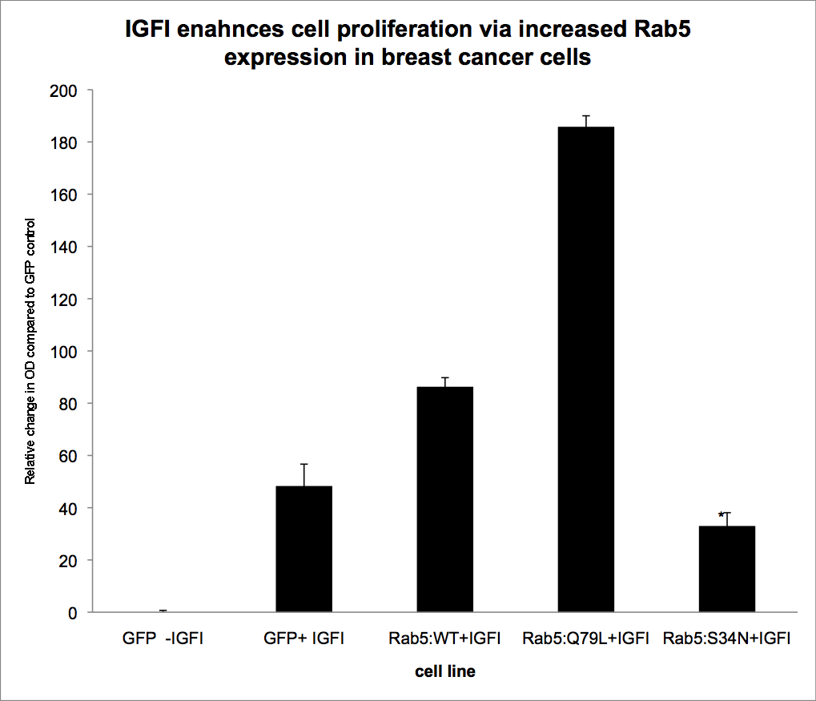
B442
Rab5 function in breast cancer cells
N. Porther and A. Barbieri
Department of Biological Sciences, Florida International University, Miami, Fl, USA
ABSTRACT
RESULTS
CONCLUSIONS
Metastasis is characterized pathologically by cell invasion, proliferation, migration and angiogenesis. Growth factors, which include epithelial growth factor (EGF), insulin growth factors I and II (IGFI and IGFII); have been associated with most if not all of the features of metastasis. Our study has highlighted the possible role growth factors may have in mediating cancer metastasis via Rab GTPses. We determined that the invasive and migratory properties of breast cancer cells were abrogated in cell lines that only expressed the inactive (GDP-bound) form of Rab 5 irrespective of growth factor stimulation. Breast cancer cell lines expressing the wild type and active (GTP-bound) form of Rab 5 were more invasive when exposed to growth factors. In addition, we observed that Rab5 was activated in cells incubated with IGF-I in a time and concentration dependent. Our data indicates that Rab5 activation may play an integral role in cell invasion, proliferation, migration particularly in response to growth factor stimulus.
Figure 1.
Figure 1. IGFI enhances cell proliferation via Rab 5 activation. Cell proliferation was assessed after 4 8hr incubation with vehicle or IGFI of cell culture, using the MTT proliferation assay (Sigma). Briefly after the incubation period, cells were added with 100 μL of 5 mg/mL thiazolyl blue tetrazolium bromide (Sigma, St. Louis, MO) solution/well and were incubated further for 4 h in a humidified atmosphere (37°C in 5% CO₂). The absorbance was measured at 560 nm in a microplate reader. Cell proliferation was expressed as percentage absorbance values compared with the vehicle control.
Active Rab5 promoted cell proliferative in response to IGFI stimulation.
Both the migratory and invasive status of MCF7 cells was augmented in the presence of IGFI, and abrogated when the constitutive inactive form of Rab5 (Rab5-GDP) was overexpressed.
Rab5 activation is necessary in the promotion of tumorigenesis in breast cancer cells.
IGFI stimulation trigger the endocytic pathway by upregulating active Rab5 expression..
Taken together, these data suggest that Rab5 may play an important role during IGFI signaling, in advancement of breast cancer.
INTRODUCTION
Figure 2a.
Figure 2b.
Figure 2. IGFI mediates cell invasion and migration in MCF7 cells via Rab5 activation. Cells were plated in a boyden chamber with or without basement extract membrane . Treatment groups were IGFI or vehicle control and cells were incubate a 37oC for 16h. Crystal violet staining was performed and the dye extracted and the OD measuring using a plate reader at 595nm. Cell migration and invasion absorbance reading were expressed as relative percentage OD to control.
Metastasis is a multistep process that encompasses the modulation of membrane permeability and invasion, cell spreading, cell migration and proliferation of the extracellular matrix (ECM), increase in cell adhesion molecules and interaction, decrease in cell attachment –induced survival signals and propagation of nutrient supplies (blood vessels)(Fidler, 1990). In cancer, solid tumor cannot expand and spread without series of synchronized events. Changes in cell adhesion molecules (integrins, cadherin-catenins) and protease expressions have been linked to tumor invasion and metastasis. It has also been determined that ligand-growth factor receptor interactions have been associated with cancer development and metastasis.
Studies in flies (Drosophila) and mouse neurons have shown that cell migration can be mediated by endocytotic and trafficking mechanisms and dependent on Rab 5 and Rab 11 expression in epithelial cells(Shaye, Casanova, & Llimargas, 2008; Kawauchi et al., 2010). Migration of cells in hepatocellular carcinoma was also dependent on VEGF/PDGF and EGF receptor mediated tyrosine kinase endocytosis, Rab 5(Fukui et al., 2007) and Rab 11(Janssens, Sung, & Rorth, 2010; Jekely, Sung, Luque, & Rorth, 2005). Other studies have also highlighted the role of Rab 5 in cell migration due to the activation of early endosomes and modulation of other GTPases such as Rho. Rab 25, a member of the Rab subfamily, play a critical role in translocating and recycling protein from endosomes to the plasma membrane and have been implicated in advanced stages of ovarian and breast cancers and have linked to an increase in malignancy and invasiveness of the epithelial cells by modulating cell proliferation (both anchorage dependent and independent cells) and suppressing apoptosis (Cheng et al., 2004a). Therefore, we can only deduce that since the Rab GTPases are heavily involved in cell migration and motility, their role in mediating metastasis in breast cancer is more than implied and need to fully examine.
In this study, we investigated the role of Rab5 GTPase in mediating phenotypic changes in the promotion of proliferation, migration and invasion activities in breast cancer cells in the presence of IGF-1.
++
**
ACKNOWLEDGEMENTS
This work was partially supported by the National Institutes of Health grants SC1DK084343 (to MAB). (The content is solely responsibility of the authors and does not necessarily represent the official views of the National Institute of Health.)
+
Figure 3. Rab5 promotes tumorigenesis in breast cancer cells. Breast cancer cells were suspended in an agarose matrix in the absence or presence of the growth factor for several days. Cells were fed aprproximately every 2-3 days and pictures were acquired using a confocal microcope. Colonies were counted using 4 random fields of view.
Figure 3.
REFERENCES
Shaye, D. D., Casanova, J., & Llimargas, M. (2008). Modulation of intracellular trafficking regulates cell intercalation in the Drosophila trachea. Nat.Cell Biol., 10, 964-970.
Cheng, K. W., Lahad, J. P., Kuo, W. L., Lapuk, A., Yamada, K., Auersperg, N. et al. (2004a). The RAB25 small GTPase determines aggressiveness of ovarian and breast cancers. Nat.Med., 10, 1251-1256
Fidler, I. J. (1990). Host and tumour factors in cancer metastasis. Eur.J.Clin.Invest, 20, 481-486.
Fukui, K., Tamura, S., Wada, A., Kamada, Y., Igura, T., Kiso, S. et al. (2007). Expression of Rab5a in hepatocellular carcinoma: Possible involvement in epidermal growth factor signaling. Hepatol.Res., 37, 957-965.
Janssens, K., Sung, H. H., & Rorth, P. (2010). Direct detection of guidance receptor activity during border cell migration. Proc.Natl.Acad.Sci.U.S.A, 107, 7323-7328.
Jekely, G., Sung, H. H., Luque, C. M., & Rorth, P. (2005). Regulators of endocytosis maintain localized receptor tyrosine kinase signaling in guided migration. Dev.Cell, 9, 197-207.
Kawauchi, T., Sekine, K., Shikanai, M., Chihama, K., Tomita, K., Kubo, K. et al. (2010). Rab GTPases-dependent endocytic pathways regulate neuronal migration and maturation through N-cadherin trafficking. Neuron, 67, 588-602.
Figure 4. IGFI mediates Rab5 protein expression in breast cancer cells. Cells expressing Rab5: wild type were incubated in the absence or presence of IGFI. After incubation, active or GTP-bound form of Rab5 was precipitated with GST-EEA1 domain at 4°C while rocking for 1 hr. After incubation, the beads were washed three times using the lysis buffer. The pull-downs were subjected to SDS-PAGE and analyzed by immunoblotting using an anti-Rab5 antibody
Figure 4.
CTRL IGFI
Pulldown
MCF7: Rab5 WT
Rab5 WT

