Slide 1
Sex and the single weed: connecting floral and genetic diversity in Purple Loosestrife, Lythrum salicaria
Maia Bailey
Providence College

Slide 2
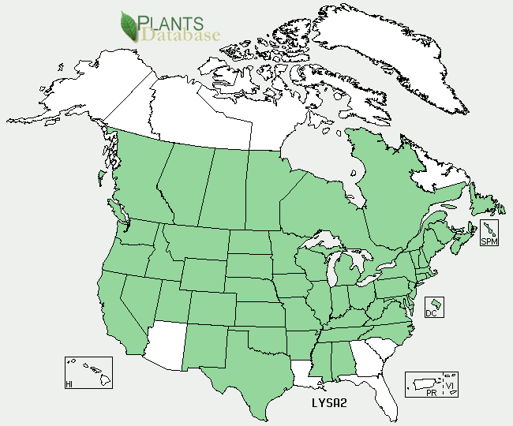
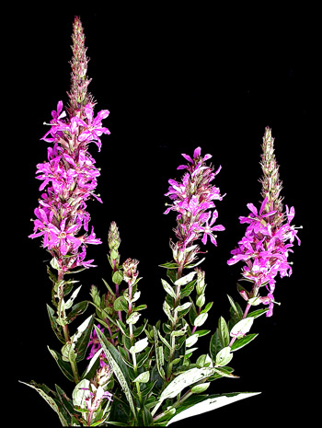
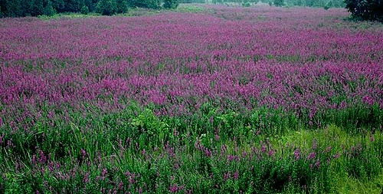
Purple Loosestrife
Photo by Brian Johnston
© Agriculture and Agri-Food Canada, Lethbridge Research Centre

Slide 3
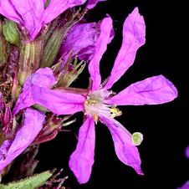
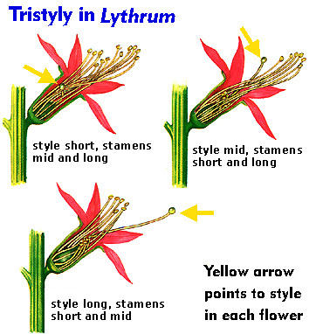
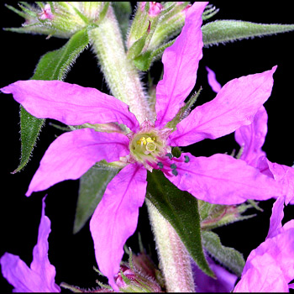
Tristyly

Slide 4
Effective population size
Alphaville
Population: 10
Betaville
Population: 10

Slide 5
Research questions
What is the floral ratio of small populations?
Do populations with skewed floral ratios make fewer seeds?
How genetically diverse are small populations?
Is floral diversity associated with genetic diversity?

Slide 6
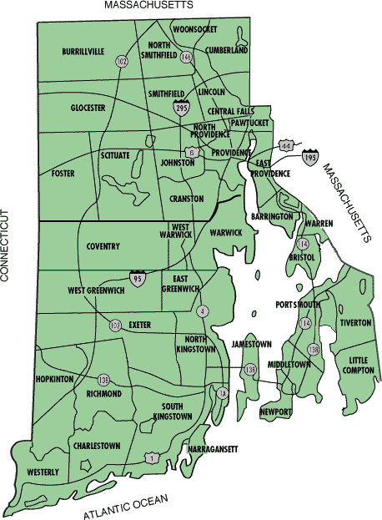
Methods
Collected leaf and fruit samples from 8 small populations
(approx. 8 – 500 indiv.)
DNA extraction, AFLP genetic markers
Seeds per fruit counted
Germination rates

Slide 7
Results
Seeds per fruit
Population
short
medium
long

