Slide 1

Getting Started in Evaluation Consulting: Questions to ask and answer along the way
Judah Viola, PhD
11/5/2011

Slide 2
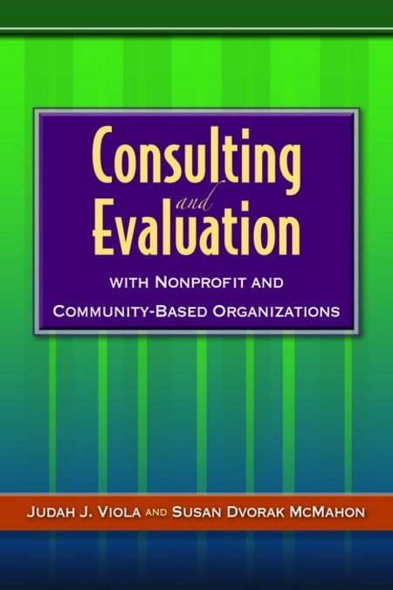
Who am I? What is my perspective?
Community Psychologist
University-based Faculty
Part-time evaluation consultant
  Non-profit/CBO/Ed/Museum/Gov’t
Interviewed & Surveyed over 45
successful consultants about career
trajectories & asked for advice

Slide 3
Four Phases of Questions & Options to Consider
Environmental Scan
Establish Niche
Choose Structure
Professional Supports
Generalist
Part-time
Sole Proprietor
Banking
Internal Assessment
Specialty Methods
Non-Profit
Accounting
External supports
Specialty Industry
Hybrid
Legal
Full-time
LLC
Special Pop
Market Needs
Partnership
Insurance
Services Offered
S or C Corp
Affiliates
Build Network of colleagues, referral sources & Continual Learning
Notes:
4 phases of questions and options to consider
Phase 1: Environmental Scanning
Phase 2: Establishing a Niche
Phase 3: Choosing a Structure
Phase 4: Finding Professional Supports
Throughout the process you’ll need to continually build your network of colleagues, referral sources, and learning

Slide 4
Phase 1: Environmental Scan
Internal Assessment (checklist 2.1)
  Am I cut out for Consulting?
  Evaluation & People skills
  Tolerance for ambiguity
External Supports
  Family? Working partner?
  Network of Colleagues
  Previous bosses/teacher who will refer you
Market Needs
  Plenty of evaluation projects for consultants in your area?
Notes:
1. Get lots of experience before you try to do it on your own
-Most of the informants seemed to agree that the initial step to consulting should be working under some established consultant for two main reasons: experience and networking.
2. Be prepared for a rocky start
-All of the informants spoke of an initial instability of income: projects tend to come in fits and spurts. There's not a lot of money to be made at first. The first two years tend to be the most difficult.
3. Communication skills or “People Skills” are most important
-There was consensus on this topic. The ability to build rapport and trust are paramount. The most successful consultants have superior listening, reflecting, negotiating, dialogue facilitation, and conflict resolution skills. In addition, it is helpful to be able to communicate across disciplines, cultures, and styles.
4. Expertise & Confidence in your own ability are also key
-Knowing what you’re doing, being able to deliver on your commitments, and providing top-notch services are what is going to lead to your next job.
Knowledge of the clients' business beyond the scope of an existing project is extremely important as well: provides opportunities to suggest other projects and overall shows one's interest and involvement.
5. Your two best marketing tools are your past projects & your involvement in professional organizations
-Every consultant gets the majority of their jobs through referrals from clients or colleagues (as opposed to advertising, or cold calling). If you impress your clients they will refer you to their colleagues. Keeping in touch with past clients increases the likelihood of future work. If you demonstrate your ability to your colleagues they will pass on information about potential jobs.

Slide 5
GENERAL Traits & Skills Checklist
Comfort speaking across disciplines & levels of an organization
Authenticity, self-confidence, & patience to build trust in others
Excellent oral & written communication skills
Ability to say “no” even if it will disappoint someone
Self-discipline, attention to detail, drive to complete projects on time
Thick skin & a willingness to learn from my mistakes
Awareness of weaknesses as well as strengths
Strong organizational skills
Flexibility & tolerance for ambiguity & financial insecurity
Desire for continual learning
Appreciation & openness to diversity of thought and culture
Interest in proving myself over & over again

Slide 6
Specific Skill Sets Required to Consult Effectively
Ability to synthesize what clients tell me & clearly articulate back
Ability to quickly diffuse resistance & resolve conflict with clients
Ability to establish a safe, open, learning environment in groups
Understanding of org. systems & interrelationships between parts
Capacity to apply theoretical models of org. beh. & performance
Understanding of dynamics of collaboration & ability to facilitate
Understanding of basic community organizing methods
Understanding of adult learning principles & the ability to use them when facilitating workshops, trainings, or conducting presentations or writing reports.
Skills in using a variety of data collection and analysis methods.
Tech literacy & competence as well as recording & presentation equipt.
Ability to clarify & articulate the values and beliefs that guide my work
Notes:
If there are more than 3 out of the 12 items on checklist 2 that you can not honestly check
off, you may not yet be ready to begin consulting independently.

Slide 7
External Supports
An understanding partner or family
Community of consultants/professional colleagues
Established reputation
Referral sources
Financial resources to rely on when getting started. (e.g., part-time job, savings, partner’s income)
Space (rent or work from home? Depends on financial resources, workload, personal preferences, and home situation)
Notes:
An understanding partner,
spouse, or family, as well as community of other consultants will most likely become your
support system. A good network of professional colleagues and a strong, established reputation
are necessary so that you can continue acquiring new clients. In order to be an effective resource
that community organizations will seek out, you also need to be well-connected with colleagues
whom you can refer jobs that you do not have the time or skills to complete. Of course a good
professional network is also crucial so that you can pull in needed expertise as required on the
jobs that you do take on or just have someone to bounce ideas off of or commiserate with.
In addition, you need to have enough financial resources to rely on when you are getting
started. Starting slowly, while maintaining your job, or making the transition by working parttime
while building a network of clients, or having a cushion through the income of a significant
other can all be potential options in the beginning. Space is another important external resource,
and decisions about whether to rent office space or work from home should take into account
your financial resources, workload, personal preferences, and home situation.

Slide 8
Phase 2: Establishing a Niche
1. Grant Writing
2. Asset Mapping/Needs Assessments
3. Program Development
4. Strategic Planning
5. Logic Modeling
6. Evaluation Training
7. Process Evaluations
8.Outcome/Impact/Summative Evaluations
9. Policy Research or topical area research 9. Advocacy
10. Data Analysis
11. Report Writing
Notes:
Leadership Training/Executive Coaching - helping to transform management and
executives into better leaders, listeners and learners.

Slide 9
Phase 4: Finding Professional Supports
Most consultants recommend setting up a separate checking account for the business and a savings account to set aside money for taxes
Accounting (use one at least once)
  Only 40% of respondents used an accountant when they began consulting; the rest wish they had. Now, over 90% of the fulltime consultants use one.
Lawyers are particularly helpful for getting incorporated and for support in reviewing or drafting early contracts
Affiliates are good for teaming up on large projects or those which require additional expertise. Have people to refer clients to when you are busy or when the project is outside of your expertise.

Slide 10
Build Networks for Support, Continual Learning, & Referrals
Tactics that Don’t Cost Money
1. Invite potential clients to mini-presentations
2. Find a reason to call your current and past clients
3. Pass on your extra work to a trusted colleague.
4. Refer out projects outside of your scope.
5. Share advice, ideas, materials, instruments with colleagues & clients.
6. Write letters to the editor newspapers & journals
7. Write a book chapter or book
8. Tactfully ask your clients to refer you to colleagues if they are satisfied with your work.
9. Teach a course at a college or university or lead a workshop for a professional society
10. Create a list of success stories you have had with past clients to share with potential clients.
Notes:
Additional Networking Tips
Time and time again, we hear from the experts in this field that they survive and thrive on word of mouth business. All of the consultants interviewed said they already knew the person who got them their first consulting job prior to starting their practice.
Attend/Present at Professional events:
Join and be active in Professional organizations (e.g. Institute of Management Consultants USA (IMC USA) is often cited as a useful resource for independent consultants. CEA, AEA, ASTD
Look for Opportunities outside of your specialty
Get involved in Community work: (can help you stay in touch with neighbors, and can help fill a social void when you start your consulting practice. build a reputation as a leader and a problem solver)
Find a Mentor
Working with other consultants (via subcontracting)
Maintaining Relationships with Past Clients
Referral sources found at local Universities:
Professors (in and out of your discipline’s department, school or college)
Alumni- who do consulting work themselves
Community Relations Offices – may be able to link you up with organizations looking for assistance
Service-Learning offices – The site where they send students can often use professional help as well.
Community Research Centers – These centers often have to turn away requests that do not fit into their focus areas
Grants office/Office of Sponsored Programs & Research
Reference Librarians are some of the most helpful people on earth when it comes to looking for obscure information

Slide 11
Additional Networking Tips
Look for Opportunities outside of your specialty
Get involved in Community work
Find a Mentor
Working with other consultants (via subcontracting)
Maintaining Relationships with Past Clients
Find Referral sources at local Universities:
  Professors
  Alumni- who do consulting work themselves
  Community Relations & Service Learning Offices
  Research Centers
  Grants/Sponsored Programs & Research
  Reference Librarians
Notes:
Additional Networking Tips
Time and time again, we hear from the experts in this field that they survive and thrive on word of mouth business. All of the consultants interviewed said they already knew the person who got them their first consulting job prior to starting their practice.

