Slide 1

Gathering the Needles
Evaluating the Impact of Gold Open Access Content with Traditional Subscription Journals
Alison Bobal
Head, Collection Development & Metadata
University of Nebraska Medical Center
Jill Emery
Collection Development
Portland State University
Attribution-NonCommercial-NoDerivs 2.0 Generic (CC BY-NC-ND 2.0)

Slide 2
What Is This All About?
1. More content from subscription publishers is being published as open access articles
2. Project COUNTER Release 4 created a report entitled: JR1-GOA (gold open access)
3. Cannot easily see what your institution is publishing OA, but what is being used as OA
4. Assess impact on subscription business models
5. Find ways to sustain & enhance move to OA

Slide 3
Who’s Involved?
1. For this study, we looked at five publishers: Elsevier, NPG, Sage, Springer, & Wiley
2. Picked journal packages in common with exception of Wiley
3. All these publishers are engaged in promoting hybrid open access publishing

Slide 4
Publishers | Name of your hybrid OA Program | Year Began | # of journals Participating
Elsevier | Elsevier Open Access | 2006 | 1,690 out of 3,696
Nature PG | NPG Open | 2007 | 78 out of 136
Sage Publications | Sage Choice | 2006 | 769 out of 800
Springer B.V. | Springer Open Choice | 2004 | 1,657 out of 2,181
John Wiley & Sons Publishers | Wiley Open Access | 2004 | 743 out of 1,500

Slide 5
What are the Costs of Hybrid Publishing?
Publisher Hybrid APC Costs Intermixed w/Subscriptions
Elsevier $500-$5,000 No, completely separate
Nature PG $2,700-$4,400 Discount given on subs
Sage $3,000 Discounts given on subs but
not packages
Springer $3,000 Say on web site they take OA into
consideration
John Wiley & Sons $3,000 Discounts given on subs

Slide 6
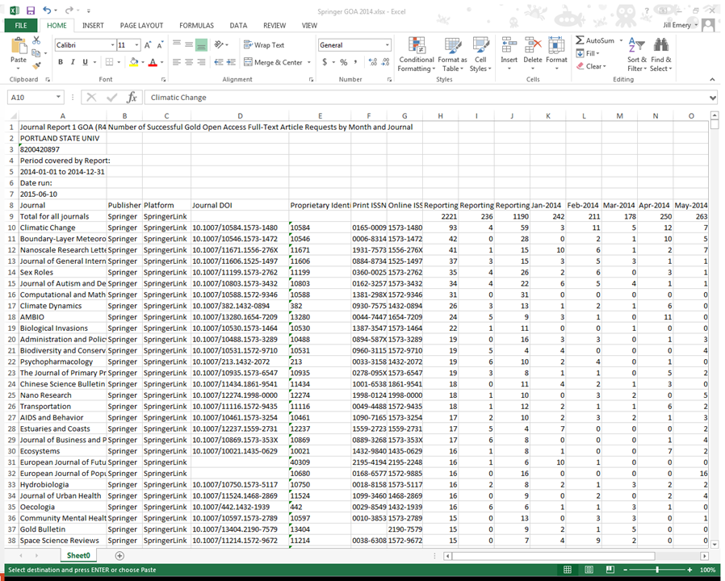

Slide 7
Looking at the Numbers
placeholder for usage information
Portland State University downloads in 2014
Elsevier Total Usage: 190,658
Elsevier GOA Usage: 4,010
Nature PG Total Usage: 16,978
Nature PG GOA Usage: 1,353
Sage Total Usage: 92,730
Sage GOA Usage: 279
Springer Total Usage: 45,248
Springer GOA Usage: 2,221
Wiley Total Usage: 90,644
Wiley GOA Usage: 1,159
University of Nebraska Medical Center downloads in 2014
Elsevier Total Usage: 277,301
Elsevier GOA Usage: 7,895
Nature PG Total Usage: 65,204
Nature PG GOA Usage: 6,537
Sage Total Usage: 17,320
Sage GOA Usage: 688
Springer Total Usage: 22,260
Springer GOA Usage: 2,445

Slide 8
Top GOA Used Titles
Portland State University
University of Nebraska Medical Center
PNAS: National Academy of Sciences
Nucleic Acids Research: OUP
Scientific Reports: Nature PG
Nature: Nature PG
Procedia - Social and Behavioral Sciences: Elsevier
ProQuest Dissertations and Theses
Optics Express: OSA
Mountain Research and Development: IMS
BioScience: AIBS
SAGE Open: SAGE Publications
PNAS: National Academy of Sciences
Scientific Reports: Nature PG
Cell Death & Disease: Nature PG
Cell Reports: Elsevier
Nature: Nature PG
Nature Communications: Nature PG
BMJ: BMJ Publishing Group
Journal of Biological Chemistry: ASBMB
British Journal of Cancer: Nature PG
SAGE Open: SAGE Publications

Slide 9
Why Review?
Setting a baseline for future evaluation
Promotion/Advocacy of OA
Utilizing new statistic

Slide 10
Impact on Subscriptions
With majority of GOA usage being under 5% effect is negligible
Could be used in negotiations of package deals
Understanding the total cost of publication

Slide 11
Questions?

